Slide 1

From Reservation Table to EPIC:
A Historical Perspective
Hsien-Hsin Sean Lee
School of ECE
Georgia Institute of Technology
December 4, 2002

Slide 2
Pipeline Design
Pipelining increases throughput
Linear pipeline is straightforward
L
L
L
L
L
input
output
F1
F2
F3
F4

Slide 3
Non-linear (or Dynamic) Pipeline
Stages might have different latencies
Multiple paths out of one stage to other stages
Multi-functional
Machine X
input
F1
F2
F3
output
Machine X
Generalized form of pipeline definition

Slide 4
Reservation Table [Davidson’71]
Machine X
input
F1
F2
F3
output
Reservation Table
Time →
 | 0 | 1 | 2 | 3 | 4 | 5 | 6
F1
F2
F3
Stage →

Slide 5
Reservation Table
Machine X
input
F1
F2
F3
output
Reservation Table
Time →
 | 0 | 1 | 2 | 3 | 4 | 5 | 6
F1 | X
F2
F3
Stage →

Slide 6
Reservation Table
Machine X
input
F1
F2
F3
output
Reservation Table
Time →
 | 0 | 1 | 2 | 3 | 4 | 5 | 6
F1 | X
F2 |  | X
F3
Stage →

Slide 7
Reservation Table
Machine X
input
F1
F2
F3
output
Reservation Table
Time →
 | 0 | 1 | 2 | 3 | 4 | 5 | 6
F1 | X
F2 |  | X | X
F3
Stage →

Slide 8
Reservation Table
Machine X
input
F1
F2
F3
output
Reservation Table
Time →
 | 0 | 1 | 2 | 3 | 4 | 5 | 6
F1 | X
F2 |  | X | X
F3 |  |  |  | X
Stage →

Slide 9
Reservation Table
Machine X
input
F1
F2
F3
output
Reservation Table
Time →
 | 0 | 1 | 2 | 3 | 4 | 5 | 6
F1 | X |  |  |  | X
F2 |  | X | X
F3 |  |  |  | X
Stage →

Slide 10
Reservation Table
Machine X
input
F1
F2
F3
output
Reservation Table
Time →
 | 0 | 1 | 2 | 3 | 4 | 5 | 6
F1 | X |  |  |  | X | X
F2 |  | X | X
F3 |  |  |  | X
Stage →

Slide 11
Reservation Table
Machine X
input
F1
F2
F3
output
Reservation Table
Time →
 | 0 | 1 | 2 | 3 | 4 | 5 | 6
F1 | X |  |  |  | X | X
F2 |  | X | X
F3 |  |  |  | X |  |  | X
Stage →

Slide 12
Consider an Instruction Sequence
x₁
x₂
x₃
x₄
x₅
x₆
y₀
F1
y₁
F2
y₂
F3
y₃
F1
y₄
F1
y₅
F3
Out
i0
i1
i2
i3
i4
i5
Instruction Sequence X
Reservation Table
Time →
 | 0 | 1 | 2 | 3 | 4 | 5 | 6
F1 | X |  |  |  | X | X
F2 |  | X | X
F3 |  |  |  | X |  |  | X
Stage →

Slide 13
Pipelining
OK, the sequence latency is 7 cycles
How do I initiate the next iteration
  Definitely not every 7 cycle
How to pipeline it without any resource conflict, i.e. F1, F2 and F3
How to reach maximum throughput?
Time →
 | 0 | 1 | 2 | 3 | 4 | 5 | 6
F1 | X |  |  |  | X | X
F2 |  | X | X
F3 |  |  |  | X |  |  | X
Stage →

Slide 14
Nomenclature Definition [Davidson’71][Davidson et al.’75]
Reservation Table
Compute time: Time units to complete one iteration of a reservation table
Latency sequence: Sequence of latencies between successive iterations
Latency cycle: A latency sequence that repeats itself indefinitely
Average latency (or in fact throughput): average time units between initiations
Minimum Achievable Latency (MAL) (= maximum throughput): Smallest average latency by any control strategy
Collision: Attempt by 2 different initiations to use same resource at the same time

Slide 15



Finding Initiation Intervals
An invalid initiation: iteration 1 and 2 conflicts in F2 @ c2 and F1 @ c5
A valid initiation
Question: How do we find all the possible and valid initiations?

Slide 16
Define Collision Vector
Collision vector
  A d-bit binary sequence where d is the compute time of the reservation table
  The d bits are labeled 0 to d-1 from left to right with a 0 indicating no collision and a 1 indicating collision
Use collision vector to
  Schedule events in pipeline
  Find all possible schedule
  Find the schedule with maximum throughput

Slide 17
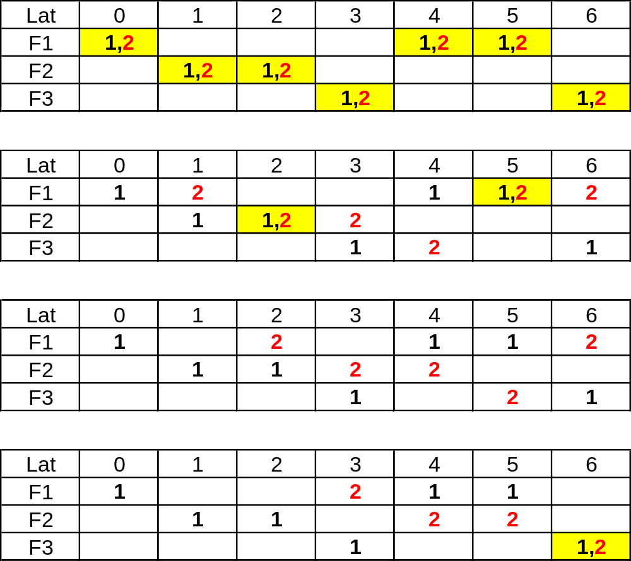
Collision Vector Generation
Collision Vector = 1xxxxxx
Collision Vector = 11xxxxx
Collision Vector = 110xxxx
Collision Vector = 1101xxx

Slide 18
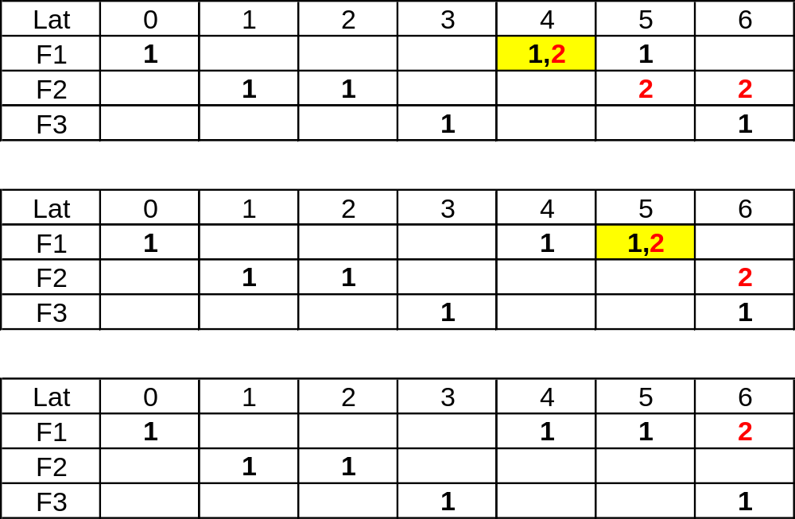
Collision Vector Generation
Collision Vector = 11011xx
Collision Vector = 110111x
Collision Vector = 1101110
Initial Collision Vector (ICV) = 1101110

Slide 19
To Find All Possible Schedules: State Diagram Generation Algorithm
{CV}proc = {CV}finish = φ;
add ICV to {CV}proc;
while ({CV}proc ⊄ φ) {
get aCV from {CV}proc ; push aCV to {CV}finish;
newCV = aCV << 1; // shift in zero
if (newCV[MSB] == 1)
// create a new collision vector
else
if (spawn new initiation)
newCV = newCV | ICV; // bit-by-bit logical OR
else
// create a new collision vector
if (newCV ∈ ({CV}proc U {CV}finish))
merge newCV with colliding node
else
define a new directional arc from aCV to newCV
add newCV to {CV}proc
}

Slide 20
State Diagram (See whiteboard)
1101110
Initial collision vector

Slide 21
State Diagram of X
1101110
Initial collision vector
1011100
*
0111000
1111110
1110000
1111100
1100000
1111000
*
1000000
*
0000000

Slide 22
Reduced (Modified) State Diagram
1101110
6
1101110
1011100
≥7
2
6
≥7
*
1111110
0111000
1111110
1110000
1111100
1100000
1111000
1101110
≥6
*
1000000
2
≥6
*
0000000
1111110

Slide 23
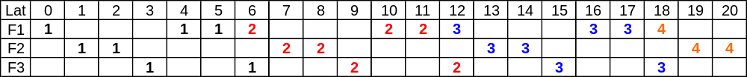
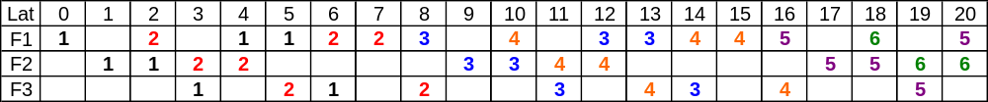
Two Possible Schedules
6
6
6
Schedule 1:
Latency sequence = <6, 6, 6, 6, 6, ..>
Latency cycle = (6)
Avg latency = 6
≥6
1101110
2
≥6
1111110
2
6
2
6
2
Schedule 2: (Greedy algorithm)
Latency sequence = <2, 6, 2, 6, 2, 6, ..>
Latency cycle = (2, 6)
Avg latency = (2+6)/2 = 4 = MAL
≥6
1101110
2
≥6
1111110

Slide 24
Sometimes Greedy Fails to be Optimal
3
8
3
Greedy initiation: Latency sequence = <3, 8, 3, 8, ….>
Average latency = 5.5 cycles
4
4
4
4
4
Optimal initiation: Latency sequence = <4, 4, 4, 4, ….>
Average latency = 4 cycles = MAL

Slide 25
Case When Greedy Fails to be Optimal
11100111
≥8
3
4
≥8
11111111
11110111
4
Reduced State Diagram

Slide 26
The End of Story?
Not quite…
Is the schedule really optimal?
  It is, based on the given schedule
  Look at the utilization of each Functional units
    F1 ≈ 78% ; F2 ≈ 56%; F3 ≈ 44%
  Sometimes we need to know how to sacrifice your queen to save the game..

Slide 27
Improving Throughput by Inserting Delay [Patel & Davidson’76]
output
input
S1
S2
S3
 | 0 | 1 | 2 | 3 | 4
S1 | X |  |  |  | X
S2 |  | X |  | X
S3 |  |  | X | X
Initial Collision Vector
11101
Pipeline Latency = 5 cycles

Slide 28
State Diagrams
11101
11010
10100
≥5
11101
3
*
01000
Modified state diagram
*
10000
00000
*
State diagram
MAL=3; Can we do better than 3?

Slide 29
Delay Insertion
D1
output
input
S1
S2
S3
D2
 | 0 | 1 | 2 | 3 | 4 | 5 | 6
S1 | X |  |  |  | X |  | X
S2 |  | X |  | X
S3 |  |  | X | X | X
Initial Collision Vector
D2
1010001
D1
Pipeline Latency = 7 cycles

Slide 30
Reduced State Diagram
4, ≥7
1010001
5
≥7
5
1
4, ≥7
1110001
3
1110011
4, ≥7
1
5
3
3
1011001
New latency sequence = <3,1,3,1,3,1,…>
MAL = (3+1)/2 = 2

Slide 31
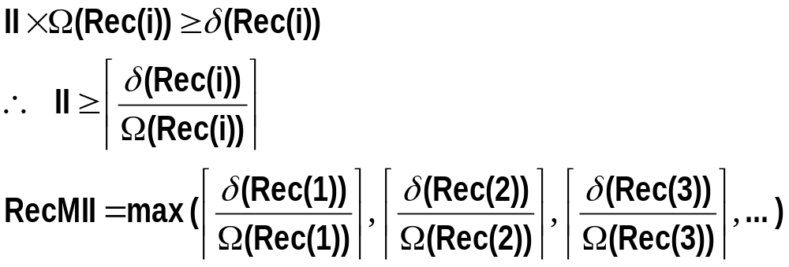
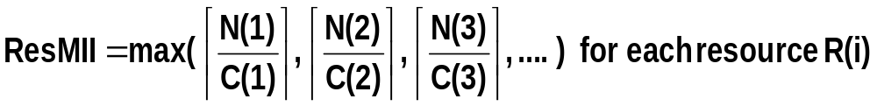
Polycyclic (or Modulo) Scheduling [Rau & Glaeser’81]
x₁
x₂
x₃
x₄
x₅
x₆
y₀
F1
y₁
F2
y₂
F3
y₃
F1
y₄
F1
y₅
F3
Out
i0
i1
i2
i3
i4
i5
MII = max( max(3/1,1/1,2/1), 0) = 3
Minimal Iteration Interval = MII = max(ResMII, RecMII)

Slide 32
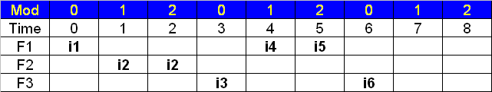
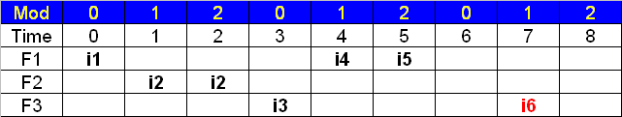
Polycyclic (or Modulo) Scheduling [Rau & Glaeser’81]
x₁
x₂
x₃
x₄
x₅
x₆
y₀
F1
y₁
F2
y₂
F3
y₃
F1
y₄
F1
y₅
F3
Out
i0
i1
i2
i3
i4
i5
Instruction Sequence X
According to modulo constraint
Sacrifice one cycle in latency of single iteration

Slide 33
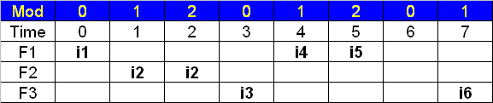
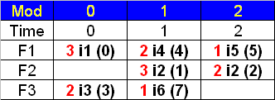
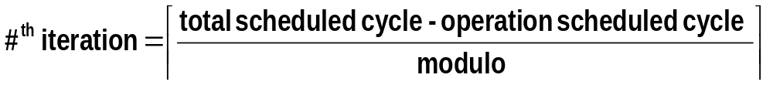
Modulo Reservation Table
Modulo Reservation Table (MRT) : Red represents the #^{th} iteration overlapped

Slide 34
State Diagrams Based New Schedule
11001100
≥6
10011000
11001100
*
2
≥6
00110000
11111100
3
*
11101100
11111100
11101100
01100000
11111000
≥6
3
11110000
11011000
11100000
Reduced State Diagram
10110000
*
Min latency seq = <3,3,3,3,…>
MAL = 3
11000000
*
10000000
00000000
*

Slide 35

Optimal Schedule
Modulo Reservation Table (MRT) : Red represents the #^{th} iteration overlapped
Optimal schedule, constrained by available resources
F1 reaches 100% utilization in steady-state, cannot do better than this
MAL = throughput = 3 cycles

Slide 36
Register Allocation Issues
So far, we only care for resource availability
How about architectural registers?
  When operations from multiple iterations are overlapped
  When the same schedule is desired
Solutions
  Rotating register file [Rau et al.’89] [Intel Itanium]
    Early days: TRW/ESL’s Polycyclic Architecture back in early 80’s
    Mid- to late-80s: Cydrome’s Cydra 5
    Still used today: Intel/HP Itanium processor family
  Modulo variable expansion (MVE) [Lam’88]
    Need loop unrolling, therefore, code expansion
    Run out of architectural registers fairly quickly

Slide 37
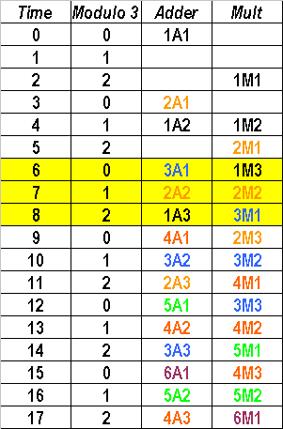
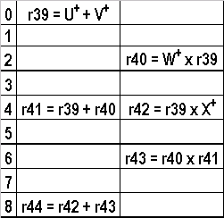
Another Code Example
U
V
+
A1
W
x
M1
X
x
+
M2
A2
x
M3
+
A3
Y

Slide 38
Register Rotation (i0 = Prolog)
Iteration | Time (mod-3) | Adder | Multiplier
ite i0 | 0 | r39 = r85 + r86
 | 1
 | 2 |  | r40 = r88 x r39

Slide 39
Register Rotation (i1 = Prolog)
Iteration | Time (mod-3) | Adder | Multiplier
ite i0 | 0 | r39 = r85 + r86
 | 1
 | 2 |  | r40 = r88 x r39
ite i1 | 3 | r39 = r85 + r86
 | 4 | r42 = r40 + r41 | r43 = r40 x r88
 | 5 |  | r40 = r88 x r39
Register rotating +1
r40@i1 = r39@i0
r41@i1 = r40@i0

Slide 40
Register Rotation (i2 = Kernel)
Iteration | Time (mod-3) | Adder | Multiplier
ite i0 | 0 | r39 = r85 + r86
 | 1
 | 2 |  | r40 = r38 x r39
ite i1 | 3 | r39 = r85 + r86
 | 4 | r42 = r40 + r41 | r43 = r40 x r88
 | 5 |  | r40 = r88 x r39
ite i2 | 6 | r39 = r85 + r86 | r45 = r42 x r43
 | 7 | r42 = r40 + r41 | r43 = r40 x r88
 | 8 | r46 = r44 + r45 | r40 = r88 x r39
Register rotating +1
r42@i2 = r40@i0
r43@i2 = r42@i1
r44@i2 = r43@i1

Slide 41
Register Rotation (i3 = Kernel)
Iteration | Time (mod-3) | Adder | Multiplier
ite i0 | 0 | r39 = r85 + r86
 | 1
 | 2 |  | r40 = r88 x r39
ite i1 | 3 | r39 = r85 + r86
 | 4 | r42 = r40 + r41 | r43 = r40 x r88
 | 5 |  | r40 = r88 x r39
ite i2 | 6 | r39 = r85 + r86 | r45 = r42 x r43
 | 7 | r42 = r40 + r41 | r43 = r40 x r88
 | 8 | r46 = r44 + r45 | r40 = r88 x r39
ite i3 | 9 | r39 = r85 + r86 | r45 = r42 x r43
 | 10 | r42 = r40 + r41 | r43 = r40 x r88
 | 11 | r46 = r44 + r45 | r40 = r88 x r39
Register rotation
wraps around if exceeding specified bound

Slide 42
Register Rotation (i4 & i5 Epilog)
Iteration | Time (mod-3) | Adder | Multiplier
ite i4 | 12 |  | r45 = r42 x r43
 | 13 | r42 = r40 + r41 | r43 = r40 x r88
 | 14 | r46 = r44 + r45
ite i5 | 15 |  | r45 = r42 x r43
 | 16
 | 17 | r46 = r44 + r45
Start draining the pipeline

Slide 43
Final Schedule
time | Adder | Multiplier
0 | r39 = r85 + r86 | r45 = r42 x r43
1 | r42 = r40 + r41 | r43 = r40 x r88
2 | r46 = r44 + r45 | r40 = r88 x r39
Kernel code is determined
How about prolog and epilog?
  Use stage predicate to conditional execute instructions

Slide 44
Final Schedule (Itanium Scheme)
mov ar.lc = LC // Loop count
mov ar.ec = 2 // Epilog count
mov pr.rot = 0x10000 // set pr[16]=1
L1top:
(p16) r39 = r85 + r86
(p18) r45 = r42 x r43
(p17) r42 = r40 + r41
(p17) r43 = r40 x r88
(p18) r46 = r44 + r45
(p16) r40 = r88 x r39
br.ctop L1top
Code snippet
Before entering the loop, set p16 =1
When the modulo-scheduled loop branch (e.g. br.ctop) encountered
  p63 is set to 1 by hardware
  All registers (rotating registers and predicate rotating registers) rotate as each stage (iteration) advances

Slide 45
Counted Branch in Itanium
==0 epilog
LC?
EC?
(Prolog/
kernel)
!=0
>1
==1
==0
LC--
LC=LC
LC=LC
LC=LC
EC = EC
EC--
EC--
EC=EC
Pr[63]=1
Pr[63]=0
Pr[63]=0
Pr[63]=0
RRB--
RRB--
RRB--
RRB=RRB

Slide 46
Predicate Register Rotation in Loops
After: LC = LC-1
EC = 2
Stage 0 (Prolog)
p18 | 0
p17 | 0
p16 | 1
p63 | 0
p18
Adder | Multiplier
(p16) r39 = r85 + r86 | (p18) r45 = r42 x r43
(p17) r42 = r40 + r41 | (p17) r43 = r40 x r88
(p18) r46 = r44 + r45 | (p16) r40 = r88 x r39
p17
p16
p63
Rotating predicate registers

Slide 47
Predicate Register Rotation in Loops
After: LC = LC-2
EC = 2
Stage 1 (Prolog)
p18 | 0
p17 | 0
p16 | 1
p63 | 1
p62 | 0
Adder | Multiplier
(p16) r39 = r85 + r86 | (p18) r45 = r42 x r43
(p17) r42 = r40 + r41 | (p17) r43 = r40 x r88
(p18) r46 = r44 + r45 | (p16) r40 = r88 x r39
p18
p17
p16
p63
Rotating predicate registers

Slide 48
Predicate Register Rotation in Loops
After: LC = LC-3
EC = 2
Stage 2 (Kernel)
p18 | 0
p17 | 0
p16 | 1
p63 | 1
p62 | 1
p61 | 0
Adder | Multiplier
(p16) r39 = r85 + r86 | (p18) r45 = r42 x r43
(p17) r42 = r40 + r41 | (p17) r43 = r40 x r88
(p18) r46 = r44 + r45 | (p16) r40 = r88 x r39
p18
p17
p16
p63
Rotating predicate registers

Slide 49
Predicate Register Rotation in Loops
After: LC = 0 (last iteration in kernel)
EC = 2
Stage (LC-1) (Kernel)
p18 | 1
p17 | 1
p16 | 1
p63 | 1
p62 | 0
p61 | 1
p60 | 1
p59 | 1
Adder | Multiplier
(p16) r39 = r85 + r86 | (p18) r45 = r42 x r43
(p17) r42 = r40 + r41 | (p17) r43 = r40 x r88
(p18) r46 = r44 + r45 | (p16) r40 = r88 x r39
p18
p17
p16
p63
Rotating predicate registers

Slide 50
Predicate Register Rotation in Loops
After: LC = 0
EC = 1
Stage LC (Epilog)
p18 | 1
p17 | 1
p16 | 1
p63 | 1
p62 | 0
p61 | 0
p60 | 1
p59 | 1
Adder | Multiplier
(p16) r39 = r85 + r86 | (p18) r45 = r42 x r43
(p17) r42 = r40 + r41 | (p17) r43 = r40 x r88
(p18) r46 = r44 + r45 | (p16) r40 = r88 x r39
p18
p17
p16
When LC=0 and the modulo-scheduled loop branch encountered,
  p63 is set to 0 by hardware
  all registers (rotating registers and predicate rotating registers) rotate as each stage (iteration) advances
p63
Rotating predicate registers

Slide 51
Predicate Register Rotation in Loops
After: LC = 0
EC = 0 (last loop iteration)
Stage LC+1 (Epilog)
p18 | 1
p17 | 1
p16 | 1
p63 | 1
p62 | 0
p61 | 0
p60 | 0
p59 | 1
Adder | Multiplier
(p16) r39 = r85 + r86 | (p18) r45 = r42 x r43
(p17) r42 = r40 + r41 | (p17) r43 = r40 x r88
(p18) r46 = r44 + r45 | (p16) r40 = r88 x r39
p18
p17
When LC=0 and the modulo-scheduled loop branch encountered,
  p63 is set to 0 by hardware
  all registers (rotating registers and predicate rotating registers) rotate as each stage (iteration) advances
p16
p63
Rotating predicate registers

Slide 52
Philosophy of EPIC Scheduling
Most of the “new” Itanium features traced back to research done in the 70s
More Itanium evolved features related to what we mentioned
  Modulo schedule if-converted using qualifying predicates; so no need for hierarchical reduction [Hsu & Davidson’86]
  Speculative load support for a modulo-scheduled loop with multiple exits [Mahlke et al. ’92]
  Multi-way branch support
  Combined rotating registers with stacked registers —Register Stack Engine (RSE)
  Parallel compares (height reduction)

