Slide 1


Ally: OS-Transparent Packet Inspection Using Sequestered Cores
Jen-Cheng Huang ¹, Matteo Monchiero², Yoshio Turner³, Hsien-Hsin Lee¹
¹Georgia Tech | ²Intel Labs | ³HP Labs
Notes:
Good morning everyone, my name is Jen-Cheng Huang.
Today I am going to talk about our project which uses a set of simple HW/FW modifications to enable OS-transparent and efficient packet inspection

Slide 2


Deep Packet Inspection (DPI)
Deployment of Packet Processing Services
Middle
Boxes
Internet
Data Center
Intrusion Detection
Content
Insertion
Traffic
Classification
Notes:
Packet processing services such as Deep Packet Inspection are used in data centers for functions like “intrusion detection”, content insertion and traffic classification
The DPI services are usually provided by specialized hardware and deployed at the boundary
between the external network and the data center to process the traffic in/out the data center

Slide 3

Problem
Local Traffic is growing in importance…
But The traffic within the data center is not inspected!
Internet
Middle
Boxes
Data Center
Notes:
In addition, The local traffic within the data center is growing in importance since the consolidation of different applications and services become prevalent in order to exploit abundant server resources.
(Mutually untrusted services) – data center model Interacting between those services become more….
Middle boxes become bottleneck….more network overhead
However, using the conventional deployment is unable to inspect the traffic local to the data center
So we need the DPI services to be deployed on-demand throughout the data center.

Slide 4
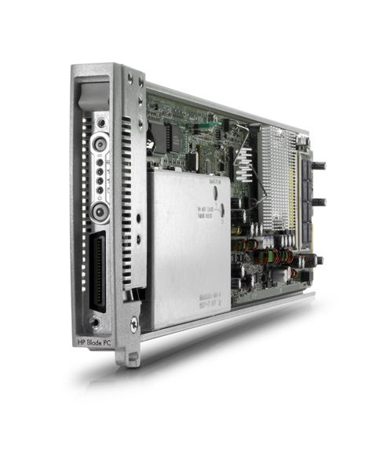

Approach
“Co-locate” DPI with the server
DPI appliance
Leverage abundant CPU resources
Leverage existing management interfaces
on servers, e.g. HP iLO
Server
Compatible with heterogeneous architecture, e.g. on-chip accelerators
Notes:
(no animation) Rather than having specialized hardware, we propose to co-locate the DPI appliance along with servers. There are two main advantages. First, we can leverage abundant number of CPU resources.
To manage those distributed DPI appliances, we can leverage the management interfaces already built in the server.
()Explain HP iLO a bit – management channel…service processor…..how to use it with DPI colocation
()Accelerator structure

Slide 5
Requirements
Transparency
Independent to the server’s software stack
Efficiency
Low overhead packet interception
Isolation
Resistant to attacks
Notes:
Here are the requirements that we need to consider when we co-locate the DPI appliances.
1. Transparency – The DPI application should not be bound to any particular service provided by the server software stack. The network manager of the data center has the flexibility to deploy any DPI applications of his choice
2. Efficiency – The overhead of packet interception needs to be low to catch up with the line speed
3. Isolation – The DPI application needs to be more resistant to attacks since it is privileged and used for security and management purpose.

Slide 6

Related Work
ETTM: a scalable fault tolerant network manager. C. Dixon et al. NSDI ‘11
Virtualization Support for DPI deployment
Transparency
Hypervisor Overhead
Hypervisor Vulnerability
Guest
VM
DPI
VM
SW
Hypervisor
HW
Processors
Virtualized Platform
Notes:
There is an existing work using virtualization to deploy DPI services. The DPI VM is used to inspect all traffic transmitted/received by the servers.
However, this approach does not satisfy with the transparency property since the DPI VM needs to provide the services corresponding to a particular hypervisor for intercepting packets
Trapping to hypervisor frequently incurs extra overhead
In addition, the hypervisor could potentially been compromised because of large hypercall interface exposed.

Slide 7
Ally Architecture
Multi-core processor
Unprivileged Partition
Privileged Partition
Software Stack
(OS + Applications)
Software Stack
(DPI Application)
NIC Traffic
core
core
core
core
core
core
NIC
Notes:
This shows the high-level figure of our Ally architecture
Instead of using virtualization, we choose to statically partition the hardware into privileged partition and unprivileged partition.
Privileged applications including DPI run inside the privileged partition. This partition has a separate and independent software stack from the unprivileged partition
The software stack inside the unprivileged partition is not changed. And all the other services are running inside this partition

Slide 8
Outline
Introduction & Motivation
Architecture
Overview
Multicore Partitioning
Packet interception
Evaluation
Conclusions
Notes:
I just introduced the motivation of our work and the high level architecture that we propose.
Next I will explain the details of our Ally architecture and the HW modifications we’ve made.

Slide 9
Baseline Architecture
Last
Level
Cache
Main Memory
Core
Interrupt
Controller
Core
Interrupt
Controller
MMU
MMU
MMU
MMU
MMU
MMU
Interconnect
Northbridge
Memory Controller
IOMMU
Interrupt Unit
NIC
Service
Processor
BIOS
External
Network
Management Network
Notes:
1. The figure shows the modifications that we need in Ally architecture.
2. For HW parts, we slightly modified MMU, IOMMU and Interrupt Unit to construct the privileged partition.
3. On Firmware part, we have modified the BIOS to insert customized booting procedure.
() Change acronyms to make them more meaningful

Slide 10
Ally Architecture
Unprivileged partition
Privileged partition
Last
Level
Cache
Main Memory
Core
Interrupt
Controller
Core
Interrupt
Controller
MMU
MMU
MMU
MMU
MMU
MMU
Interconnect
Northbridge
Memory Controller
IOMMU
Interrupt Unit
NIC
Service
Processor
BIOS
External
Network
Management Network
Notes:
1. The figure shows the modifications that we need in Ally architecture.
2. For HW parts, we slightly modified MMU, IOMMU and Interrupt Unit to construct the privileged partition.
3. On Firmware part, we have modified the BIOS to insert customized booting procedure.
() Change acronyms to make them more meaningful

Slide 11
Outline
Introduction & Motivation
Architecture
Overview
Multicore Partitioning
Packet interception
Evaluation
Conclusions
Notes:
1. I have explained our target architecture as well as the HW/FW modifications that we need.
2. Now I am going to explain the functionalities Ally provide as well as the required HW/FW modifications

Slide 12
Multicore Partitioning
Multi-core processor
Unprivileged Partition
Privileged Partition
Software Stack
(OS + Applications)
Software Stack
(DPI Application)
Invisible
core
core
core
core
core
core
NIC
Notes:
1. The fundamental functionality is to do the multicore partitioning. The goal is to provide an isolated environment for the privileged partition.
2. On the software part, different from any OS or hypervisor based proposals, the privileged partition in Ally has independent software stack which does not share with the unprivileged partitions.
3. On the hardware part, the privileged partition has segregated cores and memory in order to provide isolation and QoS guarantee.

Slide 13

Core Sequestration
Modify the BIOS to hide privileged core information from the OS
Ally Booting Procedure:
BSP core - the first core that boots
AP cores - the other cores
IPI - Inter-processor interrupts
…...
AP
DPI
Engine
Initialize
DPI core waits for
IN/OUT packets
AP
BSP
Core Info
Table
AP
OS retrieves
cores information
Wakeup
IPI
AP
Update
Notes:
1. To make the privileged cores hidden from the rest of the system, we propose to modify BIOS hide the corresponding information since the BIOS is used to provide HW information to the OS.
2. The shapes in gray color show the normal booting procedure. In the normal booting procedure, The BSP core starts executing the BIOS procedure and sends the IPI to all the rest cores. Each AP core runs pre-defined procedure and enters its information to a core information table which is later used by the OS.
3. In our customized procedure, one of the AP is assigned as a privileged core and starts initializing DPI engine and then waiting for incoming packets. Note that the privileged API core does not update the Core information Table in order to hide its existence.
4(try not to say only one DPI core)

Slide 14
Memory Protection
Partition the memory into two physically contiguous regions
Main Memory
Privileged partition
Page Table
Unprivileged partition
CR3
Boundary
Register
TLB
TLB Miss Handler
Range Checking
TLB
Miss
TLB Fill
MMU
Unprivileged Core
Notes:
1. To protect the memory of privileged partition, using another level of page table to do protection will incur a lot of overhead.
2. Instead, we chose to partition the main memory into two physically contiguous regions. (animation)
3. We add a special register which stores the boundary between the privileged and unprivileged partitions to the MMU.
4. In case of TLB misses of the unprivileged core, the returned physical address will be checked against the boundary register to see if the access falls in the range of unprivileged partition.
5. Since the overhead of TLB misses dominates, the overhead of range checking is negligible.

Slide 15
Outline
Introduction & Motivation
Architecture
Overview
Multicore Partitioning
Packet interception
Evaluation
Conclusions
Notes:
1. Now I have explained how privileged partition can be created. In the next section, I will explain how to use perform efficient packet interception in the privileged partition.

Slide 16
Packet Interception
Multi-core processor
Unprivileged Partition
Privileged Partition
Software Stack
(OS + Applications)
Software Stack
(DPI Application)
NIC Traffic
core
core
core
core
core
core
NIC
Notes:
For packet interception, the packets need to be inspected before the OS sees the packets.
And the interception process should incur low overhead.

Slide 17
Packet Interception
Virtualization of the Descriptor Queues
OS memory
DPI memory
Descriptor queues replicated
Descriptor queues
Only one copy of the packet buffers
NIC
Notes:
1. This shows the conventional way the OS interacting with the NIC. Each descriptor in the descriptor queue points to a packet buffer. To manipulate the queue, OS and NIC access MMIO registers to produce and consume packets. And the NIC uses interrupts to notify the OS some events happen (animation)
2. Our solution is to virtualize the descriptor queues for packet interception.
3. The real queue is seen by the DPI core and the NIC while the virtual queue is only seen by the OS core. And the DPI core is responsible for synchronize between the real queue and virtual queue.
() Mention memory mapped IO

Slide 18
Packet Interception
Virtualization of the Descriptor Queues
Device independent, software independent
No copying on packet buffers
Processor and NIC communication
Queue manipulation uses Memory Mapped IO (MMIO) accesses
NIC event notification uses Interrupt

Slide 19
MMIO redirection
OS core
IPI
DPI core
Load/store
MMU
R/W redirection
DPI memory
MMU detects specific MMIO addresses
MMU redirects RW to a reserved region in DPI memory
MMU sends IPI to DPI core
Notes:
1. This figures shows how MMIO redirection works. The MMU on the OS core traps on specific MMIO addresses.
2. The MMU redirects RW to a reserved region in DPI memory. Also, the MMU sends an IPI to DPI core to notify the event of queue manipulation.
3. Then the DPI core starts inspecting packets by checking the content of the descriptor queues.
() no acronym…IPI….MMIO

Slide 20
Ally Hardware Properties
Simple extensions to existing hardware components
No impact expected on critical timing paths
Compatible with virtualization support (Intel VT-x/EPT, AMD SVM/NPT)
Notes:
Here are the outlines of our hardware modification properties. First, The HW extensions are simple without complicated algorithms.
Second, the extensions do not incur overhead on critical timing path. The Range checking and MMIO redirections have negligible overhead.
Lastly, all our HW modifications are compatible with contemporary virtualization technology.

Slide 21
Outline
Introduction & Motivation
Architecture
Overview
Multicore Partitioning
Packet interception
Evaluation
Conclusions
Notes:
1. Now I have introduced the Ally architecture and its corresponding HW modifications. Let’s look at the evaluation of Ally architecture.

Slide 22
Evaluation
Full system emulation
QEMU
Core sequestration
HW changes
Real machine prototype
Hardware
Intel Core 2 duo 2.66 GHz with 1 Gbit Intel NIC
Benchmarks
Netperf
SPECweb
Systems
Ally, Linux and Xen
Notes:
1. To evaluate Ally architecture, we use QEMU which is a full system simulator to validate our HW changes and most importantly, is to verify the firmware modification for core sequestration
2. (optional) In order to evaluate the packet interception overhead, we used a core 2 duo machine with 1 Gbit NIC to run netperf benchmark and specweb.
3. Netperf is used to measure the basic packet interception performance while Specweb is used as a real world workload.
4. We compare Ally with two other systems: Linux and Xen. The three systems are described in the following slides.

Slide 23
System Configurations
Netperf/
Specweb
Netperf/
Specweb
Snort
Snort
Kernel
Kernel
NIC Driver
IP queue
Queue Virtualization
SW
SW
NIC Driver
HW
DPI core
OS core
HW
DPI core
OS core
Ally
Linux
Notes:
1. For Ally system, we mimic the queue virtualization by modifying NIC driver. And we built the interface between Snort and the descriptor queue to fetch packets.
2. In this system, the kernel is not modified and any OS service is not used.
() change figure to layer cake
() mention cpusets to pinning core

Slide 24
System Configurations
Netperf/
Specweb
Snort
Dom0 Kernel
DomU
Kernel
SW
Hypervisor
HW
DPI core
OS core
Xen
Notes:
1. For Ally system, we mimic the queue virtualization by modifying NIC driver. And we built the interface between Snort and the descriptor queue to fetch packets.
2. In this system, the kernel is not modified and any OS service is not used.
() change figure to layer cake
() mention cpusets to pinning core

Slide 25
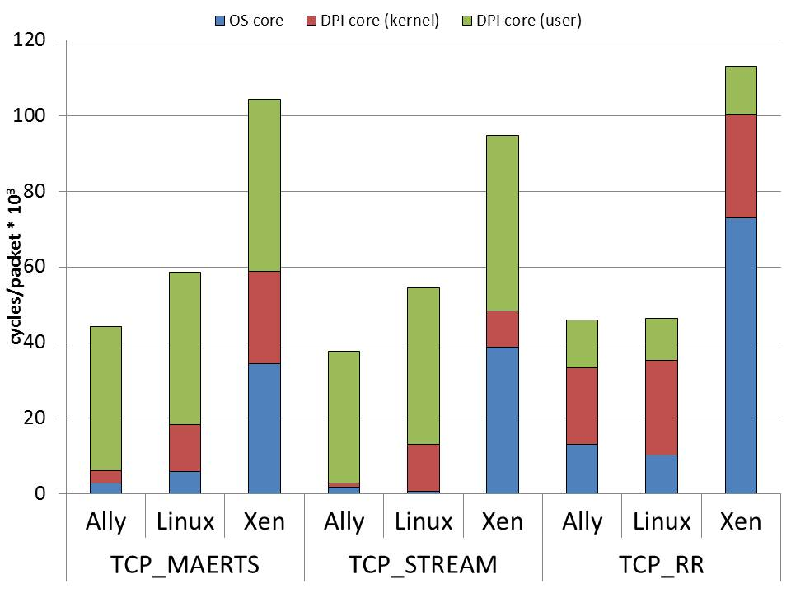
Netperf CPU Usage
Notes:
TCP_STREAM is a micro-benchmark used to test the maximum throughput of data flow going out the server. TCP_MAERTS is the opposite direction. TCP_RR is the request/response test and one transaction at a time.
This figure shows the processing cost per packet. In all three settings, CPUs are saturated by Snort which has the similar overhead per packet over three systems.
The DPI core kernel space overhead in Ally is mainly due to queue virtualization which involves expensive MMIO accesses.
In Linux and Xen, their packet interception mechanism contributes to the major overhead in the DPI core kernel space
The hypervisor has significant overhead on both OS core and DPI core (kernel space) because of frequently generated hypercalls

Slide 26
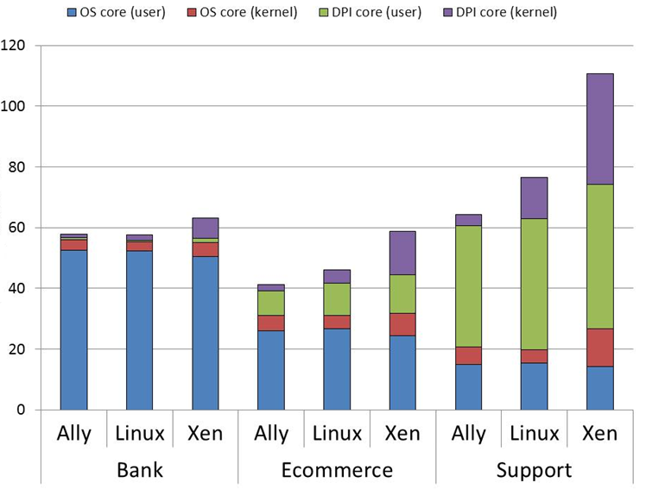
SPECweb CPU Usage
cycles/request * 10⁶
Notes:
1. In the specweb, we evaluate the packet processing overhead under three different traffic intensity.
2. The results shows the processing cost per request.
3. Bank has the bottleneck on the OS core for traffic encryption while Support can send out the largest number of packet per requests. Ecommerce is in between these two.
4. In Ally, the packet interception overhead slightly increases. However, the packet interception overhead increases exponentially.
5. Therefore, Ally has a more stable packet interception overhead under different traffic intensity.
() no exponentially…just a lot more

Slide 27
Outline
Introduction & Motivation
Architecture
Overview
Multicore Partitioning
Packet interception
Evaluation
Conclusions
Notes:
1. I have finished the evaluation section. I am going to conclude the talk.

Slide 28
Conclusions
Ally: a framework for transparent deployment of packet inspection appliances
Ally uses a set of simple HW/FW extensions enable reliable multicore partitioning and efficient packet inspection
Ally is fully compatible with new virtualization technology as well as heterogeneous architecture
Notes:
We propose Ally, a framework for OS transparent packet inspection.
() special purpose accelerator is compatible with Ally

Slide 29
Thanks

Slide 30
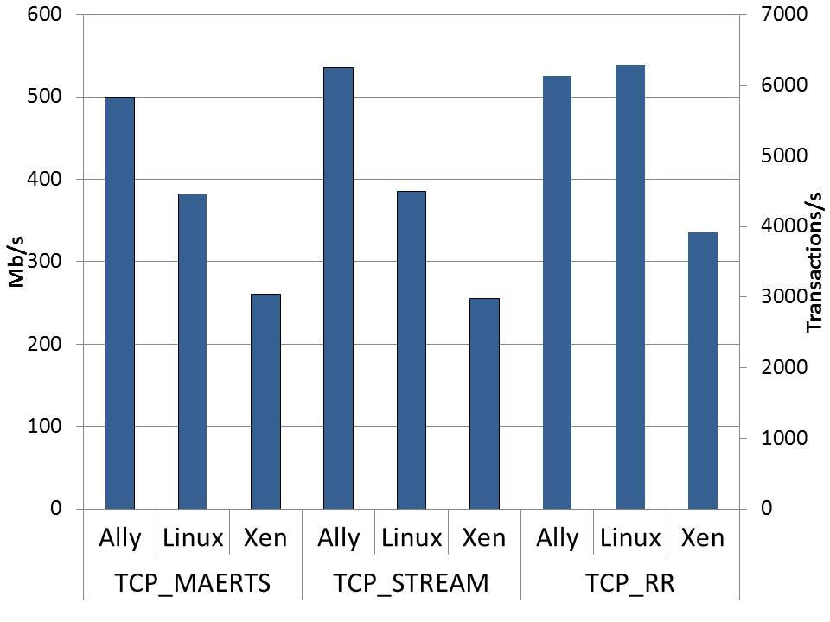
Throughput

Slide 31
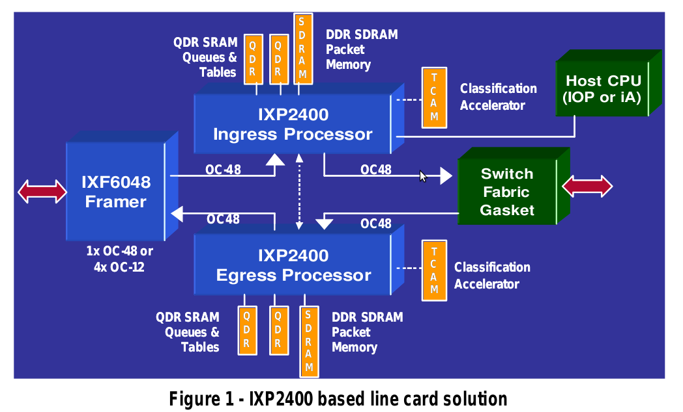
DPI using Network Processor
Notes:
Here is an existing solution for DPI
The network card has an embedded network processors.
The problem of this approach is flexibility since a special programming model is required to program network processor and it’s bound to a particular types of network processors
Limited resources including cores and memory – compared to what we have on the processor platform.

Slide 32
Conventional Architecture
Multi-core processor
Unprivileged Partition
Software Stack
(OS + Applications)
core
core
core
cores
cores
cores
NIC
Notes:
This is the simplified figure showing the architecture we have today.

Slide 33
Transmission Path
Multi-core processor
Unprivileged Partition
Privileged Partition
Software Stack
(OS + Applications)
Software Stack
(DPI Application)
core
core
core
core
core
core
NIC

Slide 34
Receive Path
Multi-core processor
Unprivileged Partition
Privileged Partition
Software Stack
(OS + Applications)
Software Stack
(DPI Application)
core
core
core
core
core
core
NIC

Slide 35
Processor
Unprivileged partition
Privileged partition
Main Memory
OS core
Local APIC
DPI core
Local APIC
Last Level Cache
OS core
Local APIC
DPI core
Local APIC
Privileged partition
OS core
Local APIC
DPI core
Local APIC
MMU
MMU
MMU
MMU
MMU
MMU
Unprivileged partition
Interface
Interface
Interface
Interface
Interface
Interface
On chip interconnect
Integrated Northbridge
Memory Controller
PCIe ctrl
DMI Ctrl
IOMMU
Interrupt Unit
NIC
Platform Controller Hub
BIOS
Network
IOAPIC
Management Network
Management NIC
Service Processor

Slide 36
Processor
Unprivileged partition
Privileged partition
Main Memory
OS core
Local APIC
DPI core
Local APIC
Last Level Cache
OS core
Local APIC
DPI core
Local APIC
Privileged partition
OS core
Local APIC
DPI core
Local APIC
MMU
MMU
MMU
MMU
MMU
MMU
Unprivileged partition
Interface
Interface
Interface
Interface
Interface
Interface
On chip interconnect
Integrated Northbridge
Memory Controller
PCIe ctrl
DMI Ctrl
IOMMU
Interrupt Unit
NIC
Platform Controller Hub
BIOS
Network
IOAPIC
Management Network
Management NIC
Service Processor

Slide 37
MMU Modification – Memory Protection
Main Memory
Privileged partition
Page Table
DPI core boundary register
Unprivileged partition
CR3
Special_reg
TLB
TLB Miss Handler
phys_addr
>
special_reg ?
Notes:
Rather than using another level of page table to do protection because of large overhead it incurs.
We simply partition the physical memory into two contiguous regions.
And we use a special MMIO registers set by the DPI application to indicate the range of the privileged partition.

Slide 38
Memory Protection Procedure
Main Memory
Privileged partition
Page Table
DPI core boundary register
Unprivileged partition
CR3
Special_reg
TLB
TLB miss
TLB Miss Handler
Virtual Address
phys_addr
>
special_reg ?

Slide 39
Memory Protection Procedure
Main Memory
Privileged partition
Page Table
DPI core boundary register
Unprivileged partition
CR3
Special_reg
TLB
TLB miss
TLB Miss Handler
Virtual Address
phys_addr
>
special_reg ?
TLB fill

Slide 40
Memory Protection
Multi-core processor
Unprivileged Partition
Privileged Partition
Software Stack
(OS + Applications)
Software Stack
(DPI Application)
Invisible
core
core
core
core
core
core
NIC

Slide 41
Processor
Unprivileged partition
Privileged partition
Main Memory
OS core
Local APIC
DPI core
Local APIC
Last Level Cache
OS core
Local APIC
DPI core
Local APIC
Privileged partition
OS core
Local APIC
DPI core
Local APIC
MMU
MMU
MMU
MMU
MMU
MMU
Unprivileged partition
Interface
Interface
Interface
Interface
Interface
Interface
On chip interconnect
Integrated Northbridge
Memory Controller
PCIe ctrl
DMI Ctrl
IOMMU
Interrupt Unit
NIC
Platform Controller Hub
BIOS
Network
IOAPIC
Management Network
Management NIC
Service Processor
Notes:
1. The colored parts are the components which need to be modified
2. Our modifications are mainly on MMU, IOMMU, BIOS and Interrupt Unit

Slide 42
Processor
Unprivileged partition
Privileged partition
Main Memory
OS core
Local APIC
DPI core
Local APIC
Last Level Cache
OS core
Local APIC
DPI core
Local APIC
Privileged partition
OS core
Local APIC
DPI core
Local APIC
MMU
MMU
MMU
MMU
MMU
MMU
Unprivileged partition
Interface
Interface
Interface
Interface
Interface
Interface
On chip interconnect
Integrated Northbridge
Memory Controller
PCIe ctrl
DMI Ctrl
IOMMU
Interrupt Unit
NIC
Platform Controller Hub
BIOS
Network
IOAPIC
Management Network
Management NIC
Service Processor

Slide 43
MMU Modification – MMIO Redirection
Physical Page
Redirection Bit
TLB Miss Handler
TLB
Check uncacheable address map
Physical
Address
Remapped
Address
Redirection
Table

Slide 44
MMIO Redirection – TLB Miss
On a TLB miss, the TLB miss handler does the page table walk
Physical Page
Redirection Bit
TLB miss
TLB Miss Handler
Page Table Lookup
TLB
Virtual Address

Slide 45
MMIO Redirection – TLB Miss
The TMH checks if the resulting physical address falls in an uncacheable page and hence potentially a MMIO page
Physical Page
Redirection Bit
TLB Miss Handler
Physical
Address
TLB
Check uncacheable address map

Slide 46
MMIO Redirection – TLB Miss
If the page is uncacheable, the TMH looks up the redirection table to check if any address in this page needs to be redirected
Physical Page
Redirection Bit
TLB Miss Handler
TLB
Check uncacheable address map
Physical
Address
Physical
Address
Remapped
Address
Redirection
Table

Slide 47
MMIO Redirection – TLB Miss
If any address in the page needs to be redirected, the TMH sets the redirection bit in addition to fill the TLB
Physical Page
Redirection Bit
TLB Miss Handler
TLB
TLB fill
Check uncacheable address map
Physical
Address
Remapped
Address
Redirection
Table

Slide 48
MMIO Redirection – TLB Hit
On a TLB hit, if the redirection bit is set, the MMU looks up the Last Level Cache (LLC) used to cache translations in Redirection Table
Redirection Bit
Physical Page
TLB
Virtual Address
Physical
Address
Remapped
Address
Physical Address
LLC
Offset

Slide 49
MMIO Redirection – TLB Hit
If a translation is found, the MMU returns the translated address and sends IPI to privileged cores.
Redirection Bit
Physical Page
TLB
Physical
Address
Remapped
Address
Translated
Address
LLC
Physical
Address
Hit
Generate IPI

Slide 50
MMIO Redirection – TLB Hit
If the LLC misses, then Redirection Table Lookup is performed
Redirection Bit
Physical Page
TLB
Physical
Address
Remapped
Address
Redirection Table
Lookup
LLC
Physical
Address
Miss

Slide 51
Interrupt Unit Modification
OS
core
DPI
core
If Source == NIC, Redirect Interrupt
Interrupt Unit
NIC

Slide 52
Interrupt Redirection
When NIC raises an interrupt, The interrupt Unit redirects the interrupt to DPI core
OS
core
DPI
core
If Source == NIC, Redirect Interrupt
Interrupt Unit
Interrupt
NIC

Slide 53
Interrupt Redirection
After the NIC interrupt is handled, DPI core sends an IPI to OS core mimicking NIC interrupt
OS
core
DPI
core
IPI
If Source == NIC, Redirect Interrupt
Interrupt Unit
NIC

Slide 54
Summary of Hardware Modifications
Unit | Description | Purpose
OS-core MMU | Prevent memory accesses to DPI memory from OS-core | Protection
 | Redirect MMIO accesses to DPI memory from OS-core and interrupt DPI core | Packet Interception
IOMMU | Prevent non authorized DMA to DPI Memory | Protection
IOAPIC | Redirect NIC interrupts to DPI-core | Packet Interception
All Units | Protected configuration registers | Protection

Slide 55
Functional Evaluation
Full system emulation
QEMU
Validate Hardware and Firmware Changes

Slide 56
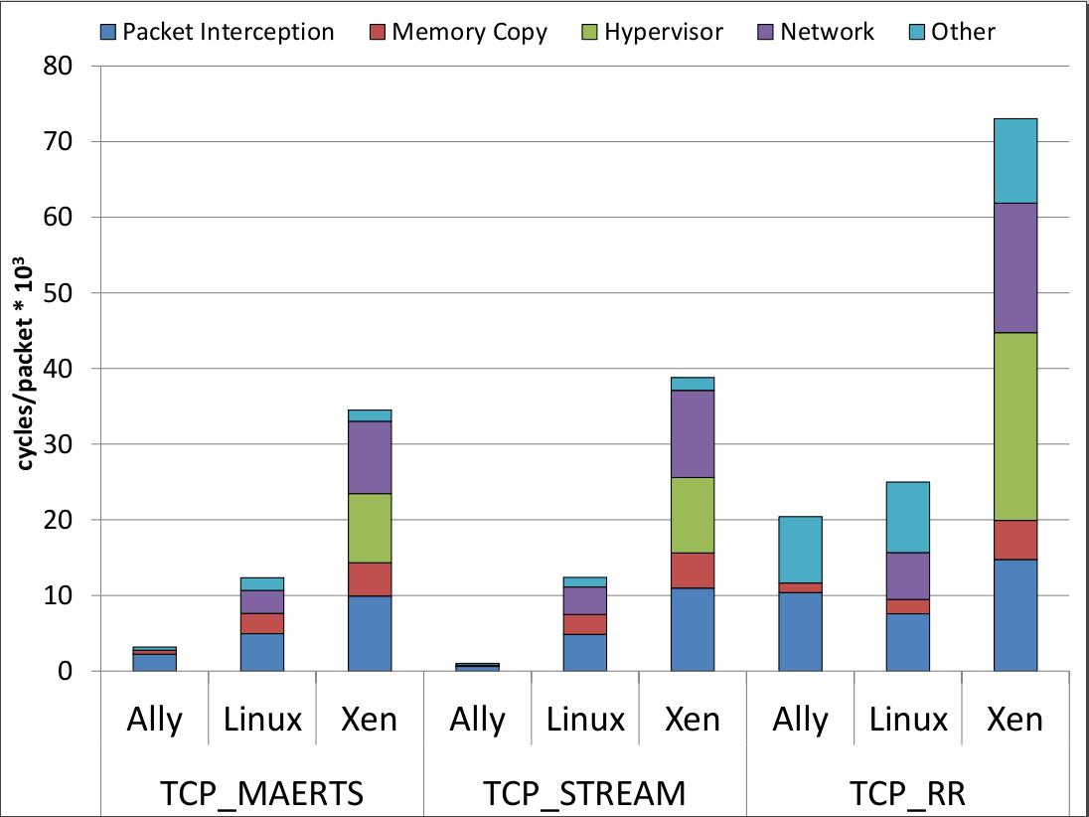
DPI core Usage
Notes:
MMIO registers update coalescing

Slide 57
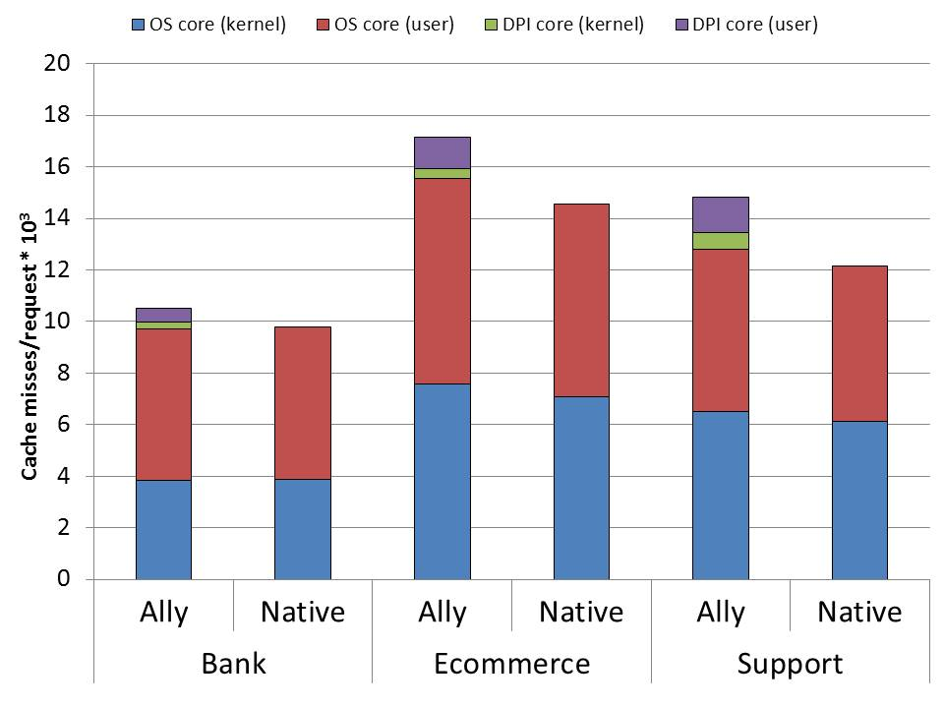
SPECweb Cache Misses
Notes:
The traffic intensity is small

Slide 58
Memory Protection
Multi-core processor
Unprivileged Partition
Privileged Partition
Software Stack
(OS + Applications)
Software Stack
(DPI Application)
Invisible
core
core
core
core
core
core
How?
Modified MMU
NIC

Slide 59
Challenges
Make privileged partition protected and invisible from the unprivileged partition
Core Sequestration
Memory Protection
Intercept packets efficiently
Packet Interception
Notes:
Here are the key challenges of constructing such environment:
The first challenge is how to make privileged partition protected and invisible from the unprivileged partition.
To address this challenge, we propose new core sequestration and memory protection mechanisms.
And the second challenge is how to minimize the packet interception overhead in order to catch up with line speed.
We propose a new packet interception scheme to address this issue.
All of our approaches are based on minimum hardware and firmware modifications which I am going to explain

Slide 60
Ally System
Linux
Other Apps
Core
kernel
Snort
DPI
Core
NIC Driver
Queue Virtualization
NIC Traffic
NIC
Notes:
1. For Ally system, we mimic the queue virtualization by modifying NIC driver. And we built the interface between Snort and the descriptor queue to fetch packets.
2. In this system, the kernel is not modified and any OS service is not used.
() change figure to layer cake
() mention cpusets to pinning core

Slide 61
Linux System
Linux
Snort
Other Apps
Core
Core
kernel
IP queue
NIC Driver
NIC Traffic
NIC
Notes:
1. We use Linux system to compare the packet interception interface in Ally with the original interface used in normal Linux
2. The original interface uses IP queue to intercept packets and pass them to the Snort before traversing the rest of the network stack.
() Not a correct system to deploy DPI appliance
() Use it for comparison…make sure Ally doesn’t screw up in comparison

Slide 62
Xen System
Linux
Snort
Other Apps
Core
Core
VM #0
VM #1
IP queue
Hypervisor
NIC Traffic
NIC
Notes:
1. This is the setting similar to the related work we introduced. We use this model to analyze the extra overhead incurred by hypervisor.

