Slide 1

Efficient System-on-Chip Energy Management with a Segmented Counting Bloom Filter
Mrinmoy Ghosh- Georgia Tech
Emre Özer- ARM Ltd
Stuart Biles- ARM Ltd
Hsien-Hsin Lee- Georgia Tech

Slide 2
Outline
Introduction to Counting Bloom Filters
Use of Counting Bloom Filters for Early Cache Miss Detection
Segmented Counting Bloom Filter
Evaluation
Results

Slide 3
Counting Bloom Filters
Insertion
Presence Bit
Counters
Vector
Hash
Function
Data A
1
1

Slide 4
Counting Bloom Filters
Deletion
Presence Bit
Counter
Hash
Function
Data A
0
0

Slide 5
Counting Bloom Filters
Query
Presence Bit
Counter
Hash
Function
Data B
0
0
Data Not Present
Bloom Filters gives a certain indication of the absence of data

Slide 6
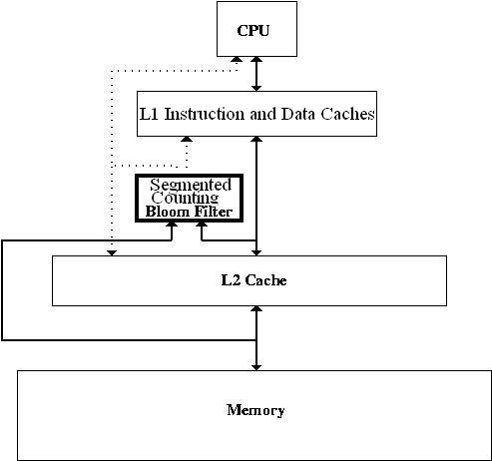
Early Cache Miss Detection with Counting Bloom Filters
1. A Miss in L2 Cache is expensive
2. Checking the Filter is much cheaper than checking the cache
CPU Power Down
L1 Drowsy
L2 Drowsy
Actions that may be taken on Early Cache Miss Detection
Power Down the CPU
Turn L1 and L2 Caches Drowsy
Wake up when data returns from memory
Linefill/Evict Info

Slide 7
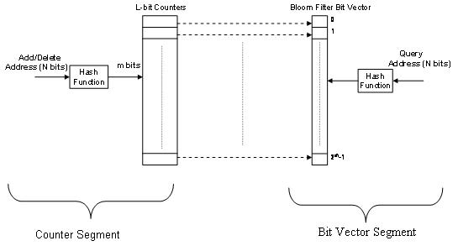
Segmented Counting Bloom Filters
Only the vector is needed to know the result of a query
Updates to the counter are more frequent than the bit vector

Slide 8
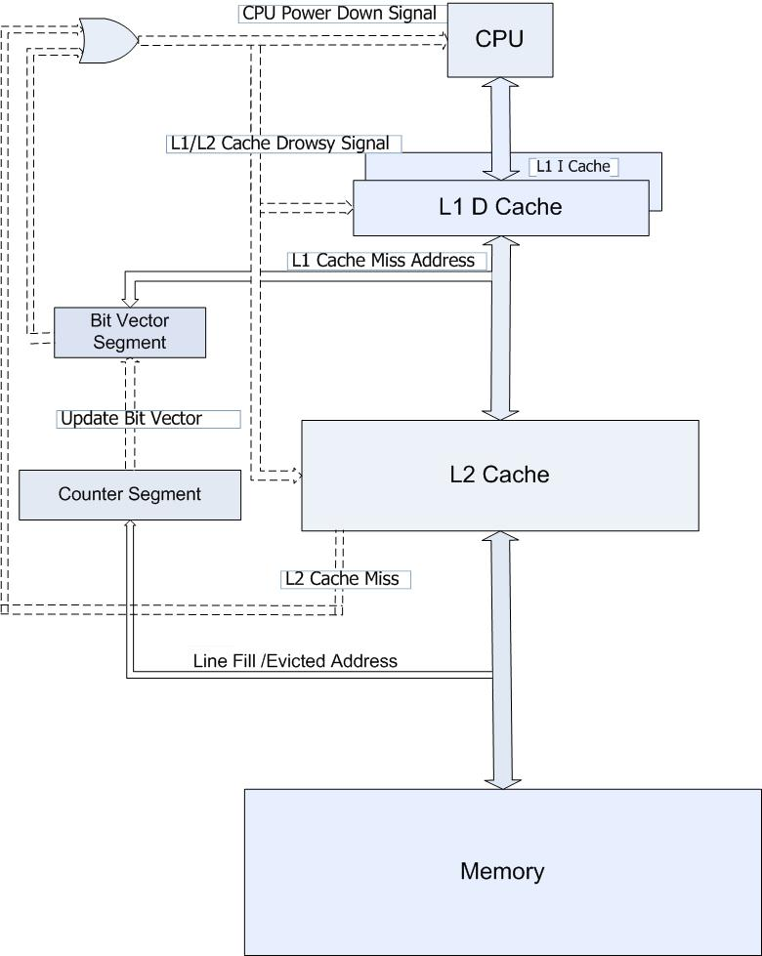
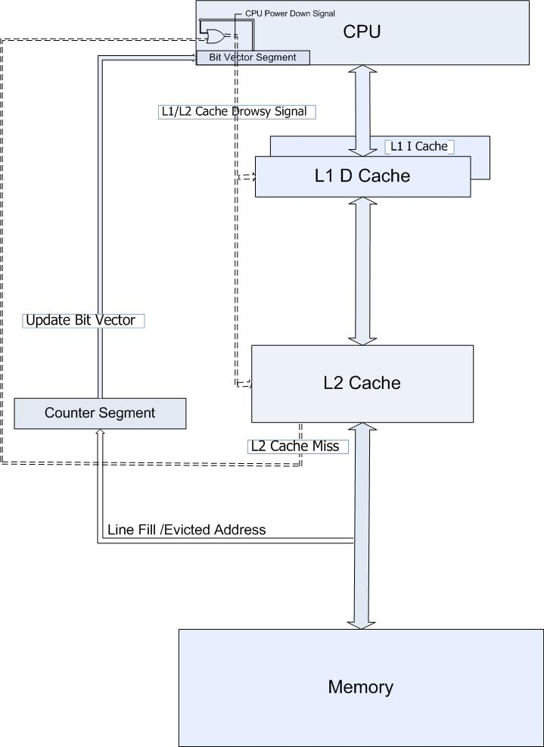
Early Cache Miss Detection with a Segmented Counting Bloom Filter
Bit Vector Segment
Bit Vector
Segment
Inclusive L2 Cache

Slide 9
Advantages of Segmenting the Bloom Filter
Lower Energy per access
Can be kept in close proximity to the structure that needs the Bloom Filter information (In this case the processor core)
Counter can be run at lower frequency saving energy

Slide 10
Methodology
Cache simulation done using Simplescalar on Spec INT 2000 Benchmarks for 2 billion instructions.
Energy Estimates for Caches, Vector, Counter, using Artisan 90nm TSMC SRAM and Register File generator

Slide 11
Configurations
Configuration 1
  2-way 8KB L1 I and D Caches
  4-way 64KB Unified L2 Cache
  Bit vector size = 8192 bits
  Counter array size = 8192 3-bit counters
  L1 Latency = 1 cycle
  L2 Latency = 10 cycles
Configuration 2
  2-way 32KB L1 I and D Caches
  4-way 256KB Unified L2 Cache
  Bit vector size = 32768 bits
  Counter array size = 32768 3-bit counters
  L1 Latency = 4 cycles
  L2 Latency = 30 cycles

Slide 12
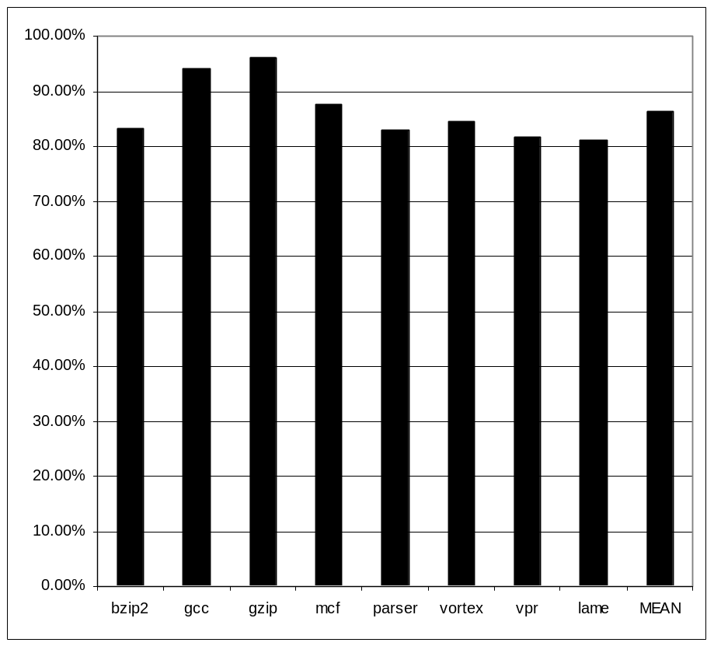
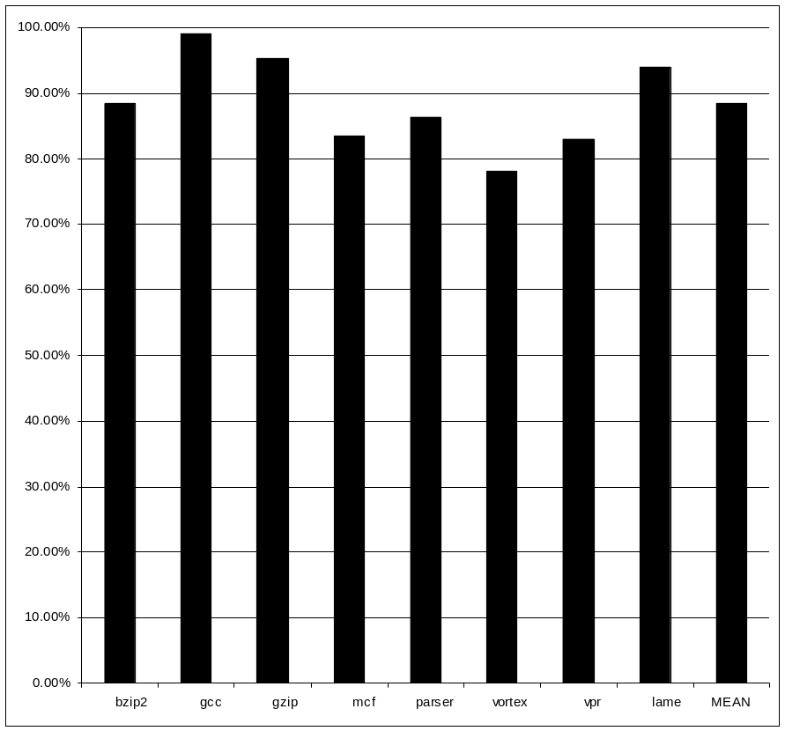
Results(Miss Filtering Rates)
Config 1
Config 2

Slide 13
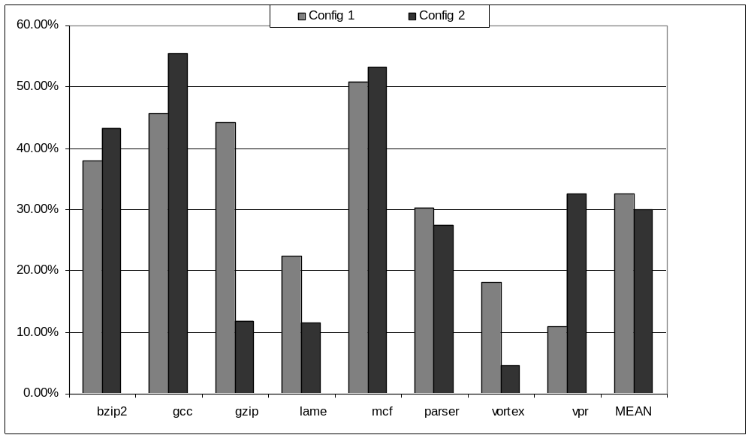
Results (Dynamic Power Savings)

Slide 14
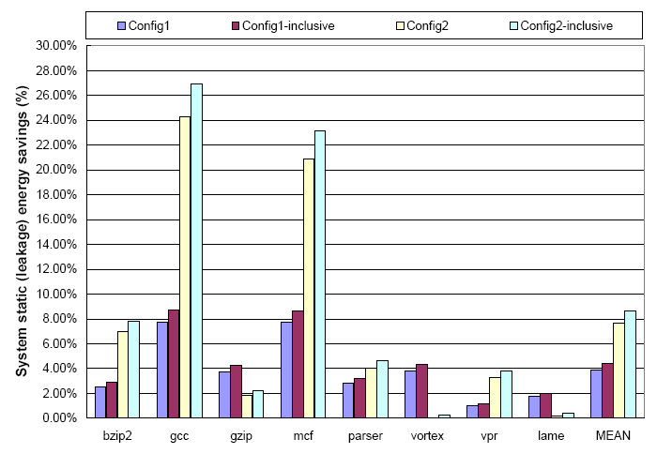
Results (Static Power Savings)

Slide 15
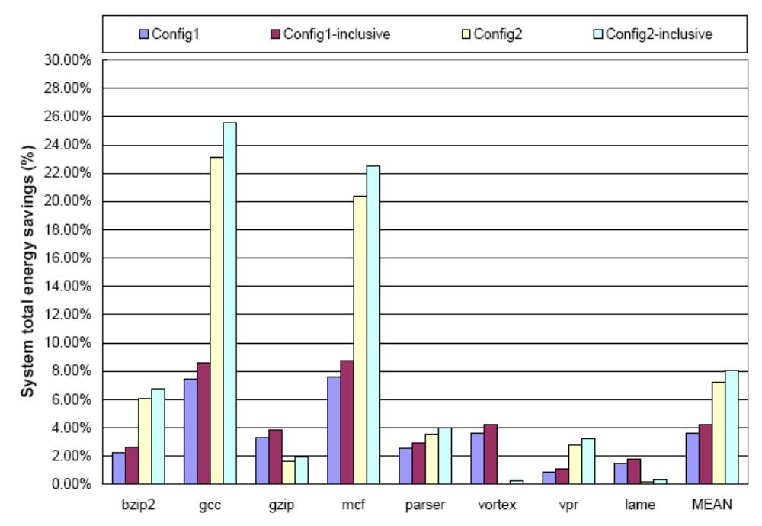
Results (Total System Energy Savings)

Slide 16
Summary
Counting Bloom Filters helps in early cache miss detection
Early cache miss detection leads to energy savings and performance improvements
Segmenting the Counting Bloom Filter leads to more energy savings as the filter and counters run at different frequencies
Total System Energy savings of up to 25% and 8% on the average

Slide 17
Thank You

Slide 18
Dealing with Counter Overflow
Policy 1:
  Disable the counters that overflow and keep the result of the bit vector as 1.
  When sufficient counters overflow, flush the cache (Very Rare)
Policy 2:
  Keep another associative hardware structure with few entries.
  Each entry would have the index of the counter which has overflowed and the value of the counter.
  This structure is generally off and is switched on only when at least one counter overflows
  If all the entries of this structure is used up, flush the cache.

Slide 19
Consistency Between Counters and Vector
Since counters run at a different frequency, there will be a delay in updating the bit vector. This may potentially lead to error.
Case 1:
  Counter becomes 1 to 0 on a replacement and bit vector is not updated. Subsequent bit vector queries say that data may be present when it is not. This is incorrect but safe as cache access continues normally.
Case 2:
  Counter becomes 0 to 1 on a linefill and bit vector is not updated in time. Subsequent bit vector queries say that data is absent and accesses go to main memory. This is incorrect and unsafe, since data in memory may be stale.
Solution:
  Update counter on a miss instead of a linefill. Since on a miss the line will eventually come from memory and by that time the bit vector would be updated. Thus this is a safe solution.

