Slide 1


Exploiting Access Semantics and Program Behavior to Reduce Snoop Power in Chip Multiprocessors
Chinnakrishnan S. Ballapuram
Ahmad Sharif
Hsien-Hsin S. Lee

Slide 2

Concurrent Execution in CMP
Single-threaded program
Multi-threaded program
Code, Data
Code Data
Registers, Stack
(Local)
Registers, Stack
(Local)
Registers, Stack
(Local)
Registers, Stack
(Local)
Thread 0
Thread 0
Thread 1
Thread 2
Shared Last Level Cache

Slide 3
Self-Modifying Code (SMC) Snoop
Core 0
Core 1
Core 2
Core 3
SMC snoop
SMC snoop
SMC snoop
SMC snoop
IL1
IL1
DL1
IL1
DL1
IL1
DL1
IL1
DL1

Slide 4
Snoop for Core 0 DL1 Miss
Core 0
Core 1
Core 2
Core 3
SMC snoop
SMC snoop
SMC snoop
SMC snoop
IL1
IL1
DL1
IL1
DL1
IL1
DL1
IL1
DL1
CMP core interconnect
L2 queue (FIFO)
Other logic and buffers
L2 cache
Snoop queue (FIFO)
External interconnect

Slide 5
External Snoop Request
Core 0
Core 1
Core 2
Core 3
SMC snoop
SMC snoop
SMC snoop
SMC snoop
IL1
DL1
IL1
DL1
IL1
DL1
IL1
DL1
CMP core interconnect
L2 queue (FIFO)
Other logic and buffers
L2 cache
Snoop queue (FIFO)
External interconnect

Slide 6
Modified L2 Eviction, External Request, etc
Core 0
Core 1
Core 2
Core 3
SMC snoop
SMC snoop
SMC snoop
SMC snoop
IL1
IL1
DL1
IL1
DL1
IL1
DL1
IL1
DL1
CMP core interconnect
L2 queue (FIFO)
Other logic and buffers
L2 cache
Snoop queue (FIFO)
External interconnect

Slide 7
Modified L2 Eviction, External Request, etc
Core 0
Core 1
Core 2
Core 3
SMC snoop
SMC snoop
SMC snoop
SMC snoop
IL1
As # of cores increases
Power ↑
Performance ↓
DL1
IL1
DL1
IL1
DL1
IL1
DL1
CMP core interconnect
L2 queue (FIFO)
Other logic and buffers
L2 cache
Snoop queue (FIFO)
External interconnect

Slide 8
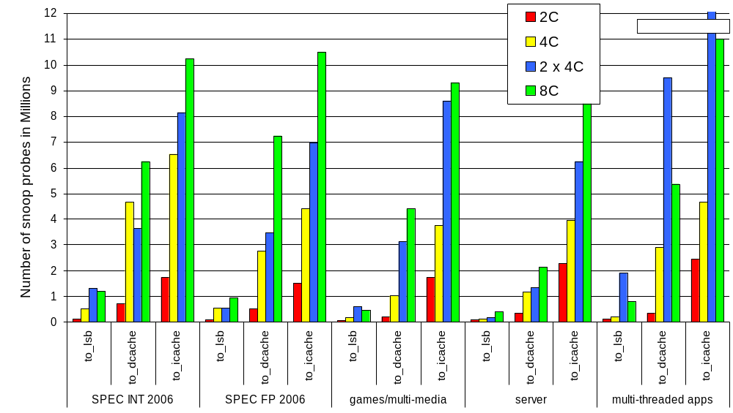
Number of Snoop Probes
SMC Snoops to I-Cache > Snoops to D-Cache > Snoops to LSB.

Slide 9
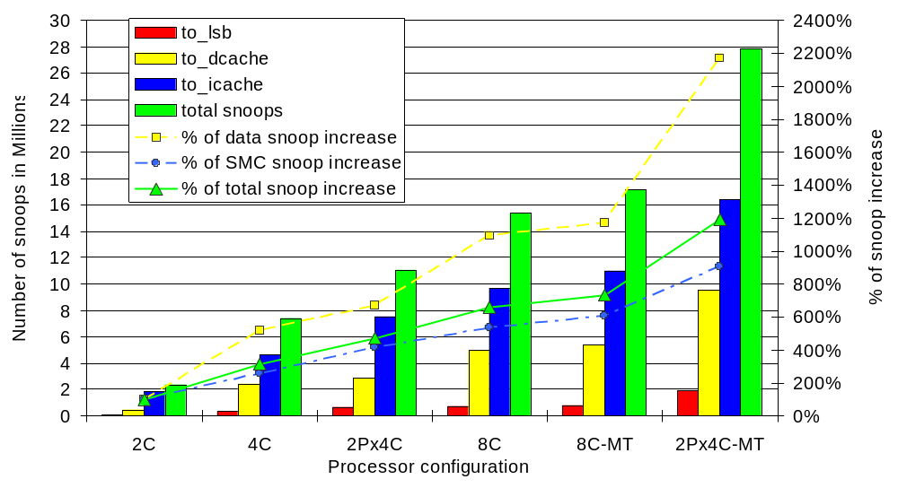
Snoop Probe and Snoop Rate
~22x increase
~12x increase
% of data snoop > % of instruction cache snoop

Slide 10
We propose two techniques to reduce the power consumed by snoop probes:
1. Selective Snoop Probe (SSP)
2. Essential Snoop Probe (ESP)

Slide 11
Selective Snoop Probe (SSP)
- SSP for SMC
- SSP for Non-Stack Accesses
- SSP for Stack Accesses

Slide 12
Selective Snoop Probe (SSP)
- SSP for SMC

Slide 13
Normal Operation: To Support SMC
Core 0
L1
I-Cache
SMC snoop probe
From RS or LSB
dispatch
L1
D-cache
MSHR

Slide 14
SSP (SMC) – No SMC Snoop if BF1 miss
To filter SMC/XMC snoops
Core 0
cntr
u1
HASH
L1
I-Cache
All store addr
SMC snoop probe
BF1
From RS or LSB
dispatch
L1
D-cache
r1
MSHR
r1 – read Bloom filter
u1 – update Bloom filter
cntr- counting Bloom filter

Slide 15
SSP (SMC) – No SMC Snoop if BF1 Hit
Core 0
cntr
u1
HASH
L1
I-Cache
All store addr
SMC snoop probe
BF1
From RS or LSB
dispatch
L1
D-cache
r1
MSHR
r1 – read Bloom filter
u1 – update Bloom filter
cntr- counting Bloom filter

Slide 16
Selective Snoop Probe (SSP)
- SSP for Stack Accesses

Slide 17
Normal Operation: Always Snoop for All Accesses
Core 0
From RS or LSB
dispatch
L1
D-cache
MSHR
Snoop probes
Snoop
probes
Snoop controller
dL1 miss
Snoop
queue
L2 queue
Last Level Cache

Slide 18
SSP – Stack Accesses
Core 0
Annotated by Front-End
From RS or LSB
dispatch
L1
D-cache
MSHR
All addresses
(carry S-bit annotation)
Snoop controller
dL1 miss
0
Snoop
queue
1
0
L2 queue
0
Last Level Cache

Slide 19
Selective Snoop Probe (SSP)
- SSP for Non-Stack Accesses

Slide 20
SSP – Non-stack Accesses Update BF2
Core 0
L1 D-cache
MSHR
From RS or LSB
dispatch
ME
SI
ME
SI
u2
u2
All non-stack addresses
HASH
cntr
BF2
Snoop controller
Filter snoops to
non-stack region
1
Snoop
queue
0
r2 – read Bloom filter
u2 - update Bloom filter
cntr - counting Bloom filter
0
L2 queue
0
Last Level Cache

Slide 21
SSP – Non-stack Accesses Read BF2
Core 0
L1 D-cache
MSHR
From RS or LSB
dispatch
ME
SI
ME
SI
u2
u2
All addresses
(carry S-bit
annotation)
r2
All non-stack addresses
All non-stack addresses
HASH
cntr
r2
BF2
Snoop controller
Filter snoops to
non-stack region
1
dL1 miss
Snoop
queue
0
r2 – read Bloom filter
u2 - update Bloom filter
cntr - counting Bloom filter
0
L2 queue
0
Last Level Cache

Slide 22
SSP - Selectively Send Snoop Probes
Core 0
L1 D-cache
MSHR
From RS or LSB
dispatch
ME
SI
ME
SI
u2
u2
u2
All addresses
(carry S-bit
annotation)
u2
All non-stack addresses
All non-stack addresses
Selectively send snoops
Selectively send snoops
HASH
cntr
BF2
Snoop controller
Filter snoops to
non-stack region
1
dL1 miss
Snoop
queue
0
r2 – read Bloom filter
u2 - update Bloom filter
cntr - counting Bloom filter
0
L2 queue
0
Last Level Cache

Slide 23
Essential Snoop Probe (ESP)
- ESP for SMC
- ESP for all variables

Slide 24
Essential Snoop Probe (ESP)
- ESP for SMC

Slide 25
SMC – Normal Operation
Core 0
Every Store Snoops
I-cache
Other pipe stages
L1 I-$
From RS or
LSB
dispatch
L1 D-$

Slide 26
ESP ⎯ Essential Snoop Probe
SMC-CR=1
Core 0
Other pipe stages
L1 I-$
From RS or
LSB
dispatch
L1 D-$
OS sets a control register bit (SMC-CR)
SMC-CR=1 ⇒ Non Self-Modifying Code
SMC-CR=0 ⇒ Self-Modifying Code

Slide 27
Essential Snoop Probe (ESP)
- ESP for all variables

Slide 28
Normal Operation – Snoop for All Variables
Core 0
Other pipe stages
L1 I-$
From RS or
LSB
dispatch
L1 D-$
Snoop probes
Snoop probes
CMP interconnect domain
Snoop controller
dL1 miss
Snoop
queue
L2 queue
Last Level Cache

Slide 29
Essential Snoop Probe (ESP) – SMN bit 1
Core 0
Other pipe stages
L1 I-$
From RS or
LSB
dispatch
L1 D-$
CMP interconnect domain
Snoop controller
dL1 miss
with SMN bit annotation
1
Snoop
queue
1
0
L2 queue
0
SMN bit – Snoop-Me-Not bit is 0/1
SMN bit
Last Level Cache

Slide 30
Essential Snoop Probe (ESP) – SMN bit 0
Core 0
Other pipe stages
L1 I-$
From RS or
LSB
dispatch
L1 D-$
ESP
ESP
ESP
CMP interconnect domain
Snoop controller
dL1 miss
with SMN bit annotation
0
Snoop
queue
1
0
L2 queue
0
SMN bit – Snoop-Me-Not bit is 0/1
SMN bit
Last Level Cache

Slide 31
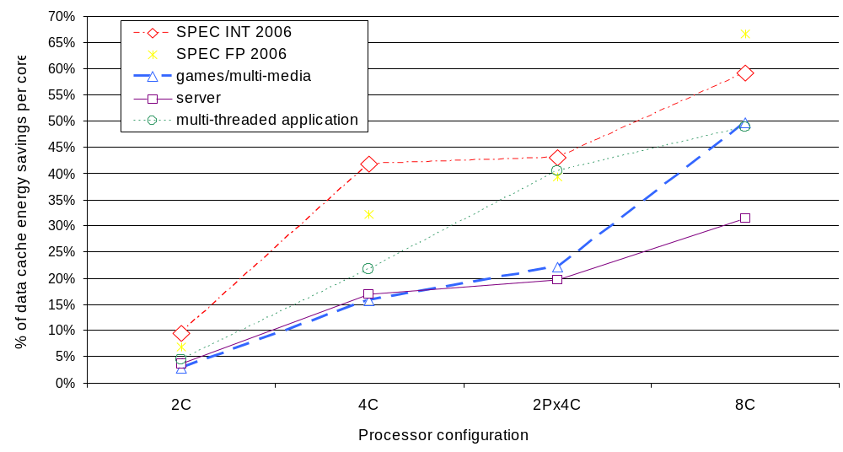
Energy Savings in D-Cache Using SSP
In the 2C config 5% - 10% data cache energy savings and in the 8C config 30% - 65% is achieved.
The data cache energy savings increases with the number of cores on the die as the number of snoops to all the cores increases.

Slide 32
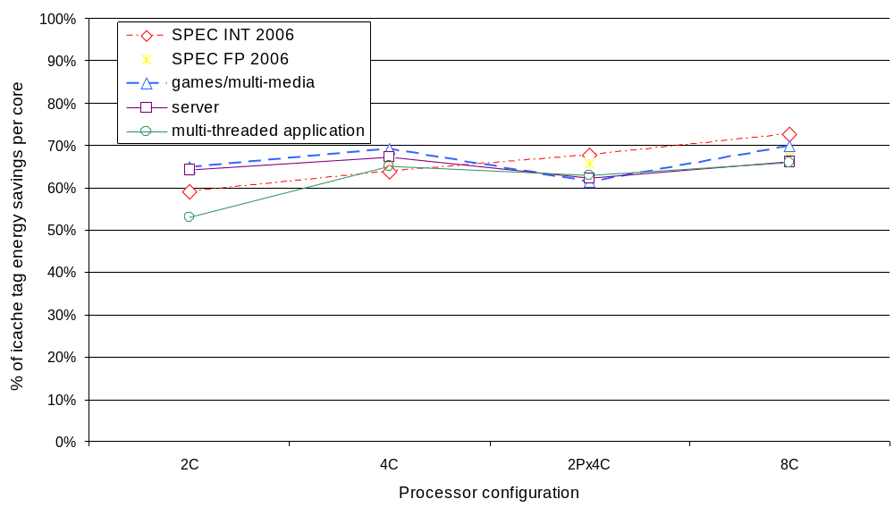
Energy Savings in I-Cache Using SSP
There is a 50% - 70% instruction cache tag energy savings is achieved across all processor configurations.

Slide 33
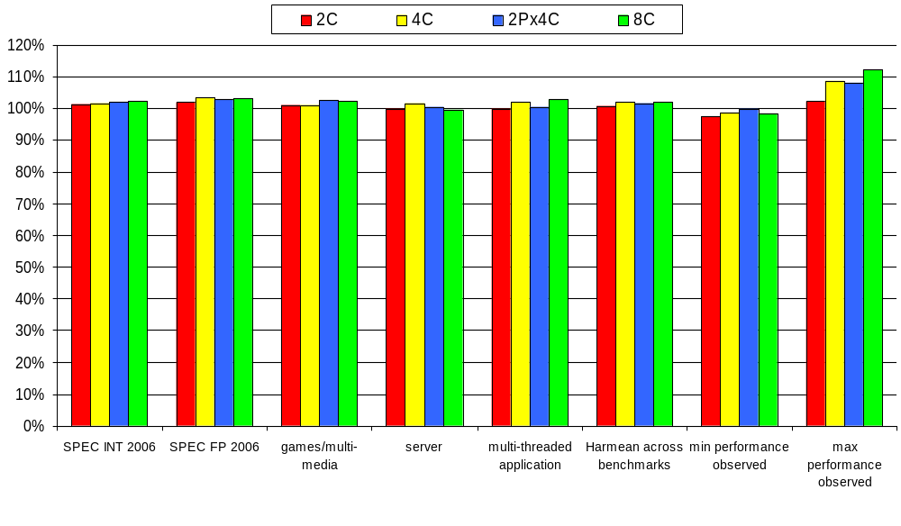
Performance Impact with SSP
On average there is 1% - 2% performance improvement across various benchmark categories and different processor configurations is achieved.

Slide 34
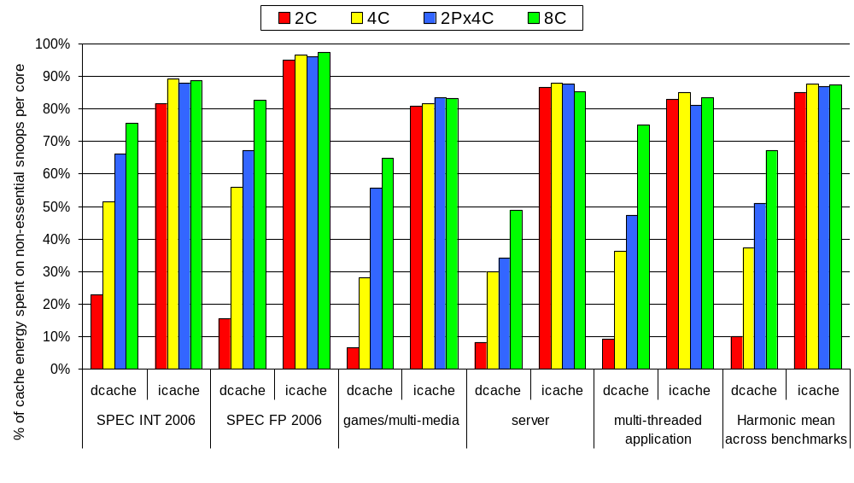
Energy Savings with ESP
It shows that 5% to a maximum of 82% data cache energy is spent on the non-essential snoop probes that can be eliminated using the ESP technique.
Also, 85% of the snoops to the instruction cache tag energy can be eliminated using ESP.

Slide 35
Conclusion
Semantics and program behavior are useful indicators
They are exploited to reduce power due to snoops
We proposed
  Selective Snoop Probe (SSP)
  Essential Snoop Probe (ESP)
Energy Reduction Results
  5% to 65% in D-cache per core
  50% to 70% in I-cache per core
1% - 2% performance improvement
Extensible to optimize integrated platforms with graphics processor

Slide 36

Thank You !
Georgia Tech
Electrical and Computer Engineering
MARS Labs
http://arch.ece.gatech.edu

Slide 37
BACKUP

Slide 38
Simulation Infrastructure
Execution Engine | 4-wide, Out-of-Order
Load buf / Store buf / RS / ROB | 96 / 64 / 128 / 256 entries
L1 / L2 latency | 4 / 8 cycles
L1 I, L1 D cache size | 32KB, 8 way, 64B
L2 Cache | 4MB, 16 way, 64B
L1 TLB entries | 128, 4 way
Memory | 2GB, DDR 2 timings
CACTI 4.2 | 70nm power model
Benchmark class | Example applications
Server | specJBB, TPCC
SPEC FP 2006 | wrf, namd, lbm, soplex
SPEC INT 2006 | hmmer, gobmk, omnetpp, gcc
Games and multi-media | shooters, realtime strategy, raytracer
Multi-threaded applications | ray tracer, cinebench

Slide 39
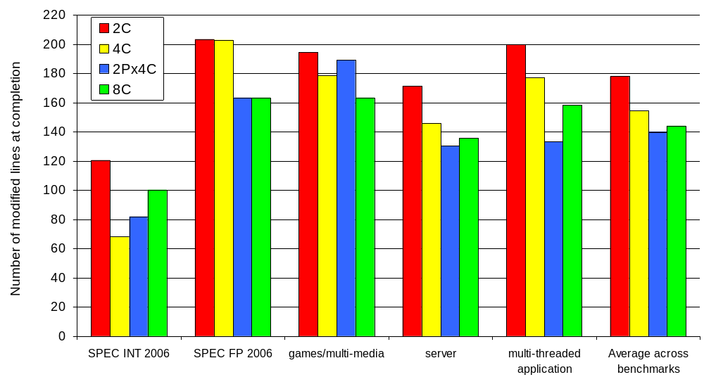
Number of Modified Lines
It shows the number of modified lines that needs to be evicted to the last level cache.

Slide 40
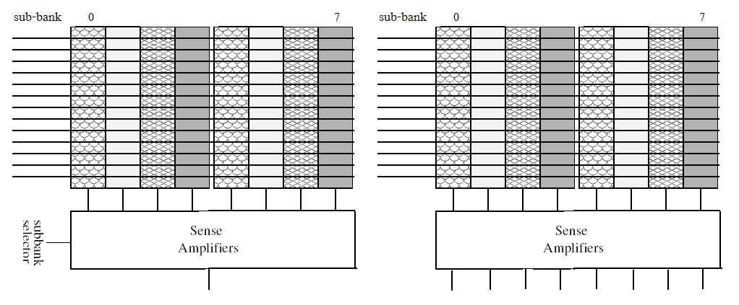
Cache access Vs Snoop access
Cache access – Read one sub-bank (8 bytes)
Snoop access – Need to read all sub-banks to ship the data to other cores or other processor in an MP system. (all 64 bytes, cache line size)

Slide 41
Hash functions
Cache Line
(physical address)
(48-bits)
MESI
state
Tag + Index bits
Data
If M/E state
If S state
cntr
cntr
HASH 3
HASH 3
47
33
Tag + Index bits [6-32]
15
6
Unused bits
C
B
A
cntr
cntr
cntr
HASH 3
If bit-10 is 0, HASH3 = A ^ B ^ C
If bit-10 is 1, HASH3 = (A ^ 0x22) ^ B ^ C

Slide 42
Incoming Events to LLC
Incoming events to the last level cache
RFO
Data Read
Code fetch
Shared L2 evict

Slide 43
Incoming Events to LLC and Sources of Snoop Triggers
Incoming events to the last level cache | iL1 of this core | dL1 of this core
RFO | - | Event trigger
Data Read | - | Event trigger
Code fetch | Event trigger
Shared L2 evict

Slide 44
Snooped Units in the Triggered Core
Incoming events to the last level cache | iL1 of this core | dL1 of this core | LSB of this core | MSHR, WBB of this core
RFO | - | Event trigger | - | -
Data Read | - | Event trigger | - | -
Code fetch | Event trigger | SMC snoop | Snoop store buffer only (updated writes) | Snoop (update writes)
Shared L2 evict | - | Snoop | - | Snoop

Slide 45
Snoop Probes for Incoming Data Read
Incoming events to the last level cache | iL1 of this core | dL1 of this core | LSB of this core | MSHR, WBB of this core | iL1 of other 3 cores | dL1 of other 3 cores | LSB of other 3 cores | MSHR, WBB of other 3 cores | Shared L2 queue
RFO | - | Event trigger | - | - | XMC snoop to invalidate line | Snoop | snoop load buffer only to invalidate | Snoop to invalidate pending requests | Snoop to invalidate
Data Read | - | Event trigger | - | - | XMC snoop to invalidate line | Snoop | - | Snoop | Snoop
Code fetch | Event trigger | SMC snoop | Snoop store buffer only (updated writes) | Snoop (update writes) | - | XMC snoop | Snoop store buffer only (update writes) | Snoop | SMC Snoop
Shared L2 evict | - | Snoop | - | Snoop | - | Snoop | - | Snoop | Snoop

Slide 46
Snoop Triggers and Snoop Units
Incoming events to the last level cache | iL1 of this core | dL1 of this core | LSB of this core | MSHR, WBB of this core | iL1 of other 3 cores | dL1 of other 3 cores | LSB of other 3 cores | MSHR, WBB of other 3 cores | Shared L2 queue
RFO | - | Event trigger | - | - | XMC snoop to invalidate line | Snoop | snoop load buffer only to invalidate | Snoop to invalidate pending requests | Snoop to invalidate
Data Read | - | Event trigger | - | - | XMC snoop to invalidate line | Snoop | - | Snoop | Snoop
Code fetch | Event trigger | SMC snoop | Snoop store buffer only (updated writes) | Snoop (update writes) | - | XMC snoop | Snoop store buffer only (update writes) | Snoop | SMC Snoop
Shared L2 evict | - | Snoop | - | Snoop | - | Snoop | - | Snoop | Snoop
 | SMC snoop to iL1 | On all store addr disp | - | - | SMC snoop to iL1 | On all store addr disp | - | - | -

