Slide 1


Entropy-Based Low Power Data TLB Design
Chinnakrishnan Ballapuram
Kiran Puttaswamy
Gabriel H. Loh*
Hsien-Hsin “Sean” Lee
School of Electrical and Computer Engineering
College of Computing*
GeorgiaTech
Atlanta, GA 30332

Slide 2

Outline
Motivation
Overview of Entropy and measurement
Entropy based DATA TLB
Simulation Result
Conclusion

Slide 3
Motivation
TLB
  Major processor power contributor
    I-TLB & D-TLB are looked up for every instruction and memory references
    TLBs are fully / highly associative
Traditionally we lookup the TLB using all 20-bits of the VPN
  Is it possible to reduce the number of bits for address translation?

Slide 4
Outline
Motivation
Overview of Entropy and measurement
Entropy based DATA TLB
Simulation Result
Conclusion

Slide 5

Overview of Entropy
Entropy is a measure of “uncertainty” or “unexpectedness”
  Where P(xi) is the probability of the occurrence of VPN xi
For example, let there be 32 random memory accesses
  case 1:
    if 16 accesses go to VPN 0x12340, and the other 16 accesses go to 0x12341
      then H = 1 bit implying we need only one bit to encode
  case 2:
    if 8 accesses go to VPN 0x12340, 8 accesses to 0x12341, 8 accesses to 0x12342, and the other 8 accesses to 0x12343
      then H = 2 bits implying we need two bits to encode

Slide 6
Memory Organization
max mem
reserved
STACK grows downward
Protected
HEAP grows upward
AAAA_AAFF
Static GLOBAL Data Region
Read-only region
AAAA_AA00
Code Region
reserved
min mem
ARM Architecture

Slide 7
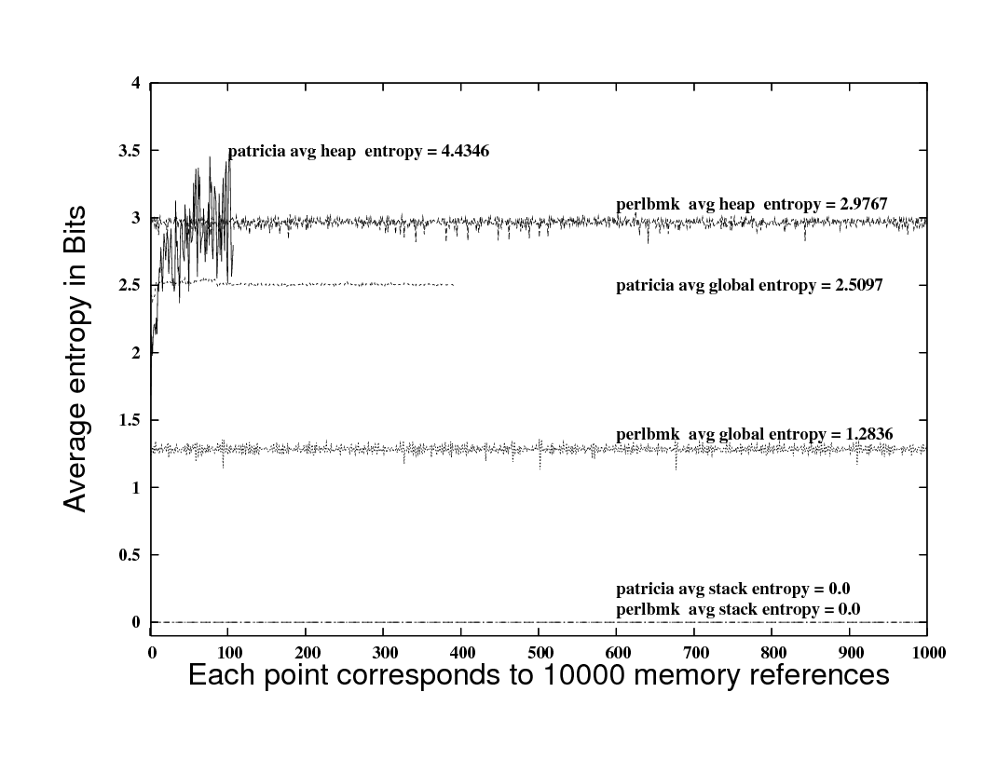
Entropy in virtual page number trace
At MAX, log₂10000 = 13.28 bits
=> we need to pre-charge 14 bits in the TLB for correct address translation
=> 2^14 unique virtual pages are accessed
Entropy of 2 bits means that, we need to pre-charge only 2 bits during this period of 10000 memory references => only 4 unique pages are accessed
From the above graph, stack entropy << (global entropy < heap entropy)

Slide 8
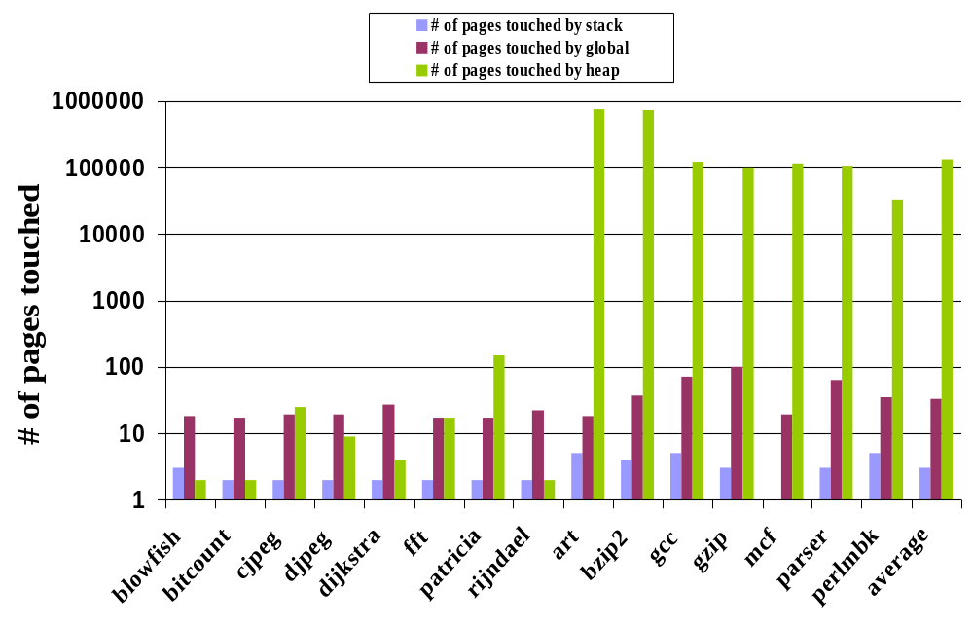
Total number of pages accessed

Slide 9
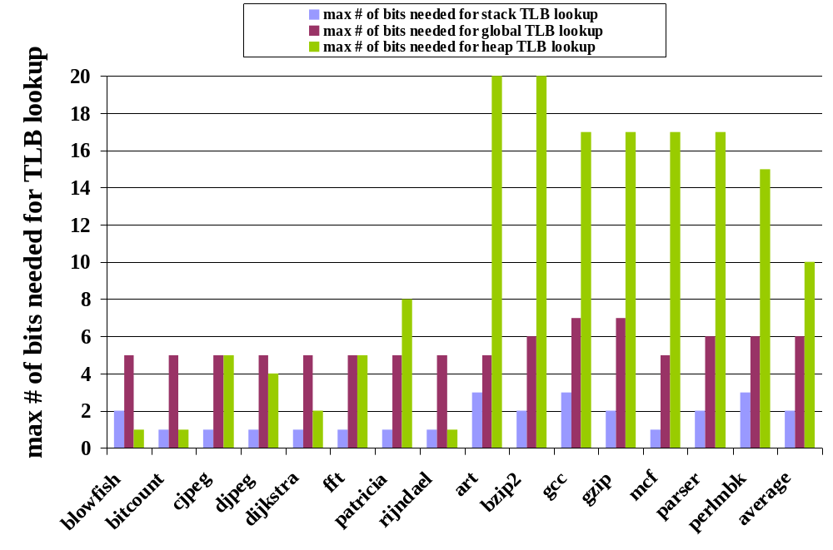
Max number of bits needed
Small bars for stack and global suggest that few bits are enough for TLB tag match lookup instead of the whole 20-bit VPN

Slide 10
Outline
Motivation
Overview of Entropy and measurement
Entropy based DATA TLB
Simulation Result
Conclusion

Slide 11
Microarchitecture of ESAM
VA
AGU
ld_data_base_reg
ld_env_base_reg
ld_data_bound_reg
S
G
H
MS
S
G
H
MS
VA
VA
MOB
Data Address Router
(DAR)
1
0
0
0
1
0
0
0
0
1
0
0
0
1
0
0
0
0
1
0
0
0
1
0
ESP-TLB
Entropy based SPeculative TLB
EDT-TLB
Entropy based DeTerminstic TLB
ESP
EDT
sTLB
0
gTLB
0
3
7
uTLB
0
To Processor
31
To Processor
hCache
gCache
sCache
Unified L2 Cache

Slide 12
Entropy-based semantic d-TLB
ESP-TLB (Entropy based Speculative TLB)
  Stack region accesses
    Very high locality
    Very low entropy
  Few bits are enough!
EDT-TLB (Entropy based Deterministic TLB)
  Global region accesses
    Clearly defined as part of the executable file format
    # of pages can be determined after the program compilation and before execution
  Fixed number of bits is required!

Slide 13
Entropy based SPeculative stack TLB
VPN
Stack base
0x bfffc
Stack grows
downward
0x bfffb
Pre-charge logic
4KB page
Smallest sTLB VPN accessed = 0x bfffa
V
$sp
0x bfff9
0
VPN bit enable
Stack TLB 1
0
Modified binary
prefix sum logic
0
Smallest sTLB
VPN accessed
P
VPN
Copied
When
C < P
C < P
Yes
19 0
+ve clock edge
-ve clock edge
V – Valid bit
MS-Bit – marked only on
mis-speculation
--- Active only when stack
grows and crosses page
boundary
Current sTLB VPN
C
Counter
Load
Buffer
MS
B
I
T
MS
B
I
T
Store
Buffer
Memory Order Buffer (MOB)
20-bit stack VPN
Common case address translation path

Slide 14
Entropy based DeTerminstic global TLB
Global data size = ld_data_bound – ld_data_base;
Number of pages = global data size / 4096;
Number of bits needed = log2(number of pages);
Deterministic fixed bits =
mod_binary_prefix_sum (number of bits needed)
ld_data_base
Deterministic fixed bits
Ex: 0x 0001F
ld_data_bound
Load / Store Buffer
Pre-charge logic
20-bit VPN
0
Global TLB 1
Values known after compilation
Store before execution
7

Slide 15
Outline
Motivation
Overview of Entropy and measurement
Entropy based DATA TLB
Simulation Result
Conclusion

Slide 16
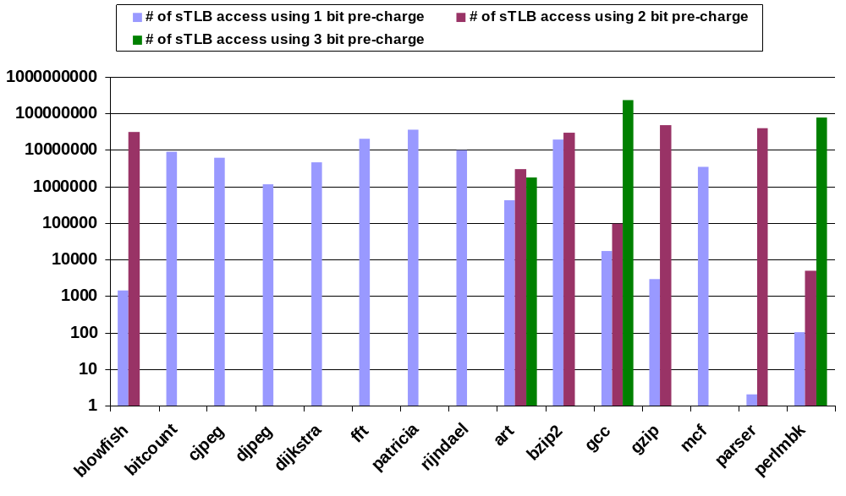
Effectiveness of ESP-TLB

Slide 17
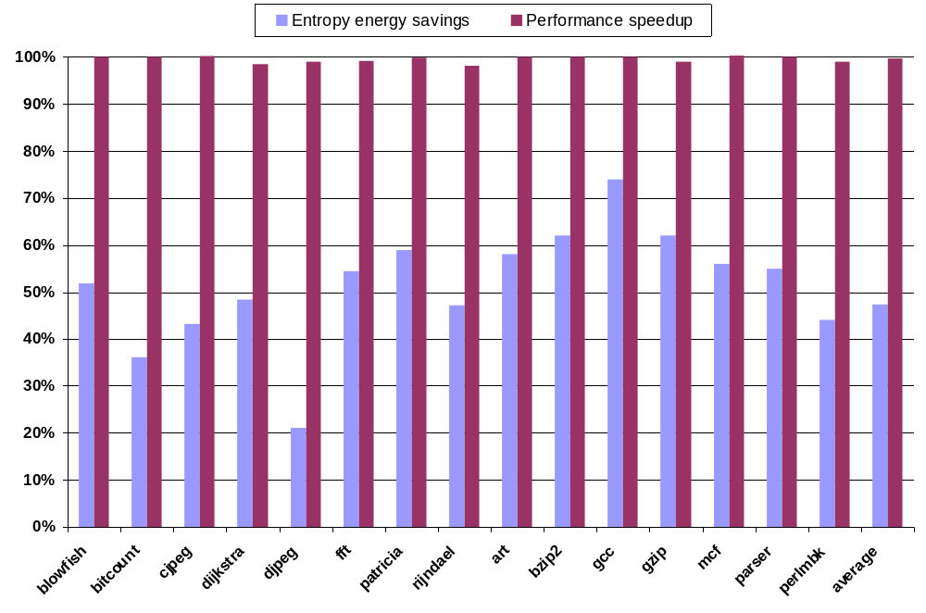
Energy savings using ESP-TLB and EDT-TLB
Energy savings of 47% with less than 1% penalty

Slide 18
Conclusion
Stack and global VPNs have low entropy.
Proposed ESP-TLB and EDT-TLB to exploit this behavior to reduce energy.
Energy savings and performance impact
  47% energy saving
  With less than 1% penalty

Slide 19
Thank you.
http://arch.ece.gatech.edu

