Slide 1
Predicate-Aware Scheduling:
A Technique for Reducing
Resource Constraints
Mikhail Smelyanskiy, Scott Mahlke, Edward Davidson
Department of EECS
University of Michigan
Hsien-Hsin (Sean) Lee
School of ECE
Georgia Institute of Technology
Notes:
My name is Mikhail Smelyanskiy. The title of my talk is: Predicate-aware Scheduling: A Technique for Reducing Resource Constraints.
In this talk we are going to describe a new scheduling scheme, called Predicate-Aware Scheduling, which achieves better schedules on predicated code.
We will also describe a new extension to conventional VLIW architecture and show how it can be used to support predicate-aware scheduling.

Slide 2
Motivation
Predication eliminates branch instructions
  but increases resource requirements
Predicate-aware scheduling oversubscribes resources
  reduces resource requirements
  reduces schedule length
A
br cond
0: A
1: p1,p2=pred_def(cond)
2: B if p1
3: C if p2
4: E
0: A
1: p1,p2=pred_def(cond)
2: B if p1 C if p2
3: E
T
F
B
C
D
Notes:
Compiler often uses predication to expose more instruction level parallelism. Predication eliminates branches from the code and converts control statements into straight-line code. Example of predication is shown on this slide. The middle box shows the predicated if-then-else statement on the left. The branch is removed, and instead predicate defining operation is inserted, which sets predicate p1 and its complement predicate p2. Operations B and C are predicated. At run time, either B will execute or C will execute, but not both, since they are guarded under disjoint predicates. Operations B and C are called disjoints.
The problem with predication is the resource requirements on all control paths are added. This can lead to increased schedule length. For example, the above code will take 4 cycles on single functional unit machine. The disjoint operations B and C will all be unconditionally issued to a functional unit at cycles 2 and 3 regardless of the value of their guarding predicate. But only one of these operations will execute at run time – the other will be nullified As the result we waste either cycle 2 or cycle 3, since functional unit is not utilized during the cycle in which it executes nullified operation.
The predicate-aware scheduling scheme that we propose, combines the disjoint operations C and D to oversubscribe (or share) a functional unit in the same cycle 2. The predicates are then read early at run time before operations go to the functional unit, and the operation guarded under FALSE predicate will be nullified so that the resource conflict will never occur. As the result, ALU will always be utilized in cycle 2. This leads to decreased schedule of 3 cycle instead of 4.

Slide 3
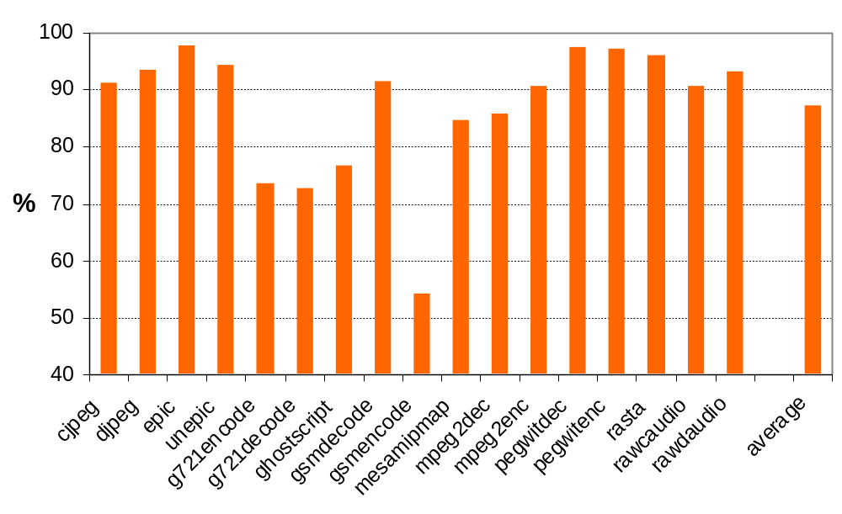
Potential for Disjoint Operations
Combining reduces dynamic operation count by 13%
Notes:
We have shown that it is possible to reduce schedule length combine operations to reserve the same resource in the same cycle. Now we want to see how much combining opportunity there is in the code to see if the technique should be investigated further.
This graph shows the potential of operations combining. The right bar show the percentage of dynamic operations that remain after optimal combining has been done in every region. Of course only regions with at least two disjoint operations will be effected by combining. A group of combined operations counts only once regardless of how many operations are in the group. We can see that on average total dynamic operation count can be reduced by 13%. As we will see later, the actual performance improvement that results from combining can be higher or lower than 13% depending on resource and latency constraints of the machine.

Slide 4
Outline
Motivation
Resource Pressure Problem in Predicated Code
PRAVO: PRedicate-Aware VLIW Processor
Predicate-aware Scheduling
Performance Results
Conclusion and Future Work
Notes:
This is the agenda for the rest of our presentation. First I will discuss the resource pressure problem in predicated code in more details and show an example how predicate-scheduling can be used to reduce this pressure in modulo scheduled loops.
Then I will describe PRAVO processor that can support predicate-aware schedules without compromising the performance of non-predicate-aware code.
Then I will shows the changes that need to be made to conventional scheduling algorithm in order to realize predicate-aware scheduler.
At the end of the talk I will show some of our experimental results.

Slide 5
Modulo Scheduling Example
Source Code
Predicated Code
for(i=0; i < im_size; i++)
{
if (q_im[i] ≥ 1)
res[i] = q_im[i] * bin_size – correction;
else if (q_im[i] ≤ -1)
res[i] = q_im[i] * bin_size – correction;
else
res[i] = bin_size + correction;
}
op1: t1 = load(i1, q_im) if T
op2: p1,p2=pred_def (t1 ≥ 1) if T
op3: t2 = multsub(t1, tbs, tcor) if p1
op4: store(i1, res, t2) if p1
op5: p3,p4 = pred_def (t1 ≤ -1) if p2
op6: t2 = multadd(t1, tbs, tcor) if p3
op7: store(i1, res, t2) if p3
op8: t2 = add(tbs, tcor) if p4
op9: store(i1++, res, t2) if p4
op10: if (i++ < im_size) goto op1 if T
Three control paths: P_{T}, P_{FT}, P_{FF}
Notes:
This example code is slightly modified loop from epic image compression benchmark from Mediabench. We will use in the next couple of slides.
The source code is shown on the left. It has three control paths labeled Pt, Pft and Pff. The control paths and corresponding operations which execute on these control paths are color coded blue, red and green. The operations which execute on all control paths are colored black.
The corresponding predicated code is shown on the right. Notice, all the branches are removed. Instead, we have inserted predicate-defining operations which define the corresponding predicate for each operation in the code.
We are going to assume the baseline machine with three functional units: ALU, MEMORY and BRANCH.
Also, in the rest of the paper, we are going to use modulo scheduling scheme to demonstrate our technique. The same idea are trivially extended to deal with acyclic code scheduling.

Slide 6
Traditional Modulo Schedule (Rau 94)
Modulo Schedule
 | Modulo Scheduled Loop Kernel
 | ALU | MEM | BR
I0 | op6 | op1
I1 | op8
I2 | op2 | op4
I3 | op5 | op7
I4 | op3 | op9 | op10
 | II=5
Time | Iteration i | Iteration i + 1
0 | op1
1
2 | op2
3 | op5
4 | op3 op10
5 | op6 | op1
6 | op8
7 | op4 | op2
8 | op7 | op5
9 | op9 | op3 op10
10 |  | op6
11 |  | op8
12 |  | op4
13 |  | op7
14 |  | op9
II=5
Notes:
Here we show the modulo schedule of the example loop. modulo scheduling is an instance of software pipelining, in which all iterations have the same schedule. The pipelined loop schedule is obtained by shifting each iteration multiples of initiation interval (II) until repetitive pattern (called kernel) is formed.
In our example kernel is the gray region on the left table. Its resource usage is shown on the right.
We can see that initiation interval is resource limited and is 5 in this case: there are 5 alu operations and only 1 alu. This is because traditional ms sums up the resource constraints along all three paths, regardless of which path executes.

Slide 7
Two Predicate-Aware Modulo Schedules
Modulo Scheduled Loop Kernel 1
ALU | MEM |  | BR
op3 op6 | op1
op8 | op7
op2 | op9
op5 | op4 |  | op10
FW = 3 |  | II = 4
Modulo Scheduled Loop Kernel 2
ALU | MEM |  | BR
op3 op6 op8 | op1
op5 | op4 op7
op2 | op9 |  | op10
FW = 4 |  | II = 3
Resource oversubscription can produce more efficient schedules (if colored operations can share entry)
Larger Fetch Width (FW) allows more oversubscription and faster schedule
Notes:
We see that alu operations op3, op6 and op8 are colored different colors – they are all disjoint – their predicates are never true at the same time. We can compress three colors into one entry of the table, which will produce three rows instead of 5 in the first columns. We can also compress memory ops op4 op7 and op9 into a single entry, which will produce 2 rows in the second column. This will lead to II of 3 cycles.
Unfortunately, if the fetch width is only 3 as the table 1 demonstrates, the minimum schedule length is 4 since there are 10 operations total. Hence compressing three operations to share the same functional units will not improve the schedule because of fetch width constrains.
The second table is the predicate-aware schedule for the same loop and fetch width of 4. Now allowing three disjoint add operations to share the same ALU unit does reduce schedule length to 3 cycles.
Further increases in fetch width yield no additional performance gain because there is only one alu and three alu operations on the longest control path.
Notice that in general, we can place an arbitrary number of operations into the single entry at a given row as long as we don’t exceed the fetch width.

Slide 8
Baseline Architecture Model
Must-use Resources
May-use
Predicate Register File
FETCH
DISPATCH
DECODE
REGISTER
READ
PRED READ
&
EXECUTE
WRITE
BACK
Predicate Register File is only accessed in EXECUTE stage
  Resources from FETCH to EXECUTE are unconditionally reserved
Notes:
In the next two slides we are going to describe the proposed changes to the baseline architecture to support predicate-aware scheduling.
This slide shows the baseline VLIW processor. It has six stages: from fetch to write back. The fetched operations are unconditionally dispatched to corresponding functional units regardless of the value of the guarding predicates. And only when operation completes its execution, the predicate register file is accessed to read the value of the guarding predicate and operation is nullified if the predicate is FALSE..
We conceptually divide the processor into two kinds of resources: must-use and may-use. Must-use resource is required regardless of the value of operation’s guarding predicate. The may use is only required when operations’ predicate is TRUE. The point of division is operation nullification point. For example, in the baseline processor, register and memory ports, as well as functional units are all must-use resources and since they occur before the predicate is read and hence must be unconditionally reserved by all operations regardless of value of the predicate. These must-use resources pose the resource constraints and cause schedule length increase. The only may-use resource on baseline processor is the write-back stage.

Slide 9
Predicate-aware Architecture (PRAVO)
Must-use Resources
May-use Resources
Predicate Register File (PRF)
FETCH
PRED READ
&
DISPATCH
DECODE
REGISTER
READ
EXECUTE
WRITE
BACK
PRF is accessed early in DISPATCH stage
  increases predicate defining operation latency
Notes:
Predicate-aware processor that we propose, makes more resources may-use, by allowing the predicates to be read and FALSE guarded operations to be discarded as early as dispatch stage. Hence a number of provably disjoint operations can oversubscribe the may resource in the same cycle, since at most one operation will use this resources after the dispatch stage. As the result, the resource requirements of the group of disjoint operations is now not the sum but the maximum of the requirements of each operation.
Notice, doing predicate read early will increase the latency of predicate defining operation, which will cause the problem in the latency constraint code regions.

Slide 10
Predicate-aware Architecture (PRAVO)
Must-use Resources
May-use Resources
Predicate Register File (PRF)
FETCH
DECODE
PRED READ
&
DISPATCH
REGISTER
READ
EXECUTE
WRITE
BACK
DECODE and DISPATCH are reversed
Notes:
To mitigate the impact of increased latency, we interchange the decode and dispatch stages of the pipeline. This change is likely to raise the complexity of the decode/dispatch logic.
Finally, the compiler will combine and mark the disjoint operations only when it can improve the performance. Only these operations predicates will be accessed early in the dispatch stage. All the other operations proceed normally as on the baseline processor.

Slide 11
Three Main Changes to Conventional Scheduler
Acyclic Scheduler
4
Build DDG
Reservation
Tables
1
5
Compute
ResMII / RecMII
Cyclic Scheduler
2
3
Predicate defining operation edge latency adjustment
ResMII computation
Predicate-Aware Reservation Table
Notes:
In the next 4 slides we are going to describe the main changes to the scheduling algorithm to support predicate-aware scheduling.
This slide shows the main five scheduling steps for both acyclic and cyclic scheduling algorithm.
First, the data dependence graph is constructed in which edges between dependent operations are marked with the corresponding latencies. Next, in the case of modulo scheduling the resource and recurrence constrained initiation intervals are computed to provide a starting II for the main scheduler.
The main scheduler schedules each operation granting resource and latency constrains until the entire region is scheduled.
Both schedulers use resource reservation table to avoid resource conflicts.
The three changes we made to scheduling algorithm are highlighted in yellow. We are going to talk about them next.

Slide 12
Data Dependence Graph
Latency Adjustment
Original
Brute force
Selective
p1,p2=pred_def
p1,p2=pred_def
p1,p2=pred_def
1
1
2
2
2
1
+₁ if p1
ld if p2
+₁ if p1
ld if p2
+₁ if p1
ld if p2
1
1
1
1
1
1
+₂ if p1
+₃ if p2
+₂ if p1
+₃ if p2
+₂ if p1
+₃ if p2
1
1
1
+₄ if p2
+₄ if p2
+₄ if p2
Time | A | M
0 | p1,p2= pred_def
1 | +₁ if p1 | ld if p2
2 | +₃ if p2
3 | +₄ if p2
4 | +₂ if p1
Time | A | M
0 | p1,p2= pred_def
1
2 | +₁ if p1 | ld if p2
3 | +₃ if p2 +₂ if p1
4 | +₄ if p2
Time | A | M
0 | p1,p2= pred_def
1 |  | ld if p2
2 | +₁ if p1 +₃ if p2
3 | +₂ if p1 +₄ if p2
Notes:
As we said before, in order to read predicates earlier, the predicate-defining operation latency must be increased. The simple way is to increase the latency of all predicate-defining operations. This can unnecessarily increase the critical path length of the predicate aware schedule.
The example on the left shows the original data dependence graph together with its five cycle schedule on the baseline machine. Note, every red colored operation is disjoint from every green colored operation.
If predicate defining operation latency is increased to two cycles, the length of the critical path is increased to 4 cycles and so is the length of predicate-aware schedule
Notice ,since the load operation can not be combined with anything else, the edge latency to this load from cmpp does not need to be increased. Scheduling load at cycle 1 allows two ops to be combined in cycles 2 and 3 each and hence results in 3 cycle schedule.

Slide 13
Computation of Resource-Constrained Lower Bound
p1,p2=pred_def
+₄ if p2
1
1
+₃ if p2
+₁ if p1
ld if p2
+₂ if p1
+₂ if p1
1
1
+₄ if p2
+₂ if p1
+₃ if p2
+₁ if p1
+₁ if p1
+₃ if p2
1
p,p=
ld if p2
p1,p2=
ld if p
+₄ if p2
A
M
FW
A^{may}
M^{may}
FW^{must}
Original (ResMII=5)
Predicate-Aware (ResMII=3)
Predicate-aware ResMII computation
  “first-fit” combining
  Fetch Width (FW) resource constraint
Notes:
In modulo scheduling, the initial value of initiation interval is constrained by the resource bound, or ResMII. To compute this bound the baseline algorithm increments the resource usage count for each operation that uses this resource .For this example code on the left, as the figure shows, ALU is used 5 times, memory is used once and 2 fetch width resources are used 3 times each. The ALU is most heavily used resource : its usage count is 5 which is the value of ResMII in this case.
To compute ResMII for the predicate-aware scheduling, the resource usage count is not incremented if the operation can be combined and share this resource with the other operations already using this resource. For example, add 3 will not increment ALU resource count, since it can share ALU with already placed add 2. So does add 3 which shares resource with add4. Notice, Fetch Width resource is the must-use resource as it occurs before operation nullification point, and therefore it cannot be shared: hence its usage count has to be incremented for every operation.

Slide 14
Reservation Table (similar to [Warter 92])
Time | Res 1 | … | Res n | Res n+1
0 | op1 |  | op1
1 | op2 |  | op2
…
r | op3 |  |  | op3
Time | Res1 ^{may} |  |  | … | Res n^{must} | Res n+1^{must}
0 | op1 | op2 | p1 | p2 |  | op1 | op2
1
…
r | op3 |  | TRUE |  |  | op3
One operation per RT entry
Multiple disjoint operations per RT entry
Check disjointness (using PQS [Johnson96])
Notes:
As last change to base line scheduler we have made the resource reservation table predicate-aware.
The example of conventional reservation table is shown on the left. It is realized as two dimensional matrix in which columns are resources and rows are scheduling times.
The scheduler tries to place each operation in the earliest available time with unreserved entries in RT. Each operation requires all of its resources unconditionally, regardless of the value of its guarding predicate. Therefore, each entry of RT can only be reserved by one and only one operations.
Predicate-aware reservation table models allows multiple operations to share may-use resources.
May-use resource entries have two fields in the PA RT: list of disjoint operations that reserved the entry and the predicate expression. The predicate expression (such as p1 or p2 in the table) represents the disjunction of all the paths on which the predicates guarding disjoint operations evaluate to True. When scheduler tries to place operation in the entry, it first calls predicate query system which uses the predicate expression to check if operation’s guarding predicate is disjoint from other operations that already reserved the entry. If so, it places operation into the list of disjoint operations and updates the predicate expression to contain a new condition , or new path, under which resource is busy.. Otherwise it tries another RT entry.

Slide 15
Performance Results
Compare the performance of baseline and predicate-aware scheduling
Compiler Support
  Trimaran and ELCOR [Trimaran99]
Mediabench [Lee97] benchmark suite was evaluated
Processor Models (BA – base, PA – predicate-aware)
 | Fetch Width | Int ALU | cmpp latency | Memory
BA42 | 4 | 2 | 1 | 1
PA42 | 4 | 2 | 1 / 2 / 3 | 1
BA64 | 6 | 4 | 1 | 2
PA64 | 6 | 4 | 1 / 2 / 3 | 2
Notes:
The goal of our study was to compare performance of baseline and PA scheduling techniques.
We have implemented PA inside ELCOR, which is Trimaran back end optimization module. We have evaluated the entire Mediabench suite.
The processor models used are shown in the table. We have used 2 base processor models in our study: 4-wide machine with 2 integer units and 6-wide machine with 4 integer units. We have also used two corresponding 4- and 6- wide PRAVO processors. We will show the PRAVO processor results for three predicate-defining operation latencies of 1 2 and 3. Predicate-defining operations are called cmpps in ELCOR. According to our PRAVO architecture cmpp latency of 1 is not achievable, but we use it for comparison purpose.

Slide 16
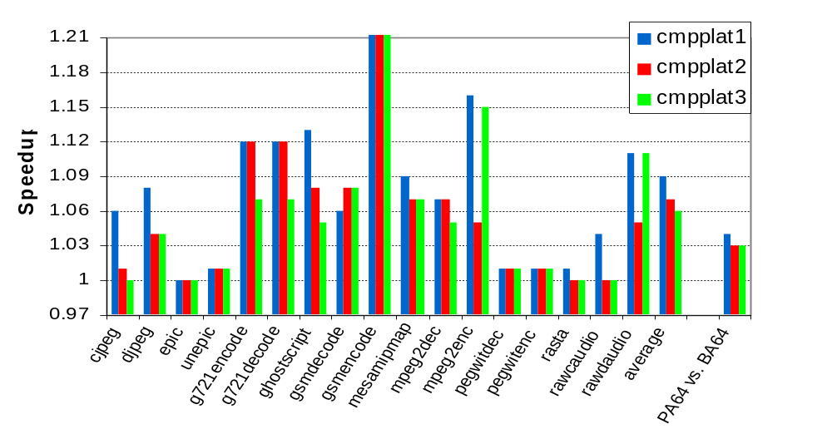
Predicate-aware Speedup over Baseline
(PA42 vs. BA42)
average
Speedup is only due to improvable PA regions
Speedup decreases for higher latency and wider machine
Notes:
This slide shows overall speed-up obtained by the three 4-wide PRAVO processors over corresponding 4-wide base processor for each Mediabench application which are shown along x-axes. The three bars on the right, show the average speed-up for the three 6-wide PRAVO machine.
The speedup measured as the ratio of execution time of baseline over PRAVO is shown along y axis.
The speedup is only due to improved predicate-aware (or PA) regions, which are the regions that contain at least two disjoint operations.
We notice that gsmencode gain 37% speedup on average with all three PRAVO processors. That’s because it is dominated by the modulo scheduled loop that contains large balanced if-then-else statements.
In most of the cases speedup decreases as we go to higher cmpp latencies and wider PRAVO processor. We will show more insight into this in just a little bit.
Notice for some application, speedup increases as we go to higher latencies. For example speedup mpeg2enc goes from 7 to 15% when cmpp latency is increased from two to three. This is due to the fact that when PAMS fails to find a schedule for a current value of initiation interval it finds the schedule with the larger II and generally smaller epilogue size. For the loop with the short trip count (which is the case in mpeg2enc) this can lead to better performance than smaller II and larger epilogue.

Slide 17
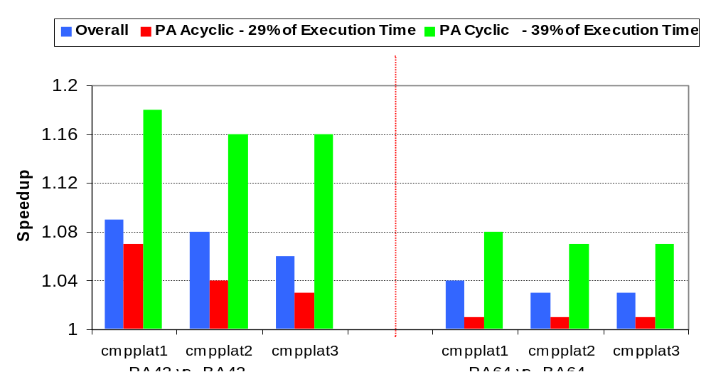
Average Speedup Breakdown
Only 68% of regions are PA scheduled
PA is more effective in modulo scheduled loops
Notes:
This slide shows the average speedup breakdown for acyclic and cyclic predicate-aware regions which correspond to the red and yellow bars on the graph. The fist blue bar is the overall speedup.
The first three bars show the speedup breakdown achieved by 4-wide 4-integer unit baseline machine over corresponding 2 integer unit baseline machine. The next group of three graphs shows the speedup breakdown of 4-wide PRAVO machine over 4-wide baseline machine for 3 cmpp latencies. The remaining two bars show similar data for 6-wide machine.
PA regions constitute 68% of the total execution time. But from the graph we see that PA scheduling is more effective in modulo scheduled loops (which are only 29% of the total execution time) than it is in acyclic code regions as we go to longer cmpp latencies and wider machines. For cmpp latency of 3 overall performance improvement is largely determined by these regions.
Finally, the speedup that PRAVO machine gains over baseline machine with the same number of integer units is about one half of the speedup gained by the baseline machine with the larger number of integer units.

Slide 18
Speedup Analysis
Predicate-Aware Acyclic Region
Predicate-Aware Cyclic Region
4-wide
cmpplat=2
4-wide
cmpplat=3
6-wide
cmpplat=2
4-wide
cmpplat=2
4-wide
cmpplat=3
6-wide
cmpplat=2
30
30
27
27
24
24
21
21
18
18
15
15
Cycles
Cycles
12
12
9
9
6
6
3
3
0
Case 1
Case 2
Case 3
0
Case 4
Case 5
Case 6
PA Potential ▬ Base Sched. Length ▬ PA Sched. Length ▬ PA Critical Path Length ▬ PA Resource Bound
Notes:
This slide shows the insight into the speedup in acyclic and cyclic regions. The scheduling headroom of the PA scheduler is determined by the gap between baseline schedule length (shown as the black bar) and the largest of the critical path length and resource constrains of the predicate-aware scheduler (represented by the green and blue bars). Acyclic regions are generally latency bound: the green bar is always higher than the blue bar as case1 shows. As we increase cmpp latency as in case 2, critical path length of pa schedule increases as expected, shrinking the headroom for the scheduler. When we go to a wider machine for the same latency, as in case 3, critical path length remains the same, but baseline schedule length decreases (since wider machine has more resources) shrinking the pa scheduler headroom again.
Cyclic regions are resource bound as shown in cases 4, 5 and 6. The green bar (or RecMII) is much smaller than ResMII (a blue bar). As we go to a higher cmpp latency (case 5), the performance drops insignificantly, due to the increased size of the loop epilogue. As we go to wider machine in case 6, the baseline schedule length (the II) decreases significantly, leaving less room for PA improvement.

Slide 19
Summary and Future Work
Summary
Predicate-aware Scheduling
  reduces resource constraints in predicated code
  is supported by PRAVO architecture
  is effective in cyclic regions (16% speedup on 4-wide PRAVO)
Future work
  More resource sharing can be achieved by combining probabalistically disjoint operations
Notes:
Predicate-aware scheduling allows the compiler to put processor
resources to better use in code with conditional branches
Allow disjoint operations to reserve the same resources knowing at run-time only 1 will really use it
:Overall speedup X% across all benchmarks Do very well in loops where resource constraints often dominate Scalar code is generally only small gains because sentence constrains are more dominant.

Slide 20

Q&A and Suggestions

Slide 22
Modulo Scheduling Using PART
Time | A ^{may} |  | M ^{may} |  | B ^{may} |  | must IW1 | must IW2 | must IW3
0 |  |  | op1 | P_{T} | P_{FT} | P_{FF} |  |  | op1
1
2 | op2 | P_{T} | P_{FT} | P_{FF} |  |  |  |  | op2
3 |  |  |  |  | op10 | P_{T} | P_{FT} | P_{FF} | op10
4 | op5 | P_{T} | P_{FT} | P_{FF} |  |  |  |  |  | op5
5 | op3 | P_{T} |  |  |  |  | op3
6
7 | op6 op8 | P_{FT} | P_{FF} |  |  |  |  |  | op6 | op8
8
9 |  |  | op4 op9 | P_{T} | P_{FF} |  |  |  | op4 | op9
10 |  |  | op7 | P_{FT} |  |  |  | op7
11
Notes:
This example demonstrates how PAMS schedules the example code and achieves schedule length of 4 which is 20% improvement over 5 cycle baseline schedule.
Every operation is color coded tha same color as its control path. Operations which are on all control paths are colored black.
Operation1 is on all three control paths which is represented by its predicate expression which is the disjunction of all paths. Thus, no other operation can reserve this resource.
op6 and op8 at time 7 of the schedule both share ALU unit since they are different color: i.e., they are on two disjoint paths Pft nd Pff represented by their predicate expression. op3 is only on Pft path, but there was no other operation to combine it with.

Slide 23
Speedup Analysis
Predicate-Aware Acyclic Region
Predicate-Aware Cyclic Region
4-wide
cmpplat=1
4-wide
cmpplat=2
6-wide
cmpplat=1
4-wide
cmpplat=1
4-wide
cmpplat=2
6-wide
cmpplat=1
30
30
27
27
24
24
21
21
18
18
15
15
Cycles
Time
12
12
9
9
6
6
3
3
0
Case 1
Case 2
Case 3
0
Case 4
Case 5
Case 6
PA Potential ▬ Base Sched. Length ▬ PA Sched. Length ▬ PA Critical Path Length ▬ PA Resource Bound
Notes:
This slide shows the insight into the speedup in acyclic and cyclic regions. The scheduling headroom of the PA scheduler is determined by the gap between baseline schedule length (shown as the black bar) and the largest of the critical path length and resource constrains of the predicate-aware scheduler (represented by the green and blue bars). Acyclic regions are generally latency bound: the green bar is always higher than the blue bar as case1 shows. As we increase cmpp latency as in case 2, critical path length of pa schedule increases as expected, shrinking the headroom for the scheduler. When we go to a wider machine for the same latency, as in case 3, critical path length remains the same, but baseline schedule length decreases (since wider machine has more resources) shrinking the pa scheduler headroom again.
Cyclic regions are resource bound as shown in cases 4, 5 and 6. The green bar (or RecMII) is much smaller than ResMII (a blue bar). As we go to a higher cmpp latency (case 5), the performance drops insignificantly, due to the increased size of the loop epilogue. As we go to wider machine in case 6, the baseline schedule lenth (the II) decreases significantly, leaving less room for PA imporvement.

