Slide 1


Analyzing Performance Vulnerability due to Resource Denial-Of-Service Attack on Chip Multiprocessors
Dong Hyuk Woo Georgia Tech
Hsien-Hsin “Sean” Lee Georgia Tech

Slide 2



Cores are hungry..
“Yeah, I’m still hungry..”

Slide 3

Cores are hungry..
More bus bandwidth?
  Power..
  Manufacturing cost..
  Routing complexity..
  Signal integrity..
  Pin counts..
More cache space?
  Access latency..
  Fixed power budget..
  Fixed area budget..

Slide 4
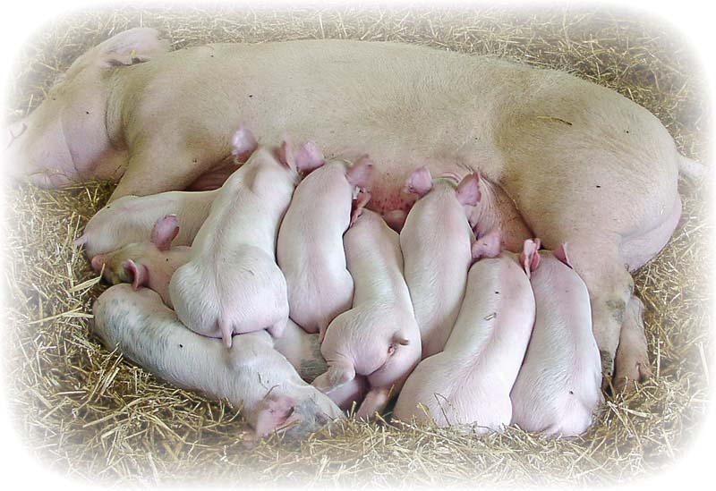
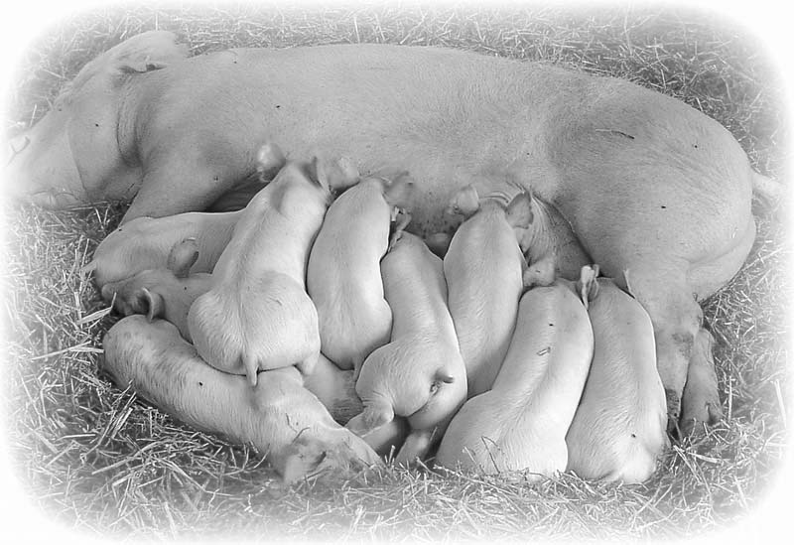
Competition is intensive..
“Mommy, I’m also hungry!”

Slide 5


What if one core is malicious?
“Stay away from my food..”

Slide 6

Type 1: Attack BSB Bandwidth!
Generate L1 D$ misses as frequently as possible!
  Constantly load data with a stride size of 64B (line size)
  Memory footprint: 2 x (L1 D$ size)
Normal Core
Malicious Core
L1 I$
L1 D$
L1 I$
L1 D$
Shared L2$

Slide 7
Type 2: Attack the L2 Cache!
Generate L1 D$ misses as frequently as possible!
And occupy entire L2$ space!
  Constantly load data with a stride size of 64B (line size)
  Memory footprint: (L2$ size)
Note that this attack also saturates BSB bandwidth!

Slide 8
Type 3: Attack FSB Bandwidth!
Generate L2$ misses as frequently as possible!
And occupy entire L2$ space!
  Constantly load data with a stride size of 64B (line size)
  Memory footprint: 2 x (L2$ size)
Note that this attack is also expected to
  saturate BSB bandwidth!
  occupy large space of the L2 cache!

Slide 9
Type 4: LRU/Inclusion Property Attack
Variant of the attack against the L2 cache
LRU
  A common replacement algorithm
Inclusion property
  Preferred for efficient coherent protocol implementation
Normal core accesses shared resources more frequently.
way
set

Slide 10
To be more aggressive..
Class II
  Attacks using Locked Atomic Operation
    Bus locking operations
      To implement Read-Modify-Write instruction
Class III
  Distributed Denial-of-Service Attack
    What would happen if the number of malicious threads increases?

Slide 11
Simulation
SESC simulator
SPEC2006 benchmark
Number of Cores | 4
Issue width | 3
L1 I$ | 2-way set associative 32KB cache with 64B line (1 cycle hit latency)
L1 D$ | 2-way set associative 32KB cache with 64B line (1 cycle hit latency) 8-entry MSHR
BSB data bus B/W | 64 GBps (2GHz * 256 bits)
L2$ | 8-way set associative 2MB cache with 64B line (14 cycle hit latency) Shared MSHR
FSB bandwidth | 16 GBps
DRAM latency | 100 ns

Slide 12

Vulnerability due to DoS Attack
Normal
Normal
vs.

Slide 13
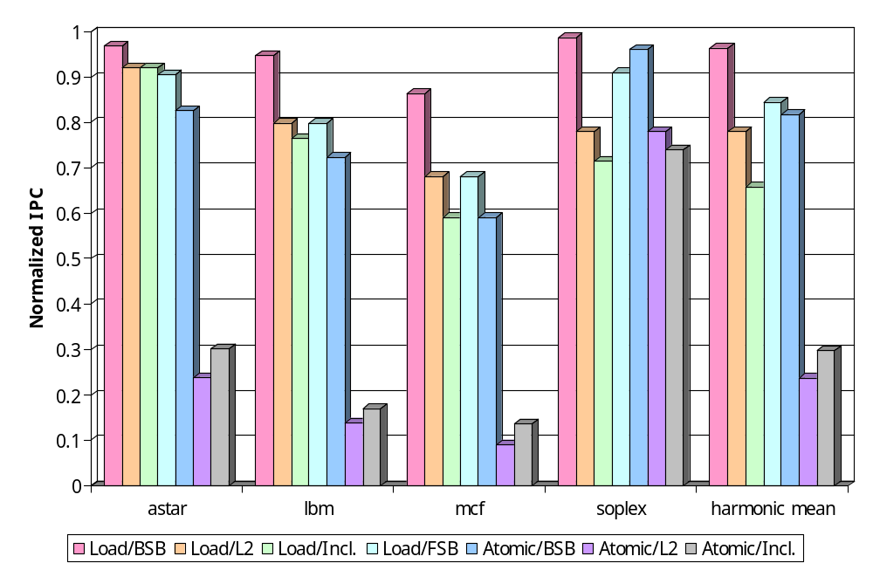
Vulnerability due to DoS Attack
High L2 miss rate
High L1 miss rate

Slide 14
Vulnerability due to DDoS Attack
Normal
Normal
vs.
Normal
Normal

Slide 15
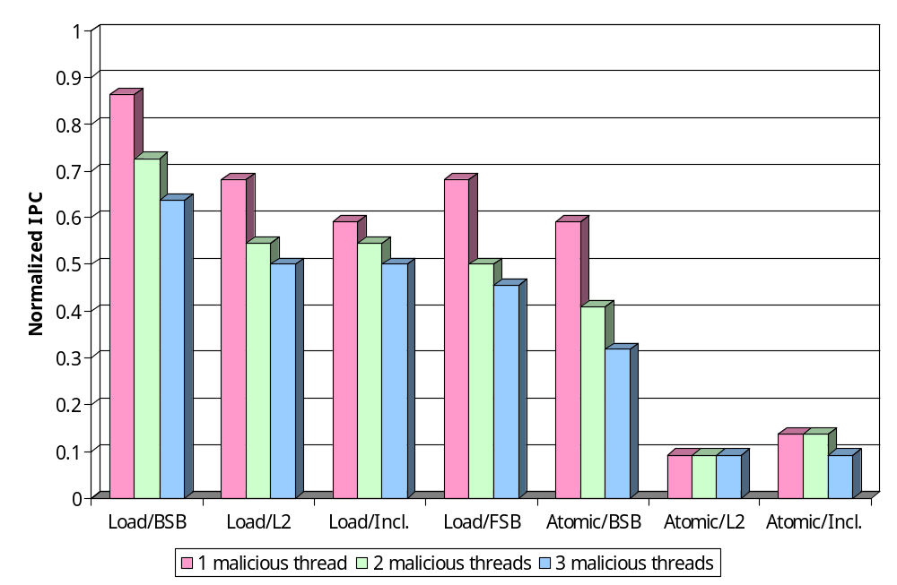
Vulnerability due to DDoS Attack

Slide 16
Suggested Solutions
OS level solution
  Policy based eviction
  Isolating voracious applications by process scheduling
Adaptive hardware solution
  Dynamic Miss Status Handler Register (DMSHR)
  Dedicated management core in many-core era

Slide 17
DMSHR
MSHR full
MSHR full
Compare
Decision from monitoring functionality
Entry 0
Entry 1
Entry 2
Entry 3
Entry 4
Entry 5
Entry 6
Entry 7
Counter

Slide 18
Conclusion and Future Work
Shared resources in CMPs are vulnerable to (Distributed) Denial-of-Service Attacks.
  Performance degradation up to 91%
DoS vulnerability in future many-core architecture will be more interesting.
  Embedded ring architecture
    Distributed arbitration
  Network-on-Chip
    A large number of buffers are used in cores and routers.

Slide 19


Q&A
Please feed them well..
Otherwise, you might face Denial-of-??? soon.. ☺
Grad students are also hungry..

Slide 20
Thank you.
http://arch.ece.gatech.edu

Slide 21
Difference from fairness work
They are only interested in the capacity issue
They might be even more vulnerable..
  Partitioning based on
    IPC
    Miss rates
  They may result in a guarantee of a large space to the malicious thread.

Slide 22
Difference between CMPs and SMPs
Degree of sharing
  More frequent access to shared resources in CMPs
Sensitivity of shared resources
  DRAM (shared resource of SMPs) >> L2$ (that of CMPs)
Different eviction policies
  OS managed eviction vs. hardware managed eviction

Slide 23
Difference between CMPs and SMTs
An SMT is more tightly-coupled shared architecture.
  More vulnerable to the attack
    Grunwald and Ghiasi, MICRO-35
      Malicious execution unit occupation
      Flushing the pipeline
      Flushing the trace cache
      Lower-level shared resources are ignored.

