Slide 1
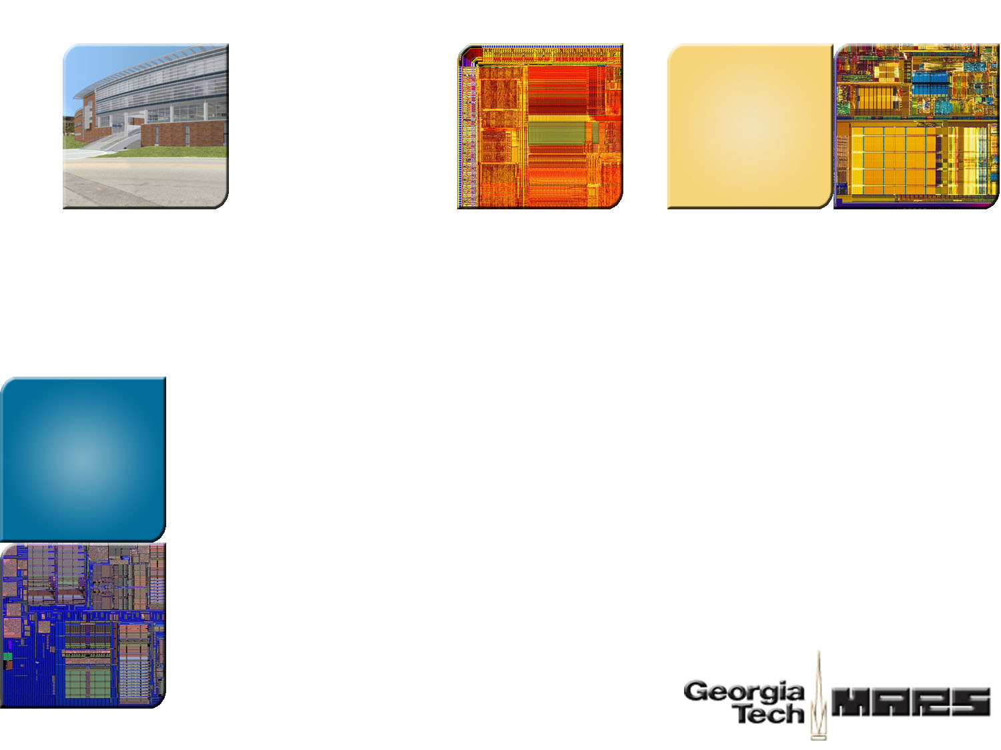


Secure Processing On-Chip
Hsien-Hsin “Sean” Lee
School of Electrical and Computer Engineering
Georgia Tech
Atlanta, GA
ARO Workshop on Embedded Systems and Network Security
Raleigh, NC, February 22, 2007

Slide 2

Layered Secure Architecture
Layer | Exploits | Solution
Application | software patching/amputation, de-compilation, worm, virus | application signing, access control, …
OS | rootkit, system call tampering kernel space eavesdrop | OS signing, virtualization, …
Firmware/ Boot image | BIOS spoof/hijack,boot image virus | TPM
Platform Level | chip interconnect/bus snoop, eavesdrop, device spoof | secure processor, memory encryption
Sub Platform Level | Power, EM emission analysis timing analysis, etc | self-timed circuit, obfuscation techniques
Package & Circuit Level | de-packaging, micro-probing, optical reverse engineer | secure packaging, private circuit

Slide 3
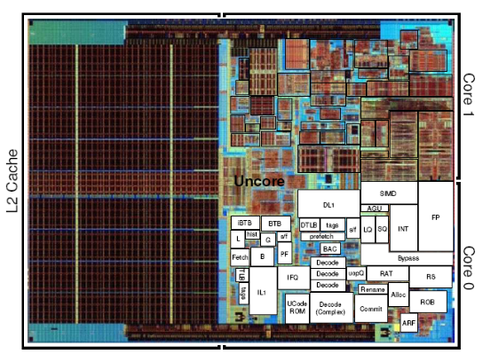
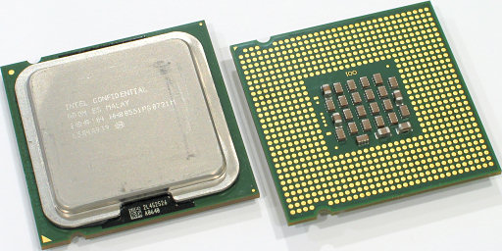

Secure Processor Assumption
Protected
Domain
Processor Core

Slide 4

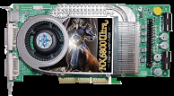
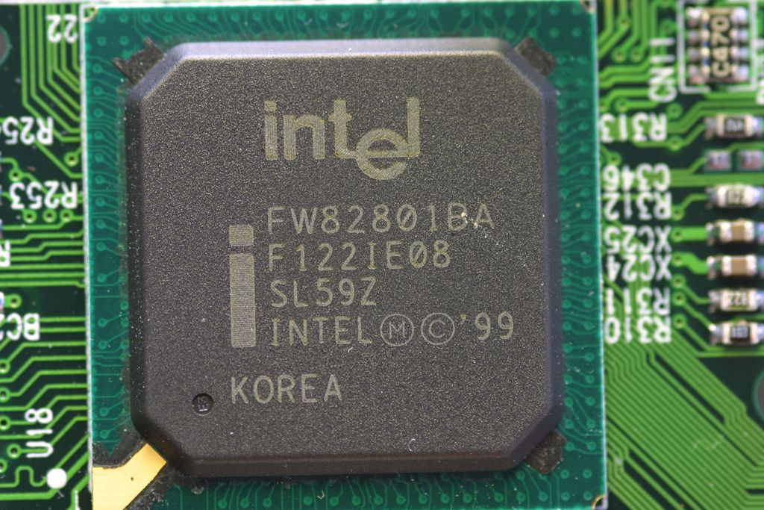

Thread Model: Physical Tampering
Protected
Domain
Processor Core
DRAM
North Bridge
South Bridge
Ethernet
Mouse
Keyboard
Disk

Slide 5

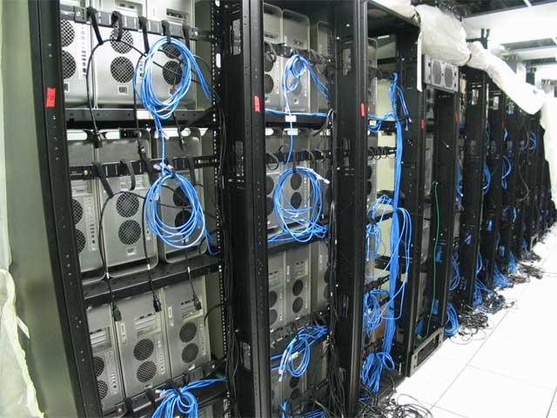


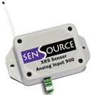
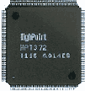
Secure Processors
Tamper-proof
distributed computing
(trusted end-system)
Secure Processor
Anti reverse engineering
Processor Core
Root
Signature
Caches
MAC hash tree
Crypto Engine
Secure Processor
Tamper-proof
embedded sensor device
Tamper-proof
digital right protection

Slide 6
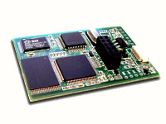
Types of HW-based Physical Attacks
HW-based physical attacks
  Trace system bus, peripheral bus
  Power/Timing analysis
  Build fake devices, device spoof (e.g., MOD-chip)
  Modify RAM
  Replay bus signals, fake bus signal injection
XBOX with MOD-chip installed. MOD-chip is a low cost bus snoop and spoof device widely used to break XBOX security.

Slide 7
Designing Secure Processors
HW-based Encryption/Authentication
  A common strategy to protect data confidentiality and integrity
  Performance, performance, performance
Deficiencies ─ Side Channels
  Power (or current) signature
  Execution time distinction
  Instruction addresses on the bus (unprotected control flow)
Potential Solutions
  Randomization
  To be effective, rethink HW design, raise the level of difficulty to break
  Design trade-off between
    power saving (☹)
    execution time, RT constraint (☹)
    security level (☺)

Slide 8
Control Flow Leakage ⎯ Example 1
Assume all code are encrypted
Control Flow Graph
Address Sequence
B1
B2
B3

Slide 9
Control Flow Leakage ⎯ Example 1
Control Flow Graph
Address Sequence
B1
Addr(B1)
B2
B3

Slide 10
Control Flow Leakage ⎯ Example 1
Control Flow Graph
Address Sequence
B1
Addr(B1), Addr(B2)
B2
B3

Slide 11
Control Flow Leakage ⎯ Example 1
Control Flow Graph
Address Sequence
B1
Addr(B1), Addr(B2), Addr(B3)
B2
B3

Slide 12
Control Flow Leakage ⎯ Example 1
Control Flow Graph
Address Sequence
B1
Addr(B1), Addr(B2), Addr(B3)
Addr(B1)
B2
B3

Slide 13
Control Flow Leakage ⎯ Example 1
Control Flow Graph
Address Sequence
B1
Addr(B1), Addr(B2), Addr(B3)
Addr(B1), Addr(B2)
B2
B3

Slide 14
Control Flow Leakage ⎯ Example 1
Control Flow Graph
Address Sequence
B1
Addr(B1), Addr(B2), Addr(B3)
Addr(B1), Addr(B2), Addr(B3)….
B2
B3

Slide 15
Control Flow Leakage ⎯ Example 1
Control Flow Graph
Address Sequence
B1
Addr(B1), Addr(B2), Addr(B3)
Addr(B1), Addr(B2), Addr(B3)….
B2
B3
repeated addresses
loop

Slide 16
Control Flow Leakage ⎯ Example 2
Control Flow Graph
Address Sequence
B1
Addr(B1)
B2
B3
B4

Slide 17
Control Flow Leakage ⎯ Example 2
Control Flow Graph
Address Sequence
B1
Addr(B1), Addr(B2)
B2
B3
B4

Slide 18
Control Flow Leakage ⎯ Example 2
Control Flow Graph
Address Sequence
B1
Addr(B1), Addr(B2), Addr(B4)
B2
B3
B4

Slide 19
Control Flow Leakage ⎯ Example 2
Control Flow Graph
Address Sequence
B1
Addr(B1), Addr(B2), Addr(B4)
Addr(B1)
B2
B3
B4

Slide 20
Control Flow Leakage ⎯ Example 2
Control Flow Graph
Address Sequence
B1
Addr(B1), Addr(B2), Addr(B4)
Addr(B1), Addr(B3)
B2
B3
B4

Slide 21
Control Flow Leakage ⎯ Example 2
Control Flow Graph
Address Sequence
B1
Addr(B1), Addr(B2), Addr(B4)
Addr(B1), Addr(B3), Addr(B4)….
B2
B3
B4

Slide 22
Control Flow Leakage ⎯ Example 2
Control Flow Graph
Address Sequence
B1
Addr(B1), Addr(B2), Addr(B4)
Addr(B1), Addr(B3), Addr(B4)….
B2
B3
B4
either B2 or B3 follows B1
conditional branch

Slide 23
Critical Data Leakage via
Value-Dependent Conditional Branches
Modular Exponentiation Algorithm
(Diffie-Hellman, RSA)
Initialize
Let S₀ = 1
For i = 0 to w-1 Do
If (bit i of k) is 1 then
Let T_{i} = (S_{i}*C) mod N
Else
Let T_{i} = S_{i}
Let S_{i+1} = T²_{i} mod N
EndFor
Return (R_{w-1})
i=0 to w-1
bit i of k = 1?
Y
N
If-branch
Else-branch
Loop End
T = C^{k} mod N
Return
Hacker’s interest : to find K (the secret)
Only 2 possibilities: key K or K

Slide 24
Consequences of Control Flow Side-channel
Leak critical information of the application
By graph matching the CFG, reused code can be ID-ed
Critical data can be leaked as well
Even partial knowledge can help competitors

Slide 25
Side-Channel Countermeasure
Randomization
Design trade-off between
  power saving
  execution time (RT constraint)
  security level

Slide 26
Solution Example:
Dynamic Control Flow Obfuscation
A Hardware Approach
To map address differently every time it appears on the bus
Relocate blocks to new location each time it is evicted from the processor
Should not write out immediately after access to avoid correlation being exposed
Notes:
Refer to section 4.4

Slide 27
Dynamic Obfuscation Example
Security
Boundary
accesses
shuffle buffer
memory
1
2
3
4
5
6
7
8
9
Start—after fill up the buffer
1
2
3
4
5
6
7
8
9
5
1
5
3
4
2
6
7
8
9
Random Replacement Algorithm

Slide 28
Dynamic Obfuscation Example
accesses
shuffle buffer
memory
1
2
3
4
5
6
7
8
9
Start—after fill up the buffer
1
2
3
4
5
6
7
8
9
5
1
5
3
4
2
6
7
8
9
Shuffle buffer
Memory
Block Address Table
Addr1
map(Addr1)
Addr2
map(Addr2)
Addr3
map(Addr3)
AddrX
map(AddrX)

Slide 29

Dynamic Obfuscation Example
accesses
shuffle buffer
memory
1
2
3
4
5
6
7
8
9
Start—after fill up the buffer
1
2
3
4
5
6
7
8
9
5
1
5
3
4
2
6
7
8
9
8
8
5
3
4
2
6
7
1
9
6
8
6
3
4
2
5
7
1
9
8
8
6
3
4
2
5
7
1
9
finish
8
6
3
4
2
5
7
1
9
Block Address Table
Addr1
map(Addr1)
Addr2
map(Addr2)
Addr3
map(Addr3)
AddrX
map(AddrX)

Slide 30
Challenges in Embedded Design
From a processor architect’s perspective
How to design a tamper-proof embedded processor
Software solutions may be slow and limited
Encryption/decryption
  A natural given
  But is insufficient due to side-channel attacks
  Need to educate next-gen processor designers
Need a well-thought-out Security-aware hardware design

Slide 31

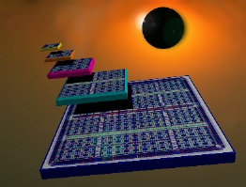
Challenges in Embedded Design
Physical Tampering
  Tamper-resistance and tamper-evidence
  Side-channel attacks
Digital Right Management
  Protect Virtual properties with encryption and right licenses
  Need a DRM-enabled graphics processor
Implications on FPGA platform
  Use FPGA for cryptographic algorithms
  Protect FPGA-based IP
  Vulnerabilities yet to be understood

Slide 32


Thank You!
http://arch.ece.gatech.edu

