Slide 1
An FPGA Approach to Quantifying Coherence Traffic Efficiency on Multiprocessor Systems
Taeweon Suh ┼, Shih-Lien L. Lu ¥, and
Hsien-Hsin S. Lee §
Platform Validation Engineering, Intel ┼
Microprocessor Technology Lab, Intel ¥
ECE, Georgia Institute of Technology §
August 27, 2007
Notes:
Thank you for the introduction.
The title of my talk is “”

Slide 2
Motivation and Contribution
Evaluation of coherence traffic efficiency
  Why important?
    Understand the impact of coherence traffic on system performance
    Reflect into communication architecture
  Problems with traditional methods
    Evaluation of protocols themselves
    Software simulations
    Experiments on SMP machines: ambiguous
  Solution
    A novel method to measure the intrinsic delay of coherence traffic and evaluate its efficiency
Notes:
As the memory wall becomes higher, it is important to understand system-wide performance impact of coherence traffic and reflect this into future communication architecture.
Traditionally, the evaluations are focused on coherence protocols themselves.
For this, software simulations were performed for evaluations.
The disadvantage of the software simulations is that it takes too long time to get useful information of system behavior.
It is difficult to do exact real-world modeling such as I/Os.
Therefore, after building SMP machines, applications are parallelized and run natively on the machine. Then people report speedup numbers,
But, it is too ambiguous to determine the contributions of the speedup.
how much of it comes from good workload parallelization and/or how about the impact of underlying communication mechanisms on performance.
Focusing on underlying communication mechanism, this 3rd contribution proposes a novel method to measure the intrinsic delay of coherence traffic and evaluate its efficiency.

Slide 3
Cache Coherence Protocol
Example
  MESI Protocol: Snoop-based protocol
Processor 0
(MESI)
Processor 1
(MESI)
Example
operation
sequence
Protocol
States
Modified
Exclusive
Shared
Invalid
S abcd
E 1234
S 1234
I -----
I 1234
M abcd
S abcd
S 1234
I -----
invalidate
shared
P0: read
cache-to-cache
P1: read
P1: write
(abcd)
Memory
P0: read
1234
Notes:
Cache-to-cache transfer is one coherency traffic. Another two are:
Read for owner ship (full memory transfer and invalidation of all other lines)
Invalidation (write to a share line) – 0-data read from memory and invalidation all other lines.

Slide 4
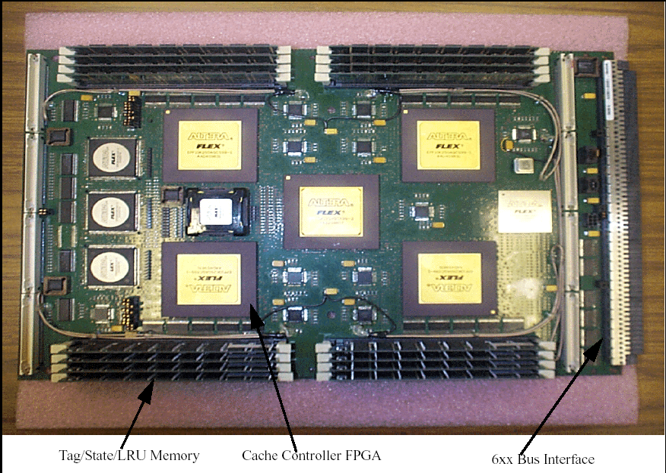
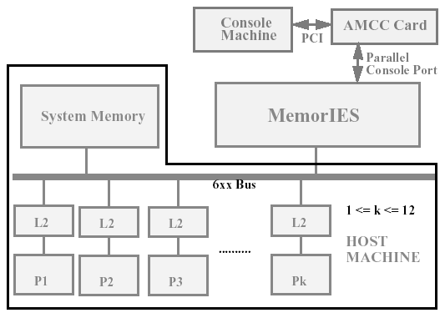
Previous Work 1
MemorIES (2000)
  Memory Instrumentation and Emulation System from IBM T.J. Watson
  L3 Cache and/or coherence protocol emulation
    Plugged into 6xx bus of RS/6000 SMP machine
  Passive emulator
Notes:
MemorIES is an emulator for L3 cache and coherence protocol emulation from IBM TJ Watson.
The picuture on the left side shows the FPGA board. It is plugged into the 6xx bus of RS/6000 SMP machine,
In RS/6000 machine, Power 3 is used as a CPU.
Power 3 has L1, L2 caches inside, and MemorIES emulates L3 cache and/or coherence protocol in L3 level by passively monitoring transactions on the bus.
AMCC (Applied Micro Circuits Corporation) Altera 10K250
In addition to these emulators, there are other cache eumulators such as ACE (active cache emulator) from Intel and HACS (hardware accelerated cache simulator) from Brigham Young Univ.

Slide 5
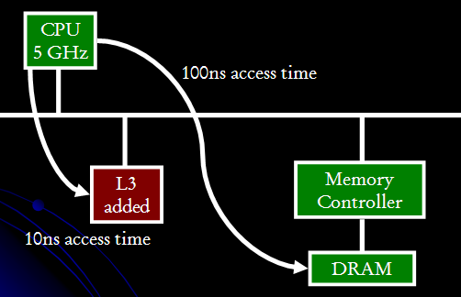
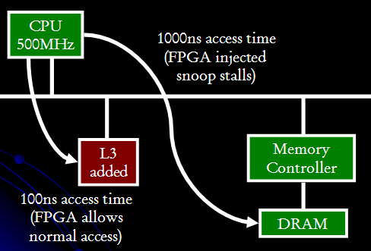
Previous Work 2
ACE (2006)
  Active Cache Emulation
  Active L3 Cache size emulation with timing
  Time dilation
Notes:
ACE published at FPGA 2006 – time dialation is the key concept.

Slide 6
Evaluation Methodology
Goal
  Measure the intrinsic delay of coherence traffic and evaluate its efficiency
Shortcomings in multiprocessor environment
  Nearly impossible to isolate the impact of coherence traffic on system performance
  Even worse, there are non-deterministic factors
    Arbitration delay
    Stall in pipelined bus
Processor 0
(MESI)
Processor 1
(MESI)
Processor 2
(MESI)
Processor 3
(MESI)
shared bus
“cache-to-cache transfer”
Memory
controller
Main memory
Notes:
First, our goal is to measure the intrinsic delay of coherence traffic and evaluate its efficiency.
That is, compared to the main memory access, how fast or slow is the cache-to-cache transfer?
Suppose, a cache miss in Processor 1 incurs cache-to-cache transfer from Processor 3.
We want to know how good this ache-to-cache transfer is compared to accessing main memory.
But, Ironically enough, even though coherence trafffic occurs in multiprocessor environment,
you cannot isolate the impact of coherence traffic in this configuration.
For example, you parallelize your application and run it on this SMP machine. Then you get speedup number and execution times.
But, you cannot figure out the contributions of coherence traffic to execution times.
Even worse, there are some non-deterministic factors.
For example, Processor 1’s request will incur cache-to-cache transfer from Processor 3,
but P1’s request is blocked by P0’s request through arbiter.
This arbitration delay is effectively reflected on cache-to-cache transfer time.
This arbitration delay is non-deterministic.
The pipelined bus also makes cache-to-cache transfer time unpredictable.
So, we came up with an idea to remove these non-deterministic factors and evaluate the efficiency of coherence traffic.

Slide 7
Evaluation Methodology (continued)
Our methodology
  Use an Intel server system equipped with two Pentium-IIIs
  Replace one Pentium-III with an FPGA
  Implement a cache in FPGA
  Save evicted cache lines into the cache
  Supply data using cache-to-cache transfer when Pentium-III requests it next time
  Measure execution time of benchmarks and compare with the baseline
Pentium-III
(MESI)
Pentium-III
(MESI)
FPGA
D$
Front-side bus (FSB)
“cache-to-cache transfer”
Memory
controller
2GB SDRAM
Notes:
Here, we am using an Intel server system, where 2 Pentium-III processors were originally equppied. Pentium-III has the MESI protocol.
Two processors are sharing a bus called front-side bus (FSB).
For experiment, one processor is replaced with an FPGA board and a cache is implemented into FPGA.
Whenever P-III evicts a cache line, FPGA grabs it and stores it into the implemented cache.
Next time P-III request the same line, FPGA supplies it through cache-to-cache transfer.
In this way, this experiment completely removed workload parallization effect and isolated the contribution of coherence traffic on system performance.

Slide 8
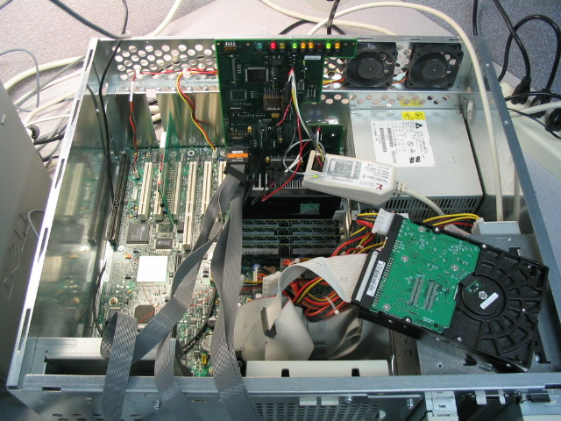
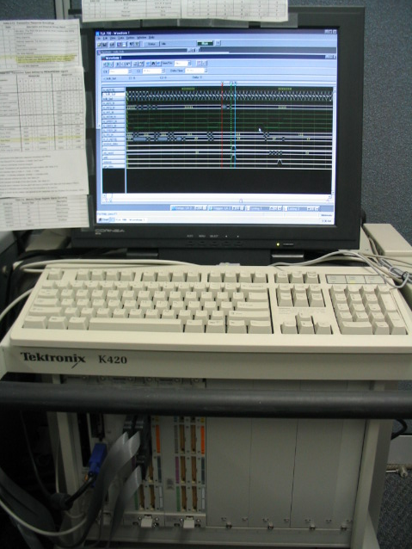
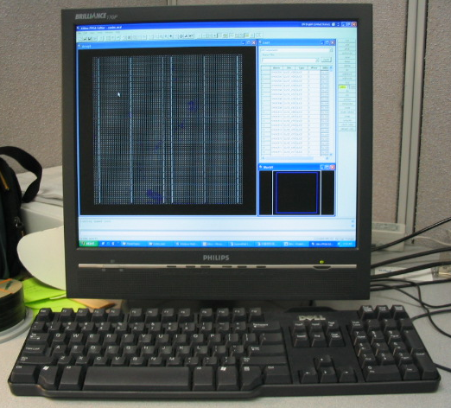
Evaluation Equipment
Intel server system
FPGA board
UART
Pentium-III
Host PC
Logic analyzer
Notes:
This slide shows the equipment pictures.
This is the Intel server system. One Pentium-III is here and the other was replaced with the FPGA board.
The FPGA board has logic analyzer ports, which are connected to the logic analyzer for debugging hardware design.
The board also has the serial ports, which are connected to PC for statistics gathering.

Slide 9
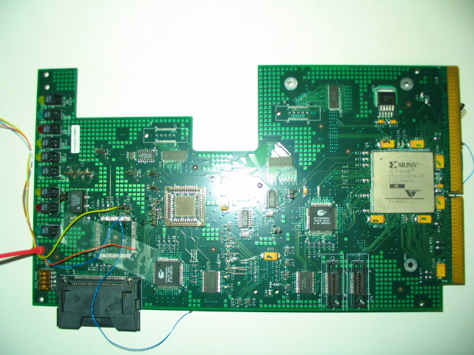
Evaluation Equipment (continued)
Xilinx Virtex-II
FPGA
FSB interface
LEDs
Logic analyzer ports

Slide 10
Implementation
Simplified P6 FSB timing diagram
  Cache-to-cache transfer on the P6 FSB
FSB pipeline stages
request1
error1
snoop
data
request2
error2
response
ADS
snoop-hit
A[35:3]#
addr
HIT#
new transaction
HITM#
TRDY#
memory controller is ready to accept data
DRDY#
DBSY#
D[63:0]#
data0
data1
data2
data3
   
Notes:
This shows simplified P6 FSB timing diagram of cache-to-cache transfer.
P6 FSB has 7 stage pipelines. Request1,2, Error1,2, Snoop, Response, Data.
Every transaction should go through these stages.
A bus transaction starts by driving address bus with strobe signal.
Then, in the snoop stage, all other processors on the bus respond,
If processors have the clean block in their caches, they assert HIT signal.
If a processor has a modifed block in its cache, it assert HITM signal.
In this experiment, FPGA asserts HITM signal if it finds the block in the implemented cache.
When cache-to-cache transfer occurs, main memory needs to be updated at the same time because O state, (owned) is not there.
By asserting TRDY, the memory controller represents its readiness to take data. Following that, the 4 chunks of data are supplied from FPGA.

Slide 11
Implementation (continued)
Implemented modules in FPGA
  State machines
    To keep track of FSB transactions
      Taking evicted data from FSB
      Initiating cache-to-cache transfer
  Direct-mapped caches
    Cache size in FPGA varies from 1KB to 256KB
    Note that Pentium-III has 256KB 4-way set associative L2
  Statistics module
Xilinx Virtex-II FPGA
Direct-mapped cache
8
Tag
Data
State machine
write-back
the rest
PC via UART
cache-to-cache
Registers for statistics
Logic Analyzer
Front-side bus (FSB)
Notes:
There are three components implemented in FPGA for this experiment.
First, state machines, The state machine follows all FSB transactions. It is instantiated 8 times because there could be 8 outstanding transactions on FSB.
The state machine takes care of all the controls such as taking evicted cache line from FSB and driving bus to supply data to FSB.
Then a cache is implemented. It is direct-mapped cache and Its size varies from 1KB to 256KB.
Finally statistics module is implemented to collect information such as the number of cache-to-cache transfers and send it to PC through UART serial connection.

Slide 12
Experiment Environment and Method
Operating system
  Redhat Linux 2.4.20-8
Natively run SPEC2000 benchmark
  Selection of benchmark does not affect the evaluation as long as reasonable # bus traffic is generated
FPGA sends statistics information to PC via UART
  # cache-to-cache transfers on FSB per second
  # invalidation traffic on FSB per second
    Read-for-ownership transactions
      0-byte memory read with invalidation (upon upgrade miss)
      Full-line (48B) memory read with invalidation
  # burst-read (48B) transactions on FSB per second
More metrics
  Hit rate in the FPGA’s cache
  Execution time difference compared to baseline
Notes:
In software-side, Redhat is running on Pentium-III and SPEC2000 benchmark is natively running on top of that, to evaluate coherence traffic efficiency.
8 benchmarks from SPEC2000 are experiemented according to different cache sizes. The experiment has been done 5 times to take average. Each experiment takes about 16 hours.
%%%%The benchmark selection does not effect the evaluation as long as the reasonable number of bus traffic is generated.
When it comes to the statistics information FPGA sends to host pc, there are three things.
First is the number of cache-to-cache transfer per second. The second is the number of invalidation transactions per second. Invalidation traffic is for read-for-owership.
There are 2 kinds of invalidation traffic on P6 FSB. First one is 0-byte memory read with invalidation and the second one is the full cache ine read with invalidation.
The last statistics information is the number of burst read transactions per second.

Slide 13
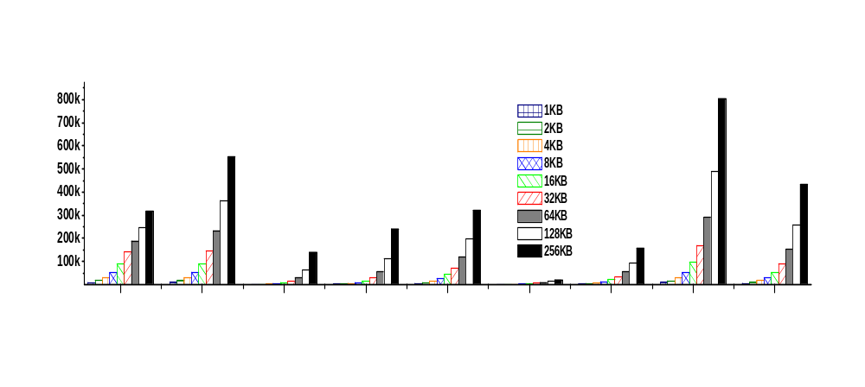
Experiment Results
Average # cache-to-cache transfers / second
Average # cache-to-cache transfers/sec
804.2K/sec
433.3K/sec
gzip vpr gcc mcf parser gap bzip2 twolf average
Notes:
Next 4 slides show experiment results.
First, this shows average number of cache-to-cache transfers occurred every second.
X-axis shows 8 benchmark programs from SPEC2000, and each program was experimented with different cache sizes from 1KB to 256KB.
Twolf incurs the largest number of transters.
With 256KB cache in FPGA, about 800K cache-to-cache transfers occurred every second.
Memory-bound applications as shown here in mcf do not necessarily show the highest cache-to-cache transfers
because they might not use evicted cache lines again and/or capacity or conflict misses could occur in the FPGA’s cache.
On average across the benchmarks, there are about 430K cache-to-cache transfers occurred every second

Slide 14
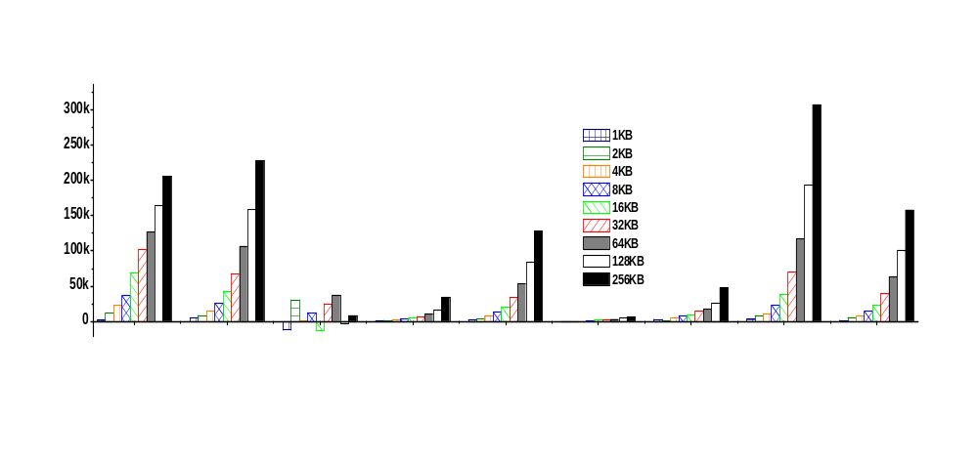
Experiment Results (continued)
Average increase of invalidation traffic / second
Average increase of invalidation traffic/sec
306.8K/sec
157.5K/sec
gzip vpr gcc mcf parser gap bzip2 twolf average
Notes:
It shows the average increase of invalidation trafffic occurred every second.
The number of Invalidation traffic is not necessarily related to the frequency of cache-to-cache transfers because it is pretty much dependent on applications’ behavior.
Applications may not write to the same line after reading it
In this case, you get cache-to-cache transfer if the address hits on the FPGA’s cache.
but, it does not generate invalidation traffic after cache-to-cache transfer,
In general however, there are some co-relations between this figure and cache-to-cache transfer figure.
For example, twolf has the highest peak here and average is close to half of the highest peak number.
Our conjecture is that the baseline also generates invalidation traffic.
When page faults occur, P-III internally executes a cache flush instruction, which in turn appears on the bus as invalidation traffic.
Depending on the background Linux system services, the amount of invalidation traffic varies over time.
Because of this effect, invaliation traffic sometimes decreases especially, when the cache size in FPGA is small.
Gcc case is rather susceptible to the Linux system perturbation because of large number of malloc functions in gcc.

Slide 15
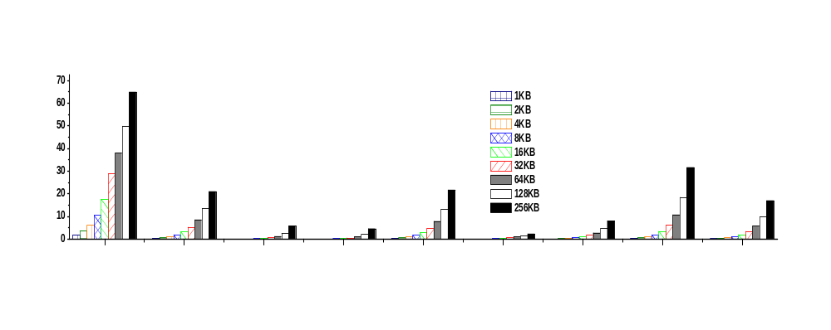
Experiment Results (continued)
Average hit rate in the FPGA’s cache
# cache-to-cache transfer
Hit rate =
# data read (full cache line)
64.89%
Average hit rate (%)
16.9%
gzip vpr gcc mcf parser gap bzip2 twolf average
Notes:
Now hit rate, hit rate is calculated from this equation.
It means how many times FPGA is able to suppy data when cache misses occur in Pentium-III.
Here, gzip has the highest hit rate, about 65% of the time, FPGA was able to suppy data when cache misses occur.
On average across the benchmarks, FPGA was able to supply data for about 17% of the cache misses.
%%because applications may not generate a lot of cache misses, but once it generates, FPGA may have that block in its cache. So, FPGA supplies data to P-III.

Slide 16
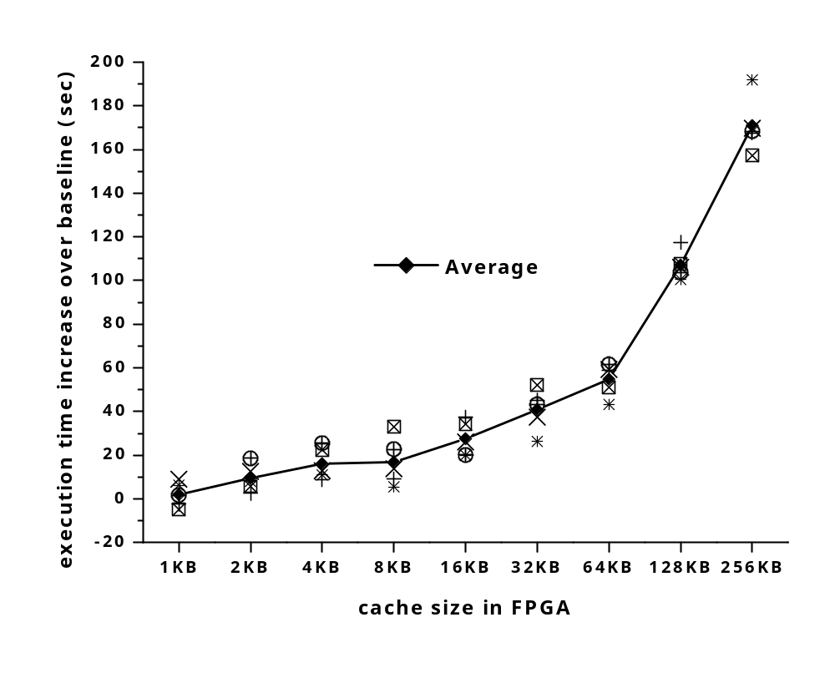
Experiment Results (continued)
Average execution time increase
  Baseline: benchmarks execution on a single P-III without FPGA
    data is always supplied from main memory
191 seconds
171 seconds
Average execution time: 5635 seconds
(93 min)
Notes:
Finally this graph shows average execution time increase over the baseline.
In baseline, we executed the benchmarks on a single P-III without FPGA.
It means that data is always supplied from main memory instead of cache-to-cache transfer.
As shown in the figure,
the execution time is increased up to 191 seconds with the help of FPGA and 171 seconds on average.
Now, let’s move on to the next slide to see the contribution of each coherence traffic to the execution time increase.

Slide 17
Run-time Breakdown
Estimate run-time of each coherence traffic
  with 256KB cache in FPGA
avg. occurrence
Estimated time =
ｘ
ｘ
avg. total execution time
sec
clock period
ｘ
latency of each traffic
cycle
 | Invalidation traffic | Cache-to-cache transfer
Latencies | 5 ~ 10 FSB cycles | 10 ~ 20 FSB cycles
Estimated run-times
69 ~ 138 seconds 381 ~ 762 seconds
Note that the execution time increased 171 seconds on average out of average total execution time (5635 seconds) of the baseline
Cache-to-cache transfer is responsible for at least 33 (171-138) second increase !
Notes:
%%We want to estimate run-time of each coherence traffic.
That is, we want to know how much time was spent on invalidation traffic and cache-to-cache transfer
You can use this formula to calcuate the time spent.
Here we know frequency of each coherence traffic and we know total execution time and clock period is about 13 ns.
But we don’t know the latencies of each coherence traffic.
So after closely watching the logic analyzer waveform and considering FSB pipeline,
we assumed that each invalidation traffic takes 5 – 10 bus cycles and each cache-to-cache transfer takes 10 – 20 bus cycles.
After plugging these numbers into the formula, we get these run times.
Note that total execution time has been increased 171 seconds on average.
After removing the contribution of invaliation traffic, we still have 33 seconds left.
So, we can say that cache-to-cache transfers are responsible for at least 33 second increase unless each invalidation traffic takes more than 10 bus cycles.
In other words, cache-to-cache transfer takes longer time than getting data from main memory.

Slide 18
Conclusion
Proposed a novel method to measure the intrinsic delay of coherence traffic and evaluate its efficiency
  Coherence traffic in P-III-based Intel server system is not efficient as expected
    The main reason is that, in MESI, main memory should be updated at the same time upon cache-to-cache transfer
Opportunities for performance enhancement
  For faster cache-to-cache transfer
    Cache line buffers in memory controller
      As long as buffer space is available, memory controller can take data
    MOESI would help shorten the latency
      Main memory need not be updated upon cache-to-cache transfer
  For faster invalidation traffic
    Advancing the snoop phase to an earlier stage

Slide 19

Questions, Comments?
Thanks for your attention!

Slide 20
Backup Slides

Slide 21
Motivation
Traditionally, evaluations of coherence protocols focused on reducing bus traffic incurred along with state transitions of coherence protocols
  Trace-based simulations were mostly used for the protocol evaluations
Software simulations are too slow to perform the broad range analysis of system behaviors
  In addition, it is very difficult to do exact real-world modeling such as I/Os
System-wide performance impact of coherence traffic has not been explicitly investigated using real systems
This research provides a new method to evaluate and characterize coherence traffic efficiency of snoop-based, invalidation protocols using an off-the-shelf system and an FPGA

Slide 22
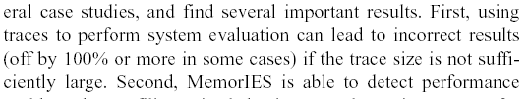
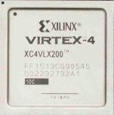
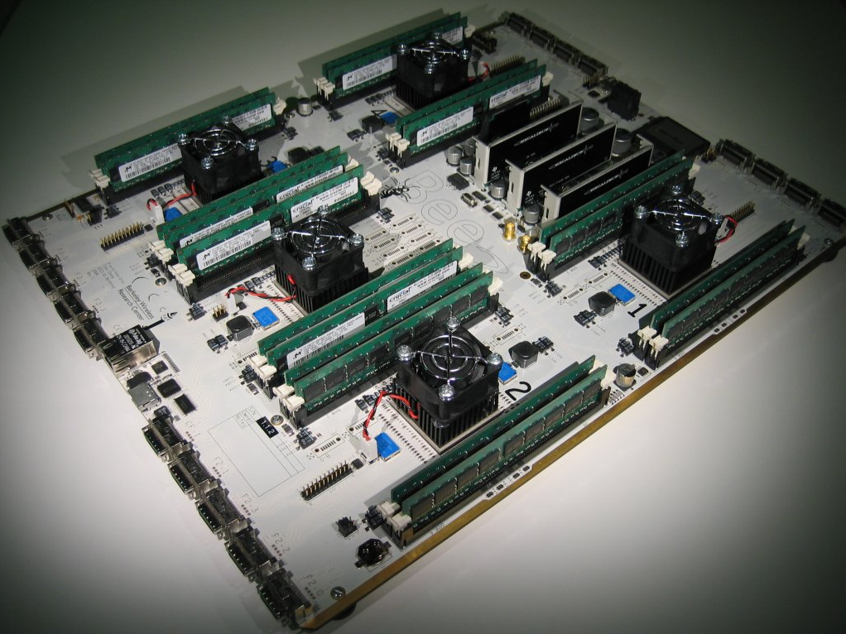
Motivation and Contribution
Evaluation of coherence traffic efficiency
  Motivation
    Memory wall becomes higher
      Important to understand the impact of communication among processors
    Traditionally, evaluation of coherence protocols focused on protocols themselves
      Software-based simulation
    FPGA technology
      Original Pentium fits into one Xilinx Virtex-4 LX200
      Recent emulation effort
        RAMP consortium
  Contribution
    A novel method to measure the intrinsic delay of coherence traffic and evaluate its efficiency using emulation technique
MemorIES (ASPLOS 2000)
BEE2 board
Notes:
RAMP (Research Accelerator for Multiple Processor)
Then the 3rd contribution is about the evaluation of the coherence traffic efficiency
As the memory wall becomes higher, it is important to understand system-wide performance impact of coherence traffic and reflect this into future communication architecture.
Traditionally, the evaluations are focused on coherence protocols themselves.
For this, software simulations were performed for evaluations.
The disadvantage of the software simulations is that it takes too long time to get useful information of system behavior.
It is difficult to do exact real-world modeling such as I/Os.
Therefore, after building SMP machines, applications are parallelized and run natively on the machine. Then people report speedup numbers,
But, it is too ambiguous to determine the contributions of the speedup.
how much of it comes from good workload parallelization and/or how about the impact of underlying communication mechanisms on performance.
Focusing on underlying communication mechanism, this 3rd contribution proposes a novel method to measure the intrinsic delay of coherence traffic and evaluate its efficiency.

Slide 23
Cache Coherence Protocols
Well-known technique for data consistency among multiprocessor with caches
Classification
  Snoop-based protocols
    Rely on broadcasting on shared bus
      Based on shared memory
        Symmetric access to main memory
    Limited scalability
    Used to build small-scale multiprocessor systems
      Very popular in servers and workstations
  Directory-based protocols
    Message-based communication via interconnection network
      Based on distributed shared memory (DSM)
        Cache coherent non-uniform memory Access (ccNUMA)
    Scalable
    Used to build large-scale systems
    Actively studied in 1990s
Notes:
Coherence protocols are very well-known technique for data consistency among caches in multiprocessors.
It is classified into snoop-based and directory-based protocols.
Its classification is based on scalablity.
Snoop-based protocol relys on broadcasting on common medium, normally shared bus.
So, it has the limited scalibility and is used to build the small-scale machines, usually up to 4 processors,
On the other hand, directory protocols rely on the message passing.
Since the messages are sent to appropriate nodes, it is a scalable protocol.
So, it is used to build large-scale systems potentially including a few hundreds to a few thousand processors.

Slide 24
Cache Coherence Protocols (continued)
Snoop-based protocols
  Invalidation-based protocols
    Invalidate shared copies when writing
    1980s
      Write-once, Synapse, Berkeley, and Illinois
    Currently, adopt different combinations of the states (M, O, E, S, and I)
      MEI: PowerPC750, MIPS64 20Kc
      MSI: Silicon Graphics 4D series
      MESI: Pentium class, AMD K6, PowerPC601
      MOESI: AMD64, UltraSparc
  Update-based protocols
    Update shared copies when writing
    Dragon protocol and Firefly
Notes:
Snoop-based protocols can be classified into invalidation-based and update-based protocols.
As the name implys, invalidation-based protocols invalidate shared copies in other processors’ caches when writing, while update-based protocols update shared copies when writing.
In general, invalidation-based protocols are known to be more robust, so most vendors use it as defalut protocol.
Snoop-based protocols were actively studied in 1980s and 1990s. Researchers proposed coherence protocols such as write-once, synapse, Berkeley, and Illinois.
Currently, most commercial vendors adopt variations mostly based on the Illinois protocol.
Dragon protocol and firefly belong to the update-based protocol

Slide 25
Cache Coherence Protocols (continued)
Directory-based protocols
  Memory-based schemes
    Keep directory at the granularity of a cache line in home node’s memory
      One dirty bit, and one presence bit for each node
    Storage overhead due to directory
    Examples
      Stanford DASH, Stanford FLASH, MIT Alewife, and SGI Origin
  Cache-based schemes
    Keep only head pointer for each cache line in home node’ directory
      Keep forward and backward pointers in caches of each node
    Long latency due to serialization of messages
    Examples
      Sequent NUMA-Q, Convex Exemplar, and Data General
Notes:
Directory-based protocols can be classified into memory-based and cache-based protocols.
Its classification is based on where to find the sharers’ locations.
Each scheme can be implemented using either invalidation-based or update-based, but the invalidation protocol is more popular because in the update-based protocol, useless updates could generate many network transactions.
First, memory-based schemes keep the directory at the granularity of a cache line in home memory.
Therefore, the disadvantage of this scheme is storage overhead because directory size is growing very fast as the number of nodes is increased.
But, there are proposed soluations such as keeping limited number of pointers in the directory.
Cache-based schemes only keep head pointer in home directory and the other information is stored in caches.
In caches, there are reserved space for forward and backward pointers, which point to the next sharer of the same block in linked list fashion.
Because of this, the advantage of this scheme is that directory overhead is small
But the disadantage is that because its structure is based on linked list, especially invalidation takes long time if there are many sharers since it has to walk throuth the list to find all the sharers
Cache-based schemes incur the long latency:
Write transaction invalidates sharers by transversing node by node
Even a read miss to a clean block involves the assists of three nodes to insert the node in the linked list
Advantages of cache-based schemes
Directory overhead is small
Linked list records the order of access, making it easier to to provide fairness.
Sending Invalidations is not centralized

Slide 26
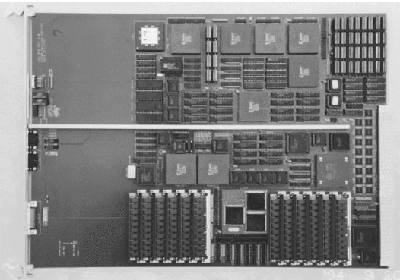
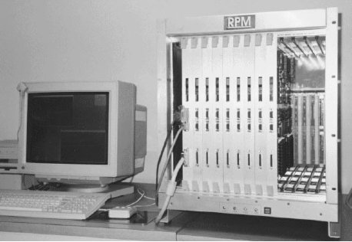
Emulation Initiatives for Protocol Evaluation
RPM (mid-to-late ’90s)
  Rapid Prototyping engine for Multiprocessor from Univ. of Southern California
  ccNUMA Full system emulation
    A Sparc IU/FPU core is used as CPU in each node, and the rest (L1, L2 etc) is implemented with 8 FPGAs
    Nodes are connected through Futurebus+
Notes:
For coherence protocol evaluation, instead of relying on software simulations, there are emulation intitaives.
RPM is a reserach project from USC. It is develped for the ccNUMA full system emulation.
The picture on the left side shows one node of the RPM’s ccNUMA prototyping. A SPARC core is used as CPU in each node, and 8 FPGAs are used to implement caches, memory controller and network interface. RPM supports up to 8 nodes as shown in the picture on the right side.

Slide 27
FPGA Initiatives for Evaluation
Other cache emulators
  RACFCS (1997)
    Reconfigurable Address Collector and Flying Cache Simulator from Yonsei Univ. in Korea
    Plugged into Intel486 bus
      Passively collect
  HACS (2002)
    Hardware Accelerated Cache Simulator from Brigham Young Univ.
    Plugged into FSB of Pentium-Pro-based system
  ACE (2006)
    Active Cache Emulator from Intel Corp.
    Plugged into FSB of Pentium-III-based system
Notes:
Directory-based protocols can be classified into memory-based and cache-based protocols.
Its classification is based on finding the locations of sharers.
Each scheme can be implemented using either invalidation-based or update-based, but the invalidation protocol is more popular because in the update-based protocol, useless updates could generate many network transactions.
First, memory-based schemes keep the directory at the granularity of a cache line in home memory.
Therefore, the disadvantage of this scheme is storage overhead because directory size is growing very fast as the number of nodes is increased.
But, there are proposed soluations such as keeping limited number of pointers in the directory.
Cache-based schemes only keep head pointer in home directory and the other information is stored in caches.
In caches, there are reserved space for forward and backward pointers, which point to the next sharer of the same block.
Because of this, the advantage of this scheme is that directory overhead is small
But the disadantage is that because its structure is based on linked list, especially invalidation takes long time if there are many sharers since it has to walk throuth the list to find all the sharers
Cache-based schemes incur the long latency:
Write transaction invalidates sharers by transversing node by node
Even a read miss to a clean block involves the assists of three nodes to insert the node in the linked list
Advantages of cache-based schemes
Directory overhead is small
Linked list records the order of access, making it easier to to provide fairness.
Sending Invalidations is not centralized

