Slide 1
InfoShield: A Security Architecture for
Protecting Information Usage in Memory
Weidong Shi – Georgia Tech
Josh Fryman – Intel Corporation
Guofei Gu – Georgia Tech
Hsien–Hsin Lee – Georgia Tech
Youtao Zhang – University of Pittsburgh
Jun Yang – University of California, Riverside

Slide 2
Overview
Information Theft
Information Protection Mechanisms
InfoShield Architecture
Characterization of Network Applications
Conclusion

Slide 3
Information Theft Example - Overflow
During normal operation…
When an attack is launched…
Kernel Space
Crypto Functions
ReadBuffer(offset, size, buf)
Code
Secret Key
Array Buffer
Data
offset
offset+size
offset
offset+size

Slide 4
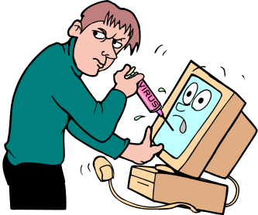
Information Theft
Invalid Input – induce victim applications to disclose secrets (in)voluntarily
  integer, pointer, array index overflow
Information Theft Trojan
    intercept, snoop security keys, passwords
Memory Scan
  keyword, fixed offset
Buffer Overflow - similar to invalid input, but
through format string attacks

Slide 5
Against Information Theft – Prior Art
Ad-hoc Solutions
    Approaches: boundary checking, model checking, stack guard, etc.
    Issues: indirect solution, passive solution
Access Control [Hydra, 75]
    Approaches: process space isolation, user/kernel isolation, etc.
    Issues: high level, coverage too broad, imprecise, insecure

Slide 6
Information Flow Analysis - Prior Art
Information Flow (IF) Analysis
    Classic IF model [Denning & Denning,77]
    Runtime IF analysis/tracking [RIFLE, 04]
Restrict Flow of Information
    Information with high security level cannot be disclosed to output channel with low security level
Issues
    Over-protection, too restrictive, every piece of derived information carries private information.

Slide 7

InfoShield: Protecting Information Usage
Runtime Check of Usage of Sensitive Information
    password, cryptographic keys, …
Restrict Information Usage
    Who can access: sensitive data must be accessed and operated by functions who are entitled to use them.
    How can be accessed: sensitive data guaranteed to be used in the way defined by application semantic
Require ISA Extension and Architectural Support

Slide 8
InfoShield Basics
inst1:
inst2:
inst3:
inst4:
… …
inst define secret usage
Secret
Shield usage
inst S: ld r4, (secret)
… …
inst S: ld r4, (secret)
… …
Memory
…
inst X: st r5, (secret)
… …

Slide 9
InfoShield Basics
inst1:
inst2:
inst3:
inst4:
… …
inst define secret usage
Secret
inst S: ld r4, (secret)
… …
inst define secret usage
Shield usage
Memory
…
inst X: st r5, (secret)
… …
inst X: st r5, (secret)
… …
Form “Authentication Chain” for Protecting Usage

Slide 10


InfoShield Basics
inst1:
inst2:
inst3:
inst4:
… …
Mallory
inst define secret usage
Secret
Hacker’s instructions
Inst H: ld r4, (secret)
inst S: ld r4, (secret)
… …
inst define secret usage
Memory
inst X: ld r5, (secret)
… …
…
inst X: st r5, (secret)
… …
“Inst H” is not in the protection chain

Slide 11
InfoShield: Information Usage Safety
Concept of Information Usage Safety
Given That Application Is Properly Designed,
    Guarantee that information is used in the way it is meant to be used.
    Ensure that private data is not misused or illegally accessed.
    Protect the integrity of dynamic usage of user private data based on the program semantic. Or in another word
Authenticates the Usage of Information

Slide 12
InfoShield: Safeguard Sensitive Data
Read/write to sensitive data is dynamically checked throughout the program execution to guarantee they are used,
    in the order as defined by the application
    by only the instructions that are supposed to use it
Architectural Model
    ISA Extension – sensitive data declaration,
    runtime access control
    Architectural support – security-aware register table and runtime checking

Slide 13
InfoShield: Architectural Support
Secure-aware Register (SR) Table
    where sensitive data are stored
    who can access the sensitive data
After a code region completes, modify SR Table
ISA Support
    SR Table management instructions
    sensitive data clear, copy

Slide 14

InfoShield Illustration
sensitive data
Addr_{low}
Define Sensitive Data
Code Region 1
Addr_{high}
Define Next Region
PC_{low}
Access Sensitive Data
Code Region 2
PC_{high}
Define Next Region
SR Table
Access Sensitive Data
Code Region 3

Slide 15
InfoShield Illustration
Addr_{low}
Code Region 1
Define Next Region
Addr_{high}
sensitive data
PC_{low}
Access Sensitive Data
Test Branch
Code Region 2
PC_{high}
True: Define Region 3
SR Table
Access Sensitive Data
Code Region 3

Slide 16
InfoShield Illustration
Addr_{low}
Code Region 1
Addr_{high}
sensitive data
PC_{low}
Access Sensitive Data
Test Branch
Code Region 2
PC_{high}
False: Define Region 4
SR Table
Access Sensitive Data
Code Region 4

Slide 17
ISA Extension Example
Addr_{low}
Addr_{high}
PC_{low}
PC_{high}
R0 <- 1
200
208
B00C
B014
R1<-0x200
R2<-0x208
SR Table
0x200
R3<-0xB00C
R4<-0xB014
0x208
SAG R0
sensitive data
SAP R0,R1,R2,R3,R4
0xB00C
0xB014
SAG: Set Address Guard
SAP: Set Address Protection

Slide 18
ISA Extension Example
Addr_{low}
Addr_{high}
PC_{low}
PC_{high}
R2<- 0xC008
200
200
208
208
B00C
C008
B014
C00C
R3<-0xC00C
SR Table
0xB00C
Ld Rx, [0x200]
0x200
0xB010
SAS R0, R2,R3
0x208
sensitive data
0xC008
0xC00C

Slide 19
Other ISA Extension
Sensitive Data Copy.
    Definition: copy a block of sensitive data
    (memory to memory DMA)
    Purpose: garbage collection
Sensitive Data Clear.
    Definition: reclaim dead sensitive data region.
    Purpose: program fault handling, garbage collection.

Slide 20
Move Checking Off the Critical Path
Load/Store Queue
EA, ROB slot, PC
EA, ROB slot
SR
Table
Cache and
Memory
Hierarchy
Data/Exceptions
ROB(or architectural equivalent)

Slide 21
Application Profile
Emulation environment
  x86 full system emulator, Bochs. Linux Server (RH6.0 distribution)
Profiled applications
openssh server,sftp server, apache server
wu-ftp server, imap server, ftp client, pine client,
and lynx web browser.
Sensitive information
    Password
    Openssh/sftp private key
    AES encryption/decryption key

Slide 22
Bochs Hack
Profiled applications
  Instrument applications (memory tainting) to expose
    where the sensitive data are stored
    when they are created and when they are destroyed
Bochs: For each process (identified via process unique CR3 value in x86)
    number of memory reads that fetch sensitive data
    number of instructions that directly manipulate loaded sensitive data

Slide 23
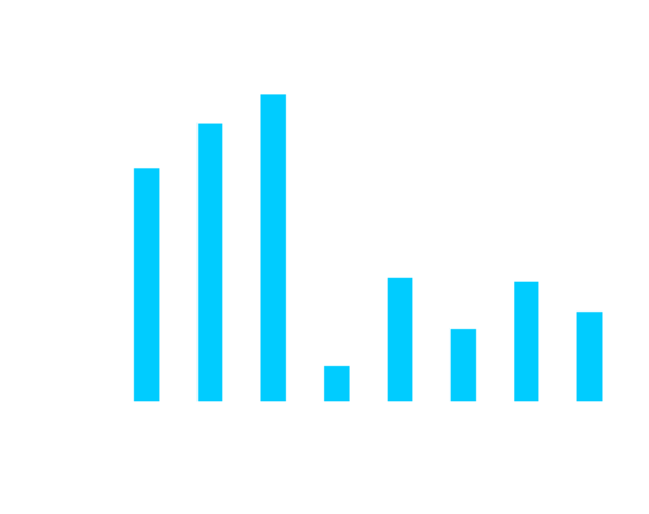
Dynamic Sensitive Data Loads/All Data Loads

Slide 24
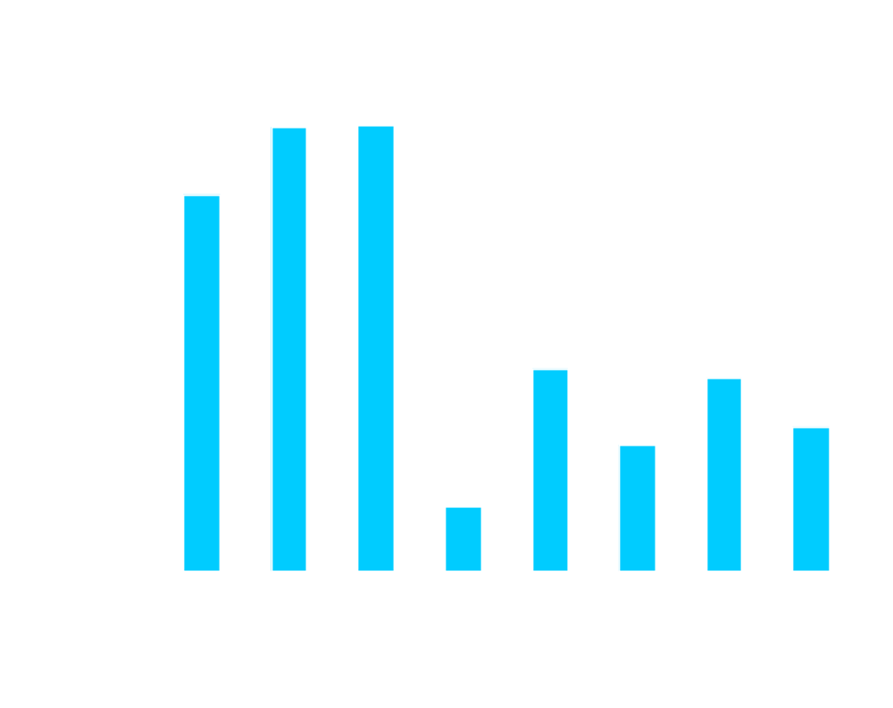
Dynamic Instructions Operating On Sensitive Data/All Instructions

Slide 25
Conclusions
Many documented real-world information thefts steal sensitive data via violation of information usage.
InfoShield enforces runtime sensitive data to be accessed or used the way as defined by program semantic.
For real-world applications, accesses to password or security keys are relatively small.

Slide 26

Thank You

Slide 27
Backup Foil

Slide 28
InfoShield: Assumptions
Computing platform itself is physically secured.
Integrity of software guaranteed.
Dynamic libraries certified and signed with digital signatures.
Software running in non-debug mode.

Slide 29
Information Theft Example -Trojan
Application
Socket DLL
Socket DLL
Trojan

Slide 30
Comparisons
A Crypto Function That Encrypts Input Data Using A Key.
    The key is considered as private data
    The encrypted data considered as non-secret.
Information flow safety
Computational safety
Information use safety
Encrypted results
carry info of the
key and considered
un-safe to be disclosed.
Encrypted result is
computationally safe to
be disclosed. It is
not feasible to extract
key from the encrypted
data.
Encrypted results are
safe to be disclosed if it
is based on correct
execution of the function
and there is no miss-use
of the key.

