Slide 1
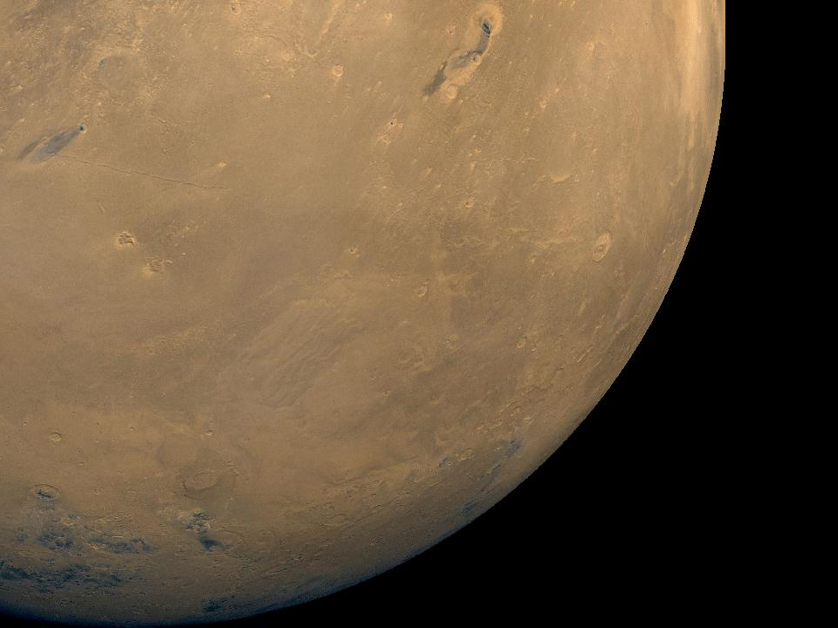

Optimizing Katsevich Image Reconstruction Algorithm on Multicore Processors
Eric Fontaine GeorgiaTech
Hsien-Hsin Lee GeorgiaTech

Slide 2

Outline
Image Reconstruction Overview
Katsevich Algorithm
Prior Work and Our Optimizations:
  PI-Interval Method
  Cone-Beam Cover Method
Our Work:
  Symmetry Method
Results
Conclusion

Slide 3
Image Reconstruction Overview
Is it possible to reconstruct the 3-D volume of an object from projections?
  Early 20th century: Radon Transform and Fourier Slice Theorem
Common methods
  MRI
    Noninvasive magnetic field applied.
    Main function FFT.
  Positron Emission Tomography
    Patient injected with radioactive matter.
    When decay, release radiation which is detected by sensors.
  Computed Tomography
    Use x-ray projections of object.
    Use filtered back-projection to obtain original volume.
Contain fine-grained and coarse-grained data parallelism.

Slide 4
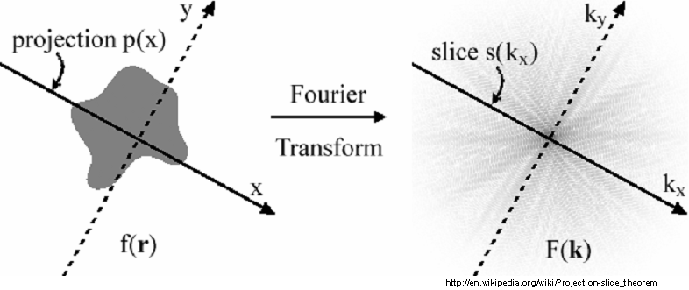
Fourier Slice Theorem
Fourier Transform of 1-D Projection of 2-D Image = Slice of 2-D Fourier Transform of Image
Formula can be rearranged as filtered backprojection.

Slide 5
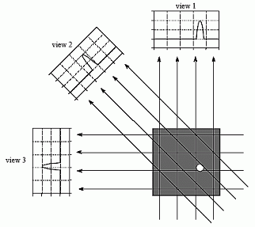
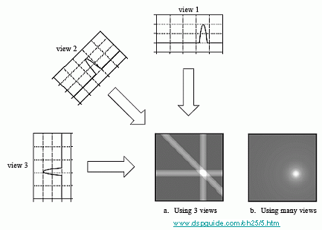
Filtered-Backprojection
Projection
Backprojection
After projections filtered, then backprojected.
  Less computationally expensive than filtering after backprojection.
Require 180 degrees of projection data.
Can be extended to fan-beams instead of parallel-beams.

Slide 6
3-D Volume?
Previous methods for 2-D slices.
Can repeat for multiple slices to get 3-D volume.
Two common 3-D back-projection algorithms.
  FDK (1985)
    Approximation, fast reconstruction.
    Use projections taken on a circular path surrounding the object.
    More accurate on the plane containing the circle.
    Can be generalized for helical scanning paths.
  Katsevich (2003)
    Theoretically exact, but also more compute-intensive.
    Use projections taken on a helical path surrounding the object.
    Can reconstruct long objects, unlike the original FDK.
    Fast scanning.

Slide 7
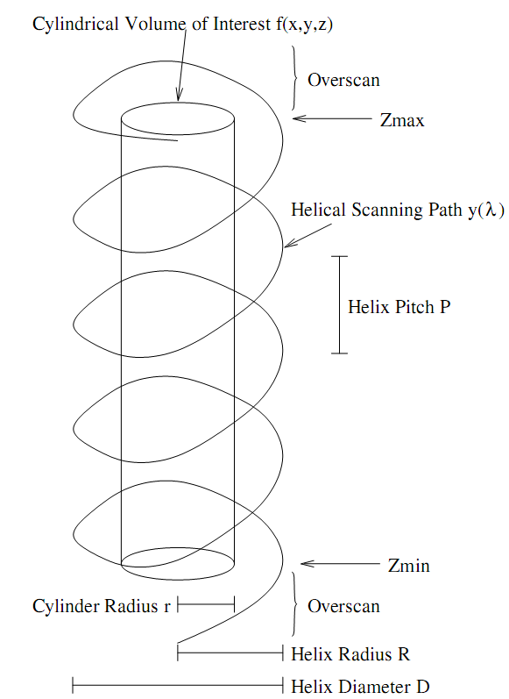
Katsevich Image Reconstruction
Reconstruct density of 3-D cylindrical volume.
  Analyze many 2-D cone-beam projections taken along helical scanning path.
First exact helical cone beam image reconstruction algorithm.
Filtered-backprojection form.
  More computationally expensive than other non-exact algorithms such as FDK.
  Also requires differentiation and remapping of projections to and from filtering coordinates.

Slide 8
Katsevich Step 1: Differentiation
Take difference between neighboring texels.
Take difference between neighboring projections.
Projection k
Differentiated Projection k
Projection k+1

Slide 9
Katsevich Step 2: Filtering
Perform horizontal convolution along kappa lines.
Remap back to projection coordinates.
Remap projection to filtering coordinates.

Slide 10
Katsevich Step 3: Backprojection
Backprojection
Backprojection
Projection
Projection
X-ray projection source
Volume of Interest
Projection is formed by line integral of density along path of ray from x-ray source to detector.
Use linear interpolation of 4 neighboring texels when looking up backprojection value.
Backprojection is the reverse – smear projection data from detector onto image voxel.

Slide 11
PI-Interval Method
PI-Interval formed by line intersecting:
  A point inside helix and two points on the helix
PI-Interval
voxel
Helical Scanning Path

Slide 12
PI-Interval Method
PI-Interval contains all data necessary for exact reconstruction.
Iterate over all projections in PI-Interval containing each voxel.
  Calculate voxel’s backprojected coordinate.
  Get projection’s value at backprojected coordinate using linear interpolation and weight appropriately.
  Accumulate contribution from each projection.
  Use special weighting for beggining and end of interval.

Slide 13
PI-Interval Method
Voxel Reconstruction Done!

Slide 14
PI-Interval Method
Parallelization Strategy:
Proj 1
Diff
Remap
Convolve
Remap
Slice 1
Proj2
Proj 3
Diff
Remap
Convolve
Remap
Slice Z Max
Proj K
Perform convolution along kappa lines.
Continue until all slices are done.
Barrier, then assign different image slices to different threads.
Remap projection to filtering coordinates.
Each thread performs backprojection of its assigned slice.
Remap back to projection coordinates.
Perform differentiation of each projection.
Assign projections to different threads.

Slide 15
PI-Interval Method Basic Optimizations
Majority of time spent calculating PI-intervals and backprojection.
  PI-intervals are constant for a particular helix.
    Precompute one slice of PI-intervals.
    PI-intervals for different horizontal slices can be determined by rotation.
    Easy ~25% speedup
Next focused on backprojection inner loop.
  Removed trival lookup tables.
    ~10% speedup.
  Used sin, cos lookup tables.
    ~15% speedup.
  Moved if statements for smoothing the ends of the PI-interval outside loop.
    Duplicated inner loop code.
    ~10% speedup.
  Removed if statements for bounds testing the backprojected coordinates.
    Needed to add extra row and column slack to projection data.
    ~3% speedup.

Slide 16
Cone-beam Cover Method
Formed by intersection of cone beam and volume.
Contain necessary data for reconstruction.
X-ray projection source

Slide 17
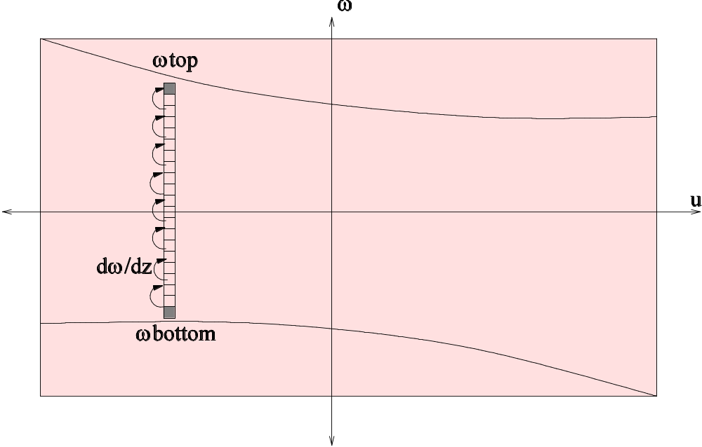
Cone-beam Cover Method
Accumulate partial image reconstruction.
Access projection and image memory linearly.
  Rotate projection 90 degrees.
Bring in two columns of projection data.
Iterate from bottom to top of projection.

Slide 18
Cone-beam Cover Method
Parallelization Strategy:
Proj 1
Shared
Image
Memory
Diff
Remap
Convolve
Remap
Proj2
Proj 3
Diff
Remap
Convolve
Remap
Proj K
Remap back to projection coordinates.
Each thread performs backprojection of its assigned projection to shared image memory.
Perform convolution along kappa lines.
Remap projection to filtering coordinates.
Assign projections to different threads.
Continue until all projections are done.
Perform differentiation of each projection.

Slide 19
SIMD Optimizations
Use SIMD for backprojection.
  Backproject 4 consecutive z voxels at a time.
  Requires data shuffling.
  Not all memory access are aligned.
  Treat top and bottom of cone beam cover specially.
Use SIMD for differentiation and remapping steps.
  Act on 4 consecutive texels at a time

Slide 20
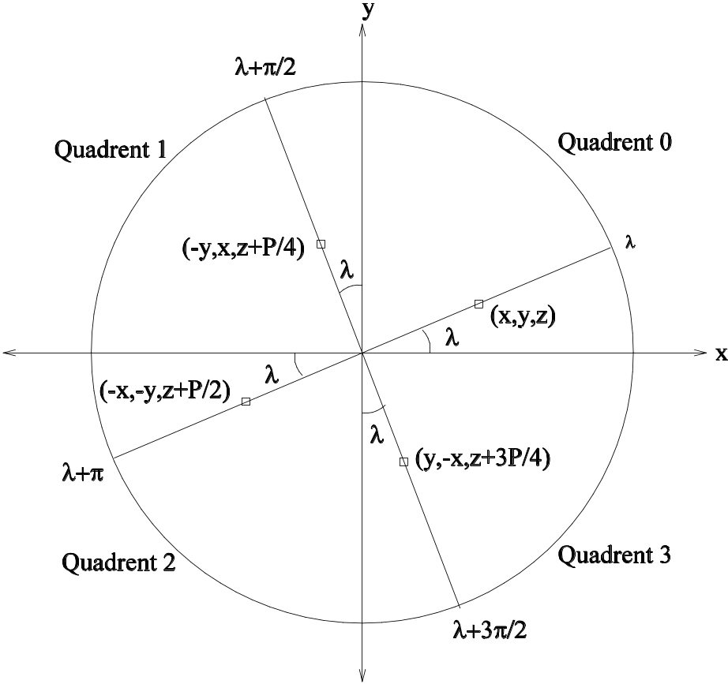
Symmetry Method
Exploit backprojection redundancy among every π/2 source projection
  due to π/2 symmetry of sin, cos.
Reduce backprojection calculations by ~4x for each turn of helix

Slide 21
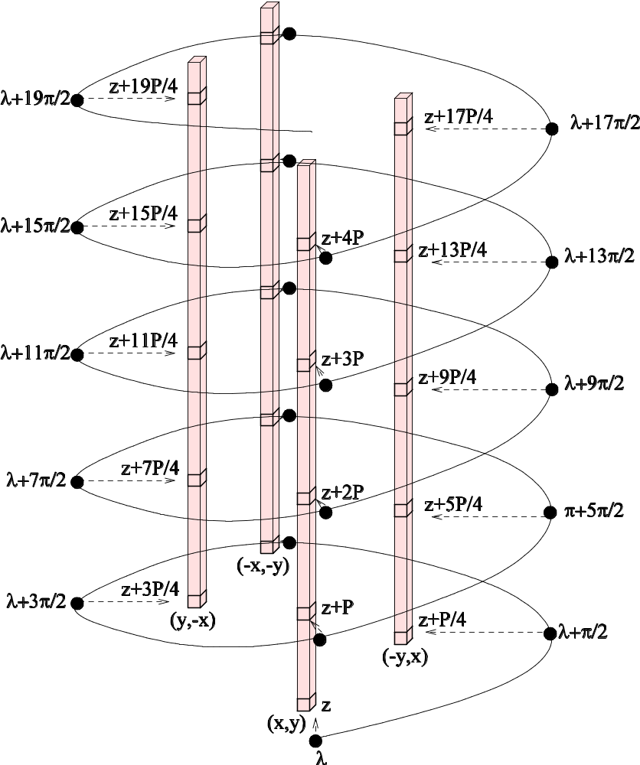
Symmetry Method
Unpacked Image Data
Packed Image Data
Z Offset 1
Z Offset 0
All the colored voxels have identical backprojection coordinates
Pack them so they occupy adjacent memory locations
Voxels with same relative “z offset” grouped together

Slide 22
Symmetry Method
Easily SIMDified.
  No need for projection or image data shuffling.
  All 128-bit memory access are aligned.
  Need projection packing step (outside of main loop).
  Need image unpacking step (outside of main loop).
  Inner loop primarily consists of SIMD memory accesses.
    Coordinate and interpolation calculations outside of inner loop.

Slide 23
Results
System:
  Two Intel 2.33 Ghz Quad Core Clovertown processors.
  4 GB Ram.
  Windows Vista.
Programming:
  C ported from open source Matlab implementation.
  OpenMP.
  Intel Performance Primitives.
  Intrinsic Assembly.
Input: 2-D Projections of Shepp-Logan Phantom.
  4 helical turns plus 1 overscan turn.
Output: 3-D density.

Slide 24
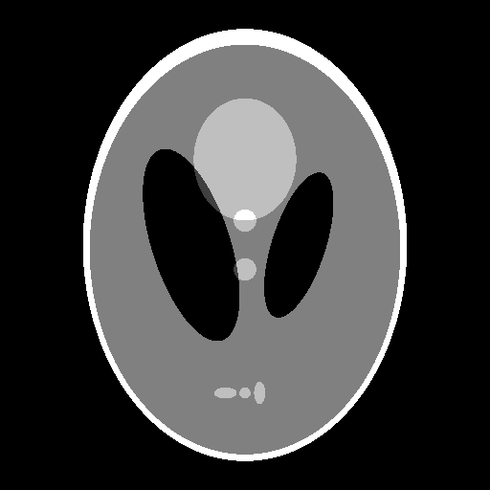
Original Shepp-Logan Phantom

Slide 25

PI-Interval Method Reconstruction

Slide 26
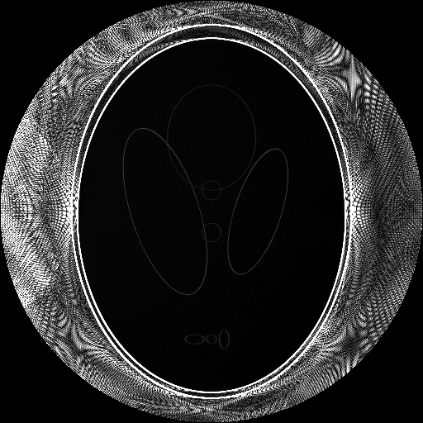
PI-Interval Method Error

Slide 27
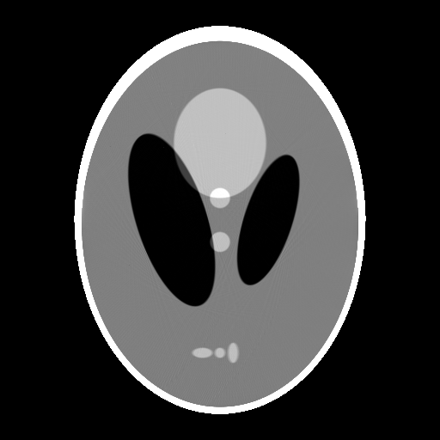
Cone-beam Cover Method Reconstruction

Slide 28
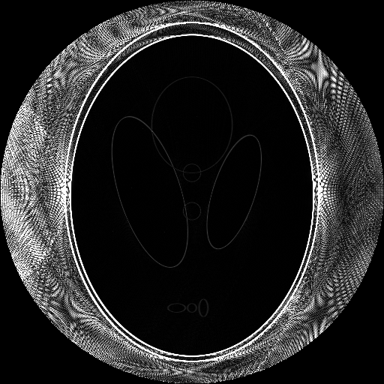
Cone-beam Cover Method Error

Slide 29

Symmetry Method Reconstruction

Slide 30

Symmetry Method Error

Slide 31
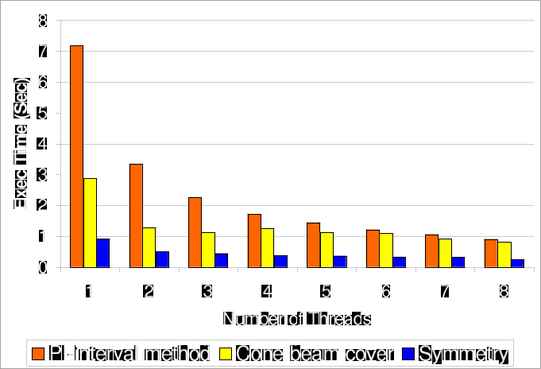
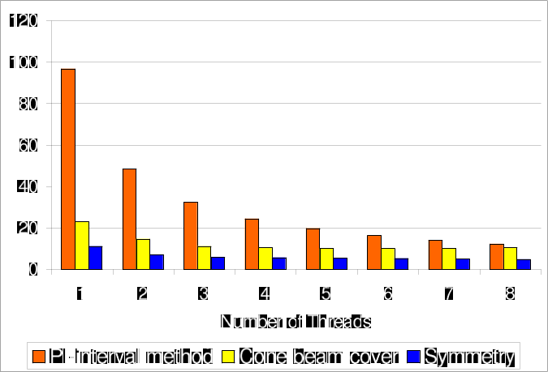
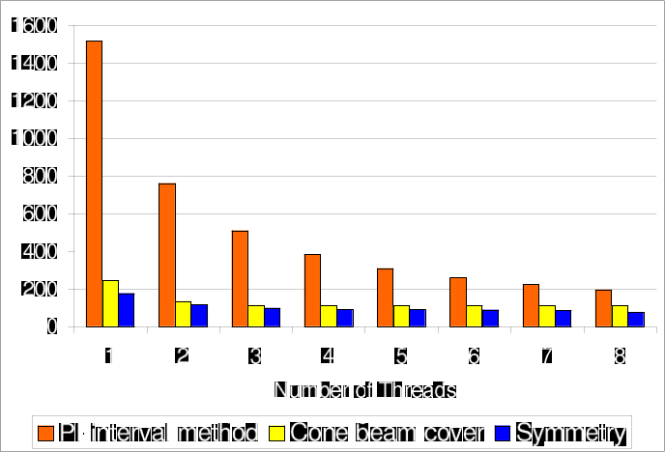
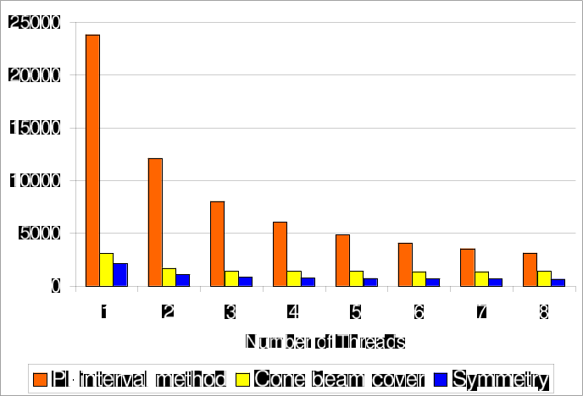
Reconstruction Time
128³ image from 640 128x32 projections
256³ image from 1280 256x64 projections
512³ image from 2560 512x128 projections
1024³ image from 5120 512x128 projections

Slide 32
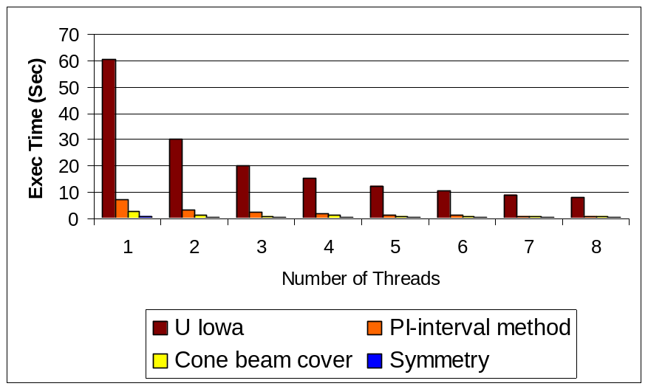
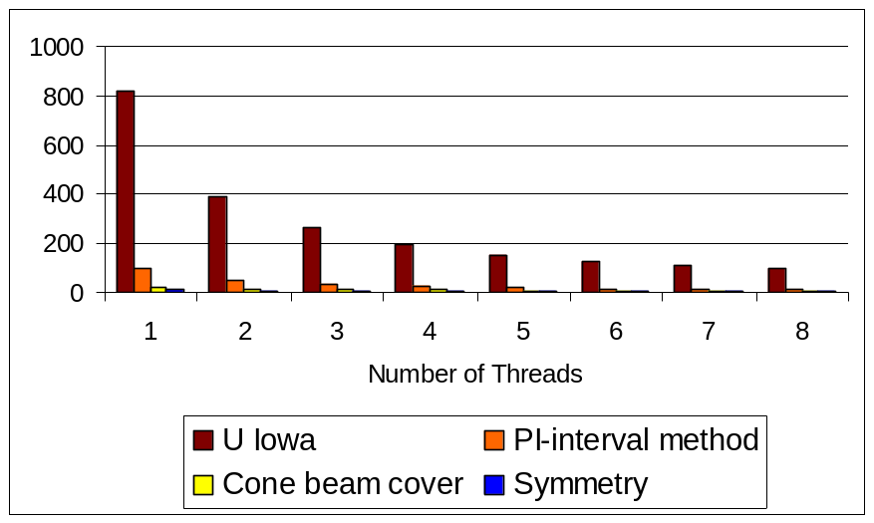
Comparison to U Iowa
128³ image from 640 128x32 projections
256³ image from 1280 256x64 projections
~ 73x speedup for Symmetry Method over U Iowa for 256^3 running on same system for 1 thread.
Note: U Iowa implementation uses MPI.
  Focused primarily on parallel speedup.

Slide 33
Reconstruction Time Breakdown
Step | Init-base Pi-Method | Opt-1T | Opt-2T | Opt-4T | Opt-8T
Derivative | 20.6 | 3.8 | 25.0 (3.0x) | 18.9 (4.0x) | 18.8 (4.0x)
Forward remap | 4.2 | 2.1
Convolve | 18.9 | 19.5
Backward remap | 31.8 | 2.5
SIMD Pack | 0 | 12.5
Backproject | 23722.2 (1.0x) | 2083.9 (11.4x) | 1062.0 (22.3x) | 728.8 (32.5x) | 623.5 (38.0x)
Total | 23798.1 (1.0x) | 2126.7 (11.2x) | 1087.3 (21.9x) | 748.2 (31.8x) | 642.3 (37.1x)
Time in seconds (speedup) for 1024³ image.

Slide 34
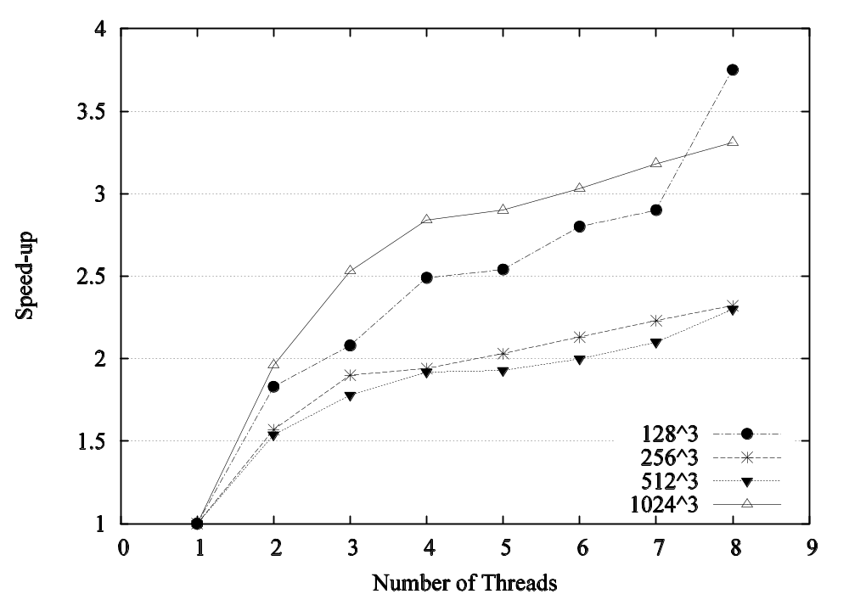
Scalability of Symmetry Method

Slide 35
Conclusion
Majority of time spent in backprojection.
37.1x speedup.
      Comparing final Symmetry Method running on eight threads to the baseline π-Interval Method running on a single thread for 1024 image reconstruction.
Symmetry Method has poor multi-thread speedup because it is memory bound.
Front-side bus bandwidth becomes saturated and limits scalability.

Slide 36
Questions?

Slide 37
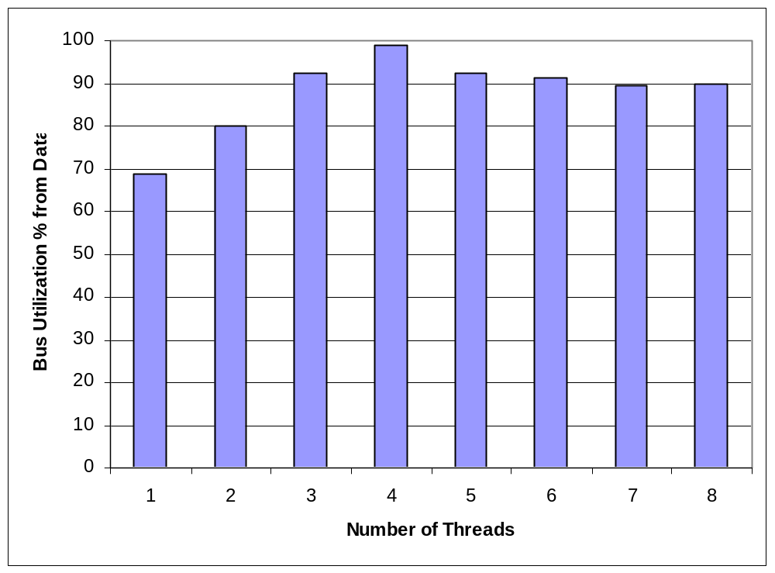
Bus Utilization
(# bus cycles data ready line high / number bus cycles) average for inner loop
1024^3 reconstruction for 60 seconds after 60 seconds warmup

Slide 38
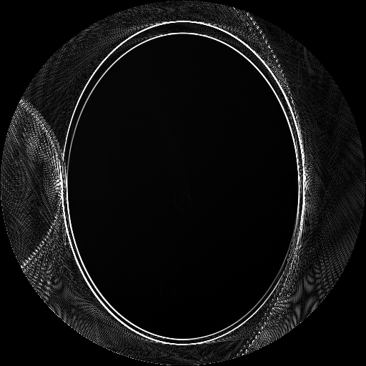
Difference between PI-Method & Cone-Beam

Slide 39
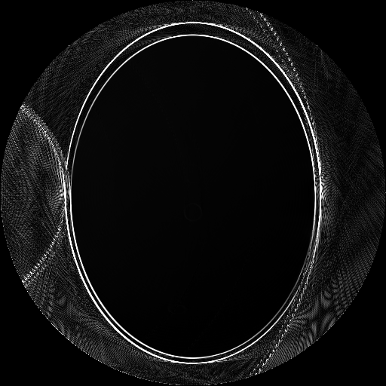
Difference between PI-Method & Symmetry

Slide 40
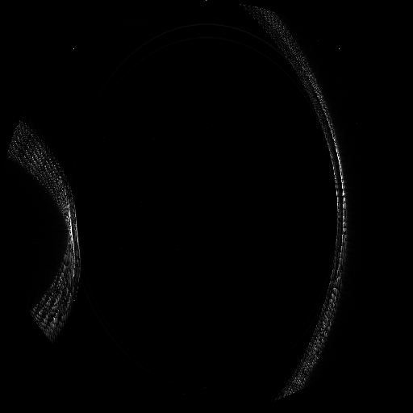
Difference between Cone-Beam & Symmetry

Slide 41
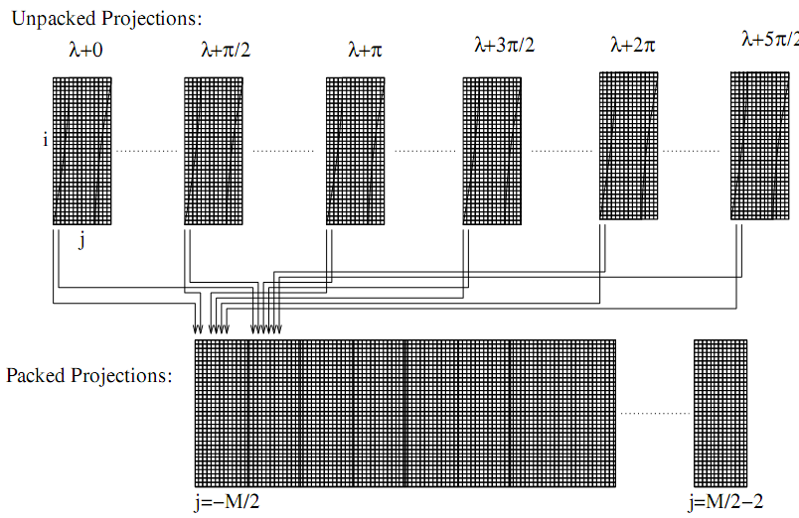
Symmetry Method: Projection Packing
Interleave columns of projections
Linear access to projection memory.

