Slide 1
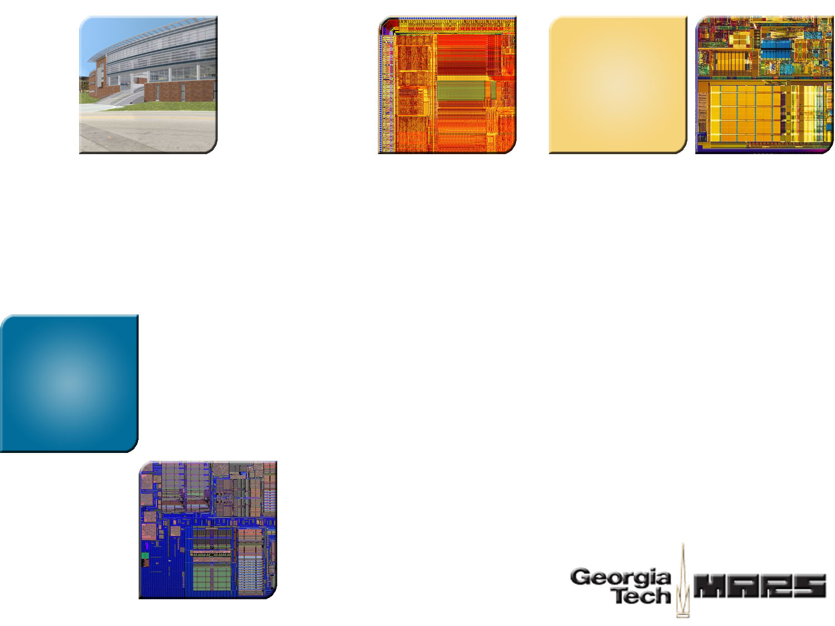
An Integrated Framework for Dependable and Revivable Architecture Using Multicore Processors
Weidong Shi Motorola Labs
Hsien-Hsin “Sean” Lee Georgia Tech
Laura Falk University of Michigan
Mrinmoy Ghosh Georgia Tech
Notes:
Good Afternoon everybody.. My name is Mrinmoy Ghosh. I am a PhD student at Georgia Tech and I would be presenting “An Integrated Framework for Dependable and Revivable Architecture Using Multicore Processors”. The co-authors of this paper are: Dr Weidong Shi, who got his PhD from Gatech and is presently at Motorola Labs, Dr Hsien-Hsin Lee, our advisor and professor at Georgia Tech and Laura Falk, a PhD student from the Univ Michigan, Ann Arbor.
This paper presents an infrastructure that enables network servers to be remote attack immune and self healing, using the emerging multicore processors. By using tightly coupled multicore systems, this research achieves hardware insulation, fine grained concurrent monitoring and backup, and facilitates fast recovery of network services with minimal performance impact.

Slide 2

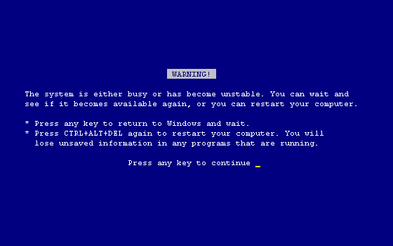
Problem Statement
Highly Available, Reliable, and Revivable networked services.
Explore new programming and usage models for Multi-core processors
Provide “architectural support” for network services to be
  Autonomic
  Remote-exploits revivable
  Self-recoverable
Achieve high performance
Notes:
The focus of this research is to provide high availability of network services.
So here I am giving an ISCA presentation, the last thing I would like is to get is the “Blue Screen of Death”. But if I do happen to get that, I would like my system to be robust enough to recover from that on a keypress..
Our research focusses on enabling a system to provide reliable network services like DNS, HTTP, FTP, detect possible attacks and gracefully recover from the attacks.
To achieve this goal we leverage the emerging multicore processors. We explore new programming and usage models in this domain to achieve remote exploit insulation and also to help detect possible attacks.
Our goal is to provide a robust architecture for network services that would be
Autonomic: It would automatically be able to monitor the state of the system, take regular backups and detect fault conditions.
Remote Exploits Survivable: It should be able to efficiently detect remote exploits and also continue to provide services to genuine users.
Self Recoverable: The system should gracefully recover from an attack by rolling back to a previously stable state.
However, the performance overhead of such a system should not be high. The system should be able to detect attacks, take backups and rollback on an error without having a significant impact on performance.

Slide 3
Problem Statement
Highly Available, Reliable, and Revivable networked services.
Explore new programming and usage models for
Multi-core processors
Provide “architectural support” for network services to be
  Autonomic
  Remote-exploits revivable
  Self-recoverable
Achieve high performance
Notes:
Our research focusses on enabling a system to provide reliable network services like DNS, HTTP, FTP, detect possible attacks and gracefully recover from the attacks.
To achieve this goal we leverage the emerging multicore processors. We explore new programming and usage models in this domain to achieve remote exploit insulation and also to help detect possible attacks.
Our goal is to provide a robust architecture for network services that would have the following properties:
It will be Autonomic: It would automatically be able to monitor the state of the system, take regular backups and detect fault conditions.
It has to be Remote Exploits Revivable: It should be able to efficiently detect remote exploits and also continue to provide services to genuine users.
It should be Self Recoverable: The system should gracefully recover from an attack by rolling back to a previously stable state.
However, the performance overhead of such a system should not be high. The system should be able to detect attacks, take backups and rollback on an error without having a significant impact on performance.

Slide 4

Toward Self-recovery Network Services
Solutions
Causes of Network Service Loss
Accidental
Aging
Intentional
Transient
Heisenbugs
Damage
DoS
Buffer Overflow
Replication
Rejuvenation
Checkpoint
Remote Exploit Self-recovery
Notes:
Here we provide a brief overview of the causes of service loss in network servers and how different techniques have been able to rectify or overcome each of the failures.
Failures may be accidental, or caused by Aging(TALK ABOUT AGING) or may be caused by intentional attacks like Denial of Service or Buffer Overflow, where the return address is overwritten to make the control flow jump to a malicious code and enable it to run in supervisor mode.
Accidental faults may be transients (like a sudden spike in network traffic)
Or Heisenbugs (Pseudo Non deterministic bugs in complex software systems)
Or may be caused by actual failure of hardware, like a Circuit breaker trip or hardware damage.
Replication or having a number of redundant machines as servers take care of most accidental losses. Rejuvenation(That is a periodic preemptive restart of a system to prevent future errors) prevents losses from aging.
Checkpointing helps prevent accidental failures, other than hardware breakdowns.
But none of the above have attack detection capabilities. So they wont be able to cope with remote attcks. This leads us to the motivation of our research to provide the capability of autonomic self healing. This enables the system to be immune from intentional remote exploits.

Slide 5
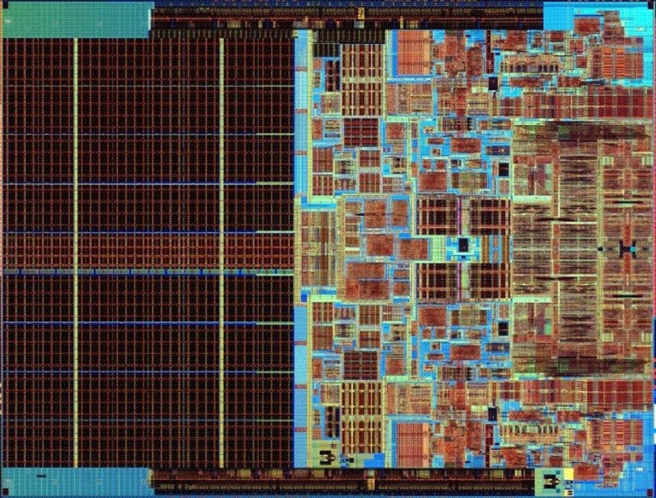
Multicore: An ideal platform
Exploit insulation:
Each core of a multicore can be
programmed to run at different
privilege levels with different OS.
Shared
L2
Server
Core
Monitor
Core
Dual Core (Merome)
Tight coupling of cores comparing with SMP
Fine-grained processor state monitoring
Concurrent monitoring, efficient state backup and recovery
Massive multi-core will have many idle cores
Notes:
Multicore precessors are an emerging platform for a number of reasons like, low complexity, scalability, lower verification costs and faster time to market. The most predominant use of such multicore processors has been to provide parallalism for multithreaded programs, and concurrency in multiprocess environments.
However, in this research we would use the Multicore platform to provide a reliable and self recovering system for network based services. Multicore processors has some great properties that make it an ideal candidate for the job.
Multicore provides a natural insulation between processes running on different cores. Each core of a multicore processor can be programmed to run different OS’s at different privilege levels. An asymmetric configuration creates a “hardware sandbox” for a system running generic services on the low privileged cores and running security services on the high privileged cores to protect the low privileged cores.
Insulation may be difficult to obtain by application level security services as they run on the same OS.
Multicores have tightly coupled cores. This allows fine grain monitoring of one core by the other without too much performance overhead, as there is in the case of an SMP that has an off chip bus.
This tight coupling allows the security services to run concurrently without a lot of interference. It also allows taking fast and light weight backups, and helps in swift recovery.
Future generations would allow having a large number of cores on a single die. However, it is unlikely that softwares would catch up soon to be able to utilize all the available resources. Thus the securiity feature would be a very important thing to have in the idle cores.

Slide 6


INDRA: A Dependable and Revivable Architecture
Control signals
Server Core
(Network Apps)
Monitor Core
CFG check
Trace
Filter
Trace
FIFO
DL1
Cache
IL1
Cache
DL1
Cache
IL1
Cache
Monitor
Code origin check
Insulation
L2 Cache
Control
Memory Interface
Watch Dog
Issue Recovery
Physical Memory Space
(used by service OS and applications)
Protected Memory Space
(monitor BIOS, OS, and SW)
Notes:
This diagram shows the basic architecture for INDRA. Indra stands for an Integrated framework for Dependable and Revivable Architecture.
“INDRA” is a Hindu god who has the power to revive dead warriors in the battlefield. (The amazing thing about the acronym is that it was not formulated by me, but by my Chinese co-author Weidong)
We only show two cores here for simplicity. One of the cores(the Server Core) is the low privileged core that is to be protected. The server core is connected to the network and provides several services like http, ftp, dns. The monitor core runs at a higher privilege level. It reads in trace samples of the programs executing in the server core to determine whether the server has been attacked.
The CFG check sends traces of Function call return sequences, to determine Buffer Overflow attacks. The code origin trace keeps track of the addresses from which instructions are fetched. The monitor matches it with a previously provided table of possible code origins to determine correctness. The trace filter is a CAM type structure that keeps track of previous trace information. It filters out performing checks on entries that have been seen before.
The control lines from the monitor to the server allows the monitor to stall the server to synchronize, or on detection of incorrect state, and also during recovery.
The memory interface watchdog is responsible to provide the physical memory insulation. It does not allow the server to access the protected memory space. The monitor can however access the whole physical memory. This insulates the server from the monitor and makes sure that the monitor cannot be compromised even though the server can.
Thus the INDRA framework achieves insulation, tightly coupled monitoring, control of the server and also allows for fast backup and recovery. We would discuss backup and recovery in subsequent slides.

Slide 7

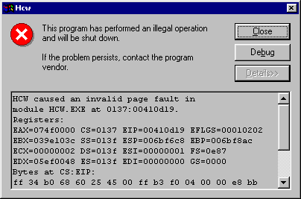
Monitor Core: Insulated Parallel Inspection
[Kiriansky et al., USENIX 2002]
Data Page
Code Page
Code Origin Check
Code Page
FunctionA()
{
Vuln_func();
A =3;
}
Vuln_func()
{
// Attack!!
// Return address changed
}
Malicious_func()
{
}
Control Flow Graph Check
Exception Handling
Notes:
The monitor core is insulated from the server core.
It inspects traces from the server to verify “code” origin. Either the application or the OS process manager informs the monitor about the execution privileges associated with the process. The monitor ensures that only instructions from original memory pages can load in the L1 Cache.
The monitor is provided with a sequence of function call and return statements. The monitor determines whether each function returns to the next instruction following the call.

Slide 8
Server Core: Request Based Recovery
Issue state backup
request
Read network request
(Request for page
arch.ece.gatech.edu)
Restore Checkpointed
State
Process network
request
Monitor Signalled
Error?
No
Yes
Notes:
INDRA has a very simple algorithm for recovering from erroneous states.
Network service is request oriented. Thus all backups are taken on the issue of a new network request. The back up system is novel and light weight and we discuss it in out subsequent slides. Other than keeping the memory state using the novel delta backup scheme, the INDRA subsystem also keeps backups of open system resources(file handles,locks etc)and the process context.
The monitor keeps a light weight backup of the previous known good state. When an intrusion is detected, the server rolls back to the previous state and resumes execution from the next service request

Slide 9
Comparison of Backup and Recovery
Approach
Backup
Recovery
Software checkpointing
Slow
Fast, modify page translation
Memory Update
Log
Fast
Log based undo slow
Virtual Checkpointing
Copy dirty page on demand, slow
Fast, modify TLB entry
INDRA
Fast, no page copy
Fast, no page copy
Notes:
In this slide we discuss the performance of several memory level backup schemes.
We observe that “software check pointing” that takes whole page backup when modified is slow in taking backups. However very fast in recovery as only the TLB translation needs to be changed to the old backup page.
On the other end of the spectrum is the Memory Update log, that keeps a log of each memory transaction. This log is very lightweight. So the backup operation is fast. Rollback is extremely slow as it needs to walk through the log and undo different operations.
Virtual Checkpointing also backs up dirty pages on demand. This suffers from the same drawbacks as Software Checkpointing as whole page backups need to be takes.
INDRA has a novel delta backup scheme, that needs to backup and recover only the cache lines that have changed. Since the whole page is never copied, it has both fast backup time and also roll back time.

Slide 10
INDRA Backup Page Record
Global Timestamp Register (GT) GT=4
TLB Extension for Backup and Rollback
Modified TLB
Local Timestamp
Active Page (Physical Address)
Tag
Backup Page
(Physical Address)
Dirty Block Bitvector
Rollback Bitvector
Rollback
Valid
Processor
Memory
Active Page
Backup Page
Backup Page (Physical Address)
Local
Timestamp
Dirty Block
Bitvector
Rollback
Bitvector
Rollback
Valid
3
Notes:
The idea behind delta backups is that INDRA only takes backups of modified lines. Also all backups are not taken at the same time but on demand.
Similarly recovery is also done on demand. This amortizes the cost of checkpointing and recovery over the applications execution. The granularity of such operations is a cache line. Thus it is very fast and light weight.
For every modified active page we keep a backup page. Also a Backup Page Record is added to the normal page table to maintain pointer to the backup page, and a few other entries to keep track of the specific lines needing backup and recovery. This extension to the page table may be carried over to the TLB as can be seen here. I would now explain each of the fields of the backup page record.

Slide 11
INDRA Backup Page Record
Global Timestamp Register (GT) GT=4
Modified TLB
TLB Extension for Backup and Rollback
Local Timestamp
Active Page (Physical Address)
Tag
Backup Page
(Physical Address)
Dirty Block Bitvector
Rollback Bitvector
Rollback
Valid
Backp Record
3
Processor
Backup Page Record
Memory
Active Page
Backup Page
Backup Page (Physical Address)
Local
Timestamp
Dirty Block
Bitvector
Rollback
Bitvector
Rollback
Valid
3
Notes:
The INDRA system has a Global Timestamp to keep track of network requests. Each time the server application receives a new request the GTS is incremented. Each time the GTS is incremented, the system also takes backup of resource allocation and the process context.
Each virtual memory page also has a local checkpoint timestamp (LTS) . A backup page X with LTS of 5 stores all original lines of X that have been modified since GTS of 5.
When the server writes to a line, the INDRA system takes a backup of the current line in the backup page, marks the corresponding bit in the dirtybitvector and then updates the line. The dirty bit vector keeps track of all lines of the page that have changed since GTS was incremented. It also tells us exactly which line have a backup of a previous state. In this way we keep backups of only those lines that have been modified and keep track with the Dirty Bitvector.
The RollBack Bitvector similarly enables incremental recovery in case of error. The roll back bitvector for a page is a bitmap of all lines whose values in the active page should be replaced with values from the backup page during recovery. Thus INDRA does not trigger immediate rollback on detection of an error. It just sets the appropriate bits in the Roll Back bit vector and sets the Rollback valid bit. Subsequent requests to lines with roll back bits set, take the line from the backup page rather than the active page. This allows rollback of individual cache lines on demand rather than doing simultaneous roll back that would have a large performance overhead.

Slide 12
INDRA Recovery Example
Current Operation
REQUEST n
Wr memory line 7
Global Timestamp Register (GT) GT=5
Modified TLB
TLB Extension for Backup and Rollback
Local Timestamp
Active Page (Physical Address)
Tag
Backup Page
(Physical Address)
Dirty Block Bitvector
Rollback Bitvector
Rollback
Valid
Backup Record
5
3
Active Page
Backup Page

Slide 13
INDRA Recovery Example
Current Operation
REQUEST n
Wr memory line 2
Global Timestamp Register (GT) GT=5
Modified TLB
TLB Extension for Backup and Rollback
Local Timestamp
Active Page (Physical Address)
Tag
Backup Page
(Physical Address)
Dirty Block Bitvector
Rollback Bitvector
Rollback
Valid
Backup Record
5
3
Active Page
Backup Page

Slide 14

INDRA Recovery Example
REQUEST n
Failure Signal
Global Timestamp Register (GT) GT=5
Modified TLB
TLB Extension for Backup and Rollback
Local Timestamp
Active Page (Physical Address)
Tag
Backup Page
(Physical Address)
Dirty Block Bitvector
Rollback Bitvector
Rollback
Valid
Backup Record
5
1
3
Active Page
Backup Page
Restore system resource allocation
Restore process context
Notes:
The INDRA system has a Global Timestamp to keep track of network requests. Each time the server application receives a new request the GTS is incremented.
Each virtual memory page also has a local checkpoint timestamp (LTS) . A backup page X with LTS of 5 stores all original lines of X that have been modified since GTS of 5.
When the server writes to a memory page, if the GTS is greater than the LTS of the page, it means that the dirty line needs backup. So a backup page is assigned (if not done before)
This timestamp is made equal to the GTS if a dirty page is backed up.

Slide 15
INDRA Recovery Example
Current Operation
REQUEST n+1
Rd memory line 7
Global Timestamp Register (GT) GT=5
Modified TLB
TLB Extension for Backup and Rollback
Local Timestamp
Active Page (Physical Address)
Tag
Backup Page
(Physical Address)
Dirty Block Bitvector
Rollback Bitvector
Rollback
Valid
Backup Record
5
1
3
Active Page
Backup Page
Notes:
The INDRA system has a Global Timestamp to keep track of network requests. Each time the server application receives a new request the GTS is incremented.
Each virtual memory page also has a local checkpoint timestamp (LTS) . A backup page X with LTS of 5 stores all original lines of X that have been modified since GTS of 5.
When the server writes to a memory page, if the GTS is greater than the LTS of the page, it means that the dirty line needs backup. So a backup page is assigned (if not done before)
This timestamp is made equal to the GTS if a dirty page is backed up.

Slide 16
INDRA Recovery Example
Current Operation
REQUEST n+1
Wr memory line 1
Global Timestamp Register (GT) GT=5
Modified TLB
TLB Extension for Backup and Rollback
Local Timestamp
Active Page (Physical Address)
Tag
Backup Page
(Physical Address)
Dirty Block Bitvector
Rollback Bitvector
Rollback
Valid
Backup Record
5
1
3
Active Page
Backup Page
Notes:
The INDRA system has a Global Timestamp to keep track of network requests. Each time the server application receives a new request the GTS is incremented.
Each virtual memory page also has a local checkpoint timestamp (LTS) . A backup page X with LTS of 5 stores all original lines of X that have been modified since GTS of 5.
When the server writes to a memory page, if the GTS is greater than the LTS of the page, it means that the dirty line needs backup. So a backup page is assigned (if not done before)
This timestamp is made equal to the GTS if a dirty page is backed up.

Slide 17
INDRA Recovery Example
Current Operation
REQUEST n+1
Handle Next Request
Global Timestamp Register (GT) GT=6
Global Timestamp Register (GT) GT=5
Modified TLB
TLB Extension for Backup and Rollback
Local Timestamp
Active Page (Physical Address)
Tag
Backup Page
(Physical Address)
Dirty Block Bitvector
Rollback Bitvector
Rollback
Valid
Backup Record
5
1
3
Active Page
Backup Page
Record system resource allocation
Record process context
Notes:
The INDRA system has a Global Timestamp to keep track of network requests. Each time the server application receives a new request the GTS is incremented.
Each virtual memory page also has a local checkpoint timestamp (LTS) . A backup page X with LTS of 5 stores all original lines of X that have been modified since GTS of 5.
When the server writes to a memory page, if the GTS is greater than the LTS of the page, it means that the dirty line needs backup. So a backup page is assigned (if not done before)
This timestamp is made equal to the GTS if a dirty page is backed up.

Slide 18
INDRA Recovery Example
Current Operation
REQUEST n+2
Wr memory line 4
Global Timestamp Register (GT) GT=6
Global Timestamp Register (GT) GT=5
Modified TLB
TLB Extension for Backup and Rollback
Local Timestamp
Active Page (Physical Address)
Tag
Backup Page
(Physical Address)
Dirty Block Bitvector
Rollback Bitvector
Rollback
Valid
Backup Record
6
1
5
3
Active Page
Backup Page
Notes:
The INDRA system has a Global Timestamp to keep track of network requests. Each time the server application receives a new request the GTS is incremented.
Each virtual memory page also has a local checkpoint timestamp (LTS) . A backup page X with LTS of 5 stores all original lines of X that have been modified since GTS of 5.
When the server writes to a memory page, if the GTS is greater than the LTS of the page, it means that the dirty line needs backup. So a backup page is assigned (if not done before)
This timestamp is made equal to the GTS if a dirty page is backed up.

Slide 19

Test Bed (Bochs + TAXI [Vlaovic & Davidson, ICCD’02])
Linux Network
Server
Monitor
(Stripped Down OS,
Security SW, 10MB)
Bochs + TAXI
Network
Requests
Server
Response
Host OS
Run production OS with real service applications, httpd, ftpd, bind, sendmail, etc.
Recoverability evaluated by applying real x86 remote exploits from security websites.
Experiment with documented exploits
Notes:
We use Bochs, a full system x86 emulator that models the entire platform including network, hard drives, VGA. Thus it supports execution of a complete OS. Bochs is a functional simulator that provides traces. These traces are used to run TAXI, a simplescalar based performance simulator to evaluate performance.
Bochs is used to simulate a dual core system that communicates through shared memory. The server core is a full blown Red Hat linux 6.0 with different network applications. The monitor core is a stripped down version of linux running the small monitor applications. The entire footprint of the monitor is less than 10MB.

Slide 20
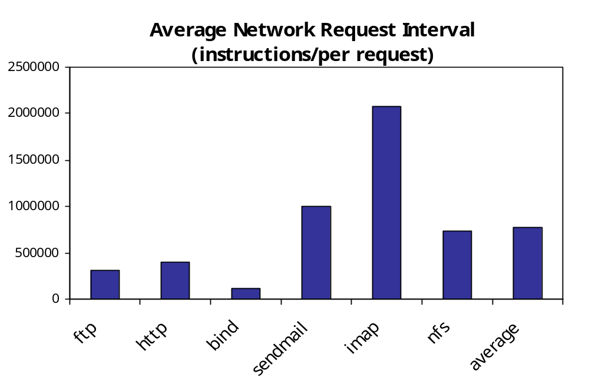
Inter-Request Interval (# of Instructions)
Notes:
Since backups are taken at the request boundaries, the number of instructions between requests gives an estimate on time between subsequent backups. We see that it is relatively short, ranging from 0.5 million to 2 million. So taking dirty page backups this often would lead to an average 4x slowdown in response time. This shows that our delta page backup scheme is more lightweight and appropriate for our application.

Slide 21
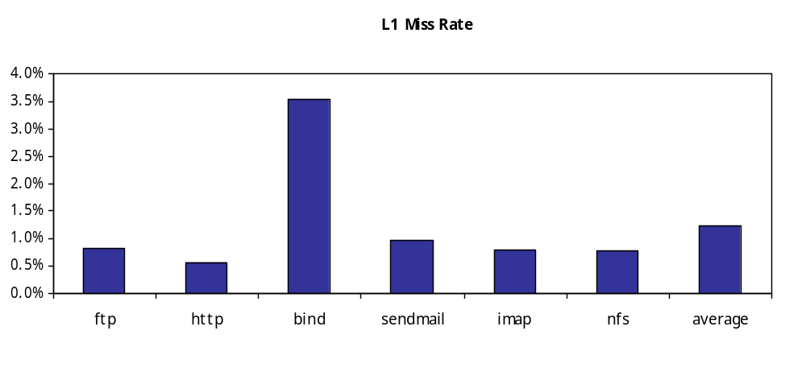
I-Cache Miss Rate
Code Origin Check reads traces of code read from L2 Cache
Number of Instructions in the Trace is Proportional to L1 I Cache Miss Rate
Overhead of monitoring code origin depends on L1 I Cache Miss Rate
Notes:
The number of I Cache misses has a very big impact on performance because the code origin check is only performed on a ICache miss. We see that for the applications we tested, ICache miss rate is lower than 2% in most cases.

Slide 22
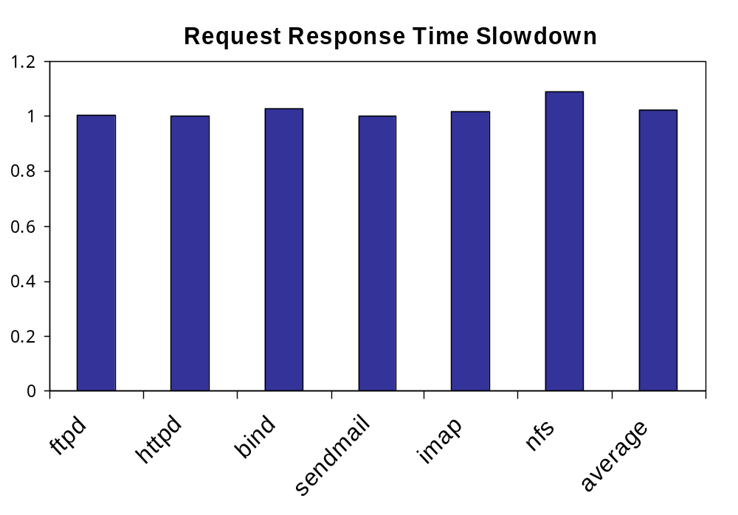
Monitoring Overhead
Notes:
To illustrate the effectiveness of our lightweight concurrent monitoring scheme, we show the performance overhead of just monitoring the server core. This does not include overheads for backup and recovery.
We see that the monitoring overhead is very very low. It is of the order of 1-2%

Slide 23
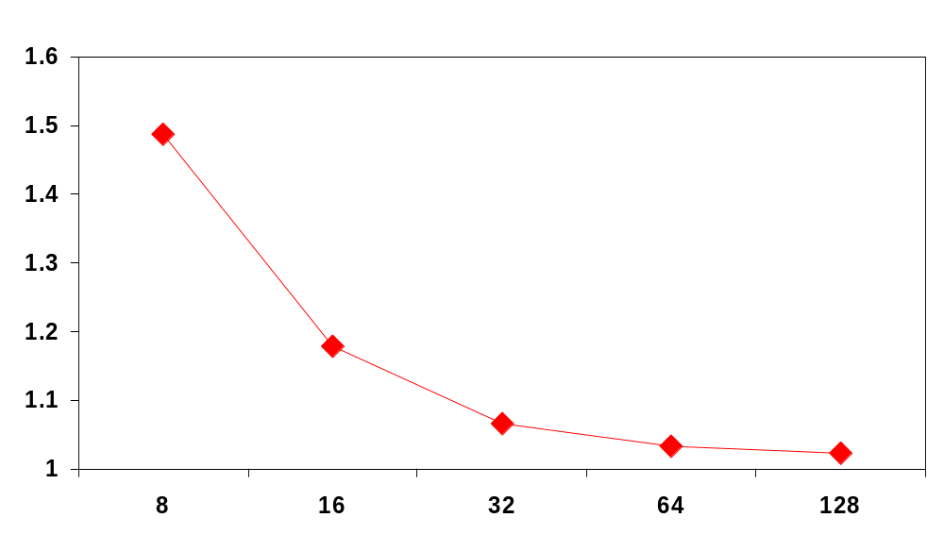
Sensitivity of Monitoring Queue Size
Queue Size vs. Performance
Slowdown
Queue Size
Notes:
The FIFO queue between the server and the monitor has a big impact on performance. This is because if the monitor cannot handle traces on time allowing the FIFO to become full, then the server is stalled till there is space in the FIFO. So the number of entries in the queue is a big design point. We see from the figure that a 32 entry FIFO is sufficient for the applications we tested.

Slide 24
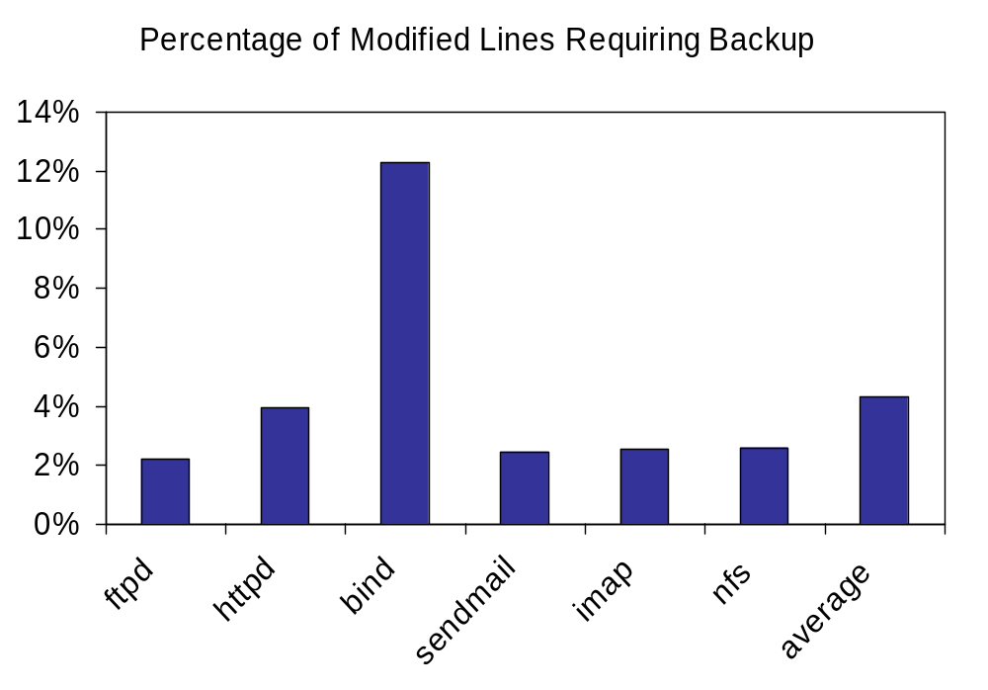
Backup Overhead of Modified Lines
Notes:
This figure shows that the dynamic number of cache lines requiring backup over all modified cache lines. We see that it is a very small percentage lower than ).04% on the average. This shows that our delta backup scheme based on network requests have very low overhead.

Slide 25
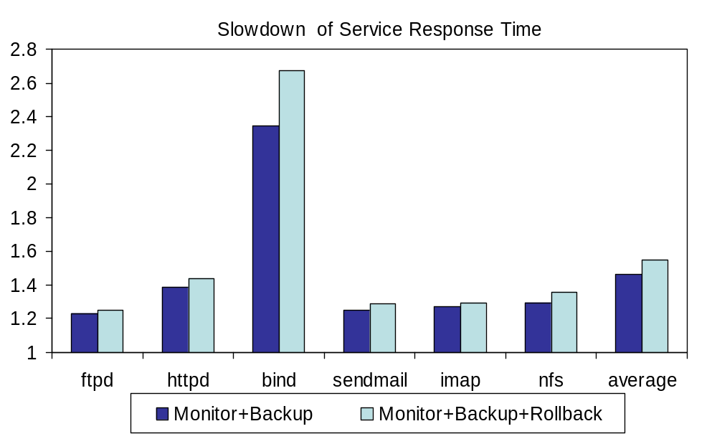
Performance of Recovery + Monitoring
Notes:
The left bar shows the relative slowdown for monitoring the server and backup. The right bar shows the slow down if every other network request causes a rollback. We see that except for Bind that has a 2.7x slowdown, all other applications perform within 40% of top performance even at this worst case situation.
Bind had a lot fewer instructions (150000) between network requests. Also the percentage of dirty lines needing backup was more for Bind.

Slide 26
Conclusions
Real time exploit monitoring with autonomic recovery increases revivability and availability.
Multicore architectures are an ideal candidate for new type of revivable system.
INDRA-based Multicore system can provide improved reliability and availability.
More research is required to explore the trade-off between availability, performance, architecture design, and cost.

Slide 27



Questions and Answers
Thank you !
http://arch.ece.gatech.edu

