Slide 1

Security Refresh
Prevent Malicious Wear-out and
Increase Durability for Phase-Change Memory with Dynamically Randomized Address Mapping
Nak Hee Seong
Dong Hyuk Woo
Hsien-Hsin S. Lee
Georgia Tech ECE

Slide 2
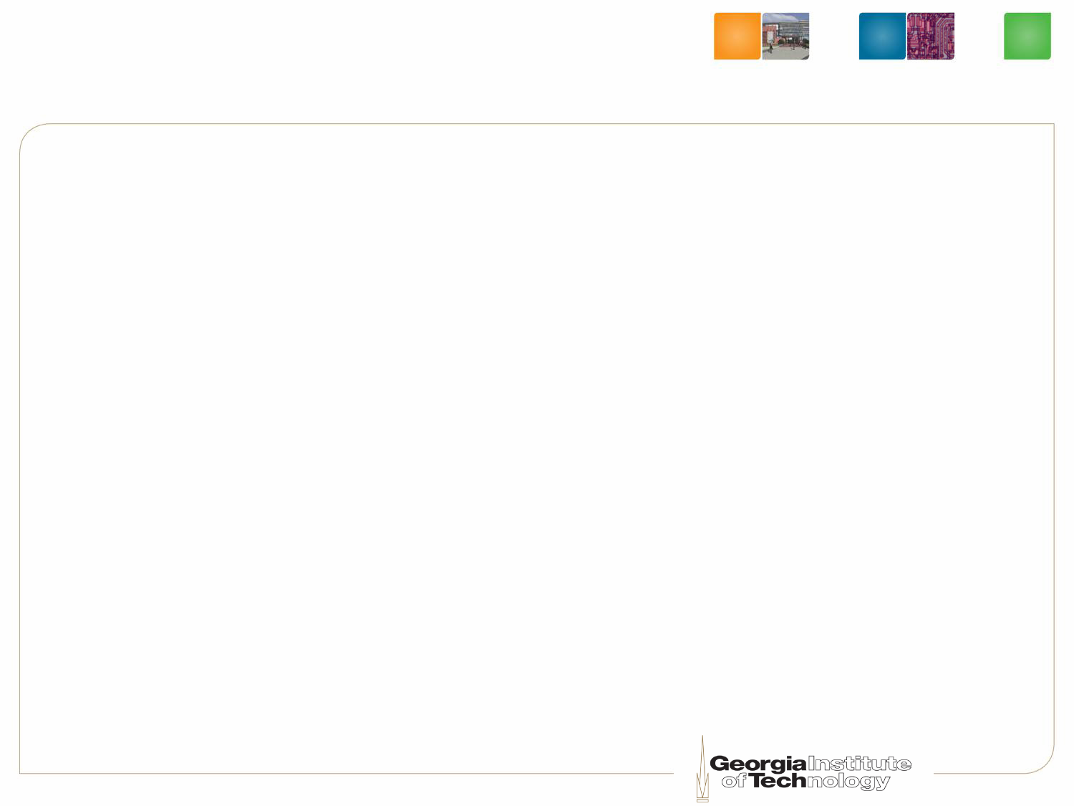


PCM as a Main Memory
Non-volatility
High density
CMOS compatible process
Better scalibility
High read / write latency
Limited write endurance (10⁸ writes)

Slide 3




Write Endurance Schemes
Reducing bit flips
Evenly wearing out
Compare-N-Write
[Yang, ISCS-07][Zhou, ISCA-36]
Row shifting &
Segment swapping
[Zhou, ISCA-36]
Flip-N-Write
[Cho, MICRO-42]
Randomized Region-Based Start-Gap
[Qureshi, MICRO-42]

Slide 4
What if we have
a malicious process?

Slide 5
Write Endurance Schemes
Reducing bit flips
Evenly wearing out
Compare-N-Write
Compare-N-Write
[Yang, ISCS-07][Zhou, ISCA-36]
Row shifting &
Segment swapping
[Zhou, ISCA-36]
DANGER
DETERMISTIC PATTERN
Flip-N-Write
[Cho, MICRO-42]
Randomized Region-Based Start-Gap
[Qureshi, MICRO-42]
DANGER
DETERMISTIC PATTERN

Slide 6
Write Endurance Schemes
Evenly wearing out
Row shifting &
Segment swapping
[Zhou, ISCA-36]
Randomized Region-Based Start-Gap
[Qureshi, MICRO-42]
Randomized Region-based Start-Gap

Slide 7
Write Endurance Schemes
Evenly wearing out
Address translation table
Row shifting &
Segment swapping
[Zhou, ISCA-36]
DANGER
HIGH HW OVERHEAD
Randomized Region-Based Start-Gap
[Qureshi, MICRO-42]
Randomized Region-based Start-Gap

Slide 8


Write Endurance Schemes
Evenly wearing out
Static randomizer
Row shifting &
Segment swapping
[Zhou, ISCA-36]
DANGER
HIGH HW OVERHEAD
Randomized Region-Based Start-Gap
[Qureshi, MICRO-42]
Randomized Region-based Start-Gap
DANGER
STATIC RANDOMIZATION
Linear mapping
G

Slide 9
Write Endurance Schemes
Evenly wearing out
Row shifting &
Segment swapping
Low-Cost
DANGER
HIGH HW OVERHEAD
Randomized Region-Based Start-Gap
Randomized Region-based Start-Gap
Dynamic Randomization
DANGER
STATIC RANDOMIZATION

Slide 10
Security Refresh

Slide 11
Security Refresh
Write Request
Using XOR to Remap
time
Refresh
Interval = 4
A(00) XOR KEY(01) = “01”
B(01) XOR KEY(01) = “00”
C(10) XOR KEY(01) = “11”
D(11) XOR KEY(01) = “10”
Refresh
MA = 00
Refresh
MA = 01
Refresh
MA = 10
Refresh
MA = 10
Ignore!!
Refresh
MA = 11
Ignore!!
Memory Address
Remapped
Memory Address
PCM
00
B(01)
(Previous)
KEY0
= 01
C(10)
01
A(00)
D(11)
10
D(11)
(Current)
KEY1
= 10
A(00)
11
C(10)
B(01)
Remap Function: MA XOR KEY
Memory Address
Remapped Memory Address

Slide 12
Security Refresh
Write Request
time
Refresh
Interval = 4
Refresh
MA = 00
Refresh
MA = 01
Refresh
MA = 10
Refresh
MA = 10
Ignore!!
Refresh
MA = 11
Ignore!!
Refresh
MA = 00
Refresh Round
PCM
(Previous)
KEY0
= 01
00
C(10)
01
D(11)
10
A(00)
(Current)
KEY1
= 10
B(01)
= 00
= 10
= 01
= 11
= 10
= 01
= 11
= 00
= 11
11
B(01)
A(00)
Remap Function: MA XOR KEY
Memory Address
Remapped Memory Address

Slide 13
Security Refresh
Write Request
time
Dynamic Remapping
Refresh
Interval = 4
Refresh
MA = 00
Refresh
MA = 01
Refresh
MA = 10
Refresh
MA = 10
Ignore!!
Refresh
MA = 11
Ignore!!
Refresh
MA = 00
Remapped by
Key = 01
Remapped by
Key = 10
Remapped by
Key = 11
Refresh Round
00
B(01)
00
B(01)
C(10)
00
C(10)
D(11)
PCM
01
A(00)
01
A(00)
D(11)
01
D(11)
C(10)
00
C(10)
10
D(11)
10
D(11)
D(11)
A(00)
10
A(00)
(Previous)
KEY0
= 01
B(01)
01
D(11)
11
C(10)
11
C(10)
C(10)
B(01)
11
B(01)
A(00)
10
A(00)
(Current)
KEY1
= 11
B(01)
11
B(01)
A(00)
Security Refresh Round (i)
Security Refresh Round (i+1)
Remap Function: MA XOR KEY
Memory Address
Remapped Memory Address

Slide 14
Evaluation Methodology
Monte Carlo Simulations
4GB PCM, 4 Banks
Attack Model
  Attack a random address for each refresh round
  Attack Latency = 600 ns

Slide 15
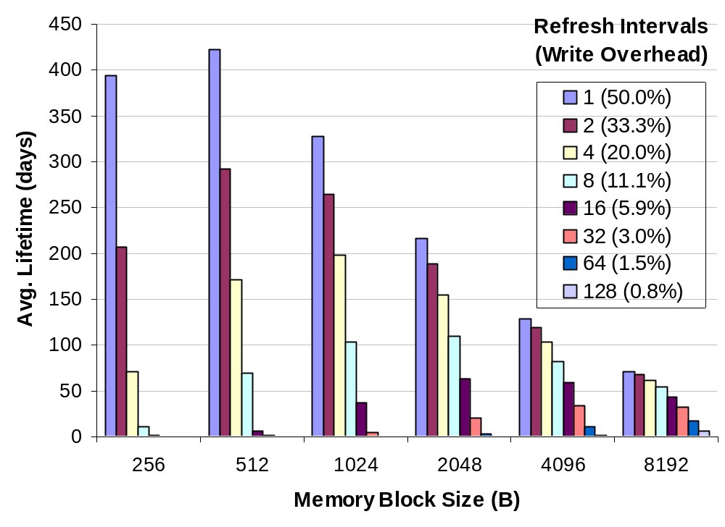
Average Lifetime Evaluation
14 months
To Increase lifetime,
- Smaller Block Size
- Shorter Refresh Round
= Region Size X Refresh Interval

Slide 16
Needs Shorter Round (Frequent Key Updates)
Smaller
region
Higher vulnerability
Higher write & performance overhead
Shorter
interval

Slide 17
Needs Shorter Round (Frequent Key Updates)
Smaller
region
Higher vulnerability
Virtually
enlarge a region
with multi-level Security Refresh
Higher write & performance overhead
Shorter
interval

Slide 18
Multi-Level
Security Refresh

Slide 19



One-Level Security Refresh

Slide 20
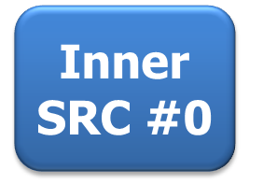








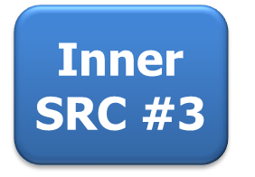

Two-Level Security Refresh

Slide 21
Two-Level Security Refresh Evaluation
Monte Carlo Simulations
4GB PCM, 4 Banks
Attack Model
  Attack a random address for an Inner Refresh Round
  Attack Latency = 600 ns
Simulation
  Memory Block Size: 256B
  Outer Region: 1GB, 128 writes for Refresh Interval

Slide 22
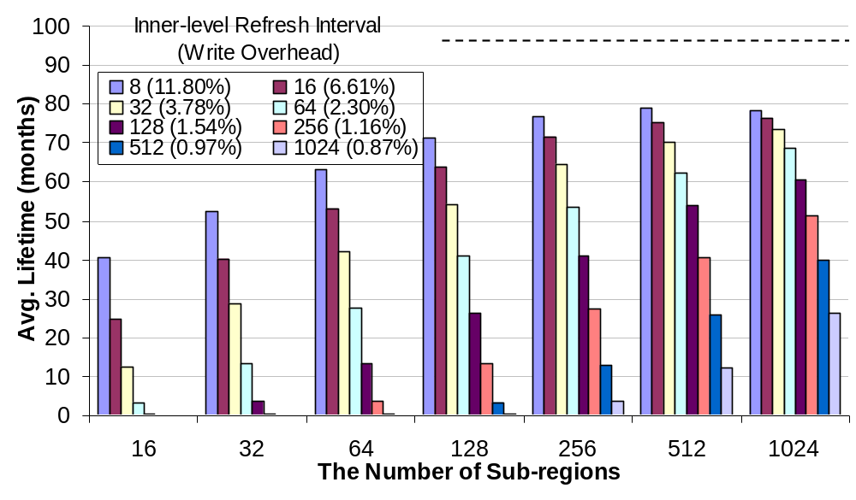
Two-Level Security Refresh Evaluation
78.8 months
1.54%

Slide 23
Summary
Security Refresh
  Both security and durability
  Low-cost, dynamic randomization
  Two-level Security Refresh
    78.8 months (11.80% write overhead)
    60.0 months (1.54% write overhead)

Slide 24



Thank You All!!
Questions?

Slide 25
Backup Slides

Slide 26
Write Endurance Schemes
Reducing bit flips
Evenly wearing out
Compare-N-Write
Compare-N-Write
Row shifting &
Segment swapping
DANGER
Compare-N-Write
DANGER
DETERMISTIC PATTERN
HIGH HW OVERHEAD
Flip-N-Write
Compare-N-Write
Randomized Region-based Start-Gap
Compare-N-Write
DANGER
Randomized Region-based Start-Gap
DANGER
DETERMISTIC PATTERN
STATIC RANDOMIZATION

Slide 27
Lifetime of Prior Works
Drawbacks
Time to fail
Redundant
Write
Reduction
Data-Comparison
& Write [Yang, ISCS2007]
Deterministic
Patterns
~2 minutes
Flip-N-Write
[Cho, MICRO2009]
Wear-leveling
Row-Shifting &
Segment-Swapping
[Zhou, ISCA2009]
High
Hardware
Cost
~34 hours
Randomized
Region-based
Start-Gap
[Qureshi, MICRO2009]
Static
Randomization
~18 minutes
or
Avg. 23 hours

Slide 28
Vulnerability of Prior Works
Data-Comparison and Write
  Repeatedly write complementary values
  2 minutes
Flip-N-Write
  Repeatedly write 0x00 and 0x01 in turn
  2 minutes
Row Shifting and Segment Swapping
  Regular shifting pattern and high hardware overhead
  2048 minutes for 16GB 16-bank PRAM memory
Randomized Region Based Start-Gap
  Static Randomized Address Mapping
  34 minutes by carefully designed side-channel attacks

Slide 29
Prior Art: Dealing with Write Endurance
Eliminating unnecessary or redundant writes
  Partial dirty writes only [Lee, ISCA-36] [Qureshi, ISCA-36]
L1 or L2
cache line
1
1
0
0
0
1
0
0
PCM Main Memory

Slide 30
Prior Art: Dealing with Write Endurance
Eliminating unnecessary or redundant writes
  Partial dirty writes only [Lee, ISCA-36] [Qureshi, ISCA-36]
  Compare & write (silent stores) [Yang, ISCS-07][Zhou, ISCA-36]
FF00
DEAD
BEEF
1234
5678
BCF0
0000
FFFF
=?
=?
=?
=?
=?
=?
=?
=?
Read
PCM Main Memory
0012
FF00
DEAD
BEEF
1234
5678
CDA0
BCF0
0000
1111
FFFF

Slide 31
Prior Art: Dealing with Write Endurance
Eliminating unnecessary or redundant writes
  Partial dirty writes only [Lee, ISCA-36] [Qureshi, ISCA-36]
  Compare & write (silent stores) [Yang, ISCS-07][Zhou, ISCA-36]
  Flip-N-write (similar to bus-inverted coding) [Cho, MICRO-42]
1110
1011
0000
0000
0000
1000
1111
0100
Idea: Reduce Hamming distance to reduce flipping
⊕
1111
1111
1110
1111
1100
1001
1111
1110
Hamming distance = 26 (out of 32) in this example
PCM Main Memory
0001
0100
1110
1111
1100
0001
0000
1010
Read

Slide 32
Prior Art: Dealing with Write Endurance
Eliminating unnecessary or redundant writes
  Partial dirty writes only [Lee, ISCA-36] [Qureshi, ISCA-36]
  Compare & write (silent stores) [Yang, ISCS-07][Zhou, ISCA-36]
  Flip-N-write (similar to bus-inverted coding) [Cho, MICRO-42]
0001
1110
0100
1011
1111
0000
1111
0000
1111
0000
0111
1000
0000
1111
1011
0100
1
Flip Bit
⊕
0000
0000
0001
0000
0011
0110
0000
0001
Hamming distance = 6 (out of 32) in this example
Store inverted data with flip bit
PCM Main Memory
0001
0100
1110
1111
1100
0001
0000
1010
0001
0001
0100
0100
1111
1111
1111
1111
1111
1111
0111
0111
0000
0000
1011
1011
1

Slide 33

Prior Art: Dealing with Write Endurance
Wear Leveling (evenly distribute writes)
  Row shifting and Segment swapping [Zhou, ISCA-36]
PCM Memory Row
counter
Shift amount
PCM Memory
Shift one byte for every 256 writes

Slide 34
Prior Art: Dealing with Write Endurance
Wear Leveling (evenly distribute writes)
  Row shifting and Segment swapping [Zhou, ISCA-36]
Memory controller
counter
PCM Memory
1MB (hot) Segment X
4k-entry map table for 4GB PCM
1MB (cold) Segment X
counter

Slide 35
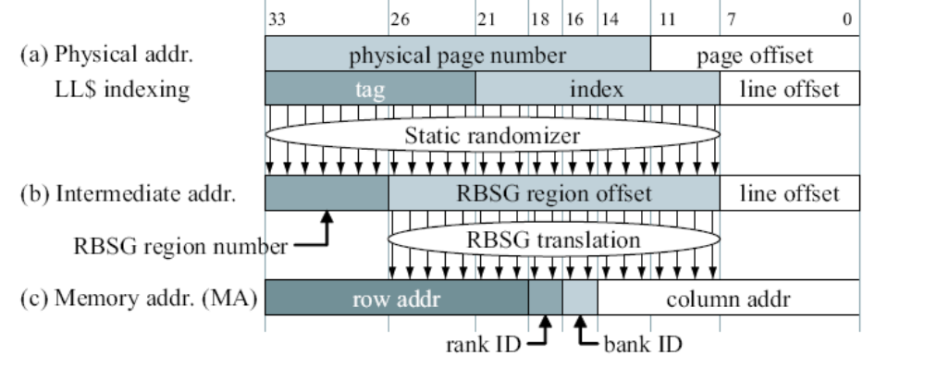
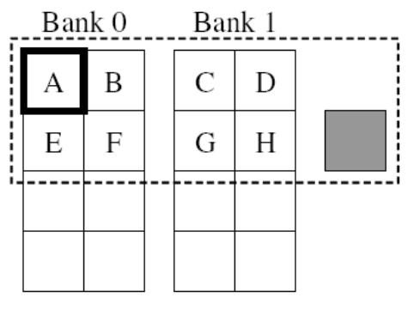
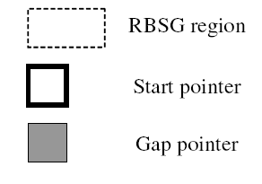
Prior Art: Dealing with Write Endurance
Wear Leveling (evenly distribute writes)
  Row shifting and Segment swapping [Zhou, ISCA-36]
  Region-based start-gap (RBSG) [Qureshi, MICRO-42]
0
A
⬅START
1
B
2
C
3
D
GAP ➔
4
PCMAddr = (Start+Addr);
(PCMAddr >= Gap) PCMAddr++)
Region counter
Animation courtesy: Moin Qureshi of IBM Corp.

Slide 36
Randomized Region Based Start-Gap
MA
PA
IA
0 0 00
C
Region #0
000
A
000
C
001
B
Address Space
Randomization
001
E
Start-Gap
Translation
0 0 01
E
0 0 10
H
1 0 11
Gap
010
C
010
H
011
D
011
B
0 0 11
B
100
E
100
D
101
F
101
A
0 1 00
D
Region #1
110
G
110
G
0 1 01
A
111
H
111
F
0 1 10
G
1 1 11
Gap
0 1 11
F

Slide 37
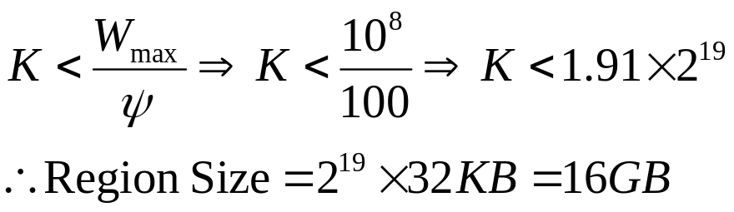
Start-Gap Configuration
System Configuration
  16GB memory, 16 banks, 32KB physical page
  150 ns and 450 ns for PCRAM read and write latency
  MC using open page policy
Start-Gap Configuration
  DWF = 16
  ψ = 100
  W_{max} = 10⁸
  Line = Physical Page
Physical
Line Address
Bank0
Bank1
Bank2
Bank15
16(n-1)+0
16(n-1)+1
16(n-1)+2
16(n-1)+15
16n+0
16n+1
16n+2
16n+15
GAP
16(n+1)+0
16(n+1)+1
16(n+1)+2
16(n+1)+15

Slide 38
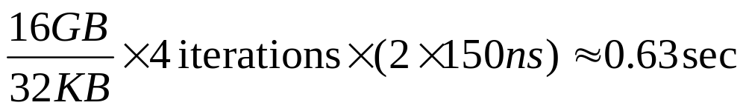
Side-Channel Attack: Step 1
Finding a set (α) of logical addresses mapped to the physically same bank
  using latency differences between bank conflict latency and bank parallel access latency
Logical
Line Address
1st Bank Set α
Bank Conflicts
Bank0
Bank1
Bank2
Bank15
Bank Parallel
Accesses
A
B
C
F
G
H
I
L
GAP
M
N
O
R

Slide 39
Side-Channel Attack: Step 2
Shifting 16 lines
Logical
Line Address
Bank0
Bank1
Bank2
Bank15
A
B
C
GAP
F
G
H
K
L
M
N
O
R

Slide 40
Side-Channel Attack: Step 3
Finding a new set (β) of physical addresses mapped to the same bank with the first set (α).
Finally, we found that H and G are physically continuous line addresses by comparing α with β.
Logical
Line Address
2nd Bank Set β
Bank0
Bank1
Bank2
Bank15
A
B
C
GAP
F
G
H
K
L
M
N
O
R

Slide 41
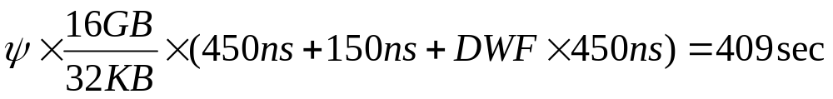
Side-Channel Attack: Step 4
Attacking the logical line address, H, for one Gap Rotation.
Attacking the logical line address, G, for one Gap Rotation.
Fail in 14 minutes
Bank0
Bank1
Bank2
Bank15
A
B
GAP
E
F
G
J
K
L
M
N
O

Slide 42
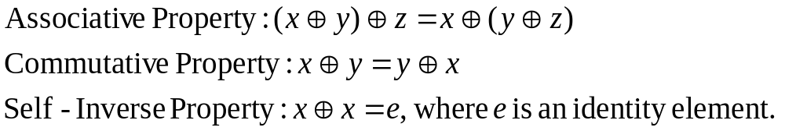
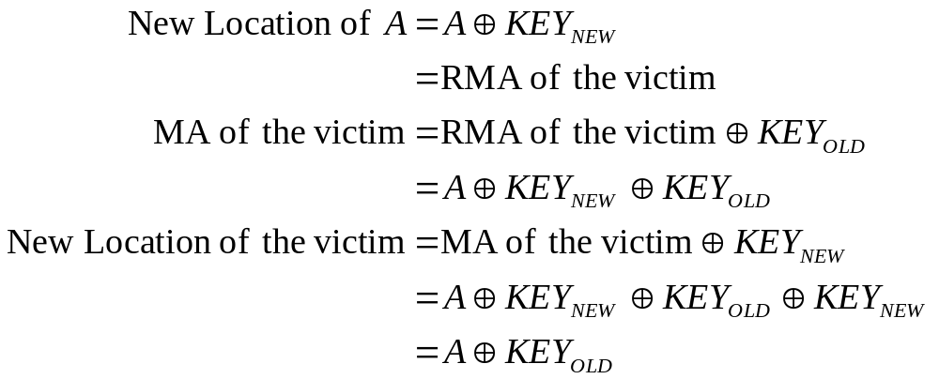
Proof of Security Refresh
Magic of XOR!!
A swapped victim is also remapped by a new key.
  Assume CRP = A.

Slide 43
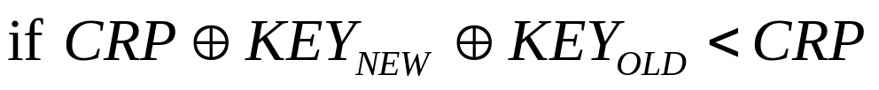
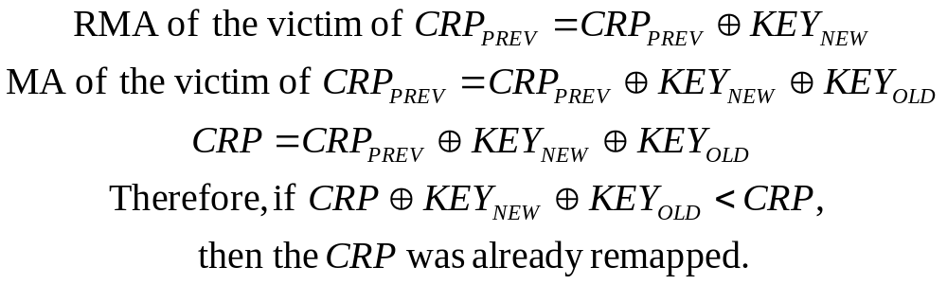
How to know already remapped or not
In other words, whether was an MA pointed by CRP the victim of a previous CRP?
  If it is true,
  Check

Slide 44

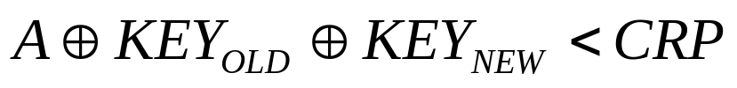
How to select a Key for Address Translation
Assume A is the MA of a coming request.
Two cases for using KEY1(KEY_{NEW}).
  If ,
  or if
Otherwise, use KEY0(KEY_{OLD}).

Slide 45
Security Refresh Flowchart
Start:
A Request from Upper Level
Upper level : Memory Controller
Lower level : PCRAM Bank Array
Is the MA
already
remapped?
GWC++
N
Y
Additional 4 requests
can be generated
for remapping.
GWC
Overflow?
N
RA=MA XOR KEY0
Y
RA=MA XOR KEY1
Is the CRP
already
remapped?
Y
Send a Request with RA
to Lower Level
CRP
Overflow?
N
N
Write
Operation?
Y
Send 4 Requests
to Lower Level
Read from (CRP XOR KEY0)
Read from (CRP XOR KEY1)
Write to (CRP XOR KEY1)
Write to (CRP XOR KEY0)
Y
N
KEY0 = KEY1
KEY1 = new key from RKG
End

Slide 46
Smaller Block Size
Total Writes =
0
4
8
12
16
20
24
28
32
36
40
44
48
52
56
60
Write Endurance
Lifetime
0
1
2
3
4
5
6
7
Block Address
Total Writes =
0
4
8
12
16
20
24
28
32
36
40
44
48
52
56
60
64
68
72
76
80
84
88
92
96
100
104
Write Endurance
Lifetime
0
1
2
3
4
5
6
7
8
9
10
11
12
13
14
15
Block Address

Slide 47
Shorter Refresh Round
Total Writes =
12
16
20
24
28
32
36
40
44
0
4
8
Write Endurance
Lifetime
0
1
2
3
4
5
6
7
Block Address
2
4
6
8
10
12
14
16
18
20
Total Writes =
22
0
24
26
28
30
32
34
36
38
40
42
44
46
48
50
52
54
56
58
60
62
64
66
68
70
Write Endurance
Lifetime
0
1
2
3
4
5
6
7
Block Address

Slide 48
Two-Level Security Refresh Rationale
Inner sub-region level
  Smaller regions
  More frequent refresh rounds with different random keys
Outer bank level
  Effectively enlarge the address remapping space
Inner and outer levels can employ their own
  Memory block sizes
  Refresh intervals

Slide 49
Two Level Security Refresh
RANK3
RANK2
RANK1
Two-level
Security
Refresh
RANK0
Chip0
Chip1
Chip7
Bank0
Bank0
Bank0
Bank0
Bank0
Bank0
Bank0
Bank0
Bank0
Request
from MC
Data
Data
Data
Protect PCRAM from side-channel attacks
by implementing Security Refresh inside a bank.

Slide 50
Two-Level Security Refresh
MC
Level
Write
Data
Read
Data
Request
Bank
Level
(SR Level 1)
PCM Bank
Upper
Level
Bank
SRC
Swap
Buffers
Sub-region
Level
(SR Level 2)
Sub-region
SRC 0
Sub-region
SRC 1
Sub-region
SRC (n-1)
Shared
Swap
Buffers
Lower
Level
Address
Decoder
Physical Array
Level
PCM Bank Array
Sub-region
0
Sub-region
1
Sub-region
(n-1)

Slide 51
Two-Level Security Refresh
Inner
SRC #0
Sub-region #0
Inner
SRC #1
Sub-region #1
Outer
SRC
PCM Region
Inner
SRC #2
Sub-region #2
Inner
SRC #3
Sub-region #3

Slide 52
Two-Level Security Refresh Example
Initial state
Refresh Interval
Bank-region: 1
Sub-region: 1
<Terminology>
MC : memory controller
BSRC : bank-level SRC
SSRC0, SSRC1 : Sub-region SRC
MA : memory address from MC
BRA : bank-level remapped address
SRA : sub-region remapped address
Bank-region
GWC = 0
KEY0 = 001
CRP = 000
KEY1 = 110
buf0
buf1
Sub-region 0
Sub-region 1
GWC = 0
KEY0 = 00
GWC = 0
KEY0 = 00
CRP = 00
KEY1 = 10
CRP = 00
KEY1 = 01
buf0
buf1
0 00
B
1 00
F
RA
0 01
A
1 01
E
0 10
D
1 10
H
Data
0 11
C
1 11
G

Slide 53
Two-Level Security Refresh Example
MC
Level
Refresh Interval
Bank-region: 1
Sub-region: 1
Rd 000
Wr 000, I
BSRC
Wr 001, I
Bank-region
Bank
Level
(SR Level 1)
Wr 110, buf0
GWC = 0
Wr 001, buf1
Overflow
KEY0 = 001
Rd 110
CRP = 000
CRP = 001
KEY1 = 110
Rd 001
buf0
buf1
SSRC0
SSRC1
Sub-region 0
Sub-region 1
Sub-region
Level
(SR Level 2)
Wr 001, I
GWC = 0
Wr 010, buf0
Overflow
KEY0 = 00
GWC = 0
KEY0 = 00
Wr 000, buf1
CRP = 00
CRP = 01
KEY1 = 10
CRP = 00
KEY1 = 01
Rd 010
Rd 000
buf0
B
buf1
D
0 00
B
D
1 00
F
0 01
A
I
1 01
E
0 10
D
B
1 10
H
0 11
C
1 11
G

Slide 54
Two-Level Security Refresh Example
MC
Level
Refresh Interval
Bank-region: 1
Sub-region: 1
Rd 000
BSRC
Bank-region
Bank
Level
(SR Level 1)
Wr 110, buf0
GWC = 0
KEY0 = 001
Wr 001, buf1
CRP = 001
KEY1 = 110
Rd 110
Rd 001
buf0
I
buf1
H
SSRC0
SSRC1
Sub-region 0
Sub-region 1
Wr 001, H
Rd 110
Sub-region
Level
(SR Level 2)
Rd 001
Wr 110, I
GWC = 0
Overflow
KEY0 = 00
GWC = 0
Wr 011, buf0
Overflow
KEY0 = 00
Wr 101, buf0
Wr 001, buf1
Wr 100, buf1
CRP = 01
CRP = 10
KEY1 = 10
CRP = 00
CRP = 01
KEY1 = 01
Rd 011
Rd 101
Rd 001
Rd 100
buf0
H
F
buf1
C
E
0 00
D
1 00
F
E
0 01
I
H
C
1 01
E
F
0 10
B
1 10
H
I
0 11
C
H
1 11
G

Slide 55
Two-Level Security Refresh Example
MC
Level
Refresh Interval
Bank-region: 1
Sub-region: 1
Rd 000
BSRC
Rd 110
Bank-region
Bank
Level
(SR Level 1)
GWC = 0
KEY0 = 001
CRP = 001
KEY1 = 110
buf0
buf1
SSRC0
SSRC1
Sub-region 0
Sub-region 1
Sub-region
Level
(SR Level 2)
Rd 110
GWC = 0
KEY0 = 00
GWC = 0
KEY0 = 00
CRP = 10
KEY1 = 10
CRP = 01
KEY1 = 01
buf0
buf1
0 00
D
1 00
E
0 01
C
1 01
F
0 10
B
1 10
I
I
0 11
H
1 11
G

Slide 56
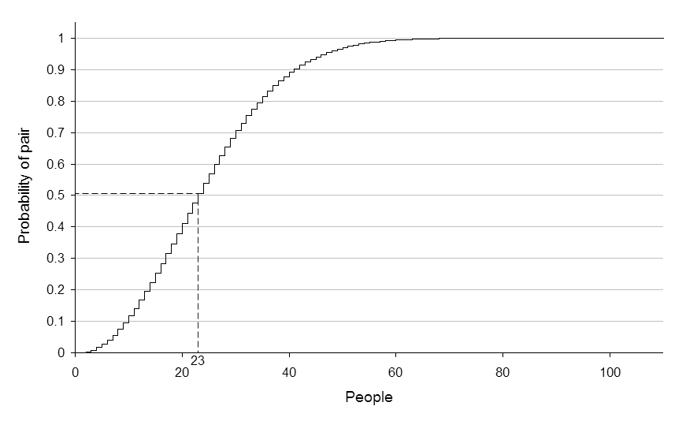
Evaluation Method
Birthday Paradox Attack
  Can fail RBSG in 1~2 months
  Our side channel attack failed RBSG much faster

Slide 57


Evaluation Method
Equivalent to “throwing random balls to buckets” (collision attack)
To fail a PCM cell takes 10⁸ collisions

Slide 58
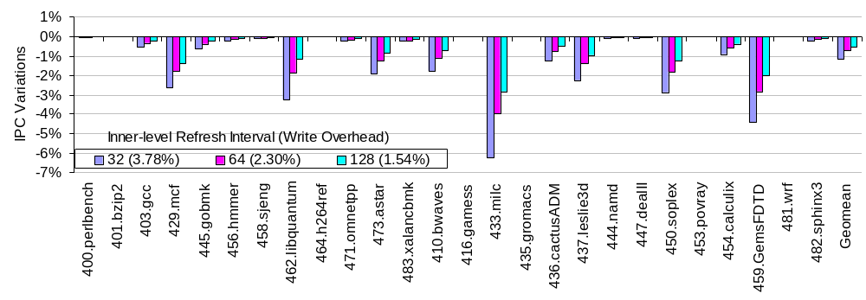
Performance Evaluation
Geometric means of IPC variations
  -1.2%, -0.7% and -0.5% for the 3 inner refresh intervals

