Slide 1
Energy Efficient D-TLB and Data Cache Using Semantic-Aware Multilateral Partitioning
Hsien-Hsin “Sean” Lee Chinnakrishnan Ballapuram
School of Electrical and Computer Engineering
Georgia Institute of Technology
Atlanta, GA 30332
ISLPED 2003

Slide 2
Background Picture
Address Translation and Caches
  Major processor power contributors
  I-TLB and d-TLB lookup for every instruction and memory reference
  TLBs are Fully Associative
Superscalar processor needs multi-ported design increasing power consumption
  multi-wide machines may need multiple memory references in the same cycle

Slide 3
Virtual Memory Space Partitioning
max mem
Based on programming language
Non-overlapped subdivisions
Split Code and Data ⇒ I-Cache and D-Cache
Split Data into Regions
  Stack (↓)
  Heap (↑)
  Global (static)
  Read-only (static)
reserved
STACK grows downward
Protected
HEAP grows upward
Static GLOBAL Data Region
Read-only region
Code Region
reserved
min mem
ARM Architecture
The unique access behavior to these regions by a program creates an opportunity to reduce power

Slide 4
Outline of the Talk
Motivation
  unique access behavior and locality are analyzed for energy reduction
Semantic-Aware Multilateral Partitioning (SAM)
  Semantic-Aware d-TLB (SAT)
  Semantic-Aware d-Cachelets (SAC)
  Selective Multi-Porting SAM Architecture
Performance/Energy/Area Evaluation
Conclusions

Slide 5

Footprint of Stack Page Accesses
Only two stack pages are required by all stack accesses
➔ stack band is small
In general, x-axis shows the working set size, y-axis shows the required TLB entries

Slide 6
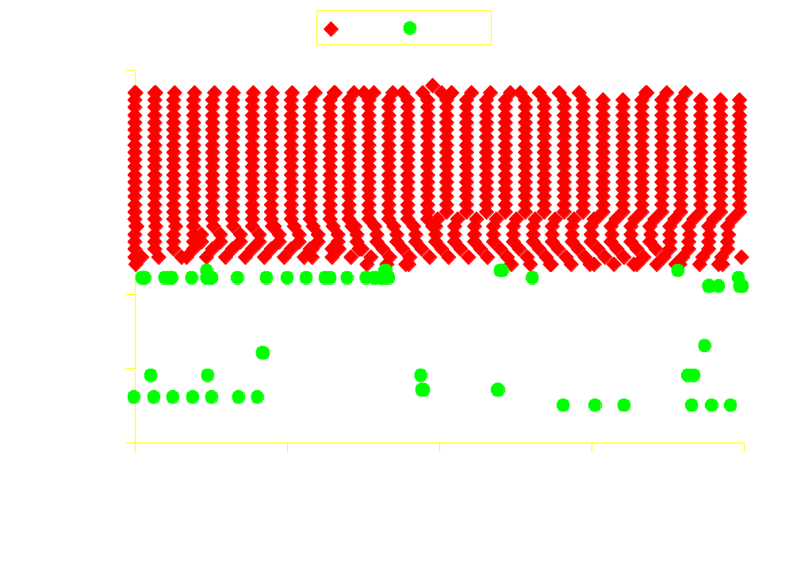
Footprint of Global and Heap Page Accesses
number of heap pages (y-axis) and heap working set (x-axis) required is greater than stack and global ➔ heap band >> global band > stack band

Slide 7
Compulsory data-TLB misses
100000
stack
global
heap
MiBench
Spec2000
10000
1000
Number of compulsory TLB Misses
100
10
1
cjpeg
djpeg
fft
bzip2
gcc
mcf
parser
blowfish
bitcount
dijkstra
rijndael
patricia
H-Mean
highly active heap accesses evict the useful stack and global entries due to conflict misses

Slide 8
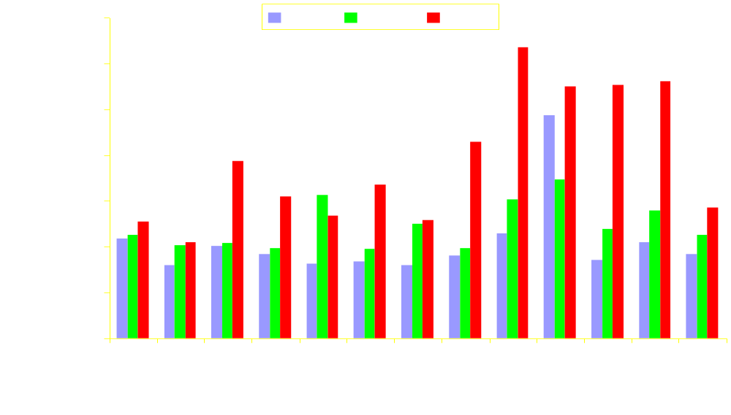
Compulsory data-Cache misses
Number of compulsory Cache Misses
smaller stack and global working set than heap ➔ smaller stack and global cache size is enough to capture most of the memory accesses to these semantic regions

Slide 9
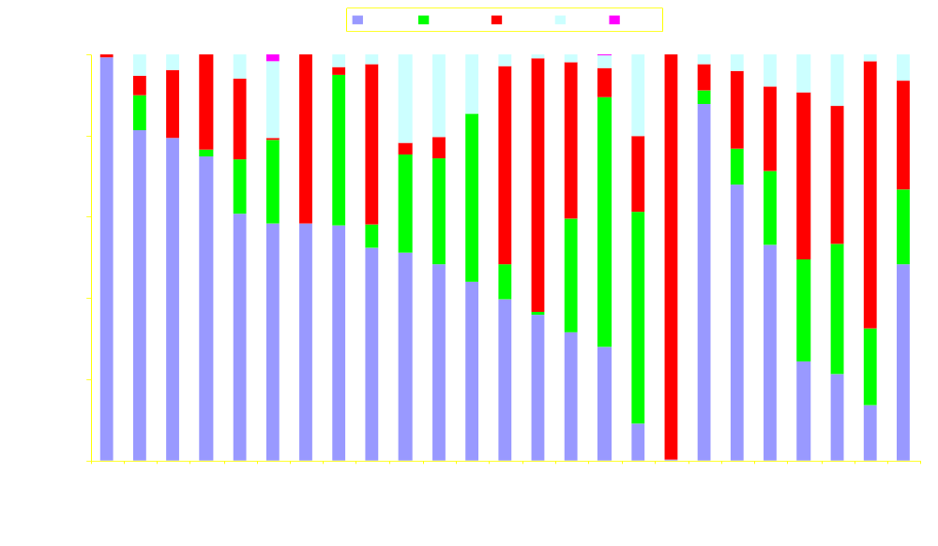
Dynamic Data Memory Distribution
~40 % of the dynamic memory accesses go to the stack which is concentrated on only few pages
4 memory accesses ~= 2 stack, 1 global and 1 heap

Slide 10
Semantic-Aware Memory Architecture
ld_data_base_reg
Data Address Router
Virtual address
ld_env_base_reg
ld_data_bound_reg
sTLB
gTLB
sTLB
0
0
1
1
Most of the memory
references go to
2
3
smaller stack and global TLB
uTLB
smaller stack and global cache
0
1
➔ Reduced power consumption
63
To Processor
To Processor
hCache
gCache
sCache
sCache
Unified L2 Cache

Slide 11
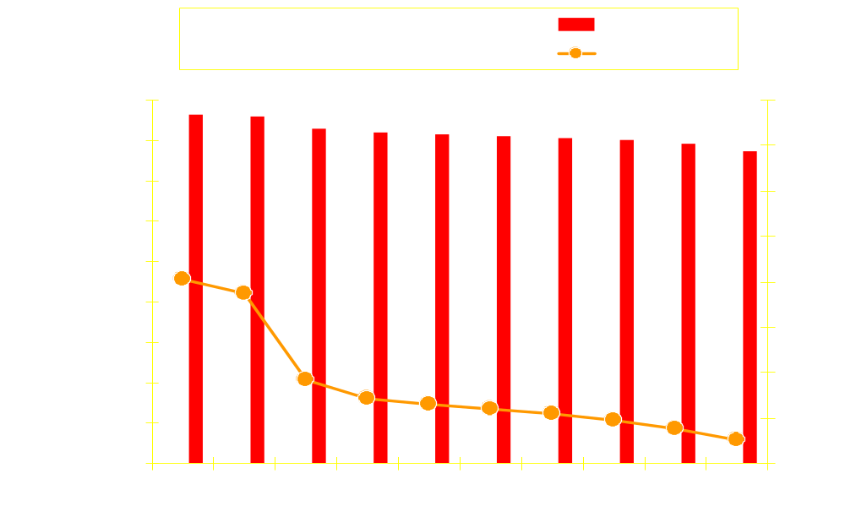
Semantic-Aware TLB Misses
TLB Miss Rate
Number of TLB Misses
Number of TLB Entries
The number of hTLB misses does not come down even at 512 TLB entries

Slide 12
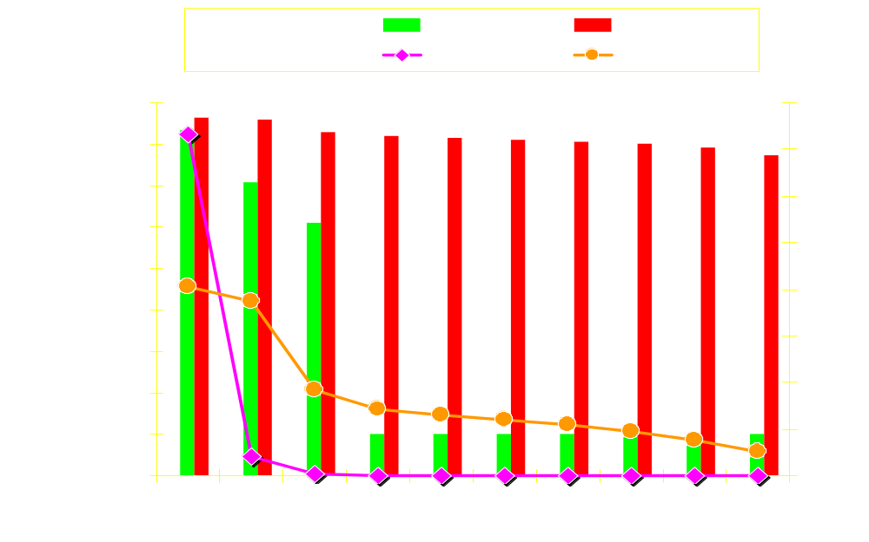
Semantic-Aware TLB Misses
TLB Miss Rate
Number of TLB Misses
Number of TLB Entries
The number of gTLB misses saturate at 8 TLB entries

Slide 13
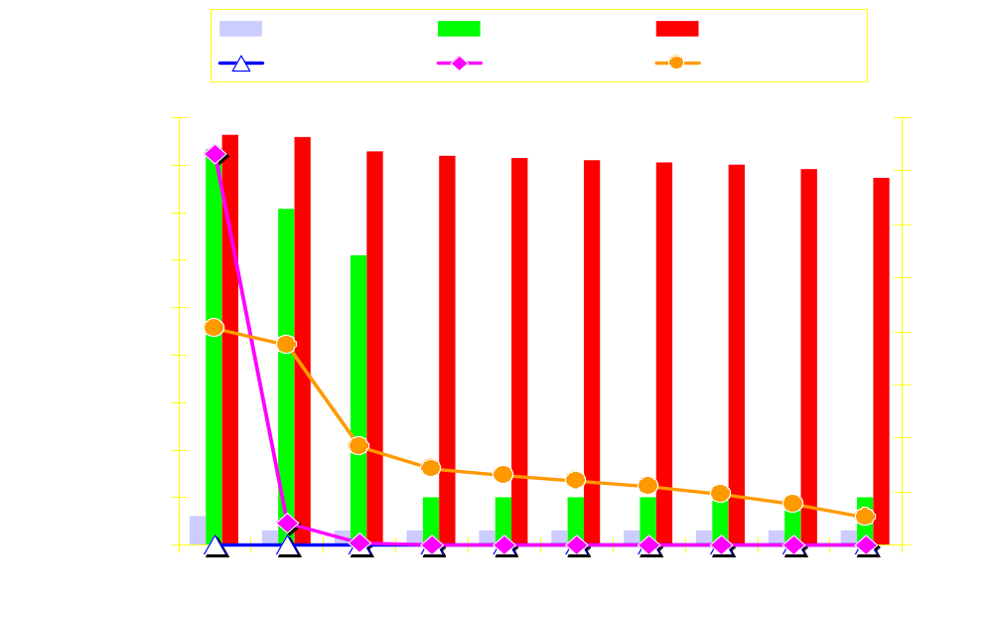
Semantic-Aware TLB Misses
TLB Miss Rate
Number of TLB Misses
Number of TLB Entries
The number of sTLB misses saturate faster than global and heap

Slide 14
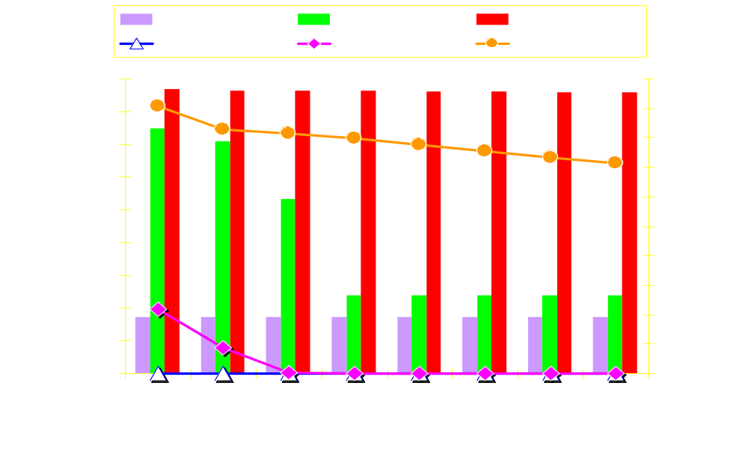
Semantic-Aware Cache Misses
Cache Miss Rate
Number of Cache Misses
Cache Size in KB
Stack demonstrate very stable working set size than the other two. Global saturates at a reasonable rate.

Slide 15
Simulation Infrastructure
Target Architecture: ARM
Performance: Simplescalar
Power: Integrated Wattch Power Model
Access Time/Area: CACTI 3.0
Execution Engine | Out-of-Order
Fetch / Decode / Issue / Commit | 4 / 4 / 4 / 4
L1 / L2 / Memory Latency | 1 / 6 / 150
TLB hit / miss latency | 1 / 30
L1 Cache baseline | DM 32KB
L1 stack / global / heap Cachelet | 8KB / 8KB / 16 KB
L2 Cache | 4w 512KB
Cache line size | 32B

Slide 16
Design Effectiveness of SAM
Performance Ratio
d-TLB Energy w/ SAT
L1 d-Cache Energy w/ SAC
~4% Perf.
Loss
1.00
0.90
0.80
0.70
0.60
0.50
~35% Energy
Savings
0.40
0.30
0.20
0.10
0.00
cpeg
djpeg
fft
bzip2
gcc
mcf
Avg
blowfish
bitcount
dijkstra
rijndael
patricia
parser

Slide 17
Multi-porting Effectiveness of SAM
Performance Ratio
d-TLB Energy w/ SAT
L1 d-Cache Energy w/ SAC
1.00
0.90
~4% Perf.
Loss
0.80
0.70
0.60
0.50
0.40
~45% Energy
Savings
0.30
0.20
0.10
0.00
cpeg
djpeg
fft
bzip2
gcc
mcf
parser
Avg
blowfish
bitcount
dijkstra
rijndael
patricia
Baseline: 2 port TLB/Cache
SAM: 2 port s-TLB/Cache, 1 port g- and h-TLB/Cache

Slide 18
Multi-porting Access Time / Die Area
 | Baseline | Semantic-Aware Cachelets (SAC)
Cache Model | 32KB unified | 8KB sCachelet | 8KB gCachelet | 16KB hCachelet | Total SAC Area | Area Savings
R/W ports | 2 | 2 | 1 | 1
Access time (ns) | 1.125 | 0.826 | 0.692 | 0.816
Area (mm²) | 5.304 | 1.393 | 0.616 | 1.095 | 3.104 | 41.5 %
Cache Model | 64KB unified | 16KB sCachelet | 16KB gCachelet | 32KB hCachelet | Total SAC Area | Area Savings
R/W ports | 2 | 2 | 1 | 1
Access time (ns) | 1.630 | 0.949 | 0.816 | 0.948
Area (mm²) | 8.942 | 2.555 | 1.095 | 2.246 | 5.897 | 34.1 %
area savings with 4% performance loss

Slide 19
Conclusions
Presented Semantic-Aware Multilateral technique to reduce d-TLB and data cache energy consumption
  data TLB – 36 % energy savings
  data Cache – 34 % energy savings
  4 % performance loss
Selective Multi-porting SAM reduces energy and area
  data TLB – 47 % energy savings
  data Cache – 45 % energy savings
  4 % performance loss

Slide 20


Slide 21
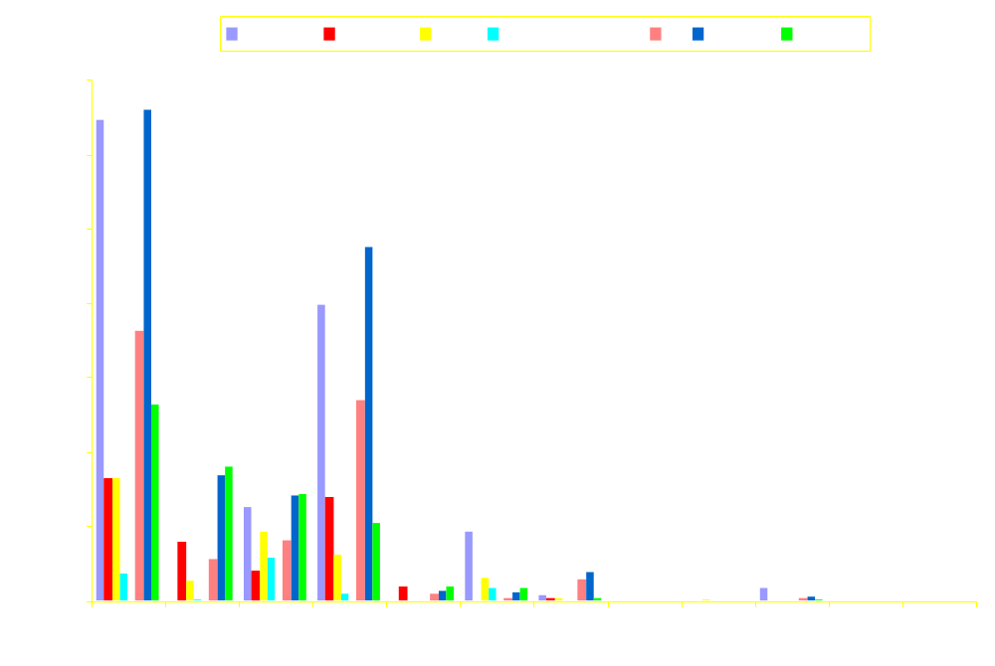
Distribution of Parallel TLB Activity
Parallel Number of TLB Accesses

Slide 22
Cost-Effective TLB configuration
bm | Bf | Bc | Cj | Dj | Dij | Fft | Rij | Pat | Bz | Gc | Par
dTLB base | 32 | 32 | 128 | 64 | 64 | 64 | 32 | 256 | 64 | 64 | 64
sTLB | 2 | 2 | 2 | 2 | 2 | 2 | 2 | 2 | 4 | 4 | 4
gTLB | 8 | 8 | 8 | 8 | 32 | 8 | 8 | 8 | 16 | 16 | 16
hTLB | 16 | 32 | 128 | 64 | 32 | 64 | 32 | 256 | 64 | 64 | 64

Slide 23
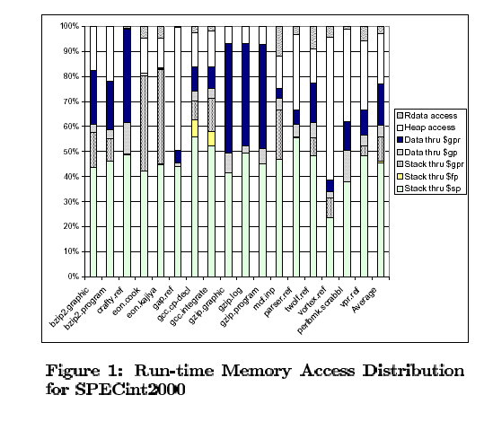

Slide 24
Design Effectiveness of SAM
1
blowfish
bitcount
0.98
cjpeg
0.96
djpeg
dijkstra
Speed
0.94
fft
0.92
rijndael
patricia
0.9
bzip2
0.88
gcc
0
0.2
0.4
0.6
0.8
1
mcf
parser
Energy
average

