Slide 1
Synonymous Address Compaction for Energy Reduction in Data TLB
Chinnakrishnan Ballapuram
Hsien-Hsin S. Lee
Milos Prvulovic
School of Electrical and Computer Engineering
College of Computing
Georgia Institute of Technology
Atlanta, GA 30332

Slide 2
Background
Address Translation
  Major power processor power contributors
  I-TLB and D-TLB lookup for every instruction and memory reference
  TLBs are highly associative
Multi-porting increasing power consumption

Slide 3
Outline
Motivation
  Unique access behavior and locality are analyzed for energy reduction opportunities
Synonymous Address Compaction
  Intra-Cycle Compaction
  Inter-Cycle Compaction
  Implementation Details
Performance/Energy Evaluation
Conclusions

Slide 4
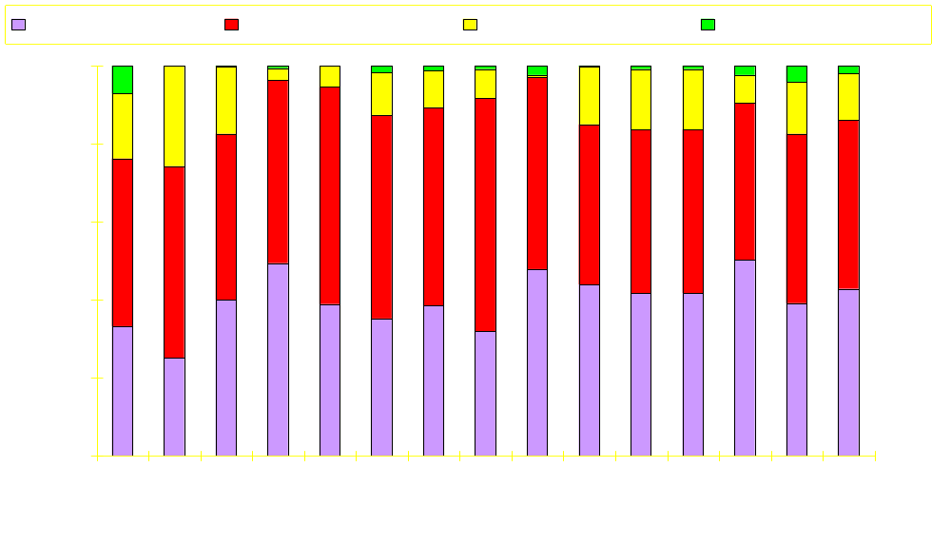
Breakdown of d-TLB accesses
% of data TLB accesses
More than 1 d-TLB lookup for 58% accesses (4-wide machine)
They often access the same page (intra-cycle synonymous accesses)

Slide 5
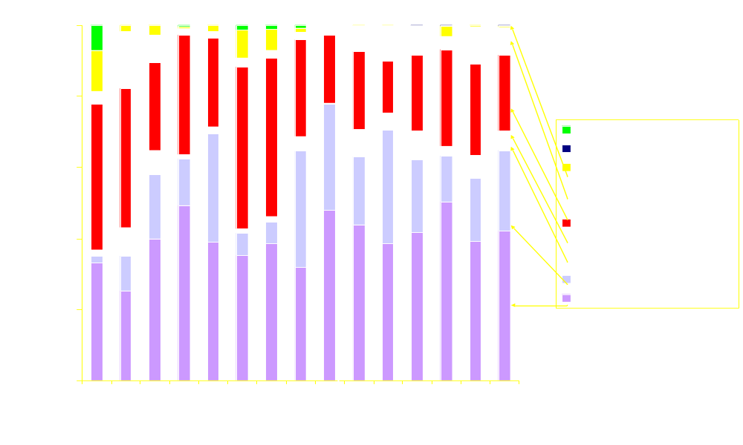
Breakdown of Synonymous Intra-cycle Accesses in d-TLB
% of data TLB accesses
~30% of accesses have synonyms indicating redundancy
With intra-cycle compaction, 1/2 of syn(1) accesses, 2/3 of syn(2) accesses, and 3/4 of syn(3) accesses can be eliminated

Slide 6
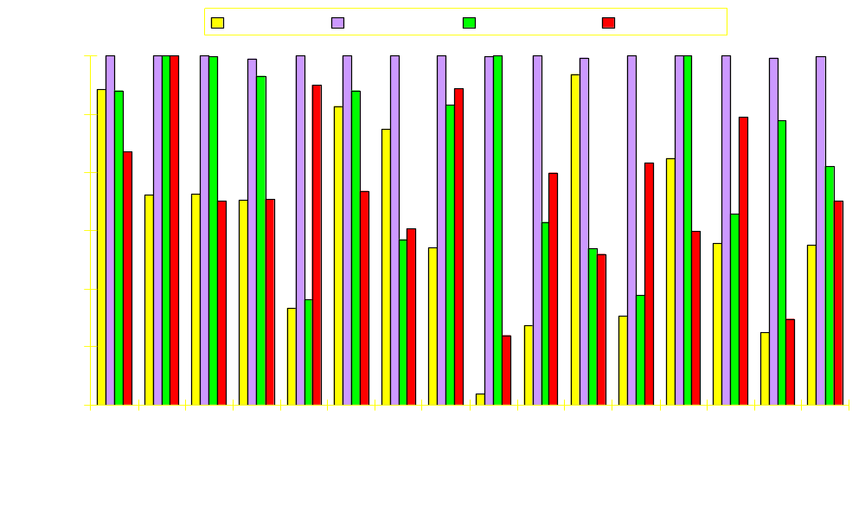
Inter-cycle Reuse of d-TLB Translations
% of data TLB accesses
Inter-cycle synonymous accesses
  68% of accesses could reuse the last address translation
More reuses can be achieved by partitioning dTLB into stack (99%), global (82%), and heap (75%)

Slide 7
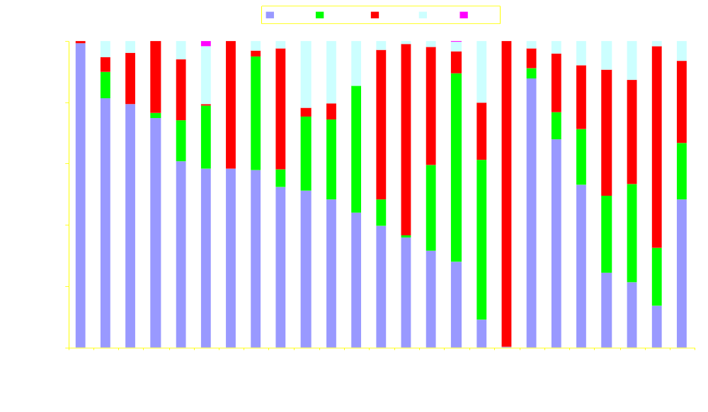
Dynamic Data Memory Distribution
~40 % of the dynamic memory accesses go to the stack which is concentrated on only few pages
4 memory accesses ~= 2 stack, 1 global and 1 heap

Slide 8
Semantic-Aware Memory Architecture
ld_data_base_reg
Data Address Router
Virtual address
ld_env_base_reg
ld_data_bound_reg
sTLB
gTLB
0
0
1
1
2
Most of the memory accesss go to smaller stack and global TLB/cache
➔ Reducing power
3
uTLB
0
1
63
To Processor
To Processor
hCache
gCache
sCache
Unified L2 Cache

Slide 9
VPN compaction mechanisms
Cycle i
0xdeadbeee
0xdeadbeef
0xdeadbef0
0xffffffff
Cycle (i+1)
0xdeadbef2
0xdeadbeef
0x12345678
-----
Virtual address access sequence
Cycle i
0xdeadb
0xdeadb
0xdeadb
0xfffff
Cycle (i+1)
0xdeadb
0xdeadb
0x12345
-----
VPN translation lookup in d-TLB

Slide 10
VPN compaction mechanisms
Cycle i
0xdeadbeee
0xdeadbeef
0xdeadbef0
0xffffffff
Cycle (i+1)
0xdeadbef2
0xdeadbeef
0x12345678
-----
Virtual address access sequence
Cycle i
0xdeadb
0xdeadb
0xdeadb
0xfffff
Cycle (i+1)
0xdeadb
0xdeadb
0x12345
-----
VPN translation lookup in d-TLB
Intra-cycle compaction
Cycle i
0xdeadb
-----
-----
0xffffffff
Cycle (i+1)
0xdeadb
-----
0x12345
-----
VPNs after intra-cycle compaction

Slide 11
VPN compaction mechanisms
Cycle i
0xdeadbeee
0xdeadbeef
0xdeadbef0
0xffffffff
Cycle (i+1)
0xdeadbef2
0xdeadbeef
0x12345678
-----
Virtual address access sequence
Cycle i
0xdeadb
0xdeadb
0xdeadb
0xfffff
Cycle (i+1)
0xdeadb
0xdeadb
0x12345
-----
VPN translation lookup in d-TLB
Intra-cycle compaction
Cycle i
0xdeadb
-----
-----
0xffffffff
Cycle (i+1)
0xdeadb
-----
0x12345
-----
VPNs after intra-cycle compaction
Inter-cycle compaction
Cycle i
0xdeadb
0xdeadb
0xdeadb
0xfffff
Cycle (i+1)
-----
-----
0x12345
-----
VPNs after inter-cycle compaction

Slide 12
Intra-cycle compaction mechanism
Reservation Station
AGUs
IUs
AGUs
IUs
FPUs
Load
Buffer
Store
Buffer
Memory Order
Buffer
Six 20-bit comparators
32-entry fully-associative
Data TLBs
Physical
Address

Slide 13
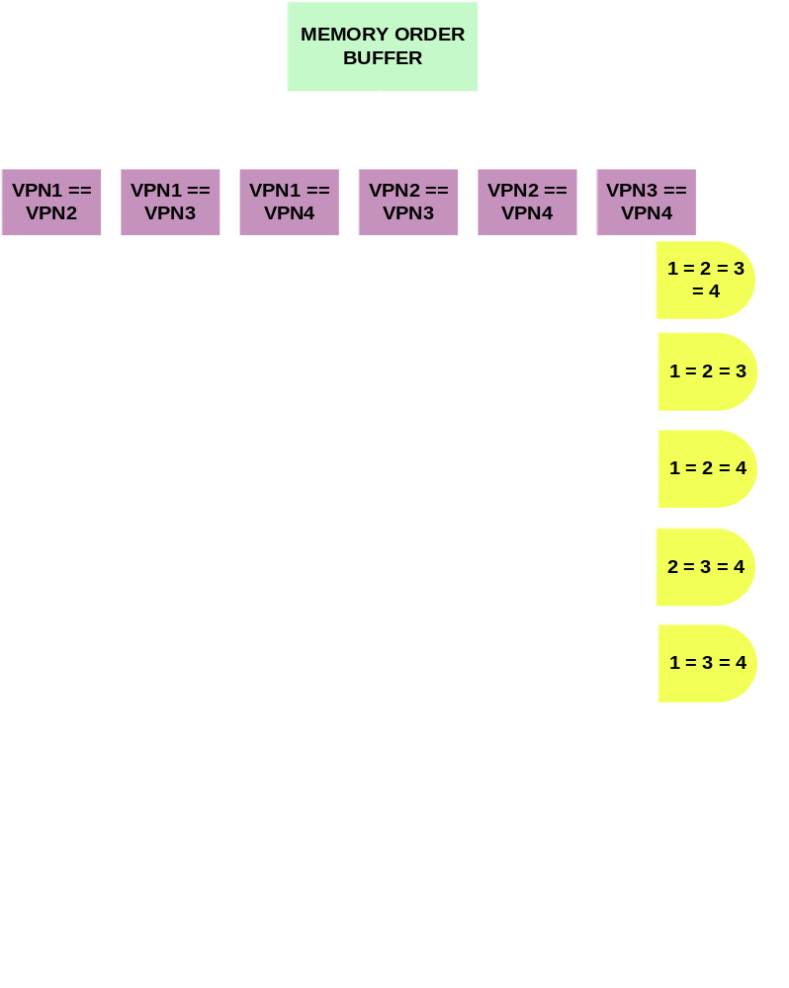
Comparator Logic

Slide 14
Inter-cycle Compaction Mechanism
ld_data_base_reg
Data Address Router
Virtual address
ld_env_base_reg
ld_data_bound_reg
sTLB
gTLB
0
0
1
1
last access reuse
2
MRU Latch
3
MRU Latch
last access reuse
uTLB
0
32
MRU Latch
To Processor
To Processor
hCache
gCache
sCache
Unified L2 Cache

Slide 15
Simulation Parameters
Execution Engine | Out-of-Order
Fetch / Decode / Issue / Commit | 4 / 4 / 4 / 4
L1 / L2 / Memory Latency | 1 / 6 / 150
TLB hit / miss latency | 1 / 30
L1 Cache baseline | DM 32KB, 32B
L2 Cache | 4w 512KB, 32B
Number of TLB entries | 32
Each 20-bit comparator power | 300 uW
Each MRU latch power in TLB | 140 uW

Slide 16
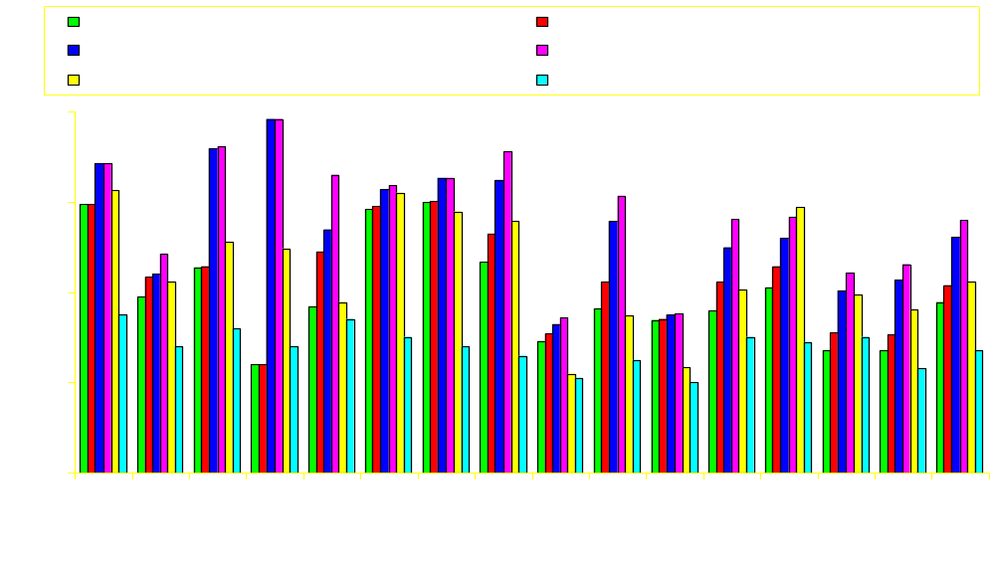
Energy Savings via Synonymous Compaction
data TLB Energy Savings %
Intra-cycle compaction ⎯ 27%
Inter-cycle compaction ⎯ 42%
Inter-cycle semantic-aware ⎯ 56%

Slide 17
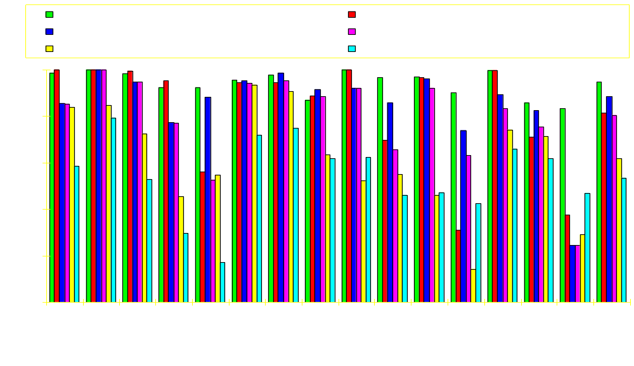
Performance Impact w/ Synonymous Compaction
Performance Speedup
Intra-cycle compaction ⎯ 9%
Inter-cycle compaction ⎯ 8%
Inter-cycle semantic-aware ⎯ 4%

Slide 18
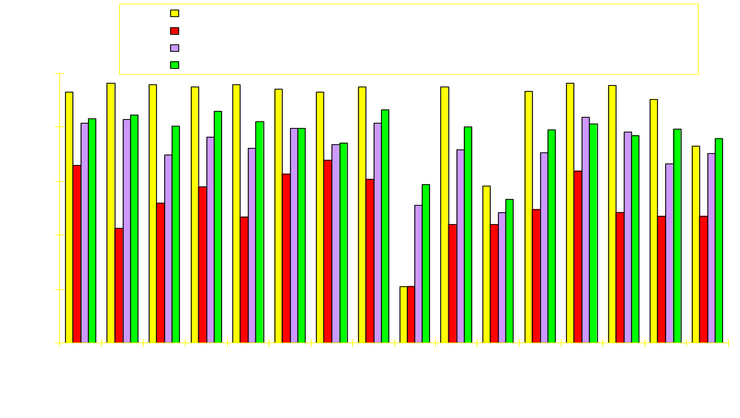
I- and d-TLB Energy Savings via Synonymous Compaction
TLB Energy Savings %
Combining compaction for iTLB and dTLB gives 85% and 52% energy savings
Overall 70% TLB energy savings
Using semantic-aware, overall 76% energy savings

Slide 19
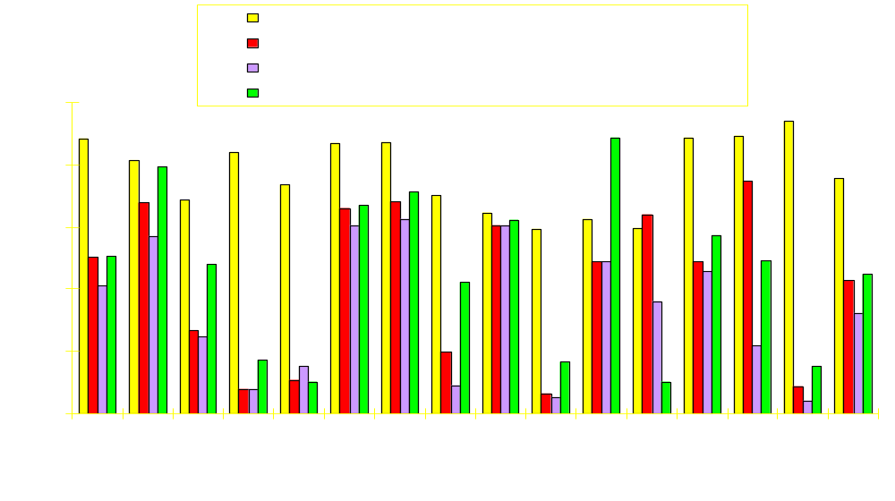
I- and d-TLB Performance Impact w/ Synonymous Compaction
Performance Speedup
Combining compaction for iTLB and dTLB have 5% and 13% performance impact
Using semantic-aware, overall 13% performance impact

Slide 20
Conclusions
Consecutive TLB accesses are highly synonymous
Proposed synonymous address compaction to exploit this behavior
Reduce energy for d-TLB and i-TLB
Energy savings and performance impact
  Intra-cycle ⎯ 27% and 9%
  Inter-cycle ⎯ 42% and 8%
  Semantic-aware ⎯ 56% and 4%

Slide 21

Q and A

