Slide 1

A Scan-Island Based Design Enabling
Pre-Bond Testability in Die-Stacked Microprocessors
Dean L. Lewis Hsien-Hsin S. Lee
Georgia Institute of Technology

Slide 2
Outline
Introduction to 3D
Motivation
Challenges
Design
Experimental Results
Conclusion

Slide 3
3D Integration
Technology
  Stack multiple active layers vertically
  Tightly integrate with die to die (d2d) vias
Benefits
  Routing freedom
  Higher performance
  Lower power
Kiran Puttaswamy,
“Designing High-Performance Microprocessors in 3-Dimensional Integration Technology,”
Ph.D. dissertation, Georgia Institute of Technology, Atlanta, GA, USA, 2007

Slide 4
3D Die Stacking
Bond Pads
Layer 4
Face to Back
Layer 3
Back to Back
Layer 2
Face to Face
Layer 1
Notes:
Die stack showing the three possible bond styles
Face-to-face – small, fast, dense… best bond possible
Back-to-back – big… not nearly as nice as face-to-face, but required for using stacks of more than 2 layers
Face-to-back – this bond pattern is repeatable (i.e. we don’t have to flip every other die to bond in this way). Thus, it may be cheapest

Slide 5
3D Assembly
Wafer to Wafer
Wafer to Die
Die to Die
Notes:
Three ways to stack die: wafer to wafer, wafer to die, and die to die
Wafer to wafer – two wafers are bonded and then the chip stacks are cut apart. Pre-bond test is pointless here as we can’t choose to only bond good chips to good chips. This design is easiest to align
Wafer to die – requires pre-bond test. Harder to align, but potential for much better yield
Die to die – hardest to align. Benefits over wafer to die not obvious

Slide 6

3D Integration and Testability
Analog
Technology
Level
DRAM
CMOS
ALU 4
ALU 3
Architecture
Level
ALU 2
ALU 1
BitLine2
BitLine2
Circuits
Level
BitLine1
BitLine1
BitLine0
BitLine0
Notes:
Three levels of 3D integration: technology, architecture, and circuit. These are not mutually exclusive. For example, a six-die stack may contain two analog, two memory, and two cmos. Within each pair, architectural blocks could be partitioned across layers, and some blocks may even be 3D circuit partitions. The expect f2f, b2b, f2f, b2b, f2f bonding style encourages this style of partitioning
Technology – die layers manufactured in different processes and then bonded at BEoL. This allows production of each layer in its own highly optimized high-yield process while still achieving very high integration. This avoids the trade-off SoC and SiP work has had to make.
Architecture – layers are the same processing technology. Architectural blocks are partitioned across layers to significantly reduce the length and thus cost of inter-block communication buses
Circuit – individual transistors are partitioned across layers, reducing the length of local buses. This tends to be effective only in wire-dominated structures such as many-ported register files and adders. Potentially, this partitioning can also reduce inter-block buses due to reduced block footprints.

Slide 7
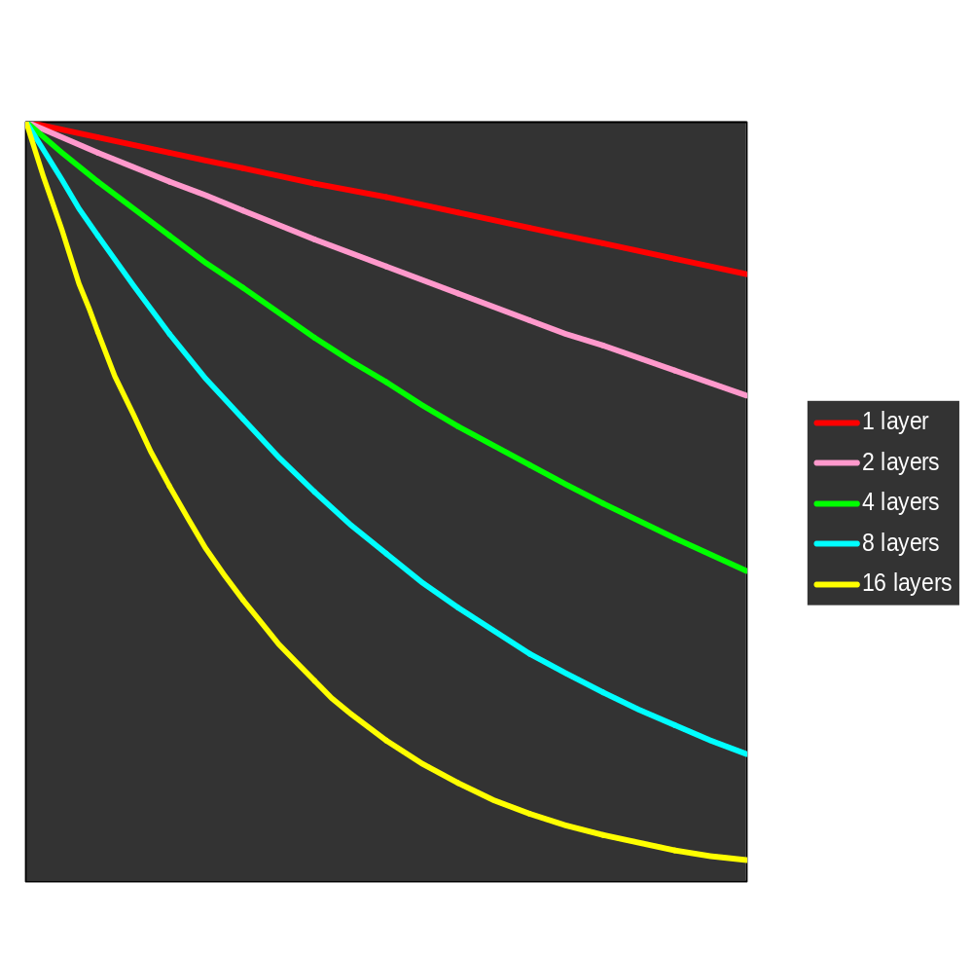
Motivation
95%
100%
95%
90%
81%
66%
Stack Yield
44%
0%
100%
Single Layer Yield
80%
Notes:
Shows exponential decay in final stack yield as number of layers increases

Slide 8
Purpose
Enable Pre-bond 3D Test
  Test Strategy
  Hardware Requirements
  Secondary Concerns

Slide 9
Pre-bond Challenges

Slide 10
Pre-bond Test Challenges
Incomplete Circuits
Architectural Level
Circuit Level
10,000 +
I Cache
Fetch
Decode
Reorder
Buffer
Issue
Out of Order
Execution
D Cache
Commit
Complete Architectural Design
Possible Pre-bond Partition
Complete Register File Design
Pre-bond Circuit
Notes:
Technology Level: no worries, all planar test applies
Architectural Level: planar case, chip can be tested with a combination of scan and test programs
3D case, test programs fail because architecture is incomplete
Circuit Level: planar case, circuits are fully complete and functional, allowing for test
3D case, circuits are functionally broken. How do you test something that’s functionally broken?
10000+ : simple test solution would be to probe all vias. But there may be tens of thousands of vias, which is far beyond the capabilities of test equipment

Slide 11
Pre-bond Test Challenges
Wafer Probing
Probing
Probe Pads
Notes:
Probing: planar case, during test, probing causes extreme stress and damage to bond pads. Damage is repaired by C4 solder when wires are bonded
3D case, can a thinned 3D wafer survive the stress of probing, or will it simply snap?
Probe pads: test pads get buried during the stacking process, so area devoted to them is wasted post-bond. This area is used only once during product’s lifetime. Additionally, no back-side test pads are available in the bottom layer

Slide 12
Pre-bond Test Challenges
Supporting Nets
Power, Ground, Clocks, Etc.
Complete Clock Tree Net
Pre-bond Clock Tree Nets
Notes:
Planar case: all nets are fully connected and ready for use during test
3D case: nets may exist in islands (particularly clocks). We could probe each individually, but that only works for a handful of islands. What about 100s?

Slide 13
Proposed Solution

Slide 14
Test Strategy
Alpha 21364
3D Pre-bond Test
IEEE 1149.1 TAP
LTC
CSC
CSC
ISP
ISP
IEEE 1149.1 TAP
LTC
Notes:
TAP = test access port. Includes test clock, test mode select (controls transitions in TAP’s state machine), test reset, scan in, and scan out (together scan in and scan out create a 1-bit wide scan chain access port)
CSC = central scan controller. Interfaces chip to TAP and ATE. Provides n-bit wide scan chain access (i.e. access to n scan chains in parallel; 32 in the 21364, multiplexed with the 64 bits of the data bus). Allows for much faster test than the TAP
ISP = island scan port. Controls scan islands (most importantly, it allows tester to either access or bypass the island’s chains). Connected to CSC by n-bit bus
LTC = layer test controller. Same as ISP. Pre-bond, n-bit wide bus and control signals exposed to ATE

Slide 15
Layer Border Scan Flops
Post-bond
Bus From Another Layer
Pre-bond
Bus To Another Layer
Test_Enable
Si
Pipeline Stage Register
So
Low
Add
High
Add
Flags
Scan Registers
Notes:
Here’s an example of the use of border scan flop
Pre-bond: scan registers must provide and observe test values because the adder’s source and sink are on another layer
Post-bond: data comes from and is delivered to the adder from another layer, so the scan flops are disconnected from the buses. Scan registers can be reused as BILBO registers, MISRs, PRPGs, etc

Slide 16
Scan Flops Not Required
Post-bond
Bus From Another Layer
Pre-bond
Bus To Another Layer
Si
So
Pipeline Stage Register
Low
Add
Low
Add
High
Add
High
Add
Flags
Notes:
Of course, it may often be the case that we don’t need new flip-flops for scan. Here, the buses source and sink pipeline stages at the input and output. We can simply add scan to these stages, which is much less costly than completely separate scan registers.

Slide 17
Test Pads
Faceside Test
Reuse Post-Bond
Notes:
Faceside test: to test the layer pre-bond, faceside testing is necessary. Faceside is good because the wafer does not have to be thinned before test and because all layer test can be tandarized (the unthinned die that ends up nearest the heatsink cannot be backside probed). The downside is that the test pads consume area equal to a few hundred faceside vias and thus must be used judiciously
Reuse: If we can, we’d like to reuse the test pads for other purposes. For example, we can form some decap with the power and ground test pads.

Slide 18
Power and Ground
Planar Die
Die Stack
Notes:
Planar Die: ideal power and ground nets are interlaced as shown
Die Stack: same design applies. However, here, for each layer, we flip the nets horizontally. By adding vias as shown, we create a very tightly nit 3D grid of power and ground
Pre-test: this leaves power and ground fully connected for pre-bond test
Post-bond: notice that if we place the test pads as shown, they neatly stack into the decap we want

Slide 19
Clock Routing
Power/Routing Optimized
Pre-bond Test Optimized
Layer 1
Layer 1
Layer 2
Layer 2
Notes:
Power: an optimal 3D clock tree will be routed almost entirely on one layer, with vias connecting small clock islands on other layers to the main tree. This is very efficient in terms of power and routing area. This is completely untestable
Test: an optimal 3D test clock tree will be complete within all layer independent of all other layers. Just a single via merges the trees on separate layers together. This is a big waste of power and routing area

Slide 20
Real Clock Tree
Notes:
But a real clock tree isn’t a single node; it has buffers as shown here

Slide 21
Real 3D Clock Tree
Layer 1
Layer 2
Layer 3
Layer 4
Notes:
Similarly, a real 3D clock tree will have buffers. Though not drawn explicitly, there are vias connecting the all the last level buffers

Slide 22
Testable 3D Clock Tree
EN
Layer 1
Layer 2
CLK
CLK
EN
Layer 3
Layer 4
Notes:
We create an independent clock tree for every layer (denoted here by the black, blue, red, and green trees). The white, last-level buffers represent an array of four buffers. Each tree has a control signal which can disable that tree. Thus we can turn off all but one tree during normal operation, saving significant power while simultaneously enabling pre-bond test.

Slide 23
More Trees Are Better
Pre-bond Test
Reliability
X
Notes:
Reliability: if a fault occurs within one clock tree, the processor can switch to another clock tree and continue operation
Thermal-Aware: BURITO balances the skew under two different thermal profiles. Multiple trees allow us to design separate trees for each thermal profile, minimizing skew across a large operating range. If (target profiles > number of layers), we can use BURITO to design one tree for multiple profiles.

Slide 24
Experiment and Results

Slide 25
Experiment
Based on 21264 Architecture
Floorplanned microarchitecture blocks
  Two die layers
Determined widths of inter-die buses
Laid out scan cell
E. Wong and S.-K. Lim. “3D Floorplanning with Thermal Vias.”
In Design, Automation, and Test in Europe Proceedings, pp. 878-883, 2006.
Notes:
Laid out in 0.27u technology, which is close to the EV67 (21264A) manufactured in 0.25u

Slide 26
Results
ICache
FP
EU1
IntQ
IE
U2
IE
U4
Scan Cell Size | 75.8 μm²
Inter-die Vias | 2397
Scan Cell Count Two cells per via | 4794
Area | 0.363 mm²
Overhead | 0.165%
DCache
Layer 1
DTLB
IE
U1
FPEU2
FP
Map
FPQ
DIS
IRF
1
FP
RF
IMap
LSQ
BPred
Layer 2
Ftch
Dcd
IRF2
IE
U3
ITLB
Mem
Ctlr
BIU
Notes:
LTC size not significant compared area consumed by the border flip flops
Worst case analysis:
Academic scan-flop layout, which is potentially 50% bigger than an industrial design
0.27u layout versus Alpha’s 0.25u process, so once again bigger than it should have been
Two scan-flops for every inter-die wire. In many cases, wires may source or sink a flip-flop, in which case those FFs could be made scannable to avoid the extra scan cells
No scan-flop reuse. We assume no scan cells are reused in the post-bond test hardware. In a real design, there is great potential for use reuse, further minimizing cost

Slide 27
Conclusion
Pre-bond test a necessity for integrating 10+ layers
Pre-bond test can be achieved with current manufacturing technologies and test techniques
Area cost is insignificant
Clock can be designed to both enable pre-bond test and maximize power savings

Slide 28
Backup Slides

Slide 29
Scan and Non-Neighboring Blocks
Si
I Fetch
ALU
So
Notes:
Here, we see two units, Fetch and ALU, adjacent on the same layer. The sources and sinks for both units exist on other layers.
(MOUSE CLICK)
Pre-bond, we have no inputs to activate these units or outputs to observe.
(MOUSE CLICK)
In order to test, we add scan flops as in the previous example. Here, the sink flops for the Fetch unit also serve as source flops for the ALU.
(MOUSE CLICK)
To test, we scan in the test data from Si. The ALU test values come first, then the Fetch values. The test bits are color-coded to indicate the unit they relate to.
(WAIT FOR SCAN TO FINISH)
(MOUSE CLICK)
We clock the layer once, and the test inputs move to the outputs. Notice that the next test bit is ready for scan in. Note that the leftmose register has cleared. This denotes Don’t Care values which are not relevant to the test.
(MOUSE CLICK)
We scan the registers again. The test outputs are scanned out while the next set of test inputs is scanned in. This process is repeated until all test vectors have been applied.
In this way, both units are tested simultaneously, yet they never share values and thus are tested independently.

Slide 30
Clock Routing Area
2D Clock
3D Clock
Equal Wiring Required
Notes:
Back-up slide – Demonstrates that the pre-bond test clock is no more costly than normal planar clock trees for a rectangular design

Slide 31
Clock Routing Area
2D Clock
3D Clock
50% More Wire in the Limit
Notes:
Back-up slide – Demonstrates that the pre-bond test clock is, in the limit, 50% larger than planar clock for square design. Limit means infinite repetitions of the H-tree.

Slide 32
Clock Routing Layer
2D Clock
3D Clock
Notes:
Redundant pre-bond test clocks do consume routing area that would be available in a stack with a purely performance-driven 3D tree. However, this loss of routing area is no worse than the planar case.

Slide 33
Die-to-Die Bonding
Tezzaron Super-Via™
Standard Planar Die
Top Layer Metal
Device and Metal Layers
Bulk Silicon
S. Gupta, M. Hilbert, S. Hong, and R. Patti. “Techniques for Producing 3D ICs with High-Density Interconnect.”
In Proceedings of the 21st International VLSI Multilevel Interconnection Conference, Waikoloa Beach, HI, USA, 2004
Notes:
Gray = bulk silicon
White = active silicon + metal stack + inter-metal dialectric
Yellow = copper

Slide 34
Die-to-Die Bonding
Tezzaron Super-Via™
1 – Dialectric Fill
Notes:
Gray = bulk silicon
White = active silicon + metal stack + inter-metal dialectric
Yellow = copper
Blue = same as inter-metal dialectric

Slide 35
Die-to-Die Bonding
Tezzaron Super-Via™
2 – Super-Via™ Etch
Notes:
Gray = bulk silicon
White = active silicon + metal stack + inter-metal dialectric
Yellow = copper
Blue = same as inter-metal dialectric

Slide 36
Die-to-Die Bonding
Tezzaron Super-Via™
3 – Barrier Deposition
Notes:
Gray = bulk silicon
White = active silicon + metal stack + inter-metal dialectric
Yellow = copper
Blue = same as inter-metal dialectric
Green = oxide + SiN. SiN prevents Cu diffusion

Slide 37
Die-to-Die Bonding
Tezzaron Super-Via™
4 – Connection Etching
Notes:
Gray = bulk silicon
White = active silicon + metal stack + inter-metal dialectric
Yellow = copper
Blue = same as inter-metal dialectric
Green = oxide + SiN. SiN prevents Cu diffusion

Slide 38
Die-to-Die Bonding
Tezzaron Super-Via™
5 – Barrier and Cu Deposition
Notes:
Gray = bulk silicon
White = active silicon + metal stack + inter-metal dialectric
Yellow = copper
Blue = same as inter-metal dialectric
Green = oxide + SiN. SiN prevents Cu diffusion
Red = Ta or TaN. conductive

Slide 39
Die-to-Die Bonding
Tezzaron Super-Via™
6 – Expose Bond
Notes:
Gray = bulk silicon
White = active silicon + metal stack + inter-metal dialectric
Yellow = copper
Blue = same as inter-metal dialectric
Green = oxide + SiN. SiN prevents Cu diffusion
Red = Ta or TaN. conductive

Slide 40
Die-to-Die Bonding
Tezzaron Super-Via™
7 – Bond to Second Layer
Thermal
Diffusion
Bonding
Notes:
Gray = bulk silicon
White = active silicon + metal stack + inter-metal dialectric
Yellow = copper
Blue = same as inter-metal dialectric
Green = oxide + SiN. SiN prevents Cu diffusion
Red = Ta or TaN. conductive

Slide 41
Die-to-Die Bonding
Tezzaron Super-Via™
8 – Thin Second Layer
Grinding
and CMP
Notes:
CMP = chemical-mechanical planarization (or polishing). Chemical used to weaken surface while mechanical used to brush away weakened material. Think toothbrush plus toothpaste
Gray = bulk silicon
White = active silicon + metal stack + inter-metal dialectric
Yellow = copper
Blue = same as inter-metal dialectric
Green = oxide + SiN. SiN prevents Cu diffusion
Red = Ta or TaN. conductive

Slide 42
Die-to-Die Bonding
Tezzaron Super-Via™
9 – Expose Via
Notes:
Gray = bulk silicon
White = active silicon + metal stack + inter-metal dialectric
Yellow = copper
Blue = same as inter-metal dialectric
Green = oxide + SiN. SiN prevents Cu diffusion
Red = Ta or TaN. conductive

Slide 43
Die-to-Die Bonding
Tezzaron Super-Via™
10 – Repeat Pad Construction
Notes:
Gray = bulk silicon
White = active silicon + metal stack + inter-metal dialectric
Yellow = copper
Blue = same as inter-metal dialectric
Green = oxide + SiN. SiN prevents Cu diffusion
Red = Ta or TaN. conductive

