Slide 1
Eager Writeback — A Technique for Improving Bandwidth Utilization
Hsien-Hsin Lee Gary Tyson Matt Farrens
Intel Corporation, Santa Clara
University of Michigan, Ann Arbor
University of California, Davis
Notes:
I am here today to communicate with you about my work on Eager Writeback , A technique for improving bandwidth utilization, In this work, I am going to show you a fairly simple memory type extension, called eager writeback that has the capability of re-distributing memory bandwidth by early dirty line evictions to fill unused memory bandwidth and improve the performance of streaming or multimedia type of applications. This research was done with professor….

Slide 2
Agenda
Introduction
Memory Type and Bandwidth Issues
Memory Reference Characterization
Eager Writeback
Experimental Results and Analysis
Conclusions
Notes:
My notes

Slide 3
Modern Multimedia Computing System
The Host Processor
L2
Cache
Core Processor
Back-Side Bus
Front-Side Bus
Commands →
← Data
Graphics
System
Memory
(DRAM)
A.G.P.
Processing
Unit
Chipset
Command and Texture Traffics
Texture data
Local
Frame
Buffer
I/O
I/O
I/O
Notes:
CPU reads data from main memory, and performs some manipulation, generates commands for graphics processor and stores those commands to the graphics memory space.
Technique such as Direct RDRAM from RAMBUS , they try to provide as much as possible bandwidth on the memory bus in order to satisfy the needs of system memory bandwidth consumed by CPU and the graphics accelerator.

Slide 4
Memory Type Support
Page-based programmable memory types
  Uncacheable (e.g. memory-mapped I/O)
  Write-Combining (e.g. frame buffers)
  Write-Protected (e.g. copy-on-write when fork)
  Write-Through
  Write-Back or Copy-Back
Notes:
The memory type associated with a particular memory can be programmed in some memory type range registers.
UC – The system memory is not cached. The sequence of all reads and writes are executed in program order without reordering, in other words, strongly ordered.
WC – A weak ordering mode. system memory locations are not cached. Write ordering is unimportant. The processor will execute a burst-write transaction (in a cache line size) to the uncacheable memory if the WC buffer is filled. Otherwise, partial write transactions will be executed. This will be inefficient
WP: writes are propagated to the system bus and causes all corresponding cache lines on all processors on the bus to be invalidated.

Slide 5
Write-through vs. Writeback
CPU
CPU
writes
Reads
writes
Reads
L1$
L1$
allocate
Dirty
writes
allocate
Main
Memory
Main
Memory
Notes:
You write through all levels of memory hierarchies. This could throttle the bus bandwidth all the time every time you write something to the memory. However, it is one way to reduce conherency misses in MP systems. Because every write will propagate the most-up-to-date data to the outermost globally observable memory location.

Slide 6
Potential WB Bandwidth Issues
Conflict on the bus while streaming data in
  Incoming : Demand fetches
  Outgoing : Dirty Data
Dirty data
  Can steal cycles amid successive data streaming
  Delay of data delivery for critical path
  Writeback (Castout) buffer could be ineffective
How to alleviate the conflicts ?
  Try to find balance between WT and WB
Notes:
To find the right trigger for cache line writeback

Slide 7
Probability of Rewrites to Dirty Lines
1
1
0.9
0.9
0.8
0.8
0.7
0.7
Xlock-mount
0.6
0.6
POV-ray
0.5
0.5
xdoom
0.4
0.4
Xanim
0.3
0.3
Average
0.2
0.2
0.1
0.1
0
0
MRU
MRU - 1
LRU + 1
LRU
MRU
MRU - 1
LRU + 1
LRU
L1 data cache
L2 cache
4-way caches using x-benchmark [Austin 98]
Pr(R|D) = # re-dirty / # dirty lines entering a particular LRU state
MRU lines are much more likely to be written
Notes:
Denominator: when a cache line enters the state, e.g. LRU, is dirty.

Slide 8
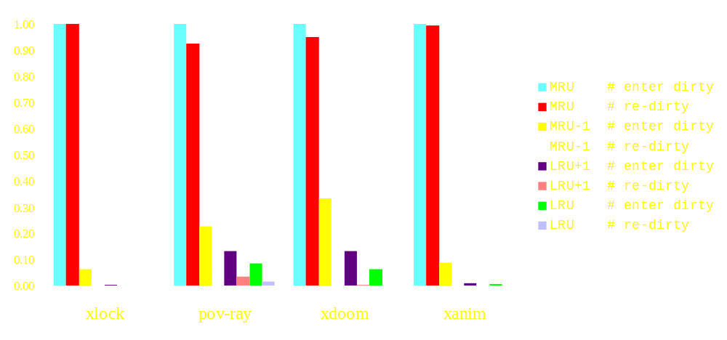
Normalized L1 Dirty Line States
Enter dirty ⎯ the first time a line is written
Re-dirty ⎯ writing to a dirty line
Notes:
If touched again by reads, NO PROBLEM. It’s not dirty anymore. Even if touched by writes, it accounts for a very small overheads.

Slide 9
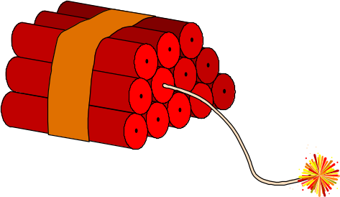
Eager Writeback Trigger
Dirty lines enter LRU state !
Notes:
A dirty enters the LRU state becomes a good candidate to be the trigger for eager writeback.

Slide 10
Eager Writeback Mechanism
Cache Miss Address
Set-Associative Cache
way0
LRU bits
Data
set0
MSHR
Forward
Path
Block
Data
Addr
Writeback Buffer
01
Block
Data
Data
Addr
Return
Next Level Cache/Memory
Notes:
This is easier for illustration, in reality, the cache line does not move around. The LRU bits point to the line that is Least Recently Used

Slide 11
Eager Writeback Mechanism
Cache Miss Address
Set-Associative Cache
way0
LRU bits
Data
set0
MSHR
Forward
Path
Block
Data
Addr
Writeback Buffer
00
Block
Data
Data
Addr
Return
Next Level Cache/Memory
Notes:
This is easier for illustration, in reality, the cache line does not move around. The LRU bits point to the line that is Least Recently Used

Slide 12
Eager Writeback Mechanism
Cache Miss Address
Set-Associative Cache
way0
LRU bits
Data
set0
MSHR
Forward
Path
Block
Data
Addr
Writeback Buffer
00
Block
Data
Data
Addr
Return
Next Level Cache/Memory

Slide 13
Eager Writeback Mechanism
Cache Miss Address
Set-Associative Cache
way0
LRU bits
Data
set0
MSHR
Forward
Path
Block
Data
Addr
Writeback Buffer
00
Block
Data
Data
Addr
Return
X
Next Level Cache/Memory

Slide 14
Eager Writeback Mechanism
Cache Miss Address
Set-Associative Cache
way0
LRU bits
Data
set0
MSHR
Forward
Path
Block
Data
Addr
Set ID
Eager Queue (EQ)
set IDs
Writeback Buffer
00
Block
Data
Data
Addr
Return
Trigger when entry freed
Next Level Cache/Memory

Slide 15
Simulation Framework
Simplescalar suite
8-wide OOO superscalar machine
Enhanced memory subsystem modeling
Non-blocking caches (32KB L1 / 512 KB L2)
  Model MSHRs for all cache levels
  Model WC memory type
2-level Gshare (10-bit) branch predictor
RDRAM model (single-channel)
Model limited bus bandwidth
  peak front-side bus bandwidth = 1.6 GB/s
Notes:
Well, we are from Michigan. So we use Simplescalar to make sure we receive the best possible support from Todd’s office, which is 10 meters away from my office.

Slide 16
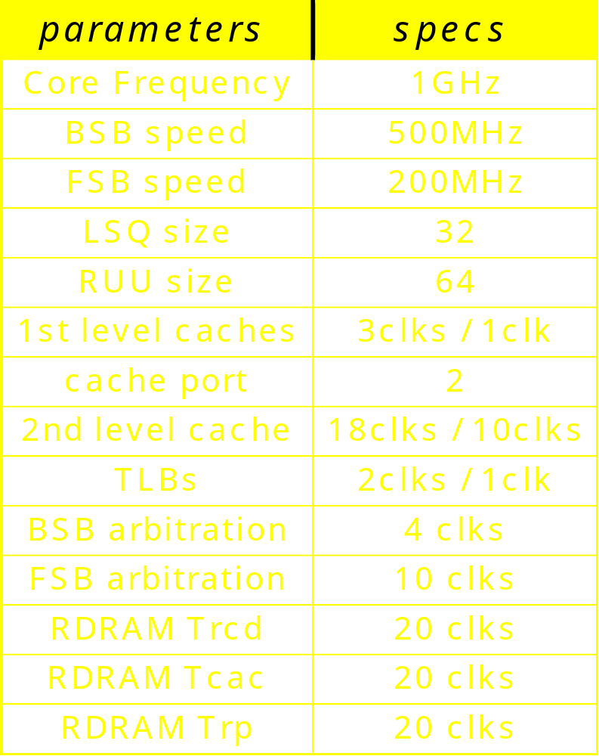
Simulation Framework

Slide 17
Case Studies
3D Geometry Engine
  A triangle-based rendering algorithm
  Used in Microsoft Direct3D and SGI OpenGL
3D model
Geom engine
Xform
Driver
Buffer
Light
Driver
To AGP
memory
Streaming

Slide 18
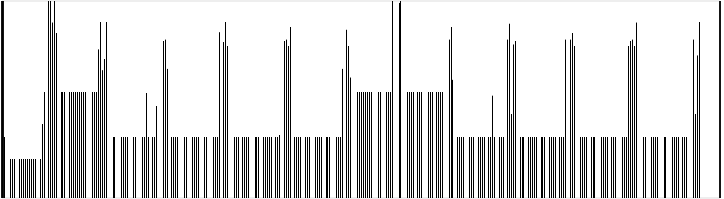
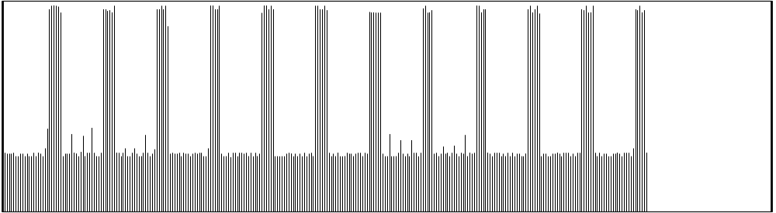
Bandwidth Shifting (Geometry Engine)
1.6GB/s
Baseline Writeback
0.6GB/s
0
Execution time →
1.6GB/s
Eager Writeback
0.4GB/s
0
Notes:
18

Slide 19
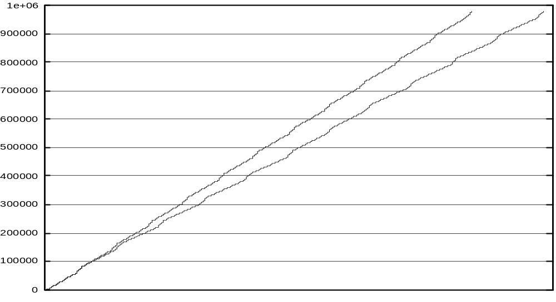
Load Response Time
Eager Writeback
e.g. 600k^{th} load
Vertex ID ↓
Baseline Writeback
Execution time →

Slide 20

Performance of Geometry Engine
Free writeback represents performance upper bound

Slide 21
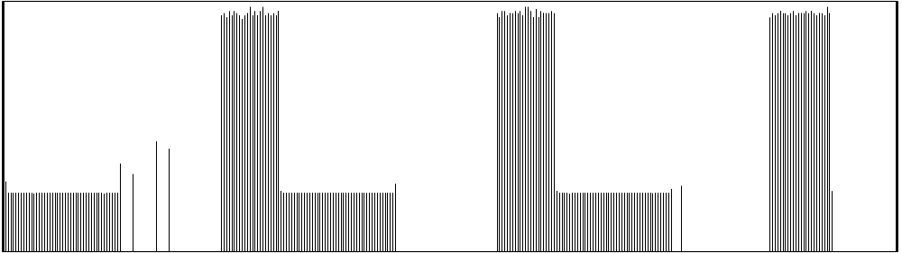
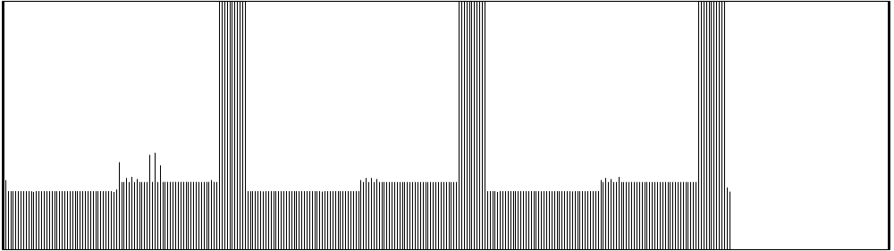
Bandwidth Filling (Streaming)
1.6GB/s
Baseline Writeback
0
Execution time →
1.6GB/s
Eager Writeback
0

Slide 22

Performance of Streaming Benchmark

Slide 23
Conclusions
Writebacks compete bandwidth with demand misses
Demand data delivery can be deferred
LRU dirty lines are rarely promoted again
Eager writeback
  Triggered by dirty lines entering LRU state
  Additional programmable memory type
  Shift writeback traffic
  Effective for content-rich apps, e.g. 3D geometry
  Can be extended for
    Improving context switch penalty
    Reducing coherency misse latencies for MP systems (similar technique: LTP [LaiFalsafi 00] )
Notes:
Global data and stack data show good life span and their working set sizes are rather small compared to the dynamically allocated heap data.

Slide 24

Questions & Answers
Bandwidth problem can be cured with money. Latency problems are harder because the speed of light is fixed ⎯ you cannot bribe God.
⎯ David Clark, MIT

Slide 25
That's all, folks !!!
http://www.eecs.umich.edu/~linear

Slide 26
Backup Foils

Slide 27
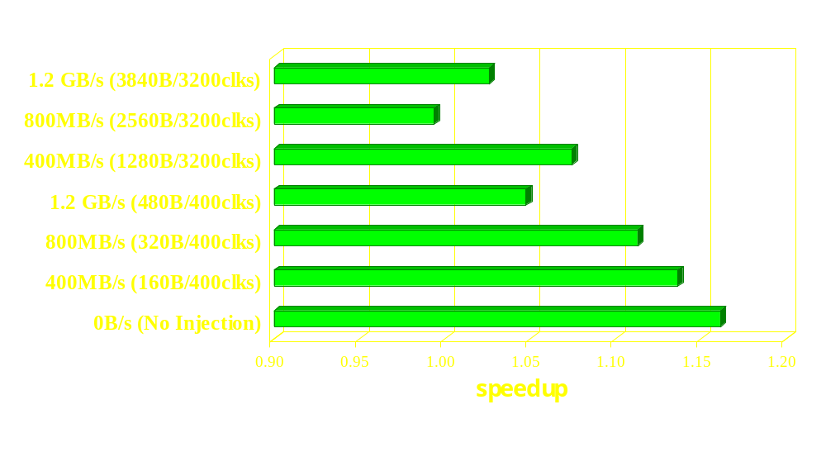
Speedup with Traffic Injection
Imitating bandwidth stealing from other bus agents
Uniform memory traffic injection

Slide 28
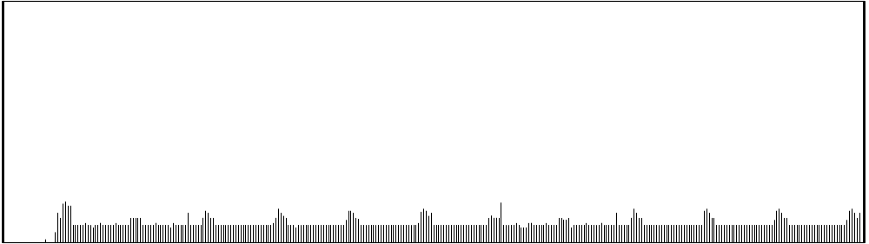
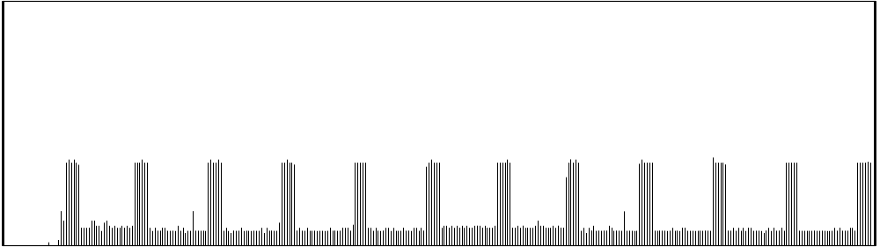
Injected Memory Traffic (0.8GB/s)
1.6GB/s
320B/400 clks
0
Execution time →
1.6GB/s
2560B/3200 clks
0

