Slide 1
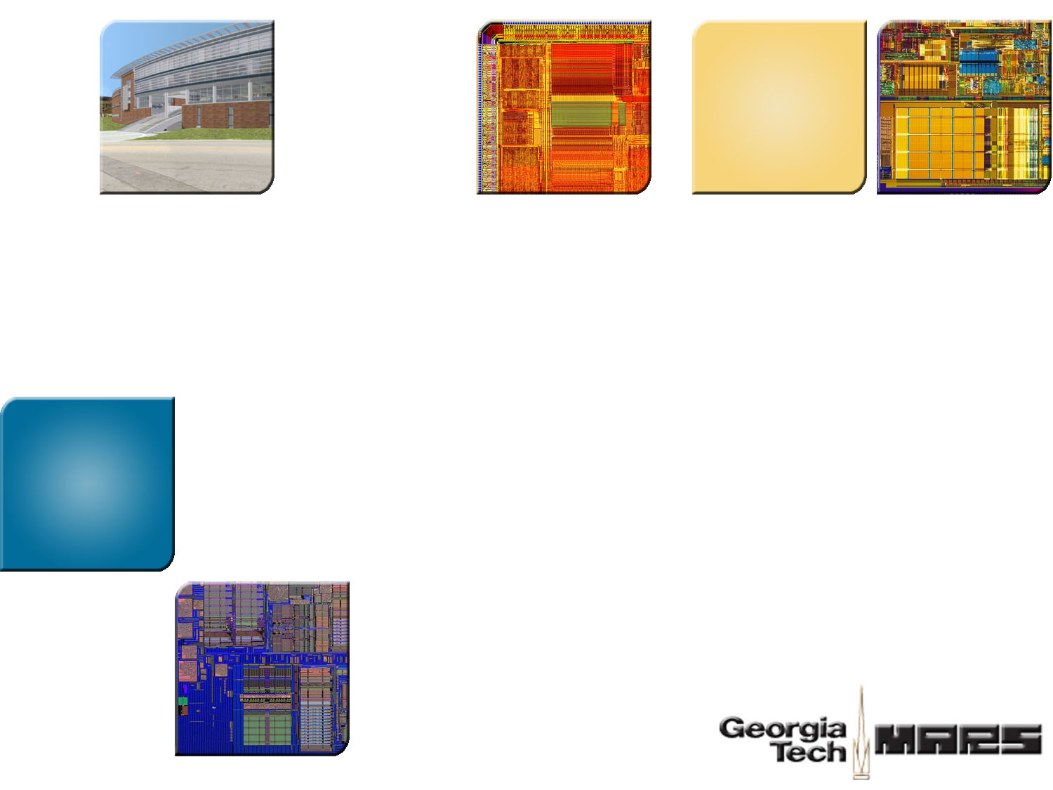
An Empirical Study for ASF Transactional Memory System
Reducing False Transactional Conflicts
with Speculative Sub-blocking State
Lifeng Nai Georgia Tech
Hsien-Hsin S. Lee Georgia Tech

Slide 2

Why Transactional Memory (TM)?
Parallel programming
Deadlock
Priority inversion
Buggy
Limited concurrency
Programmability
Productivity
Performance
Power
Locks are NOT our friends

Slide 3
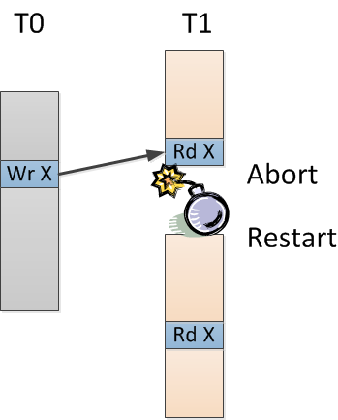
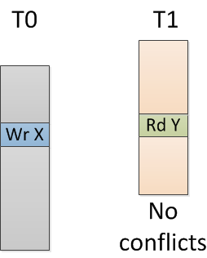
Transactional Memory
Transaction: a sequence of memory loads and stores that follow ACID properties
ACID properties: Atomicity, Consistency, Isolation and Durability
Case2: with conflicts
Case1: no conflicts

Slide 4
TM Systems
Software Transactional Memory (STM)
Hardware Transactional Memory (HTM)
Industry’s implementations
Sun’s Rock processor
IBM BlueGene/Q processor
AMD’s Advanced Synchronization Facility (ASF)
Intel’s Haswell

Slide 5
ASF Overview
ASF: Advanced Synchronization Facility
Buffering
L1 Cache
Tag
V
D
Data
SW
SR
Conflict detection
L1 Cache
Tag
V
D
Data
SW
SR
1
1
Conflict
Commit
Abort
Invalidate
L1 Cache
Tag
V
D
Data
SW
SR
1
1
L1 Cache
Tag
V
D
Data
SW
SR
1
1

Slide 6

Problem
Detecting conflicts at cache line granularity leads to false transactional conflict problem
TX 0 (core 0)
TX 1 (core 1)
Load X1
Store X2
SW
SR
SW
SR
1
1
Invalidate
False Conflicts

Slide 7
Outline
Introduction
Motivation
False conflict behavior
Previous work
Access pattern of false conflicts
Implementation
Evaluation
Conclusion

Slide 8
False Conflict Behavior
On average, false conflict rate is 46.7%

Slide 9
False Conflict Behavior
Breakdown of different false conflict types
Both are important false conflict types

Slide 10


Previous Work
Software technique: tailored data structure according to cache line size
Compromise programmability
Lack of portability
Hardware technique
Speculative multi-threading (SpMT)
Transactional conflict decoupling and value prediction (DPTM)
Only handle WAR false conflicts
Only for lazy conflict detection

Slide 11
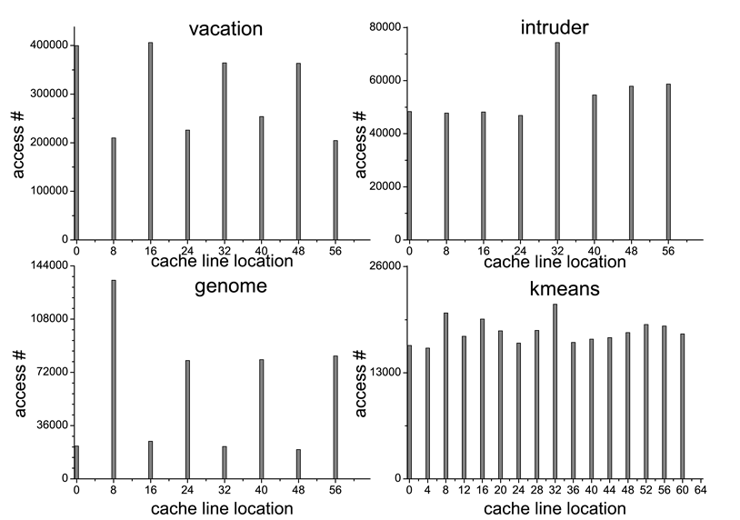
Access Pattern of False Conflicts
Access # by location inside cache lines
They all share a regularly scattered
distribution pattern inside cache lines
Sub-blocking

Slide 12
Outline
Introduction
Motivation
Implementation
Basic mechanism
Why dirty state
Example
Evaluation
Conclusion

Slide 13
Basic Mechanism
Cache block
Sub-block
Sub-block
SPEC
WR
SPEC
WR
SPEC | WR | State
0 | 0 | Non-speculate
0 | 1
1 | 0 | Speculative read
1 | 1 | Speculative write
Extra bits per cache line:
2 × N sub-blocks
Dirty
False conflicts of different sub-blocks
can be completely avoided
Transactional load access
Transactional store access

Slide 14

Why Dirty State?
Problem
T0
T1
TX begin
TX begin
WR A
Sub-block written by others
-> dirty state
RD B: cache miss
No true conflict
Hit dirty sub-block
-> Treated as cache miss
RD A: cache hit
TX commit
Conflict miss detected
S-write
S-read
S-write
S-read
A
B
A
B

Slide 15
Example
T0
T1
TX begin
TX begin
WR A
RD B
No true conflict
RD A: hit dirty state
treated as cache miss
TX abort
Get data A from L2
TX commit
none
S-read
none
none
none
S-read
none
S-read
Dirty
S-write
none
none
none
A
B
A
B

Slide 16
Outline
Introduction
Motivation
Implementation
Evaluation
Simulation methodology
Results
Conclusion

Slide 17
Simulation Methodology
Simulator: PTLsim with ASF extension
Benchmark suites: STAMP and RMS-TM
Feature | Description
Processors | 8 AMD Opteron 2.2GHz Out-of-Order cores
L1 DCache | 64KB, 64B cache line size, VIPT, 2-way set associative, 3 cycles latency
Private L2 cache | 512KB, PIPT, 16-way set-associative, 15 cycles latency
Private L3 cache | 2MB, PIPT, 16-way set-associative, 50 cycles latency
Main memory | 2048MB, 210 cycles latency
D-TLB | 48 L1 entries, fully associative, 512 L2 entries, 4-way set associative

Slide 18
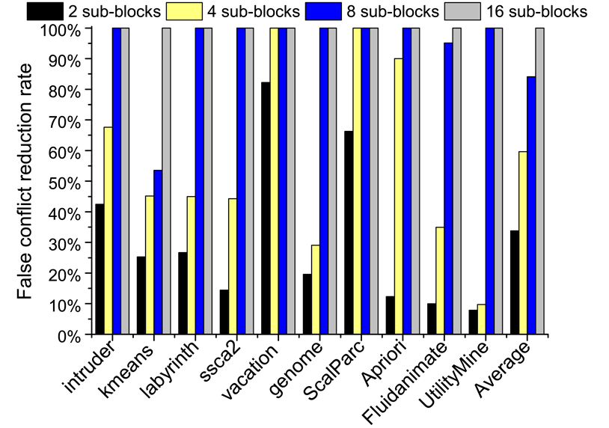
Results
False conflict reduction rate
Default Value
On average
2 sub-blocks: 33.7%
4 sub-blocks: 59.6%
8 sub-blocks: 84.1%
16 sub-blocks: 100%
Capacity overhead
2 sub-blocks: 0.58%
4 sub-blocks: 1.17%
8 sub-blocks: 2.3%
16 sub-blocks: 4.7%

Slide 19
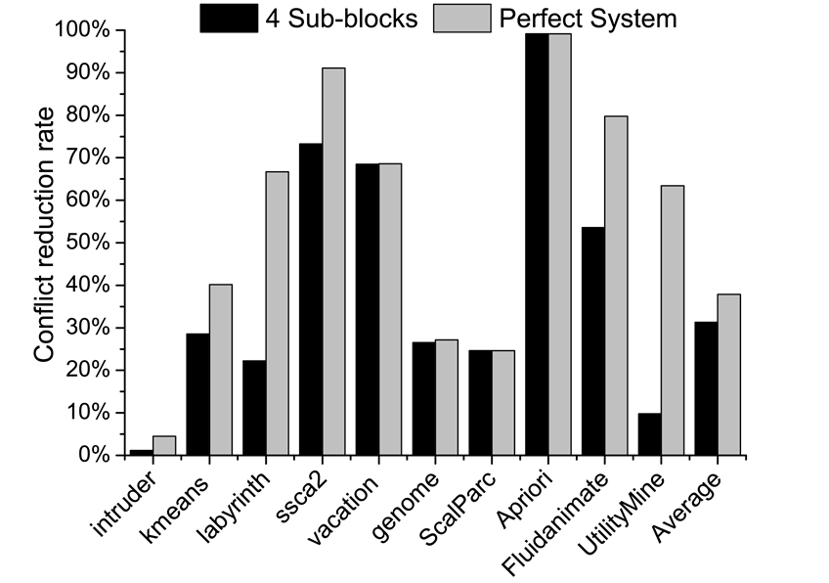
Results
Overall conflict reduction
HTM without false conflicts
83% of Perfect System’s reduction rate

Slide 20
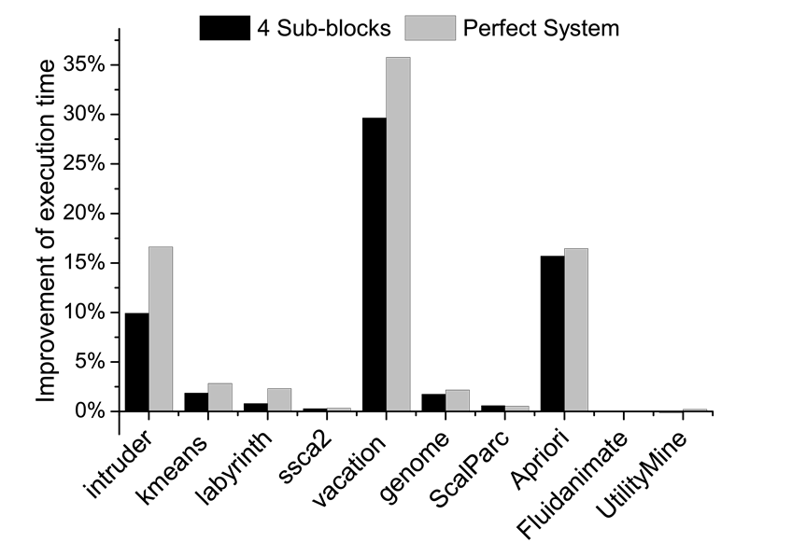
Results
Improvement of execution time
Achieve 82% of Perfect System’s
performance improvement

Slide 21
Conclusions
Detecting conflict at cache line granularity leads to large number of false transactional conflicts
By using speculative sub-blocking state, false conflicts can be significantly reduced
With 4 sub-blocks, our proposed technique can achieve 83% of perfect system’s conflict reduction rate and 82% of perfect system’s performance improvement

Slide 22


Thank you
http://arch.ece.gatech.edu

Slide 23
Georgia Tech MARS Labs http://arch.ece.gatech.edu

