Slide 1
Kicking the Tires of Software Transactional Memory:
Why the Going Gets Tough
Richard M. Yoo
Yang Ni
Adam Welc
Bratin Saha
Ali-Reza Adl-Tabatabai
Hsien-Hsin S. Lee
Georgia Tech
Intel Corporation
Intel Corporation
Intel Corporation
Intel Corporation
Georgia Tech

Slide 2
Overview
Intel C/C++ STM on large workloads
Fluid dynamics, game engine, speech recognition, STAMP, etc.
Intel C/C++ compiler v10.0
McRT/Happyville STM
Performance bottlenecks and solutions
Programming issues
NOTE: Sometimes we use a single global lock (GLOCK) as a baseline

Slide 3
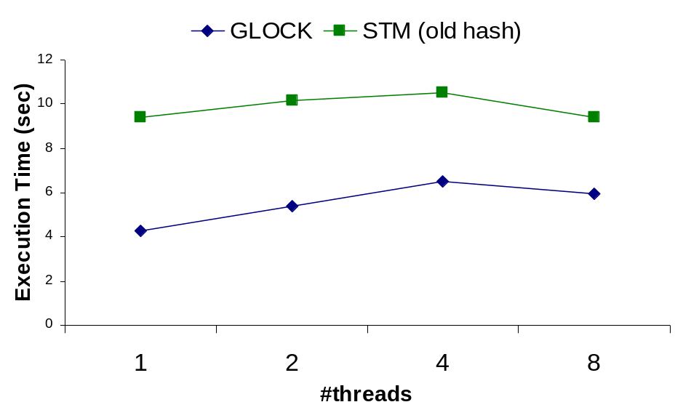
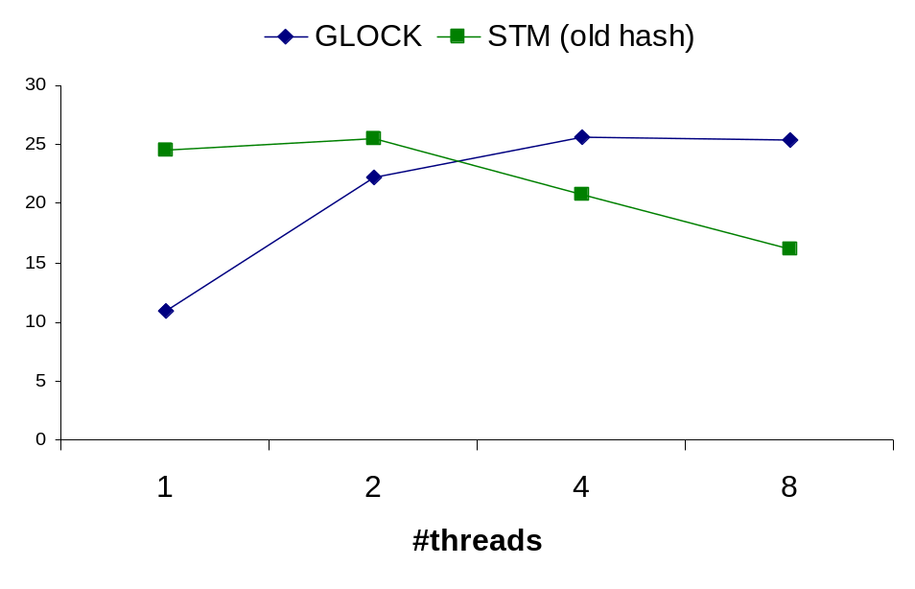
Bottleneck #1: False Conflicts
Performance Results on Genome
Performance Results on Vacation
Poor scalability due to conflicts -- >90% false conflicts
The same STM had no problems on SPLASH-2

Slide 4
Bottleneck #1: False Conflicts (contd.)
Mapping to transaction records [PPoPP’06]
  Addresses map to a transaction record via a hash function
  Different addresses can map to the same record
31
20
19
6
5
0
Address
Reserved to avoid cache line ping ponging
Ownership Table
0x0000
Transaction Record
…
0x3FFF

Slide 5
Bottleneck #1: False Conflicts (contd.)
New hash function
  Use 4 additional bits to index into transaction record
  Effectively increases coverage from 14 bits to 18 bits
31
23
20
19
6
5
0
Address
Ownership Table
0x0000
…
…
0x3FFF

Slide 6
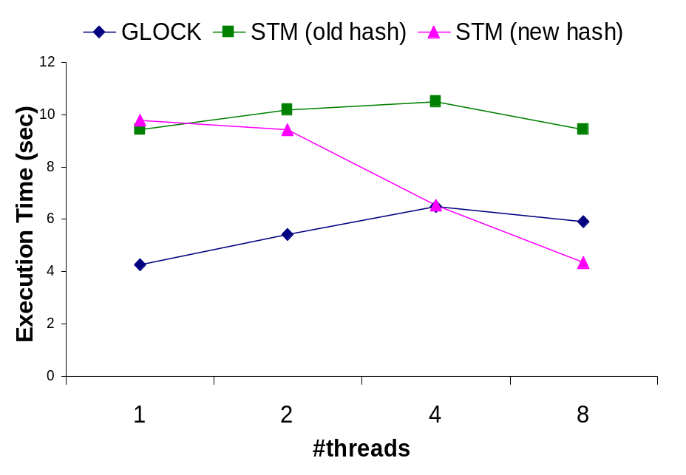
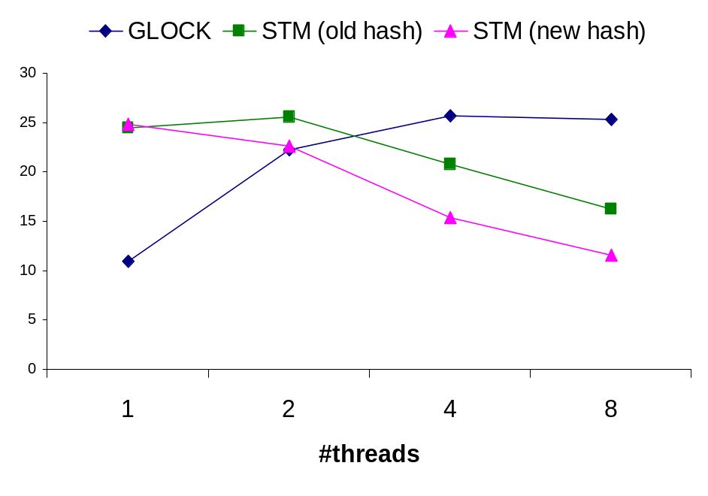
Bottleneck #1: False Conflicts (contd.)
Performance Results on Genome
Performance Results on Vacation
False conflicts are a non-issue in all our workloads
64 bit address space can be problematic

Slide 7
Bottleneck #2: Over-Instrumentation
Compiler generates more barriers than necessary
  thread-local memory accesses,
  objects alternating between modification and constant phase
  Constant global objects
 | TxLD (optimal) | TxLD (compiler) | TxST (optimal) | TxST (compiler) | TxLD overhead | TxST overhead
Genome | 58,701,959 | 624,073,490 | 2,252,291 | 19,078,705 | 10.63x | 8.60x
Kmeans | 86,666,710 | 255,662,754 | 86,666,710 | 86,666,711 | 2.95x | 1.00x
Vacation | 785,775,435 | 925,584,125 | 26,300,714 | 122,543,905 | 1.18x | 4.66x
Transactional Barrier Counts on STAMP

Slide 8
Bottleneck #2: Over-Instrumentation (contd.)
New language construct tm_waiver
  No instrumentation on a block or function marked with tm_waiver
Allows incremental optimization, but use with caution
tm_atomic {
Y = ++X;
tm_waiver {
++local; // no instrumentation
}
}

Slide 9
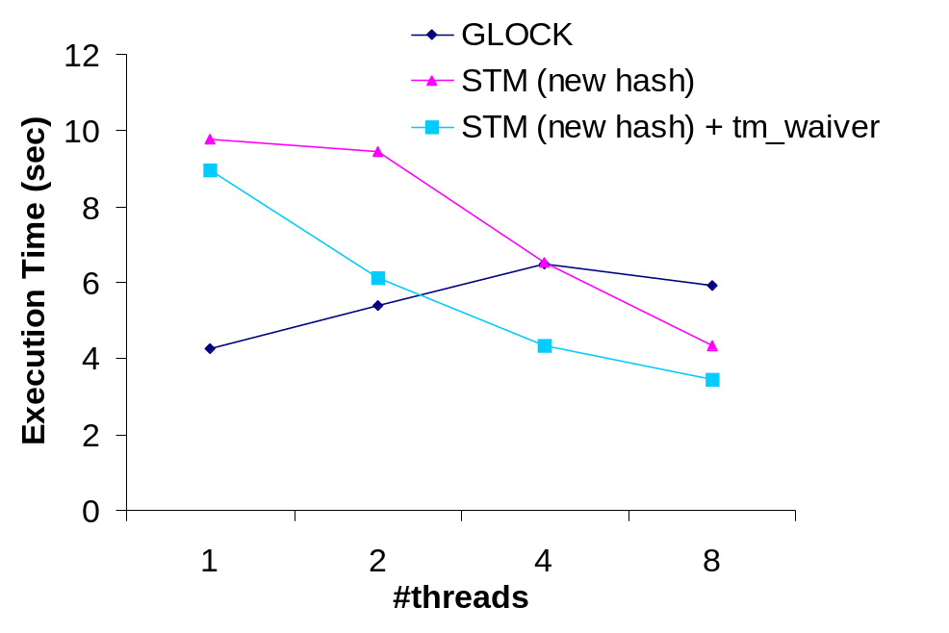
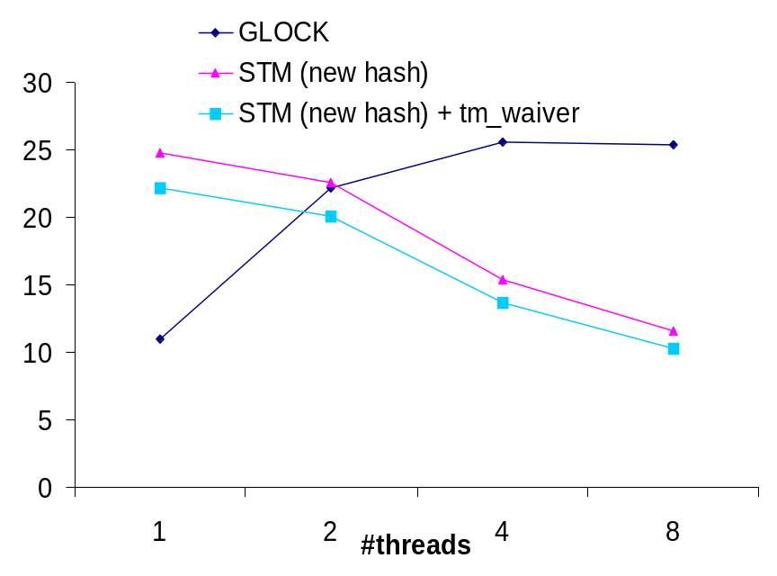
Bottleneck #2: Over-Instrumentation (contd.)
Performance Results on Genome
Performance Results on Vacation
tm_waiver used for
  thread-local object allocation routines
  quasi-static shared objects

Slide 10
Bottleneck #3: Privatization-Safety
Privatization
  A thread privatizes a shared object inside critical section
  Then continues accessing the object outside the critical section
Breaks isolation between transactional and non-transactional access
Globally visible queue Q
Thread 1 | Thread 2
Item item; tm_atomic { item = Q.pop(); } int r1 = item.val1; … | tm_atomic { if (! Q.empty()) { Item item = Q.head(); item.val1++; } }

Slide 11
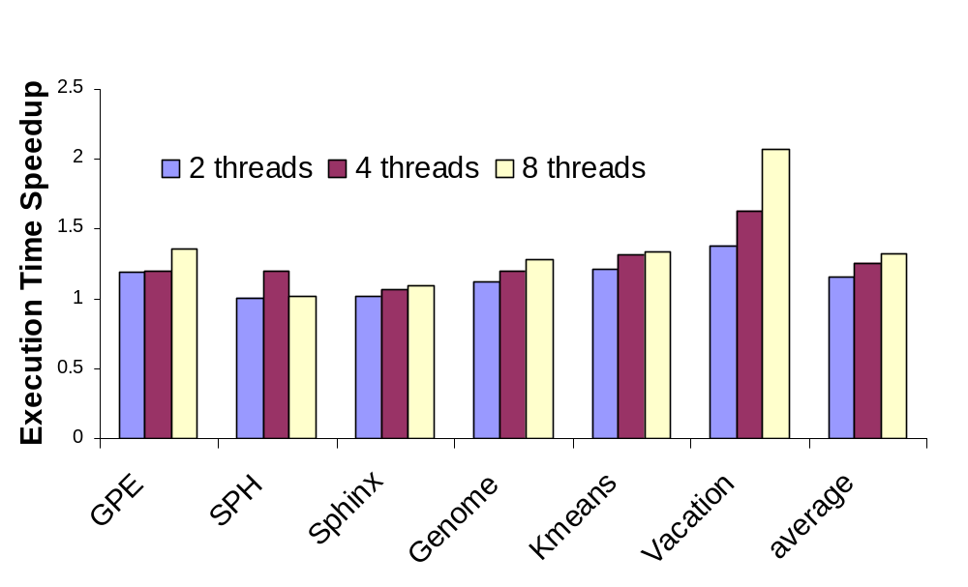
Bottleneck #3: Privatization-Safety (contd.)
API to let programmer selectively turn off privatization

Slide 12
Other Issues
Small transactions overwhelmed by fixed costs
  Eg. SPH: ~1 load and ~2 stores for a transaction
  Different code for small transactions
Workloads without block structured atomics
  Eg. Berkeley DB
  Block structure easier for compiler optimizations
Annotating transactional functions can be a burden
  40% of functions in vacation
Many workloads required condition synchronization

Slide 13
Adaptive STM
Many workloads would not scale at first
Cumulative stats would shed no light
  Low contention, no false conflicts, …
And then we remembered … the devil is in the details …

Slide 14
Sphinx Transactional Characteristics
Per Critical Section Contention (4 threads)
  Only critical section 601 suffers from high abort rate
critical section | tx_begin | commit | abort | abort % | code size (lines)
602 | 1314 | 1312 | 2 | 0.15% | O(1)
542 | 222481 | 221043 | 1438 | 0.65% | O(1)
559 | 220908 | 220908 | 0 | 0.00% | O(1)
601 | 12306 | 6194 | 6112 | 49.67% | O(1000)
571 | 42917 | 42889 | 28 | 0.07% | O(1)
588 | 42770 | 42770 | 0 | 0.00% | O(1)
301 | 1313 | 1312 | 1 | 0.08% | O(1)

Slide 15
Game Physics Contention Analysis
Per Critical Section Breakdown
  Only one critical section does not scale
1 threads
critical section | tx_begin | commit | abort | abort rate
74 | 22596 | 22596 | 0 | 0.00%
1120 | 171607 | 171607 | 0 | 0.00%
1131 | 170666 | 170666 | 0 | 0.00%
215 | 10296420 | 10296420 | 0 | 0.00%
2 threads
critical section | tx_begin | commit | abort | abort rate
74 | 29763 | 22598 | 7165 | 24.07%
1120 | 171658 | 171658 | 0 | 0.00%
1131 | 170716 | 170716 | 0 | 0.00%
215 | 10304252 | 10299481 | 4771 | 0.05%
4 threads
critical section | tx_begin | commit | abort | abort rate
74 | 98810 | 22601 | 76209 | 77.13%
1120 | 172023 | 172023 | 0 | 0.00%
1131 | 171083 | 171083 | 0 | 0.00%
215 | 10327854 | 10321462 | 6392 | 0.06%
8 threads
critical section | tx_begin | commit | abort | abort rate
74 | 156165 | 22599 | 133566 | 85.53%
1120 | 172094 | 172094 | 0 | 0.00%
1131 | 171155 | 171155 | 0 | 0.00%
215 | 10334072 | 10325713 | 8359 | 0.08%

Slide 16
Conclusion
Intel C/C++ STM on realistic workloads
  Intel C/C++ compiler v10.0
  Happyville/McRT STM
  whatif.intel.com for updates
New performance bottlenecks & language issues
Used a combination of language and runtime techniques

