Slide 1
The Elusive Metric for
Low-Power Architecture Research
Hsien-Hsin “Sean” Lee Joshua B. Fryman
A. Utku Diril Yuvraj S. Dhillon
Center for Experimental Research in Computer Systems
Georgia Institute of Technology
Atlanta, GA 30332
Workshop for Complexity-Effective Design, San Diego, CA, 2003

Slide 2
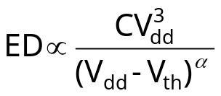
Background Picture
Energy-Delay product (EDP) [Gonzalez & Horowitz 96]
  “Power” is meaningless (∝ frequency)
  “Energy per instruction” is elusive (∝ CV²)
  “Energy × Delay” (J/SPEC or J × IPC) is better
  Use Alpha-power model,
  Note that no “physical” meaning of EDP
Widespread adoption
  De facto standard by community
  Metric for energy and complexity effectiveness
New architectural techniques have arrived
  New hardware exploiting low-power opportunities
  Temperature-aware power detectors
  Voltage & Frequency Scaling
  Multi-threshold voltage

Slide 3
Outline of the Talk
Potential pitfalls
  Yeah, we all know, it is obvious…. but
Which “E” goes in ED product?
Impact of new hardware (more transistors)
Methodology matters in deep submicron processes
Observations
Summary

Slide 4
Calculating ED Product
New architecture solutions save energy at the expense of (insensitive) performance loss
A number of research results were reported in the following manner:
  Technique “X” for Data Cache
    Reduce 50% energy of Data Cache
    Lose 20% IPC
    EDP = (1-0.5)×(1+0.2) = 0.60 ⇒ Very Energy efficient
  Technique “Y” for Branch Predictor
    Reduce 10% energy of Branch Predictor
    Lose 20% IPC
    EDP = (1-0.1)×(1+0.2) = 1.08 ⇒ Energy inefficient

Slide 5
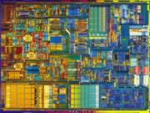
So What is E and What is D in EDP?
Hypothetical black box
  Battery (i.e. E) shared by ⇒
    CPU, DRAM, chipsets, graphics, TFT, Wi-Fi, HDD, flash disk
  D typically account for some system effect such as DRAM latency
Improvement proposed:
  Remove 5% of E from flash disk
  No delay incurred
Is this a good design decision?
  Flash disk is 10% of total E in system
  Improvement amounts to 0.5% system impact
  “In-the-noise” improvement
  Is the “complexity” worth the effort?
So, is EDP used in the right way? And is EDP so important?
DDR-
DRAM
Gfx card
C.S.
flash
HDD
802.11
TFT Display
Battery

Slide 6
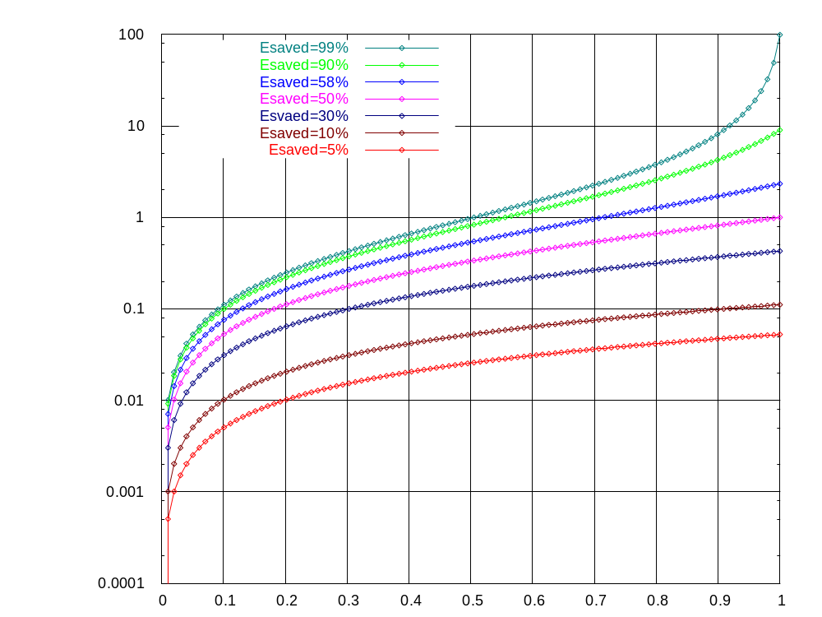
Energy Efficiency: E versus D
Maxmum Delay Tolerance
Power Distribution of a FU w.r.t. target system

Slide 7
Example: Energy Efficiency: E vs. D
Maxmum Delay Tolerance
Tolerate ~25%
performance loss
Energy Distribution w.r.t. target system

Slide 8
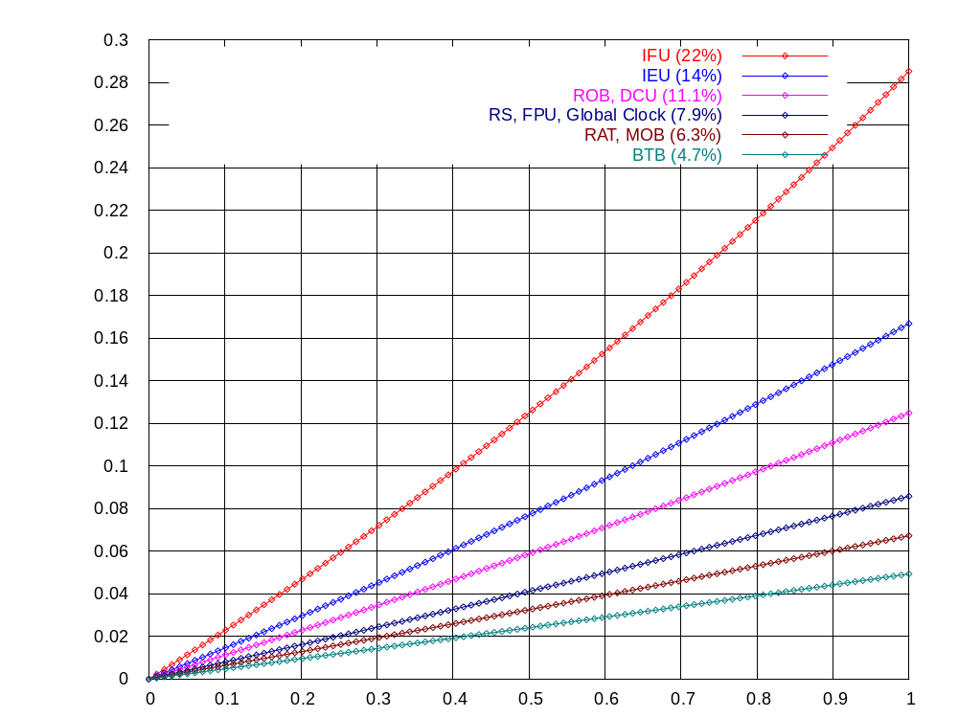
Using EDP: Pentium Pro
Data Source: [Brooks et al. 00]
Assume 100% for CPU
40% IFU power reduction can tolerate < 10% performance loss
Maximum Delay Tolerance
Energy Saved for a functional unit u

Slide 9
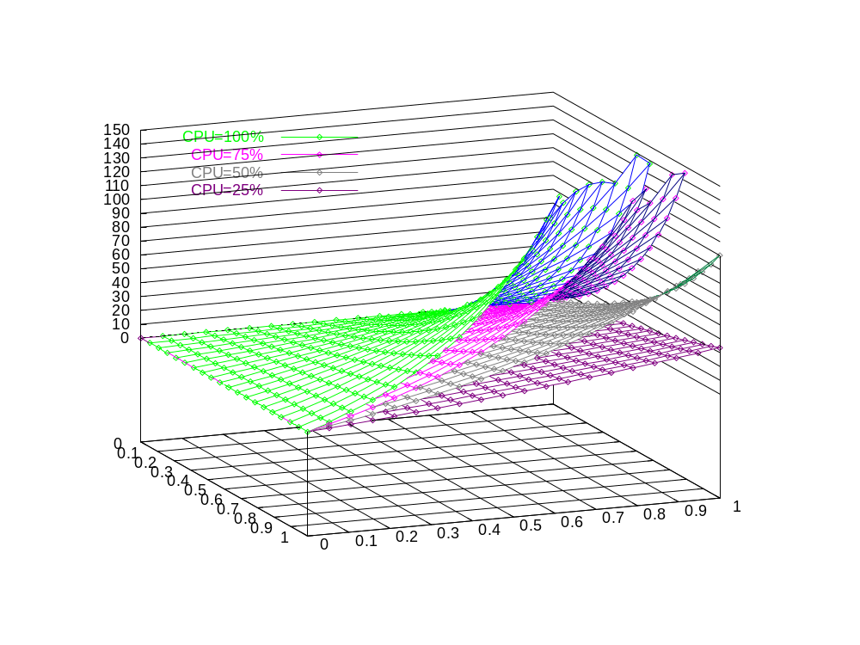
But CPU is not 100% of a System
Maximum Delay Tolerance
Energy Distribution of μ
w.r.t. CPU only
Energy Saving for a functional unit μ

Slide 10
Case Study: Filter Cache [Kin et. al 97,00]
The Filter Cache design as reported
  58% Energy savings in “L1 Caches”
  21% IPC degradation
  ED product as shown
    (1-0.58)(1+0.21) << 1
    suggests this is a winning design
Question is “which E ?”

Slide 11
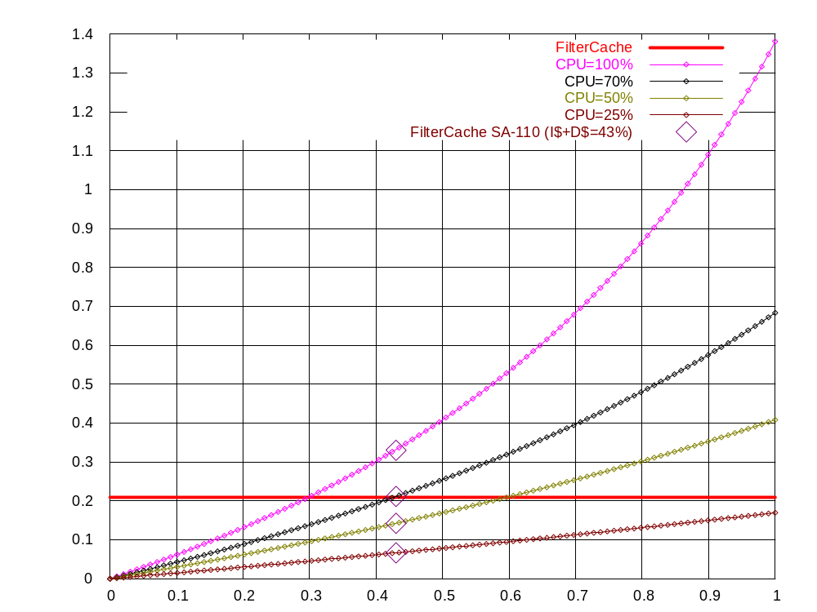
Filter Cache: E Values
Esaved = 58% [Kin et al. 00]
Use StrongARM 110
43% (◊) energy by Caches
  27% in I-CACHE
  16% in D-CACHE
CPU=X% stands for X% of overall power drawn by CPU
Delay Tolerance
  33% : CPU=100%
  21% : CPU=70%
  14% : CPU=50%
  6% : CPU=25%
Not energy-efficient if CPU < 70%
Maximum Delay Tolerance
FC slowdown 21%
Energy distribution for a functional unit u wrt CPU only

Slide 12
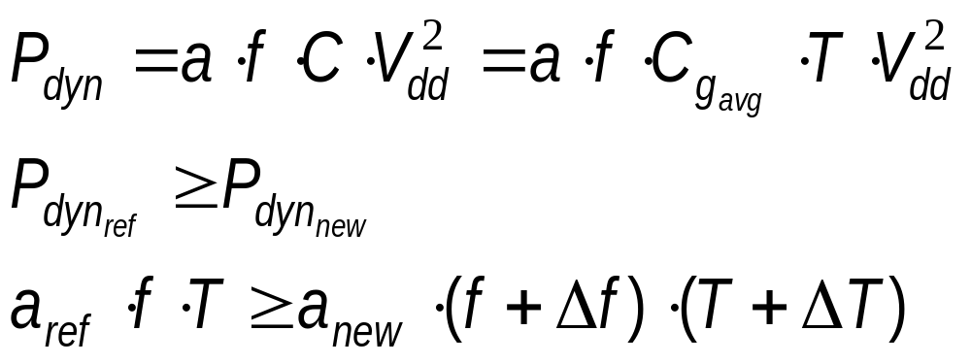
Rethinking EDP:
Switching Activity vs. New Hardware
Ignore leakage and short-circuit power
Dynamic switching power is dominant
The “E” would be below
  T: Transistor count
  f: frequency

Slide 13
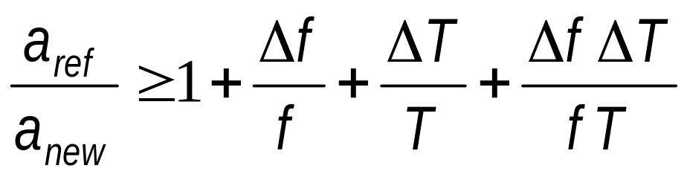
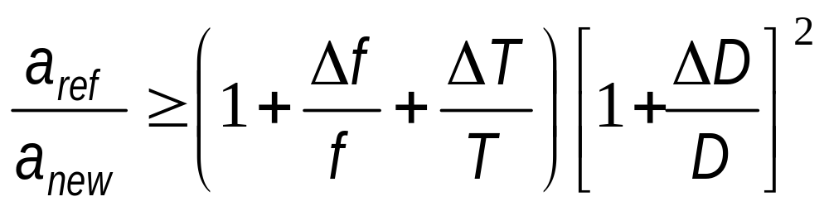
ED Variables
The elegant ratio governing E…
To include the application delay, D…
Can be applied to Macromodeling to determine the trade-off between transistor count and performance degradation

Slide 14
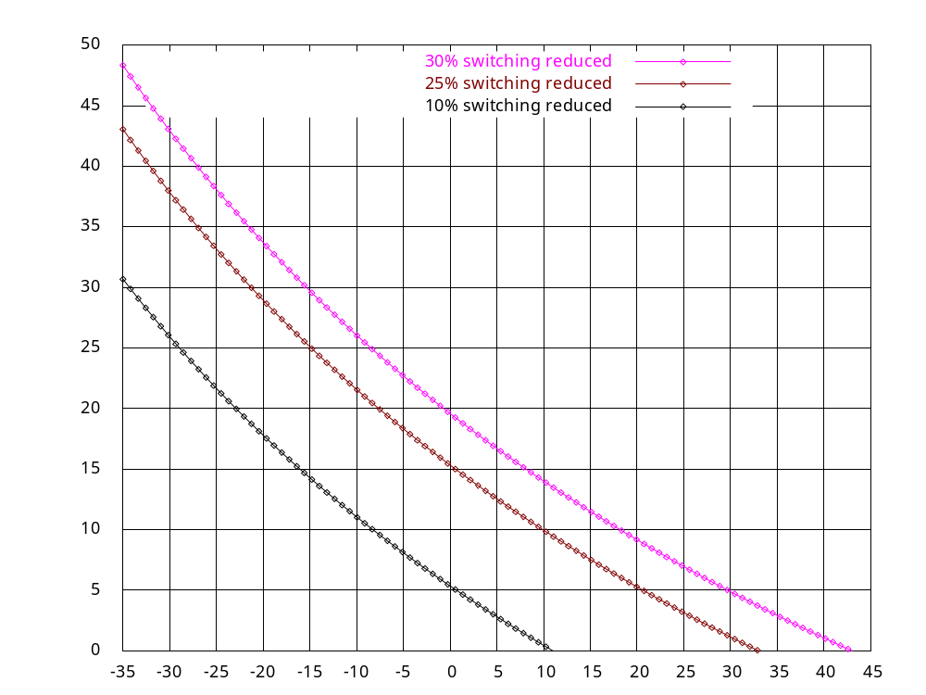
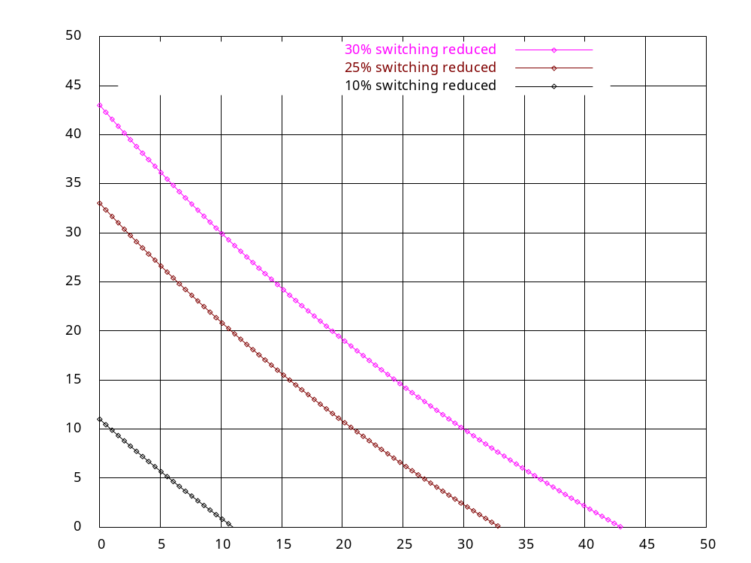
Impact of Additional Transistor Count
% Impact on D
% Impact on f
% Impact on T (given freq. unchanged)
% Impact on T (given delay unchanged
by frequency scaling
Given a new avg switching probability of new architecture
LHS: Trading transistors with delay given no freq. scaling
RHS: Delay recovered by freq. scaling

Slide 15
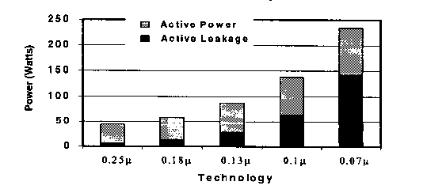
Role of Leakage Energy
As Deep Sub-Micron (DSM) era is upon us...
More than 50%
power
from leakage
Source: Intel Corp. Custom Integrated Circuits Conference 2002
Leakage ignorance could revert conclusion
Early architecture evaluation
  Leakage cannot be isolated from switching during evaluation
  Additional HW can be harmful

Slide 16
Evaluate the Leakage when adding HW in Early Stage of Arch Definition
Example: Dual-speed pipeline [Pyreddy and Tyson’01]
Idea appears to be plausible
  Identify critical instructions [Tune et al 01] [Seng et al. 01]
  Two datapaths: fast and slow
  Critical inst → fast pipe; remainder to slow
  Slow pipe consumes less E than fast pipe
    E.g. Multi-voltage supply, lower frequency
Let’s evaluate and assume:
  N instructions;
  x → slow datapath
  (N-x) → fast datapath
How does leakage impact efficiency?
What x value to achieve energy efficiency?
x% inst
non-critical
1-x% inst
critical
slow
fast

Slide 17
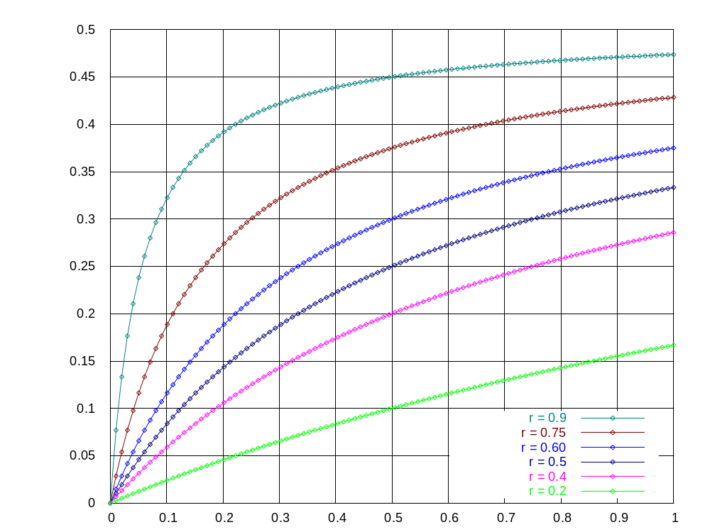
Dual Datapath Leakage Impact
”r” is power ratio of slow vs. fast
A small r ⇒
  impair performance
  Slow path becomes critical path
Minimum instructions to Slow Datapath
Today
Static-to-Total Energy Ratio
Soon to be

Slide 18
Dual Datapath Leakage Impact
”r” is power ratio of slow vs. fast
A small r ⇒
  impair performance
  Slow path becomes critical path
% of non-critical inst needed for slow datapath
  Today: ~17%
  Soon: ~40%
Soon to be
Minimum instructions to Slow Datapath
Today
Static-to-Total Energy Ratio

Slide 19
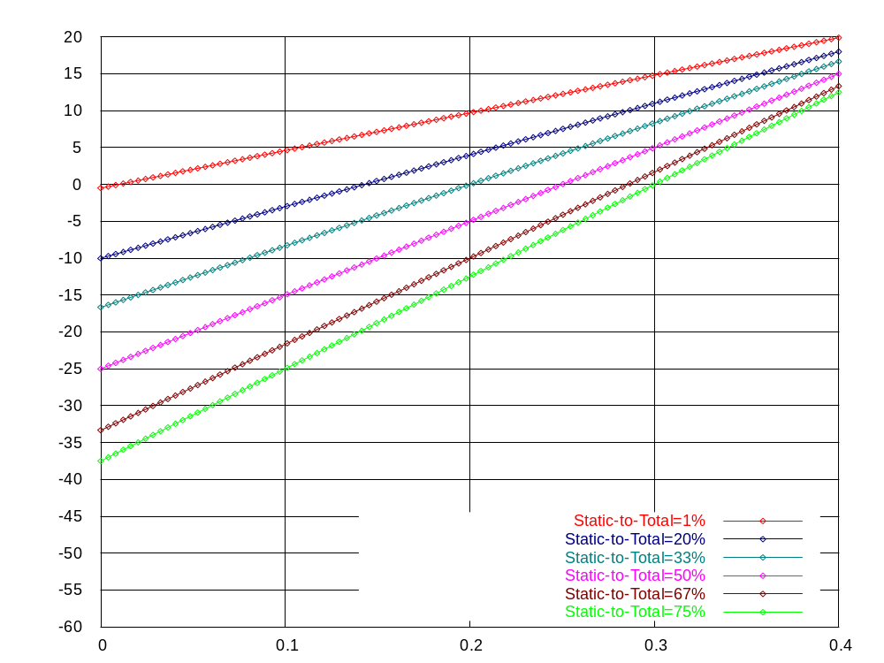
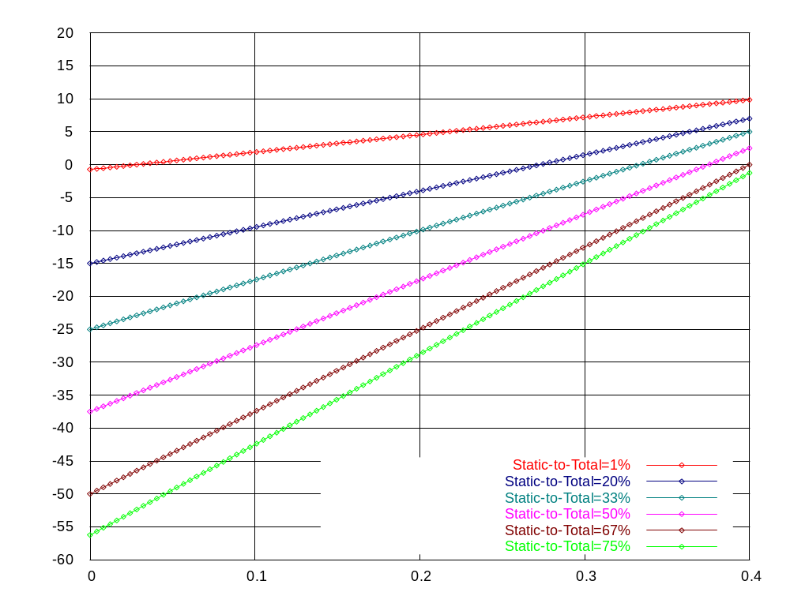
Energy Savings v. # Inst of Slow Path
r = 75%
r = 50%
X-axis : % of instructions to non-critical datapath
Y-axis : % Energy saved
If send 30% instructions to non-critical datapth
  Only save ~5% energy (savings only on datapath) in DSM for r=75%
  Consume more energy in DSM for r=50%
Is the extra complexity paid off?

Slide 20
Observations
It is insufficient to examine ED product on a microscale; the entire system must be examined.
Adding HW complexity for low energy needs to be evaluated thoroughly
  If the target process is not DSM, ED product can be examined via simplified ratio analysis
  For DSM process
    Leakage must be accounted for in local and system E
    Additional HW could be an overkill

Slide 21
Summary
Low-power architecture research:
  Metric ⎯ could be elusive
  Methodology ⎯
    More susceptible to reverse conclusions than performance research, if not meticulously applied
    2nd order effect today ⇒ 1st order effect tomorrow
  “Complexity” can be ineffective in energy reduction
Purposes of our study
  Provide analytical models and methodology for early evaluation
  No intention to invalidate prior results
    WCED ≠ WDDD
  Raise more discussions
  To get it right in education

Slide 22

That’s All Folks !

