Slide 1
Stack Value File :
Custom Microarchitecture for the Stack
Hsien-Hsin Lee Mikhail Smelyanskiy
Chris Newburn Gary Tyson
University of Michigan
Intel Corporation
Notes:
In this talk, we propose a new storage structure, the stack value file, which replaces the cache for stack data. This stack value file is optimized for the particular reference characteristics of stack accesses. By constructing a custom structure for stack references, we will show that overall execution performance is improved while memory traffic is significantly reduced.

Slide 2
Agenda
Organization of Memory Regions
Stack Reference Characteristics
Stack Value File
Performance Analysis
Conclusions
Notes:
My notes

Slide 3
Memory Space Partitioning
max mem
Based on programming language
Non-overlapped subdivisions
Split code and data ⇒ I-cache & D-cache
Split data into regions
  Stack (↓)
  Heap (↑)
  Global (static)
  Read-only (static)
reserved
Stack grows downward
Protected
Heap grows upward
Global Static Data Region
Code Region
Read-only data
reserved
min mem

Slide 4
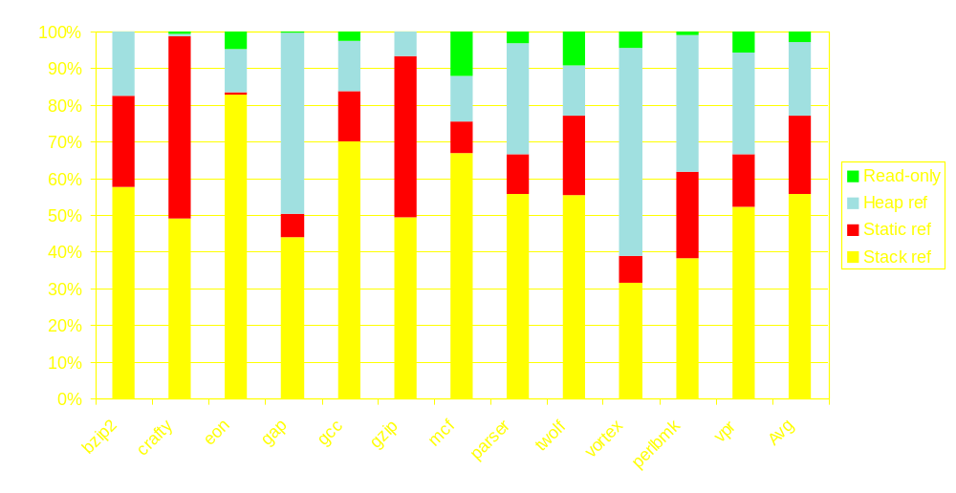
Memory Access Distribution
SPEC2000int benchmark (Alpha binary)
42% instructions access memory

Slide 5
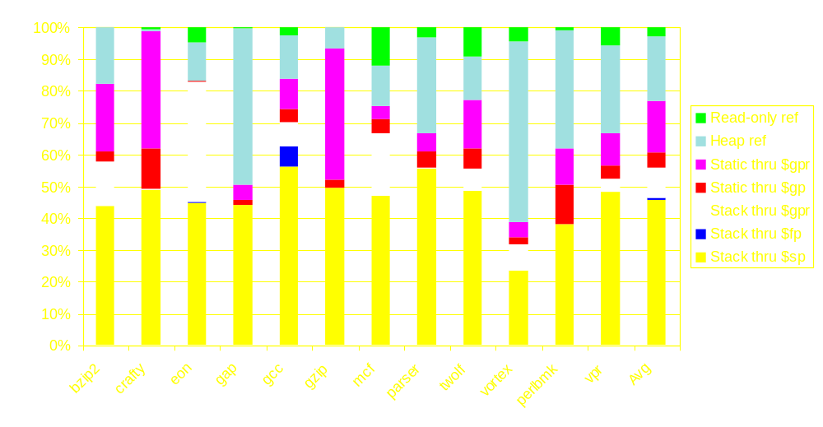
Access Method Breakdown
86% of the stack references use ($sp+disp)
Notes:
We will use this characteristic in the stack value file as you will see later to reduce the latency of the stack references

Slide 6
Morphing $sp-relative References
Morph $sp-relative references into register accesses
Use a Stack Value File (SVF)
Resolve address early in decode stage for stack-pointer indexed accesses
Resolve stack memory dependency early
Aliased references are re-routed to SVF
Notes:
We can exploit the fact that stack references use $sp+displacement addressing by converting the displacement value into an index in the SVF early in the pipeline. I will show this conversion in a few slides. The effect of this early indexing is that the latency of an SVF references will equal that of a register access, not an L1 cache access which would occur much later in the pipeline.

Slide 7
Stack Reference Characteristics
Contiguity
  Good temporal and spatial locality
  Can be stored in a simple, fast structure
    Smaller die area relative to a regular cache
    Less power dissipation
  No address tag need for each datum
Notes:
In addition to the restriction of the addressing mode, there are several other characteristics of stack references that we will exploit in our scheme.
First, the active portion of the cache tends to be a single contiguous region and, furthermore, it’s a relatively small region. The working set of the stack is relatively small. This means that our storage structure unlike conventional cache need not to be made multiple lines, the working set will fit into one larger line, say 2 kb line. Therefore, we don’t need address tags, we’ll have faster access to it and it my have less power dissipated.

Slide 8
Stack Reference Characteristics
First touch is almost always a Store
  Avoid waste bandwidth to bring in dead data
  A register write to the SVF
Deallocated stack frame
  Dead data
  No need to write them back to memory
Notes:
Another feature of stack references and how they fit into normal cache structures is that the 1st reference to a new activation record is a store, this is because by convention region above a stack is undefined and the first use should be a store. What this means for a cache structure, when we have a cache miss it’s like to be caused by a store, and it’s likely that the data in the rest of the cache line is also to be a store before it’s read. This wastes bandwidth by bring in dead data. We’ll avoid this in our SVF design.
Additionally, deallocated stack frames need not be written back to memory since by convention when memory is deallocated in the stack, it becomes undefined. This is because I just mentioned the first time we access when it’s reallocated it would be a store.

Slide 9
Baseline Microarchitecture
Issue
Execute
Commit
Fetch
Decode
Dispatch
Ld
/St
MOB
Unit
DecoderQ
Reservation Station / LSQ
Reg
Instr
-Cache
Decoder
Renamer
(
RAT)
Func Unit
ArchRF
ReOrder
Buffer

Slide 10
Microarchitecture Extension
Issue
Execute
Commit
Fetch
Decode
Dispatch
Ld
/St
MOB
Unit
DecoderQ
Reservation Station / LSQ
Reg
Instr
-Cache
Decoder
Renamer
(
RAT)
Func Unit
Morphing
Pre-Decode
offset
ArchRF
Max
ReOrder
Buffer
SP
Hash
Stack
SP
Value
File
interlock

Slide 11
Microarchitecture Extension
stq $r10, 24($sp)
TOS
Issue
Execute
Commit
Fetch
Decode
Dispatch
Ld
/St
MOB
Unit
DecoderQ
Reservation Station / LSQ
Reg
Instr
-Cache
Decoder
Renamer
(
RAT)
Func Unit
Morphing
Pre-Decode
offset
ArchRF
Max
ReOrder
Buffer
SP
Hash
Stack
SP
Value
File
interlock

Slide 12
Microarchitecture Extension
stq $r10, 24($sp)
TOS
Issue
Execute
Commit
Fetch
Decode
Dispatch
Ld
/St
MOB
Unit
DecoderQ
Reservation Station / LSQ
Reg
Instr
-Cache
Decoder
Renamer
(
RAT)
Func Unit
Morphing
Pre-Decode
offset
3
ArchRF
Max
ReOrder
Buffer
SP
Hash
Stack
SP
Value
File
interlock
Notes:
-

Slide 13
Microarchitecture Extension
stq $r10, 24($sp)
$r35 ↔ ROB-18
TOS
Issue
Execute
Commit
Fetch
Decode
Dispatch
Ld
/St
MOB
Unit
DecoderQ
Reservation Station / LSQ
Reg
Instr
-Cache
Decoder
Renamer
(
RAT)
Func Unit
Morphing
Pre-Decode
offset
ArchRF
Max
ReOrder
Buffer
SP
Hash
Stack
SP
Value
File
interlock

Slide 14
Microarchitecture Extension
stq $r10, 24($sp)
$r35 ↔ ROB-18
TOS
Issue
Execute
Commit
Fetch
Decode
Dispatch
Ld
/St
MOB
Unit
DecoderQ
Reservation Station / LSQ
Reg
Instr
-Cache
Decoder
Renamer
(
RAT)
Func Unit
Morphing
Pre-Decode
offset
ArchRF
Max
ReOrder
Buffer
SP
Hash
Stack
SP
Value
File
interlock

Slide 15
Microarchitecture Extension
stq $r10, 24($sp)
$r35 ↔ SVF3
TOS
Issue
Execute
Commit
Fetch
Decode
Dispatch
Ld
/St
MOB
Unit
DecoderQ
Reservation Station / LSQ
Reg
Instr
-Cache
Decoder
Renamer
(
RAT)
Func Unit
Morphing
Pre-Decode
offset
ArchRF
Max
ReOrder
Buffer
SP
Hash
Stack
SP
Value
File
interlock

Slide 16
Why could SVF be faster ?
It reduces the latency of stack references
It effectively increases the number of memory port by rerouting more than ½ of all memory references to the SVF
It reduces contention in the MOB
More flexibility in renaming stack references
It reduces memory traffic

Slide 17
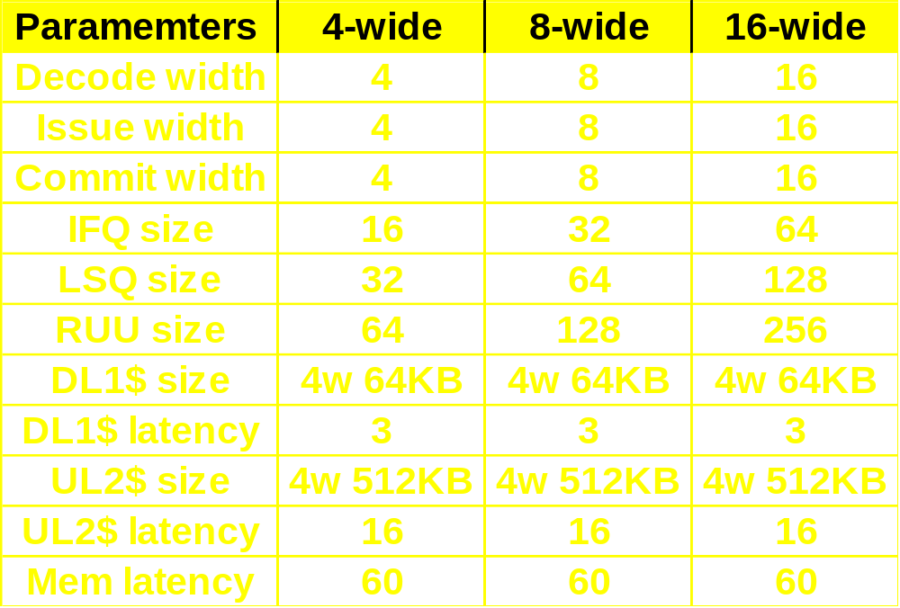
Simulation Framework
Simple Scalar (Alpha binary), OOO model

Slide 18
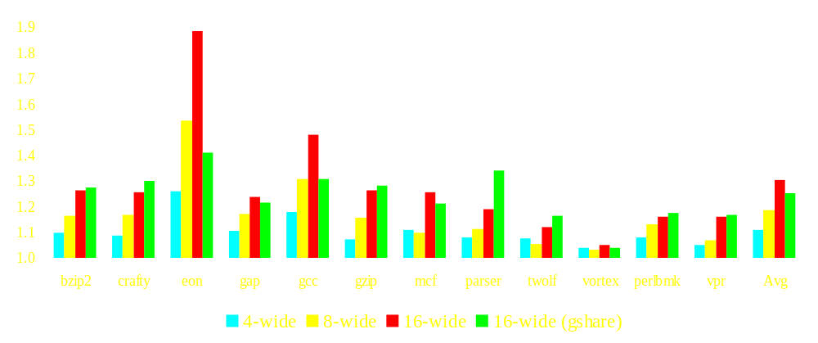
Speedup Potential of SVF
Assume all references can be morphed
~30% speedup for a 16-wide with dual-ported L1

Slide 19
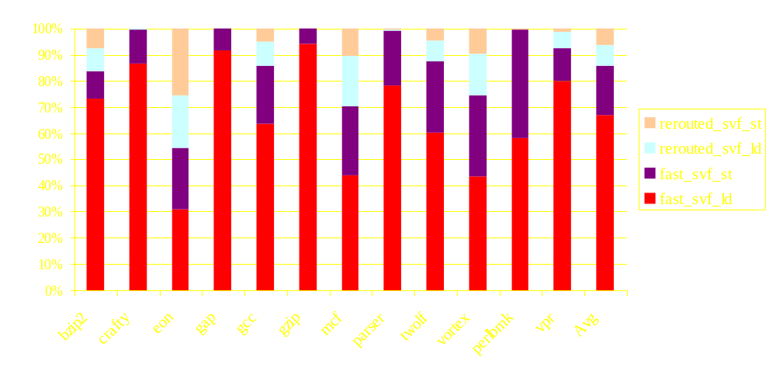
SVF Reference Type Breakdown
86% stack references can be morphed
Re-routed references enter normal memory pipeline

Slide 20
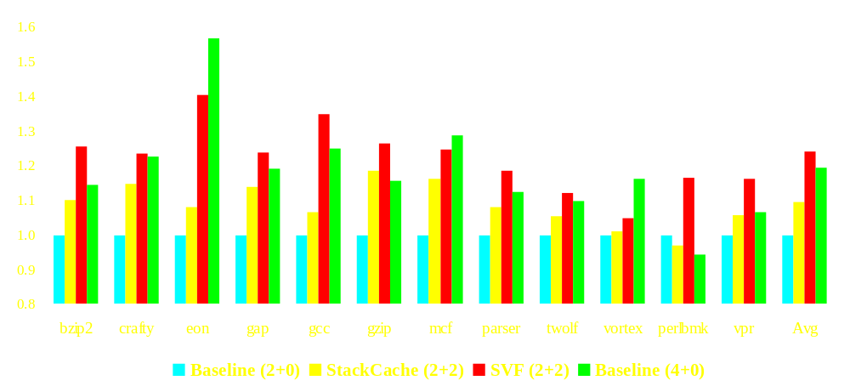
Comparison with stack cache
(R+S) : Regular and Stack or SVF cache ports
Notes:
Point out the oddball case of perlbmk. The reason of SC2+2 is slower than the baseline is because SC misses dominate the critical path

Slide 21
Memory Traffic
SVF dramatically reduces memory traffic by many order of magnitude.
  For gcc, ~28M (Stk$ ↔ L2) reduced to ~86K (SVF ↔ L1).
Incoming traffic is eliminated because SVF does not allocate a cache line on a miss.
Outgoing traffic consists of only those words that are dirty when evicted (instead of entire cache lines).

Slide 22
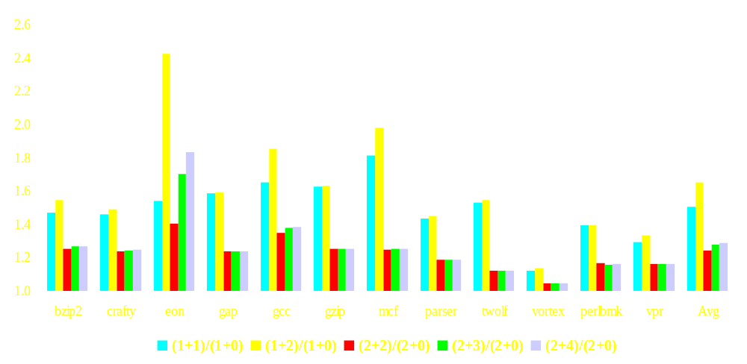
SVF over Baseline Performance
(R+S) : Regular and SVF cache ports

Slide 23
Conclusions
Stack references have several unique characteristics
  Contiguity, $sp+disp, first reference store, frame deallocation.
Stack Value File
  a microarchitecture extension to exploit these characteristics
  improves performance by 24 - 65%

Slide 24

Questions & Answers

Slide 25
That's all, folks !!!
http://www.eecs.umich.edu/~linear

Slide 26
Backup Foils

Slide 27
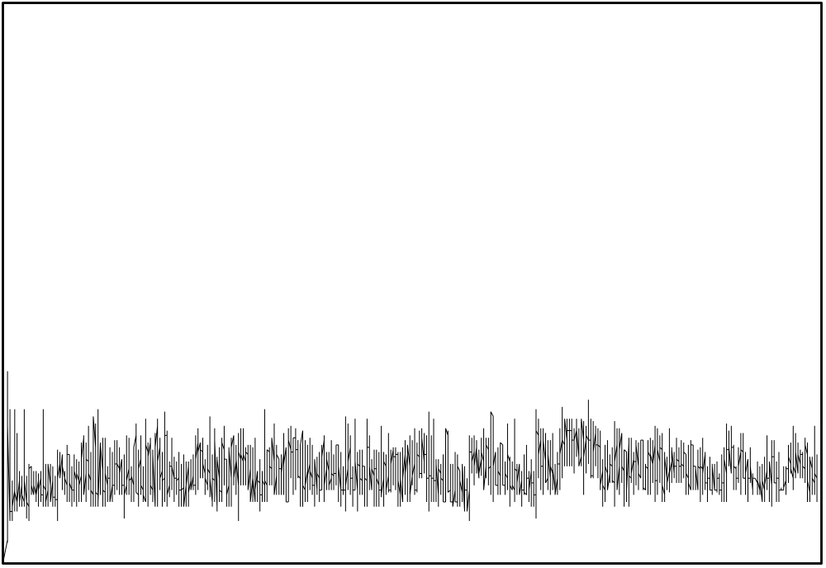
Stack Depth Variation

Slide 28
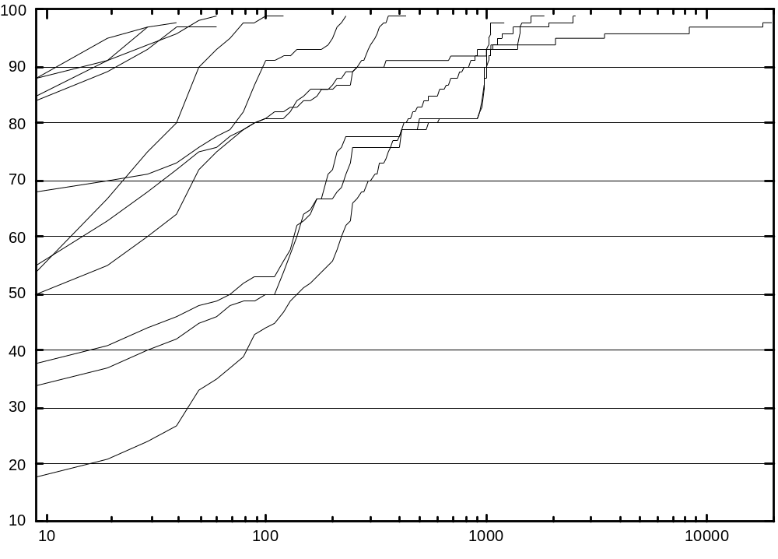
Offset Locality of Stack
Cumulative offset within a function call
Avg: 3b - 380b
>80% offset within“400b”
>99% offset within“8Kb”
Cumulative %
Offset in Bytes (Log scale)

Slide 29
Conclusions
Stack reference features
  Contiguity
  No dirty writeback when stack deallocated
Stack Value File
  Fast indexing.
  Alleviate multi-porting L1 cache.
  Smaller, No tags, and less power.
  Exploiting ILP
Notes:
Global data and stack data show good life span and their working set sizes are rather small compared to the dynamically allocated heap data.

