Slide 1
Characterizing
Private Transformer-Based Models
via MPC
Yongqin Wang, G. Edward Suh, Wenjie Xiong, Benjamin Lefaudeux
Brian Knott, Murali Annavaram, Hsien-Hsin S. Lee

Slide 2
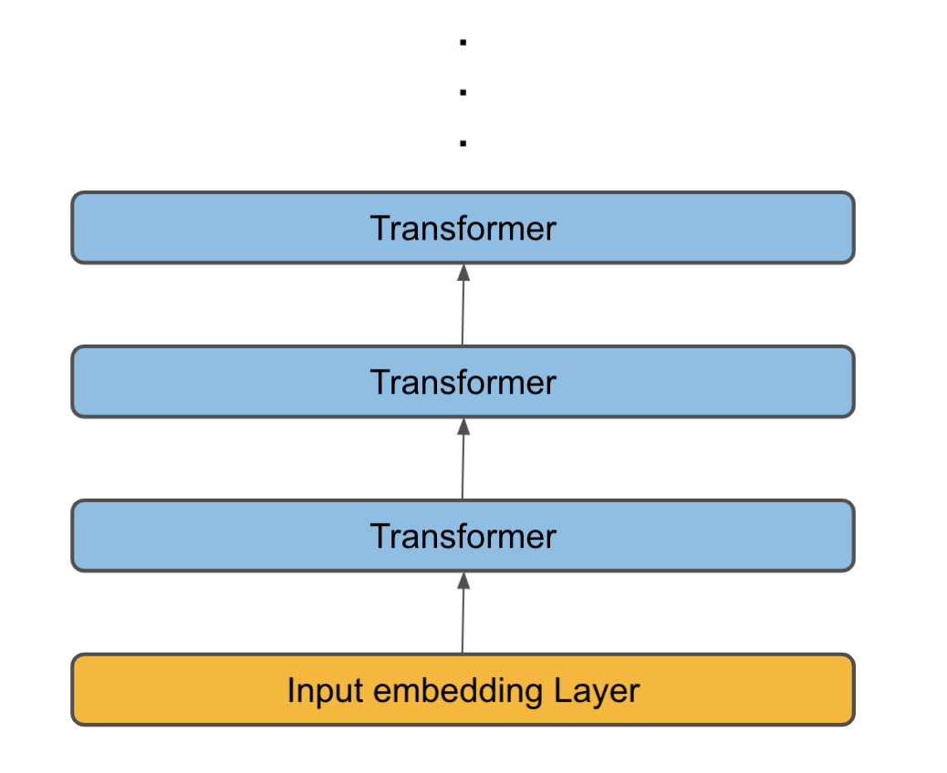
Objectives
P1
P2
P3
Secrete Share #1
Secrete Share #2
Secrete Share #3
Characterizes Inference Runtime & Challenges when MPC is implemented on Transformer-based models

Slide 3
Outline
Backgrounds
Transformer-based Models
Embedding tables
Transformer
Secure Multi-party Computing
General Terms
Secret Sharing
Approximations
Characterizations
Softmax overhead Analysis
Dynamic Range Issue
Accuracy & Performance trade-offs for embedding tables using tensor-train decomposition

Slide 4
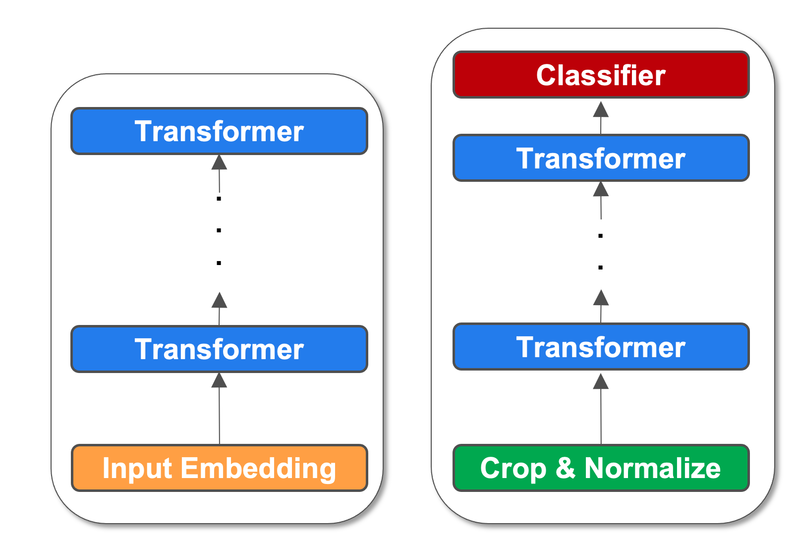
Transformer-Based Models
Natural Language Processings: BERT, RoBERT, XLM, XLMR
Vision Models: ViT
Two Main components in transformer-based models

Slide 5
Transformer-Based Models
Natural Language Processings: BERT, RoBERT, XLM, XLMR
Vision Models: ViT
Two Main components in transformer-based models

Slide 6
Embedding Table
Categorical Data -> Embedding Space
Categorical Data is very difficult to use
Semantically similar items are not close
E = A^{T} * W
W is embedding table (a matrix)
A is categorical data
Music | Map | Vlog | News | History
0 | 1 | 0 | 0 | 0
Music | Map | Vlog | News | History
0 | 0 | 0 | 0 | 1
Two sparse vector for most watched video types
Embedding tables makes inputs more meaningful

Slide 7
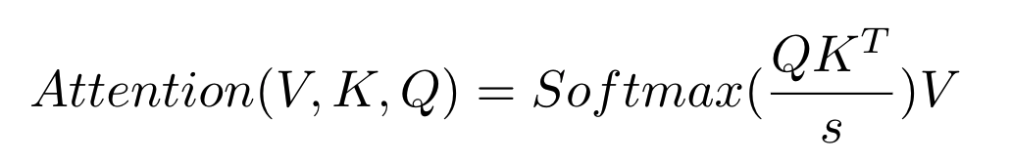
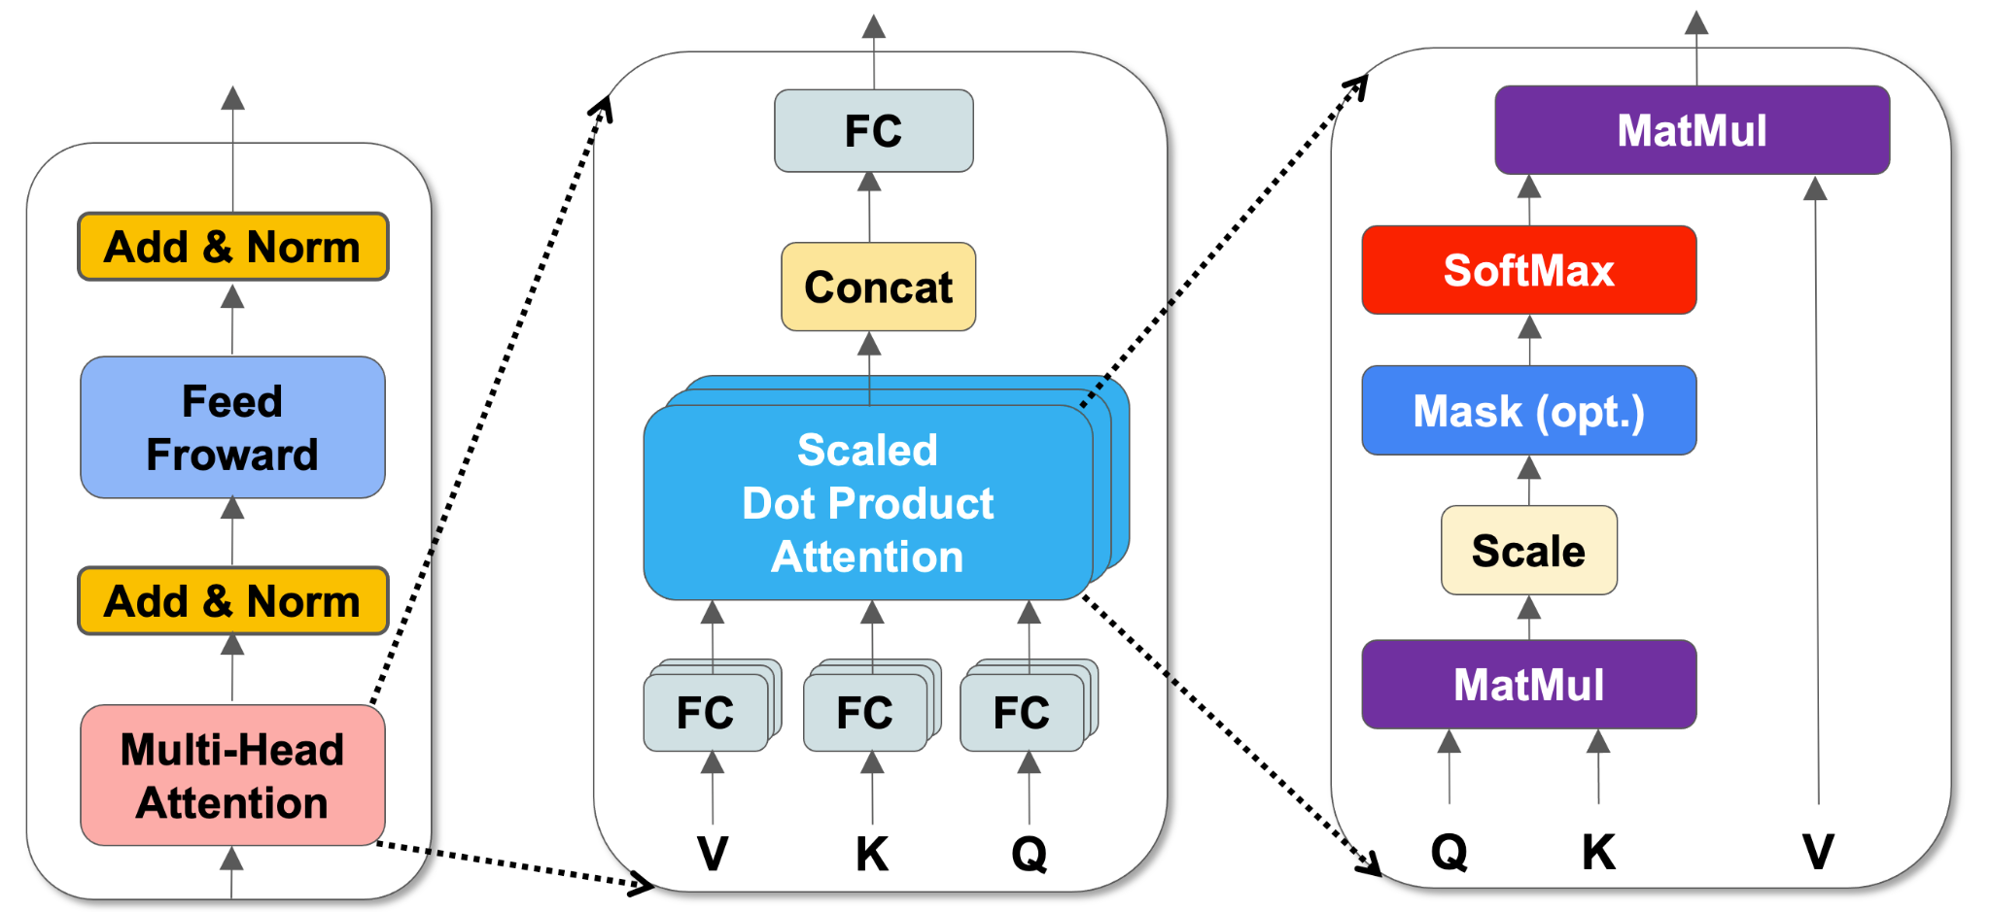
Transformer
Linear(ACT(Linear(x)))
Transformer Computation Components:
Linear, Activations, Softmax

Slide 8
Outline
Backgrounds
Transformer-based Models
Embedding tables
Transformer
Secure Multi-party Computing
General Terms
Secret Sharing
Approximations
Characterizations
Softmax overhead Analysis
Dynamic Range Issue
Accuracy & Performance trade-offs for embedding tables using tensor-train decomposition

Slide 9
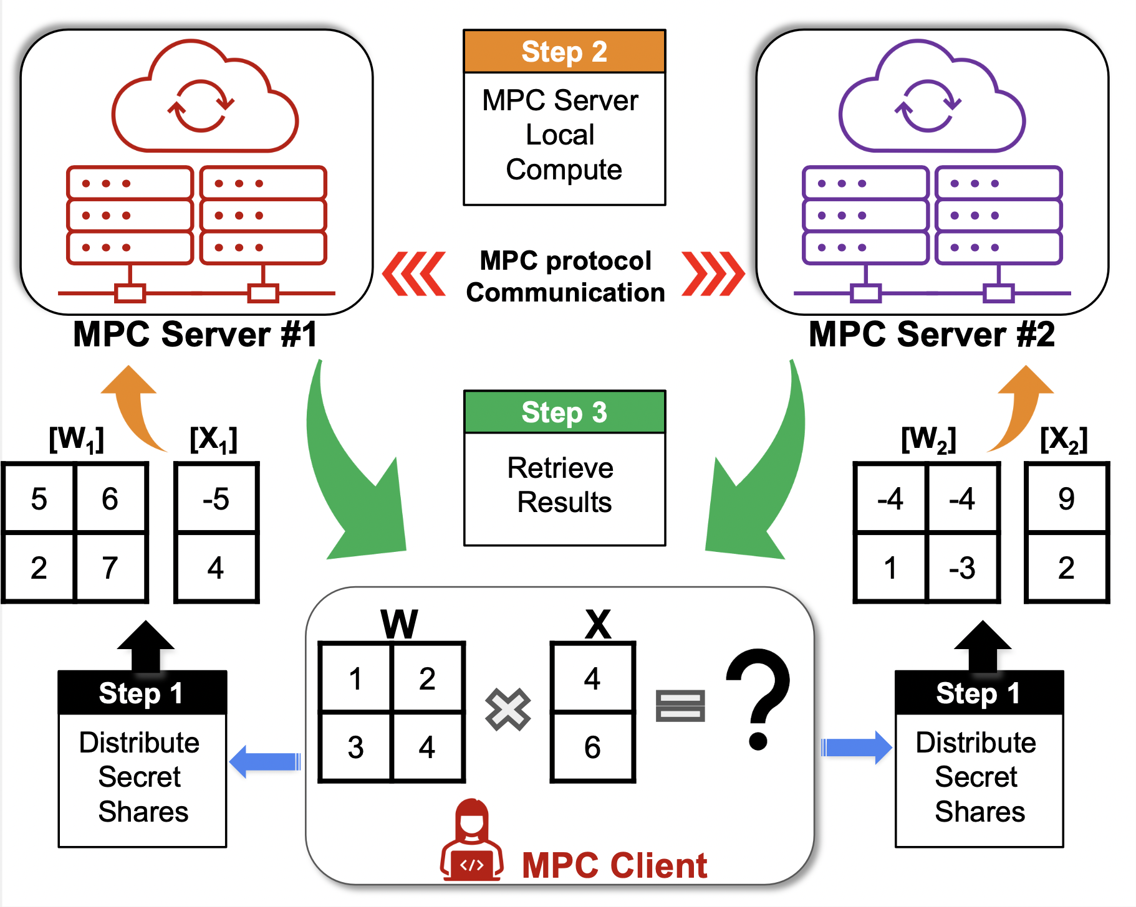
Secure Multi-Party Computing
Secure cloud computing protocol
Step #1
Distribute shares
Additive & binary
Step #2
MPC servers computes
Step #3
Retrieve Results
MPC protocols allows secure remote computation

Slide 10
MPC Secrete Share Distribution
Additive Secrete Sharing
Beaver Triple Multiplications
MPC server Communication is required
Additions : adding local shares
Binary Secrete Sharing
Bit extractions
Bitwise manipulations
Usually implemented as Fixed point
Additive:
Share(x, 2) -> x - r, r
Such that x₁ + x₂ = x
Binary:
Share(x, 2) -> x₁= r,, x₂=x xor r
Such that x₁ xor x₂ = x
Additive good for adding/multiplying, Binary is good for bitwise ops

Slide 11
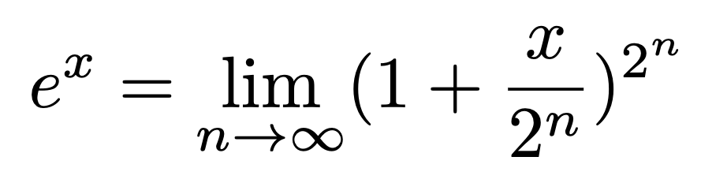
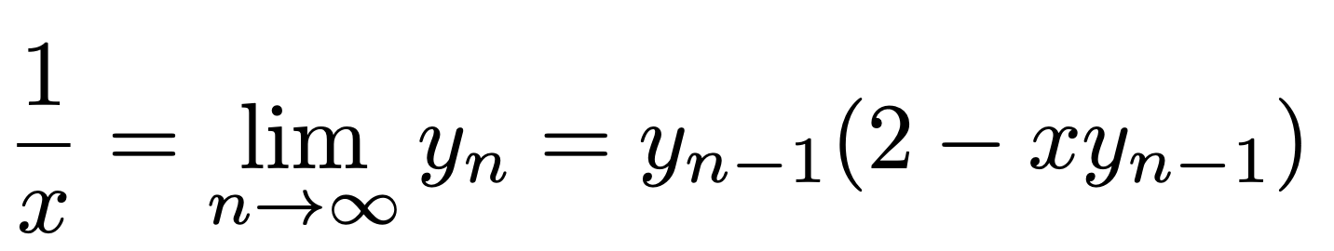
Approximated Non-linear Functions
Exponential
Reciprocal
Due to the use of fixed points & approximation, there exists a dynamic range
Non-linear functions are approximated in MPC

Slide 12
Outline
Backgrounds
Transformer-based Models
Embedding tables
Transformer
Secure Multi-party Computing
General Terms
Secret Sharing
Approximations
Characterizations
General Decomposition
Softmax overhead Analysis
Dynamic Range Issue
Accuracy & Performance trade-offs for embedding tables using tensor-train decomposition

Slide 13
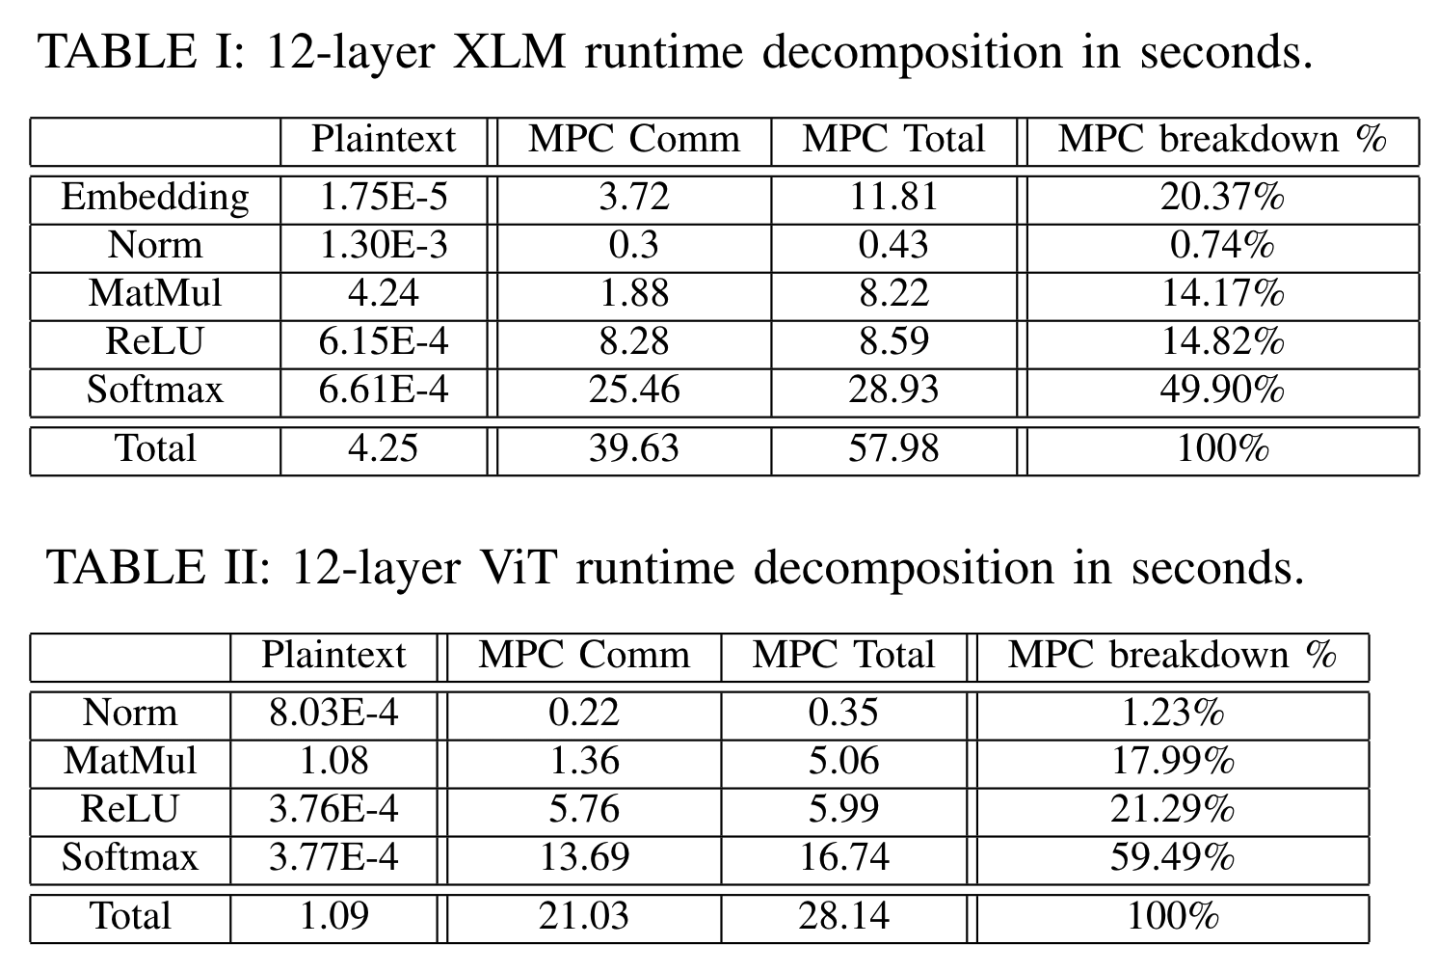
Transformer Model 2-party runtime
Crypten GPU
Softmax dominates
Embedding
Implemented as matmul
Softmax function is slow in MPC

Slide 14
Transformer Model 2-party runtime
Crypten GPU
Softmax dominates
Embedding
Implemented as matmul
Softmax function is slow in MPC

Slide 15
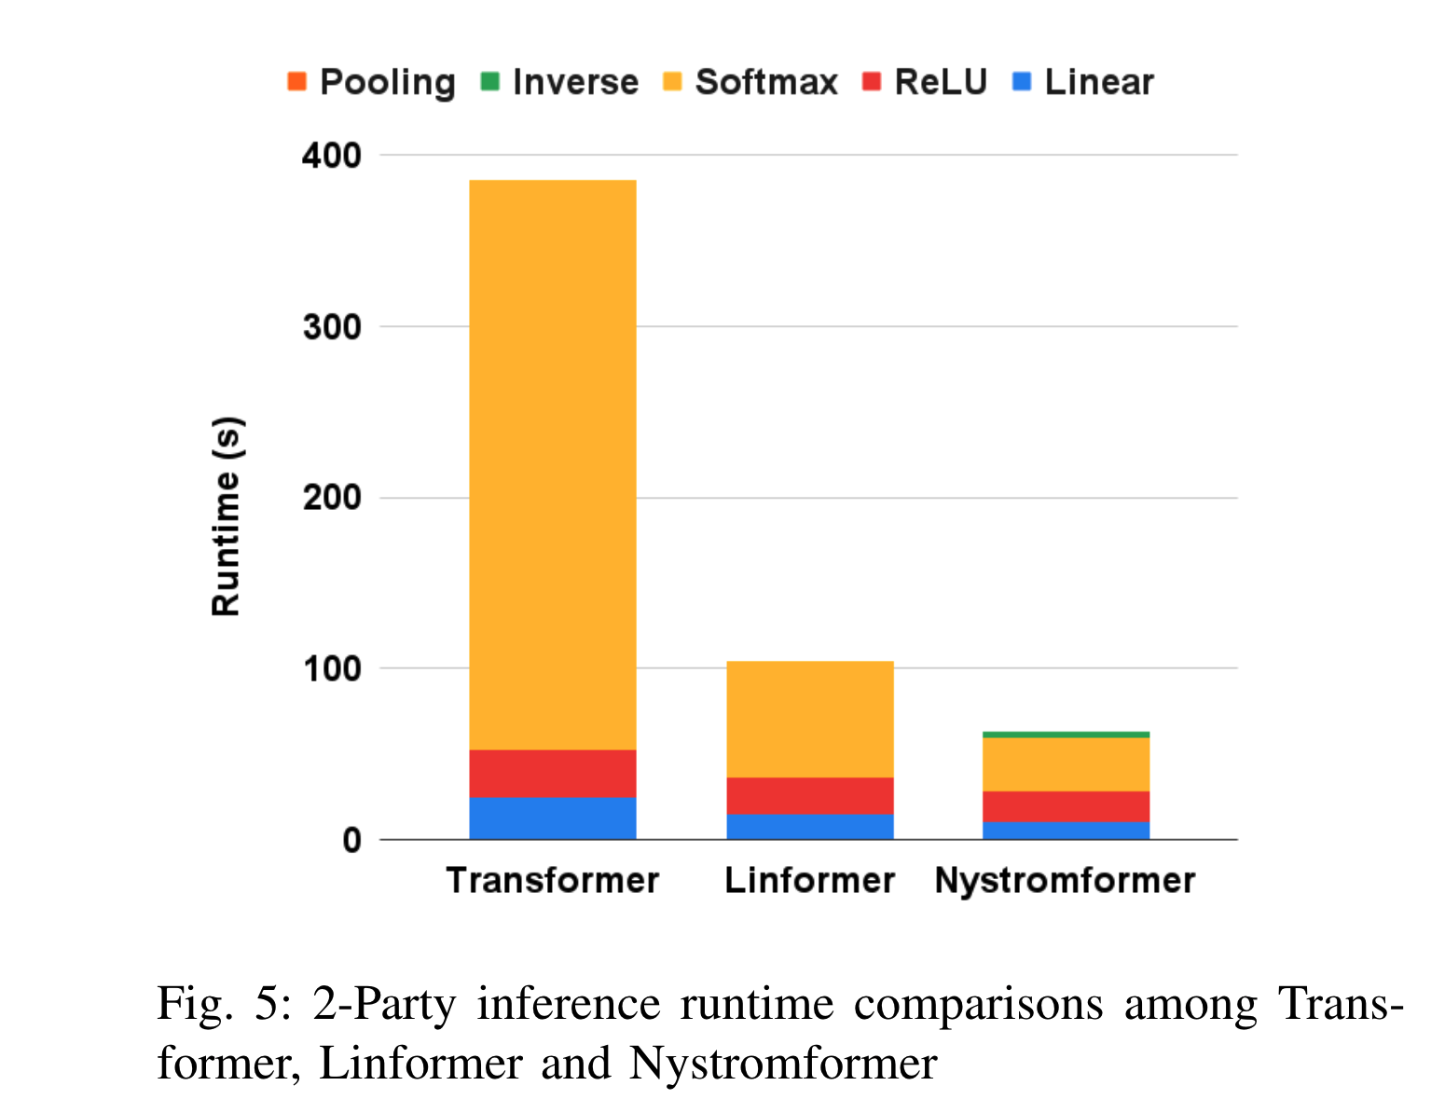
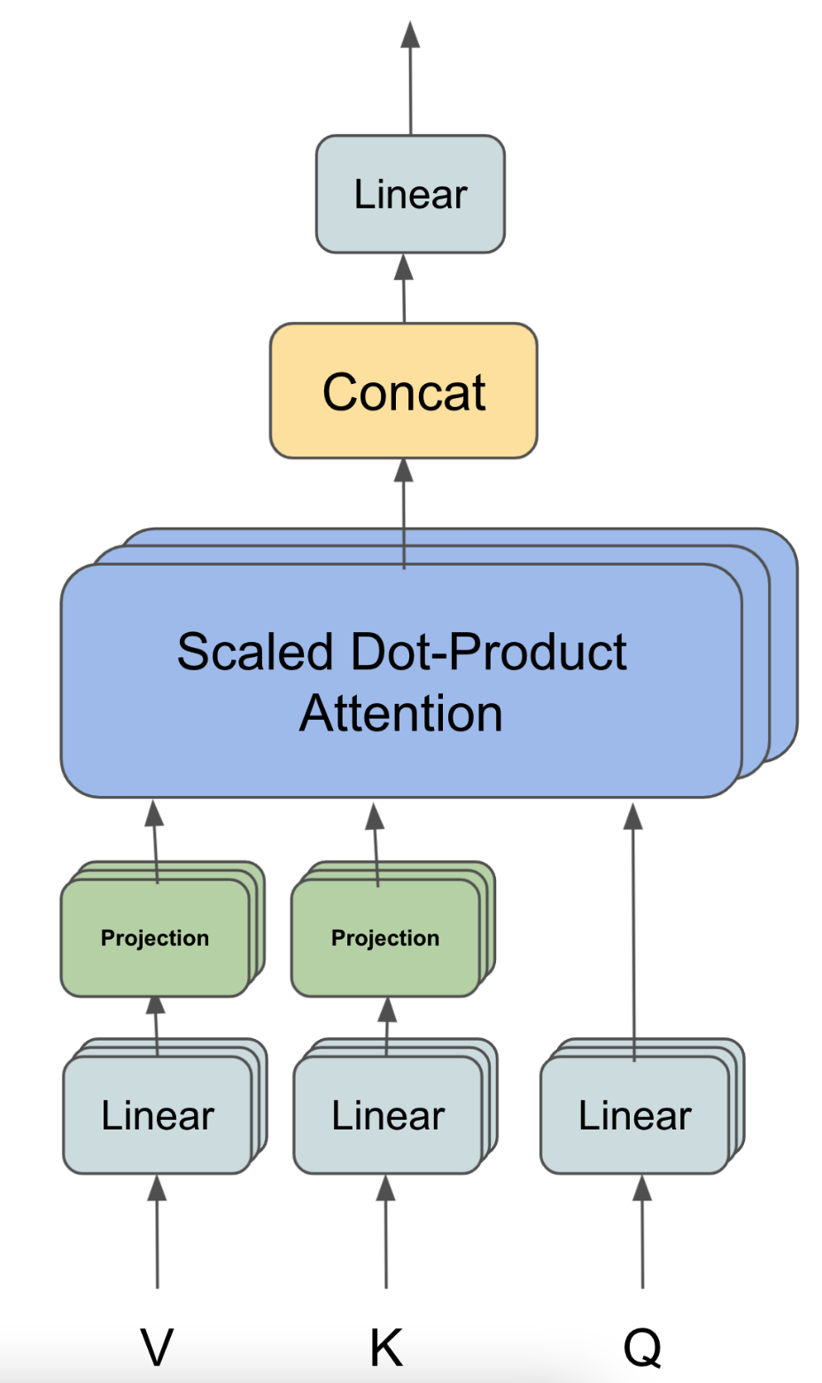
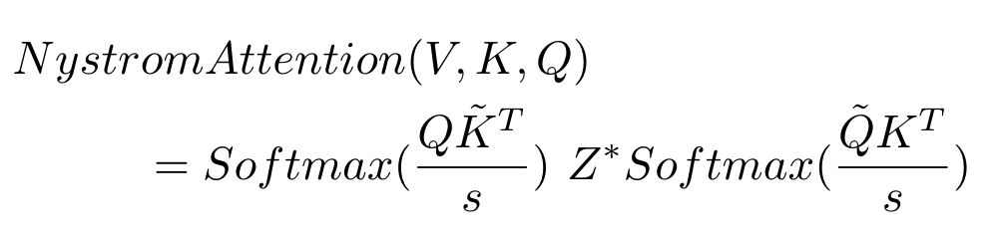
Other Transformers
Nystromformers & Linformer
Reduce dimensions
Nystromformers
Linformers
Softmax is still bottleneck for other Transformer Architecture

Slide 16
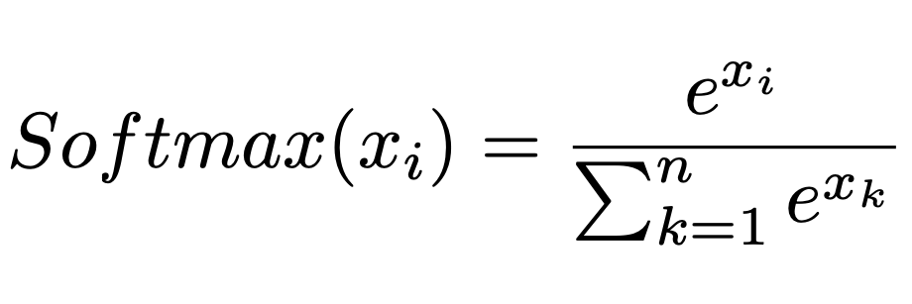
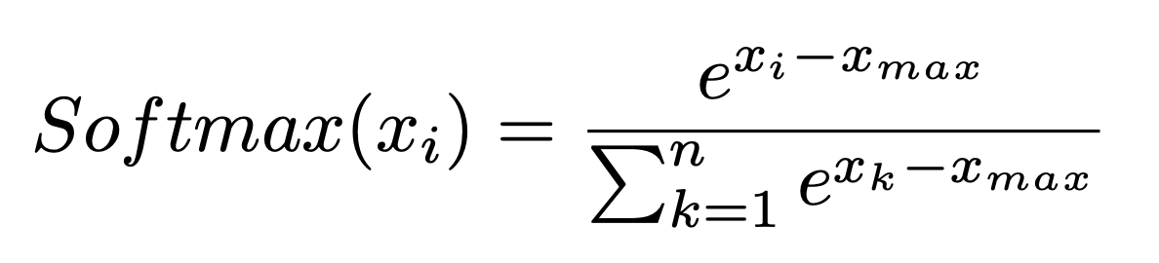
Softmax Analysis
Maximum function for numerical stability (80% of total softmax)
Exponential function explodes quickly
Comparison in MPC is expensive
Step#1 Compute differences
Step#2 Extract MSB
Require conversion between additive & binary sharing (a very expensive operations)
2 rounds of communications

Slide 17
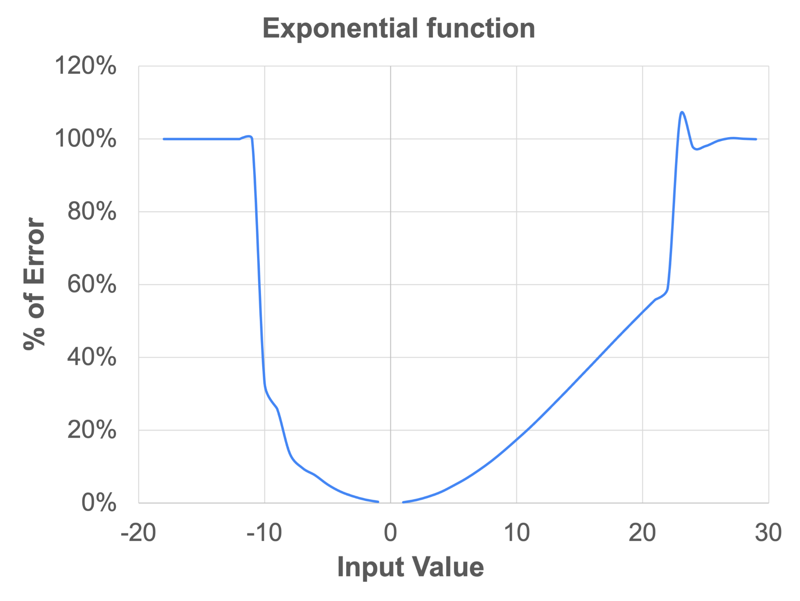
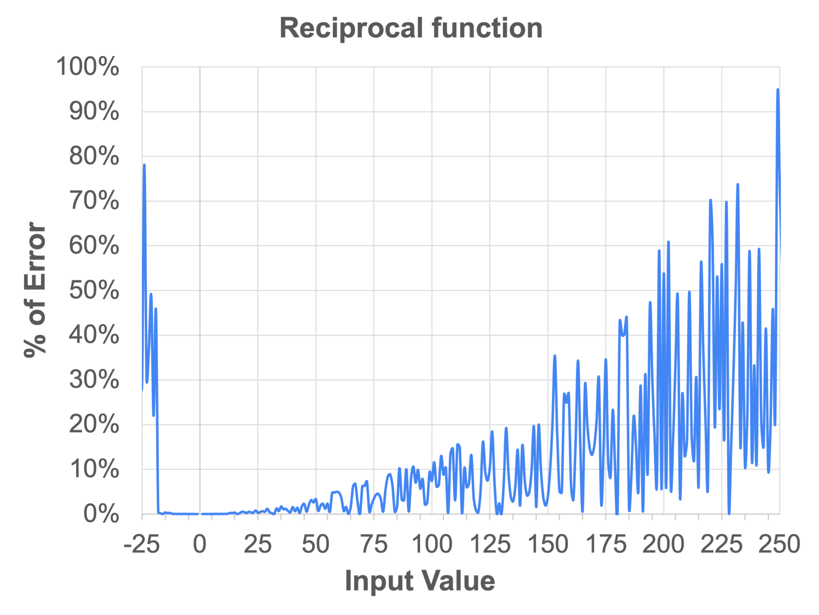
Dynamic Range
Exponentials & Reciprocals are Approximated
Tight dynamic range for non-linear functions
Exponential -> Reciprocal
Very challenging due to instability of MPC approximations

Slide 18
Dynamic Range Challenges
Challenge #1: New non-linear functions
Outside dynamic range leads to random guess
Example: GeLU function
Challenge #2: Replacing the MAX very challenging
Tight Dynamic range for both Exponential & Reciprocals
Two challenges related to the dynamic range

Slide 19
Dynamic Range Challenge #2
Sum of Exponentials followed by a reciprocal
Any increase to the input of Exponential leads to
Inputs out of Reciprocal dynamic range

Slide 20
Outline
Backgrounds
Transformer-based Models
Embedding tables
Transformer
Secure Multi-party Computing
General Terms
Secret Sharing
Approximations
Characterizations
General Decomposition
Softmax overhead Analysis
Dynamic Range Issue
Accuracy & Performance trade-offs for embedding tables using tensor-train decomposition

Slide 21
Security Concerns about Embedding Tables
Embedding Looks ups - > Pooling operations
Access Patterns leaks
OS can peak Page number
Prime & Probe
Not well studied for MPC ML
Music | Map | Vlog | News | History
0 | 1 | 0 | 0 | 0
Music | Map | Vlog | News | History
0 | 0 | 0 | 0 | 1
Recommendation Models -> Users’ preferences or clicks
NLP -> Vocabulary IDs
Embedding table accesses leak input information

Slide 22
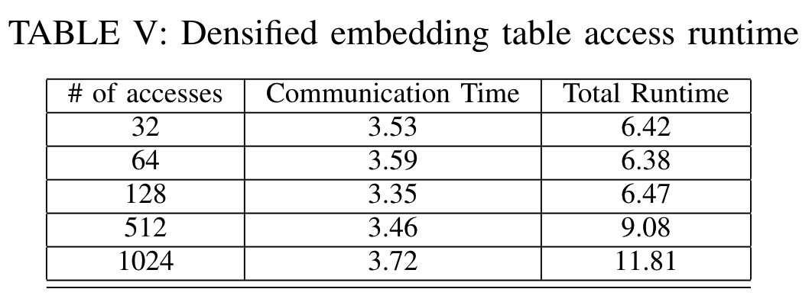
Mitigations to Embedding Table Accesses
Access them all
Densified
Native one-hot matrix mul
Factor them & Access them all
Decompose Bigger Tables into smaller ones
Tensor Train Decomposition
Trade Computations for Communications

Slide 23
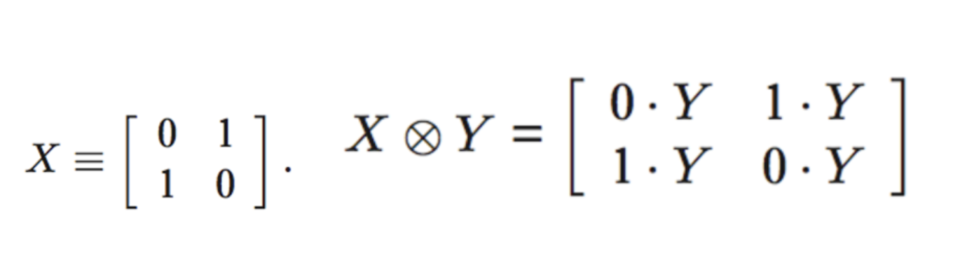
Tensor Product Decomposition
4x4 matrix
two 2 x 2 matrices
16 -> 8
Several Configuration runtime is reasonable
Great reduction in oblivious data memory size

Slide 24
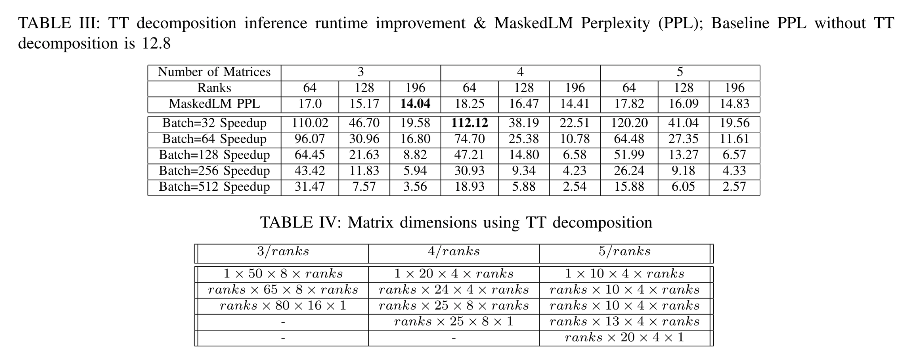
Decomposition Configurations & their runtime
The original Matrix size is [120,004 x 1024]

Slide 25
Thank You !

Slide 26
Tensor Product
Open sourced accuracy
Skewed : a subset of entries are more frequently accessed
Production data
Less skewed
Shows Accuracy degradation
DLRMs
Future experiments
Learn Decomposition from trained table
Study accuracy impacts on new Models and datasets
Requires accuracy studies

