Slide 1
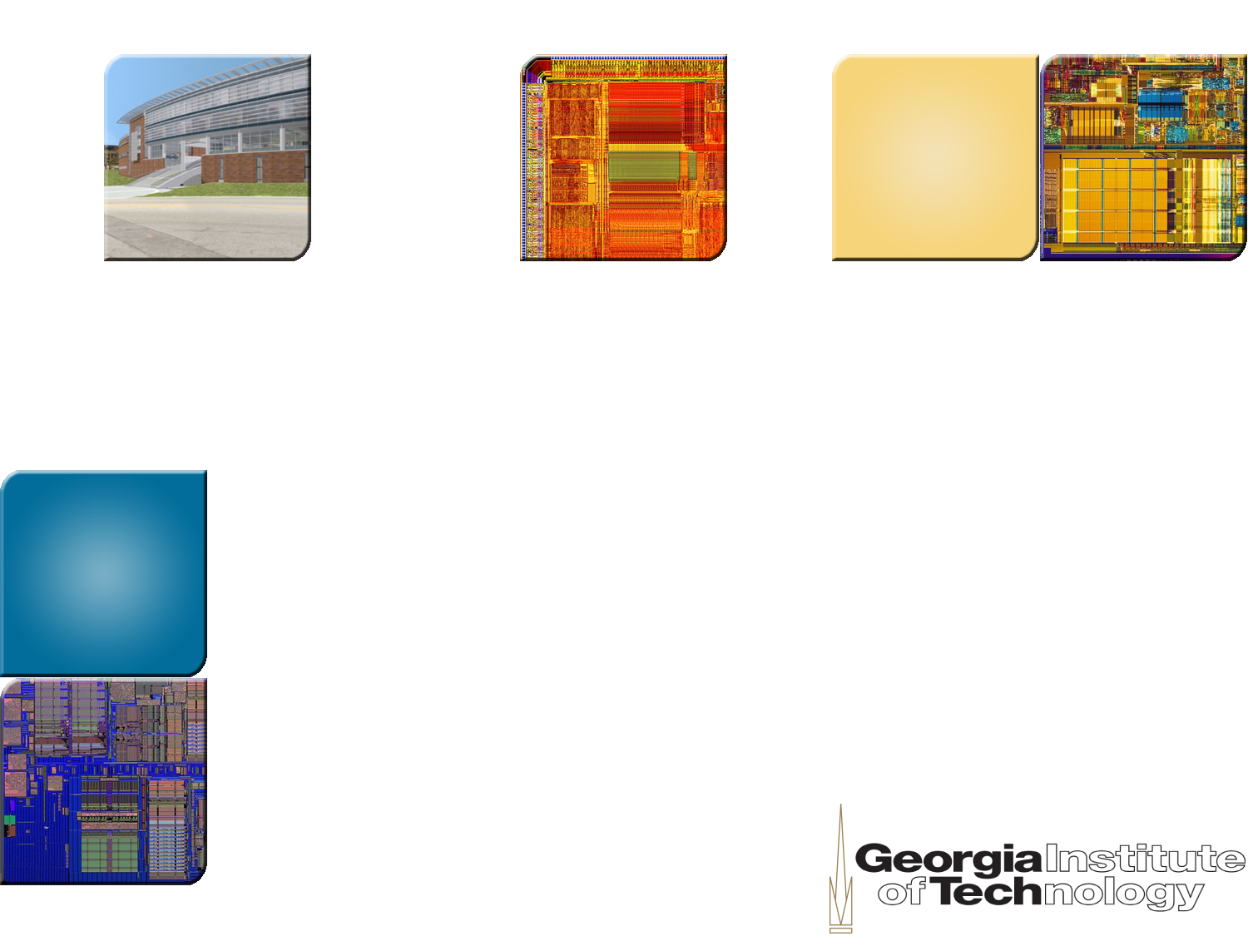
ECE8833 Polymorphous and Many-Core Computer Architecture
Lecture 2
From Reservation Table to EPIC Architecture
Prof. Hsien-Hsin S. Lee
School of Electrical and Computer Engineering

Slide 2

Pipeline Design
Pipelining increases throughput
Linear pipeline is straightforward
L
L
L
L
L
input
output
S1
S2
S3
S4
[See handout: Peter Kogge’s book]

Slide 3
Non-linear (or Dynamic) Pipeline
Stages might have different latencies
Multiple paths out of one stage to other stages
Multi-functional
input
output
S1
S2
S3
Machine X
Generalized form of pipeline definition

Slide 4
Reservation Table [Davidson’71]
Machine X
input
output
S1
S2
S3
Reservation Table
Time →
 | 0 | 1 | 2 | 3 | 4 | 5 | 6 | 7
S1
S2
S3
Stage →

Slide 5
Reservation Table [Davidson’71]
Machine X
input
output
S1
S2
S3
Reservation Table
Time →
 | 0 | 1 | 2 | 3 | 4 | 5 | 6 | 7
S1 | X
S2
S3
Stage →

Slide 6
Reservation Table [Davidson’71]
Machine X
input
output
S1
S2
S3
Reservation Table
Time →
 | 0 | 1 | 2 | 3 | 4 | 5 | 6 | 7
S1 | X | X
S2
S3
Stage →

Slide 7
Reservation Table [Davidson’71]
Machine X
input
output
S1
S2
S3
Reservation Table
Time →
 | 0 | 1 | 2 | 3 | 4 | 5 | 6 | 7
S1 | X | X
S2 |  |  | X
S3
Stage →

Slide 8
Reservation Table [Davidson’71]
Machine X
input
output
S1
S2
S3
Reservation Table
Time →
 | 0 | 1 | 2 | 3 | 4 | 5 | 6 | 7
S1 | X | X
S2 |  |  | X
S3 |  |  |  | X
Stage →

Slide 9
Reservation Table [Davidson’71]
Machine X
input
output
S1
S2
S3
Reservation Table
Time →
 | 0 | 1 | 2 | 3 | 4 | 5 | 6 | 7
S1 | X | X
S2 |  |  | X |  | X
S3 |  |  |  | X
Stage →

Slide 10
Reservation Table [Davidson’71]
Machine X
input
output
S1
S2
S3
Reservation Table
Time →
 | 0 | 1 | 2 | 3 | 4 | 5 | 6 | 7
S1 | X | X
S2 |  |  | X |  | X
S3 |  |  |  | X |  | X
Stage →

Slide 11
Reservation Table [Davidson’71]
Machine X
input
output
S1
S2
S3
Reservation Table
Time →
 | 0 | 1 | 2 | 3 | 4 | 5 | 6 | 7
S1 | X | X |  |  |  |  | X
S2 |  |  | X |  | X
S3 |  |  |  | X |  | X
Stage →

Slide 12
Reservation Table [Davidson’71]
Machine X
input
output
S1
S2
S3
Reservation Table
Time →
 | 0 | 1 | 2 | 3 | 4 | 5 | 6 | 7
S1 | X | X |  |  |  |  | X | X
S2 |  |  | X |  | X
S3 |  |  |  | X |  | X
Stage →

Slide 13
Nomenclature Definition
Reservation Table
Compute time: Time units to complete one iteration of a reservation table
Latency sequence: Sequence of latencies between successive iterations
Latency cycle: A latency sequence that repeats itself indefinitely
Average latency (or in fact throughput): average time units between initiations
Minimum Achievable Latency (MAL) (= maximum throughput): Smallest average latency by any control strategy
Collision: Attempt by 2 different initiations to use same resource at the same time
[Davidson’71][Davidson et al.’75]

Slide 14
Collision Test for Initiating New Iterations
T=
0
1
2
3
4
5
6
7
8
9
S1
X
X
X
X
S2
X
X
S3
X
X
O
O
O
O
O
O
O
O

Slide 15
Collision Vector
Collision vector
  A d-bit binary sequence where d is the compute time of the reservation table (e.g., how long an instruction is gonna stay in the pipeline)
  The d bits are labeled 0 to (d-1) from left to right with a 0 indicating no collision and a 1 indicating collision
Goal: use collision vector to schedule events in pipeline

Slide 16
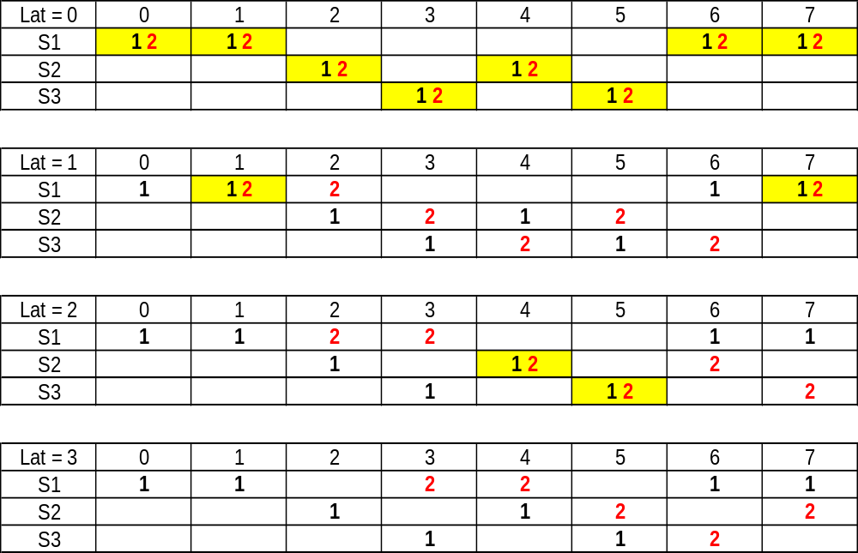
Collision Vector of Machine G
Collision Vector = 1xxxxxxx
Collision Vector = 11xxxxxx
Collision Vector = 111xxxxx
Collision Vector = 1110xxxx

Slide 17
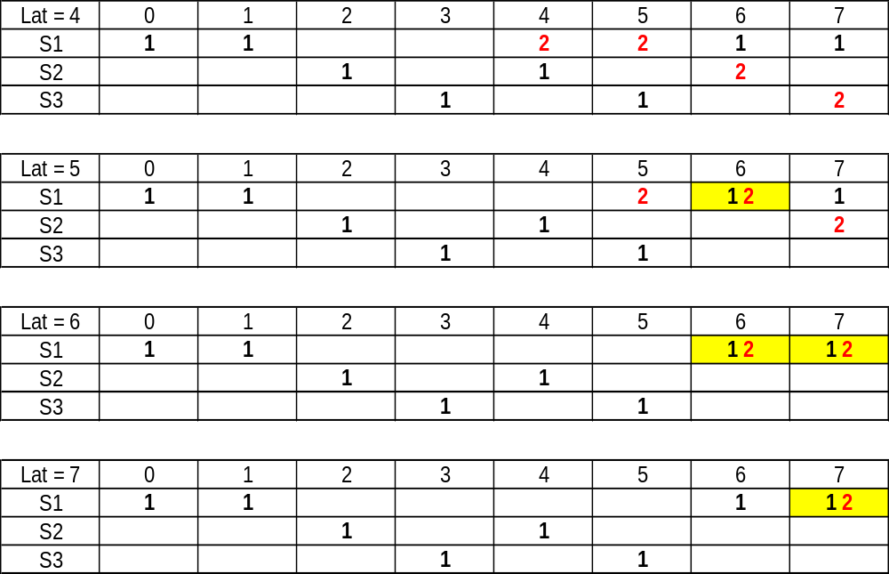
Collision Vector of Machine G
Collision Vector = 11100xxx
Collision Vector = 111001xx
Collision Vector = 1110011x
Collision Vector = 11100111

Slide 18
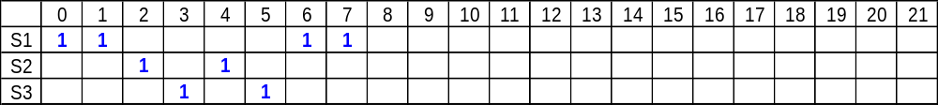
Pipeline Schedules of Machine G
How do I initiate the next job in a pipelined fashion?
  Of course, without resource conflict
How to achieve maximum throughput?

Slide 19
Pipeline Schedules of Machine G
3
8
3
Greedy initiation
Latency sequence = <3, 8, 3, 8, ….>
Average latency = (3+8)/2 = 5.5 cycles
4
4
4
4
4
Optimal initiation
Latency sequence = <4, 4, 4, 4, ….>
Average latency = 4 cycles

Slide 20
To Find All Possible Schedules:
State Diagram Generation Algorithm
{CV}proc = {CV}finish = φ;
add ICV to {CV}proc;
while ({CV}proc ⊄ φ) {
get aCV from {CV}proc ; push aCV to {CV}finish;
newCV = aCV << 1; // shift in zero
if (newCV[MSB] == 1)
// create a new collision vector
else
if (spawn new initiation)
newCV = newCV | ICV; // bit-by-bit logical OR
else
// create a new collision vector
if (newCV ∈ ({CV}proc U {CV}finish))
merge newCV with colliding node
else
define a new directional arc from aCV to newCV
add newCV to {CV}proc
}

Slide 21
State Diagram (See Whiteboard)
11100111
Initial collision vector

Slide 22
State Diagram of Machine G
11100111
*: a new iteration schedule is started
11001110
10011100
*
11111111
00111000
*
11000000
11111110
01110000
11110111
10000000
11111100
11101110
*
*
00000000
11111000
11011100
*
11110000
10111000
11100000

Slide 23
Modified State Diagram of Machine G
≥8
11100111
≥8
3
4
≥8
11111111
11110111
4

Slide 24
Modified State Diagram of Machine G
≥8
11100111
≥8
3
4
≥8
11111111
11110111
4
Latency sequence = <3, 8, 3, 8, 3, 8, ..>
Latency cycle = (3, 8)
Average latency = (3+8)/2 = 5.5

Slide 25
Modified State Diagram of Machine G
11100111
≥8
3
4
≥8
11111111
11110111
4
Latecny sequence = <4, 4, 4, 4, 4, ..>
Latency cycle = (4)
Avg latency = 4 = MAL

Slide 26
Improving Throughput by Delay Insertion
output
input
S1
S2
S3
 | 0 | 1 | 2 | 3 | 4
S1 | X |  |  |  | X
S2 |  | X |  | X
S3 |  |  | X | X
Initial Collision Vector
11101
Pipeline Latency = 5 cycles
[Patel & Davidson ISCA’76]

Slide 27
State Diagrams
11101
11010
10100
≥5
11101
3
*
01000
Modified state diagram
*
10000
00000
*
State diagram
MAL=3; Can we do better than 3?

Slide 28
Delay Insertion
D1
output
input
S1
S2
S3
D2
 | 0 | 1 | 2 | 3 | 4 | 5 | 6
S1 | X |  |  |  | X |  | X
S2 |  | X |  | X
S3 |  |  | X | X | X
Initial Collision Vector
D2
1010001
D1
Pipeline Latency = 7 cycles

Slide 29
1010001
*
*
0100010
1110011
2
2
3
*
*
*
0001000
*
3
3
1011001
0011000
0010000
*
*
0110000
*
0100000
*
1110001
0110010
3
*
1000000
3
3
1100000
*
2
2
*
0000000
*

Slide 30
1010001
*
*
0100010
1110011
2
2
3
*
*
*
0001000
*
3
3
1011001
0011000
0010000
*
*
0110000
*
0100000
*
1110001
0110010
3
*
1000000
3
3
1100000
*
2
2
*
0000000
*

Slide 31
Modified State Diagram
4, ≥7
1010001
5
≥7
5
1
4, ≥7
1110001
4
1110011
3, ≥7
1
5
3
3
1011001
New latency sequence = <3,1,3,1,3,1,…>
MAL = (3+1)/2 = 2

Slide 32
List Scheduling
U
V
P = U + V;
Q = P x W;
Y = X x P + (P + Q) x Q;
+
A1
W
x
M1
X
x
M2
+
Build data dependency graph (DDG)
Assign a priority of “0” to all operations having no successors
Assign each of the remaining operations the maximum of the properties of all the successor operations plus the execution time of that operation
A2
x
M3
+
A3
Y

Slide 33
List Scheduling
U
V
P = U + V;
Q = P x W;
Y = X x P + (P + Q) x Q;
+
A1
8
W
x
M1
Latency: Adder — 2 cycles
Multiplier — 2 cycles
X
x
6
M2
+
4
Build data dependency graph (DDG)
Assign a priority of “0” to all operations having no successors
Assign each of the remaining operations the maximum of the properties of all the successor operations plus the execution time of that operation
Schedule instructions based on priority
A2
2
x
2
M3
+
0
A3
Schedule = {A1, M1, A2, M2, M3, A3}
Y

Slide 34
List Scheduling
U
V
Reservation Table
+
A1
TIME | ADDER | MULT
0 | A1
1
2 |  | M1
3 |  | M2
4 | A2
5
6 |  | M3
7
8 | A3
8
W
x
M1
X
x
6
M2
+
4
A2
2
x
2
M3
+
0
A3
LS (a heuristic) provides near-optimal schedule
But no guarantee for optimality, especially, in terms of throughput
Y
Schedule = {A1, M1, A2, M2, M3, A3}

Slide 35
List Scheduling
TIME | ADDER | MULT
0 | A1
1
2 |  | M1
3 |  | M2
4 | A2
5
6 |  | M3
7
8 | A3
≥ 5
110110001
5, 7, ≥ 9
2
7
5, ≥ 9
111110101
7
111110001
Modified State Diagram of the code example
Reservation Table
Optimal latency sequence = <2, 5, 2, 5, 2, 5, …>
MAL = (2+5)/2 = 3.5 cycle per initiation

Slide 36
List Scheduling
: under-utilization
Question: Can a better scheduling algorithm be designed to saturate functional unit occupation?
Motivation: use the same schedule with a “fixed” initiation interval (II) to achieve optimal throughout

Slide 37
Modulo Scheduling
Exploit ILP among loop iterations (large number of iterations)
Use the same schedule
Overlap execution of consecutive iterations
Constant initiation rate ⎯ Initiation Interval (II)
Minimum II (MII) generates an optimal schedule with maximum throughput
Originally developed for polycyclic architecture (or horizontal architecture, or aka VLIW later) at TRW/ESL
Other equivalent names:
  Cyclic Scheduling
  Polycyclic scheduling
  Software pipelining

Slide 38
Definition of GVC
General Vector Computations (GVC) are loops with
  Number of iterations is known before execution
  No conditional branches within
  No data dependency between iterations, i.e., no loop-carried dependency (or no recurrence)
GVC scheduling (i.e., modulo scheduling)
  Use the same schedule for every iteration ⇒ use the same code
[Rau MICRO-14]

Slide 39
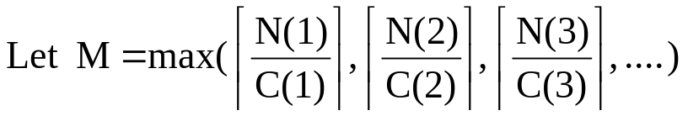
Definition (cont.)
Assume a resource R(i) has C(i) identical copies
STEPS for modulo scheduling
  Determine N(i): number of usages for each R(i)
    M = MII (or ResII) for GVC, i.e., successive iterations are to be scheduled M cycles apart with each iteration having the same schedule
  Schedule operations in the program DAG by considering
    Input constraint (due to true dependency)
    Modulo constraint (due to resource limitation)
      No more than C(i) operations can be scheduled at the same cycle

Slide 40

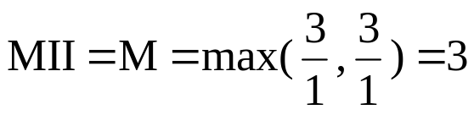
Modulo Scheduling for GVC
U
V
Assume 2 FUs
  1 adder with a 2-cycle latency
  1 mult with a 2-cycle latency
Ignore memory loads for U, V, W, X
Determine MII (=ResII)
  Directed acyclic graph consists of 3 adds and 3 multiplies
+
A1
8
W
x
M1
X
x
6
M2
+
4
A2
2
x
2
M3
+
0
A3
Y
Schedule = {A1, M1, A2, M2, M3, A3}

Slide 41
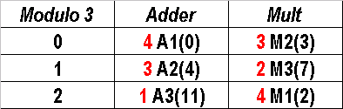
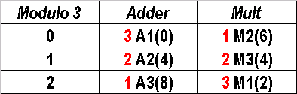
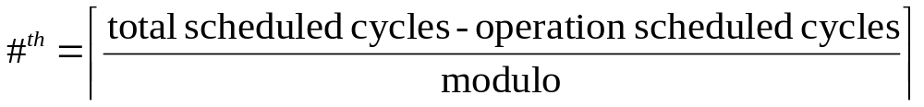
Modulo Reservation Table (MRT)
See white board
Schedule = {A1, M1, A2, M2, M3, A3}
Schedule = {A1, M1, A2, M3, M2, A3}
MRT: If M2 precedes M3
MRT: If M3 precedes M2

Slide 42
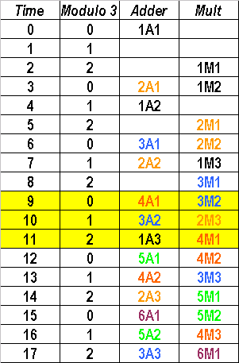
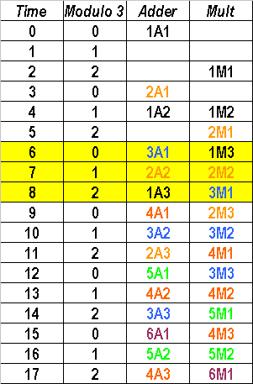
Modulo Scheduling for GVC
If M2 precedes M3
If M3 precedes M2

Slide 43
Verify with Modified State Diagram
Schedule for M3 preceding M2
≥ 9
3, 6, ≥8
3
101010001
1
111011001
5
111110011
1
5
101110001
5
9
Optimal sequence = <3,3,3,3,..>
MAL = 3 = MII
Correspond to the result from Modulo Scheduling

Slide 44
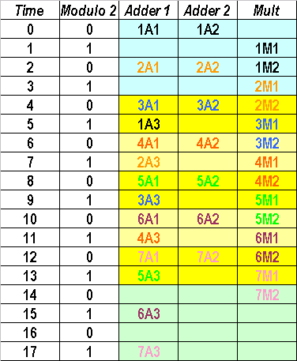

Another Modulo Scheduling Example
Given 2 adders (1-cycle) & 1 multiplier (2-cycle)
A
B
C
D
E
3
+
A1
+
A2
3
prolog
M1
x
x
M2
1
1
+
5x kernel
0
A3
Z
MII = max(3/2, 2/1) = 2
Modulo Reservation Table
epilog
Multiplier is fully utilized

Slide 45
Register Allocation
How to deal with registers
  Lifetime of live registers span across many iterations
  When the same schedule (i.e., same arch registers) is desired
Solutions
  Modulo variable expansion (MVE) [Lam’88]
    Need loop unrolling
    Code size expansion
    Pressure on architectural register file
  Rotating register file [Rau’82] [Intel Itanium]
    TRW/ESL’s Polycyclic Architecture
    Cydrome’s Cydra 5
    Intel/HP Itanium processor family

Slide 46
Modulo Variable Expansion
Each variable of the schedule could be assigned to multiple registers
Steady state might need to be unrolled
Degree of unrolling = Max { lifetime(vari) / MII for every vari}

Slide 47
Concept of MVE
ite1
ite2
ite1
ite2
Write r1
Write r1
X
Fix
register allocation
X
Write r2
X
X
Read r1
X
Read r1
X
Read r2
Write r1
X
Time
X
Read r1
Time
Modulo
scheduled
Note that r1 is alive across 2 iterations
Therefore, need 2 copies of the original r1

Slide 48
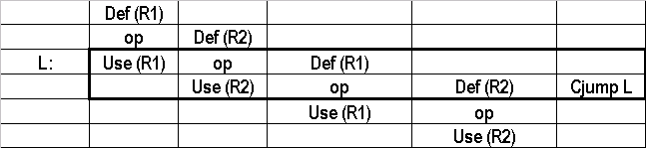
Modulo Variable Expansion
Each variable of the schedule could be assigned to multiple registers
Steady state might need to be unrolled
Degree of unrolling = Max { lifetime(vari) / MII for every vari}
Valued assigned by Def() can be used 2 cycles later

Slide 49
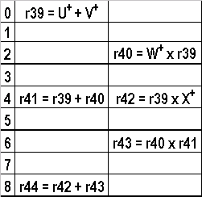
Post-Register Allocation Schedule

Slide 50
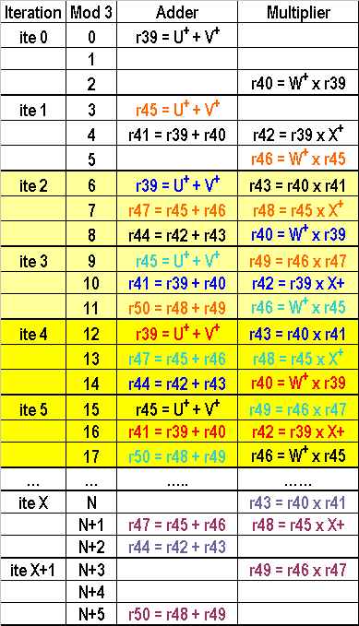
Modulo Variable Expansion
For example, r39 and r45 represents the same variable in the schedule for different stages
r46 only used for the next stage
Code expansion and register pressure could be issues
prolog
kernel
unrolled “twice”
L1top:
r39 = U⁺ + V⁺
r43 = r40 x r41
r47 = r45 + r46
r48 = r45 x X⁺
r44 = r42 + r43
r40 = W⁺ x r39
r45 = U⁺ + V⁺
r49 = r46 x r47
r41 = r39 + r40
r42 = r39 x X⁺
r50 = r48 + r49
r46 = W⁺ x r45
brne L1top // assume free loop control
epilog
Kernel Code Snippet

Slide 51
Rotating Register File
Issues of Modulo Variable Expansion
  Unroll several iterations to the schedule
  Result in a large amount of code expansion
  Result in extensive usage of architectural registers
Rotating register file
  A hardware technique
  Solving problem without code duplication
  Similar to register window plus renaming: keep old iteration values on the stack (Itanium calls the hardware Register Stack Engine or RSE)

Slide 52
Register Rotation (i0 = Prolog)
Iteration | Time (mod-3) | Adder | Multiplier
ite i0 | 0 | r39 = r85 + r86
 | 1
 | 2 |  | r40 = r88 x r39

Slide 53
Register Rotation (i1 = Prolog)
Iteration | Time (mod-3) | Adder | Multiplier
ite i0 | 0 | r39 = r85 + r86
 | 1
 | 2 |  | r40 = r88 x r39
ite i1 | 3 | r39 = r85 + r86
 | 4 | r42 = r40 + r41 | r43 = r40 x r88
 | 5 |  | r40 = r88 x r39
Register rotating +1
r40@i1 = r39@i0
r41@i1 = r40@i0

Slide 54
Register Rotation (i2 = Kernel)
Iteration | Time (mod-3) | Adder | Multiplier
ite i0 | 0 | r39 = r85 + r86
 | 1
 | 2 |  | r40 = r38 x r39
ite i1 | 3 | r39 = r85 + r86
 | 4 | r42 = r40 + r41 | r43 = r40 x r88
 | 5 |  | r40 = r88 x r39
ite i2 | 6 | r39 = r85 + r86 | r45 = r42 x r43
 | 7 | r42 = r40 + r41 | r43 = r40 x r88
 | 8 | r46 = r44 + r45 | r40 = r88 x r39
Register rotating +1
r42@i2 = r40@i0
r43@i2 = r42@i1
r44@i2 = r43@i1
When allocate a new dest register, be careful of what are still alive!

Slide 55
Register Rotation (i3 = Kernel)
Iteration | Time (mod-3) | Adder | Multiplier
ite i0 | 0 | r39 = r85 + r86
 | 1
 | 2 |  | r40 = r88 x r39
ite i1 | 3 | r39 = r85 + r86
 | 4 | r42 = r40 + r41 | r43 = r40 x r88
 | 5 |  | r40 = r88 x r39
ite i2 | 6 | r39 = r85 + r86 | r45 = r42 x r43
 | 7 | r42 = r40 + r41 | r43 = r40 x r88
 | 8 | r46 = r44 + r45 | r40 = r88 x r39
ite i3 | 9 | r39 = r85 + r86 | r45 = r42 x r43
 | 10 | r42 = r40 + r41 | r43 = r40 x r88
 | 11 | r46 = r44 + r45 | r40 = r88 x r39
Register rotation
wraps around if exceeding specified bound

Slide 56
Register Rotation (i4 & i5 Epilog)
Iteration | Time (mod-3) | Adder | Multiplier
ite i4 | 12 |  | r45 = r42 x r43
 | 13 | r42 = r40 + r41 | r43 = r40 x r88
 | 14 | r46 = r44 + r45
ite i5 | 15 |  | r45 = r42 x r43
 | 16
 | 17 | r46 = r44 + r45
Start draining the pipeline

Slide 57
Final Kernel Schedule
time | Adder | Multiplier
0 | r39 = r85 + r86 | r45 = r42 x r43
1 | r42 = r40 + r41 | r43 = r40 x r88
2 | r46 = r44 + r45 | r40 = r88 x r39
Kernel code is determined
How about prolog and epilog?
  Can we use the same schedule to represent them?
  Use stage predicate to conditional execute instructions

Slide 58
Final Schedule (Itanium Scheme)
mov ar.lc = LC // Loop count
mov ar.ec = 2 // Epilog count
mov pr.rot = 0x10000 // set pr[16]=1
L1top:
(p16) r39 = r85 + r86
(p18) r45 = r42 x r43
(p17) r42 = r40 + r41
(p17) r43 = r40 x r88
(p18) r46 = r44 + r45
(p16) r40 = r88 x r39
br.ctop L1top
Code snippet
Before entering the loop, set p16 =1 (p16 is the first rotating predicate register)
When the modulo-scheduled loop branch (e.g., br.ctop) encountered
  p63 is set to 1 by hardware in the prolog code (see next slide)
  All registers (rotating registers and predicate rotating registers) rotate as each stage (iteration) advances

Slide 59
Counted Branch in Itanium
ctop, cexit
==0 epilog
LC?
EC?
(Prolog/
kernel)
!=0
>1
==1
==0
LC--
LC=LC
LC=LC
LC=LC
EC = EC
EC--
EC--
EC=EC
Pr[63]=1
Pr[63]=0
Pr[63]=0
Pr[63]=0
RRB--
RRB--
RRB--
RRB=RRB

Slide 60
Predicate Register Rotation in Loops
Stage 0 (Prolog)
p18 | 0
p17 | 0
p16 | 1
p63 | 0
Adder | Multiplier
(p16) r39 = r85 + r86 | (p18) r45 = r42 x r43
(p17) r42 = r40 + r41 | (p17) r43 = r40 x r88
(p18) r46 = r44 + r45 | (p16) r40 = r88 x r39
p18
p17
p16
p63
Rotating predicate registers

Slide 61
Predicate Register Rotation in Loops
After: LC = LC-1
EC = 2
Stage 0 (Prolog)
p18 | 0
p17 | 0
p16 | 1
p63 | 1
Adder | Multiplier
(p16) r39 = r85 + r86 | (p18) r45 = r42 x r43
(p17) r42 = r40 + r41 | (p17) r43 = r40 x r88
(p18) r46 = r44 + r45 | (p16) r40 = r88 x r39
p18
p17
p16
p63
Rotating predicate registers

Slide 62
Predicate Register Rotation in Loops
After: LC = LC-2
EC = 2
Stage 1 (Prolog)
p18 | 0
p17 | 0
p16 | 1
p63 | 1
p62 | 0
Adder | Multiplier
(p16) r39 = r85 + r86 | (p18) r45 = r42 x r43
(p17) r42 = r40 + r41 | (p17) r43 = r40 x r88
(p18) r46 = r44 + r45 | (p16) r40 = r88 x r39
p18
p17
p16
p63
Rotating predicate registers

Slide 63
Predicate Register Rotation in Loops
After: LC = LC-3
EC = 2
Stage 2 (Kernel)
p18 | 0
p17 | 0
p16 | 1
p63 | 1
p62 | 1
p61 | 0
Adder | Multiplier
(p16) r39 = r85 + r86 | (p18) r45 = r42 x r43
(p17) r42 = r40 + r41 | (p17) r43 = r40 x r88
(p18) r46 = r44 + r45 | (p16) r40 = r88 x r39
p18
p17
p16
p63
Rotating predicate registers

Slide 64
Predicate Register Rotation in Loops
After: LC = 0 (last iteration in kernel)
EC = 2
Stage (LC-1) (Kernel)
p18 | 1
p17 | 1
p16 | 1
p63 | 1
p62 | 0
p61 | 1
p60 | 1
p59 | 1
Adder | Multiplier
(p16) r39 = r85 + r86 | (p18) r45 = r42 x r43
(p17) r42 = r40 + r41 | (p17) r43 = r40 x r88
(p18) r46 = r44 + r45 | (p16) r40 = r88 x r39
p18
p17
p16
p63
Rotating predicate registers

Slide 65
Predicate Register Rotation in Loops
After: LC = 0
EC = 1
Stage LC (Epilog)
p18 | 1
p17 | 1
p16 | 1
p63 | 1
p62 | 0
p61 | 0
p60 | 1
p59 | 1
Adder | Multiplier
(p16) r39 = r85 + r86 | (p18) r45 = r42 x r43
(p17) r42 = r40 + r41 | (p17) r43 = r40 x r88
(p18) r46 = r44 + r45 | (p16) r40 = r88 x r39
p18
p17
p16
When LC=0 and the modulo-scheduled loop branch encountered,
  p63 is set to 0 by hardware
  all registers (rotating registers and predicate rotating registers) rotate as each stage (iteration) advances
p63
Rotating predicate registers

Slide 66
Predicate Register Rotation in Loops
After: LC = 0
EC = 0 (last loop iteration)
Stage LC+1 (Epilog)
p18 | 1
p17 | 1
p16 | 1
p63 | 1
p62 | 0
p61 | 0
p60 | 0
p59 | 1
Adder | Multiplier
(p16) r39 = r85 + r86 | (p18) r45 = r42 x r43
(p17) r42 = r40 + r41 | (p17) r43 = r40 x r88
(p18) r46 = r44 + r45 | (p16) r40 = r88 x r39
p18
p17
When LC=0 and the modulo-scheduled loop branch encountered,
  p63 is set to 0 by hardware
  all registers (rotating registers and predicate rotating registers) rotate as each stage (iteration) advances
p16
p63
Rotating predicate registers

Slide 67
Modulo Scheduling with Recurrence
Recurrence imposes inter-iteration dependency (as opposed to intra-iteration dependency discussed previously), e.g., induction variable
Define
  Rec(i) : instance of recurrence i
  δ(k): latency (or delay) of node k
  δ(Rec(i)) = Σ δ(node) for each node on the path
  Ω(i): distance of a recurrence, i.e., # of iterations ago the value was generated
Ω(i) = 1
i(c)
δ(+) =2
....
....
....
Recurrence
i(p)
δ(x) =2
Rec(i)
i(c): consumer inst
i(p): producer inst
: adder (+)
: multiplier (x)

Slide 68
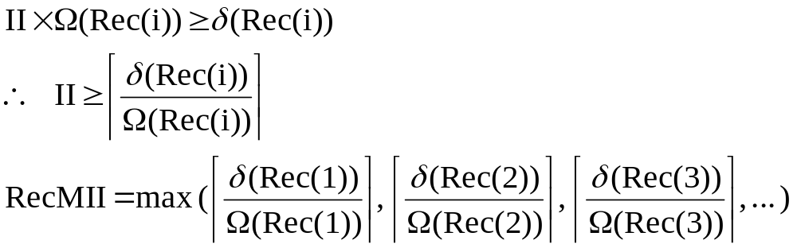
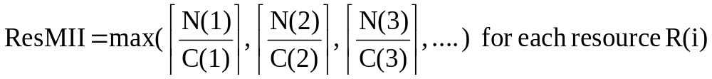
Modulo Scheduling with Recurrence
For a valid schedule ⇒
As discussed
MII = max(ResMII, RecMII)
Also note that schedule can be unrolled to take advantage of fractional lower bounds instead of taking a ceiling value
  E.g. MII = 1.5 before ceiling function. Compiler can unroll it twice to reach an MII=1.5 .

Slide 69
Modulo Scheduling with Recurrence
Ω(Rec) = 1
δ(Rec) = 4 (due to A1 + M2)
MII = max( RecII=4, ResII=3 ) = 4
U
V
Ω = 1
+
A1
W
TIME | ADDER | MULT
0 | A1
1
2
3
4
5
6
7
8
9
10
X
x
M1
x
+
M2
A2
x
M3
+
A3
Y

Slide 70
Modulo Scheduling with Recurrence
MII = max( RecII=4, ResII=3 ) = 4
Schedule recurrence circuit first
U
V
Ω = 1
+
A1
W
TIME | ADDER | MULT
0 | A1
1
2 |  | M2
3
4 | A1
5
6 |  | M2
7
8 | A1
9
10
X
x
M1
x
+
M2
A2
x
M3
+
A3
Y

Slide 71
Modulo Scheduling with Recurrence
TIME | ADDER | MULT
0 | A1
1
2 |  | M2
3 |  | M1
4
5 | A2
6
7
8 |  | M3
9
10 | A3
mod | ADDER | MULT
0 | A1 (0) | M3 (8)
1 | A2 (5)
2 | A3 (10) | M2 (2)
3 |  | M1 (3)
U
V
Ω = 1
+
A1
W
x
M1
X
x
+
M2
A2
MRT
( Utilization drops down to 75%)
x
M3
+
A3
Y

Slide 72
Modulo Scheduling with Branches
So how to deal with conditional flow?
Need to convert loop body into straight-line code
Solutions
  Without predication
    Hierarchical reduction [Lam’88]
    Enhanced modulo scheduling [Walter et al.’92]
  If-conversion, i.e., predicated execution [Itanium]
  All at a cost of code expansion

Slide 73
Hierarchical Reduction (HR)
Schedule the program hierarchically
Start from innermost conditional construct
Collapse from innermost to outermost
List schedule the then and else branches independently
Reduce the construct into a single node
  Take Union of the 2
  Pad the shorter of the 2 branches to have the same latency as the longer one
Iterate the process till the entire scheduling scope is reduced to a single node

Slide 74
Conceptual View of HR
cond
then
else

Slide 75
A Simple HR Example
L1:
r4 ← (r2 + r1)
bne r1, 0, L2
for (i=0; i<MAX; i++) {
if (i==0) {
k = A[i] * c1;
}
else {
k = A[i] * c2;
}
A[i] = k;
u += sizeof(i);
t += (u + k);
}
r5 = r4 * c1
Conditional construct
Inner loop
jmp L3
L2:
r5 = r4 * c2
L3:
(r2+r1) ← r5
r1 = r1 + 8
r7 = r1 + r5
r8 = r8 + r7
bne r1, r3, L1
** To reduce the conditional construct to a single node **

Slide 76
A Simple HR Example
L1:
r4 ← (r2 + r1)
bne r1, 0, L2
for (i=0; i<MAX; i++) {
if (i==0) {
k = A[i] * c1;
}
else {
k = A[i] * c2;
}
A[i] = k;
u += sizeof(i);
t += (u + k);
}
r5 = r4 * c1
Conditional construct
Inner loop
jmp L3
L2:
r5 = r4 * c2
L3:
(r2+r1) ← r5
r1 = r1 + 8
r7 = r1 + r5
r8 = r8 + r7
bne r1, r3, L1
** To reduce the conditional construct to a single node **

Slide 77
A Simple HR Example
L1:
op4: r4 ← (r2 + r1)
op5: bne r1, 0, L2
op5: bne r1, 0, L22
L21:
op6: r5 = r4 * c1
op7: jmp L3
op6: r5 = r4 * c1
op7: jmp L3
L2:
op8: r5 = r4 * c2
op5: beq r1, 0, L21
L3:
op9: (r2+r1) ← r5
L22:
op8: r5 = r4 * c2
op10: r1 = r1 + 8
op11: r7 = r1 + r5
op12: r8 = r8 + r7
Split the conditional construct to 2 pieces of straight line codes

Slide 78



Hierarchical Reduction
Assume
  2 uniform functional units
  Unit latency for both FUs
List Schedule each straight line code
Collapse (Union) 2 schedules into a single node
Define the whole new node as “op5*” which needs
  2 FUs (ResII = 2)
  With a new latency 2 cycle
op5: bne r1, 0, L22
op6: r5 = r4 * c1
op5: beq r1, 0, L21
op7: jmp L3
op8: r5 = r4 * c2
∪
op5*

Slide 79
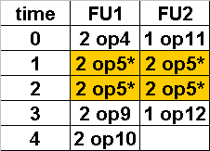
Modulo Scheduling after HR
L1:
op4: r4 ← (r2 + r1)
op4
op5: bne r1, 0, L2
δf
Ω=1
op5*
op6: r5 = r4 * c1
δf
Reduced MRT
op7: jmp L3
op5*
use 2 FUs
for 2 cycles
δf
op9
δa
Ω=1
L2:
op8: r5 = r4 * c2
δf
L3:
op9: (r2+r1) ← r5
op12
op10
op11
Ω=1
op10: r1 = r1 + 8
op11: r7 = r1 + r5
δf
DDG
op12: r8 = r8 + r7
reserved by op5*

Slide 80
Kernel Schedule with HR
FU1 | FU2
r4 ← (r2 + r1) | r7 = r1 + r5
bne r1, 0, L2b
r5 = r4 * c1 | jmp L3
(r2+r1) ← r5 | r8 = r8 + r7
r1 = r1 + 8
bne r1,r3,L1
jmp Epilog
r5 = r4 * c2
(r2+r1) ← r5 | r8 = r8 + r7
r1 = r1 + 8
bne r1,r3,L1
L1:
r4 ← (r2 + r1)
L1:
bne r1, 0, L2
r5 = r4 * c1
L3:
jmp L3
kernel
L2b:
L2:
r5 = r4 * c2
L3:
(r2+r1) ← r5
r1 = r1 + 8
r7 = r1 + r5
Iteration x
Reduced construct
Iteration x+1
r8 = r8 + r7
bne r1, r3, L1

Slide 81
Kernel Schedule with HR
FU1 | FU2
r4 ← (r2 + r1) | r7 = r1 + r5
bne r1, 0, L2b
r5 = r4 * c1 | jmp L3
(r2+r1) ← r5 | r8 = r8 + r7
r1 = r1 + 8
bne r1,r3,L1
jmp Epilog
r5 = r4 * c2
(r2+r1) ← r5 | r8 = r8 + r7
r1 = r1 + 8
bne r1,r3,L1
L1:
r4 ← (r2 + r1)
L1:
bne r1, 0, L2
r5 = r4 * c1
L3:
jmp L3
kernel
L2b:
L2:
r5 = r4 * c2
L3:
(r2+r1) ← r5
r1 = r1 + 8
r7 = r1 + r5
Iteration x
Reduced construct
Iteration x+1
r8 = r8 + r7
bne r1, r3, L1

Slide 82
Modulo Scheduling with If-Conversion
L1:
r44 ← (r42 + r41)
bne r41, 0, L2
L1: r44 ← (r42 + r41)
cmp.ne.unc p18,p19 = r41,0
(p18) r45 = r44 * c1
(p19) r45 = r44 * c2
(r42+r41) ← r45
r41 = r41 + 8
r47 = r41 + r45
r48 = r48 + r47
bne r41, r43, L1
for (i=0; i<MAX; i++) {
if (i==0) {
k = A[i] * c1;
}
else {
k = A[i] * c2;
}
A[i] = k;
u += sizeof(i);
t += (u+k);
}
r45 = r44 * c1
jmp L3
L2:
r45 = r44 * c2
L3:
(r42+r41) ← r45
r41 = r41 + 8
Convert 4 basic blocks to a single basic block
r47 = r41 + r45
r48 = r48 + r47
Inner loop
bne r41, r43, L1

Slide 83
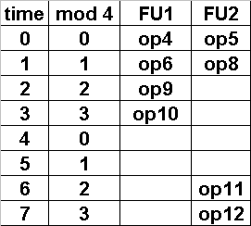
Modulo Schedule If-Converted Loop
op4
op5
op6
op8
op9
op10
op11
op12
r44 ← (r42 + r41)
cmp.ne.unc p18,p19 = r41,0
(p18) r45 = r44 * c1
(p19) r45 = r44 * c2
(r42+r41) ← r45
r41 = r41 + 8
r47 = r41 + r45
r48 = r48 + r47
Assume (same as prior example)
  2 uniform functional units
  Unit latency for both FUs
MII = max(ResII=4, RecII=4) = 4

Slide 84
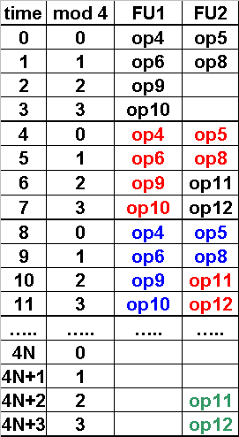
Modulo Schedule If-Converted Loop
op4
op5
op6
op8
op9
op10
op11
op12
r44 ← (r42 + r41)
cmp.ne.unc p18,p19 = r41,0
(p18) r45 = r44 * c1
(p19) r45 = r44 * c2
(r42+r41) ← r45
r41 = r41 + 8
r47 = r41 + r45
r48 = r48 + r47
prolog
kernel
Assume (same as prior example)
  2 uniform functional units
  Unit latency for both FUs
MII = max(ResII=4, RecII=4) = 4
epilog

Slide 85
Modulo Schedule If-Converted Loop
Function Unit 1 | Function Unit 2
(p16) r44 ← (r42 + r41) | (p16) cmp.ne.unc p18,p19 = r41, 0
(p18) r45 = r44 * c1 | (p19) r45 = r44 * c2
(p16) (r42 + r41) ← r45 | (p17) r48 = r42 + r46
(p16) r41 = r41 + 8 | (p17) r49 = r49 + r48
Final Modulo Schedule
Use rotating register file support in the final schedule
Instructions with qualifying predicates (p18,p19) are not assigned stage predicates (p16, p17)
If p16==0, cmp.unc will evaluate and set both predicates to 0

Slide 86
Final Schedule with Loop Control
mov ar.lc = LC // Loop count
mov ar.ec = 1 // Epilog count
mov pr.rot = 0x10000 // set pr[16]=1
(p16) r44 = (r42+r41) (p16) cmp.ne.unc p18,p19=r41,0
(p18) r45 = r44 * c1 (p19) r45 = r44 * c2
(p16) (r42+r41) = r45 (p17) r48 = r42 + r46
(p16) r41 = r41 + 8 (p17) r49 = r49 + r48
br.ctop L1top
L1top:

Slide 87
Modulo Schedule If-Converted Loop
TS | FU1 | FU2
0 | (p16) r44 ← (r42 + r41) | (p16) cmp.unc p18,p19 = r41, 0
p19 | 0
p18 | 0
p17 | 0
p16 | 1
p63 | 0
p19
p18
p17
p16
p63
Stage 0 (Prolog)

Slide 88
Modulo Schedule If-Converted Loop
TS | FU1 | FU2
0 | (p16) r44 ← (r42 + r41) | (p16) cmp.unc p18,p19 = r41, 0
1 | (p18) r45 = r44 * c1 | (p19) r45 = r44 * c2
p19 | 1
p18 | 0
p17 | 0
p16 | 1
p63 | 0
p19
p18
p17
p16
p63
Stage 0 (Prolog)

Slide 89
Modulo Schedule If-Converted Loop
TS | FU1 | FU2
0 | (p16) r44 ← (r42 + r41) | (p16) cmp.unc p18,p19 = r41, 0
1 | (p18) r45 = r44 * c1 | (p19) r45 = r44 * c2
2 | (p16) (r42 + r41) ← r45 | (p17) r48 = r42 + r46
p19 | 1
p18 | 0
p17 | 0
p16 | 1
p63 | 0
p19
p18
p17
p16
p63
Stage 0 (Prolog)

Slide 90
Modulo Schedule If-Converted Loop
TS | FU1 | FU2
0 | (p16) r44 ← (r42 + r41) | (p16) cmp.unc p18,p19 = r41, 0
1 | (p18) r45 = r44 * c1 | (p19) r45 = r44 * c2
2 | (p16) (r42 + r41) ← r45 | (p17) r48 = r42 + r46
3 | (p16) r41 = r41 + 8 | (p17) r49 = r49 + r48
p19 | 1
p18 | 0
p17 | 0
p16 | 1
p63 | 0
p19
p18
p17
p16
p63
Stage 0 (Prolog)

Slide 91
Modulo Schedule If-Converted Loop
TS | FU1 | FU2
0 | (p16) r44 ← (r42 + r41) | (p16) cmp.unc p18,p19 = r41, 0
1 | (p18) r45 = r44 * c1 | (p19) r45 = r44 * c2
2 | (p16) (r42 + r41) ← r45 | (p17) r48 = r42 + r46
3 | (p16) r41 = r41 + 8 | (p17) r49 = r49 + r48
p19 | 1
p18 | 0
p17 | 0
p16 | 1
p63 | 0
p19
p18
p17
p16
p63
Stage 0 (Prolog)
p19 | 1
p18 | 1
p17 | 0
p16 | 1
p63 | 1
p62 | 0
p19
TS | FU1 | FU2
4 | (p16) r44 ← (r42 + r41) | (p16) cmp.unc p18,p19 = r41, 0
5 | (p18) r45 = r44 * c1 | (p19) r45 = r44 * c2
6 | (p16) (r42 + r41) ← r45 | (p17) r48 = r42 + r46
7 | (p16) r41 = r41 + 8 | (p17) r49 = r49 + r48
p18
p17
p16
p63
Stage 1 (Kernel)

Slide 92
Modulo Schedule If-Converted Loop
p16 | 1
p63 | 0
p62 | 1
p61 | 1
p60 | 0
p19
TS | FU1 | FU2
4N | (p16) r44 ← (r42 + r41) | (p16) cmp.unc p18,p19 = r41, 0
4N+1 | (p18) r45 = r44 * c1 | (p19) r45 = r44 * c2
4N+2 | (p16) (r42 + r41) ← r45 | (p17) r48 = r42 + r46
4N+3 | (p16) r41 = r41 + 8 | (p17) r49 = r49 + r48
p18
p17
p16
p63
Stage N (Kernel)
p19 | 0
p18 | 0
p17 | 1
p16 | 1
p63 | 0
p62 | 0
p61 | 1
p60 | 0
p63
TS | FU1 | FU2
4N+4 | (p16) r44 ← (r42 + r41) | (p16) cmp.unc p18,p19 = r41, 0
4N+5 | (p18) r45 = r44 * c1 | (p19) r45 = r44 * c2
4N+6 | (p16) (r42 + r41) ← r45 | (p17) r48 = r42 + r46
4N+7 | (p16) r41 = r41 + 8 | (p17) r49 = r49 + r48
p19
p18
p17
Stage N (Epilog)
p16

Slide 93
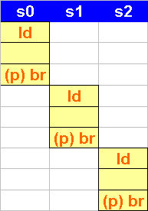
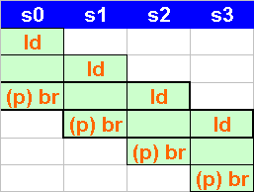
Complexity with Exceptions due to Instruction Speculation
Modulo scheduling overlap multiple iterations could cause
  Load instructions bypass predicated branches, i.e. load speculation
Resolved by sentinel operations [Mahlke’92][Itanium]

Slide 94
Example of Load Speculation in Itanium
ld8.s r1=[r5];; // speculative
// Other instructions
(p1) br.cond L1
chk.s r1, recovery
add r2=r1, r3
(p1) br.cond L1
ld8 r1=[r5];;
add r2=r1, r3
If an exception is generated in ld8.s
  NaT (Not a Thing) bit of general register r1 is set
  Exception is deferred until a corresponding chk.s encountered
  NaT is propagated through all dependent instructions
  If chk.s reads a set NaT on the checked register, execution branches to the recovery code

Slide 95
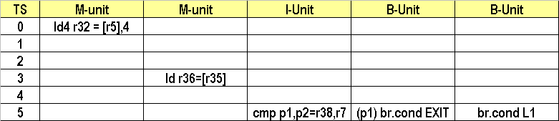
Example of Modulo Schedule
L1: ld4 r4=[r5],4;; // load w/ post-increment
ld4 r9=[r4];;
cmp.eq.unc p1,p2=r9,r7
(p1) br.cond EXIT
br.cond L1;;
MII = RecMII = 1 for Itanium
Modulo scheduling

Slide 96
Modulo Schedule with chk.s
T | M-Unit | M-Unit | M-Unit | M/I-Unit | B-Unit | B-Unit
0 | ld4.s r32=[r5],4
1 | ld4.s r32=[r5],4
2 | ld4.s r32=[r5],4
3 | ld4.s r32=[r5],4 | ld4.s r36=[r35]
4 | ld4.s r32=[r5],4 | ld4.s r36=[r35]
5 | ld4.s r32=[r5],4 | ld4.s r36=[r35] | chk.s r38,recv | p1,p0=(r38==r7) | (p1) br EXIT | br L1
Modulo scheduling with rotating registers

