Slide 1
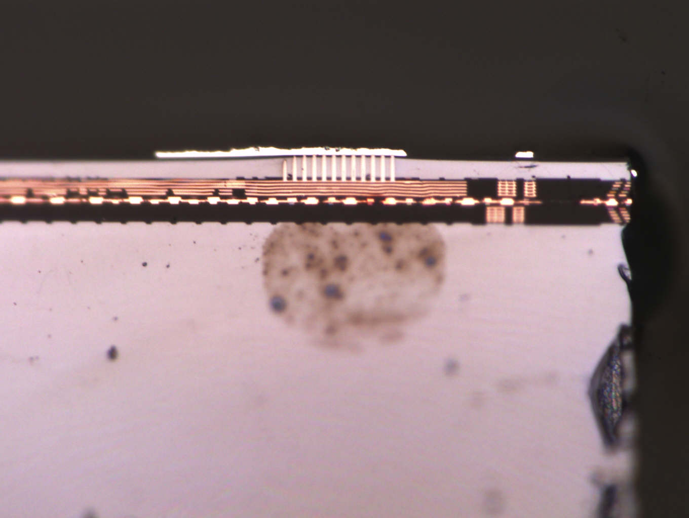
looks like open
TSV in I/O cell
6.47um
core die
5.30um
P/G F2F Via
mem die

Slide 2
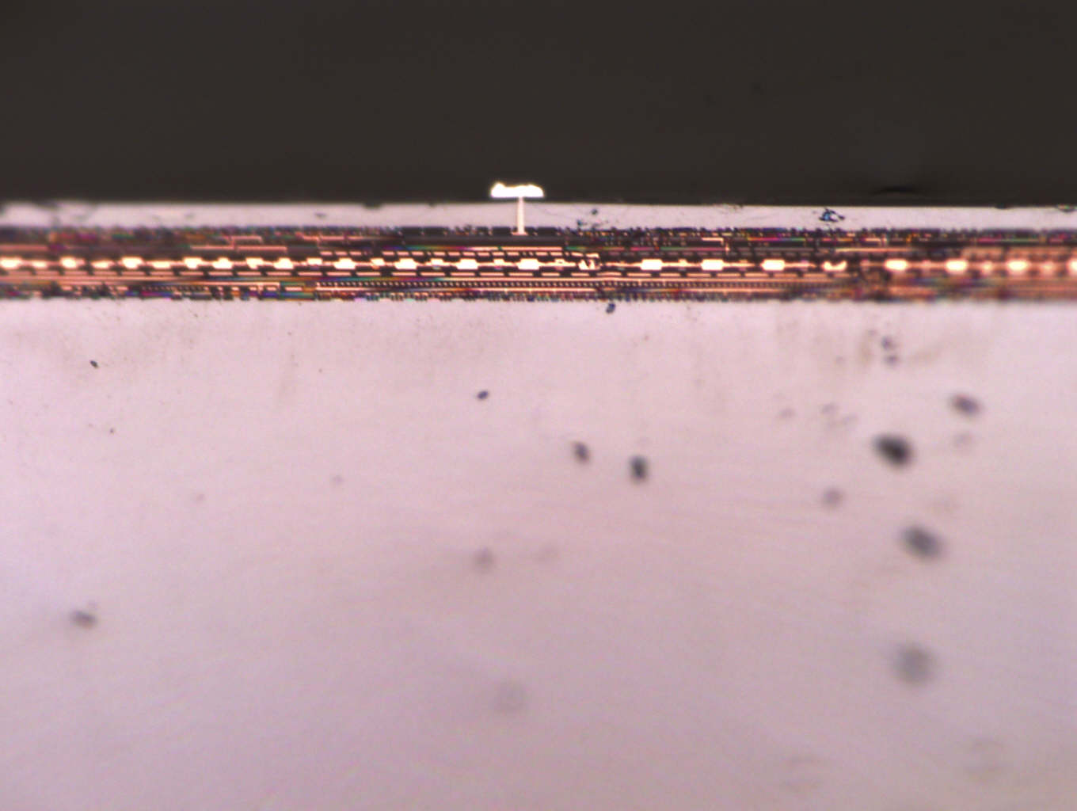
dummy TSV
P/G F2F Via

