Slide 1
High Performance Non-blocking Switch Design in 3D Die-Stacking Technology
Dean L. Lewis, Sudhakar Yalamanchili,
Hsien-Hsin S. Lee
IEEE Computer Society Annual Symposium on VLSI
Tampa, Fl, 2009
http://arch.ece.gatech.edu/mars.html

Slide 2

3D Integration
Multiple layers of silicon

Slide 3

3D Integration
Multiple layers of silicon
Interconnected with TSVs
  Etched through thinned wafers

Slide 4
3D Integration
Multiple layers of silicon
Interconnected with TSVs
  Etched through thinned wafers
Several integration options
  Technology
    Different processing technologies are tightly integrated

Slide 5
3D Integration
Multiple layers of silicon
Interconnected with TSVs
  Etched through thinned wafers
Several integration options
  Technology
    Different processing technologies are tightly integrated
  Architecture
    Blocks split across layers
ALU 0
ALU 1
ALU 2
ALU 3

Slide 6
3D Integration
Multiple layers of silicon
Interconnected with TSVs
  Etched through thinned wafers
Several integration options
  Technology
    Different processing technologies are tightly integrated
  Architecture
    Blocks split across layers
  Circuit
    Transistors split across layers

Slide 7
Switch Design
INPUTS
OUTPUTS

Slide 8
Switch Design
Strictly non-blocking
  Any free input/output pair can be connected
  No effect on existing connections
Connect(3,2)

Slide 9
Switch Design
Strictly non-blocking
  Any free input/output pair can be connected
  No effect on existing connections
Connect(3,2)

Slide 10
Switch Design
Strictly non-blocking
  Any free input/output pair can be connected
  No effect on existing connections
Weakly non-blocking
  Any free input/output pair can be connected
  Existing connections may need to be rearranged
Connect(3,2)

Slide 11
Switch Design
Strictly non-blocking
  Any free input/output pair can be connected
  No effect on existing connections
Weakly non-blocking
  Any free input/output pair can be connected
  Existing connections may need to be rearranged
Connect(3,2)

Slide 12
Switch Design
Strictly non-blocking
  Any free input/output pair can be connected
  No effect on existing connections
Weakly non-blocking
  Any free input/output pair can be connected
  Existing connections may need to be rearranged
Connect(3,2)

Slide 13
Switch Design
Strictly non-blocking
  Any free input/output pair can be connected
  No effect on existing connections
Weakly non-blocking
  Any free input/output pair can be connected
  Existing connections may need to be rearranged
Blocking
  Making a new connection may disconnect an existing connection
Connect(3,2)

Slide 14
Switch Design
Strictly non-blocking
  Any free input/output pair can be connected
  No effect on existing connections
Weakly non-blocking
  Any free input/output pair can be connected
  Existing connections may need to be rearranged
Blocking
  Making a new connection may disconnect an existing connection
Connect(3,2)

Slide 15
Switch Design
Strictly non-blocking
  Any free input/output pair can be connected
  No effect on existing connections
Weakly non-blocking
  Any free input/output pair can be connected
  Existing connections may need to be rearranged
Blocking
  Making a new connection may disconnect an existing connection
Connect(3,2)

Slide 16
Crossbar
Strictly Non-blocking
Lots of switch points
Little wiring

Slide 17
Crossbar
Strictly Non-blocking
Lots of switch points
Little wiring
Very long critical path
Connect(15,15)

Slide 18
Row-Split 3D Crossbar
Cannot target wiring directly
  Too short and direct
Instead, change critical path using 3D design
Split rows in half, placing each half on a different layer
Add multiplexers to bypass unused half
Critical path wirelength is reduced by 25%

Slide 19
Row-Split 3D Crossbar
Cannot target wiring directly
  Too short and direct
Instead, change critical path using 3D design
Split rows in half, placing each half on a different layer
Add multiplexers to bypass unused half
Connect(15,15)

Slide 20
Column-Split 3D Crossbar
Complimentary to row-split design

Slide 21
Column-Split 3D Crossbar
Complimentary to row-split design
Connect(15,15)

Slide 22
Column-Split 3D Crossbar
Complimentary to row-split design
Row-split and column-split designs can be applied simultaneously in a four-layer stack
  50% reduction in critical path wirelength
Connect(15,15)

Slide 23
Crossbar – System View
Crossbars are great at small sizes
This makes them good for a NoC design
  Individual components (processors, routers, caches) are 3D
  NoC architecture is planar (shown)
  Of course, both components and NoC could be 3D
P2
P3
P0
P1

Slide 24
Crossbar – System View
Crossbars are great at small sizes
This makes them good for a NoC design
  Individual components (processors, routers, caches) are 3D
  NoC architecture is planar (shown)
  Of course, both components and NoC could be 3D
P2
P3
P0
P1

Slide 25
MIN
Multistage interconnect network
Weakly non-blocking
Less hardware but more complex wiring than crossbars
Usually more appropriate for larger switches
Example system: many-input router chip
Interconnect Stage
Interconnect Stage
Interconnect Stage
Interconnect Stage
Interconnect Stage
Interconnect Stage

Slide 26
Perfect Shuffle
Interconnect pattern – deck of cards perfectly shuffled
Lots of overlapping wiring, so lots of wiring tracks

Slide 27
Perfect Shuffle
Interconnect pattern – deck of cards perfectly shuffled
Lots of overlapping wiring, so lots of wiring tracts
Two long hops on critical path: (3,7) and (4,0)

Slide 28
Perfect Shuffle – Wiring
Pattern in the overlaps that 3D can target to relieve congestion

Slide 29
Perfect Shuffle – Wiring
Pattern in the overlaps that 3D can target to relieve congestion
Nodes 0 and 4 both connect to 0 and 1 in the next stage

Slide 30
Perfect Shuffle – Wiring
Pattern in the overlaps that 3D can target to relieve congestion
Nodes 0 and 4 both connect to 0 and 1 in the next stage
Similarly, nodes 3 and 7 share 6 and 7

Slide 31
3D Perfect Shuffle
Split MIN into bottom half and top half
Place top half over bottom half

Slide 32
3D Perfect Shuffle
Split MIN into bottom half and top half
Place top half over bottom half
Those old longest paths are now much shorter

Slide 33
3D Perfect Shuffle
Split MIN into bottom half and top half
Place top half over bottom half
Those old longest paths are now much shorter
Consequently, critical path is reduced

Slide 34
Butterfly Shuffle
Interconnect pattern – wiring destination doubles at each stage
Lots of overlapping wires in the outer stages

Slide 35
Butterfly Shuffle
Interconnect pattern – wiring destination doubles at each stage
Lots of overlapping wires in the outer stages

Slide 36
Butterfly Shuffle
Interconnect pattern – wiring destination doubles at each stage
Lots of overlapping wires in the outer stages
These wires do not share switch resources

Slide 37
Butterfly Shuffle
Interconnect pattern – wiring destination doubles at each stage
Lots of overlapping wires in the outer stages
These wires do not share switch resources

Slide 38
3D Butterfly Shuffle
Use a “bit-split” partition
This removes half of overlapping wires from each outer stage

Slide 39
3D Butterfly Shuffle
Use a “bit-split” partition
This removes half of overlapping wires from each outer stage
Now many fewer wiring tracts required per stage

Slide 40
3D Butterfly Shuffle
Use a “bit-split” partition
This removes half of overlapping wires from each outer stage
Now many fewer wiring tracts required per stage
Critical path is significantly reduced

Slide 41
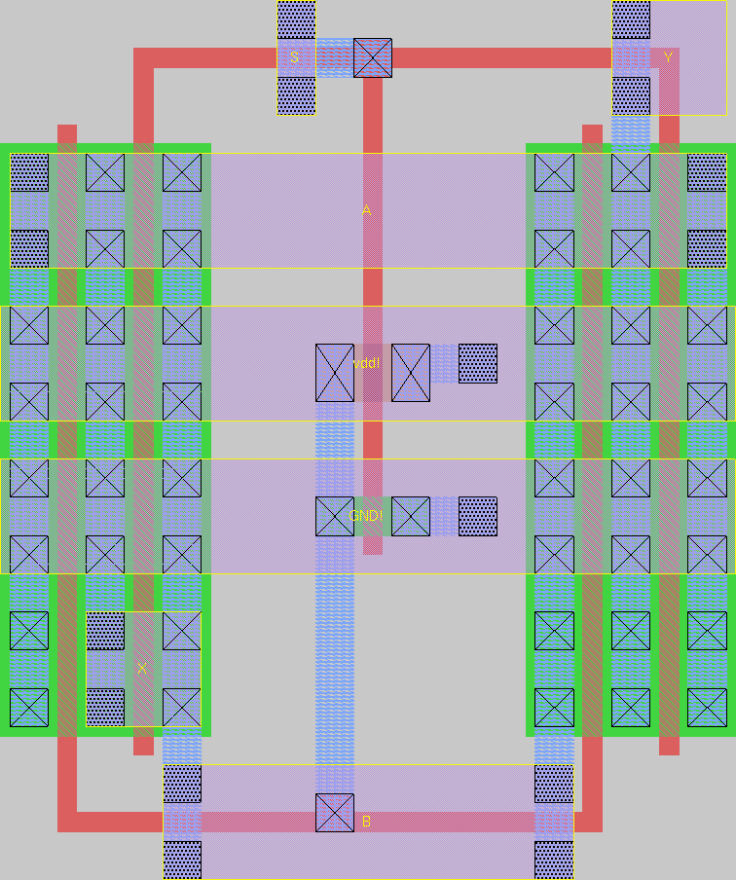
Experimental Setup
Switch cell
  130nm technology
TSV
  Tezzaron 3D process
  10um x 1.7um x 1.7um
HSPICE simulation
  Lvl49 130nm transistor
  Stick diagrams for wiring stages
  Intel 130nm wire parasitics

Slide 42
Results
1.01
1.02
0.93
0.90
0.92
0.91
0.85
0.88
0.80
0.76
0.74
0.76

Slide 43
Conclusion
Switches are a key component of networks both large and small
3D integration can be used to effectively improve switch performance
3D circuit design effectively targets and reduces long critical paths
Generally, 3D integration reduces area, delay, and energy simultaneously
These reductions are significant
  8% - 26%
3D will be a powerful design optimization technology in near-future products

Slide 44
Thank you!
http://arch.ece.gatech.edu/mars.html

