Slide 1
Testing Circuit-Partitioned
3D IC Designs
Dean L. Lewis, Hsien-Hsin S. Lee
IEEE Computer Society Annual Symposium on VLSI
Tampa, Fl, 2009
http://arch.ece.gatech.edu/mars.html

Slide 2

3D Integration
Multiple layers of silicon

Slide 3

3D Integration
Multiple layers of silicon
Interconnected with TSVs
  Etched through thinned wafers

Slide 4
3D Integration
Multiple layers of silicon
Interconnected with TSVs
  Etched through thinned wafers
Several integration options
  Technology
    Different processing technologies are tightly integrated

Slide 5
3D Integration
Multiple layers of silicon
Interconnected with TSVs
  Etched through thinned wafers
Several integration options
  Technology
    Different processing technologies are tightly integrated
  Architecture
    Blocks split across layers
ALU 0
ALU 1
ALU 2
ALU 3

Slide 6
3D Integration
Multiple layers of silicon
Interconnected with TSVs
  Etched through thinned wafers
Several integration options
  Technology
    Different processing technologies are tightly integrated
  Architecture
    Blocks split across layers
  Circuit
    Transistors split across layers

Slide 7
Motivation
100%
Stack Yield
0%
100%
80%
Single Layer Yield
Notes:
Shows exponential decay in final stack yield as number of layers increases

Slide 8
Motivation
95%
100%
Stack Yield
0%
100%
80%
Single Layer Yield
Notes:
Shows exponential decay in final stack yield as number of layers increases

Slide 9
Motivation
95%
100%
95%
90%
81%
66%
Stack Yield
44%
0%
100%
80%
Single Layer Yield
Notes:
Shows exponential decay in final stack yield as number of layers increases

Slide 10
Previous Work
Alpha 21364
3D Pre-bond Test
IEEE 1149.1 TAP
LTC
CSC
CSC
ISP
ISP
IEEE 1149.1 TAP
LTC
* Dean L. Lewis and Hsien-Hsin S. Lee. A Scan-Island Based Design Enabling Pre-bond Testability in Die-Stacked
Microprocessors. In Proceedings of the IEEE International Test Conference 2007 (ITC), Santa Clara, CA, October, 2007.
Notes:
TAP = test access port. Includes test clock, test mode select (controls transitions in TAP’s state machine), test reset, scan in, and scan out (together scan in and scan out create a 1-bit wide scan chain access port)
CSC = central scan controller. Interfaces chip to TAP and ATE. Provides n-bit wide scan chain access (i.e. access to n scan chains in parallel; 32 in the 21364, multiplexed with the 64 bits of the data bus). Allows for much faster test than the TAP
ISP = island scan port. Controls scan islands (most importantly, it allows tester to either access or bypass the island’s chains). Connected to CSC by n-bit bus
LTC = layer test controller. Same as ISP. Pre-bond, n-bit wide bus and control signals exposed to ATE

Slide 11
Previous Works – Results
ICache
FP
EU1
IntQ
IE
U2
IE
U4
DCache
Layer 1
Scan Cell Size | 75.8 μm²
Inter-die Vias | 2397
Scan Cell Count Two cells per via | 4794
Area | 0.363 mm²
Overhead | 0.165%
DTLB
IE
U1
FPEU2
FP
Map
FPQ
DIS
IRF
1
FP
RF
IMap
LSQ
BPred
Layer 2
Ftch
Dcd
IRF2
IE
U3
ITLB
Mem
Ctlr
BIU
Notes:
LTC size not significant compared area consumed by the border flip flops
Worst case analysis:
Academic scan-flop layout, which is potentially 50% bigger than an industrial design
0.27u layout versus Alpha’s 0.25u process, so once again bigger than it should have been
Two scan-flops for every inter-die wire. In many cases, wires may source or sink a flip-flop, in which case those FFs could be made scannable to avoid the extra scan cells
No scan-flop reuse. We assume no scan cells are reused in the post-bond test hardware. In a real design, there is great potential for use reuse, further minimizing cost

Slide 12
Kogge-Stone Adder
Binary summation tree
  P and G signals represented by arrows
Trades off hardware for reduced fan-out
7
6
5
4
3
2
1
0
0
7
6
5
4
3
2
1
0
0
7
6
5
4
3
2
1
0
0
7
6
5
4
3
2
1
0
0

Slide 13
Kogge-Stone Adder
Binary summation tree
  P and G signals represented by arrows
Trades off hardware for reduced fan-out
In second stage, there are two disjoint sets of logic
7
6
5
4
3
2
1
0
0
7
6
5
4
3
2
1
0
0
7
6
5
4
3
2
1
0
0
7
6
5
4
3
2
1
0
0

Slide 14
Kogge-Stone Adder
Binary summation tree
  P and G signals represented by arrows
Trades off hardware for reduced fan-out
In second stage, there are two disjoint sets of logic
  These sets do not interact, yet they compete for wiring tracts
Four sets at third level
7
6
5
4
3
2
1
0
0
7
6
5
4
3
2
1
0
0
7
6
5
4
3
2
1
0
0
7
6
5
4
3
2
1
0
0

Slide 15
Bit-Split Kogge-Stone Adder
Bit-splitting separates disjoint logic sets across layers
  For two layers, we get an even layer and an odd layer
7
6
5
4
3
2
1
0
0
7
6
5
4
3
2
1
0
0
7
6
5
4
3
2
1
0
0
7
6
5
4
3
2
1
0
0

Slide 16
Bit-Split Kogge-Stone Adder
Bit-splitting separates disjoint logic sets across layers
  For two layers, we get an even layer and an odd layer
TSVs shuffle P&G signals in first level of logic
7
6
5
4
3
2
1
0
0
7
6
5
4
3
2
1
0
0
7
6
5
4
3
2
1
0
0
7
6
5
4
3
2
1
0
0

Slide 17
Bit-Split Kogge-Stone Adder
Bit-splitting separates disjoint logic sets across layers
  For two layers, we get an even layer and an odd layer
TSVs shuffle P&G signals in first level of logic
Now the second and third stages are much less congested
0
0
0
0
6
4
2
0
0
0
0
0
6
4
2
0
0
0
0
0
6
0
4
0
2
0
6
4
0
0
2
1
0
0
0
0
6
4
2
1
0
0
0
0
6
4
2
0
0
0
0
0
6
4
2
1
0
0
0
0
7
5
3
1

Slide 18
Bit-Split Kogge-Stone Adder
But now first stage is much more complex
0
0
0
0
6
4
2
0
0
0
0
0
6
4
2
0
0
0
0
0
6
0
4
0
2
0
6
4
0
0
2
1
0
0
0
0
6
4
2
1
0
0
0
0
6
4
2
0
0
0
0
0
6
4
2
1
0
0
0
0
7
5
3
1

Slide 19
Bit-Split Kogge-Stone Adder
But now first stage is much more complex
Bit-splitting can be repeated
  TSVs in first two levels
  One-fourth the complexity in all other levels
0
0
0
0
6
4
2
0
0
0
0
0
6
4
2
0
0
0
0
0
6
0
4
0
2
0
6
4
0
0
2
1
0
0
0
0
6
4
2
1
0
0
0
0
6
4
2
0
0
0
0
0
6
4
2
1
0
0
0
0
7
5
3
1

Slide 20
Bit-Split Kogge-Stone Adder
But now first stage is much more complex
Bit-splitting can be repeated
  TSVs in first two levels
  One-fourth the complexity in all other levels
Trading off TSVs for reduced complexity
0
0
0
0
6
4
2
0
0
0
0
0
6
4
2
0
0
0
0
0
6
0
4
0
2
0
6
4
0
0
2
1
0
0
0
0
6
4
2
1
0
0
0
0
6
4
2
0
0
0
0
0
6
4
2
1
0
0
0
0
7
5
3
1

Slide 21
Testing the Adder
Few TSVs located near the edge of the circuit
  Scan-based test acceptable
7
6
5
4
3
2
1
0
0
7
6
5
4
3
2
1
0
0
7
6
5
4
3
2
1
0
0
7
6
5
4
3
2
1
0
0

Slide 22
Testing the Adder
Few TSVs located near the edge of the circuit
  Scan-based test acceptable
Add a scan-cell to each TSV
  Two per adder column
No observation cells required
  Values generated in level one logic observable at adder POs
7
6
5
4
3
2
1
0
0
7
6
5
4
3
2
1
0
0
7
6
5
4
3
2
1
0
0
7
6
5
4
3
2
1
0
0

Slide 23
Many-Port Register File
Many ports to allow parallel access to many entries
  20 or more in recent out-of-order processors

Slide 24
Many-Port Register File
Many ports to allow parallel access to many entries
  20 or more in recent out-of-order processors
Wiring in cell grows quadratically with port count
  Required to make room for extra word- and bit-lines

Slide 25
Many-Port Register File
Many ports to allow parallel access to many entries
  20 or more in recent out-of-order processors
Wiring in cell grows quadratically with port count
  Required to make room for extra word- and bit-lines
This increases
  Cell size
  Word-line length
  Bit-line length
All of these slow circuit down

Slide 26
Port-Split Register File
To fight quadratic growth, we split ports across layers
This reduces
  Cell size
  Word-line length
  Bit-line length
A very big win for 3D
But how do we test the top layer pre-bond

Slide 27
Memory Test
Suk and Reddy's Test B
  Write '0' to all cells

Slide 28
Memory Test
Suk and Reddy's Test B
  Write '0' to all cells
  Write '1' to a particular cell
Write

Slide 29
Memory Test
Suk and Reddy's Test B
  Write '0' to all cells
  Write '1' to a particular cell
  Read written cell and neighbors
Read
Read
Read
Read

Slide 30
Memory Test
Suk and Reddy's Test B
  Write '0' to all cells
  Write '1' to a particular cell
  Read written cell and neighbors
This algorithm tests not only each cell's functionality but also bridging between neighboring cells
Standard neighborhood
  Four adjacent cells

Slide 31
Pre-bond Memory Test
We can't write to cells
Write

Slide 32
Pre-bond Memory Test
We can't write to cells
But we can write through them

Slide 33
Pre-bond Memory Test
We can't write to cells
But we can write through them
Transmit test
  Write

Slide 34
Pre-bond Memory Test
We can't write to cells
But we can write through them
Transmit test
  Write and read simultaneously
Requires at least one write and one read port per layer

Slide 35
Experimental Setup
Design
  3D layouts using the 3D Magic tool
  DRC rules from MITLL 180nm process
  Simulation with HSPICE
  Lvl 49 transistor model
Adder Test
  Verilog models
    Separate bottom, top, and integrated models for 3D adder
  FlexTest for test modeling
RF Test
  Algorithm

Slide 36
64-Bit Planar KS Adder

Slide 37
64-Bit 3D KS Adder
Bottom Layer
Top Layer

Slide 38
Kogge-Stone Comparison

Slide 39
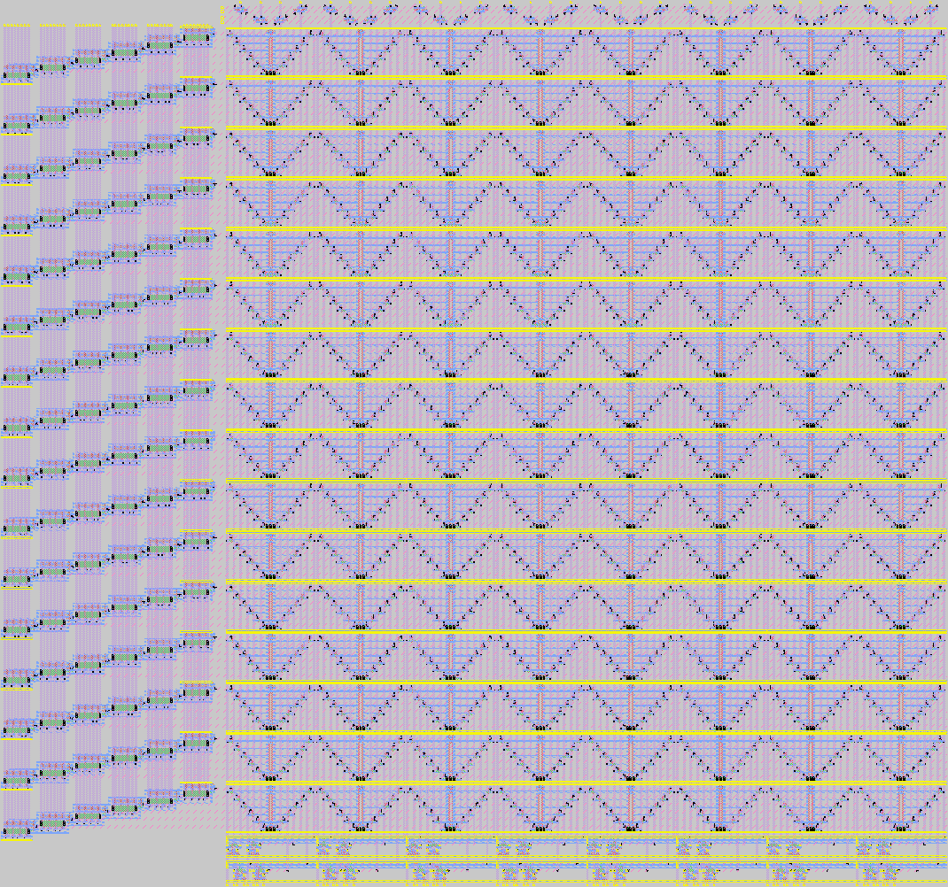
128-bit, 6-port Planar RF

Slide 40
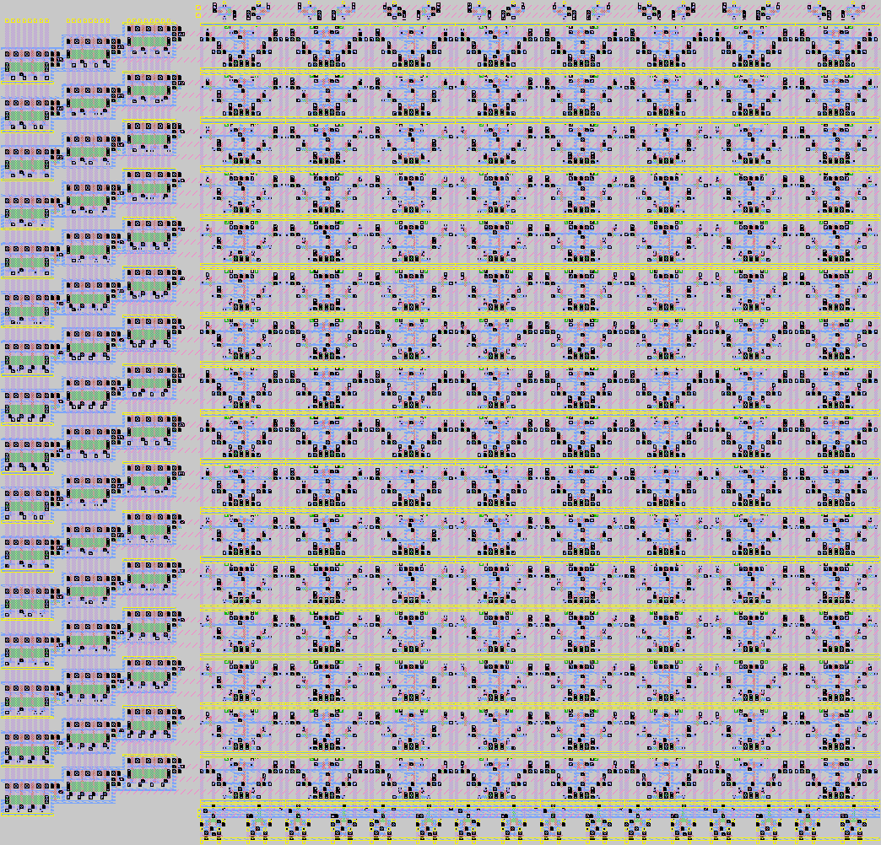
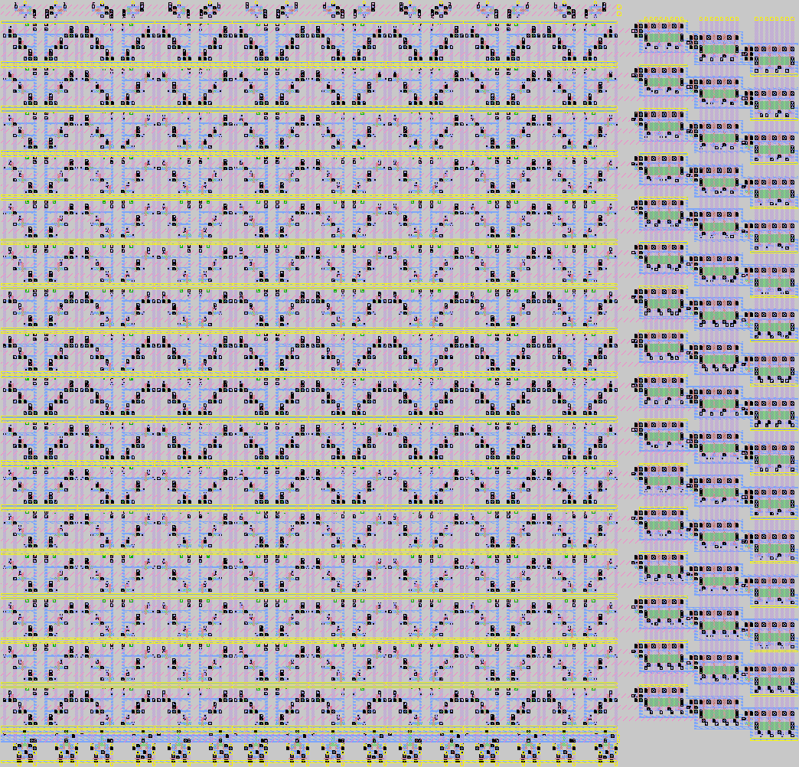
128-bit, 6-port 3D RF
Bottom Layer
Top Layer

Slide 41
Register File Comparison

Slide 42
Register File Comparison

Slide 43
Conclusion
3D pre-bond circuit test can be done
It can be done using straight-forward extensions to planar scan-based test
Even circuit-partitioned designs can, in most cases, be tested with scan-chain test
Some designs will require new test algorithms
Complete 3D test is similar in cost to, and sometimes significantly less, planar test

Slide 44
Thank you!
http://arch.ece.gatech.edu/mars.html

