Slide 1
Choice Predictor for Free
Mongkol Ekpanyapong
Pinar Korkmaz
Hsien-Hsin S. Lee
School of Electrical and Computer Engineering
Georgia Institute of Technology
Atlanta, GA 30332
Presented by
Dr. Youfeng Wu
Intel Corportaion

Slide 2
Branch Prediction Schemes
Static Branch Prediction
Predict at compile time
Based on inst. type or profilings
Work well on easy-to predict branch such as for-loop
Dynamic Branch Prediction
Predict at run time
Using hardware to track run-time behavior
More accurate
Require more die area and power dissipation

Slide 3
Bimodal Branch Predictor
Using counters to determine branch direction
Example of bimodal branch predictor
Branch addr
Counter > 1 :: hit
Counter <= 1 :: miss
2 bit-counter

Slide 4
Global Branch Predictor
Using global branch history to determine the direction
Example of global branch predictor
Pattern History Table (PHT)
Branch History
Pattern
Branch History Register (BHR)
(Shift left when update)
00…..00
00…..01
Rc-k
Rc-1
00…..10
1
1
. . . . .
1
0
index
2 bit-counter
11…..10
11…..11

Slide 5
Hybrid Branch Predictor
Combining advantages of different branch predictors
Increasing branch prediction accuracy
Use choice predictor to decide which branch predictors to favor
Employs by many high performance processors

Slide 6
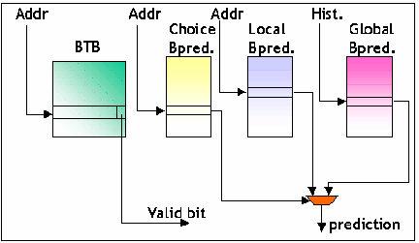
Example of Hybrid Branch Predictor

Slide 7
Motivation
Choice Predictor
Bimodal Predictor
Global Predictor
for i = 0 to 100000
a: if(i>0) …..
b: if(i%2 == 0) …..
end for
Branch address
Branch address
Branch history
a: bimodal
b: global
2 bit-counter

Slide 8
Outline
Introduction
Related Work
Static Prediction Generation
Experimental Results
Conclusion

Slide 9
Related Work
Profile guided branch prediction by Fisher and Freundenberger [ASPLOS,1992]
Program based branch prediction by Ball and Larus [PLDI,1993]
Static correlated branch prediction by Yang and Smith [TOPLAS, 1999]
Branch classification by Chang et al. [IJPP, 1999]
Static methods in hybrid branch prediction by Grunwald
Branch prediction on demand by Chaver [ISLPED, 2003]

Slide 10
Outline
Introduction
Related Work
Static Prediction Generation
Experimental Results
Conclusion

Slide 11
Static Prediction Generation
Profile guided static choice prediction
We can eliminate choice predictor
  Less area
  Less power consumption for updating
We propose two classification models
  Static Correlation Choice (SCC) prediction
  Static Choice (SC) prediction

Slide 12
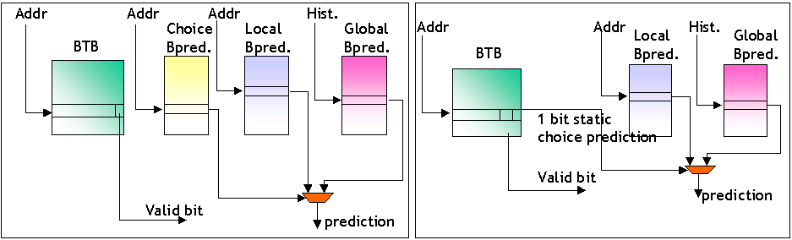
Static Choice Prediction

Slide 13
SCC Model
If biased branch (more than 90% hit rate) then favor bimodal
C_{LP} = # consecutive taken and not taken for a given branch address
E.g. branch pattern = 111100000101010 then C_{LP} = 3 + 4 = 7
C_{GP} = # consecutive taken and not taken of k-history group for a given branch address
E.g. Suppose k =2 and branch history is as follows:
101000001111 for the 00 group, 11111111110 for the 01 group,
1110 for the 10 group, and 1000000 for the 11 group
Then C_{GP} = 7 + 9 +2 +5 = 22.
If C_{LP} > C_{GP} then favor bimodal branch predictor
Else favor global branch predictor

Slide 14
SC Model
Using results collected from software based choice predictor from simulator
Count number of predication using bimodal and global branch prediction, favor the majority
This can be done by incorporate simulator into profile guided compiler

Slide 15
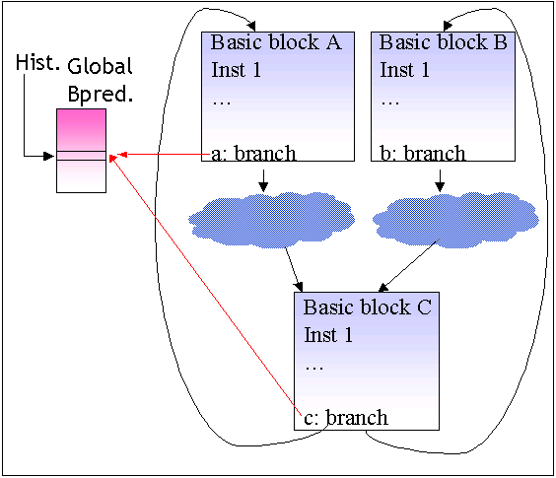
Comparing between SCC and SC
SC model consider aliasing into account
Consider if branch a and c destructively interfere each other in global branch predictor table
SCC will still favor global branch predictor
SC will favor bimodal

Slide 16
Outline
Introduction
Related Work
Static Prediction Generation
Experimental Results
Conclusion

Slide 17
Simulation Infrastructure
Execution Engine | Out-of-order
Fetch Width | 8 instruction
Issue Width | 8 instruction
ALU Units | 4 units
Branch Target Buffer | 4-way, 4096 sets
Register Update Unit | 128 entries
Cache organization | 4-way split I- and D-L1:
 | 64 KB each
 | 2 cycle hit latency
 | 32 bytes line
 | 4-way L2(unified):
 | 512 KB
 | 16 cycle hit latency
 | 64 bytes line
Memory latency | 120 core cycles

Slide 18
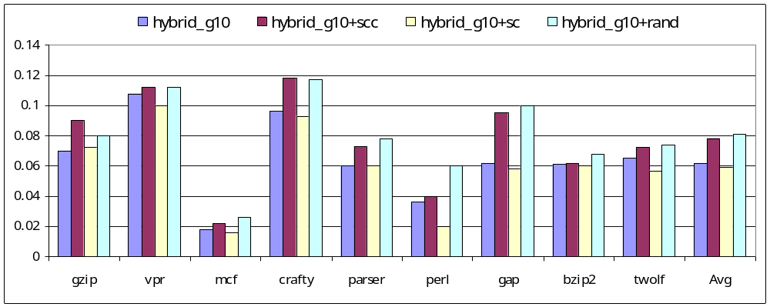
Miss Prediction Rates

Slide 19
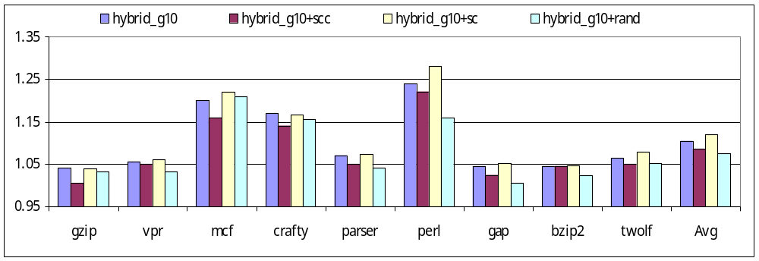
Normalized Speedup

Slide 20
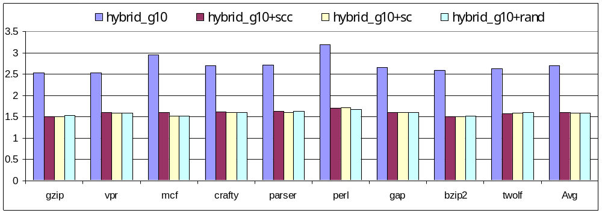
Normalized Power Consumption

Slide 21
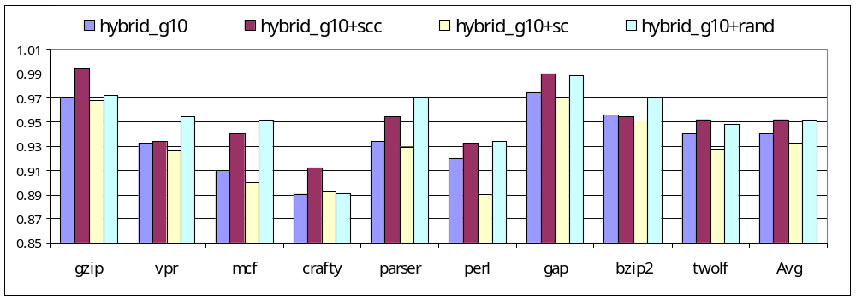
Normalized Processor Energy

Slide 22
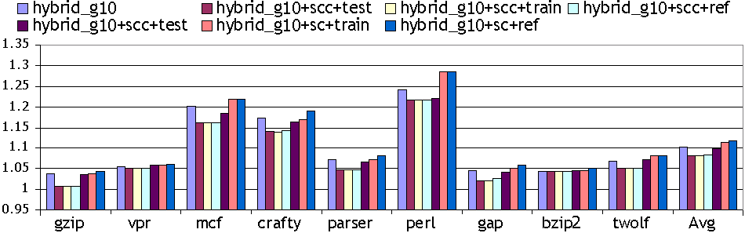
Normalized Performance on
Different Input Sets

Slide 23
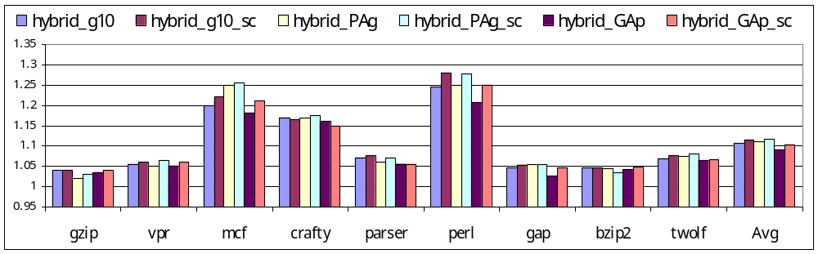
Normalized Performance on Different Hybrid Branch Predictors

Slide 24
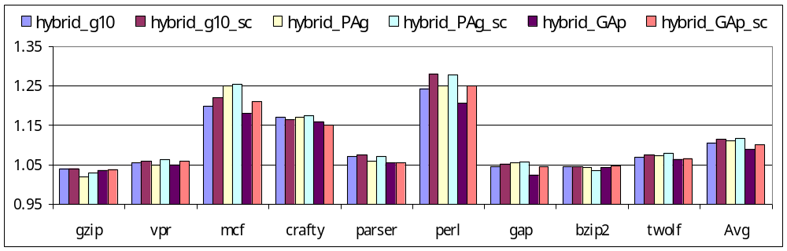
Normalized Power on Different Hybrid Branch Predictors

Slide 25
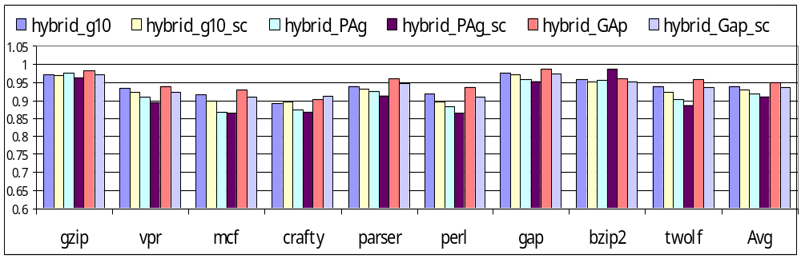
Normalized Energy on
Different Hybrid Branch Predictors

Slide 26
Normalized Area of
Hybrid branch predictors
Branch predictor | Normalized area
gshare11 | 1.9822
gshare12 | 4.806
hybrid_g10 | 2.973
hybrid_g10+scc/sc | 1.986
hybrid_g11 | 3.955
hybrid_g11+scc/sc | 2.968
hybrid_PAg | 4.946
hybrid_PAg+sc | 3.959
hybrid_GAp | 3.713
hybrid_Gap+sc/scc | 2.726

Slide 27
Outline
Introduction
Related Work
Static Prediction Generation
Experimental Results
Conclusion

Slide 28
Conclusion
We propose two profile-guided techniques Static Correlation Choice and Static Choice
From this, we can eliminate the need of choice predictor which can save power (40% on avg.) and area (27% on avg.)
It can be extended to more complex branch predictors with more complex choice predictor

Slide 29
Thank You

