Slide 1
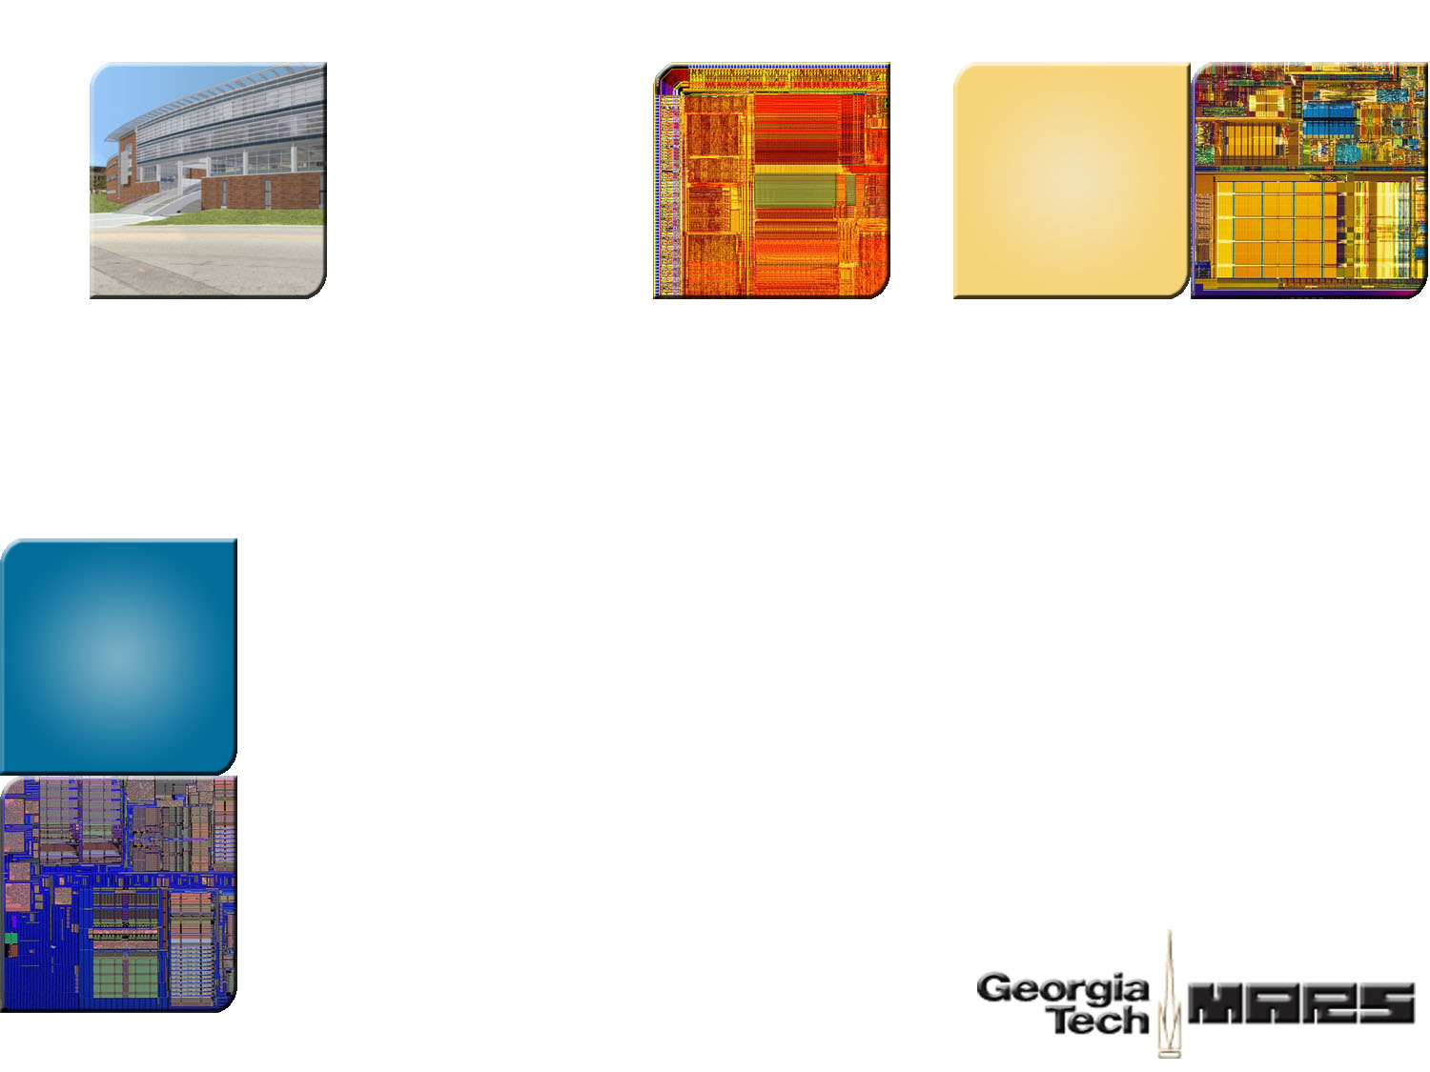



Noise-Direct: A Technique for Power Supply Noise Aware Floorplanning Using Microarchitecture Profiling
Fayez Mohamood*
Michael Healy
Sung Kyu Lim
Hsien-Hsin “Sean” Lee
School of Electrical and Computer Engineering
Georgia Institute of Technology
AMD, Inc*

Slide 2
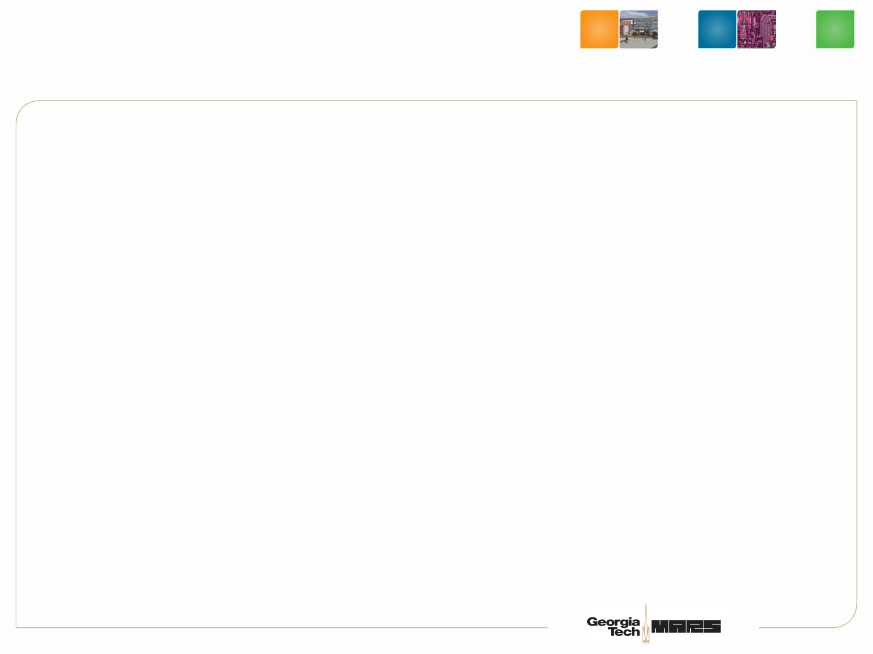

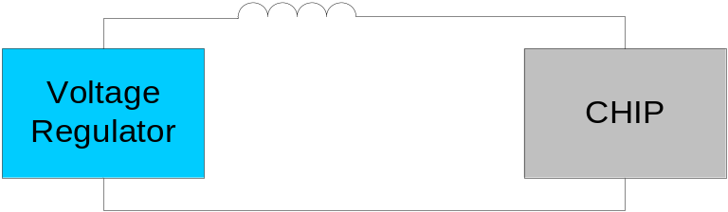

Inductive Noise
V
t
Power supply noise caused due to high variability in current per unit time
  ΔV = L(di/dt)
Reliability Issue that needs to be guaranteed
  Typically done through a multi-stage decap placement (motherboard/package/on-die)
Can be addressed by an over-designed power network, however
  Leads to high use of multi-stage decap
  More metal for power grid, leaving less for signals
Chip is designed to account for a program that can induce the worst-case power supply noise
Notes:
So let me explain quickly what di/dt is, and why it is more of a concern now. Conside a simple first order model, with a power supply, a voltage regulator and a microprocessor. Everything is fine as long as the chip draws steady state current. But when there is a sudden current demand, the chip will experience a voltage drop because the power supply is unable to respond instantaneously. What you see is a dip that can cause a glitch in the power supply network. The traditional way to mitigate this effect is to add a decap that can alleviate (but not eliminate) this issue by bringing the dip within the violation margin.
Since voltages have to be preserved within the margin, di/dt presents reliability issue that NEEDS to be guaranteed. Addressed my a multi stage decap nad an overdesigned power grid. “Talk from slide” `

Slide 3
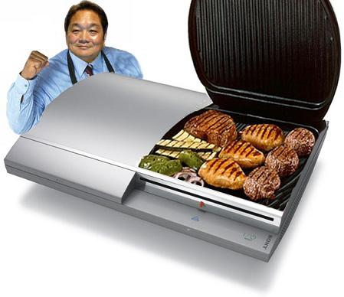
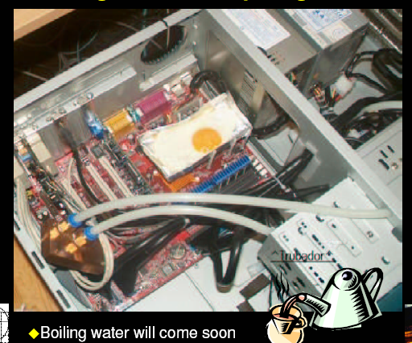
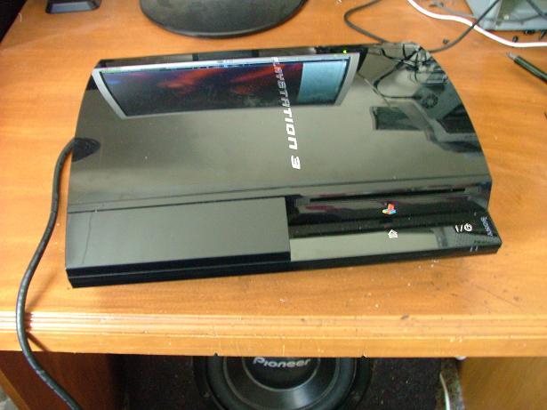
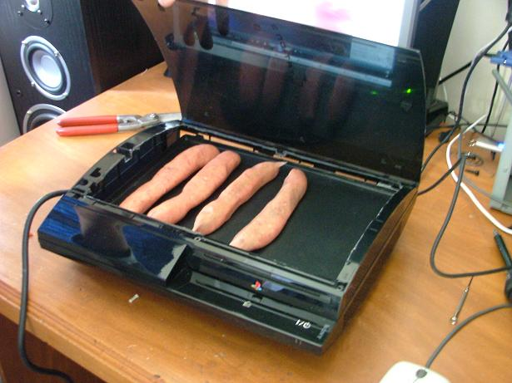
Why Now
More active devices on chip
  Higher power consumption
Source: K. Skadron

Slide 4
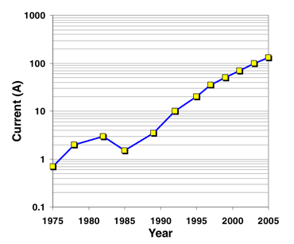
Why Now?
More active devices on chip
  Higher power consumption
Exponential increase in current consumption
  Intel reports 225% increase per unit area per generation
Device size miniaturization leads to lower operating voltages
  Lower noise margins
Aggressive power saving techniques
  Clock-gating
Multi-core trend can exacerbate di/dt issues
Source: Intel Technology Journal
Volume 09, Issue 04 Nov 9, 2005
Notes:
So this is obviously not a new problem, then why is it important now? Well, there are multiple technology trends that are responsible. So first, power consumption is up from a decade ago, chips are getting feature rich. Intel reports a 225% increase per unit per area generation in current consumption. The graph on the bottom right shows the current consumption trend for major chips over the last few decades. Traditional feature size scaling also leads to lower operating voltages. So even if the noise margin stays the same as a percentage, the absolute voltage noise margin gets smaller.
But importantly, the multi core trend is exacerbating di/dt issues at the package level, both because power consumption goes up and because dynamic power management between cores increases varibaly. But most importantly, this work is going to focus on one of the most importanat sources of high frequency inductive noise, mainly coarse gated clock gating techniques that result in local variations of current demand across the chip

Slide 5

Worst-case Design Inefficiency
Is the design reliable?
YES
Ship IT !
NO
NO
Worst-case Design
Average-case Design
Post-Design Decap Allocation
  Consumes chip real-estate
  Contributes to leakage
Finer clock gating domains
  Increases design complexity
Ex: Design package/heatsink for
worst-case thermal profile
Static control through physical design
Dynamic di/dt control for worst case
(see Mohamood et al. in MICRO-39)
Ex: DTM (Dynamic Thermal Management)
Thermal diode monitoring to throttle
CPU activity
A one-size-fits-all approach is needed
Notes:
As I mentioned before, di/dt violations need to be guaranteed, so this is done through worst case design. Explain the slides and examples.

Slide 6
Inductive Noise Taxonomy
Inductive Noise Classes
Low – Mid Frequency
High Frequency
Characteristics
Caused by global transient
Typically in the 20-100 MHz range
Does not require instantaneous
response
Mostly due to local transient
(clock-gating)
di/dt effects over 10s of cycles
Instantaneous response critical
Mitigation
Low impedance path between
power supply and package
Handled by package/bulk decap
Low impedance path between
cells and power supply nodes
Handled by on-die decap
M. Powell, T.N. Vijaykumar (ISCA’03/’04)
R. Joseph, Z. Hu, M. Martonosi (HPCA ‘03/’04)
K. Hazelwood, D. Brooks (ISLPED ‘04)
Pant, Pant, Wills, Tiwari (ISLPED ‘99)
M. Powell, T.N. Vijaykumar (ISLPED ’03)
F. Mohamood, M. Healy, S. Lim, H.-H. Lee (MICRO-39)
and this paper..
Notes:
Explain low frequency and high frquency noise

Slide 7
di/dt from Microarchitectural Perspective
Noise characteristics reflect program behavior
  Static characteristics
    Functional Unit Usage
    Location of modules relative to power pin
  Dynamic characteristics like cache misses
  E.g. power virus
Can floorplanning can exploit the above characteristics?
  Use microarchitectural information to identify “problematic” modules
  Optimize the floorplan based on benchmark profile information

Slide 8
Exploiting Floorplanning for di/dt
High frequency di/dt is a function of the chip floorplan
Factors affecting noise at a module:
  Frequency and intensity of switching activity
  Distance between each μarch module and power-pins
  Proximity to a simultaneously switching module
Formulating the problem:
  Quantify fine-grained microarchitectural activity
  Employ a floorplanning algorithm that optimizes for di/dt
Result is a floorplan that is inherently noise tolerant (for the average case)

Slide 9
Noise-Direct Design Methodology
Noise-Direct Floorplanner
Weights are used as forces in
a Force-directed floorplanner
Micro-architecture
Profiling
Weight Assignment
(α and γ )
Profile microarchitectural module activity to quantify average-case behavior
Quantifying metrics:
  Self-Switching Weight (α)
  Correlated-Switching Weight (γ)
Optimized floorplan:
  Direct modules with high α closer to power-pins
  Direct module pairs with high γ away from each other

Slide 10
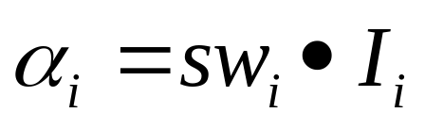
Self-Switching Weight
Self-Switching Weight (α)
  Relative likelihood of a module switching at a given time
  Certain modules gated far more than others
  For instance, the I$ is likely to be accessed all the time (except during fetch bottlenecks) → Low α
# of switching
Intensity
(Current consumption)

Slide 11
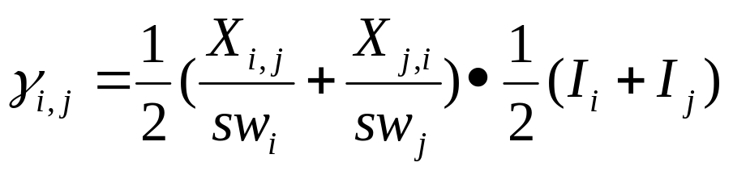
Correlated Switching Weight
Correlated-Switching Weight (γ)
  Relative likelihood of a module pair switching simultaneously at a given time
  Microarchitecture dependent metric
  For instance, a VIPT cache would result in an I$ and I-TLB that are accessed in parallel → High γ
Xi,j : correlated switching for i
Average correlated Intensity

Slide 12
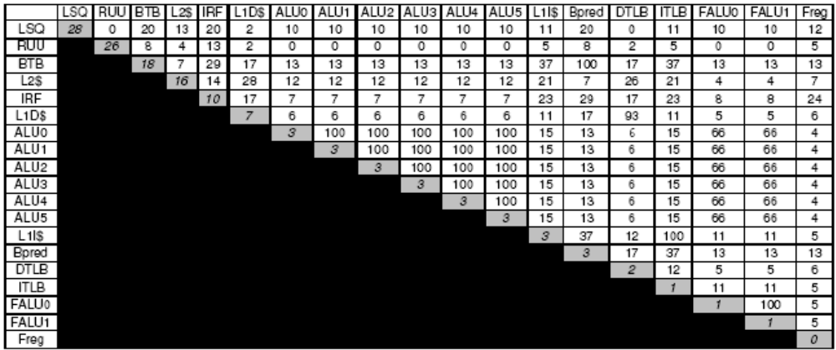
Self- and Correlated-Switching Activity

Slide 13
Force-Directed Floorplanning
Power Pin

Slide 14
Force-Directed Floorplanning
Module 3
Power Pin
Module 1
Module 2

Slide 15
Force-Directed Floorplanning
Module 3
Power Pin
Module 1
Net Force
Module 2

Slide 16
Force-Directed Floorplanning
Module 3
Power Pin
Module 1
Net Force
Module 2
Center Force

Slide 17
Force-Directed Floorplanning
Module 3
Power Pin
Module 1
Net Force
Module 2
Center Force
Density Force

Slide 18
Force-Directed Floorplanning
Module 3
Power Pin
Module 1
Net Force
Module 2
Center Force
Density Force
Correlation
Force (γ)

Slide 19
Force-Directed Floorplanning
Module 3
Power Pin
Module 1
Net Force
Module 2
Center Force
Density Force
Correlation
Force (γ)
Pin Force (α)
x, y directions

Slide 20
Force-Directed Floorplanning
Module 3
Power Pin
Module 1
Net Force
Module 2
Center Force
Density Force
Correlation
Force (γ)
Pin Force (α)
x, y directions

Slide 21
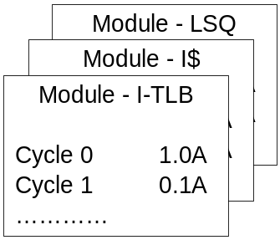
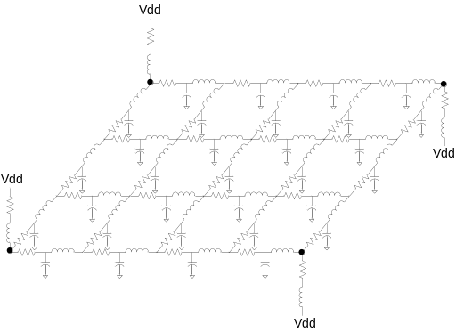
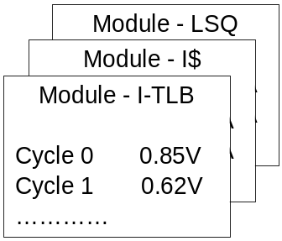
Noise (∆V) Analysis Method
Benchmark profiling
Spice PWL Files
Module Current Profile
Use Wattch to profile benchmark phases for worst-case switching activities
SPICE Output - Voltage Profile
Module Voltage Profile
Noise Analysis - SPICE

Slide 22
Simulated Processor Model
Parameters | Values
Fetch/Decode Width | 8-wide
Issue/Commit Width | 8-wide
Branch Predictor | Combining 16K-Entry Metatable Bimodal: 16K Entries 2-Level: 14 bit BHR, 16K entry PHT
BTB | 4-way, 4096 sets
L1 I$ & D$ | 16KB 4-Way 64B Line
I-TLB & D-TLB | 128 Entries
L2 Cache | 256KB, 8-way, 64B Line
L1/L2 Latency | 1 cycle/6 cycles
Main Memory Latency | 500 cycles
LSQ Size | 64 entries
RUU Size | 256 entries

Slide 23
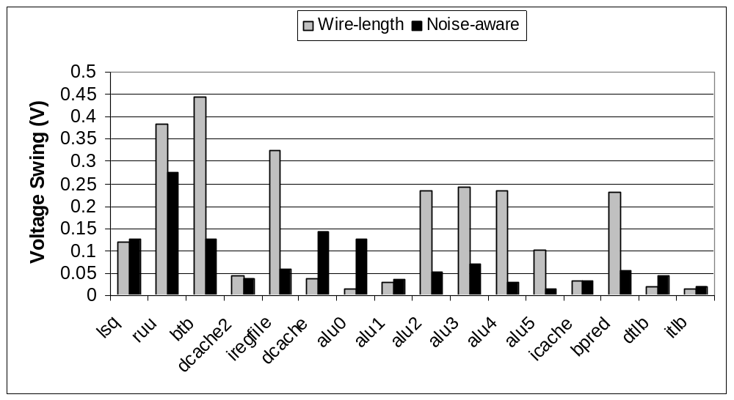
Power Supply Noise
Most worst-case voltage swings are pushed below margin
For exceptions, most are still below the threshold (10%), and the remaining are marginal
Outliers due to
  Other ALUs (other than alu0) have higher correlation (γ)
  Dcache does not have high correlation (γ) with others

Slide 24
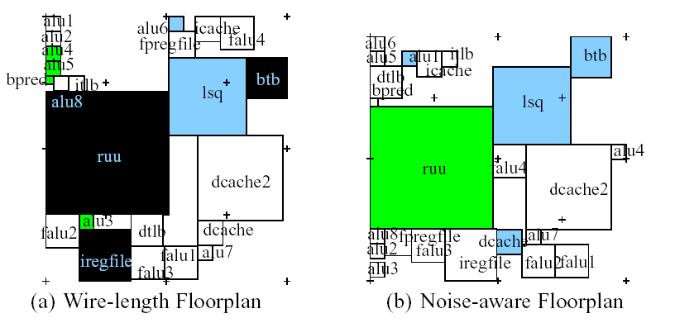
Noise Tolerance of Microarch Modules
Noise > 30 %
Noise > 10-20 %
Noise 20-30 %
Below Noise Margin

Slide 25
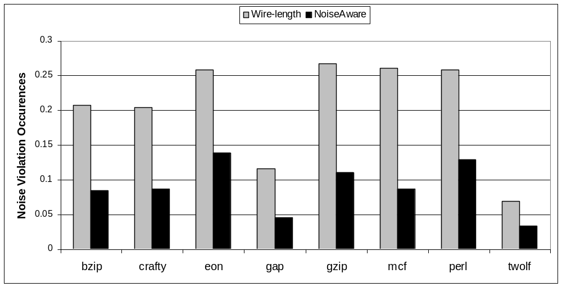
Noise Violation Frequency
Noise margin violations are reduced by more than half
Illustrates the potential for better performance in presence of a dynamic di/dt control mechanism

Slide 26
Dealing with Worst-Case
Even with Noise-Direct, worst-case must be guaranteed
We advocate: Noise Direct + Dynamic di/dt control
  Details in our paper in MICRO-39, 2006
  Use decay counters for each module
  Control simultaneous gating
    Based on a queue-based controller in each power domain
    Throttle gating when threshold is exceeded
  Other synergistic approaches
    Pre-emptive ALU gating
    Progressive gating for large modules
    Based on a queue-based controller in each power domain
    Throttle gating when threshold is exceeded

Slide 27
Conclusion
Traditional design methodologies continue to be inefficient
Inductive noise no longer a design afterthought
Decaps consume chip real-estate, and contribute to leakage, eroding benefits from clock-gating
Our research proposes
  Cooperative physical design and microarchitecture techniques
  Noise-Direct: Floorplanning for the average-case
  Guarantee worst case through dynamic di/dt control

Slide 28



Thank you
http://arch.ece.gatech.edu
http://www.3D.gatech.edu

Slide 29
BACKUP FOIL

Slide 30
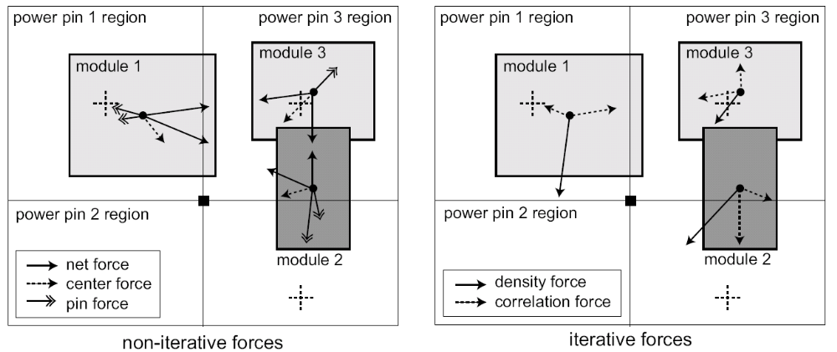
Illustration of Various Forces
Forces
  Net Force → Modules in the same net pulled closer
  Center Force → Modules pulled towards center to keep within boundary
  Correlation Force → Modules with high correlation are separated
  Density Force → Modules in high density region pushed out to minimize overlap
  Pin Capacity Force → Modules pushed away from power pins for even distribution

Slide 31
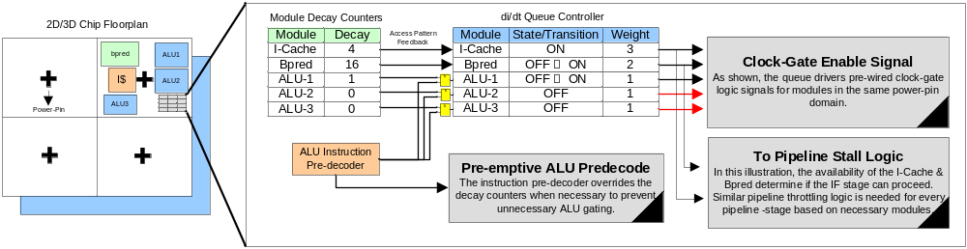
Floorplan-Aware Dynamic di/dt Controller
Chip Floorplan
Pre-wired Clock-Gaters
Pre-emptive ALU
gating
Pipeline Stall Logic
Published in MICRO-39
Use decay counters for each module
Control simultaneous gating
  Based on a queue-based controller per power domain
  Throttle gating when threshold is exceeded
Other synergistic approaches
  Pre-emptive ALU gating
  Progressive gating for large modules

Slide 32
Exampple
Re-sizeable
Sliding Window
Cycle:
1
Pre-wired
Clock Gating Signal
2
3
5
4
7
6
0
Floorplan
LSQ
di/dt Queue Controller
I$ and LSQ violates
3 Amp Threshold!
Module | Decay | Weight | State
I$ |  | 2
LSQ |  | 3
B-Pred |  | 1
Total Weight = 2
<
Threshold = 3
Gate OFF I$
Fetch Blocked
Request for LSQ
&
B-Pred Decay → 0
I$
3
Gate OFF LSQ
2
1
0
ON →OFF
OFF
ON
B-Pred
3
2
1
0
3
ON →OFF
OFF
OFF →ON
ON
ON
3
2
1
0
OFF
ON→OFF
ON
Cluster with three modules in same power pin domain
Assume permissible gating threshold → 3 Amps
ON→OFF is a negative switch
OFF→ON is a positive switch

Slide 33
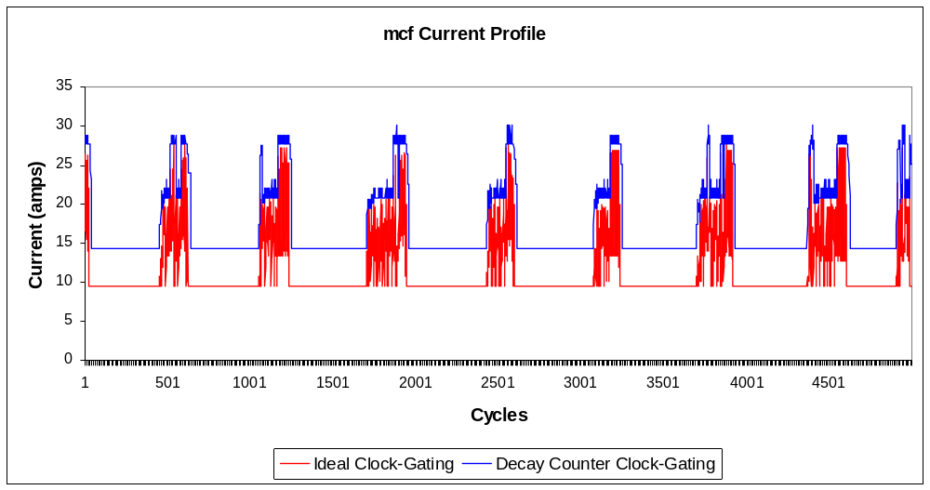
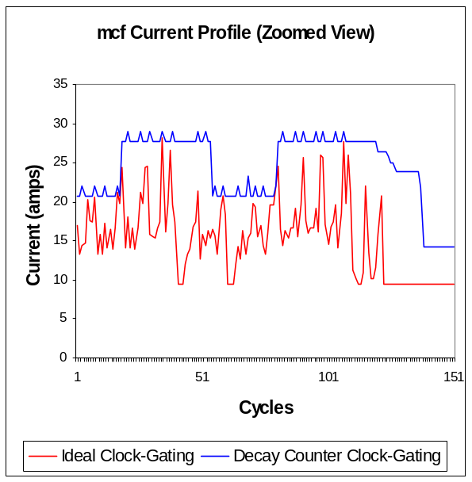
Full Chip Analysis
Low ILP benchmark – 164.mcf
Decay counter maintains an optimal power envelope
Smoothens the down-ramp

Slide 34
Comparison of Physical Dimension
Wirelength-driven
  Total wirelength = 804.86 mm
  Area = 69.35 mm²
Noise-Direct
  Total wirelength = 825.87 mm (2.6%↑)
  Area = 67.97 mm²
  Overhead of dynamic controller
    Very small, compared to the asset of the entire processor
    A few entry queue in each power domain

Slide 35
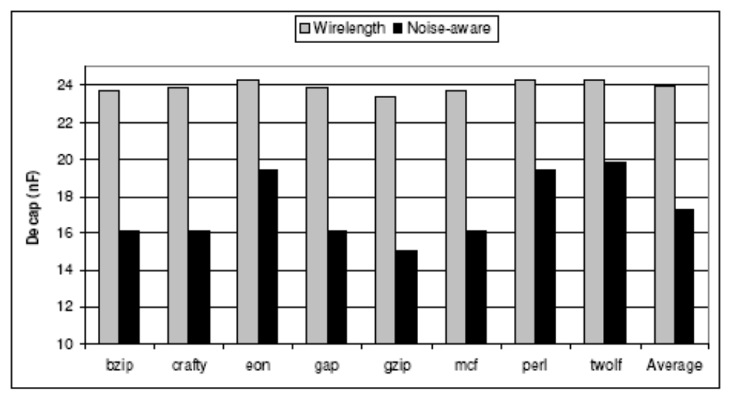
Decoupling Capacitance Requirement

