Slide 1
Hardware Assisted Control Flow Obfuscation for Embedded Processors
Xiaotong Zhuang
Tao Zhang
Hsien-Hsin (Sean) Lee
Santosh Pande
Georgia Institute of Technology
Atlanta, GA 30332

Slide 2
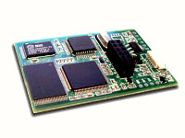
Types of Security Attacks
Software-based attacks
  Software reverse engineering, de-assembly
  Software patching
Hardware-based physical attacks
  Trace system from system bus, peripheral bus
  Power/timing differential analysis
  Build fake devices, device spoof (MOD chip)
  Modify RAM
  Replay bus signals, fake bus signal injection
  Trigger fake interrupts
XBOX with MOD-chip installed. MOD-chip is a low cost bus snoop and spoof device widely used to break XBOX security.

Slide 3
Deficiency in Encryption/Authentication
A common approach to protect data from being pirated.
The security strength is provable.
Cannot protect “addresses”
Program control flow is unprotected can be leaked. We will show examples later.

Slide 4
Agenda
Secure processor model
Control flow leaking
Hardware obfuscator
Performance Analysis
Conclusion

Slide 5
Unsecure Processor Model
Memory
Processor Chip
Notes:
HW encryption/decryption on the processor
Data encrypted before leaving the processor,
And decrypted when they come back.

Slide 6
Secure Processor Model
Insecure
Secure
Memory
Processor Chip
Boundary
Notes:
HW encryption/decryption on the processor
Data encrypted before leaving the processor,
And decrypted when they come back.

Slide 7
Control Flow Leakage ⎯ Example 1
Assume all code are encrypted
Control Flow Graph
Address Sequence
B1
B2
B3

Slide 8
Control Flow Leakage ⎯ Example 1
Control Flow Graph
Address Sequence
B1
Addr(B1)
B2
B3

Slide 9
Control Flow Leakage ⎯ Example 1
Control Flow Graph
Address Sequence
B1
Addr(B1), Addr(B2)
B2
B3

Slide 10
Control Flow Leakage ⎯ Example 1
Control Flow Graph
Address Sequence
B1
Addr(B1), Addr(B2), Addr(B3)
B2
B3

Slide 11
Control Flow Leakage ⎯ Example 1
Control Flow Graph
Address Sequence
B1
Addr(B1), Addr(B2), Addr(B3)
Addr(B1)
B2
B3

Slide 12
Control Flow Leakage ⎯ Example 1
Control Flow Graph
Address Sequence
B1
Addr(B1), Addr(B2), Addr(B3)
Addr(B1), Addr(B2)
B2
B3

Slide 13
Control Flow Leakage ⎯ Example 1
Control Flow Graph
Address Sequence
B1
Addr(B1), Addr(B2), Addr(B3)
Addr(B1), Addr(B2), Addr(B3)….
B2
B3
repeated addresses
loop

Slide 14
Control Flow Leakage ⎯ Example 2
Control Flow Graph
Address Sequence
B1
Addr(B1)
B2
B3
B4

Slide 15
Control Flow Leakage ⎯ Example 2
Control Flow Graph
Address Sequence
B1
Addr(B1), Addr(B2)
B2
B3
B4

Slide 16
Control Flow Leakage ⎯ Example 2
Control Flow Graph
Address Sequence
B1
Addr(B1), Addr(B2), Addr(B4)
B2
B3
B4

Slide 17
Control Flow Leakage ⎯ Example 2
Control Flow Graph
Address Sequence
B1
Addr(B1), Addr(B2), Addr(B4)
Addr(B1)
B2
B3
B4

Slide 18
Control Flow Leakage ⎯ Example 2
Control Flow Graph
Address Sequence
B1
Addr(B1), Addr(B2), Addr(B4)
Addr(B1), Addr(B3)
B2
B3
B4

Slide 19
Control Flow Leakage ⎯ Example 2
Control Flow Graph
Address Sequence
B1
Addr(B1), Addr(B2), Addr(B4)
Addr(B1), Addr(B3), Addr(B4)….
B2
B3
B4
either B2 or B3 follows B1
conditional branch

Slide 20
Critical Data Leakage via
Value-Dependent Conditional Branches
Modular Exponentiation Algorithm
(Diffie-Hellman, RSA)
Initialize
Let S₀ = 1
For i = 0 to w-1 Do
If (bit i of k) is 1 then
Let T_{i} = (S_{i}*C) mod N
Else
Let T_{i} = S_{i}
Let S_{i+1} = T²_{i} mod N
EndFor
Return (R_{w-1})
i=0 to w-1
bit i of k = 1?
Y
N
If-branch
Else-branch
Loop End
T = C^{k} mod N
Return
Hacker’s interest : to find X (the secret key)
Only 2 possibilities: key X or X

Slide 21
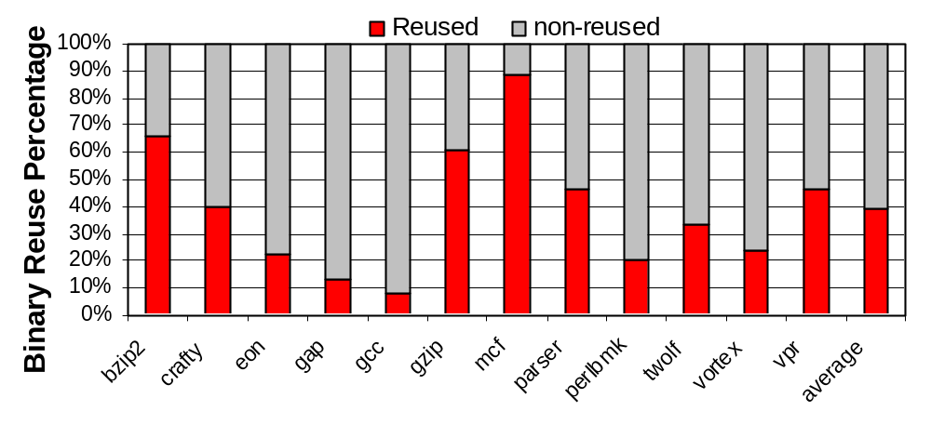
Code Reuse in SPECint2000

Slide 22
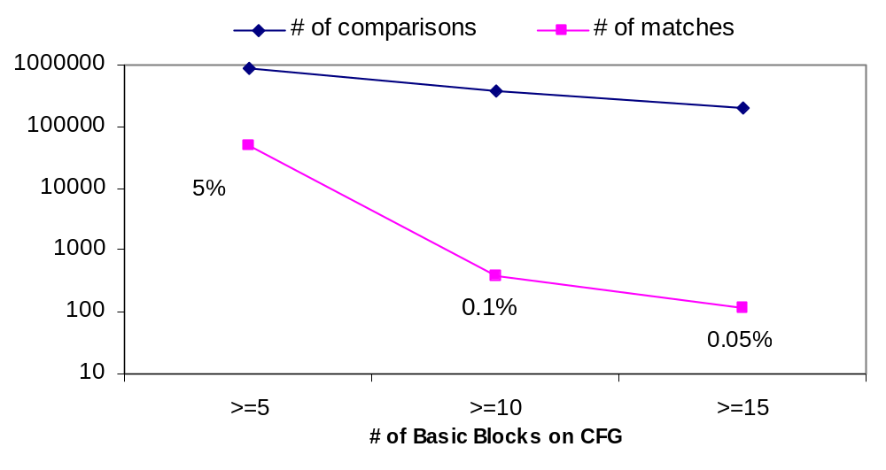
Matching CFGs for libc.a
<=5
<=10
<=15
Use graph isomorphism algorithm by Ullman
5% matching when BB<=5
Not consider BB size in this figure (thus conservative)

Slide 23
Consequences of Control Flow Leakage
Essential Information about the software
By graph matching the control flow graph with existing software, reuse code can be identified
Critical data can be leaked as well
Even partial knowledge can help competitors

Slide 24
Why not Encrypt Addresses?
Encryption/decryption only on the processor side
Memory is not secure, so no decryption on the memory side. Otherwise decrypted addresses are exposed, invalidates address encryption.
Address encryption → instruction data in memory must be relocated

Slide 25
Software Obfuscation ⎯
Static Address Encryption
Obfuscation techniques like “inlining and outlining transformation”, “loop transformation”, “control flow flattening” can somehow conceal the control flow.
Lack of ways to measure and prove the difficulty introduced. The level of protection cannot be evaluated and guaranteed quantitatively after the obfuscation.
May incur large overheads in code size due to dead code or irrelevant code.
Limited capability of static obfuscation

Slide 26
Static Address Encryption
After Address Encryption
Control Flow Graph
Memory Layout
B1
101
B1
101
B2
102
B2
102
B4
B2
B3
103
B3
103
B1
104
B4
104
B3
B4
Encryption Scheme
E_{key}(101)=103
E_{key}(102)=101
E_{key}(103)=104
E_{key}(104)=102

Slide 27
Static Address Encryption
B1
101
101
B1
101,102,104,101,103,104…
102
B2
B3
102
B2
B3
103
103
104
B4
B4
104
B1
103
101
B2
103,101,102,103,104,102…
102
B4
101
B2
B3
104
103
B1
104
B3
B4
102
Notes:
Can prevent layout leakage, but not recurrence leakage

Slide 28
Dynamic Control Flow Obfuscation
Should map address differently each time as it appears on the bus
Relocate blocks to new place every time it is evicted from the processor
Should not write out immediately after access to avoid correlation being exposed
Notes:
Refer to section 4.4

Slide 29
Obfuscator Hardware Overview
Cache
Shuffle Buffer
Controller
Block Address Table Cache
Encryption/
decryption
Encryption/
decryption
Processor side (secure)
Block Address Table
Program Address Space
Bus, memory (insecure)

Slide 30
Shuffle Buffer
A memory extension into secure side on the processor
Mutually exclusive to memory
Instructions are shuffle (relocated) when evicted from the shuffle buffer
1
2
3
4
5
6
7
8
9
Shuffle buffer
Memory
Security
Boundary

Slide 31
Dynamic Obfuscation Example
accesses
shuffle buffer
memory
1
2
3
4
5
6
7
8
9
Start—after fill up the buffer
1
2
3
4
5
6
7
8
9
5
1
5
3
4
2
6
7
8
9
Random Replacement Algorithm

Slide 32
Dynamic Obfuscation Example
accesses
shuffle buffer
memory
1
2
3
4
5
6
7
8
9
Start—after fill up the buffer
1
2
3
4
5
6
7
8
9
5
1
5
3
4
2
6
7
8
9
Shuffle buffer
Memory
Block Address Table
Addr1
map(Addr1)
Addr2
map(Addr2)
Addr3
map(Addr3)
AddrX
map(AddrX)

Slide 33
Dynamic Obfuscation Example
accesses
shuffle buffer
memory
1
2
3
4
5
6
7
8
9
Start—after fill up the buffer
1
2
3
4
5
6
7
8
9
5
1
5
3
4
2
6
7
8
9
8
8
5
3
4
2
6
7
1
9
6
8
6
3
4
2
5
7
1
9
8
8
6
3
4
2
5
7
1
9
finish
8
6
3
4
2
5
7
1
9

Slide 34
Block Address Table (BAT)
Keep address mapping information
Need to be encrypted since it is stored in insecure memory
Incur small overhead in memory (depending on program size)
Can be accelerated by “caching” the translation on-chip → BAT cache
8
6
3
4
2
5
7
1
9
Shuffle buffer
Memory
Block Address Table
Addr1
map(Addr1)
Addr2
map(Addr2)
Addr3
map(Addr3)
AddrX
map(AddrX)

Slide 35

Security Strength
We calculate that an n-recurrence can be detected by the attacker is , where M is the number of blocks in the shuffle buffer
It becomes exponentially difficult when n gets larger
A fair large shuffle buffer yields good security

Slide 36
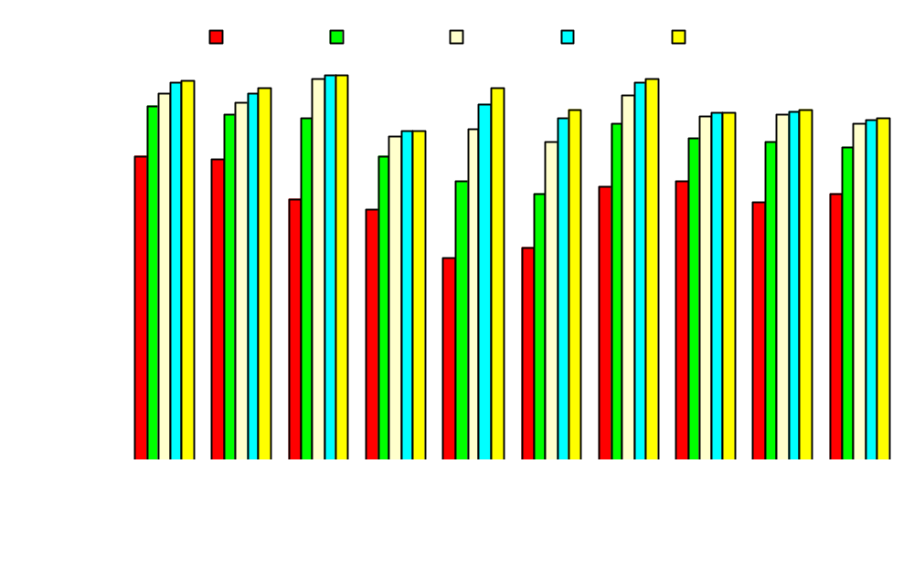
BAT Cache Hit Rate Sensitivity Study
Increases rapidly with larger cache, 61.7% (256B), 75.9% (512B), 87.5%(1KB), 92.9%(2KB), 94.1%(4KB).

Slide 37
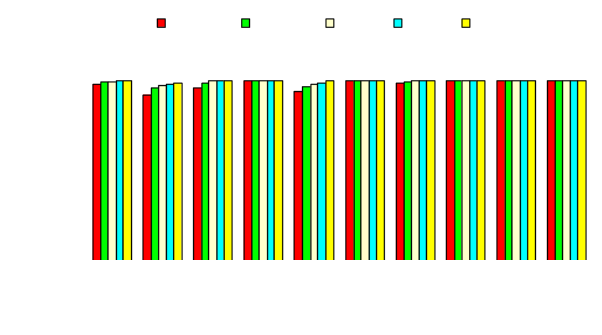
IPC Sensitivity w.r.t. BAT Cache
Larger BAT cache improves performance (only 1-2% slowdown)

Slide 38
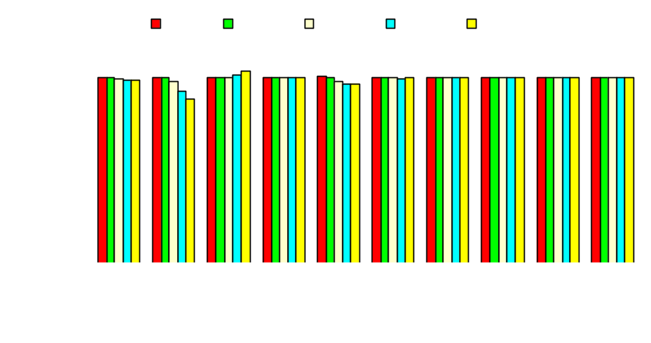
Shuffle Buffer Size Sensitivity Study
entries
Shuffle buffer when larger than 256-entry
  could negate performance by ~1%
  leads to poorer locality in BAT and higher miss rate in BAT cache because of random replacement
Notes:
We argued earlier that a shuffle buffer can function like a victim cache thus has the effect to reduce the penalty of cache misses. Some benchmarks do show the victim cache effect, e.g. jpeg, rsynth. Next, we discuss the negative effects of a larger shuffle buffer on performance. As explained earlier, whenever there is a block fetched into the shuffle buffer, the shuffle buffer has to randomly pick a block to replace. For each read/write pair, there are two accesses to the block address table. The first access is to look up the current location of the missed block and to fetch it in. The second access is a write access to update the block location for the replaced block, which is written into the current location of the fetched block. The write access is affected by the shuffle buffer size. With a larger shuffle buffer, the write accesses will have less locality, leading to more BAT cache misses and more pressure on the cache. To summarize, on average shuffle buffer sizes of 64-entry, 128-entry and 256-entry yield the same performance. A 512-entry shuffle buffer causes 0.9% slowdown and 1024-entry shuffle buffer leads to 1.1% slowdown. Nevertheless, a larger shuffle buffer will provide a stronger security guarantee as analyzed in section 6.

Slide 39
Conclusion
Software protection and informationprivacy for embedded systems cannot be compromised
Encryption/decryption is insufficient to protect addresses and the control flow from revealing.
Traditional software based obfuscation does not have provable security strength and can incur high runtime overhead.
We propose a hardware assisted control flow obfuscation technique.
We demonstrate quantitatively how difficult it is to break such protection.
The hardware solution incurs very little performance overhead.

Slide 40


Questions & Answers
That’s All Folks !

