Slide 1


Reducing Energy of Virtual Cache
Synonym Lookup using Bloom Filters
Dong Hyuk Woo GeorgiaTech
Mrinmoy Ghosh GeorgiaTech
Emre Özer ARM Ltd.
Stuart Biles ARM Ltd.
Hsien-Hsin “Sean” Lee GeorgiaTech

Slide 2

Outline
Problem Statement
Early Synonym Detection using Bloom Filter
Simulation Result
Conclusion

Slide 3





Safe Indication
“But I’m smart enough !! ” ☺
“Hey, I don’t have enough energy
to work outside all day long.
And it’s too hot!!”
?

Slide 4
Synonym Problem (1/3)
Multiple VA map to the same PA in virtual cache.
Example
  4KB pages (12 bits)
  32 bit address space
  2-way set associative 32KB cache
    256 sets (8 bits)
    64B line size (6 bits)
Virtual page number (20 bits)
Page offset (12 bits)
Tag bits (18 bits)
Cache index bits (8 bits)
Line size (6 bits)
0 0 1 0 0 0 0 1 0 0 0 0 0 0 0 0 1 1
0 0 0 0 0 0 0 1 1 0 0 0 0 1 0 0 1 0
0 0
0 1
0 0 1 0 0 1
0 0 0 1 0 0
0 0 1 0 0 0 0 1 0 0 0 0 0 0 0 0 1 1
0 0 0 0 0 0 0 1 1 0 0 0 0 1 0 0 1 0
0 1
0 1
0 0 1 0 0 1
0 0 0 1 0 0
0 0 1 0 0 0 0 1 0 0 0 0 0 0 0 0 1 1
0 0 0 0 0 0 0 1 1 0 0 0 0 1 0 0 1 0
1 0
0 1
0 0 1 0 0 1
0 0 0 1 0 0
0 0 1 0 0 0 0 1 0 0 0 0 0 0 0 0 1 1
0 0 0 0 0 0 0 1 1 0 0 0 0 1 0 0 1 0
1 1
0 1
0 0 1 0 0 1
0 0 0 1 0 0

Slide 5
Synonym Problem (2/3)
Software solution
  Page coloring
  Cache flush upon context switches
Hardware solution
  Duplicate tag arrays / reverse map
Simpler approach
  Keep only a single copy
    IBM 3090, Alpha 21264, MIPS 10000, …

Slide 6
Synonym Problem (3/3)
Virtual page number (20 bits)
Page offset (12 bits)
Tag bits (18 bits)
Cache index bits (8 bits)
Line size (6 bits)
Way 0 Tag RAM
Way 1 Tag RAM
Synonym candidate 1
Synonym candidate 1
Indexed set
Indexed set
Miss !
Synonym candidate 2
Synonym candidate 2
“Hey, I don’t have enough energy
to lookup synonyms upon every miss.
And it’s too hot!!”
Synonym candidate 3
Synonym candidate 3

Slide 7
Outline
Problem Statement
Early Synonym Detection using Bloom Filter
Simulation Result
Conclusion

Slide 8
Counting Bloom Filter
L-bit counter
0
0
0
0
0
1
0
1
0
2
0
2
Physical address1
allocation (N bit)
N:m Hash₁
0
2^{m}-2
1
2^{m}-2
0
2^{m}-1
0
2^{m}-1

Slide 9
Counting Bloom Filter
L-bit counter
0
0
0
0
0
1
0
1
0
2
1
2
Physical address2
allocation (N bit)
N:m Hash₁
1
2^{m}-2
1
2^{m}-2
0
2^{m}-1
0
2^{m}-1

Slide 10
Counting Bloom Filter
L-bit counter
0
0
0
0
0
1
0
1
1
2
1
2
Physical address3
allocation (N bit)
N:m Hash₁
1
2^{m}-2
2
2^{m}-2
0
2^{m}-1
0
2^{m}-1

Slide 11
Counting Bloom Filter
L-bit counter
0
0
0
0
0
1
0
1
1
2
1
2
Physical address1
eviction (N bit)
N:m Hash₁
2
2^{m}-2
1
2^{m}-2
0
2^{m}-1
0
2^{m}-1

Slide 12
Safe Indication using Counting BF
Counter value zero
  Any physical address mapped to this counter is never allocated. (True miss)
Counter value non-zero
  Some physical addresses mapped to this counter are allocated. (False hit)
“But I’m smart enough !! ” ☺
?

Slide 13
Loosely-coupled Counting Bloom Filter
Physical address of
evicted cache line
Physical address of
newly allocated cache line
Physical address of
requested cache line
L-bit counter
Bit vector
Hash
Hash
increment
decrement
Check if 0
Zero/Nonzero
Detector
0 (True miss)
?
1 (False hit)

Slide 14
Early Synonym Detection in V/P cache
Counter Array
CPU
Virtual address
Hash
Physical address
V/P L1
cache
TLB
Physical address
MUX
Physical
linefill address
Physical
evicted address
Hash
Phy. index of
linefill address
Phy. tag of
evicted address
Bit vector
Physical L2
true miss / false hit

Slide 15
Outline
Problem Statement
Early Synonym Detection using Bloom Filter
Simulation Result
Conclusion

Slide 16
Simulation Methodology
Bochs
  x86 full-system simulation
  Simplescalar’s cache simulator integrated
    Virtually indexed physically tagged L1 I/D cache
    L2 cache
  L1 data cache with loosely-coupled counting BF
  Much faster than trace based simulation
Power model of Artisan 90nm SRAM library
Windows application workload

Slide 17
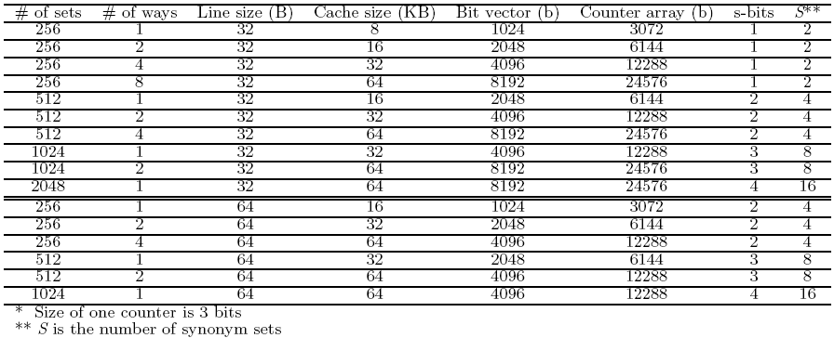
L1 Data Cache Configuration
Space overhead: less than 1/16

Slide 18
Synonym Ratio
Average synonym ratio: 0.079%
  (# of synonym found / # of L1 D cache misses)
But, we should perform synonym lookup for correctness !

Slide 19
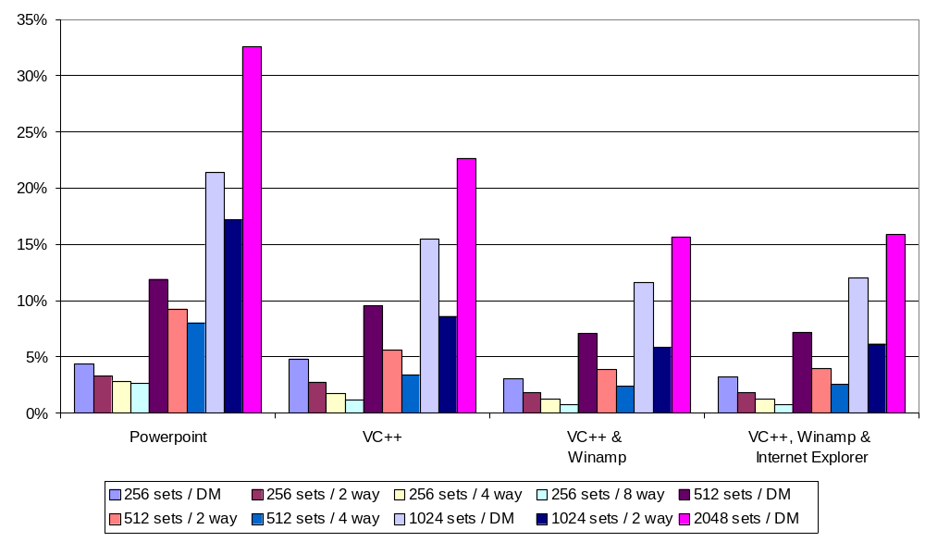
Dynamic Energy Reduction

Slide 20
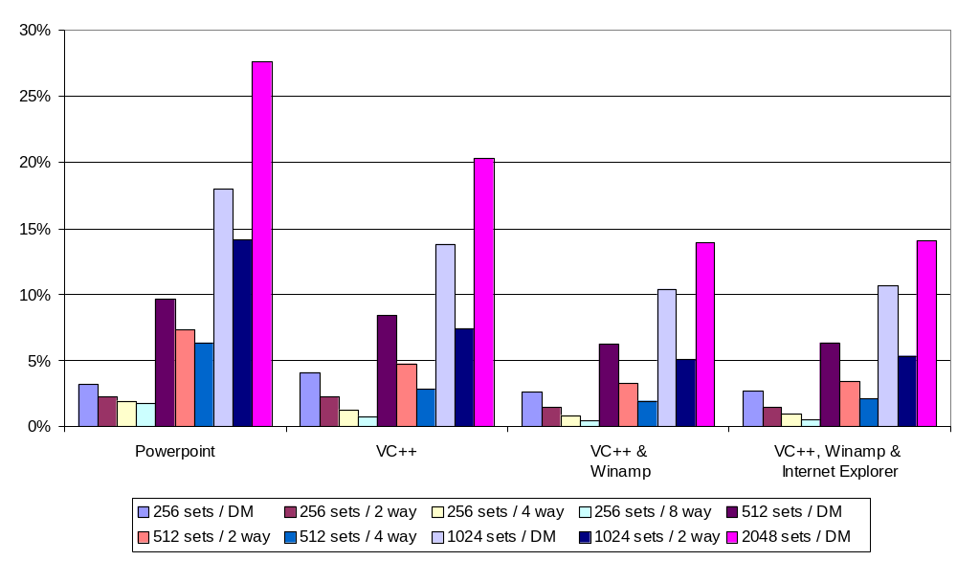
Total Energy Reduction

Slide 21
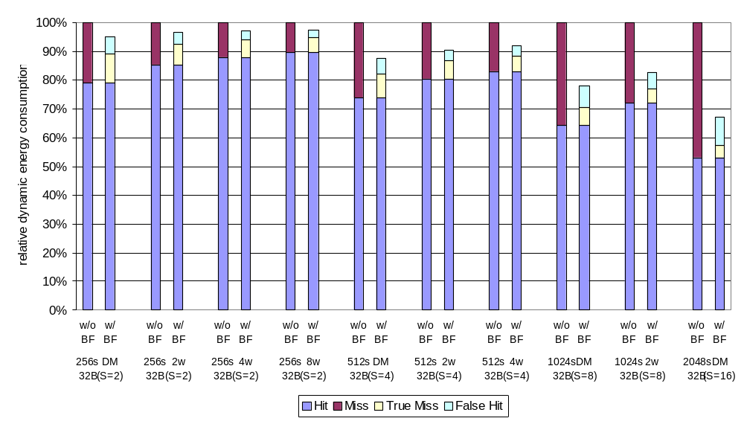
Case Study: Powerpoint (1/3)
AMD K6 series
Sun UltraSPARC series

Slide 22
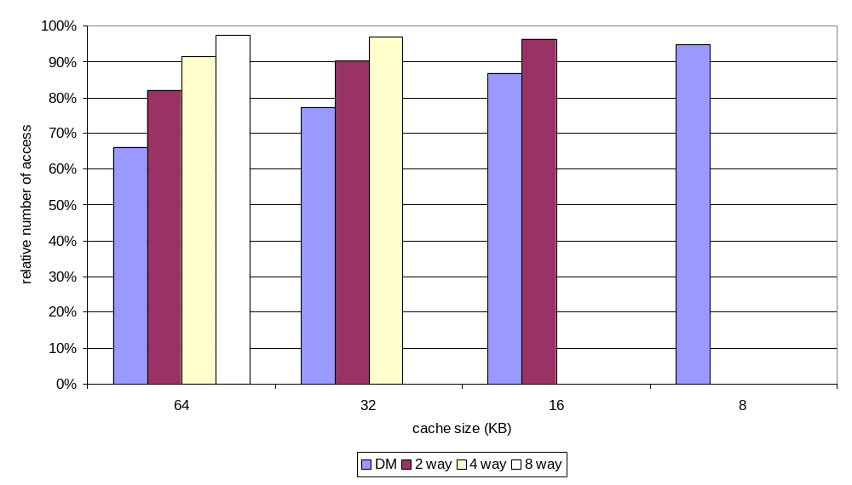
Case Study: Powerpoint (2/3)
Reduced cache contention: possible performance benefit

Slide 23
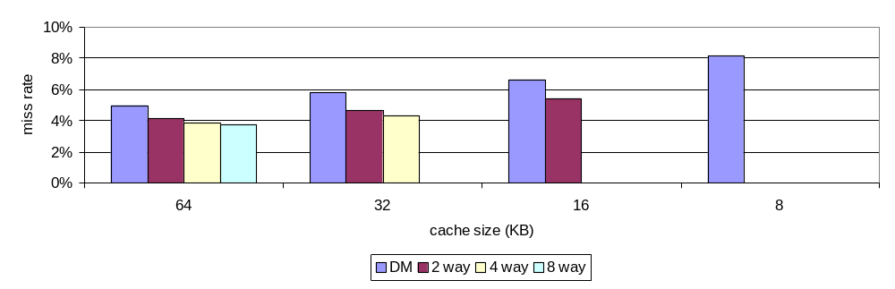
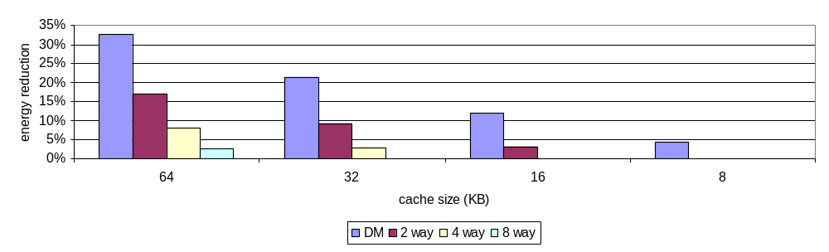
Case Study: Powerpoint (3/3)
16
8
4
2

Slide 24
Conclusion
Synonym is rarely detected.
Bloom filter enhanced L1 D cache can effectively reduce the total cache accesses by up to 33.9%.
Dynamic and overall energy consumption can be reduced by up to 32.5% and 27.6% respectively.

Slide 25
Thank you.
http://arch.ece.gatech.edu

Slide 26
Backup slides

Slide 27

Tightly-coupled Counting Bloom Filter
L-bit counter
Bit vector
Hash
M
U
X
sel
1
2
L

Slide 28
Advantage of Loosely-coupled BF
Can be kept in close proximity to the structure that needs the Bloom filter information.
Counter can be run at lower frequency saving energy.

Slide 29
Any performance impact?
Bit vector lookup
  Very small structure compared to L1 data cache
    1 cycle latency
  Can be hidden by L1 data cache lookup
  Even though it is not true, this affects the performance only when synonym really exists, which is very, very rare event.
Counter array
  Not on the critical path

Slide 30
Correctness issue with lower frequency?
Using lower frequency to counter doesn’t harm the correctness.
  Lazy transition from bit vector 1 to 0 (eviction)
    Conservatively lookup all synonym location
    Of course, no correctness issue
  Lazy transition from bit vector 0 to 1 (new allocation)
    Physical address of new line is available right after TLB transition.
    So, before L2 request returns to L1, counter array sure can be updated.
    Thus, no correctness issue

Slide 31
How did you model leakage energy?
Conservative approach
  In-order machine
  Blocking cache
  2 / 10 / 250 cycles latency (L1 / L2 / DRAM)
  Average micro-ops / x86 instruction ratio: 1.4
  Longer execution time
    Exaggerate leakage energy consumption
    Our solution is aimed for reducing dynamic energy consumption.

