Slide 1
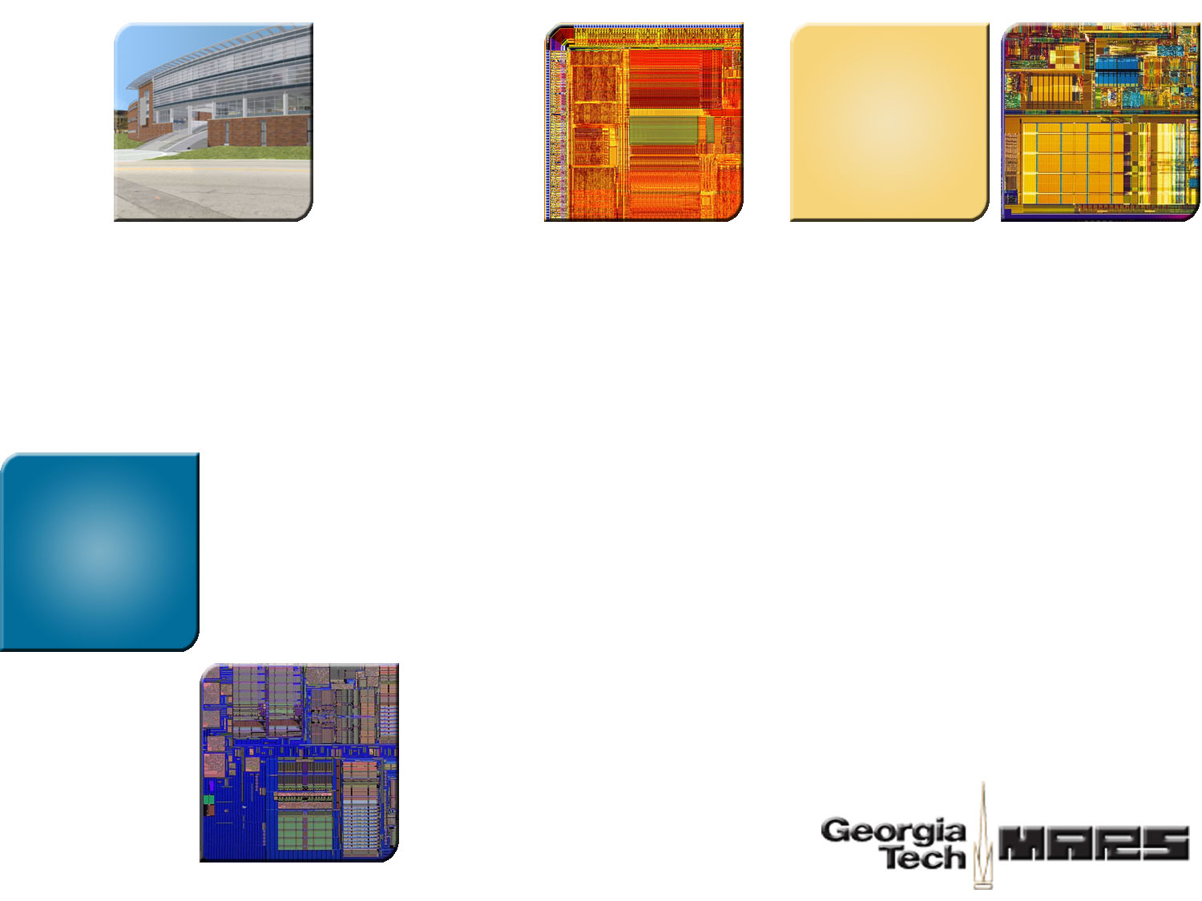


Accelerating Memory Decryption and Authentication With Frequent Value Prediction
Weidong Shi Hsien-Hsin Sean Lee
Motorola Labs Georgia Tech

Slide 2

Security Frontier
Backdoor
Probing PCB
Secure SoC
Content
Confidentiality
Clocking-Timing
Secure Processor
(e.g., IBM 06, MICRO-36/37/39, ASPLOS 02/04, ISCA32/33)
Side-channel
Isolation
Secure MMU/Buses/Memory
(CASES-04, ASPLOS-04, PACT-06)
Chip De-lidding
Die Analysis
Authentication/
Secure Token
Counterfeit Detection
Circuit Camouflage/Obfuscation/
Private Circuit
(Eurocrypt 02/06)
Embedded Secrets
Transistor
Leaf
Cell
Register/Unit
Processor
SoC

Slide 3

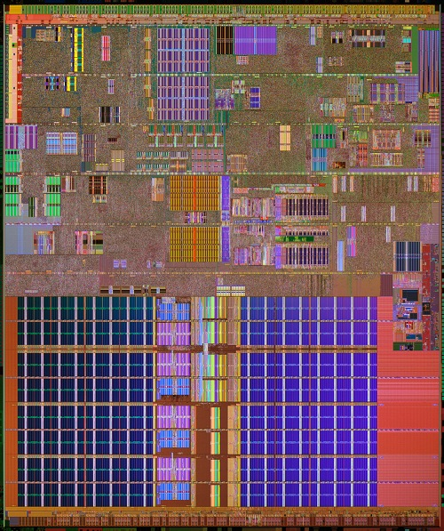

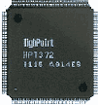

Secure Processor Architecture
Processor
Core
Memory
Enc/Dec,
Integrity
Verification
Engine
L2
Encrypted Memory
Trusted Secure Processor
[MICRO-36,37, 39, ASPLOS-02,04, ISCA-32,33, IBM SecureBlue]

Slide 4
Agenda
Counter Mode Cipher
“Direct Memory” Block Ciphers
Frequent Value Speculation
Performance Analysis
Conclusion

Slide 5

Counter Mode Encryption
Use Counter to generate a secret keystream that encrypts a memory block with a simple XOR
Turn a block cipher into a stream cipher
Nonce/IV
Counter
Secret Key
Block Cipher
(AES)
One Time Pad
Plaintxt₀
XOR
Ciphertxt₀

Slide 6
Counter Mode Encryption
Use Counter to generate a secret keystream that encrypts a memory block with a simple XOR
Turn a block cipher into a stream cipher
Nonce
Counter
Nonce
Counter+1
Nonce
Counter+N
Block Cipher
(AES)
Block Cipher
(AES)
Block Cipher
(AES)
Plaintxt₀
XOR
Plaintxt₁
XOR
Plaintxt_{N}
XOR
Ciphertxt₀
Ciphertxt₁
Ciphertxt_{N}

Slide 7
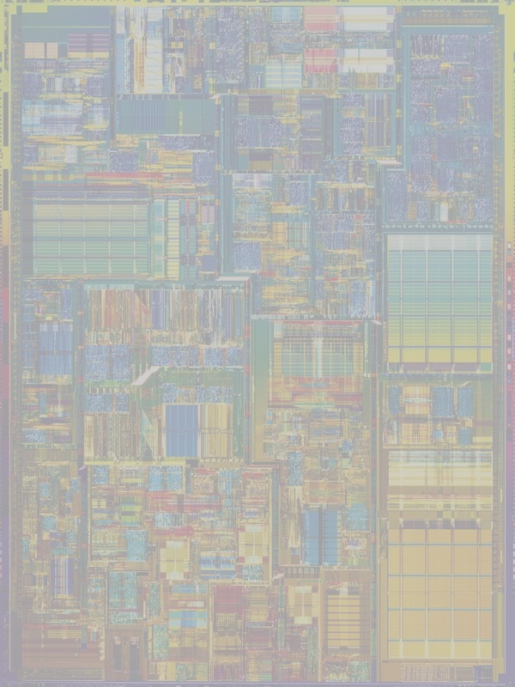
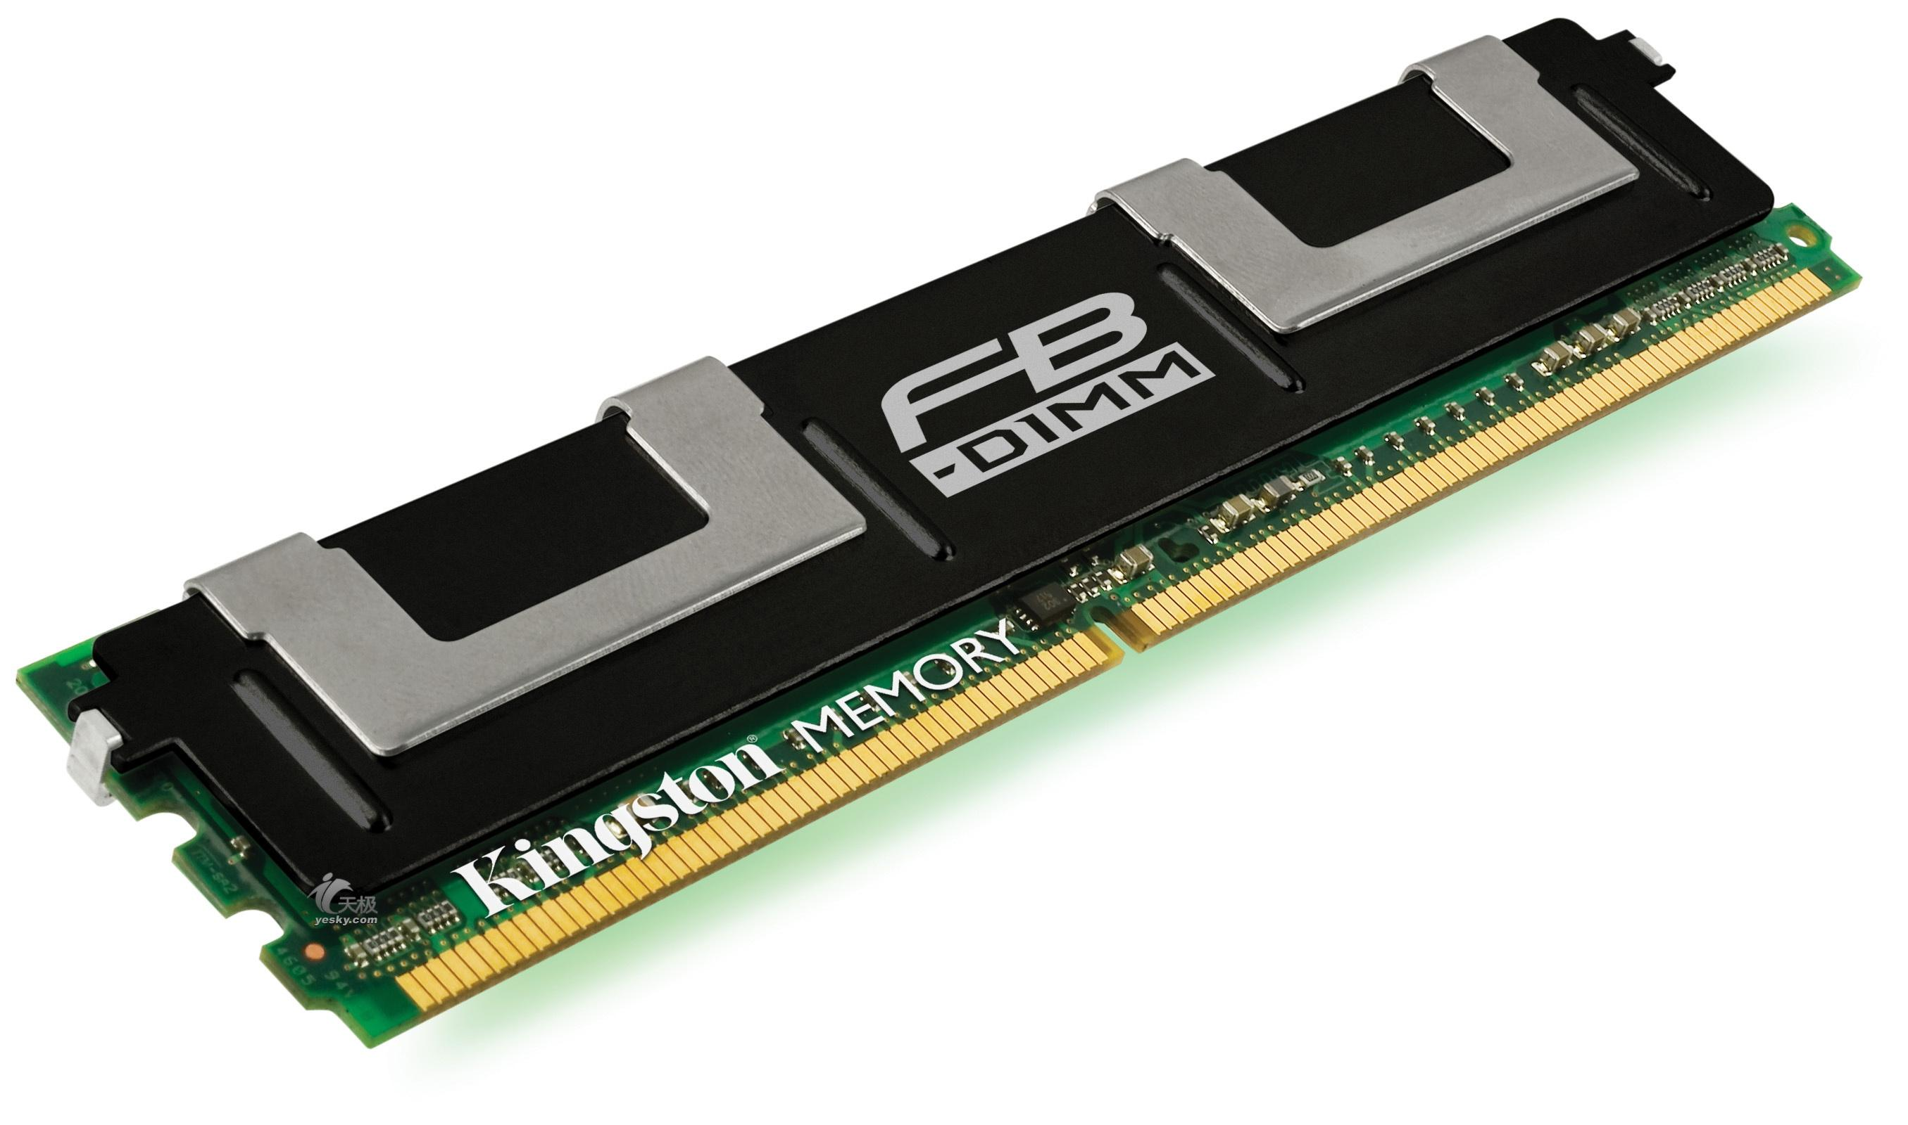
Parallelization for Counter Mode Secure Arch
OTP generation and Data fetch are done in parallel
How to obtain Counter values
  Counter Cache [MICRO36]
  Prediction & Precomputation [ISCA32]
?
Counter
Nonce
Block Cipher
(AES)
Memory
One Time Pad
Ciphertxt cache line X
XOR
Plaintxt cache line X
Secure Processor

Slide 8

Block Cipher (ECB)
“Direct” Memory Encryption
Electronic Code Book
Plaintxt₀
Secret Key
Block Cipher
(AES)
Ciphertxt₀

Slide 9

Block Cipher (ECB)
“Direct” Memory Encryption
Electronic Code Book
Plaintxt₀
Plaintxt_{N}
Secret Key
Secret Key
Block Cipher
(AES)
Block Cipher
(AES)
Ciphertxt₀
Ciphertxt_{N}

Slide 10
Block Cipher (CBC)
Cipher-Block Chaining
A dependency with the neighboring ciphertext for decrypting a target
Plaintxt₀
Plaintxt₁
Plaintxt₂
Init. Vector
XOR
XOR
XOR
Secret Key
Secret Key
Secret Key
Block Cipher
(AES)
Block Cipher
(AES)
Block Cipher
(AES)
Ciphertxt₀
Ciphertxt₁
Ciphertxt₂

Slide 11


Authenticated Encryption
C
The same cipher protects
  Confidentiality (tamper-resistance)
  Message Integrity (tamper-evidence)
Offset Code Block (OCB)
  One of the authenticated encryption methods
  Non-malleable under chosen-ciphertxt -- which counter mode is vulnerable to
  802.11i currently specifies AES-OCB as an alternative to CCM for confidentiality and integrity
A
B
C
A
B

Slide 12
Authenticated Encryption: OCB Encryption
Plaintxt_{N}
Nonce || mem addr
aL+R
XOR
L
pseudo random #
XOR
Secret Key
Block Cipher
(AES)
Secret Key
Block Cipher
(AES)
aL+R
XOR
R
Ciphertxt_{N}

Slide 13
Authenticated Encryption: OCB Authentication
Plaintxt₀
Plaintxt₁
Plaintxt₂
Plaintxt₃
Hash
5L+R
XOR
Secret Key
Block Cipher
(AES)
Message Authentication Code
(MAC)

Slide 14
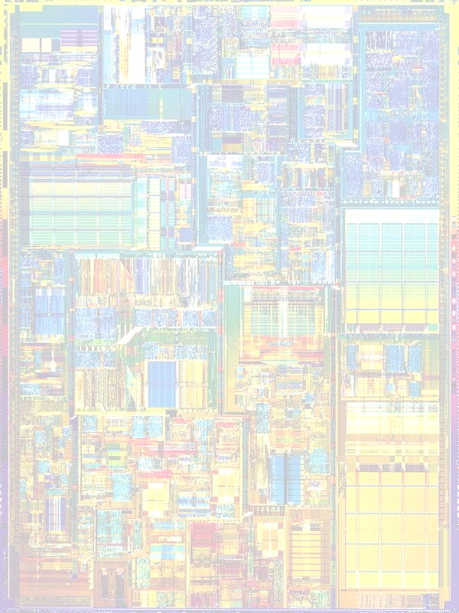
OCB ─ Decryption and Integrity Verification
Decryption can start after encrypted memory blocks are fetched.
Decrypted blocks cannot be issued till its integrity is verified.
MAC verification can take longer time than decryption.
Memory Fetch
E(B0)
E(B1)
E(B2)
E(B3)
MAC
Decryption
MAC
Verification
B0
B1
B2
B3
Issue
Issue
Issue
Issue

Slide 15
Speculations in Secure Processor
Examples of Prediction | Applicable Cipher Scenario | What can be Predicted | Why Predicable?
Counter Prediction [ISCA-32] | Counter Mode Encryption | Counter Values | Coherence of Counter Values
Value Prediction [CF-07] | “Direct” Encryption mode | Encrypted Value | Existence of Frequent Values
Improve performance by taking advantage of
  The nature of the data or,
  Statistical property of the data.
Do not compromise security as performed only within the secure boundary.

Slide 16
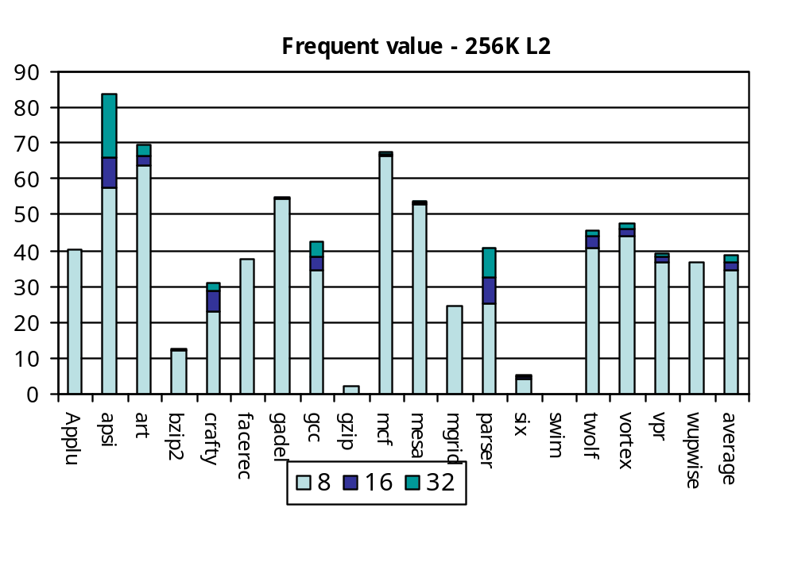
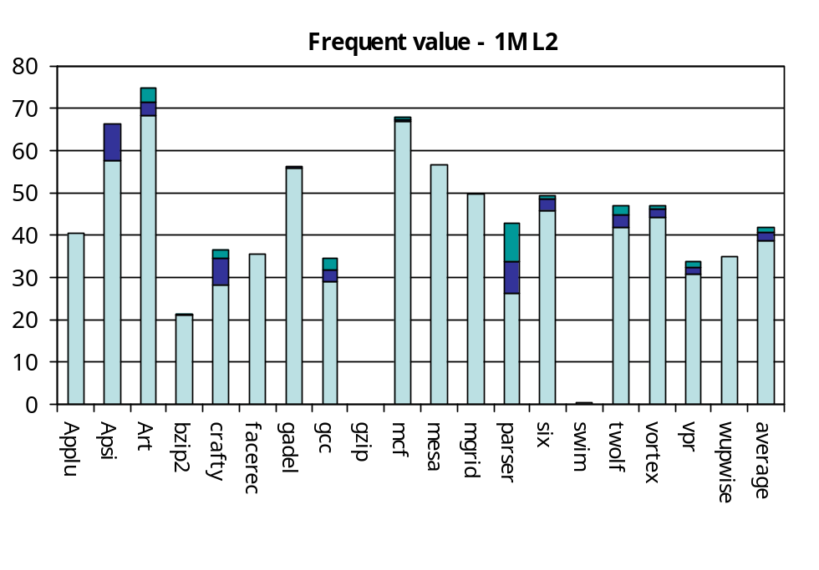
Analysis of Frequent Values
40 to 60% encrypted memory data are frequent values
8 to 32 frequent values account for over 40% encrypted data

Slide 17
Speculation Using Idle Pipelined Crypto Engine
Generate “encrypted” frequent values using otherwise idle crypto engines
Time Line
T1
T2
T3
T4
T5
T6
T7
Encryption
Pipeline
Frequent value E_{k}(A)
E_{k}(B)
E_{k}(C)
E_{k}(D)
E_{k}(E)
E_{k}(F)
E_{k}(G)
=?
E_{k}(E)
matches
Memory
Pipeline
Retrieving the Encrypted Cache Line E_{k}(X)
Integrity verification can also be speculated.
Generate MAC for speculated frequent values

Slide 18
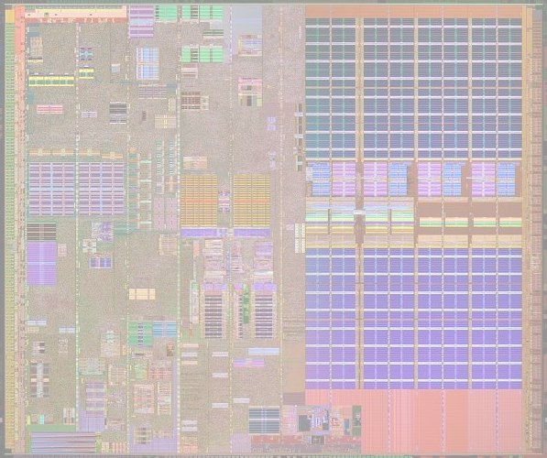
Value Prediction Based Decryption
Cache
Frequent Value Table
X
Y
Z
W
WB
Buffer
Returned
Encrypted Data
Scheduler
CAM
E(X)
E(Y)
E(Z)
E(W)
Pipelined Encryption
Engine
Pipelined Encryption
Engine
Pipelined Decryption
Engine
Secure processor

Slide 19

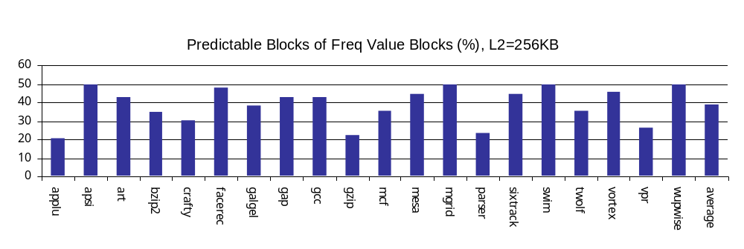
Handle Large Block Size
Four 64-bit frequent value blocks
64-bit
block
Freq Value
64-bit
block
64-bit
block
64-bit
block
64-bit
block
64-bit
block
64-bit
block
64-bit
block
64-bit
block
64-bit
block
Non-Freq Value
128-bit
Cipher
128-bit
Cipher
128-bit
Cipher
128-bit
Cipher
64-bit
block
64-bit
block
Under 128 bit cipher, is predictable.
is not.
64-bit
block
64-bit
block

Slide 20
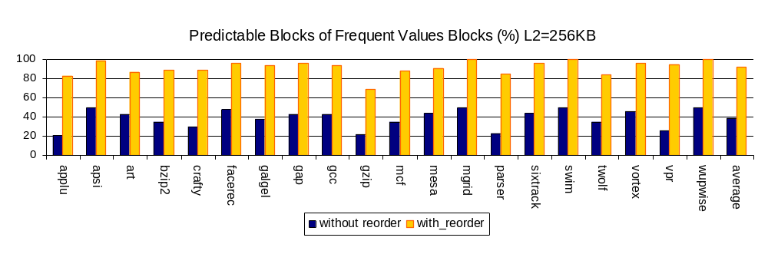
Block Re-ordering
64-bit
block
Freq Value
64-bit
block
64-bit
block
64-bit
block
64-bit
block
64-bit
block
64-bit
block
64-bit
block
64-bit
block
64-bit
block
Non-Freq Value
64-bit
block
64-bit
block
64-bit
block
64-bit
block
64-bit
block
64-bit
block
64-bit
block
64-bit
block
Predictable
Freq Value Pair
Predictable
Freq Value Pair

Slide 21
Frequent Value Map
Speculation targeted only for frequent value blocks
Overhead
  1 frequent value map bit per encrypted block (128 bits)
  8 bits per cache line (64B cache line size)
  512 bits per page
  Total 64K bits for 128-enry TLB
Can be shared for many other purposes
  frequent value based cache compression
  power saving cache
Pages in TLB
1
0
0
0
0
1
0
1
0
1
0
1
0
1
1
0
1
1
0
1
0
1
0
1
0
0
0
1
0
1
1
0
…
0
1
0
1
0
1
0
1
1
0
…
0
0
1
1
0
0
1
0
1
0
0
0
1
1
Page
0
1
0
0
0
0
1
0
…
0
0
0
1
0
1
1
0
Cache line FV bit map
Frequent Value Map for All TLB Pages

Slide 22
MAC Speculation
Speculated
Encrypted Block
Speculated
Encrypted Block
Speculated
Encrypted Block
Speculated
Encrypted Block
Memory Fetch
MAC
Speculation
MAC
Speculation
MAC
Speculation
MAC
Speculation
Comparison
Comparison
Comparison
Comparison
Compute MAC for speculated frequent value blocks
Compare
  fetched encrypted block with speculated encrypted block
  fetched MAC with speculated MAC
  If both match, issue the fetched instruction/data

Slide 23
Experimental Setup
Parameters | Value
L1 I/D Cache | DM, 16KB
L2 Cache | 4way, unified, 256KB and 1MB
Memory Bus | 8B wide, 1:4, 1:5, 1:6 Ratio
CPU Clock | 1GHz
L1 Latency | 1 cycle
L2 Latency | 8 cycles (1MB), 4 cycles (256KB)
TDES Decryption Latency | 96ns
AES Decryption Latency | 65ns
Block Size | 64-bit (Triple DES), 128-bit (AES)

Slide 24
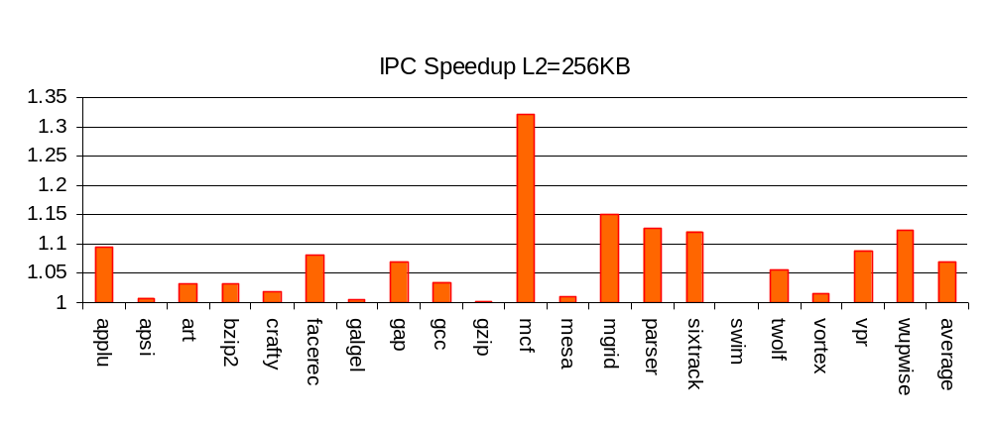
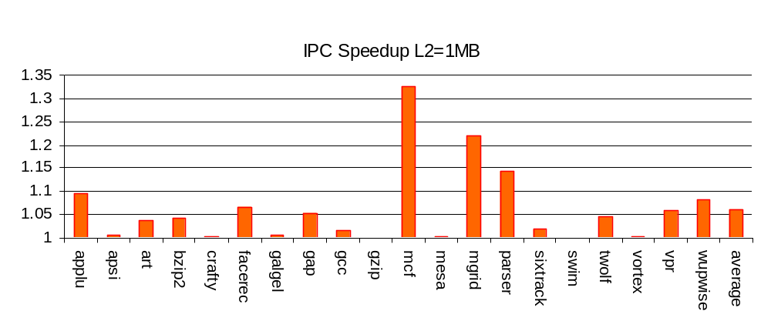
Results – Value Prediction

Slide 25
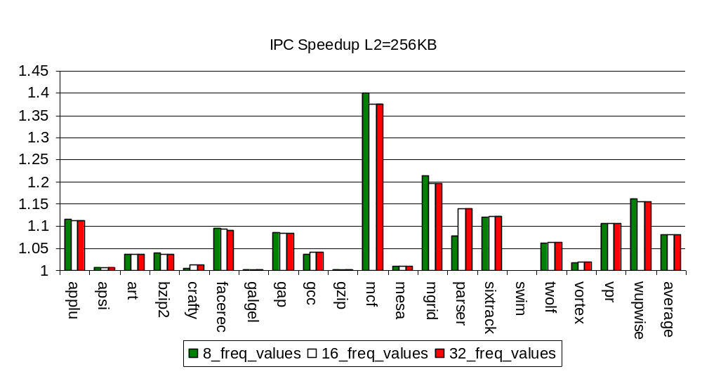
Performance ― Number of Frequent Values
64-bit block size

Slide 26
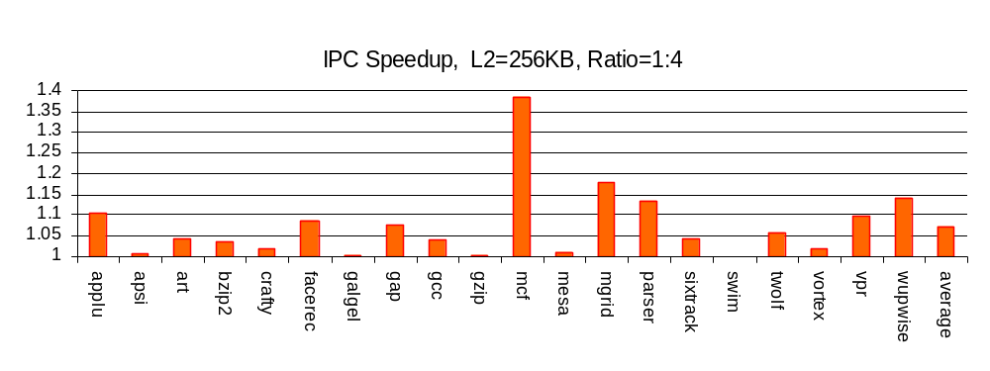
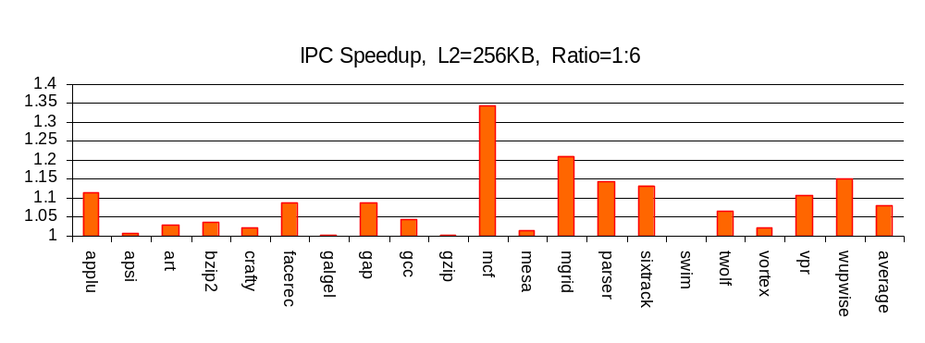
Sensitivity to Memory Speed

Slide 27
Conclusion
Frequent value speculation can hide both
  Decryption latency
  Integrity verification latency
  For direct memory block ciphers
Encrypted values demonstrate predictability.
We propose block re-ordering to consolidate the predictability
Memory-bound benchmark programs show 10%- 30% performance improvement.

Slide 28
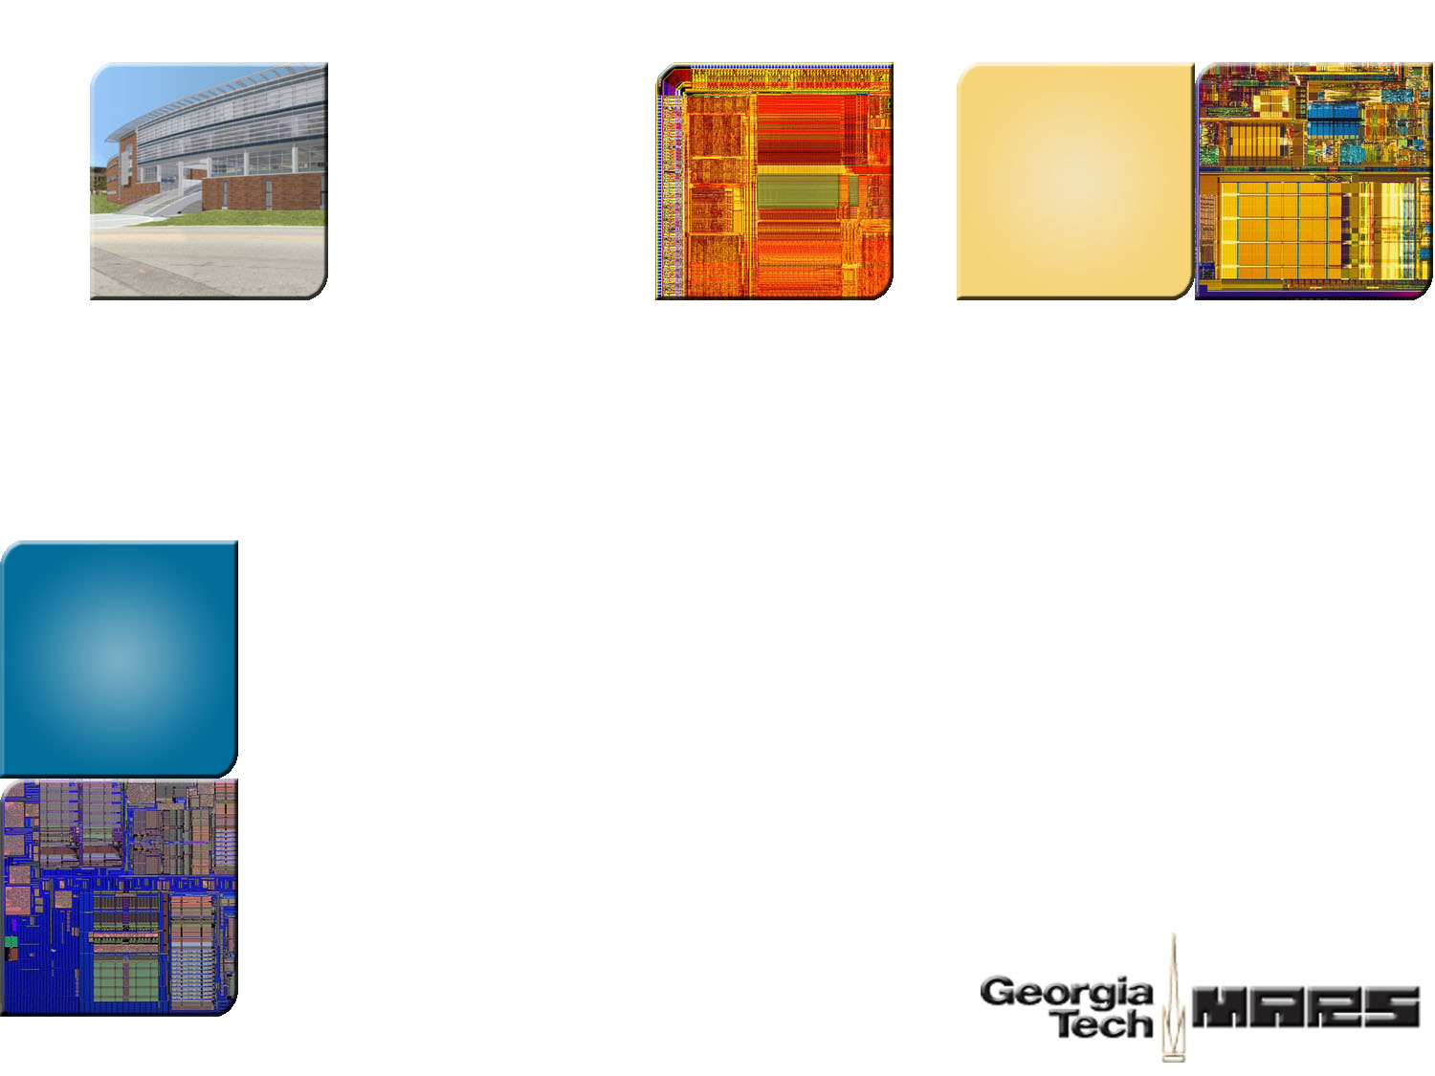

Thank You!
Georgia Tech
ECE MARS Labs
http://arch.ece.gatech.edu

