Slide 1
Profile-Guided Microarchitectural Floorplanning for Deep Submicron Processor Design
Mongkol Ekpanyapong, Jacob R. Minz, Thaisiri Watewai*, Hsien-Hsin S. Lee, and Sung Kyu Lim
Georgia Institute of Technology,
* University of California at Berkeley

Slide 2
Current Processor Design Paradigm
Computer Architecture Design
Employ the availability of silicon area.
Employ the higher clock speed to enhance the performance.
Assume unit delay model.
Architects just do their own good jobs assuming that smart CAD tools will do the rest of the work.
VLSI & Physical Design CAD
Minimize both gate and wire delay.
Minimize total die area.
Accomplish above by knowing about the design as little as possible.
CAD designers just design
a good tools assuming that computer architects did their good job.

Slide 3
Next Generation Processor Design
Computer Architecture Design
Larger capacity, no longer mean better performance.
Higher clock speed does not imply the same rate of performance improvement.
Unit delay model is no longer practical.
Good processor need some interactions with CAD tools.
VLSI & Physical Design CAD
Performance driven Physical Planning is not enough.
Employing some knowledge for the design can result in better performance.
Iterations between computer architecture design and CAD tools is necessary.
Smart CAD tools need
some help from computer architect.

Slide 4
Terminology
Profiling
The techniques for compiler or computer architecture
to collect statistic information that can result in
better optimization.
Instructions Per Cycle (IPC)
  Number of instructions that can be issued per a cycle.
Billions Instruction Per Second (BIPS)
Number of instructions that can be issued per a
given second.

Slide 5
Outline
Introduction
Related Work
Wire Delay Issues
Profile-Guided Floorplanning
Simulation Infrastructure
Experimental Results
Conclusions

Slide 6
Related Work
Ho et al. [SRC 1999,IEEE 2001]
Discussed about the impact of wire delay in deep submicron technology.
Agarwal et al. [ISCA 2000]
Raised the issue of wirelength impact in designing conventional microarchitecture in this submicron processor design.
Cong el al. [DAC 2003]
Proposed that BIPS should be used instead of IPC, widely used metric in current processor design.

Slide 7
Outline
Introduction
Related Work
Wire Delay Issues
Profile-Guided Floorplanning
Simulation Infrastructure
Experimental Results
Conclusions

Slide 8
When Wire Delay Becomes the Problem
Ho et al. classify wires to be three classes:
  Local wire.
  Global wire.
  Repeated wire.
For 30 nm technology
  Repeated wire delay is approximated to be 80pS/mm.
  A FO4 gate delay is approximately 17pS.
To archive the target high frequency, flipflop insertion
is required.
For example, the Pentium 4 processor design has
dedicated 2 pipeline stages for moving signal across
the chip due to wire delay

Slide 9
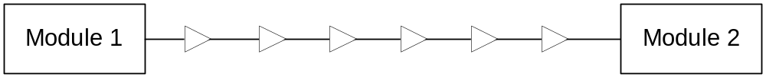
Reducing Wire Delay Impact
Buffers Insertion
Ho et al. provide the repeated wire delay equation as follows:
Flipflops Insertion
Module 1
Module 1
FF
FF
FF
FF
FF
FF
FF
FF
Module 2
Module 2
Notes:
note that l = L/n

Slide 10
Outline
Introduction
Related Work
Wire Delay Issues
Profile-Guided Floorplanning
Simulation Infrastructure
Experimental Results
Conclusions

Slide 11
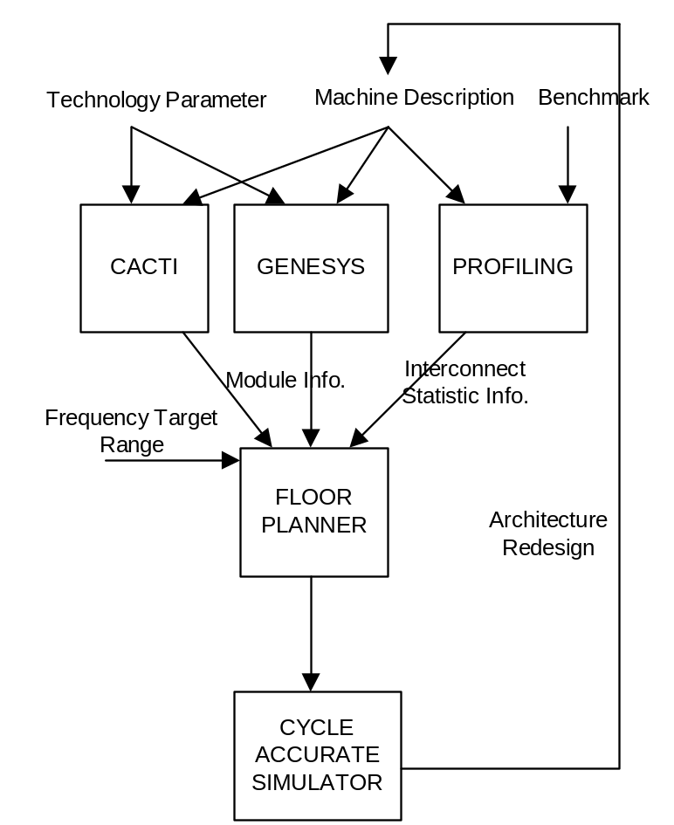
Microarchitectural Planning Framework
CACTI:
Area and delay estimator for buffer-like structure.
GENESYS:
Area and delay estimator for other structure.
PROFILING: Using Cycle-Accurate Simulator to acquire statistic information.
FLOORPLANNER
CYCLE ACCURATE SIMULATOR:
Evaluating the result.

Slide 12
Microarchitecture Planning
2 cycles
2 cycles
2 cycles
3 cycles
1 cycles
1 cycles
1 cycles
2 cycles
2 cycles
1 cycles
1 cycles
2 cycles
3 cycles
1 cycles
2 cycles
Microarchitecture
Redesign
To Simulator

Slide 13
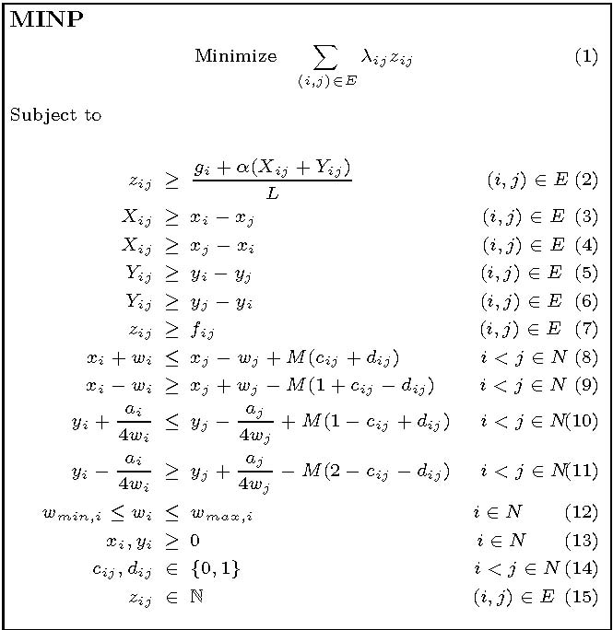
Mixed Integer Non-Linear Programming
Inputs:
f_{ij} = number of flipflops between
module i and j before
considering wire delay impact.
L = target cycle time (1/clock freq.).
g_{i} = gate delay for module i.
w_{max,i} , w_{min,i} = max. and min. half
width of module i.
λ_{ij} = interconnect traffic info.
between module i and j.
= repeated delay per mm.
Paremeters:
x_{i},y_{i}= location info for module i
w_{i} = half width of module i
Output:
z_{ij} = number of flipflops between
module i and j
Note that M is a large number.

Slide 14
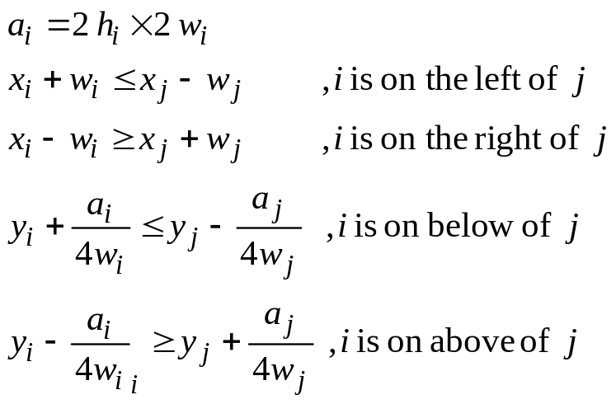
(MINP) Non-overlap Constraint
The relation between module i and j can be either left, right, above, or below relationship based on value set by binary c_{ij} and d_{ij}.
x_{i}
x_{j}
w_{i}
w_{j}

Slide 15
(MINP) Non-linear Relationship
The relation between module i and j can be either left, right, above, or below relationship based on value set by binary c_{ij} and d_{ij}.
a_{i} = 2h_{i} x 2w_{i}
x_{i}+w_{i} ≤ x_{j} – wj
, i is on the left of j
xi-wi ≥ xj + wj
, i is on the right of j
4 y_{i} w_{i} w_{j} + a_{i} w_{j} ≤ 4 y_{j} w_{i} w_{j} – a_{j} w_{i}
, i is on the below of j
4 y_{i} w_{i} w_{j} + a_{i} w_{j} ≥ 4 y_{j} w_{i}w_{j} – a_{j} w_{i}
, i is on the above of j

Slide 16
(MINP) Flipflop Constraint
Number of flipflops between modules i and j has to be larger than summation between gate delay and wire delay between these two modules divided by target cycle time.
Cycle Time (L) = 4 ns
2ns
3 ns
2ns

Slide 17
(MINP) Objective
Minimizing weighted wire length when the weight value is interconnect traffic information from profiling.
Note that which the same target technology and clock frequency: g_{i}, α, and L are constant.

Slide 18

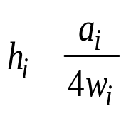
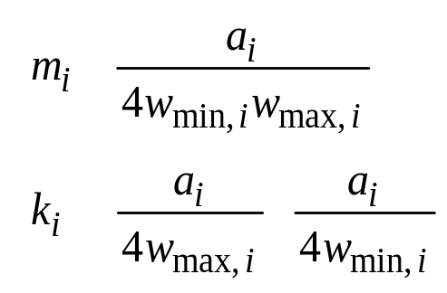



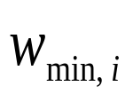
Non-Linear Relaxation
=
=
=
+
=
+

Slide 19
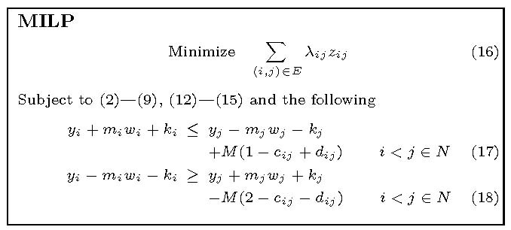
Mixed Integer Linear Programming

Slide 20
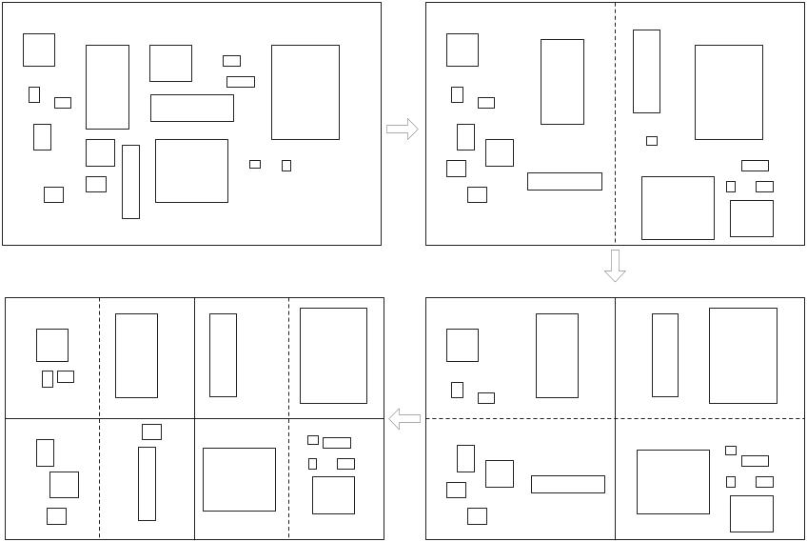
Integer Relaxation
Solving Mixed Integer Programming is NP hard.
Using bipartitioning for relaxation

Slide 21
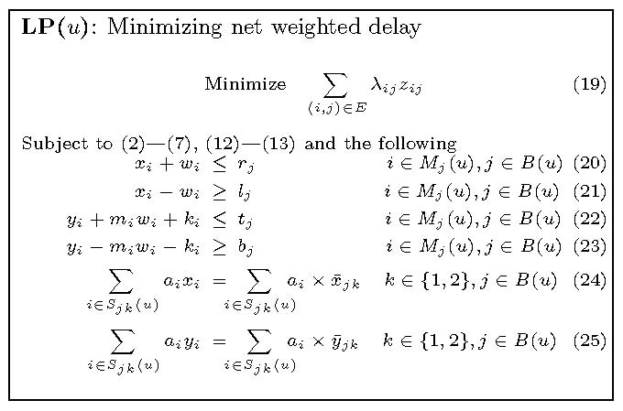
Linear Programming
Soft virtual box constraint that allow module to relocate (crossing between blocks) by maintaining center of gravity constraints.
r_{j},l_{j},t_{j},b_{j} are right, left, top, bottom of the hard virtual box constraints imposed on our floorplanner.

Slide 22
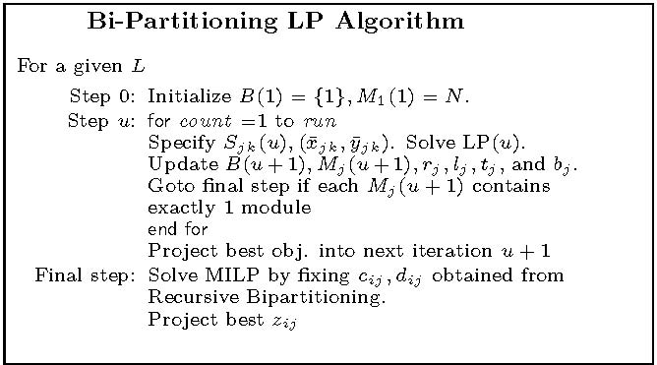
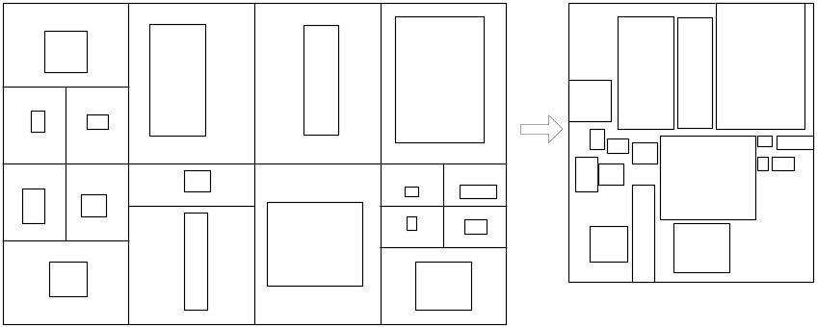
Floorplanning Algorithm
Last iteration

Slide 23
Outline
Introduction
Related Work
Wire Delay Issues
Profile-Guided Floorplanning
Simulation Infrastructure
Experimental Results
Conclusions

Slide 24
Simulation Infrastructure
fp reg file
fruu
bpred
btb
fpissue
ialu
ialu
ialu
ialu
fpu
fetch
ialu
wb
commit
dispatch
issue
ialu
ialu
ialu
fetch q
ialu
ialu
i1cache
mmu
reg file
ruu
i2cache
loadq
dl1cache
storeq
L3cache
d2cache
biu
memctrl

Slide 25
Simulator Modifications
Including a new feature of configurable
pipeline depth.
From the impact of wire delay, the pipeline depth
can be impacted by module locations.
Non-uniform forwarding latency.
Uniform latency is no longer practical.
Location information is necessary to determine forwarding latency.

Slide 26
Microarchitecture Configurations
Structure | Config 1 | Config 2 | Config 3 | Config 4 | Bits
Bpred | 128 | 512 | 512 | 512 | 2
BTB | 128 | 512 | 512 | 512 | 96
RUU | 64 | 128 | 512 | 512 | 168
Int RF | 32 | 32 | 32 | 32 | 64
FP RF | 32 | 32 | 32 | 32 | 64
L1 Icache | 8K | 64K | 8K | 8K | 512
L1 Dcache | 8K | 64K | 8K | 8K | 512
L2 Ucache | 64K | 512K | 128K | 128K | 1024
L3 Ucache | - | - | 2M | 2M | 1024
ITLB | 32 | 128 | 128 | 128 | 112
DTLB | 32 | 128 | 128 | 128 | 112
ALU | 2 | 4 | 4 | 8 | -
FPU | 1 | 2 | 2 | 4
LSQ | 16 | 64 | 128 | 128 | 84
Mem port | 1 | 4 | 4 | 4

Slide 27
Outline
Introduction
Related Work
Wire Delay Issues
Profile-Guided Floorplanning
Simulation Infrastructure
Experimental Results
Conclusions

Slide 28
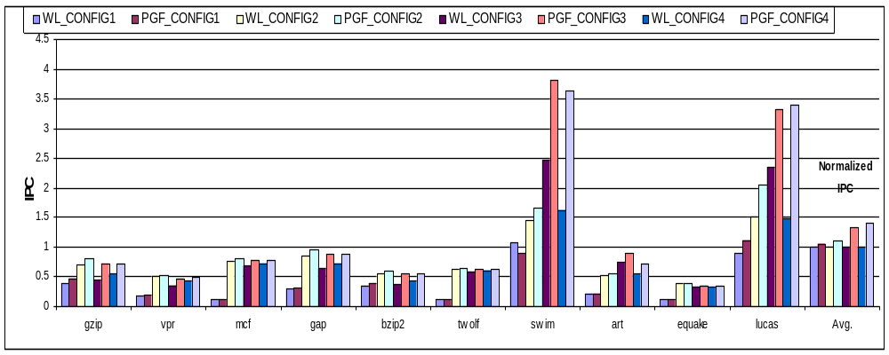
IPC improvement

Slide 29
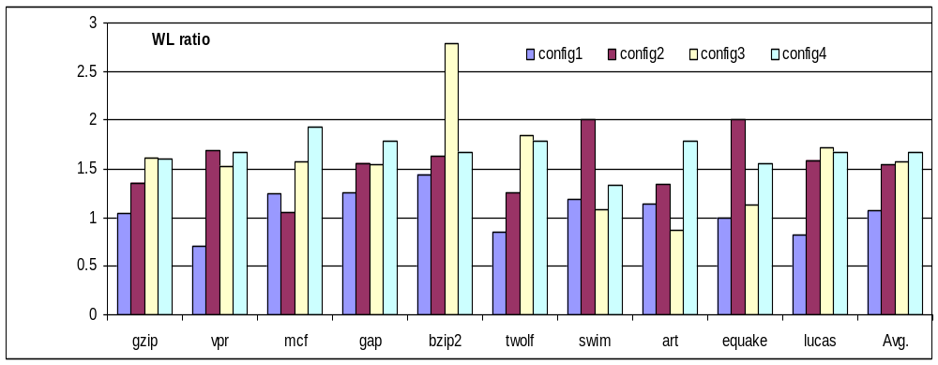
Impact on Wirelength

Slide 30
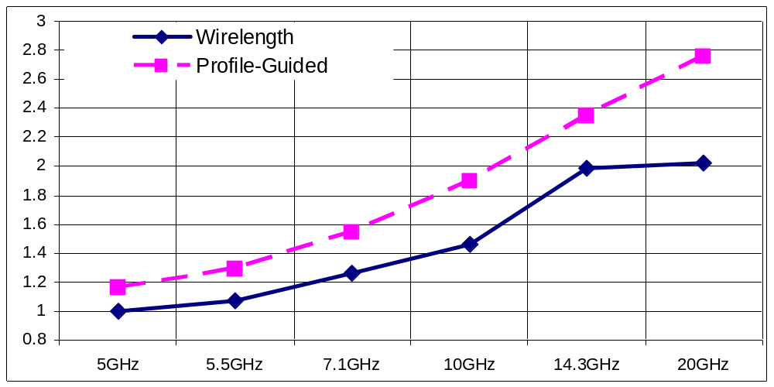
BIPS Impact on Frequency Scaling

Slide 31
Conclusions
Profile-guided floorplan is formulated using
linear programming.
Technology scaling parameters and the
information of dynamic internnection traffic between microarchitectural modules are
employed to guide the floorplanner to minimized weighted wirelength.
Our algorithm shows up to 40% result
improvement over wirelength objective floorplanning.
Our floorplanner is more scalable than a conventional approach.
Profile-guided floorplanning can outperform
Timing driven floorplannning on high frequency.

Slide 32
Thank You

