Slide 1

Cache Coherence Support for Non-Shared Bus Architecture on Heterogeneous MPSoCs
Taeweon Suh §, Daehyun Kim †,
and Hsien-Hsin S. Lee §
June 15, 2005
§ Georgia Institute of Technology, † Intel Corporation

Slide 2
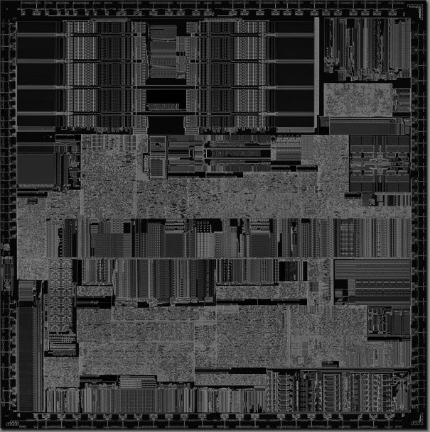
MPSoCs
Time-to-Market
Flexibility
Low cost
  Share memory interface to reduce pin count
  However, shared bus arch. hinders the versatility provided by each processor
  Non-Shared bus arch.
Real-time property
  communication between processors
Memory
IP
IP
ADC
uP
DSP
uP
Memory
Controller
Wireless IP
IP
SDRAM

Slide 3
Introduction
Cache Coherence
  Well known technique for data consistency for multiprocessor systems
Example
operation
sequence
Protocol
States
Modified
Exclusive
Owned
Shared
Invalid
P0
D$ (MOESI)
P1
D$ (MOESI)
S abcd
M abcd
P0: read
E 1234
I -----
S 1234
O abcd
I 1234
I -----
S 1234
P1: read
shared
P1: write
(abcd)
cache-to-cache
invalidate
P0: read
Memory
1234

Slide 4
Previous Work
Integration techniques for shared-bus based platform ^{[1][2][3]}
Read-to-write conversion
Shared-signal assertion
Snoop-hit buffer
Wrapper 0
Wrapper 1
Wrapper 0
Wrapper 1
Wrapper 0
Wrapper 1
Proc 0
(MEI)
Proc 1
(MESI)
Proc 0
(MSI)
Proc 1
(MESI)
Proc 0
(MEI)
Proc 1
(MESI)
Write
Shared
Bus
Read/Write
Bus
Read
Bus
Read
Read
Write-back
Memory
Controller
Memory
Controller
Memory
Controller
Snoop-hit Buffer
(single cache line)
To memory
[1] Taeweon Suh, Douglas M. Blough, and Hsien-Hsin S. Lee, Supporting cache coherence in heterogeneous multiprocessor systems, In DATE’04, Feb. 2004
[2] Taeweon Suh, Hsien-Hsin S. Lee, and Douglas M. Blough, Integrating cache coherence protocols for heterogeneous multiprocessor systems, Part 1, In IEEE Micro, July/August 2004
[3] Taeweon Suh, Hsien-Hsin S. Lee, and Douglas M. Blough, Integrating cache coherence protocols for heterogeneous multiprocessor systems, Part 2, In IEEE Micro, September/October 2004

Slide 5
Proposal
Cache Coherence-enforced Memory Controller (ccMC) for Non-Shared bus based MPSoCs
  Bypass approach
  Bookkeeping approach
Integration of invalidation-based protocols such as MEI, MSI, MESI, and MOESI
Proc 0
(MESI)
MPSoC
Proc 1
(MEI)
ccMC
Bus 0
Bus 1
Memory

Slide 6
Bypass Approach
Blindly pass bus transactions if in shared range
Very inexpensive in terms of silicon area
ccMC
Snoop-hit buffer
Bus request
mux
0
comparator
1
addr.
Bus 0
Bus 1
Start_addr_reg
Proc 0
(MESI)
MPSoC
Proc 1
(MEI)
Range_reg
Bus 0
ccMC
Bus 1
Memory

Slide 7
Bookkeeping Approach
Selectively pass bus transactions if in shared range
Expensive compared to bypass approach
ccMC
Snoop-hit buffer
States
P0 P1
if inside shared range
addr.
Bus 0
I
I
Bus 1
S
I
S
S
if M
•
M
I
Bus request
I
I
Start_addr_reg
•
•
•
MPSoC
I
I
Range_reg
Proc 0
(MESI)
Proc 1
(MEI)
Bus 0
ccMC
Bus 1
Memory

Slide 8
Example
Bookkeeping approach
MPSoC
Proc 0
(MSI)
Proc 1
(MESI)
Example
operation
sequence
I
----
S
abcd
abcd
----
I
S
1234
M
S
ccMC
Breq
P1: read
invalidate
P0
P1
shared
P1: write
(abcd)
S
S
I
M
S
Bus 0
I
Bus 1
P0: read
Memory
abcd
1234

Slide 9
Integration with no-coherence support processor
No-coherence support processors work like having MEI w/o snooping: MEI-like integrated protocol
Interrupt is used to inform possible snoop-hits
MPSoC
Proc 0
(MESI)
IRQ
Proc 1
(no hardware
support)
ccMC
Bus 0
Bus 1
Memory

Slide 10
Simulation Model
Atalanta ^{[4]} RTOS
  Home-grown RTOS in Georgia Tech
  Designed for heterogeneous multiprocessor SoCs
Atalanta kernel simulation
  Task insertion/deletion
  Tasks are managed in TCB (Task Control Block)
  TCBs are connected through doubly-linked list
  Each other’s TCB is accessible by other processor
  Update the highest priority TCB, waiting for system objects such as semaphore, when a system object is ready
[4] Di-Shi Sun, Douglas M. Blough, and Vincent J. Mooney, A New Multiprocessor RTOS Kernel for System-on-a-Chip Applications. Technical Report GIT-CC-02-09, CERCS

Slide 11
Simulation Environment
Processors
  Platform1: PPC755 (MEI) + ARM9 with MESI
  Platform2: ARM9 with MSI + ARM9 with MESI
Simulators: Seamless CVE + ModelSim
DMA0
Proc 0
Proc 1
DMA1
Bus 0
ccMC
Bus 1
100Mbps
Ethernet
320X240
LCD
controller
Memory

Slide 12
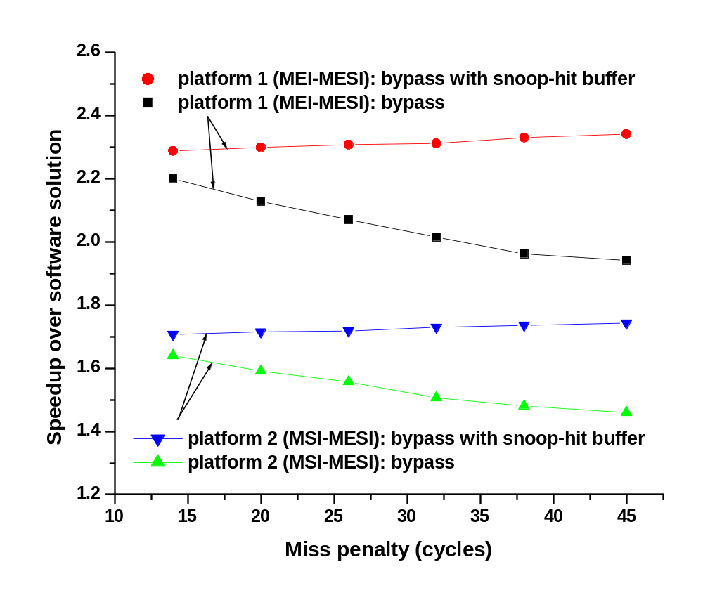
Simulation Results
Bypass Approach: 2 tasks on each processor

Slide 13
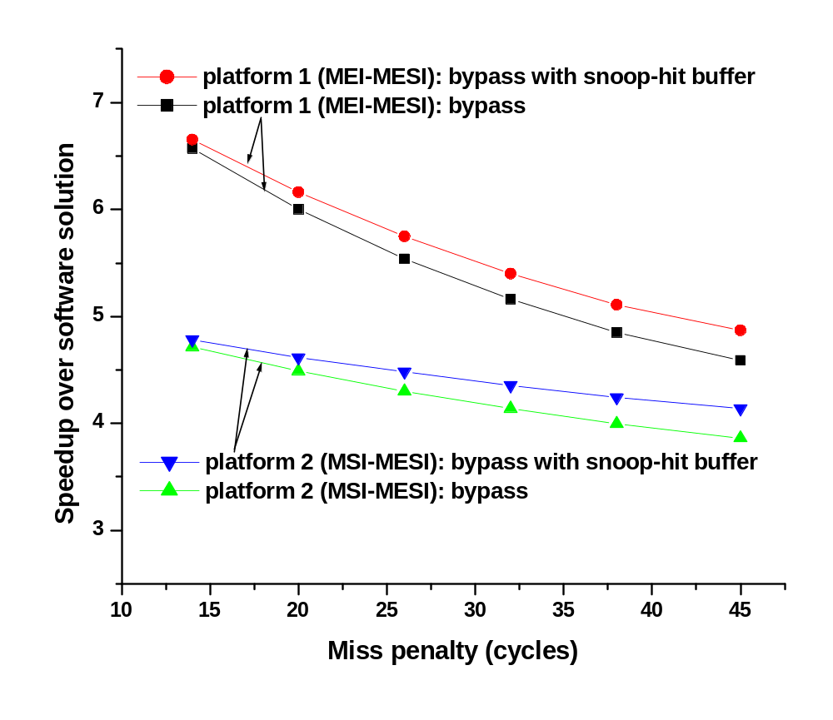
Simulation Results
Bypass Approach: 32 tasks on each processor

Slide 14
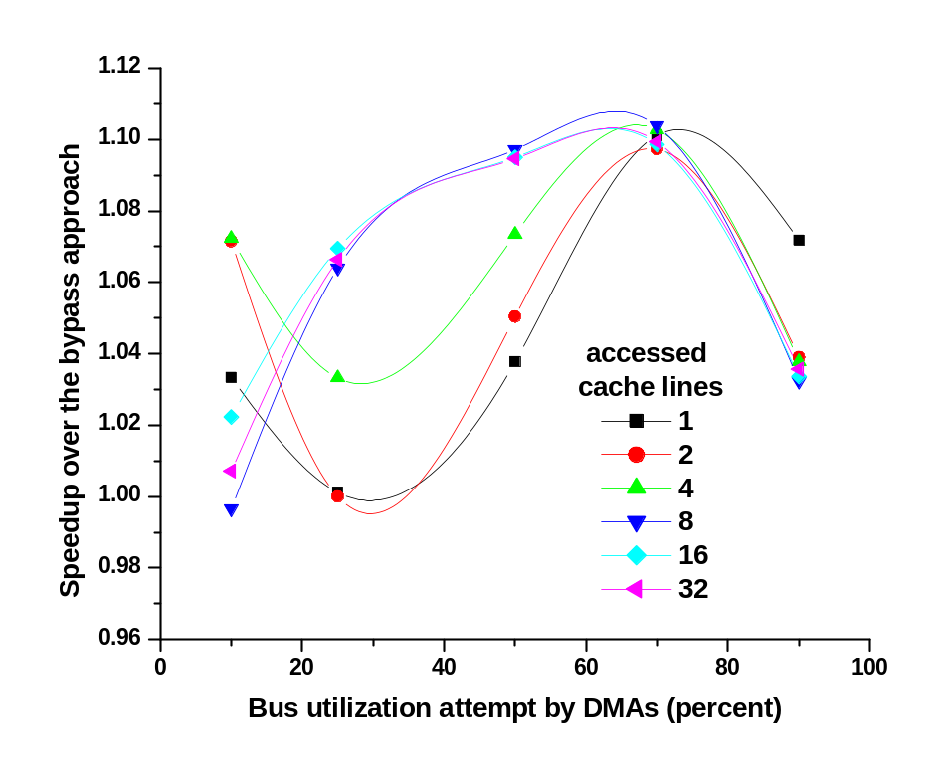
Simulation Results
Bookkeeping Approach
  Platform 2, Miss penalty 14 cycles
  Microbench simulation

Slide 15
Conclusions
Proposed integration techniques for cache coherence on Non-shared bus based-MPSoCs
  Bypass approach, Bookkeeping approach
Bypass approach
  Blindly pass shared memory operations
  Very cheap in terms of silicon area
Bookkeeping approach
  Selectively pass shared memory operations
  Expensive compared to bypass approach
Effective solutions for communication as more and more heterogeneous processors are integrated in a single chip

Slide 16

Questions, Comments?
Thanks for your attention!

Slide 17
Backup Slides

Slide 18
Motivation
Embedded systems more and more require heterogeneous processors on a chip according to applications needs
Efficient communication is imperative to meet real-time property of embedded applications
Shared-bus architecture using AMBA, CoreConnect compromises the versatility provided by each processor
Pin count restricts to use dedicated memory interface for each processor on SoCs
  Commercial MP SoCs such as TI’ OMAP and Philip’s Nexperia employ Non-shared bus architecture sharing memory interface (check Nexperia)

Slide 19
Bookkeeping Approach (cont’d)
Problem with E-state
MPSoC
Proc 0
(MSI)
Proc 1
(MESI)
Example
operation
sequence
I
----
E
1234
M
abcd
----
I
1234
E
ccMC
P1: read
P0
P1
P1: write
E
I
E
Bus 0
I
Bus 1
P0: read
Memory
1234

Slide 20
Bookkeeping Approach (cont’d)
Solution: Prohibit E-state (shared signal assertion)
MPSoC
Proc 0
(MSI)
Proc 1
(MESI)
Example
operation
sequence
I
----
S
abcd
abcd
----
I
S
1234
M
S
ccMC
Breq
P1: read
invalidate
P0
P1
shared
P1: write
S
S
I
M
S
Bus 0
I
Bus 1
P0: read
Memory
abcd
1234

Slide 21
Previous Work (cont’d)
Snoop-hit Buffer ^{[2][3]}
Region-Based Cache Coherence (RBCC) ^{[2][3]}
Snoop-hit buffer
RBCC
MEI
MESI
Wrapper 0
Wrapper 1
Wrapper 0
Wrapper 1
Wrapper 2
Proc 0
(MEI)
Proc 1
(MESI)
Proc 0
(MESI)
Proc 1
(MESI)
Proc 0
(MEI)
Bus
Read
Read
Write-back
Bus
Memory
Controller
Snoop-hit Buffer
(single cache line)
Memory
Controller
To memory
[2] Taeweon Suh, Hsien-Hsin S. Lee, and Douglas M. Blough, Integrating cache coherence protocols for heterogeneous multiprocessor systems, Part 1, In IEEE Micro, July/August 2004
[3] Taeweon Suh, Hsien-Hsin S. Lee, and Douglas M. Blough, Integrating cache coherence protocols for heterogeneous multiprocessor systems, Part 2, In IEEE Micro, September/October 2004

