Slide 1



Supporting Cache Coherence in
Heterogeneous Multiprocessor
Systems
Taeweon Suh, Douglas M. Blough, and Hsien-Hsin S. Lee
Georgia Institute of Technology

Slide 2
Introduction
Cache Coherence
  Well-known technique for data consistency among multiprocessor
  Shared memory
    MEI, MSI, MESI and MOESI protocols
    PowerPC755 : MEI protocol
    Pentium class: MESI protocol
    UltraSPARC: MOESI protocol
    AMD64 class: MOESI protocol
  Distributed shared memory
    Directory-based coherence

Slide 3
Motivation
SoC capacity increases as lithography technology advances
Applications demand heterogeneous multiprocessor and/or IPs on a chip
  DiMeNsion 8650 (LSI logic)
  AD6525 (Analog Device)
  Nexperia pnx8500 (Philips)
Snoop-based protocols fail to address coherence among heterogeneous processors

Slide 4
Contributions
Systematic integration methods of distinct coherence protocols in heterogeneous multiprocessor SoC designs
Performance improvements
Possible power savings

Slide 5
Integration Methods
Techniques to integrate coherence protocols
  Read-to-Write conversion
    S (Shared) state removal
  Shared signal assertion / de-assertion
    E (Exclusive) / S (Shared) state removal
Integrated coherence protocol
  Common states from distinct protocols
    ex) MEI, MESI integration: MEI protocol
Snoop-hit Buffer
  Performance booster
  Power saving

Slide 6
Read-to-Write Conversion
S (Shared) state removal
  MEI – MESI integration example
Operations
on cache
line X
Proc1
(MEI)
Proc2
(MESI)
Wrapper 1
Wrapper 2
(1) P2 read
I
I E
Proc 1
(MEI)
Proc 2
(MESI)
(1) P2 read
I
I E
Without
our
technique
Without
our
technique
(2) P1 read
I E
E S
(2) P1 read
I E
E S
Write
(3) P1 write
E M
S (Stale)
(3) P1 write
E M
S (Stale)
Read/Write
Bus
(4) P2 read
M
S (Stale)
(4) P2 read
M
S (Stale)
(1) P2 read
(1) P2 read
(1) P2 read
I
I E
(1) P2 read
With
our
technique
Memory
Controller
With
our
technique
(2) P1 read
(2) P1 read
(2) P1 read
I E
E I
(2) P1 read
(3) P1 write
(3) P1 write
E M
I
(3) P1 write
(4) P2 read
(4) P2 read
M I
I E
(4) P2 read
(4) P2 read

Slide 7
Shared Signal Assertion
E (Exclusive) state removal
  MSI - MESI integration example
Operations
on cache
line X
Proc1
(MSI)
Proc2
(MESI)
Wrapper 1
Wrapper 2
Proc 1
(MSI)
Proc 2
(MESI)
(1) P1 read
(1) P1 read
I S
I S
I
I
Without
our
technique
Without
our
technique
(2) P2 read
(2) P2 read
S
S
I E
I E
Shared
(3) P2 write
(3) P2 write
S(Stale)
S(Stale)
E M
E M
Read
Bus
(4) P1 read
(4) P1 read
S(Stale)
S(Stale)
M
M
(1) P1 read
(1) P1 read
(1) P1 read
I S
I
With
Our
technique
Memory
Controller
With
Our
technique
(2) P2 read
(2) P2 read
(2) P2 read
S
I S
(3) P2 write
I
(3) P2 write
(3) P2 write
S M
(4) P1 read
(4) P1 read
(4) P1 read
I S
M S

Slide 8
Snoop-hit Buffer
Snoop-hit on M-line requires 2 transactions intended for the same address
Performance enhancement and power saving
Wrapper 1
Wrapper 2
Proc 1
(MEI)
Proc 2
(MESI)
Bus
Read
Read
Write-back
Memory
Controller
Snoop-hit Buffer
(single cache line)
To memory

Slide 9
Simulation Environment
3 PowerPC755 (MEI) + 1 ARM920T (no coherence)
Verilog-HDL implementation
Simulators: Seamless CVE + VCS
Baseline: Software solution
Wrapper
nFIQ
ARM920T
(None)
PowerPC755
(MEI)
Snoop
logic
ARTRY
ASB
Arbiter

Slide 10
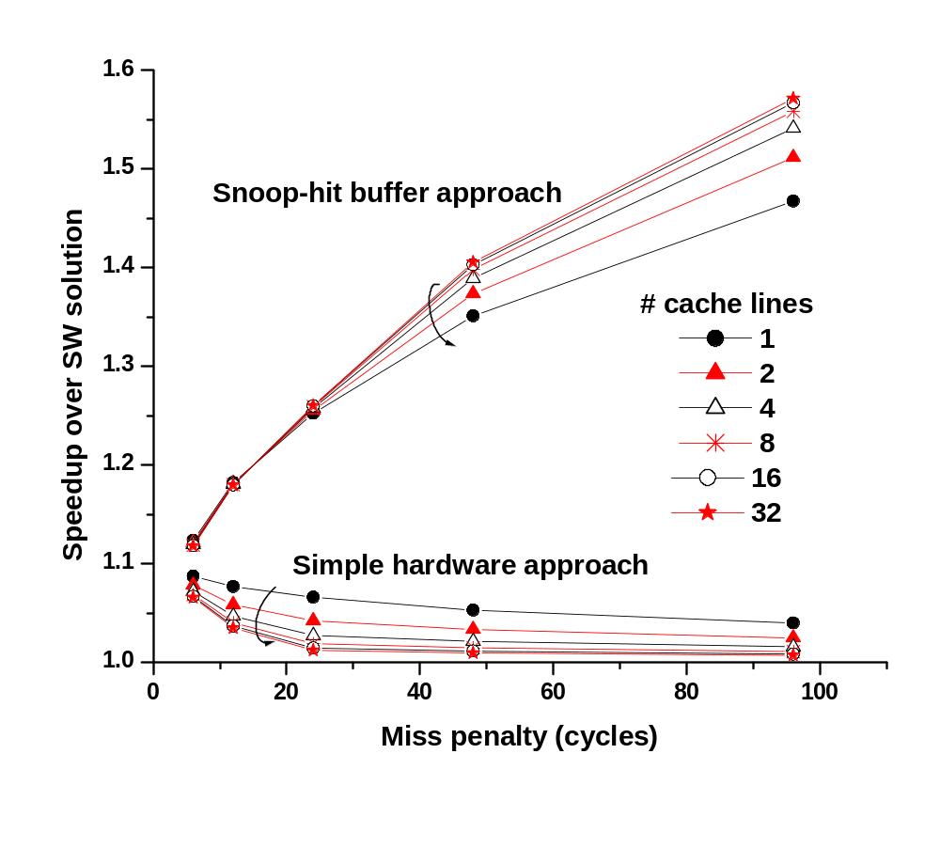
Performance Evaluation (1/3)
Worst-case simulation
  Each task accesses the same critical sections
57 %
0.97 %

Slide 11
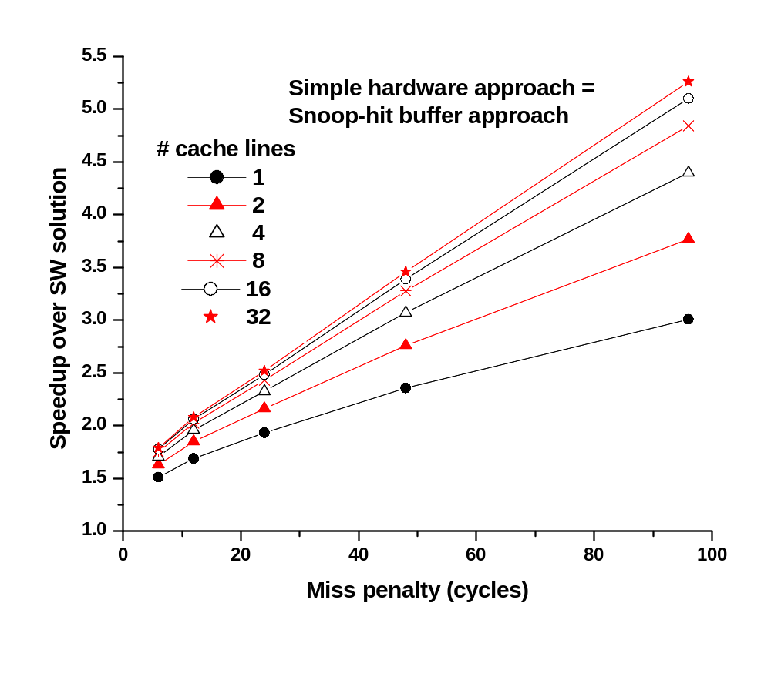
Performance Evaluation (2/3)
Best-case simulation
  Each task accesses different critical sections
426%
51%

Slide 12
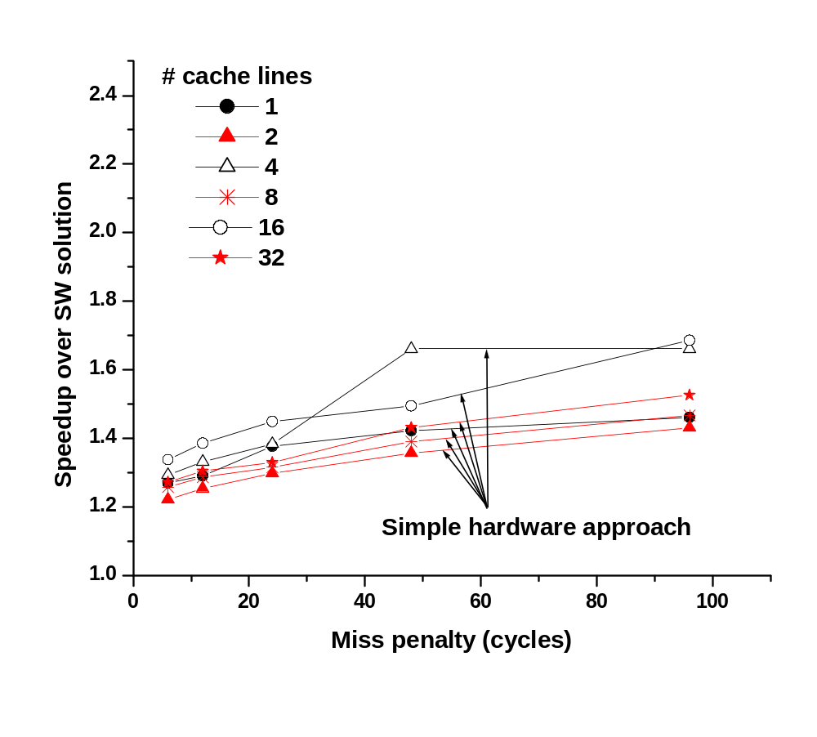
Performance Evaluation (3/3)
Typical-case simulation
  Each task randomly selects critical sections
68%
22%

Slide 13
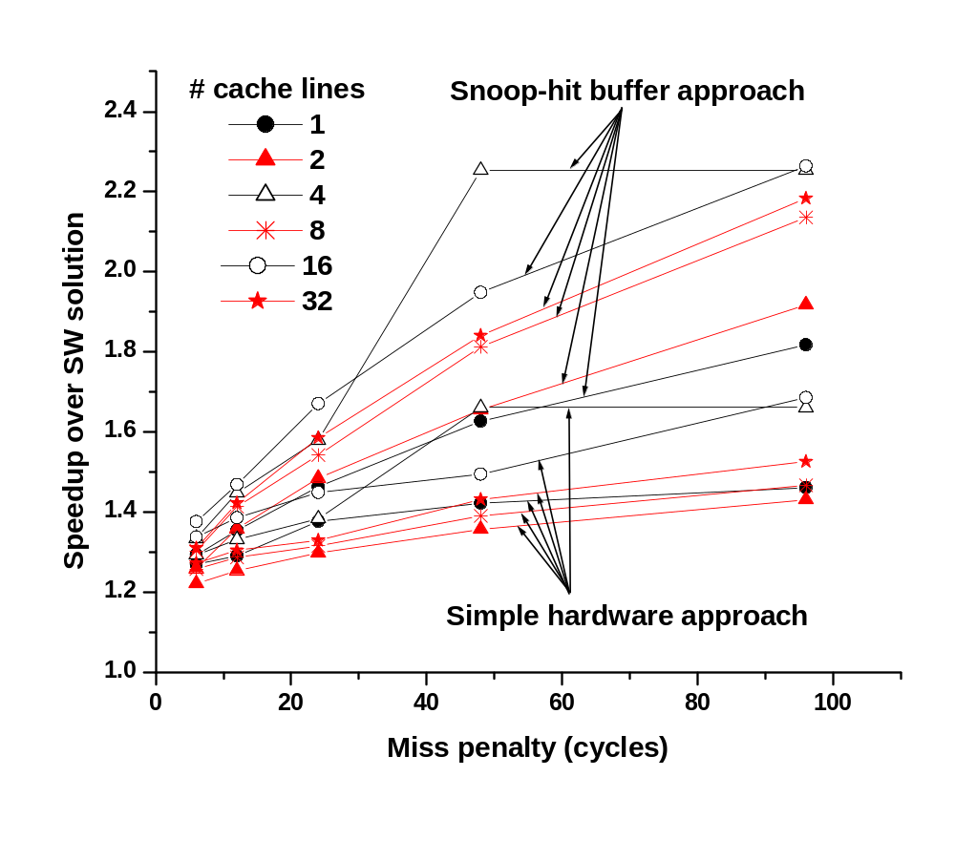
Performance Evaluation (3/3)
Typical-case simulation
  Each task randomly selects critical sections
226%
68%
26%
22%

Slide 14
Conclusions
Propose an integration method of cache coherence protocols for heterogeneous processors
  Retain common states from distinct coherence protocols
Performance improved by
  Up to 5.26X with 96-cycle miss penalty at the expense of simple hardware
Possible power savings from snoop-hit buffer
Useful and effective methods for heterogeneous multiprocessor SoC designs

Slide 15

Questions ?
Thanks for your attention!

Slide 16
Backup Slides

Slide 17
Performance Evaluation (2/5)
Simulation environments (cont.)
  Baseline: software solution
  Lock mechanism: SoCLC [Bilge’02]
Simulators
Seamless CVE (Mentor Graphics)
VCS (Synopsys)
Operating
Frequencies
PowerPC755: 100MHz
ARM920T: 50MHz
ASB: 50MHz
I$ / D$
Enabled
Memory Access Time
6 cycles for 1st word
1 cycles for each subsequent word

Slide 18
Introduction (2/2)
Cache Coherence Example
  PowerPC755: MEI protocol
PowerPC755
#1
PowerPC755
#2
PowerPC755
#3
PowerPC755
#4
D$
D$
D$
D$
GBL ARTRY TT ADDR
GBL ARTRY TT ADDR
GBL ARTRY TT ADDR
GBL ARTRY TT ADDR
32
32
32
32
Memory

Slide 19
Implementation Examples (1/2)
Intel486: Modified MESI protocol
PowerPC755: MEI protocol
Wrapper
Wrapper
Intel486
(MESI)
PowerPC755
(MEI)
INV
HITM
ARTRY
Bus
HOLD
HLDA
Arbiter
BG_BAR
BOFF
BR_BAR
BREQ

Slide 20
Implementation Examples (2/2)
PowerPC755: MEI protocol
ARM920T: No cache coherence support
Wrapper
nFIQ
ARM920T
(None)
PowerPC755
(MEI)
Snoop
logic
ARTRY
ASB
BG_BAR
BGNT
Arbiter
BR_BAR
BREQ
Problem: Hardware deadlock due to interrupt response time

