Slide 1





Microarchitectural Floorplanning Under Performance and Temperature Tradeoff
Michael Healy, Mario Vittes, Mongkol Ekpanyapong, Chinnakrishnan Ballapuram, Sung Kyu Lim, Hsien-Hsin S. Lee, and Gabriel H. Loh
Georgia Institute of Technology

Slide 2
Outline
Motivation
Problem Formulation
Algorithms
Experimental Results
Conclusions and ongoing work

Slide 3
Motivation
Wire delay/power is bad, getting worse
  Does not scale with gate delay
  consuming ~50% of chip power [Magen et al. ‘06]
Modern CPUs are wire-dominated
  Critical loops mostly due to wires [Palacharla et al. ’97]
Technology scaling of Si has to end
  physical limitations will limit device density

Slide 4
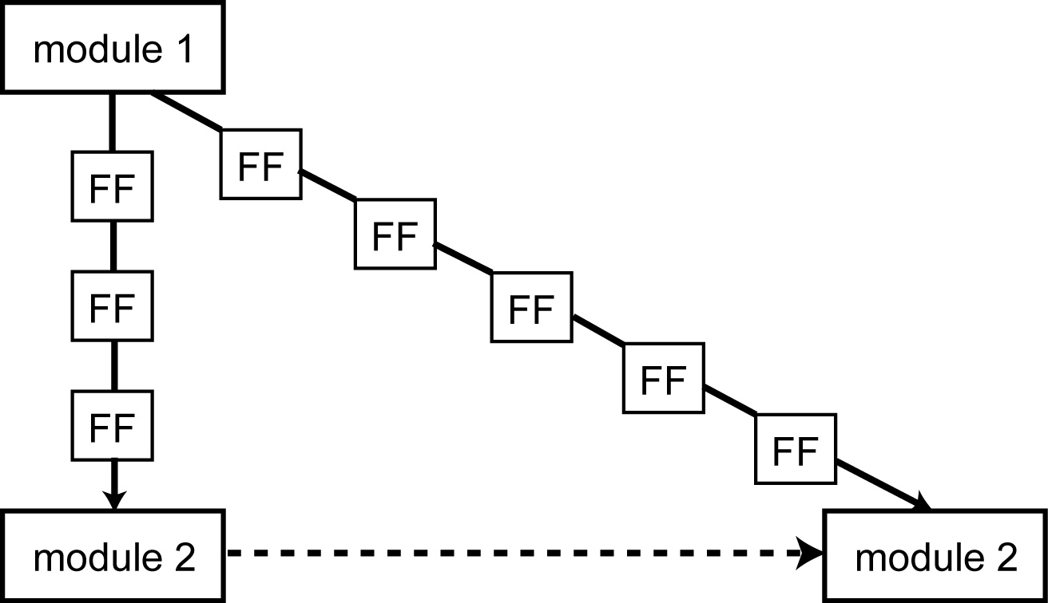
U-Architectural Floorplanning
Tackles wire delay problem
  Requires multi-cycles for global interconnect
  Larger modules: increase latency
Collaboration: physical CAD + architecture
  CAD considers architectural behavior
  Architecture considers physical layout

Slide 5
Previous Works
J. Cong, A. Jagannathan, G. Reinman, and M. Romesis, “Microarchitecture evaluation with physical planning,” DAC03
M. Casu and L. Macchiarulo, “Floorplanning for throughput,” ISPD04
M. Ekpanyapong, J. Minz, T. Watewai, H.-H. Lee, and S. K. Lim, “Profile-guided microarchitectural floorplanning for deep submicron processor design,” DAC04
C. Long, L. Simonson, W. Liao, and L. He, “Floorplanning optimization with trajectory piecewise-linear model for pipelined interconnects,” DAC04
V. Nookala, Y. Chen, D. Lilja, and S. Sapatnekar, “Microarchitecture-Aware Floorplanning Using a Statistical Design of Experiments Approach,” DAC05

Slide 6
Contributions
Extend our previous work [DAC04] to consider multiple objectives: performance, area, and thermal
Our automated design flow combines architectural power/thermal simulation for the entire microarchitecture organization (not subsystem)

Slide 7
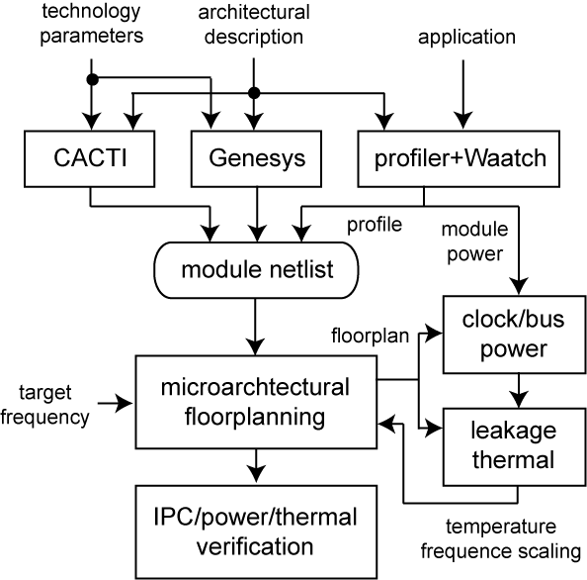
Design Flow

Slide 8
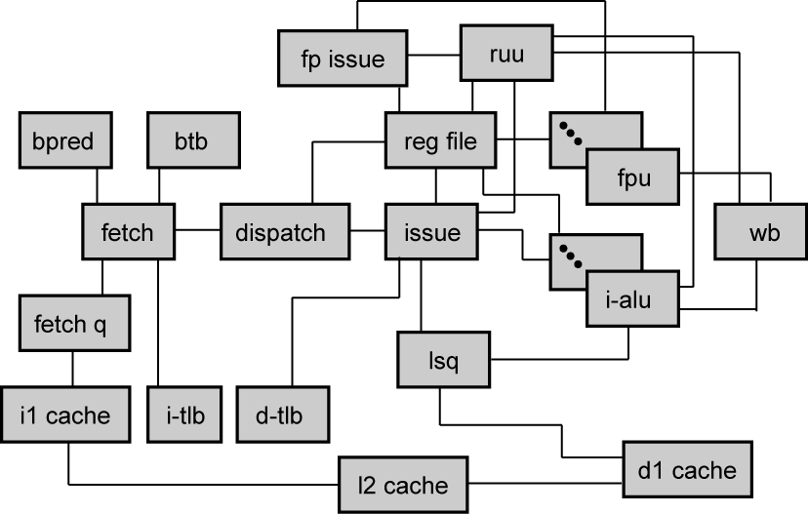
Architectural Model

Slide 9
Overview of the Floorplanning
Two-step approach
  Construct a floorplan using LP
    Perform slicing floorplan
    Perform thermal analysis
    Optimize area, performance (= profile weighted wirelength), max-temp under clock period constraint
  Refine the floorplan using SA
    Perform non-slicing floorplan using Sequence Pair [Murata et al. ‘95]
    Optimize area, performance (= profile weighted wirelength), max-temp
    Widths and heights do not change
    Perform thermal analysis

Slide 10
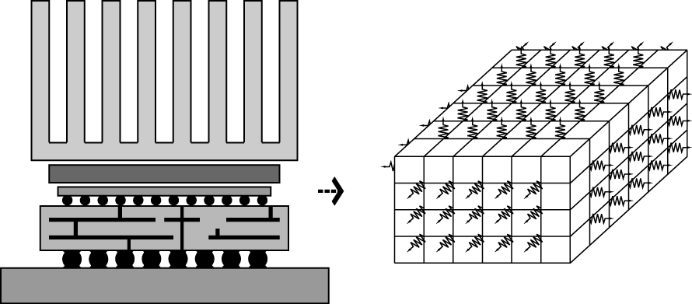
Thermal Analysis
Finite element analysis
  Temp (T) = thermal resistance (R) x power (P)
  Temperature recalculations
    floorplan perturbation changes P, R (= G)
    We update R during LP and fix R during SA

Slide 11
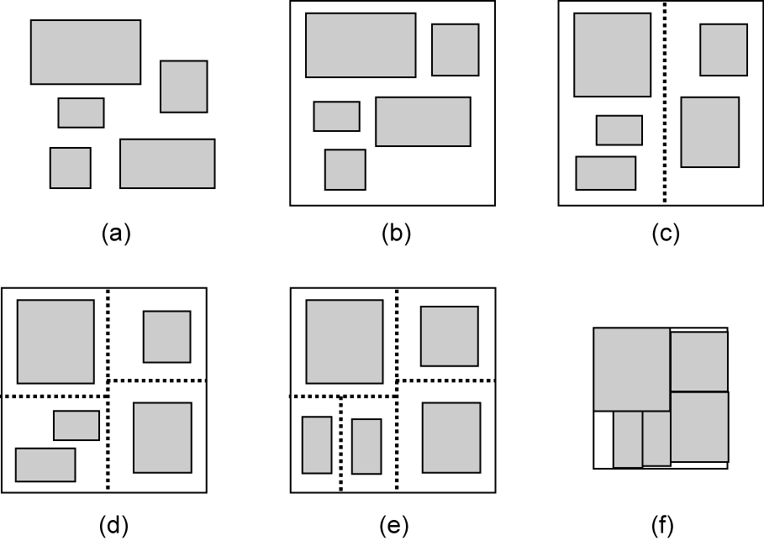
Slicing Floorplanning
Recursive bisections added

Slide 12
LP Floorplanning
Minimize
Σ(α·λ_{ij}·z_{ij} + β(1-T_{ij})(X_{ij}+Y_{ij}) + γ·X_{max})
Clock period (= C) constraint
z_{ij} ≥ [g_{i}+d_{r}(X_{ij}+Y_{ij})]/C
Non-overlapping constraint
X_{ij} ≥ x_{i}-x_{j} and X_{ij} ≥ x_{j}-x_{i}
Y_{ij} ≥ y_{i}-y_{j} and Y_{ij} ≥ y_{j}-y_{i}
Aspect ratio constraint
w_{min} ≤ w_{i} ≤ w_{max}

Slide 13
LP Floorplanning (cont)
Area constraint
X_{max} ≥ x_{i} and A·X_{max} ≥ y_{i}
Boundary constraint
x_{i}+w_{i} ≤ right_{p} and x_{i}-w_{i} ≥ left_{p}
y_{i}+m_{i}w_{i}+k_{i} ≤ top_{p} and y_{i}-m_{i}w_{i}-k_{i} ≥ left_{p}
Center-of-gravity constraint
Σa_{i}·x_{i} = Σa_{i}·x_{center} and Σa_{i}·y_{i} = Σa_{i}·y_{center}

Slide 14
SA Refinement
Further optimize LP solution
  Non-slicing floorplan tends to be better than slicing floorplan
  More accurate thermal analysis is possible
Approach
  Use “gridding” scheme [Murata et al. ‘95] to encode LP solution to SP
  Using low annealing, perturb SP to refine area, performance, thermal

Slide 15
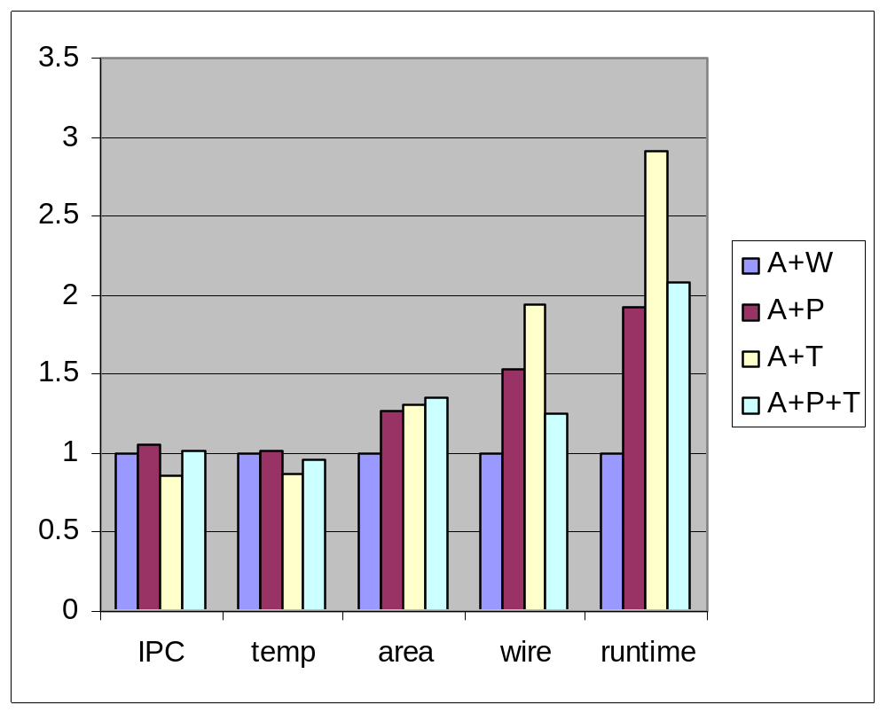
Results

Slide 16
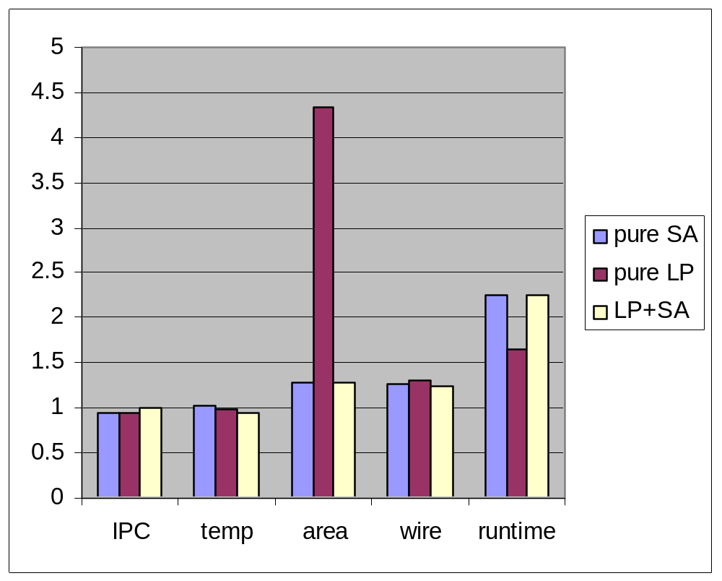
Results (cont)

Slide 17
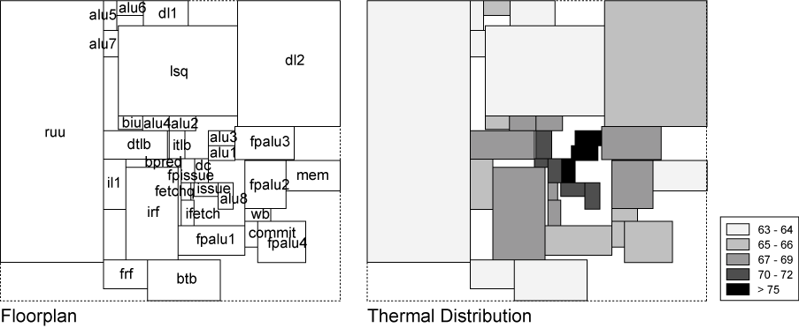
Floorplan Snapshot

Slide 18
Conclusions
Uarch floorplanning is useful in tackling wire-delay problem.
We proposed a uarch floorplanning for multiple objectives.

