Slide 1


Data Prefetching Mechanism by Exploiting Global and Local Access Patterns
Ahmad Sharif Qualcomm
Hsien-Hsin S. Lee Georgia Tech
The 1st JILP Data Prefetching Championship (DPC-1)
Notes:
Good afternoon. I will be presenting a prefetcher that we designed and evaluated using the DPC framework. It exploits local and global memory access patterns to prefetch data.

Slide 2
Can OOO Tolerate the Entire Memory Latency?
OOO can hide certain latency but not all
Memory latency disparity has grown up to 200 to 400 cycles
Solutions
  Larger and larger caches (or put memory on die)
  Deepened ROB: reduced probability of right path instructions
  Multi-threading
  Timely data prefetching
ROB
Load miss
D-cache
miss
ROB full
Untolerated Miss latency
ROB entries
De-allocated
Independent instructions filled
No productivity
Machine
Stalled
Date returned
Revised from “A 1st-order superscalar processor model in ISCA-31
Notes:
Our baseline processor model had a 128-entry ROB with an issue-width of 4. The front-end is perfect (with perfect branch prediction and no fetch hazards). The only deviation from ideal IPC is due to insufficient ILP in the program, and due to cache misses. The IPC graph looks like the one shown in this figure. There are periods of more or less steady IPC (equal to program ILP) with regions in between that have less-than-ideal IPC due to cache misses. The length of these regions depend on whether it is a L1 or L2 cache miss.
When there is a cache miss, the processor continues fetching perfectly, along with allocation into the ROB, RS and LSQ (and other microarchitectural modules). After at most 128/4 cycles, the ROB becomes full and instruction allocation stalls for the duration of the cache miss.

Slide 3
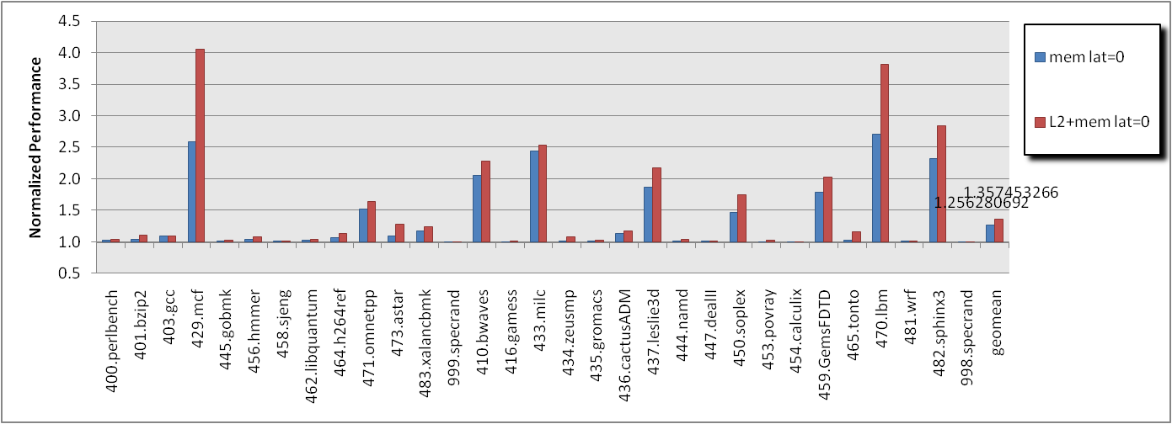
Performance Limit: L1 vs. L2 Prefetching
Result from Config 1 (32KB L1/2MB L2/~unlimited bandwidth)
L1 miss Latencies seem to be tolerated by OOO
We decided to perform just L2 prefetching
  And it turns out….. right after submission deadline, not a bright decision
Perfect mem hierarchy
Perfect L2
Skipping first 40 billions and simulate 100 millions
Notes:
This graph shows performance improvement when parts of the memory sub-system are replaced by their ideal counterparts. By ideal I mean 0-latency.
With L2 cache latency set to 0, the processor behaves as if the L1 cache is as big as the L2 with 0 cycles of latency. With memory latency=0, the processor performs as if everything was at worst an L2 hit. This is the performance we would obtain if there was a perfect prefetcher prefetching into the L2 cache.
As can be seen from this figure, most of the available performance can be obtained by having a good L2 prefetcher without worrying about prefetching into L1. This is because our processor is ideal and can hide much of the 20 cycles of latency that L2 hits have. In 20 cycles, at most 80 instructions can be executed, which can fit inside the 128-entry window.
Ahmad: If I did implement L1, at least libquantum would have given me 40-50% more and that might have improved geomean by 3-4%.

Slide 4
Objective and Approach
Prefetch by analyzing cache address patterns (addr<<6)
Identify commonly seen patterns in address delta
  462.libquantum: 1, 1, 1, 1, etc.
  470.lbm: 2, 1, 2, 1, 2, 1, etc. (in all accesses and L2 misses)
  429.mcf: 6, 13, 26, 52, etc. (sort of exponential)
Patterns can be observed from:
  All accesses (regardless hits or misses)
  L2 misses
  Our data prefetcher exploits these two based on both global and local histories
Notes:
During our initial study, we found some common memory access patterns by applications in the SPEC suite.
Mcf has exponentially increasing deltas in the accesses it does. Lbm has a fixed repeating pattern in both accesses and L2 misses (since most of it’s accesses are misses).
Some applications have detectable patterns in L2 misses, others have patterns in accesses. So we decided to use both in our design.

Slide 5
Our Data Prefetcher Organization
From d-cache:
virtual address
timestamp (not used)
hit/miss
GHB
(log all unique accesses, age-based)
Pattern Detection Logic
(state-free logic)
&
k-sized fully associative
Request Collapsing Buffer
g sized GHB
LHBs (All per-PC unique accesses, age-based)
LRU
PC_{m}
g=128
l=24
m=32
k=32
Total : ~26,000 bits (82% of 32 KB)
Rest dedicated to “temporaries”
32 bit tag
l sized LHB
Notes:
Our prefetcher uses previously stored history in both global and local history buffers and fixed pattern detection logic to predict future memory accesses of the program.
The global history buffer stores recently accessed memory addresses (cache line numbers) from the program along with hit/miss data.
Each local history buffer stores recently accessed memory addresses by particular program counters from the program, along with hit/miss data.
There is a small prefetch cache that checks whether a prefetch has been issued in the recent past to prevent redundant prefetch requests from being issued.
The total budget of our prefetcher is 30,000 bits which accounts for around 92% of the allowable budget. The rest of the budget goes to “temporary variables” according to the rules of the DPC competition.

Slide 6


Prefetcher Table Bit Count
128 entries
GHB
3584 bits
26-bit addr
2-bit info
24 entries
32
rows
LHBs
22528 bits
PC_{n}
32-bit PC
26-bit addr
2-bit info
32 26-bit frame addresses in the request collapsing buffer (832 bits)
Total: 26944 bits
Rest for temporary variables, e.g., binned output pattern, etc., but not needed

Slide 7

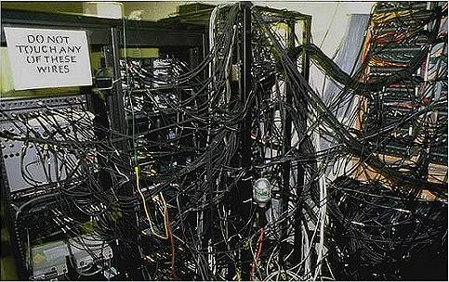
Pattern Detection Logic
Whenever a unique access is added
  Bin accesses according to region (64KB)
  Detect pattern using addr deltas (sorry, it is brute-force)
    Finding “maximum reverse prefix match” (generic)
    Finding exponential rise in deltas (exponential)
  Check request collapsing buffer
  Issue prefetch 4 deltas ahead for generic or 2 ahead for exponential
Currently assume a complex combinational logic which (may) require:
  Binning
  Sorting network
  Match logic for
    Generic patterns
    Exponential patterns
Notes:
The fixed pattern detection logic first bins accesses into regions and detects a repeating pattern by using a brute-force algorithm. It then creates requests by repeating the pattern after the current access and checks if these are present in the prefetch cache. Any request not present in the prefetch cache is issued.
The following examples show some scenarios encountered by our prefetcher, and it’s behavior upon seeing these scenarios.

Slide 8
Example 1: Basic Stride
Common access pattern in streaming benchmarks
PC-independent (GHB) or per-PC (LHB)
low memory address
high memory address
different memory region
Trigger
History Buffer
Pattern
Detection
Logic
Same bin
Notes:
The first example shows a constant stride.
Note that the differences in the cache lines can be anything, and not just 1 as shown in the figure. Also note that as long as the slot in-between the buffer belongs to a different region, the stride of 1 will be detected.

Slide 9
Example 2: Exponential Stride
Exponentially increasing stride
  Seen in 429.mcf
  Traversing a tree laid out as an array
1
2
4
8
low memory address
high memory address
Trigger
Pattern
Detection
Logic
History Buffer
Notes:
This example shows an exponentially increasing stride.
This type of access is present if a program is traversing down a tree laid out as an array.
Another pattern that some applications have is the binary search pattern: absolute values of the strides have an expoenentially decreasing pattern. In this case, a smart prefetcher can prefetch both sides of the binary search (this is part of future work and our current prefetcher does not detect this pattern).

Slide 10

Example 3: Pattern in L2 misses
Stride in L2 misses
  with deltas (1, 2, 3, 4, 1, 2, 3, 4, …)
  Issue prefetches for 1, 2, 3, 4
  Observed in 403.gcc
Accessing members of an AoS
  Cold start
  Members are separate out in terms of cache lines
  Footprint is too large to accommodate the AoS members in cache
Notes:
Repeating pattern in the L2 misses of a program can also be detected. The only difference between this and example I is that this only looks at L2 misses.

Slide 11
Example 4: Out of Order Patterns
Accesses that appear out-of-order
  (0, 1, 3, 2, 6, 5, 4) → with deltas (1, 2, -1, 4, -1, -1)
  Ordered (0, 1, 2, 3, 4, 5, 6) issue prefetches for stride 1
  See the processor issue memory instructions out-of-order
  No need to deal with if prefetcher sees memory address resolution in program order
Can be found in with any program as this is an artifact due to OOO
Notes:
These patterns make sense when re-ordered with respect to absolute addresses. In this case this pattern can be obtained if the program accesses an array sequentially but the instructions are issued out-of-order with respect to program order.
Our prefetcher can detect this situation and issue the next few prefetches.

Slide 12
Simulation Infrastructure
Provided by DPC-1
15-stage, 4-issue, OOO processor with no FE hazards
128-entry ROB
  Can potentially get filled up in 32 cycles
L1 is 32:64:8 with infrastructure default latency (1-cycle hit)
L2 is 2048:64:16 with latency=20 cycles
DRAM latency=200 cycles
Configuration 2 and 3 have fairly limited bandwidth
Notes:
The simulation infrastrucutre was provided by DPC committee. It models an out of order process with an issue width of 4 with a 128-entry ROB. It has a perfect front-end.
Three different configurations were targetted. In configuration 1, the L2 cache size is 2MB and bandwidth to L2 and memory is unlimited.
In configuration 2 the L2 cache size is 2MB and has limited bandwidth of one access per cycle. Additionally the bandwidth to memory is one per 10 cycles.
Configuration 3 is the same as configuration 2, except for a smaller L2 cache (512 KB).

Slide 13
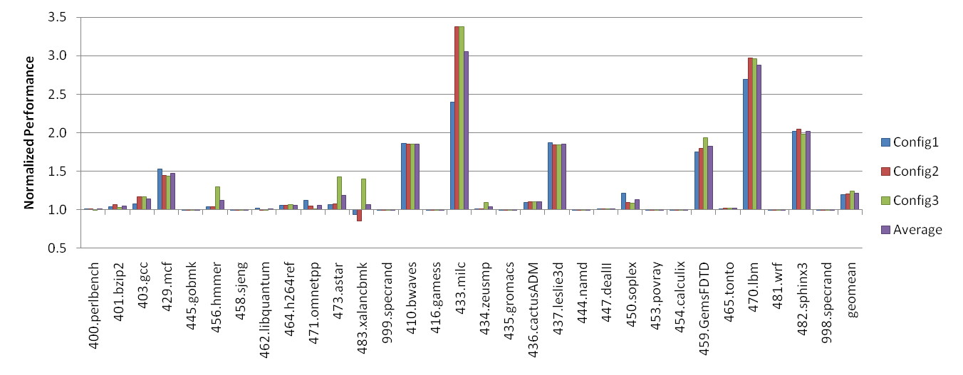
Performance Improvement
 | L1 | L2 | L2 BW | Mem BW
Config 1 | 32KB | 2MB | 1000 apc | 1000 apc
Config 2 | 32KB | 2MB | 1 apc | 0.1 apc
Config 3 | 32KB | 512KB | 1 apc | 0.1 apc
Performance Speedup (GeoMean) = 1.21x
Notes:
This slide shows our performance results. The average of three configurations of the geomean gave us 21% performance improvement.

Slide 14
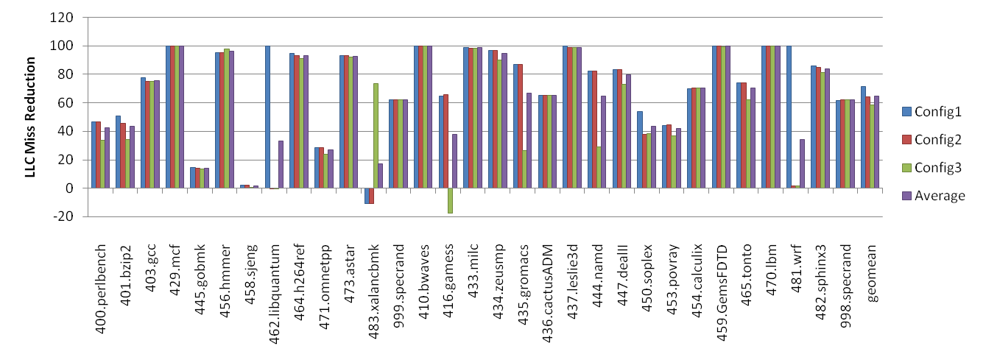
LLC Miss Reduction
Avg L2 reduction percentage : 64.88%
Reduction does not directly correlate to performance improvement though
Streaming with
regular patterns
Streaming with
regular patterns
Does not show
too many patterns
L2 queue full for
Config 2 and 3
Notes:
The number of LLC misses from using our proposed prefetcher is a hair under 65%.
For 462.libquantum, the reason for configuration 2/3 not showing any improvement is because the simulator’s L2 queue was full (and this was because of misses to identical addresses). Same can be said about 481.wrf.
483.Xalancbmk showed performance degradation because of less visible patterns (and cache pollution due to overprefetching) and because our prefetcher was too aggressive for it.
470.Lbm is a classic streaming benchmark that shows a lot of improvement with a prefetcher.

Slide 15

Wish List for a Journal Version
To make it more hardware-friendly (logic freak or more tables needed?)
Prefetch promotion into L1 cache (our ouch)
Better algorithm for more LHB utilization
Improve Scoring System for Accuracy
Feedback using closed loop
Notes:
Our prefetcher in it’s current state is very hardware un-friendly because it uses algorithms that potentially require multi-cycles to evaluate.
One direction for future work would be making it hardware friendly.
Another direction would be to assign scores to prefetches and issue based on score (we already have a part of this in the current algorithm), but don’t use it too much. We could also add feedback to the prefetcher using a closed loop.
Another few percent can be obtained by promoting certain prefetches to the L1 cache. We did not implement this due to lack of time, and are confident that it will improve performance by at least 2-3%.

Slide 16
Conclusion
GHB with LHBs shows
  A “big picture” of program’s memory access behavior
  Program history repeats itself
  Address sequence of Data access is not random
Delta Patterns are often analyzable
We achieve 1.21x geomean speedup
LLC miss reduction doesn’t directly translate into performance
  Need to prefetch a lot in advance
Notes:
With the LHB and GHB combined, we can analyze and detect a lot more patterns than we could with a more primitive scheme.
LLC misses don’t directly translate to improved performance (we reduced LLC misses by 65% but improved performance by only 21%). This was partly due to non-timely prefetches and also because we do not promote any prefetch into the L1 cache.

Slide 17


THAT’S ALL, FOLKS!
ENJOY HPCA-15
Georgia Tech
ECE MARS Labs
http://arch.ece.gatech.edu

