Slide 1
A Kinder and Gentler Tour to Computer Architecture Research
Hsien-Hsin “Sean” Lee
Assistant Professor
School of Electrical & Computer Engineering
Georgia Institute of Technology
April 1, 2003 ECE 8010 Graduate Research Seminar
Notes:
I am going to leverage the concept, “regions,” for memory subsystem optimization. Regions, are partitions of virtual memory address space by high level programming languages. In this talk, I am going to show you a couple of optimized cache architecture designs in terms of low power and high performance through analyzing the characteristics demonstrated by (distinct) memory region references.

Slide 2
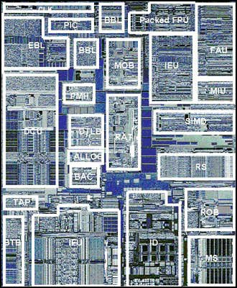
Job Description of Architects
EBL/BBL – External/Backside Bus logic
MOB - Memory Order Buffer
Packed FPU - Floating Point Unit for SSE
IEU - Integer Execution Unit
FAU - Floating Point Arithmetic Unit
MIU - Memory Interface Unit
DCU - Data Cache Unit (L1)
PMH - Page Miss Handler
DTLB - Data TLB
BAC - Branch Address Calculator
RAT - Register Alias Table
SIMD - Packed Floating Point unit
RS - Reservation Station
BTB - Branch Target Buffer
TAP – Test Access Port
IFU - Instruction Fetch Unit and L1 I-Cache
ID - Instruction Decode
ROB - Reorder Buffer
MS - Micro-instruction Sequencer

Slide 3
Roles of Architects
High Level Language
Front-end compiler
Intermediate Representation
Exposed to software
Backend compiler
(e.g. code generator,
scheduler, IR optimizer)
Binary translation,
dynamic compilation
Architects’
Responsibility
Transparent to software
Binary ISA
Binary Execution,
dynamic optimizer
ISA of Underline Machine
System Architecture
Microarchitecture
Hardware
Circuits/Devices
IC Manufacturing

Slide 4
Mainstream Architecture Design Philosophy
CISC — Complex Instruction Set Computers
  IBM 360 (a legend)
  Digital VAX
  Intel x86
RISC — Reduced Instruction Set Computers
  IBM 801 project
  Sun Sparc (from Berkeley)
  MIPS (from Stanford)
EPIC — Explicitly Parallel Instruction Computing
  Intel/HP’s answer to 64-bit ISA
  Evolved from
    VLIW (Very Long Instruction Word): Adopted by most DSP
    Polycyclic architecture (TRW-ECL)
    Cydra5 (Cydrome)
    HP Playdoh
  Challenged by AMD’s Optaron (x86-64)

Slide 5
Evolution of Processor Pipelining
5 Stages
PREF
DEC
DEC
EXEC
WB
i486 and P5 (Pentium) Microarchitecture
≥ 11 Stages
IFU1
IFU2
IFU3
DEC1
DEC2
RAT
ROB
DIS
EX
RET1
RET2
P6 (Penitum Pro, P-II, P-III, Pentium M of Centrino) Microarchitecture
≥ 20 Stages
TC NextIP
TC Fetch
Drive
Alloc
Rename
Queue
Schedule
Dispatch
Reg File
Exec
Flags
Br Ck
Drive
NetBurst (Pentium 4 and Xeon) Microarchitecture
30 to 50 Stages ?
Next Generation High Frequency Microarchitecture

Slide 6
Intel P6 Microarchitecture (PPro, P-II, P-III)
External bus
Data Cache Unit (L1)
Chip boundary
Memory
Cluster
Bus Cluster
Memory Order Buffer
Bus interface unit
AGU
Instruction Fetch Unit
MMX
IEU/JEU
Control
Flow
IEU/JEU
(Restricted)
Data
Flow
BTB/BAC
FEU
Instruction Fetch Cluster
MIU
Instruction
Decoder
Instruction
Decoder
Register Alias Table
Reservation Station
Out-of-order
(OOO) Cluster
Microcode Sequencer
Allocator
ROB & Retire RF
Issue C luster

Slide 7
Intel NetBurst Microarchitecture (P4)
BTB (4k entries)
I-TLB/Prefetcher
64 bits
μCode ROM
64-bit
System
Bus
IA32 Decoder
Trace Cache BTB
(512 entries)
Quad
Pumped
400M/533MHz
3.2/4.3 GB/sec
BIU
Execution Trace Cache
μop Queue
Allocator / Register Renamer
Memory μop Queue
INT / FP μop Queue
Memory scheduler
Fast
Slow/General FP scheduler
Simple FP
INT Register File / Bypass Network
FP RF / Bypass Ntwk
U-L2 Cache
256KB 8-way
128B line, WB
48 GB/s
@1.5Gz
AGU
AGU
2x ALU
2x ALU
Slow ALU
FP
MMX
SSE/2
FP Move
Ld addr
St addr
Simple
Inst.
Simple
Inst.
Complex
Inst.
L1 Data Cache (8KB 4-way, 64-byte line, WT, 1 rd + 1 wr port)
256 bits

Slide 8
Instruction Level Parallelism (ILP)
Exploit parallelism of instructions
RISC enables ILP exploration
Dynamic instruction scheduling (P6/Netburst)
  Register renaming
  Resolve memory aliasing : load bypassing
Static instruction scheduling (EPIC)
  A smart compiler + a dumb machine
  Profile-guided optimization
  ISA support
    Full Predicated Instruction Set
    Control speculation (ld.s: loads bypass branches)
    Data speculation (ld.a: loads bypass stores)

Slide 9
Classical ILP Issue 1: Data Supply
Limited by
  Data availability
  Data dependency
    True dependency (RAW)
    Anti dependency (WAR)
    Output dependency (WAW)
Solutions
    Bigger faster caches
    Prefetching
    More architecture registers needed
      x86 has only 8
    Better register allocator for compiler
    Register renaming
    Value prediction
c1=i1: load r2, (r12)
C2=i2: add r1, r2, #9
C3=i3: mul r2, r5, r6
δ_{TRUE}
δ_{ANTI}
δ_{OUTPUT}
ILP = 3/3 = 1

Slide 10
Classical ILP Issue 2: Instruction Supply
Limited by
  Instruction availability
  Control dependency
    Change of Flow
  Solutions
    Enlarge Basic Block size
    Branch prediction
    Branch alignment
    Trace construction
      Trace scheduling
      Trace cache
    Predicated execution (EPIC)
i1: load r1, (r11)
i2: load r2, (r12)
i3: load r3, (r13)
i4: add r2, r2, r3
i5: cmp r2, r9
i6: jge i10
i7: inc r1
i8: mul r3, r3, #5
i9: jmp i4
i10: st (r11), r1
i11: st (r12), r2
I12: exit

Slide 11
Classical ILP Issue 2: Instruction Supply
Control Flow Graph (CFG)
Limited by
  Instruction availability
  Control dependency
    Change of Flow
  Solutions
    Enlarge Basic Block Size
    Branch prediction
    Branch alignment
    Trace construction
      Trace scheduling
      Trace cache
    Predicated execution (EPIC)
BB1
BB2
BB3
BB4

Slide 12
Branch Prediction
To avoid “fetching bubbles” (ex: 4-stage pipe)
What to speculate (i.e. what to guess)?
  Branch Target Address
  Branch Direction (for conditional branches)
    Taken
    Not-Taken
IF
DE
EX
WB
1
Branch inst
Instruction Sequence
: bubbles
2
Execution Cycle

Slide 13
Gshare Branch Predictor
Pattern
History
Table
(PHT)
Branch
History
Pattern
Branch
History
Register
(BHR)
00…..00
Rc-1
00…..01
Rc-k
00…..10
: 2-bit saturation
counter
1
1
. . . . .
1
0
⊕
index
Prediction of B
11…..10
HASH
11…..11
0x1000ffec
Rc: True Branch Result of B
Program Counter (PC)
One version of two-level adaptive branch predictor
Take branch correlation into account by XOR-ing branch PC address
Implemented in AMD Athlon, MIPS R12000, Sibyte SB-1

Slide 14
Alpha 21464 (EV8) Branch Predictor
PC address
Global history
BIM
G0
G1
Meta
map4
map1
map2
map3
majority vote
prediction
Bimodal predictor used as (1) static biased predictor and (2) part of e-gskew predictor
Global predictors G0 and G1 are part of e-gskew predictor
Table sizes: 352Kbits in total (208Kbits for prediction table; 144Kbits for hysteresis table.)

Slide 15
Streamlining Instruction Traces
BB3
BB5
BB1
BB2
BB4
Fetch in Conventional Instruction Cache/Memory
Trace Cache
BB1
BB2
BB3
BB4
BB5
Fetch in Linear Memory Location

Slide 16
Trace Cache
For T.C. miss
Trace construction
Br
flag
Br
mask
Line fill buffer
Tag
Fall-thru Address
Taken Address
M branches
BB1
BB2
BB3
Branch 1
Branch 1
Branch 1
Fetch Addr
Multiple Branch Predictor
T.C. hits, N instructions
Force sequentiality in instruction fetching
Intel P4 features TC to due in part to reduce x86 decode logic, hey, it is a CISCy ISA

Slide 17
ILP Limit Study
    [Weiss and Smith ‘84] 1.58
    [Tjaden and Flynn ‘70] 1.86 (Flynn’s bottleneck)
    [Uht ‘86] 2.00
    [Smith et al. ‘89] 2.00
    [Jouppi and Wall ‘89] 2.40
    [Johnson ‘91] 2.50
    [Butler et al. ‘91] 5.8
    [Melvin and Patt ‘91] 6
    [Wall ‘91] 4.1 – 7.4 (with aggressive branch predictor)
    [Kuck et al. ‘72] 8
    [Riseman and Foster ‘72] 51 (Oracle knowledge of control flow)
    [Lee, Wu and Tyson ‘00] 72.6 / 13.7 / 8.3 (for Itanium compiled code with different scheduling scopes)
    [Nicolau and Fisher ‘84] 90 (Fisher’s optimism, Oracle knowledge of control flow using numerical programs)
    [Lam and Wilson ‘92] 7 – 158 (Investigate Control Dependency)
    [Postiff et al. ‘98] 81-363(int), 56-4003(fp) (removed SP δt and perform hierarchical bound analysis)

Slide 18
Thread-Level Parallelism (TLP)
So, ILP of single program is limited, then what?
Reality: Multiple contexts running on a system
A lot of parallelism among different threads
How about exploiting Thread-Level Parallelism?
  Concurrent execution of multiple threads
  Increase throughout of a system
  Can improve single programs’ performance if threads can look after each other

Slide 19
Multithreading Paradigms
FU1
FU2
FU3
FU4
Unused
Thread 1
Thread 2
Thread 3
Thread 4
Execution Time
Thread 5
Conventional
Superscalar
Single
Threaded
Most High
Performance
Processors
Fine-grained
Multithreading
(cycle-by-cycle
Interleaving)
Tera MTA
Coarse-grained
Multithreading
(Block Interleaving)
MIT Sparcle
(Alewife node)
Chip
Multiprocessor
(CMP)
IBM POWER4
Simultaneous
Multithreading (SMT)
Alpha EV8 (21464)
(4 threads)
Intel HyperThreading
(2 threads)

Slide 20
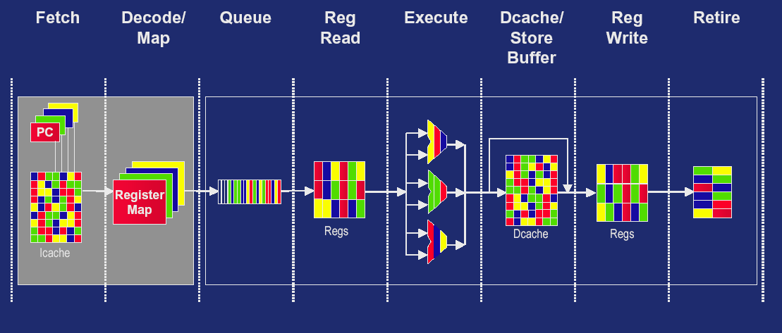
Simultaneous Multithreading (SMT)
Maintain 4 Thread (or Process) Contexts in Hardware,
i.e. No Context Switch Overheads

Slide 21
Are we there yet?
Architects have been chasing performance for last 3 decades
Performance over the last decade improved 100 folds (50-60% annually) :
  20x from process/circuit technology, aka frequency
  4x from architecture innovation
  1.4X from compiler technology
  But that was the past…
Can we maintain the same glory for the next decade?
Fact sheet:
  Mass consumers slow down upgrading PCs
  Where are the new killer apps billions of people need?

Slide 22
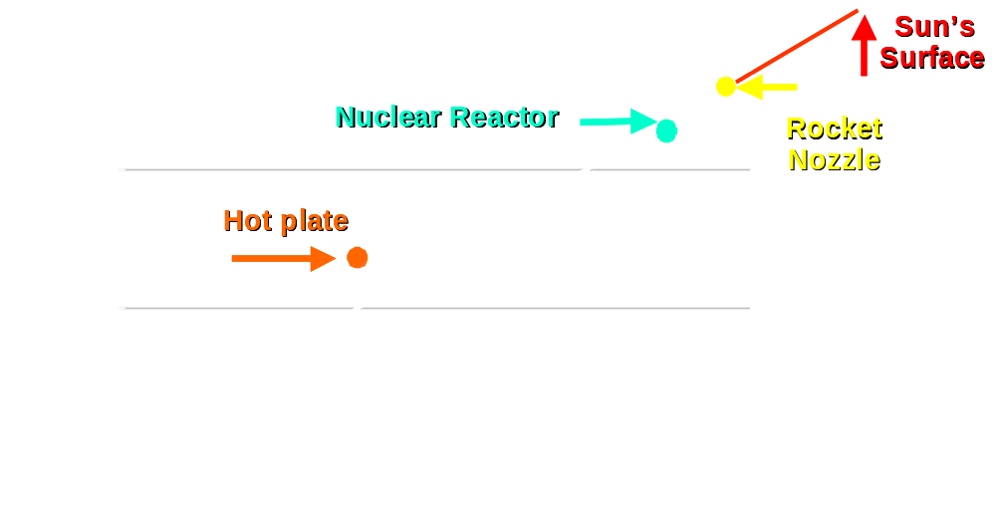
Trend of Processors’ Power Density
Pentium 4 ® processor
“Surpassed hot-plate power density in 0.5μm; Not too long to reach nuclear reactor,” Former Intel Fellow Fred Pollack.

Slide 23
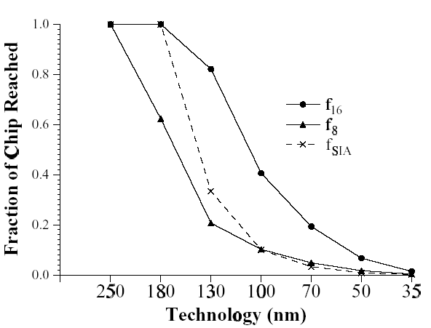
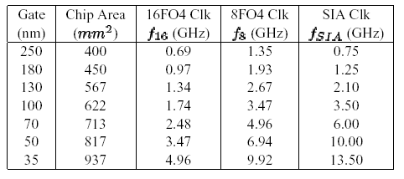
Reachability in Single Clock Cycle

Slide 24
The Road Ahead .. Beyond Performance
Power or Energy
  Clock gating
  Power (V_{dd}) gating
Wire delay
  When global wires become a nightmare
  Multi-clustered or CMP
Adaptivity
Security
And name your wish list below
  ….

Slide 25
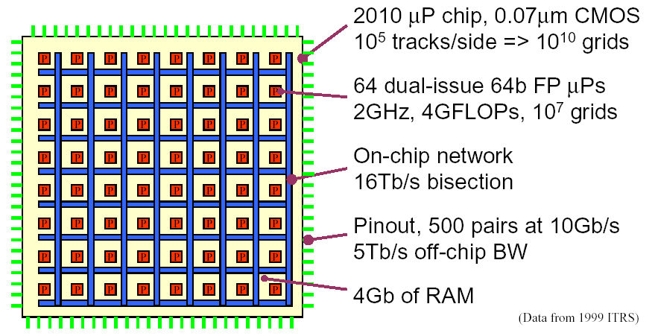
Modular Computing: year 2010

Slide 26
Intel’s Prediction: Microprocessor 2010
At least 100x Performance of Pentium 4
20 GHz
Multi-Processors on a die
Multi-Threading per processor
More application specialized ISA
  Accelerate human interface
  Accelerate communications
Some of you will help it happen

Slide 27

That’s All Folks !

