Slide 1
Algorithm for Achieving Minimum Energy Consumption in CMOS Circuits Using Multiple Supply and Threshold Voltages at the Module Level
Yuvraj Singh Dhillon
Abdulkadir Utku Diril
Abhijit Chatterjee
Hsien-Hsin Sean Lee
School of ECE,
Georgia Institute of Technology,
Atlanta, GA

Slide 2
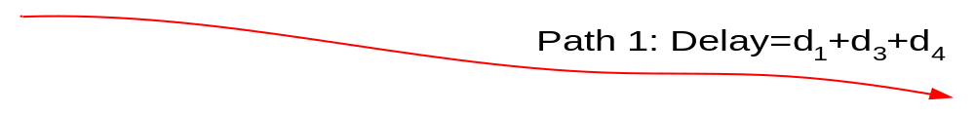
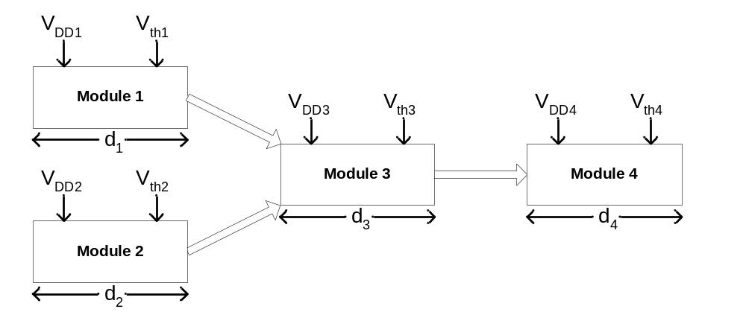
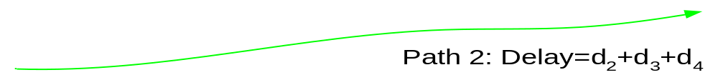

Problem Definition
Deadline,

Slide 3
Goal
Find the supply and threshold voltages to be assigned to modules such that:
  Energy is minimized
  System delay remains unaffected

Slide 4
Contributions
Obtained a minimum energy condition on supply and threshold voltages
  Applied Lagrange Multiplier Method
  Developed an iterative gradient search algorithm which rapidly converges to the optimum voltage values
Developed a heuristic approach to cluster the optimum voltages into a limited number of supply and threshold voltages

Slide 5
Overview
Module Level Delay/Energy Models
Lagrange Multiplier Formulation
Gradient Search Algorithm
Clustering Heuristic
Experimental Results
Conclusion

Slide 6
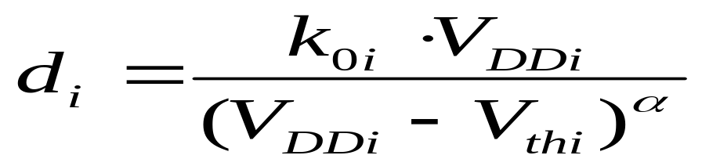
Module Level Delay Model
    V_{DDi} : Power supply voltage applied to the i^{th} module
    α : Velocity saturation coefficient
    V_{thi} : Threshold voltage
    k_{0i} : Delay constant
    To ↓ delay: ↑ V_{DD}, ↓ V_{th}

Slide 7
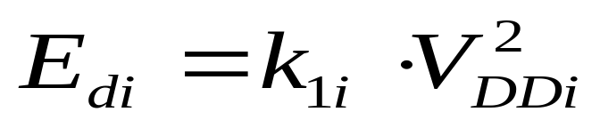

Dynamic Energy Model
Model for dynamic energy dissipation
  V_{DDi} : Power supply voltage applied to the i^{th} module
  k_{1i} : Energy constant
  k_{1i} includes the effect of both switching and short-circuit energies
  To ↓ E_{d}: ↓ V_{DD}

Slide 8
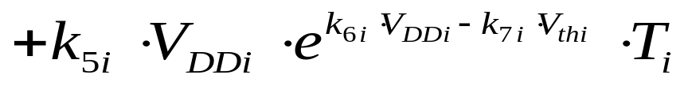
Static Energy Model
Model for static energy dissipation
  k₂, k₅ : circuit-dependent parameters
  k₃, k₄, k₆, k₇ : process-dependent parameters
  To ↓ E_{s}: ↓ V_{DD}, ↑ V_{th}

Slide 9
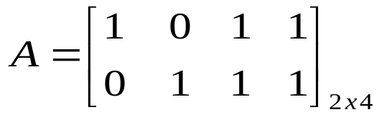

Problem Formulation
Deadline,

Slide 10
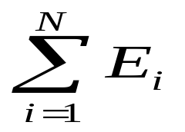
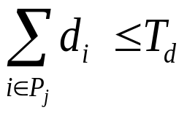
Problem Formulation
Minimize under the constraints for all paths P_{j}
  E_{i} = E_{di} + E_{si}
  T_{d} is the time constraint
  V_{DDi} and V_{thi} are the variables for each module

Slide 11
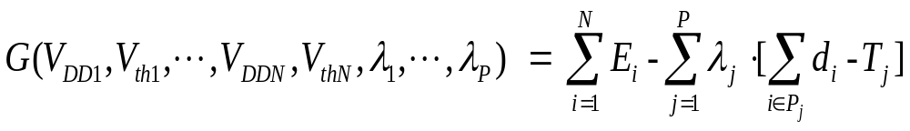
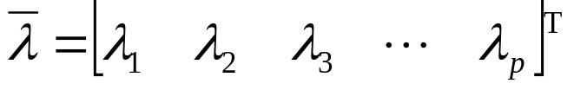
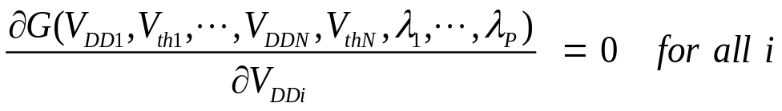
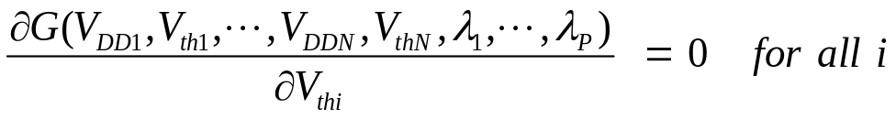
Lagrange Multiplier Formulation
where λ_{j} is the Lagrange Multiplier for the j^{th} path
For minimum energy consumption:

Slide 12
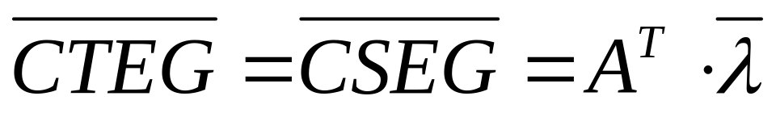
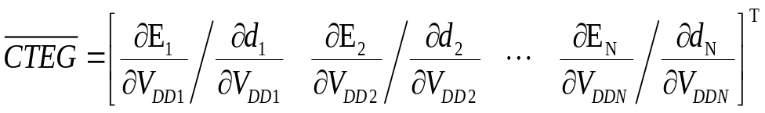
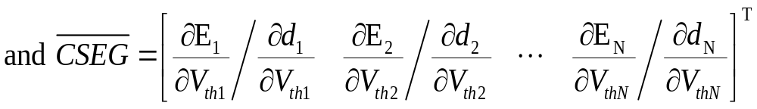
Minimum Energy Condition
  Given delay d_{i} for module i, the energy consumed by the module is minimized when
    CTEG_{i}=CSEG_{i}
Constant Threshold Energy Gradient
Constant Supply Energy Gradient

Slide 13
Gradient Search Algorithm
Step 1: Give initial delays to the modules trying to make all the path delays as close to T_{d} as possible
  Use the Zero Slack Algorithm
Step 2: For the given delay d_{i} for the i^{th} module, solve CTEG_{i}=CSEG_{i} to get V_{DDi} and V_{thi} for that module

Slide 14
Gradient Search Algorithm
Step 3: Calculate the cost for the current iteration using V_{DD} and V_{th} values
  At the minimum energy point, cost will be zero
Step 4:
  If cost is less than a predetermined value, done
  Else, continue to Step 5

Slide 15
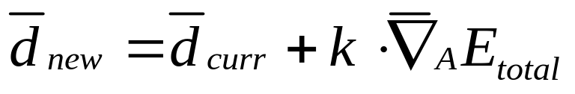
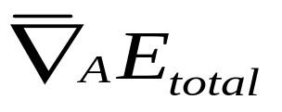
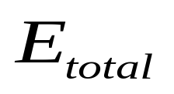
Gradient Search Algorithm
Step 5: Assign new delays to the modules
  is the gradient of along the null space vectors of A
  Adding a delay vector in the null space of A to the current delay values guarantees that the path delays do not change
  Go to Step 2

Slide 16

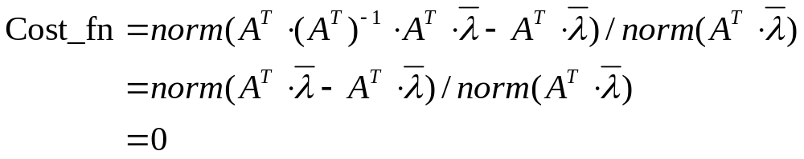
Note about Cost Function
At minimum energy,
Designers can use Cost_fn to evaluate the energy efficiency of their designs

Slide 17
Clustering Heuristic
Assume p supply voltages and q threshold voltages are available (p<N, q<N)
Step 1: Obtain initial values for the p V_{DD_p}s and q V_{th_q}s from the N optimum V_{DD_opt}s and V_{th_opt}s
Step 2: For every module i, find nearest pair [V_{DD_p}(m),V_{th_q}(n)] to [V_{DD_opt}(i),V_{th_opt}(i)] and assign to [V_{DDi},V_{thi}]

Slide 18
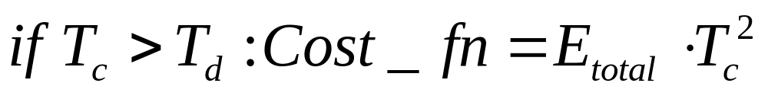
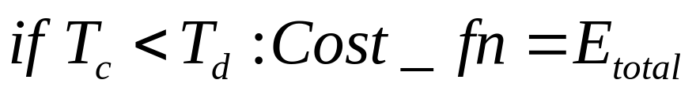
Clustering Heuristic
Step 3: Calculate the critical path delay, T_{c}
  If T_{c} is close to the constraint, T_{d}, done
  Else, continue to Step 4
Step 4: Obtain new values for the p V_{DD_p}s and q V_{th_q}s using gradient search
  Two different cost functions used:
  Go to Step 2

Slide 19
Experimental Results
Algorithm applied to ISCAS’85 circuits and a Wallace tree multiplier
  Top level modules in the Verilog description were directly mapped to the modules used in the optimization
The process-dependent parameters (k₃, k₄, k₆, k₇) were obtained from SPICE simulations of an inverter
The circuit-dependent parameters (k₀, k₁, k₂, k₅) were obtained using Synopsys Design Compiler with TSMC 0.25µ library

Slide 20
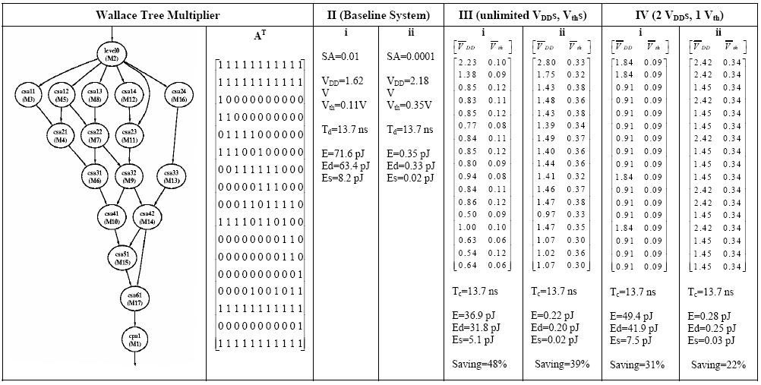
Optimizing a
Wallace Tree Multiplier

Slide 21
Baseline Circuits
(2 Switching Activities)

Slide 22
Unlimited # of V_{dd} and V_{th}

Slide 23
Clustering to 2 V_{dd} and 1 V_{th}

Slide 24
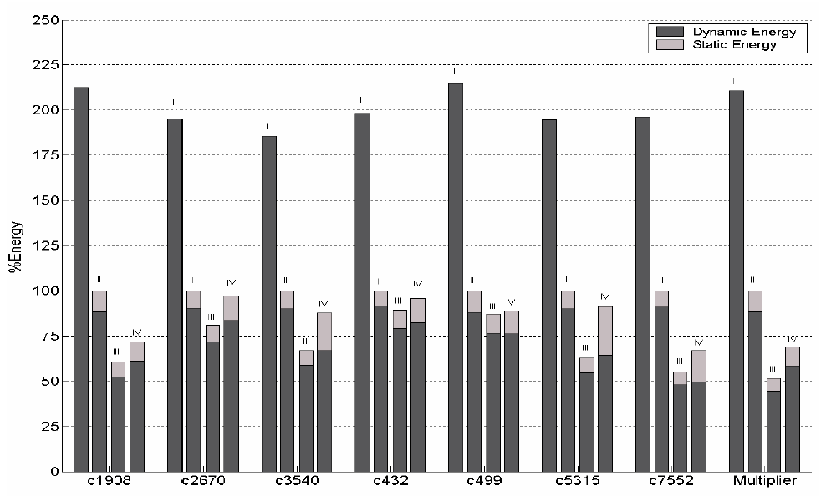
Summary of Energy Savings

Slide 25
Conclusion
Mathematical condition on the supply and threshold voltages of interconnected modules minimizes the total energy consumption under a delay constraint
Iterative gradient search algorithm rapidly converges to the optimum voltage values
Heuristic clusters the optimum voltages into a limited number of supply and threshold voltages
Achieve energy savings of up to 58.4% with unlimited number of V_{dd} and V_{th}

Slide 26
?

Slide 27
Backup Slides

Slide 28
Motivation and Goal
Usage of multiple supply voltage planes and multiple threshold voltages is becoming increasingly necessary in DSM VLSI design
  Lower power consumption without significant performance loss
Voltage optimization at gate level is highly complex
  Large numbers of paths have to be optimized for power
  The search space is huge
  Assigning different supply voltages at gate level is not technologically feasible

Slide 29
Motivation
Why optimize at module level ?
  Optimization at gate level is highly complex
    Large numbers of paths
    Search space is huge
    Assigning different supply voltages at gate level is not technologically feasible
  Number of paths is limited
  Different modules can be assigned different supply and threshold voltages

Slide 30
Summary of Delay/Energy Modeling
For any module:
  To ↓ delay: ↑ V_{DD}, ↓ V_{th}
  To ↓ E_{d}: ↓ V_{DD}
  To ↓ E_{s}: ↓ V_{DD}, ↑ V_{th}
For given fixed module delay, d_{i}, optimum V_{DDi} and V_{thi} values can be found that minimize E_{i}=E_{di}+E_{si}

