Slide 1
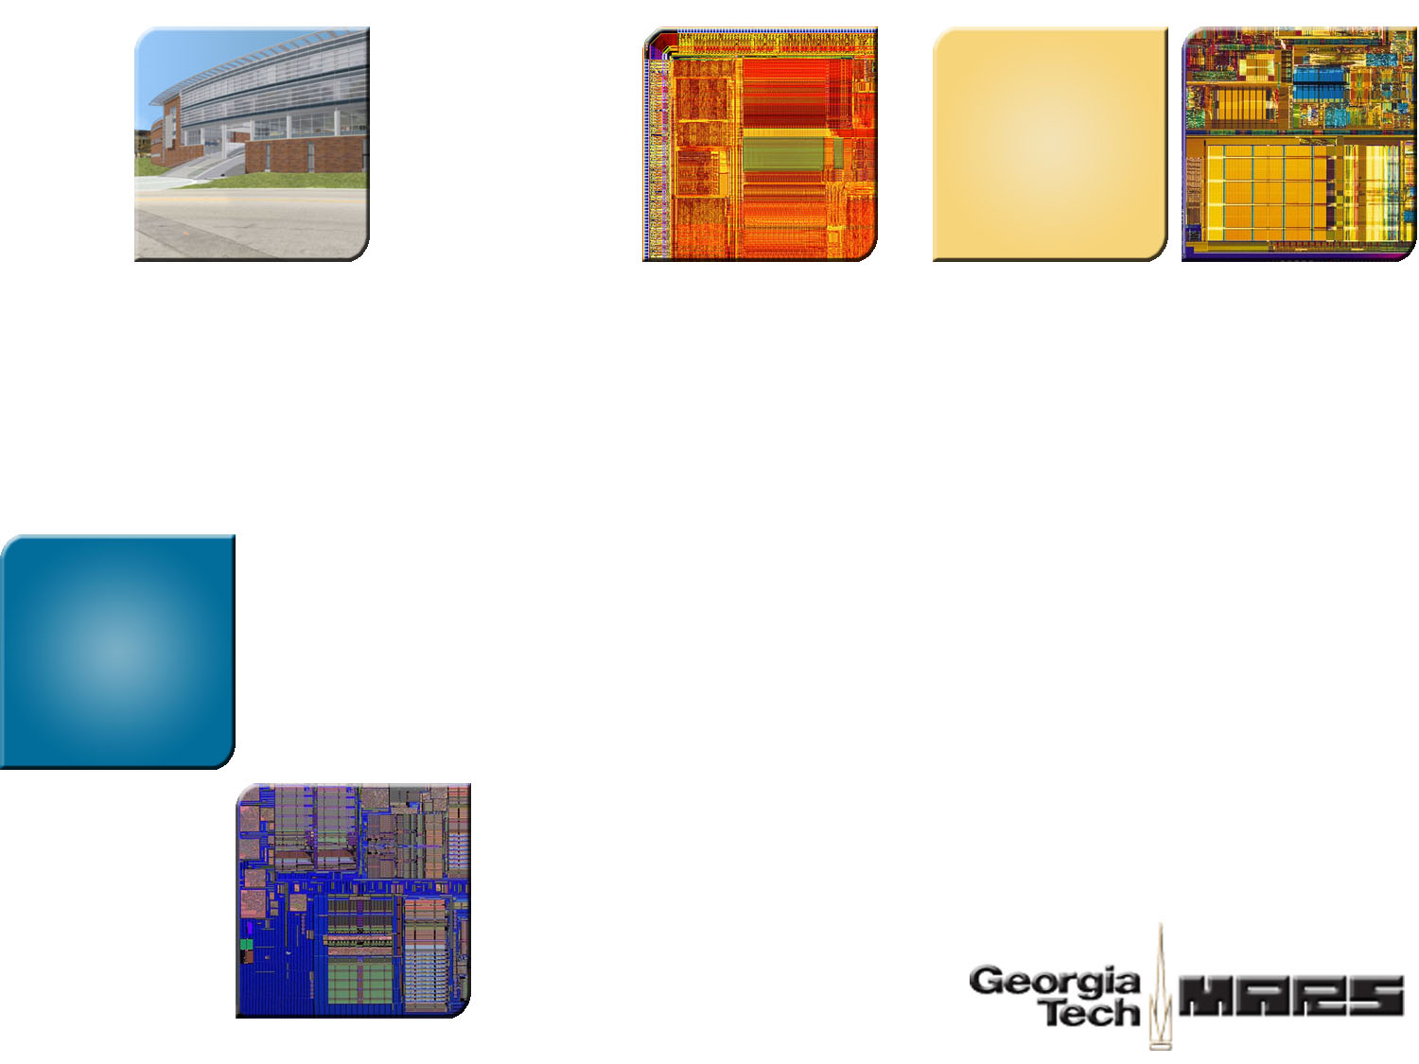

Virtual Exclusion: An Architectural Approach to Reducing Leakage Energy in Multiprocessor Systems
Mrinmoy Ghosh
Hsien-Hsin S. Lee
School of Electrical and Computer Engineering
Georgia Institute of Technology
Atlanta, GA

Slide 2
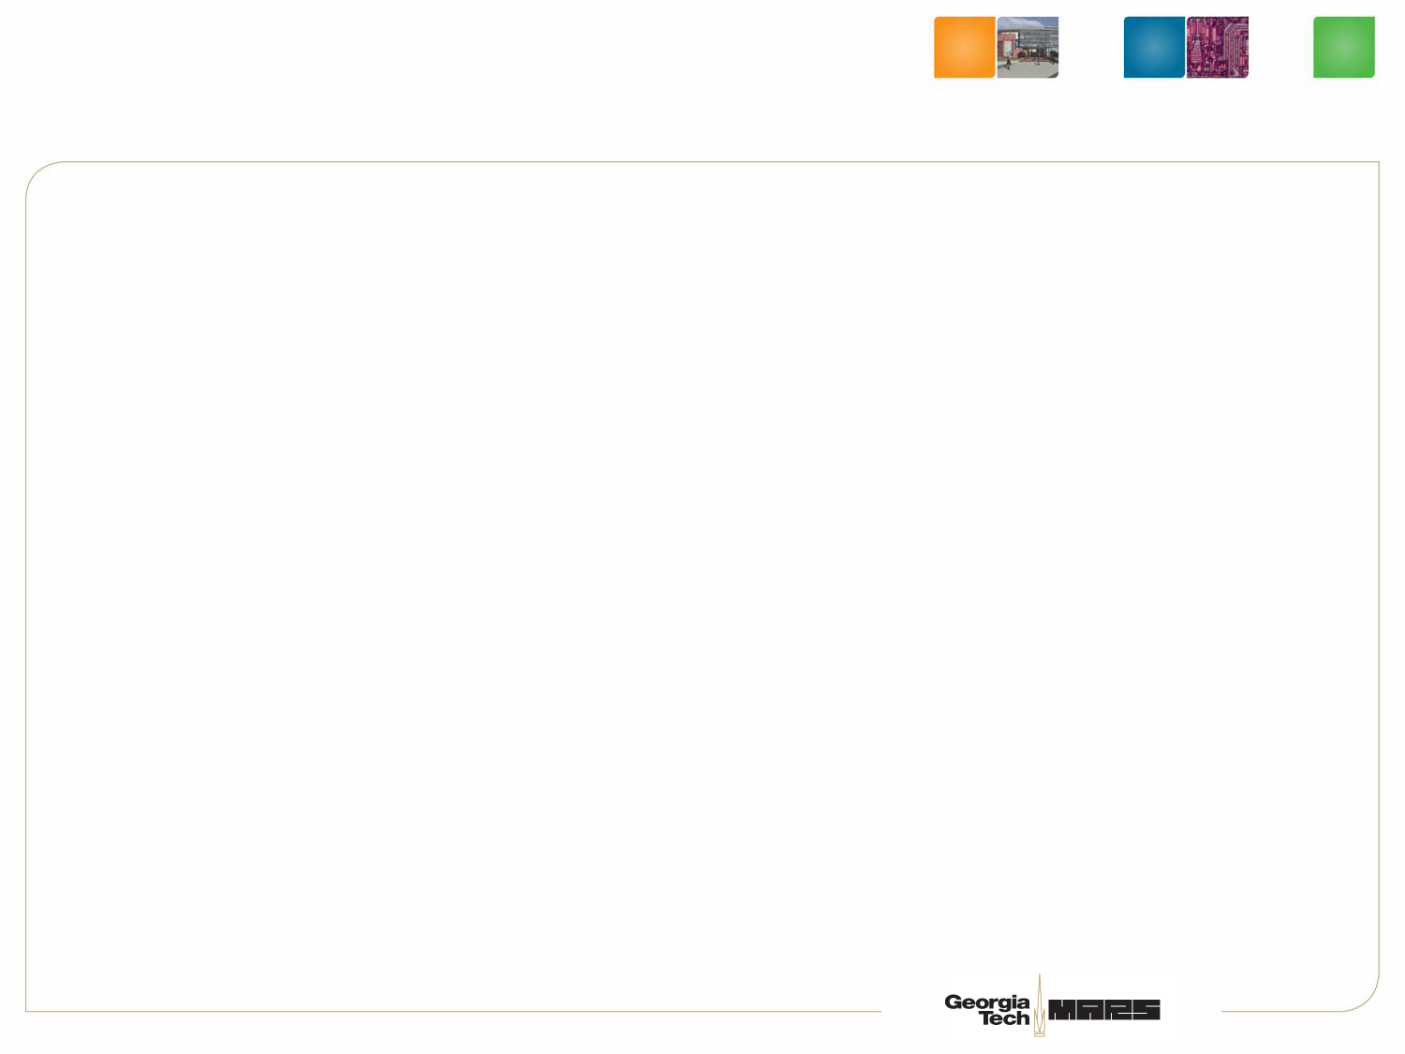
Multi-Level Inclusion in Caches
Definition of MLI:
  Cache Line present in lower level cache ➔ Cache Line present in higher level cache
Use of MLI:
  Facilitates efficient cache coherence implementation
  Shields lower level caches from snoop requests
Implementing MLI:
  “I” bit in cache tags
  Higher level cache gets info about clean evictions

Slide 3


IBM Power 4 Cache Hierarchy
Inclusion bits
L1$
L1 Tag
L2 Cache
1
Bus
snoop
Level 3 Cache
1.5MB L2 shared by 2 cores, with a 32MB L3
Inclusion maintained between L1 and L2
Inclusion indication can be false

Slide 4
Another Approach: Piranha CMP (Compaq)
Duplicate L1 tag and state
L2 controller
L2 Cache
L1$
L1 Tag
L1 Tag
Bus
snoop
8 cores (64KB I$ + 64KB D$, 1MB shared L2)
Aggregate L1 = 1MB = L2
No inclusion maintained

Slide 5

Power Implication in MLI Caches
Cache → larger → deeper
Moore’s law → more transistors for insurance?
L2 Cache
1
1
1
L1$
L1$
1
L1 Tag
L1 Tag
1
1
1
1
1
1
1
1
1
L1$
L1$
L1 Tag
L1 Tag
1
1
1
1
1
The same active information kept in both caches
With locality, L2 is rarely accessed

Slide 6
Prior Architectural Art in Saving Cache Leakage
Drowsy
Vdd
Vdd (1V)
BL
BL
Vdd Low (0.3 V)
Drowsy
Drowy Cache:
[ISCA-29][MICRO-35]
Could impact access latency
Cache Decay
[ISCA-28]
Could lead to more power
WL
Gated Vdd Control

Slide 7


Virtual Exclusion

Slide 8
Virtual Exclusion: L1 Cache Line Fill
Core
L1 Cache
2-Way L2 Cache
Tag
V
D
I
0x12341212ff001122301498ab34123445
0
Gated Vdd Control
Tag RAM
Data Array
Tag RAM
Data Array
Shared Bus

Slide 9
Virtual Exclusion: L1 Eviction
Core
L1 Cache
2-Way L2 Cache
Drowsy = 1
Vdd_low
Tag
V
D
I
0xffddeeaa109900110000001111111100
1
Gated Vdd Control
Tag RAM
Data Array
Tag RAM
Data Array
Shared Bus

Slide 10
Protocol Change ─ Snoop Forwarding
Core
L1 Cache
Forward Snoop to L1
2-Way L2 Cache
Tag
V
D
I
Tag RAM
Data Array
Tag RAM
Data Array
Snoop
Request
Shared Bus

Slide 11
Protocol Change ─ Write Invalidation
Core
L1 Cache
L1 Cache Write Notification
2-Way L2 Cache
Tag
V
D
I
Tag RAM
Data Array
Tag RAM
Data Array
Invalidation Request
Shared Bus

Slide 12

Modified Cache Decay

Slide 13
Modified Cache Decay for MLI: L2 Line Fill
Decay of counter continues even if line is in L1 Cache
Core
L1 Cache
Decay Counter
2-Way L2 Cache
Tag
DC
I
0x12341212ff001122301498ab34123445
Tag
DC
I
Tag RAM
Data Array
Tag RAM
Data Array
L2 Linefill
Shared Bus
Memory

Slide 14
Modified Cache Decay for MLI : L1 Eviction
Core
Decay of counter
unaffected by L1 Eviction
L1 Cache
Eviction
2-Way L2 Cache
Tag
DC
I
Tag
DC
I
Tag RAM
Data Array
Tag RAM
Data Array
Shared Bus
Memory

Slide 15
Modified Cache Decay for MLI: L2 Hit
Core
L1 Cache
Access hits L2 Cache
2-Way L2 Cache
Tag
DC
I
0x12341212ff001122301498ab34123445
Tag
DC
I
Tag RAM
Data Array
Tag RAM
Data Array
Shared Bus
Memory

Slide 16
Hybrid Virtual Exclusion
Observation:
  Cache decay starts decaying when L1 has high locality
Hybrid Virtual Execution does
  Virtual Execution when L1 has high locality
  Start decaying after L1 eviction

Slide 17
Hybrid Virtual Exclusion: L2 Line Fill
Core
L1 Cache
L1 & L2 virtually exclusive
2-Way L2 Cache
Tag
DC
I
0x12341212ff001122301498ab34123445
Tag
DC
I
0
Gated Vdd Control
Tag RAM
Data Array
Tag RAM
Data Array
L2 Linefill
Shared Bus
Memory

Slide 18
Hybrid Virtual Exclusion: L1 Eviction
Core
Decay starts only after line is evicted from L1
L1 Cache
Eviction
2-Way L2 Cache
Tag
DC
I
0x12341212ff001122301498ab34123445
Tag
DC
I
Tag RAM
Data Array
Tag RAM
Data Array
Shared Bus
Memory

Slide 19
Experimental Framework
Single processor model | Ultra Sparc T1 like (Niagara)
L1 data/instruction cache | 2-way 16KB, 64 byte line
L2 caches | 8-way 256KB, 512KB
L1 access | 1 cycle
L2 access (Shared for Multi-Core) (Private for SMP) | 10 cycles (normal) 12 cycles (drowsy)
Memory access | 200 cycles
DRAM | 256MB (conservative base)
Energy Baseline | Drowsy cache scheme
M5 simulator from Michigan
System level emulation
Power models integrated into M5
  ECacti from UC Irvine (leakage + dynamic)
  MICRON DRAM datasheet
2P, 4P, & 8-P SMP
Dual, Quad, & Oct- Multicore
Benchmark workload
  SPLASH-2 (ran to completion)
  SPEC 2000

Slide 20
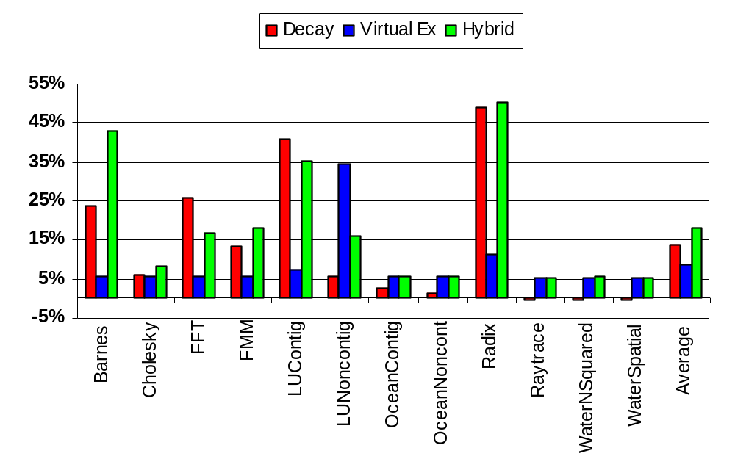
Leakage Energy Reduction (2-way SMP)

Slide 21
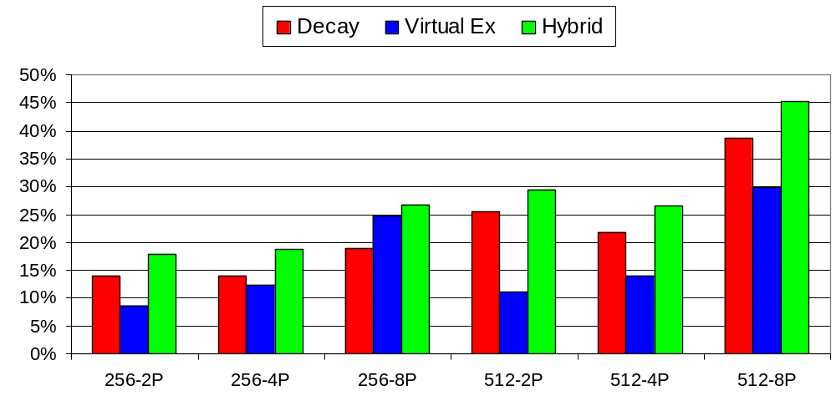
Leakage Energy Reduction (Various SMPs)
Average of SPLASH2 benchmark

Slide 22
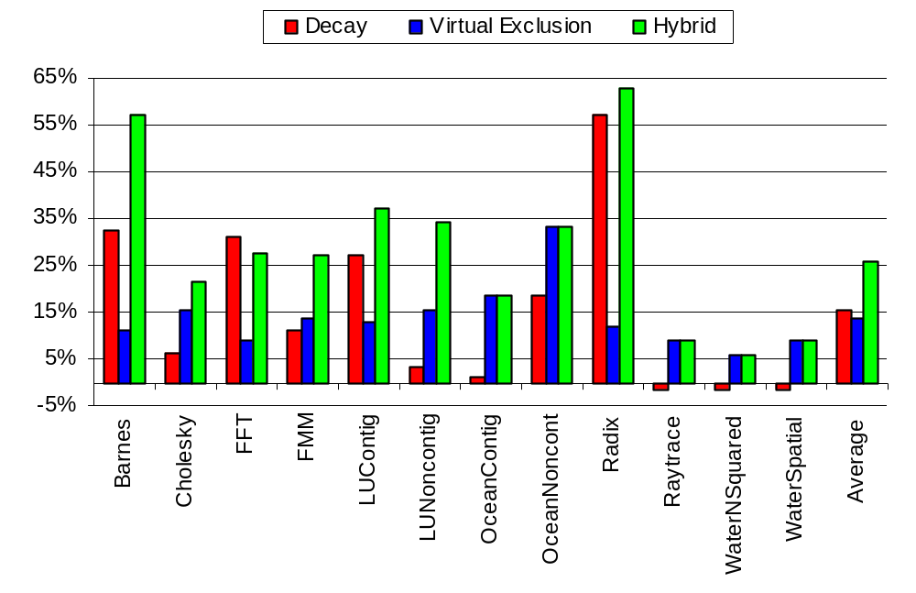
Leakage Energy Reduction (4-way Multi-Core)

Slide 23
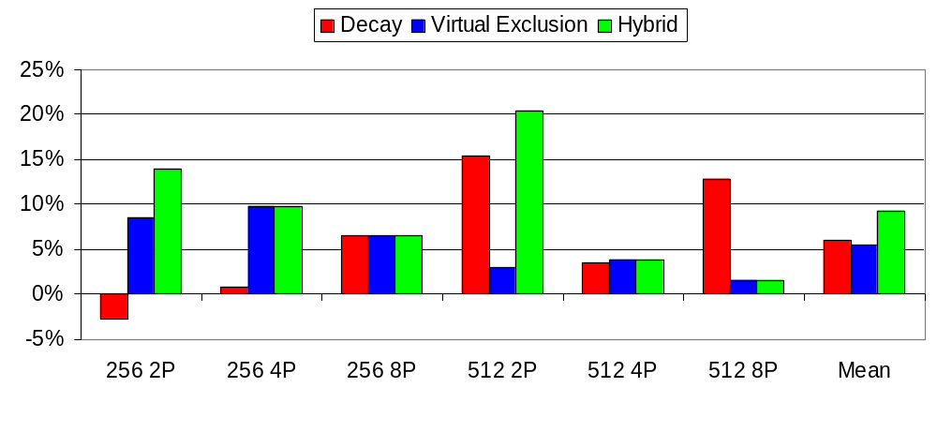
Leakage Energy Reduction (Various Multi-Cores)
Configuration | SPEC 2000 benchmark mix
2-way Multicore | bzip, gzip
4-way Multicore | bzip, gzip, crafty, gap
8-way Multicore | 2x (bzip, gzip, crafty, gap)

Slide 24
Conclusions
Prior art can violate Multi-level Inclusion for cache coherence protocols
Virtual Exclusion
  Maintain correctness for Multi-Level Inclusion
  Low overhead architectural approach
  Enhanced Cache Decay to work correctly with MLI
Significant energy savings over a drowsy cache baseline
  Symmetric Multiprocessors (46% for 8-way, SPLASH2)
  Multi-Core processors (35% for 4-way, SPLASH2)

Slide 25
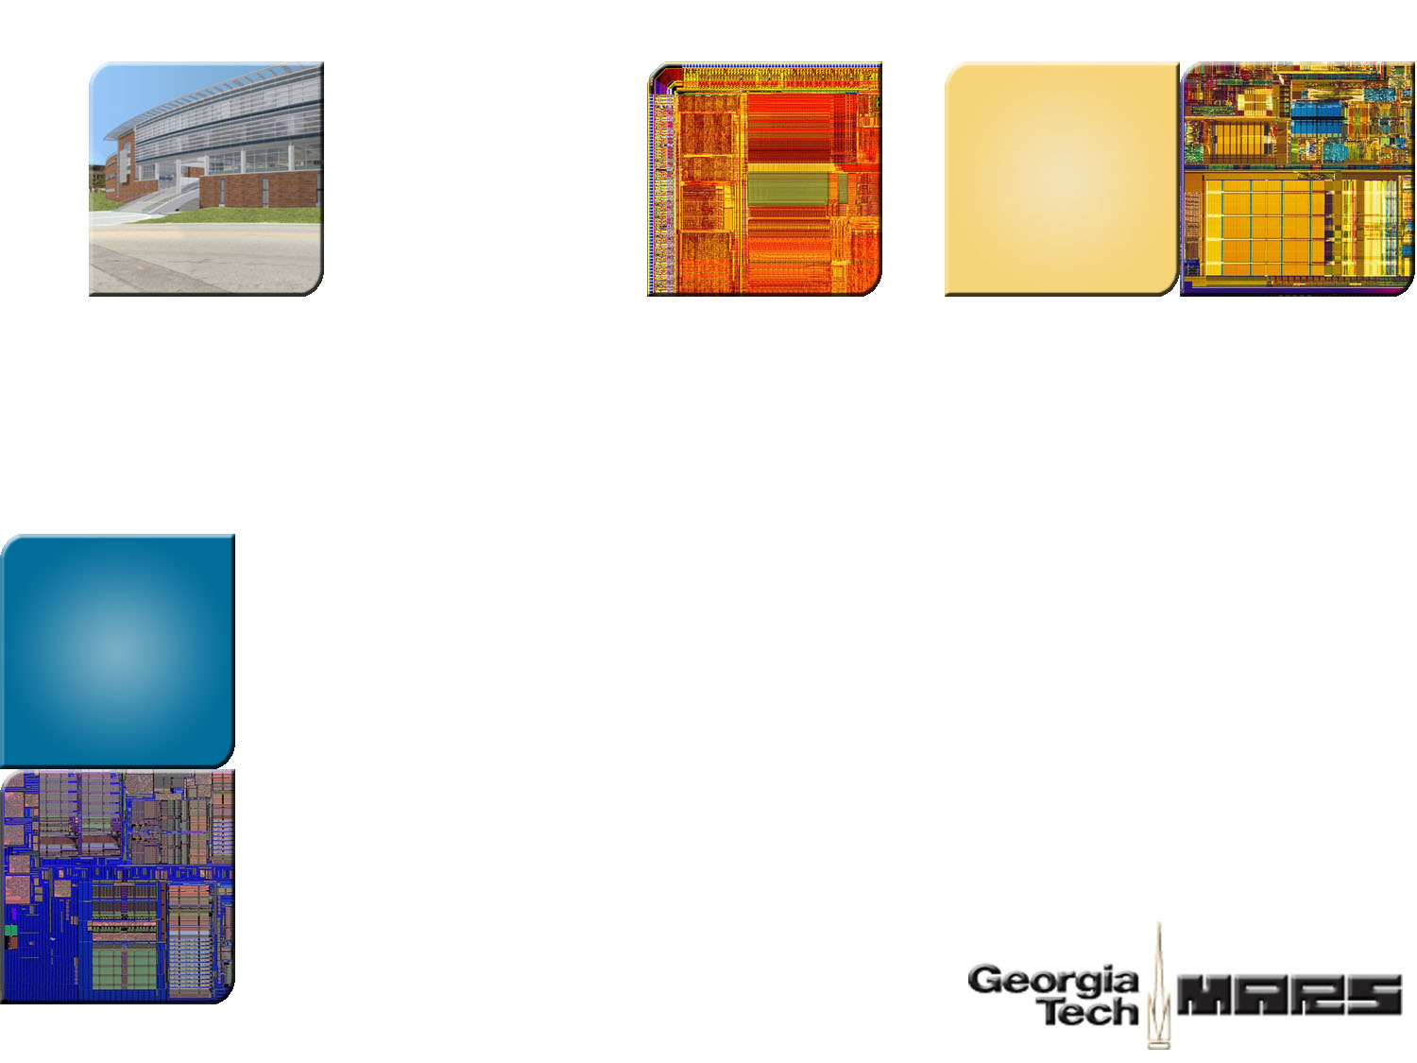

Thank You!
Georgia Tech
ECE MARS Labs
http://arch.ece.gatech.edu

Slide 26
BACKUP

Slide 27
Prior Architectural Art in Saving Cache Leakage
Cache Decay [ISCA-28]
  Use Gated-Vdd
  Turn off cache lines when not used for a while
  Can lead to more power consumption
  Did not consider cache coherence
Drowsy Cache [ISCA-29][MICRO-35]
  Maintain state in low leakage drowsy mode
  Has latency implication

