Slide 1
A Hardware-based Cache Pollution Filtering Mechanism for Aggressive Prefetches
Xiaotong Zhuang Hsien-Hsin Sean Lee
School of Electrical and
Computer Engineering
College of Computing
Georgia Institute of Technology
Atlanta, GA 30332
ICPP, Kaohsiung, Taiwan, 2003

Slide 2
Agenda
Introduction
Motivation
The Prefetch Pollution Filter
Experimental Results
Conclusion

Slide 3
Agenda
Introduction
Motivation
The Prefetch Pollution Filter
Experimental Results
Conclusion

Slide 4
Data Prefetching
Why data prefetching?
  Speed gap between CPU and main memory
  Initial data references still miss
  Performance suffers if no enough independent instructions to mask the latency
Prefetching techniques
  Hardware-based
  Software-based
Design Trend
  Memory bandwidth increase ⇒ more aggressive prefetch
  L1 cache is getting smaller for expediting accesses
When prefetching becomes “too aggressive”
  Severe pollution
  Performance overkill

Slide 5
Cache Pollution
Source of pollution
  No prefetching guarantees 100% accuracy
  HW-based prefetching can cause a lot of pollution
  Stride-based prefetching can easily become ineffective for pointer-based applications
Outcomes of pollution
  Evict useful data
  Compete for available resources
    Limited size of cache capacity
    Cache ports
    Bus bandwidth between components of memory hiearchy
  Degrade performance

Slide 6
Related Work
Prefetch buffer [Chen et al. ‘91] [Chen & Baer ‘95]
  Separate normal and prefetched data, access in parallel
  Small-size, fully-associative, in critical path
Evict-me [Wang et al. ’02]
  Reuse distance check, mark unused or distance too long
  Evict-me data have higher priority to be cast out
Dead cache line detection [Lai, Fide & Falsafi ’01]
  Detect dead blocks and replace with useful prefetches
  Prevent useful data from being evicted
Prefetch taxonomy [Srinivasan et al. ‘99]
  More detailed classification of prefetches
  Proposed “static filter”—profiling based pollution filtering

Slide 7
Our Contribution
Characterization of prefetch effectiveness
Propose and evaluate two hardware prefetch pollution filtering mechanisms
  Per-Address (PA) based
  Program Counter (PC) based
Quantify our technique through simulation

Slide 8
Agenda
Introduction
Motivation
The Prefetch Pollution Filter
Experimental Results
Conclusion

Slide 9
Prefetch Classification
Prefetch classification
  Comprehensive classification is not desirable due to its implementation complexity in hardware
  Good or effective— those referenced in the cache before they are evicted
  Bad or ineffective — those never referenced during their lifetime in the cache

Slide 10
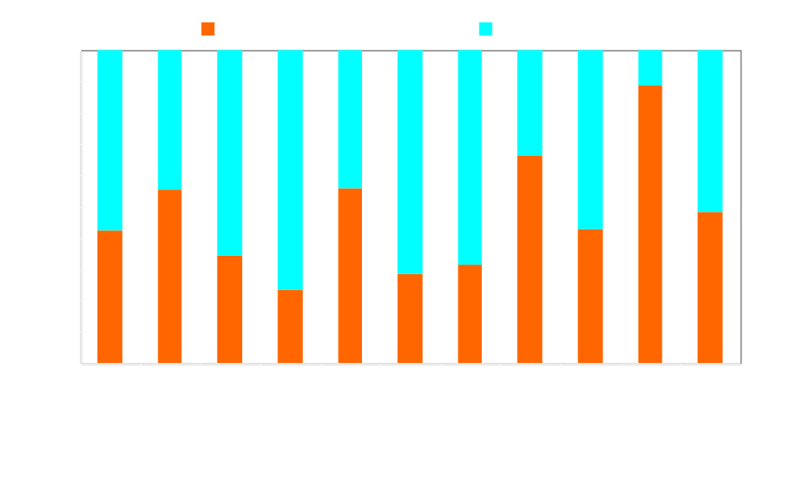
Prefetch Effectiveness
Normalized # of Prefetches
11 benchmarks, HW prefetch—NSP, SDP, SW prefetch
More than 52% prefetches are bad!!

Slide 11
Agenda
Introduction
Motivation
The Prefetch Pollution Filter
Experimental Results
Conclusion

Slide 12
Cache Pollution Filter
Prefetch Pollution Filter
History Table
array of 2-bit counters
OOO Core
Ld/st inst includ.
SW prefetches
Prefetch Queue
Issue Prefetch
LD/ST Queue
SW Prefetches
Hash
lookup
L1 Cache
Hardware
Prefetcher
Update
L2 Cache
TAG
DATA
Prefetch Indication bit (PIB)
Reference Indication Bit (RIB)

Slide 13
Prefetch Pollution Filters
PA-based
  Per-Address-based, track cache line addresses issued by each prefetch operation
  Can distinguish different prefetch addresses by the same issuing instruction
  Need longer history table to reduce aliasing
PC-based
  Track the program counter that triggers a prefetch
  SW prefetch: PC of the prefetch instruction
  HW pretetch: the memory instruction that triggers the prefetch
  Less aliasing, tolerate smaller history table, less precise

Slide 14
Agenda
Introduction
Motivation
The Prefetch Pollution Filter
Experimental Results
Conclusion

Slide 15
Simulation Configuration (Default)
Processor
Caches
Target frequency
2GHz
L1 I/D
8K, 32-byte line
DM, 1 cycle
Issue/retire width
8 per cycle
Reorder bufer
128 entries
L1 D ports
3
Load/store queue
64 entries
L2 I/D
512K 32-byte line
4 way 15 cycle delay
Branch Predictor
Bimodal with 2048 entries
L2 I/D ports
1
BTB size
4096 sets, assoc=4
Prefetcher
Memory
Queue Len
64 entries
Latency
150 core cycles
Pollution Filter
Bus
64 byte wide
Hist table
1KB, 4K entries

Slide 16
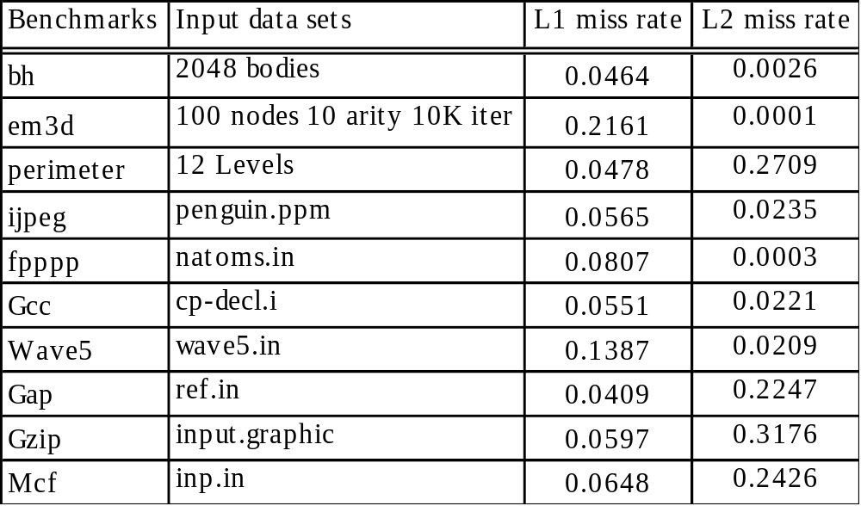
Benchmarks and Miss Rates

Slide 17
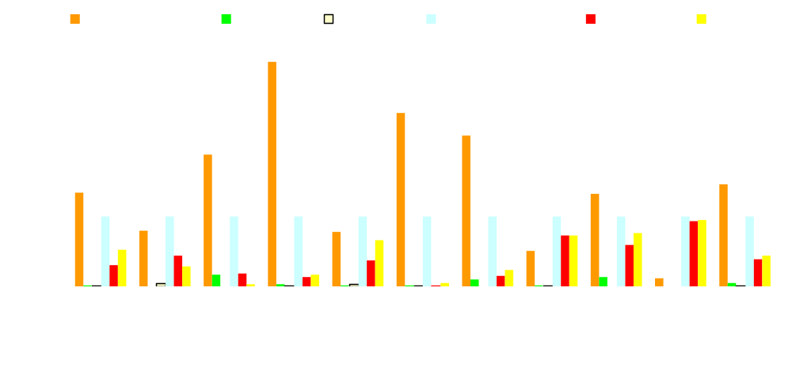
Prefetch Reduction Comparison (Default Model)
Normalized # of Prefetches
Normalized to the good one without filtering
Loss of bad prefetches: 97%(PA) 98%(PC)
Loss of good prefetches: 51%(PA) 48%(PC)
Traffic reduction: 75%(PA) 74%(PC)

Slide 18

IPC Comparison
(Default Model)
IPC
Increase: 8.2%(PA) 9.1%(PC)

Slide 19
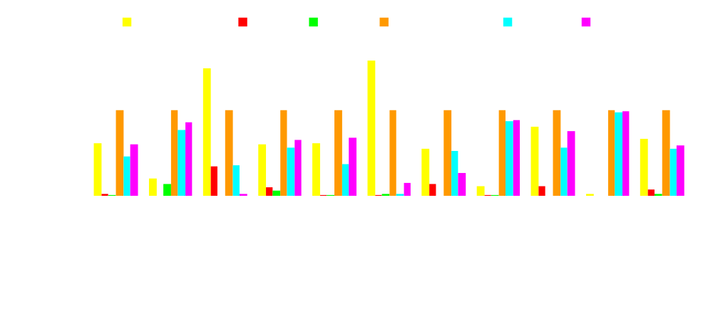
Prefetch Reduction Comparison Comparison (32KB)
Loss of bad prefetches: 91%(PA) 92%(PC)
Loss of good prefetches: 35%(PA) 27%(PC)
Traffic reduction: 52%(PA) 47%(PC)

Slide 20
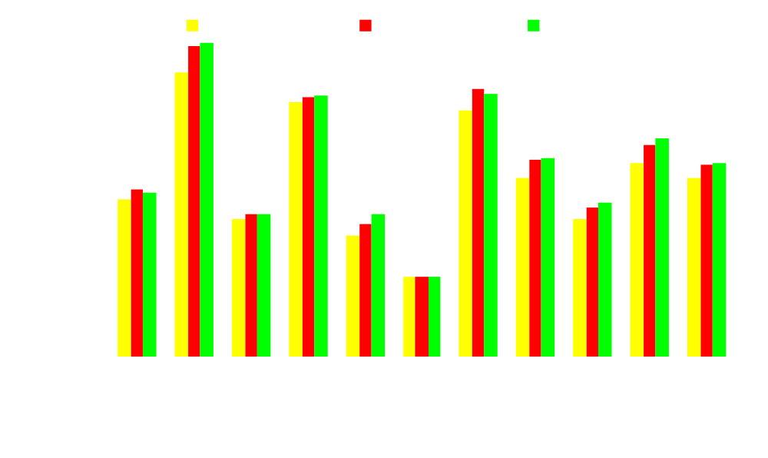
IPC Comparison
(32K Cache Model)
IPC
Increase: 7.0%(PA) 8.1%(PC)

Slide 21

IPC for Different History Table Sizes
IPC
Jump at 2k-4k, 6% <1% before & after

Slide 22
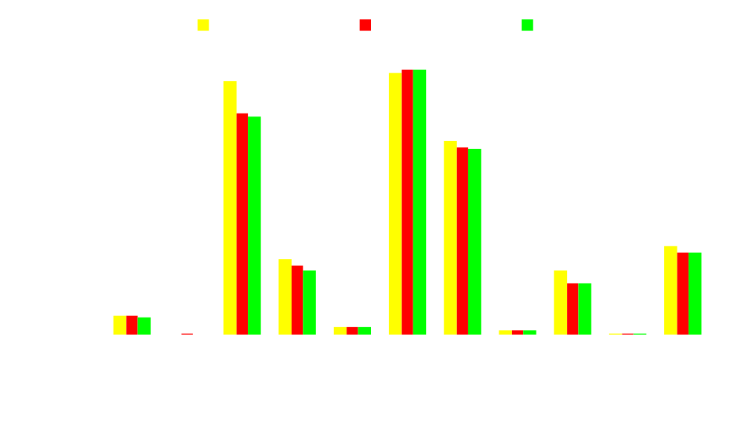
Bad/Good Prefetch Ratio for Different # of L1 Ports
Bad/Good Prefetch Ratio
6% drop from 3-port to 4-port, 2% drop from 4-port to 5-port

Slide 23
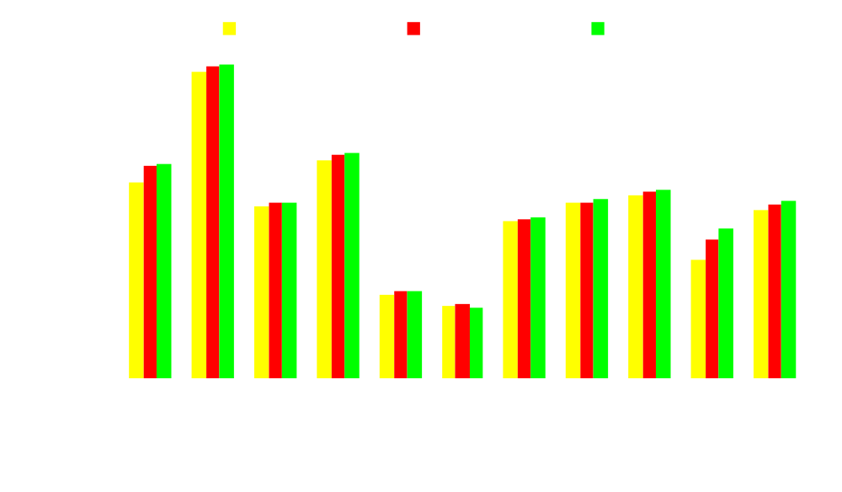
IPC for Different # of L1 Ports
IPC
4% speedup from 3-port to 4-port, <1% speedup from 4-port to 5-port

Slide 24
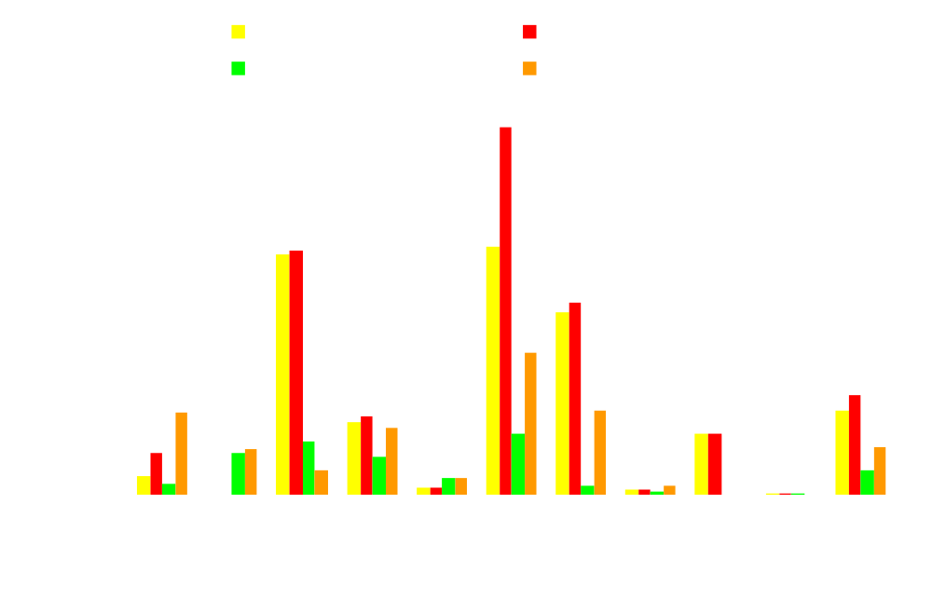
Bad/Good Prefetch Ratio w/ Prefetch Buffer
Prefbuf, on critical path, very small
Prefbuf, no reduction in traffic, short lifetime for good prefetch

Slide 25
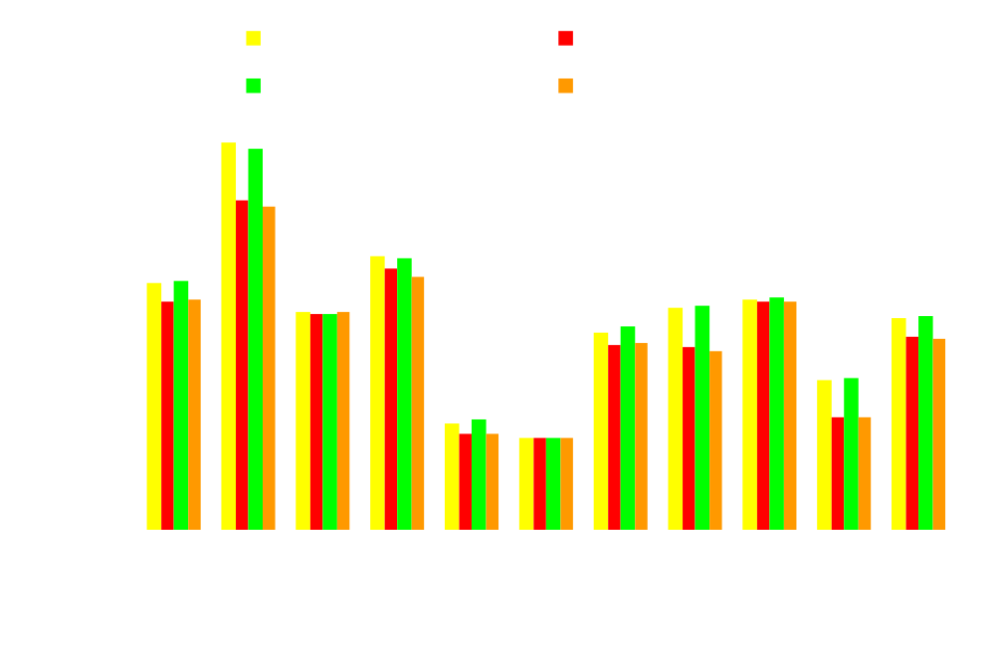
IPC Comparison w/ Prefetch Buffer
IPC
IPC Loss: 9% (PA) 10%(PC)

Slide 26
Agenda
Introduction
Motivation
The Prefetch Pollution Filter
Experimental Results
Conclusion

Slide 27
Conclusion
Too aggressive prefetching is an overkill
Lots of prefetches are ineffective
  Cannot remove SW-induced prefetches without source code
  Have to live with HW-induced prefetches
  Need dynamic HW-based prefetch filtering schemes
We propose (1) Per-Address-based and (2) Program-Counter-based that can
  Filter out ~98% bad prefetches for 8KB L1
  Filter out ~92% bad prefetches for 32KB L1
  Most good prefetches are retained ~50%(8K L1) ~70%(32K L1)
Improvement
  Traffic reduced by ~75%(8K L1) ~50%(32K L1)
  Overall IPC improved by 7% to 9%
History table size can be reasonably small
Improvements decrease when more cache ports are added
IPC loses (9-10 %) with dedicated prefetch buffer for aggressive prefetching

Slide 28

That’s All Folks !
Thanks Archbeer!

Slide 29
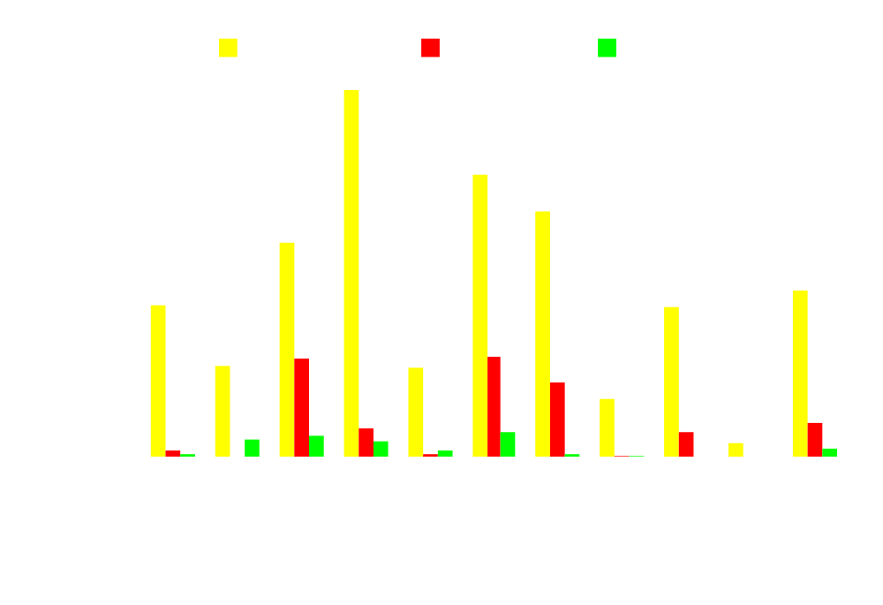
Bad/Good Prefetch Ratio Comparison (Default Model)
Bad/Good Prefetch Ratio
Reduction: 70%(PA) 91%(PC)

Slide 30
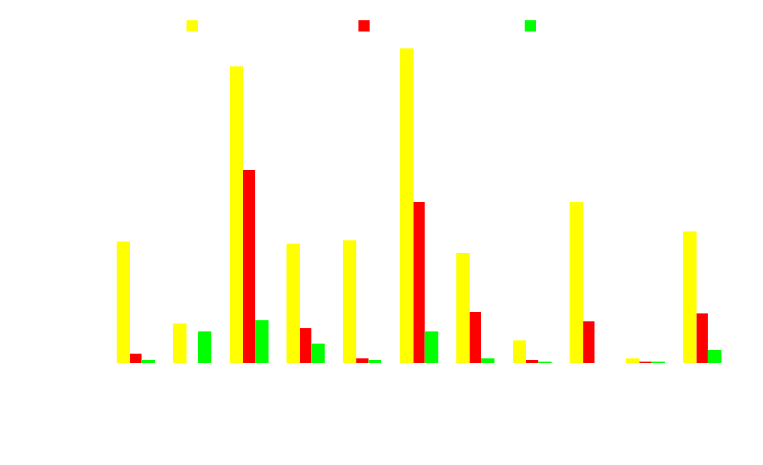
Bad/Good Prefetch Ratio Comparison (32KB)
Bad/Good Prefetch Ratio
Reduction: 75%(PA) 93%(PC)

