Slide 1
Constructing a Non-Linear Model with Neural Networks for Workload Characterization
Richard M. Yoo
Han Lee
Kingsum Chow
Hsien-Hsin S. Lee
Georgia Tech
Intel Corporation
Intel Corporation
Georgia Tech

Slide 2
Java Middleware Tuning
Workload tuning
  Finding the best workload configuration that brings about the best workload performance
  configuration parameters: things we have control over
    thread pool size, JVM heap size, injection rate, etc.
  performance indicators: workload behavior in response to configurations
    response time, throughput, etc.
Java middleware tuning
  Inherently complicated due to its nonlinearity

Slide 3
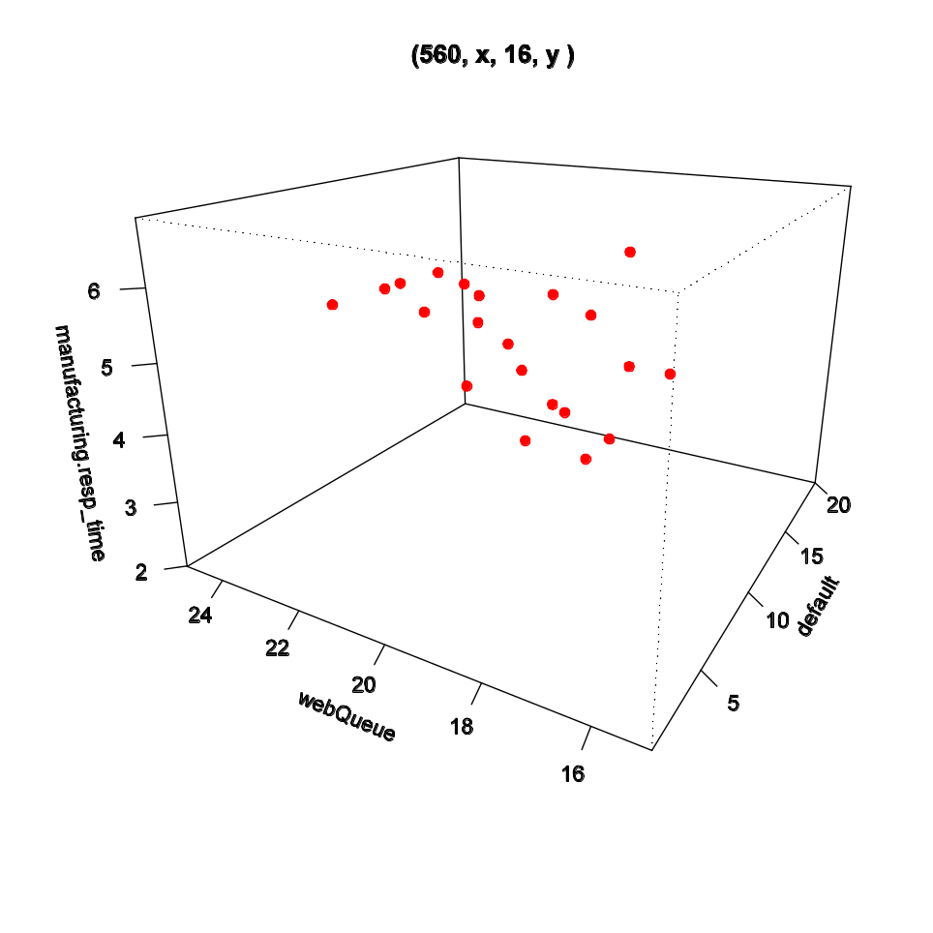
Nonlinear Workload Behavior
The performance of a workload does not necessarily improve or degrade in a linear fashion in response to a linear adjustment in its configuration parameters
  Hard to predict the performance change with respect to configuration changes
  Lottery
Sample data distribution from
a case study

Slide 4
Nonlinear Behavior in Java Middleware
Dominant in Java middleware behavior due to its stacked execution environment
Application
Java Application Server
Java Virtual Machine
Operating System
Hardware
A stacked execution environment

Slide 5
A Model Based Approach
Regard the relation between the m configuration parameters and the n performance indicators as an m -> n nonlinear function
Map the workload tuning problem to a nonlinear function approximation problem
Workload
f(x)
Configuration Parameters
X₁, X₂, … , X_{m}
Performance Indicators
Y₁, Y₂, …, Y_{n}

Slide 6

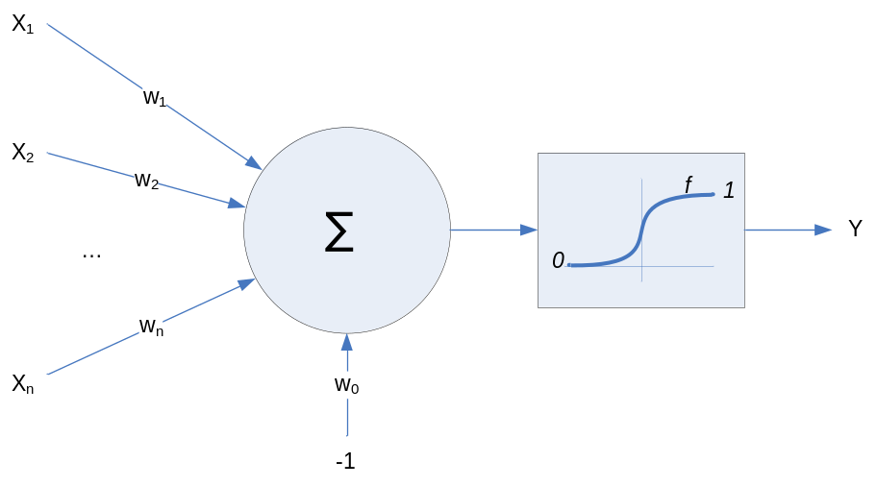
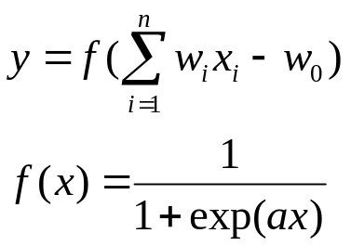
Function Approximation with Neural Networks
Artificial Neural Networks
  A network of many computational elements called perceptrons
  Weighted sum of inputs + nonlinear activation function
  Learn the input by adjusting the weights to minimize the prediction error for Y
  Depending on the structure and organization of perceptrons, many neural networks exist
A typical structure of a perceptron

Slide 7
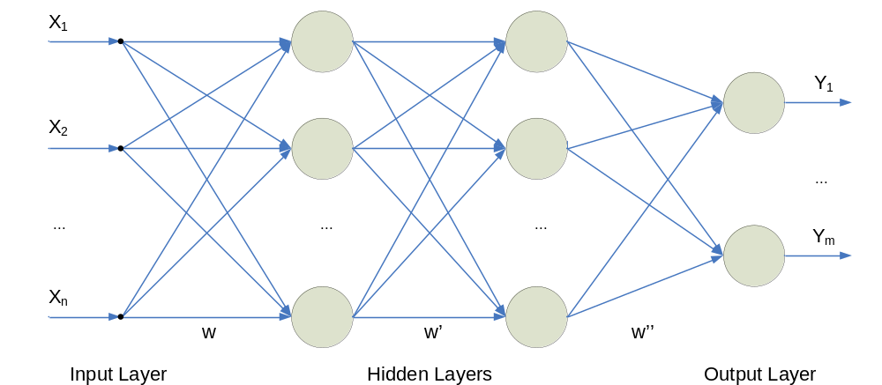
Multi-Layer Perceptrons (MLPs)
A stacked layer of multiple perceptrons
A feed-forward network
  Output from previous layer feeds the next layer
A perceptron
X₁
Y₁
X₂
Y_{m}
X_{n}
A 3-layer perceptron

Slide 8
Training MLPs
Backpropagation algorithm
  By far the most popular method (standard)
  Propagate the error of outer layer back to inner layer (blaming)
  Each layer calculates its local error that contributed to the outer layer’s error
  Adjust each layer’s weight to minimize the local error
X₁
Y₁
Y₁
X₂
Y_{m}
Y_{m}
X_{n}
A 3-layer perceptron

Slide 9
Reason for Choosing MLP
Among many neural network configurations,
  MLPs excel in function approximation
    Can approximate any nonlinear function
  MLPs are widely used in function approximation and pattern classification area

Slide 10
Training the Neural Network
Neural networks are trained with samples
Each sample is a tuple comprised of configuration parameter settings and the corresponding performance indicator values
  (X₁, X₂, … , X_{m}, Y₁, Y₂, …, Y_{n})
Present each performance sample to the neural network multiple times
X₁
Thread pool size
X₂
JVM heap size
Y₁
Response time
f(x)
10
256
13
12
256
10
10
512
9
12
512
7

Slide 11
Training the Neural Network
When presented with each samples, based on the previous knowledge, neural network tries to predict the performance indicator Y’₁, Y’₂, …, Y’_{n} by observing given configuration settings X₁, X₂, … , X_{m}
X₁
Thread pool size
X₂
JVM heap size
Y₁
Response time
f(x)
10
10
256
256
13
10?
12
256
10
10
512
9
12
512
7

Slide 12
Training the Neural Network
At the same time, neural network learns the samples by minimizing the error between predicted performance values (Y’₁, Y’₂, …, Y’_{n}) and the actual performance values (Y₁, Y₂, …, Y_{n})
10
256
10?
X₁
Thread pool size
X₂
JVM heap size
Y₁
Response time
error = 3
f(x)
10
256
13
12
256
10
10
512
9
12
512
7

Slide 13
Training the Neural Network
Process repeats over the entire samples, multiple times
Training stops when a desired minimum error bound is reached
X₁
Thread pool size
X₂
JVM heap size
Y₁
Response time
10?
11?
8?
9?
12?
10?
f(x)
10
256
13
3
1
1
2
1
0
12
256
10
10
512
9
12
512
7

Slide 14
Model Validation
Model validity = predictability over unseen samples
  Quantify the model validity by prediction accuracy over unseen samples
K-fold cross validation
  Guarantee that the sample set represents the entire sample space
divide the samples into k sets; for (i in 1:k) { leave 1 set out; model.train( k – 1 sets); error[i] = model.error( 1 set that was left out); } average the error[];

Slide 15
Summary of Model Construction
Collect performance samples with varying configurations
Train neural network with samples
Perform k-fold cross validation to validate the model

Slide 16
Workload
J2EE 3-tier web service, modeling the transactions among a manufacturing company, its clients, and suppliers
4 configuration parameters
  Thread count assigned to mfg queue
  Thread count assigned to web queue
  Thread count assigned to default queue
  Injection rate
5 performance indicators
  Manufacturing response time
  Dealer purchase response time
  Dealer manage response time
  Dealer browse autos response time
  Throughput
∴ 4 -> 5 nonlinear function approximation

Slide 17
Model Construction
Collected 54 data samples with varying configurations
Train the neural network with R statistical analysis toolkit
  Single hidden layer
  100 hidden nodes
  Maximum iteration = 120
Performed 5-fold cross validation over the model

Slide 18
Model Validation: Manufacturing Response Time
o : actual value
x : predicted value
10
10
8
8
6
6
manufacturing.resp_time
manufacturing.resp_time
4
4
2
2
0
0
0
10
20
30
40
2
4
6
8
10
Sample Index
Sample Index
Prediction for training set
Prediction for validation set

Slide 19
Model Validation: Throughput
o : actual value
x : predicted value
1000
1000
800
800
600
600
throughput
throughput
400
400
200
200
0
0
0
10
20
30
40
2
4
6
8
10
Sample Index
Sample Index
Prediction for training set
Prediction for validation set

Slide 20
Model Accuracy
Average prediction error for validation set
Harmonic mean of model accuracy = 95%
Trial | Manufacturing Response Time | Dealer Purchase Response Time | Dealer Manage Response Time | Dealer Browse Autos Response Time | Effective Transactions per second
1 | 3.30% | 10.10% | 5.70% | 9.50% | 0.10%
2 | 1.50% | 7.30% | 2.70% | 4.20% | 0.30%
3 | 4.50% | 8.90% | 3.30% | 5.00% | 0.20%
4 | 4.00% | 12.60% | 12.60% | 11.30% | 0.10%
5 | 1.40% | 11.30% | 10.70% | 6.40% | 0.20%
Average | 3.00% | 10.00% | 7.00% | 7.30% | 0.20%

Slide 21
Model Application
Now we have an accurate and valid model
Utilize this model to further improve the understandings in the workload
  Project the model to 3D by fixing 2 out of 4 configuration parameters
3 typical behaviors appeared repetitively
  Case of Parallel Slopes
  Case of Valleys
  Case of Hills

Slide 22
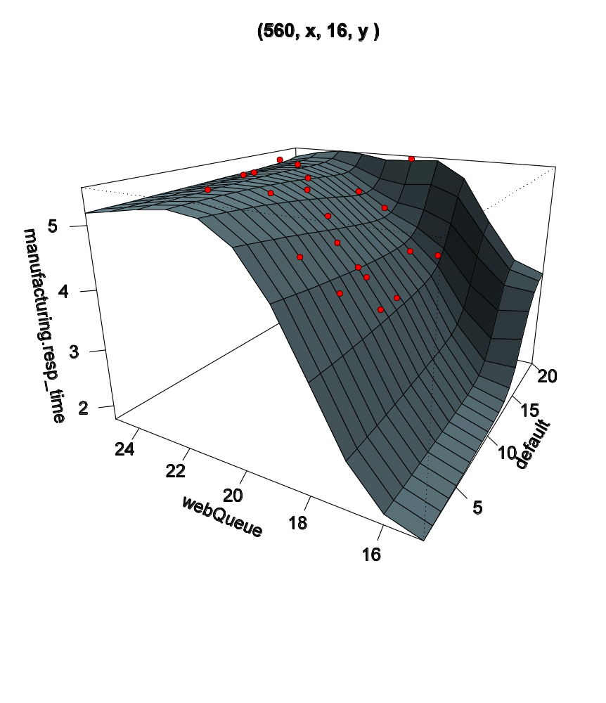
Case of Parallel Slopes
Parallel Slopes
  Injection rate and manufacturing queue fixed at (560, 16)
  Z axis: manufacturing response time
  X, Y axis: web queue and default queue value
Tuning default queue value has less effect on response time once web queue value is fixed

Slide 23
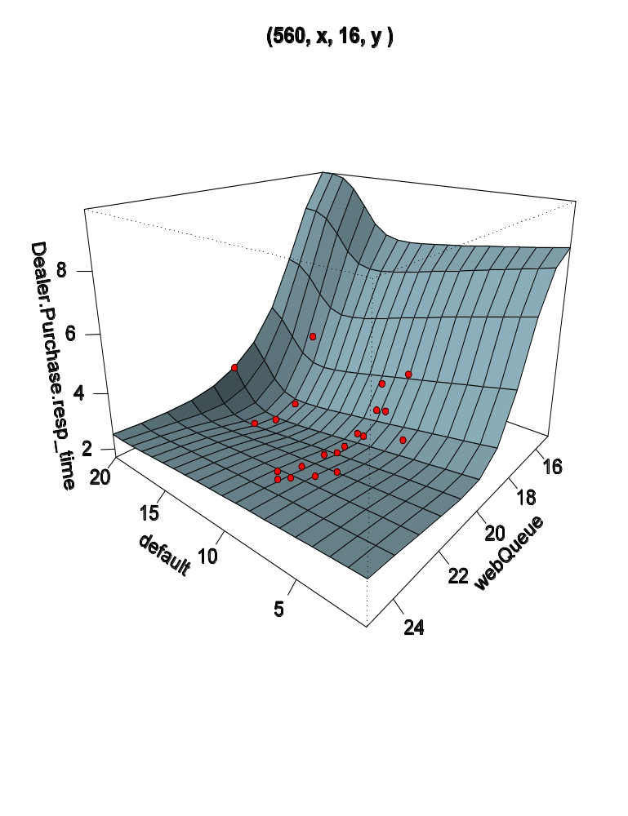
Case of Valleys
Valleys
  Injection rate and manufacturing queue fixed at (560, 16)
  Z axis: dealer purchase response time
  X, Y axis: default queue and web queue value
  Valleys formed at (default, webQueue) = (15, 18)
Default queue value and web queue value should be adjusted in a coherent way to stay in the ‘valley’

Slide 24
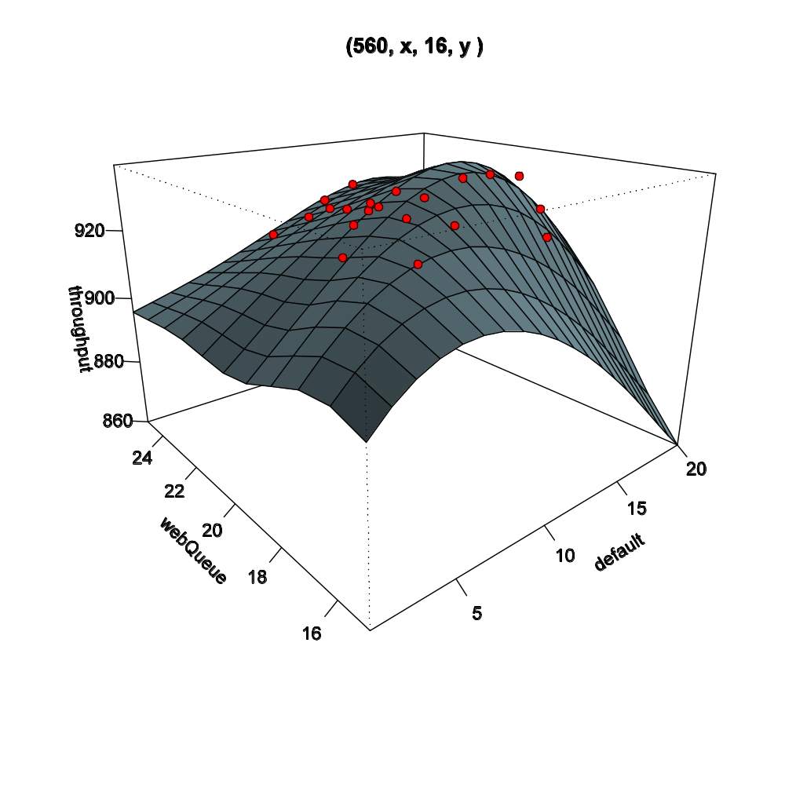
Case of Hills
Hills
  Injection rate and manufacturing queue fixed at (560, 16)
  Z axis: throughput
  X, Y axis: web queue and default queue value
Default queue value and web queue value should be adjusted in a coherent way to stay on the ‘hill’

Slide 25
Conclusion
Devised a methodology that incorporates neural network to construct and validate a nonlinear behavior model
Neural networks are an excellent tool to construct a nonlinear workload behavior model
Significant insights can be gained by analyzing these constructed models

Slide 26
Questions?
Georgia Tech MARS lab
  http://arch.ece.gatech.edu/

Slide 27
Additional Thoughts
Neural network models perform interpolation among samples
Cannot be used for extrapolation
  Cannot predict the performance for the configuration that is far apart from the training data
Known limitation of MLP

