Slide 1

Hierarchical Means:
Single Number Benchmarking with
Workload Cluster Analysis
Richard M. Yoo
Hsien-Hsin S. Lee
Han Lee
Kingsum Chow
Georgia Tech
Georgia Tech
Intel Corp.
Intel Corp.

Slide 2

Agenda
Identify a new type of workload redundancy specific to benchmark suite merger
Discuss a framework to detect workload redundancy
Propose a new set of scoring methods to workaround workload redundancy
Case study

Slide 3
Benchmark Suite Merger
Creating a new benchmark suite by adopting workloads from pre-existing benchmark suites
Examples
  MineBench will incorporate workloads from ClusBench
  Next release of SPECjvm would include workloads from SciMark2
It is good
  Create a new benchmark suite in a relatively short amount of time
  Overcome the lack of domain knowledge
  Inherit the proven credibility of existing benchmark suites
It is bad
  Significantly increases workload redundancy
Benchmark suite merger can significantly increase
workload redundancy

Slide 4
Categorizing Workload Redundancy
Natural Redundancy
  Occurs when sampling the user workload space
    Ex) Scientific applications are usually floating-point intensive
    => Scientific benchmark suite contains many floating-point workloads
  Reflects the user workload spectrum
  Traditional definition of workload redundancy in a benchmark suite
Artificial Redundancy
  Specific to benchmark suite merger

Slide 5
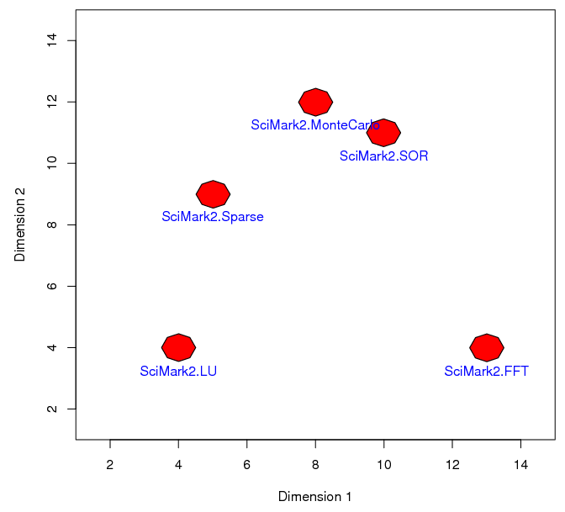
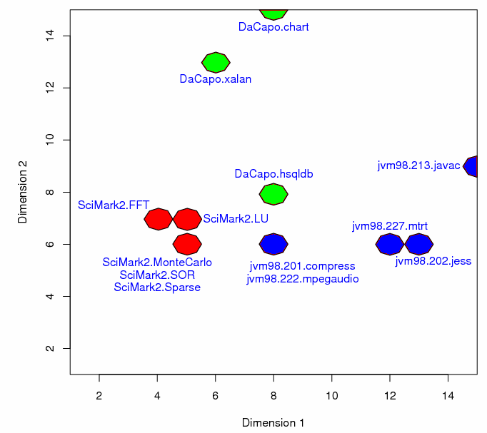
Artificial Redundancy Explained
Workload Distribution Before Merger
Workload Distribution After Merger
Newly added workloads fail to ‘mix-in’ with the rest of the workloads
All the workloads in the adoption set become redundant to each other

Slide 6
Artificial Redundancy Considered Harmful
Artificial redundancy biases the score calculation methods
  Current scoring methods (arithmetic mean, geometric mean, etc.)
    => Do not differentiate redundant workloads from ‘critical’ workloads
  Giving the same ‘vote’ to all the workloads regardless of their importance
  Redundant workloads misleadingly amplify their aggregated effect on the overall score
Compiler or hardware enhancement techniques will be misleadingly targeted for redundant workloads
Ill minded optimizations could break the robustness of the scoring metric by specifically focusing on the redundant workloads
Artificial redundancy can be avoided, and should be avoided whenever possible

Slide 7
Agenda
Identify a new type of workload redundancy specific to benchmark suite merger
Discuss a framework to detect workload redundancy
Propose a new set of scoring methods to workaround workload redundancy
Case study

Slide 8
Benchmark Suite Cluster Analysis
Detect workload redundancy by benchmark suite cluster analysis
  All the workloads in the same cluster are redundant to each other
Classify workloads that exhibit similar execution characteristics
  e.g., cache behavior, page faults, computational intensity, etc.
Current standard approach
  Map each workload to a characteristic vector
    Characteristic vector = elements that best characterize the workloads
  Apply dimension reduction / transformation to characteristic vectors
    Usually Principal Components Analysis (PCA)
    We present the alternative, Self-Organizing Map (SOM)
  Perform distance-based hierarchical cluster analysis over the reduced dimension

Slide 9
SOM vs. PCA
Why SOM?
  Superior visualization capability
    PCA usually retains more than 2 principal components
    Hard to visualize beyond 2-D
  Preserves the entire information
    Selectively choosing a few major principal components results in loss of information
  Better representation for non-linear data
    Characteristic vectors might not show a strict tendency over the rotated basis; e.g. bit-vectorized input data
More research needs to be done to prove
the superiority of one or the other

Slide 10
Self-Organizing Map (SOM)
A special type of neural network which effectively maps high-dimensional data to a much lower dimension, typically 1-D or 2-D
Creates a visual map on the lower dimension such that
  Two vectors that were close in the original n-dimension appear closer
  Distant ones appear farther apart from each other
Applying SOM to a set of characteristic vectors results in a map showing which workloads are similar / dissimilar

Slide 11
Organization of SOM
Array of neurons, called units
  Think of as ‘light bulbs’
  Each light bulb shows different brightness to different characteristic vectors
Characteristic vector for workload A?
Characteristic vector for workload B?

Slide 12
Training SOM
Utilize competitive learning
  Randomly select a characteristic vector
Characteristic vector for workload K?

Slide 13
Training SOM
Utilize competitive learning
  Find the brightest light bulb
Brightest light bulb
Characteristic vector for workload K?

Slide 14
Training SOM
Utilize competitive learning
  Reward the light bulb by making it even brighter
Brightest light bulb
Characteristic vector for workload K?

Slide 15
Training SOM
Utilize competitive learning
  Also reward its neighbor by making them brighter
Brightest light bulb
Characteristic vector for workload K?

Slide 16
Training SOM
Utilize competitive learning
  Repeat
Characteristic vector for workload B?

Slide 17
End Result of Training SOM
Each characteristic vector will light up only one light bulb
Similar characteristic vectors light up closely located light bulbs; i.e., relative distance between light bulbs imply the similarity / dissimilarity of workloads
A
B
K
H
J

Slide 18
Hierarchical Clustering
Perform hierarchical clustering over the generated SOM to obtain workload cluster information
  Closely located workloads form a cluster
A
B
K
H
J

Slide 19
Agenda
Identify a new type of workload redundancy specific to benchmark suite merger
Discuss a framework to detect workload redundancy
Propose a new set of scoring methods to workaround workload redundancy
Case study

Slide 20
Removing Redundant Workloads
Once detected, it is the best to remove redundant workloads from the benchmark suite
However…
  Conflicting mutual interests might prevent workloads from being removed
  The process can be rather difficult and delicate
Solution => Rely on score calculation methods
  Weighted mean approach
    Augment the plain mean with different weights for different workloads
    Determining the weight values can be subjective
  Hierarchical means
    Incorporate workload cluster information directly into the shape of the scoring equation

Slide 21
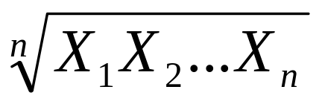
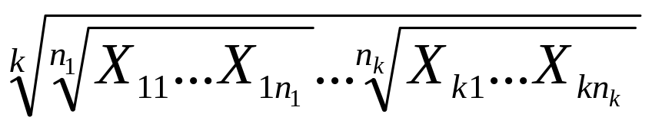
Hierarchical Means
For a benchmark suite comprised of n workloads, where the ith workload showing performance value Xi
Plain Geometric Mean:
For the same benchmark suite, if the benchmark suite forms i = 1,…,k clusters
Hierarchical Geometric Mean (HGM):
  n_{i}: number of workloads in the i^{th} cluster
  X_{ij}: performance of the j^{th} workload in i^{th} cluster

Slide 22
Hierarchical Means Explained
Geometric mean of geometric means
    Each inner geometric mean reduces each cluster to a single representative value
      Effectively cancels out workload redundancy
    Outer geometric mean equalizes all the clusters
    Gracefully degenerates to the plain geometric mean when each workload is assigned a single cluster
Apply averaging process in a hierarchical manner to eliminate workload redundancy

Slide 23
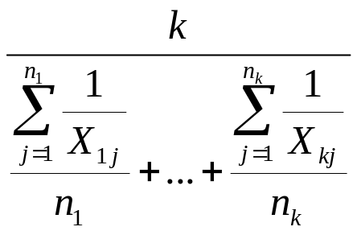
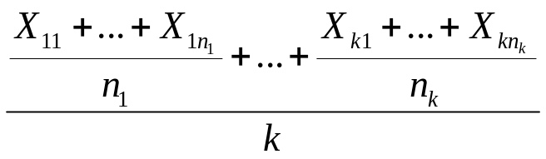
More Hierarchical Means
Hierarchical Arithmetic Mean (HAM)
Hierarchical Harmonic Mean (HHM)
Benefits of Hierarchical Means
  Effectively cancel out workload redundancy
  More objective than the weighted mean approach given that the clustering is performed based on a quantitative method
  Gracefully degenerate to their respective plain means when each workload is assigned a single cluster

Slide 24
Agenda
Identify a new type of workload redundancy specific to benchmark suite merger
Discuss a framework to detect workload redundancy
Propose a new set of scoring methods to workaround workload redundancy
Case study

Slide 25
Benchmark Suite Construction
Imitates the upcoming SPECjvm benchmark suite
  5 workloads retained from SPECjvm98
    201.compress, 202.jess, 213.javac, 222.mpegaudio, and 227.mtrt
  5 workloads from SciMark2
    Java benchmark suite for scientific and numerical computing
    FFT, LU, MonteCarlo, SOR, and Sparse
  3 workloads from DaCapo
    Java benchmark suite for garbage collection research
    Hsqldb, Chart and Xalan
The actual release version of SPECjvm is yet to be disclosed and
may eventually be different

Slide 26
Experiment Settings
System Settings
  Two different machines to compare performance: Machine A and B
  One reference machine to normalize the performance of machine A and B
Score metric for each workload
  Normalized execution time over the reference machine
Workload Characterization
  Method 1: Linux SAR counters
    Collects operating system level counters
    Architecture dependent
  Method 2: Java method utilization
    Create a bit vector denoting whether a specific API was used or not => Highly non-linear
    Architecture independent

Slide 27
Workload Distribution on Machine A
Workload distribution obtained by applying SOM to SAR counters collected from machine A
Each cell amounts to the ‘light bulb’ referred to earlier
SPECjvm98 workloads spread over dimension 1
DaCapo workloads spread over dimension 2
SciMark2 workloads fail to mix-in with the rest
  SciMark2 workloads still occupy the majority of the benchmark suite (5 / 13)

Slide 28
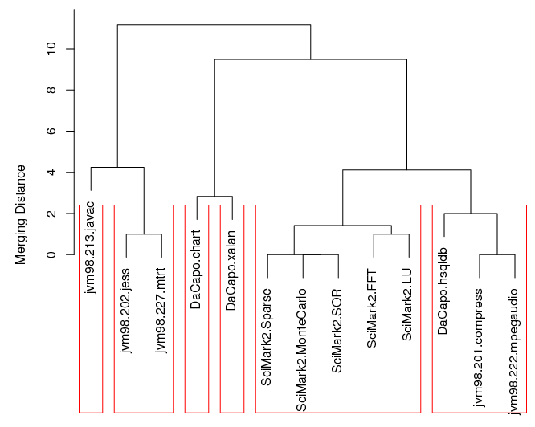
Cluster Analysis on Machine A
Dendrogram for the 6 Clusters Case
At 6 clusters, SciMark2 forms an exclusive cluster
At the same merging distance, workloads from SPECjvm98 and DaCapo are already divided into multiple clusters

Slide 29
HGM Based on Clustering Results from Machine A
 | A | B | ratio(=A/B)
2 clusters | 2.58 | 2.06 | 1.25
3 clusters | 2.62 | 2.18 | 1.20
4 clusters | 2.89 | 2.22 | 1.30
5 clusters | 2.70 | 2.24 | 1.21
6 clusters | 2.77 | 2.31 | 1.20
7 clusters | 2.63 | 2.40 | 1.10
8 clusters | 2.34 | 2.15 | 1.09
Geomean | 2.10 | 1.94 | 1.08
Score ratio can be quite different from the plain geometric mean when the effect from the redundant workloads have been removed
As the number of clusters increases, the ratio converges to that of the plain geometric mean
6 clusters case seems to be the norm

Slide 30
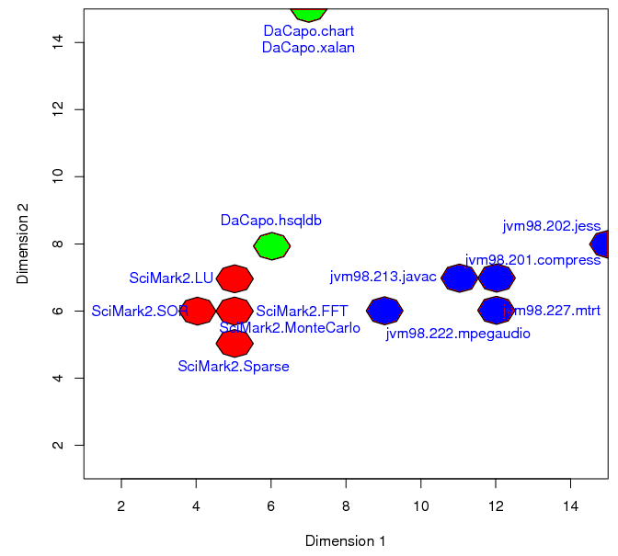
Workload Distribution on Machine B
Workload distribution obtained by applying SOM to SAR counters collected from machine B
SPECjvm98 and DaCapo workloads still spread over dimension 1 and 2
SciMark2 workloads again form a dense cluster

Slide 31
HGM Based on Clustering Results from Machine B
 | A | B | ratio(=A/B)
2 clusters | 2.42 | 2.12 | 1.14
3 clusters | 2.39 | 2.14 | 1.11
4 clusters | 2.88 | 2.42 | 1.19
5 clusters | 2.39 | 2.34 | 1.02
6 clusters | 2.75 | 2.64 | 1.04
7 clusters | 2.30 | 2.27 | 1.01
8 clusters | 2.11 | 2.10 | 1.00
Geomean | 2.10 | 1.94 | 1.08
5 or 6 cluster case seems to be the most representative
The ratio for this case (1.02 ~ 1.04) is quite different from the case for machine A (1.20 ~ 1.21)
Workload clusters can appear differently on different machines

Slide 32
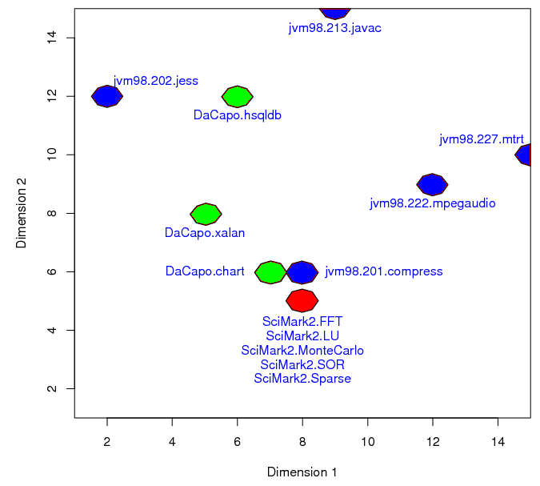
Workload Distribution by Java Method Utilization
Workload distribution obtained by applying SOM to bit vectorized Java method utilization info
Totally architecture independent characteristics
Workload distribution is quite different from the SAR counter based distribution
SciMark2 workloads all map to the same unit
  SciMark2 workloads heavily rely on self-contained math libraries

Slide 33
Case Study Conclusions
Workload clustering heavily depends on which machine is used to characterize the workloads, and how the workloads are characterized
  Utilization of microarchitecture independent workload characteristics is a necessity
  In order to accept the hierarchical means as a standard, a reference cluster distribution should be determined first
SciMark2 workloads formed a dense cluster of their own no matter the characterization method
  SciMark2 workloads are indeed redundant in our benchmark suite

Slide 34
Summary
Artificial redundancy
  Specific to benchmark suite merger
  Significantly increases workload redundancy in a benchmark suite
Hierarchical Means
  Directly incorporates the workload cluster information into the shape of the scoring equation
  Effectively cancels out workload redundancy
  Can be more objective compared to the weighted means approach

Slide 35
Questions?
Georgia Tech MARS lab
  http://arch.ece.gatech.edu

Slide 36
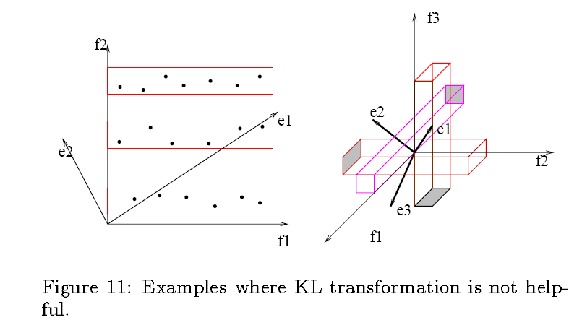
Where PCA Fails
R. Agrawal, J. Gehrke, D. Gunopulos, and P. Raghavan. Automatic subspace clustering of high dimensional data for data mining applications. In Proceedings of 1998 ACM-SIGMOD International Conference on Management of Data, Seattle, WA, June 1998.

Slide 37
SOM vs. MDS
SOM and MDS achieve similar purposes in a different way
MDS tries to preserve the metric in the original space, whereas the SOM tries to preserve the topology, i.e., the local neighborhood relations
S. Kaski. Data exploration using self-organizing maps. PhD thesis, Helsinki University of Technology, 1997.

Slide 38
Error Metrics for SOM
Quantization Error
  Average distance between each data vector and its BMU
Topographic Product
  Indicates whether the size of the map is appropriate to fit onto the dataset
Topographic Error
  The proportion of all data vectors for which first and second BMUs are not adjacent units
Trustworthiness and Neighborhood Preservation
  Determines whether the projected data points which are actually visualized are close to each other in input space
Experiment results have been validated with quantization error
G. Polzlbauer. Survey and comparison of quality measures for self-organizing maps. In Proceedings of the Fifth Workshop on Data Analysis, pages 67-82, Vysoke Tatry, Slovakia, June 2004.

Slide 39
Deciding the Number of Inherent Clusters
Still an open question in the area
Incorporation of model-based clustering and Bayes Information Criterion (BIC)
  Assume that data are generated by a mixture of underlying probability distributions
  Based on the model assumption, calculate how ‘likely’ the current clustering is
  Choose the best likely clustering
Requires a lot of sample points to approximate the model
Fraley, C., and Raftery, A. E. How many clusters? Which clustering method? – Answers via model-based cluster analysis. The Computer Journal 41, 8, pp. 578-588, 1998.

