Slide 1

Tri-Level-Cell Phase Change Memory: Toward an Efficient and Reliable Memory System
Nak Hee Seong
Sungkap Yeo
Hsien-Hsin Sean Lee
Georgia Tech
MARS Lab
Notes:
Thursday, June 27, 2013
10:30am-12:10pm
Session 6A: Non-Volatile Storage
Chair: Gabriel Loh, AMD Research

Slide 2
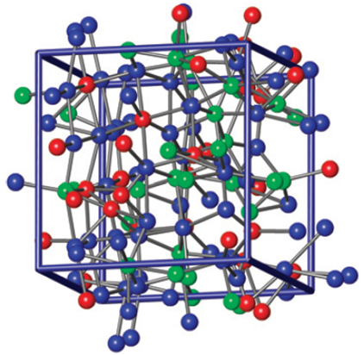
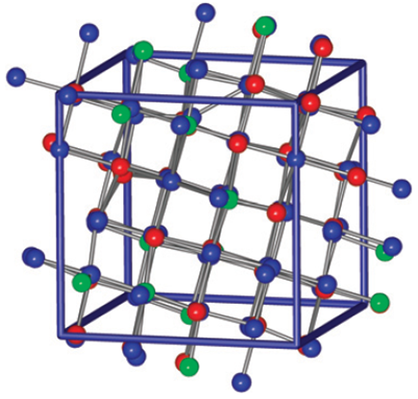
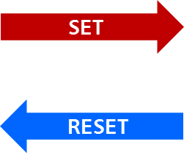
Phase Change Memory
High resistivity
Low resistivity
Source: Hegedüs & Elliott, Nature Materials & Sangyeun Cho, MICRO-42

Slide 3
Single-Level Cell vs. Multi-Level Cell
Two Storage Levels
0
1
2LC or SLC
= one bit per cell
Four Storage Levels
00₂
01₂
10₂
11₂
4LC
= two bits per cell

Slide 4
Single-Level Cell PCM
i
SET
i
RESET
t
t
# of
Cells
1k Ω
1MΩ
Ω
10³ Difference

Slide 5
Multi-Level Cell PCM
i
SET
i
i
RESET
t
t
t
# of
Cells
1k Ω
1MΩ
Ω
Storage
Level 0
Storage
Level 1
Storage
Level 2
Storage
Level 3

Slide 6
Resistance Drift
t = 1
# of
Cells
SET
RESET
Storage
Level 0
Storage
Level 1
Storage
Level 2
Storage
Level 3
Ω
Decision Boundaries

Slide 7
Resistance Drift
t = 2
# of
Cells
SET
RESET
Storage
Level 0
Storage
Level 1
Storage
Level 2
Storage
Level 3
Ω

Slide 8
Resistance Drift
t = 4
# of
Cells
SET
RESET
Storage
Level 0
Storage
Level 1
Storage
Level 2
Storage
Level 3
Ω

Slide 9
Resistance Drift
t = 8
# of
Cells
SET
RESET
Storage
Level 0
Storage
Level 1
Storage
Level 2
Storage
Level 3
Ω
Drift-induced Soft Errors!!!

Slide 10
Executive Summary
Observation ▷ MLC PCM offers capacity but not reliable
Goal ▷ Capacity & Reliability
Solution ▷ Tri-Level-Cell PCM
Challenges ▷ Conversion and ECC
Results (over 4LC PCM)
10⁵ lower soft error rates
36.4% performance improvement
Results (over SLC PCM)
1.33x higher information density

Slide 11
Multi-Level-Cell PCM
Error Models
Our Approach
Tri-Level-Cell PCM
Conversion & ECC
Evaluations
11
Notes:
11

Slide 12
Drifted Resistance
Modeled by power law equation
[Ielmini et al. IEEE TED and IEDM ‘07]
Tuned between
I. program boundaries
II. N (µ_{α},σ_{α}²)
IV. Sensing boundaries
III. N (µ_{R},σ_{R}²)

Slide 13
Probability of Drift-induced Errors (DE)
Equation X
Storage Level | log₁₀R |  | α
 | µ_{R} | σ_{R} | µ_{α} | σ_{α}
0 | 3.0 | 1/6 | 0.001 | 0.4×µ_{α}
1 | 4.0 |  | 0.02
2 | 5.0 |  | 0.06
3 | 6.0 |  | 0.10
µ_{R} - 2.75σ_{R} ≤ Program boundary ≤ µ_{R} + 2.75σ_{R} µ_{R} – 3.0σ_{R} ≤ Sensing boundary ≤ µ_{R} + 3.0σ_{R} [Xu et al., TVLSI vol.19]

Slide 14
Probability of Drift-induced Errors (DE)
Equation X
Program boundaries
N (µ_{α},σ_{α}²)
N (µ_{R},σ_{R}²)
Sensing boundaries
Probability of Soft Error

Slide 15
Probability of Drift-induced Errors (DE)
> 17%
DRAM
2.5 ~ 7.5 × 10⁻⁹ %
per bit-hour
[Schroeder et al., SIGMETRICS ’09]
~36 Hours

Slide 16
Naïve Solution (1)
Fine-tune resistance level & secure large margins
Requires more write-&-verify iterations
Compromise write latencies
Shorten lifetime
Decision Boundaries
# of
Cells
Storage
Level 0
Storage
Level 1
Storage
Level 2
Storage
Level 3
Ω

Slide 17
Naïve Solution (2)
Periodic reprogramming
Similar to DRAM scrubbing
Significantly compromises performance
Programming a 2-bit cell takes ~1μs
Consumes more write energy
# of
Cells
Storage
Level 0
Storage
Level 1
Storage
Level 2
Storage
Level 3
Ω

Slide 18
Multi-Level-Cell PCM
Error Models
Our Approach
Tri-Level-Cell PCM
Conversion & ECC
Evaluations
18
Notes:
18

Slide 19
Terminology II
Two Storage Levels
0
1
2LC or SLC
Three Storage Levels
= one bit per cell
0₃
1₃
2₃
Four Storage Levels
3LC
00₂
01₂
10₂
11₂
4LC
~ 1.5 bits per cell
≠ three bits per cell
= two bits per cell
Binary System
Ternary System

Slide 20

Proposed Solution
4-level cell PCM
unreliable
Tri-level cell PCM
Removing the most error-prone state
One step at a time
i
SET
i
i
RESET
t
t
t
# of
Cells
L0
L1
L2
1k Ω
1MΩ
Ω

Slide 21
Bandwidth-Enhanced (BE) 3LC PCM
Exploit safety margin
Relaxing programming range
Reducing programming latency
Increasing write bandwidth
i
SET
i
i
i
RESET
or
t
t
t
t
# of
Cells
Moderate-
Quenched
writing
Method*
L0
L1
L1
L2
1k Ω
1MΩ
Ω
*[Kang et al., 2008 Symposium on VLSI technology]
Notes:
MQ (moderate-quenched) programming, “Two-bit cell operation in diode-switch PCM” 2008 symposium on VLSI technology

Slide 22
Bandwidth-Enhanced (BE) 3LC PCM
More capacity than 2LC
log₂3 times denser
More reliable than 4LC
Much lower probability of drift-induced errors
Longer lifetime than 4LC
fewer write-&-verify iterations for programming
Higher write bandwidth than 4LC
Issues
Efficient conversion methods
Error correcting schemes

Slide 23
Multi-Level-Cell PCM
Error Models
Our Approach
Tri-Level-Cell PCM
Conversion & ECC
Evaluations
23
Notes:
23

Slide 24
Efficient Conversion Method
In theory
11 bits of binary = 2048 states
7 ternary cells = 2187 states
~94% utilization
Our approach
3 bits of binary = 8 states
2 ternary cells = 9 states
~89% utilization
Notation: <3,2> conversion
Simple Hardware
Realistic
Chip Config.

Slide 25
Efficient <3,2> Conversion
00
01
10
02
11
20
12
21
22
Ternary

Slide 26
Efficient <3,2> Conversion
00
01
10
02
11
20
12
21
22
Ternary

Slide 27
Efficient <3,2> Conversion
00
01
10
02
11
20
12
21
22
Ternary

Slide 28
Efficient <3,2> Conversion
000
00
01
10
001
010
100
02
11
20
011
101
110
12
21
111
22
Binary
Ternary

Slide 29
Efficient <3,2> Conversion
000
00
01
10
001
010
100
02
11
20
011
101
110
12
21
111
22
Binary
Ternary

Slide 30
ECC for Tri-Level-Cell PCM
Single Bit Error
Single Bit Error
Binary
Ternary
Legacy ECC for binary can be used
Simple (72, 64) Hamming Code
Memory controller requires minimal change
Chip configuration
Binary systems
72 bits = 9 chips * 8 bits per chip
Ternary systems
72 bits = 8 chips * 9 bits per chip
6 Ternary Cells
No redundancy!

Slide 31
Multi-Level-Cell PCM
Error Models & Recent Work
Our Approach
Tri-Level-Cell PCM
Conversion & ECC
Evaluations
31
Notes:
31

Slide 32
Drift-induced Error Rate
Elapsed Time (s) | 3LC PCM | BE-3LC PCM
2¹⁵ (9 hours) | (too small) | (too small)

Slide 33
Drift-induced Error Rate
Elapsed Time (s) | 3LC PCM | BE-3LC PCM
2¹⁵ (9 hours) | (too small) | (too small)
2²⁰ (12 days) | (too small) | 3.60E-16%

Slide 34
Drift-induced Error Rate
Elapsed Time (s) | 3LC PCM | BE-3LC PCM | BE-3LC PCM + (72,64) ECC
2¹⁵ (9 hours) | (too small) | (too small) | (too small)
2²⁰ (12 days) | (too small) | 3.60E-16% | (too small)

Slide 35
Drift-induced Error Rate
Elapsed Time (s) | 3LC PCM | BE-3LC PCM | BE-3LC PCM + (72,64) ECC
2¹⁵ (9 hours) | (too small) | (too small) | (too small)
2²⁰ (12 days) | (too small) | 3.60E-16% | (too small)
2²⁵ (1 year) | (too small) | 1.28E-10% | 2.66E-15%

Slide 36
Performance (SPEC2006)

Slide 37
Performance (SPEC2006)

Slide 38
Performance (SPEC2006)
*
*[Awasthi et al., HPCA 2012]

Slide 39
Performance (SPEC2006)

Slide 40
Performance (SPEC2006)

Slide 41
Information Density
Bits per cell
Number of Correctable Bits

Slide 42
Information Density
Bits per cell
4LC+ECC
Number of Correctable Bits

Slide 43
Information Density
Bits per cell
Number of Correctable Bits

Slide 44
Information Density
Bits per cell
Number of Correctable Bits

Slide 45
Conclusion
Conclusions
Goal: Reliable Multi-Level-Cell PCM
Analytical Error Model for MLC PCM
Tri-level-cell PCM
State-mapping <3,2> conversion
Deliver 1.33 bits per cell
Performance & Reliability: Close to SLC
4LC PCM: Immature

Slide 46

Tri-Level-Cell Phase Change Memory: Toward an Efficient and Reliable Memory System
Georgia Tech
MARS Lab
http://arch.ece.gatech.edu
Nak Hee Seong
Sungkap Yeo
Hsien-Hsin Sean Lee
Notes:
46

