Slide 1
Wire-driven Microarchitectural Design Space Exploration
Mongkol Ekpanyapong
Sung Kyu Lim
Chinnakrishnan Ballapuram
Hsien-Hsin “Sean” Lee
School of Electrical and Computer Engineering
Georgia Institute of Technology
Atlanta, GA 30332, USA
ISCAS 2005, Kobe, Japan

Slide 2

Microarchitecture Design Trend
Transistors are almost free ⎯ billions of billions [Pat Gelsinger keynote in DAC-42]
Processor architects tend to
  Increase module capacity to improve the performance (e.g. caches, BTB, ROB, etc)
  Increase the die dimension
  Assume communications are free, too
  But …..
0.5mm
1mm
Delay = 20 ns
Delay = 80 ns

Slide 3
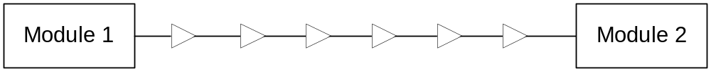
Alleviating Wire Delay
Buffers Insertion to speed up
  In reality, chip size is growing
  Issues in many via cuts, area, power, ..
Flip-Flop Insertion to meet cycle time (P4 dedicates 2 pipe stages for communication)
Module 1
Module 1
FF
FF
Latency is not
scalable !
FF
FF
FF
FF
FF
FF
Module 2
Module 2

Slide 4
Motivation
Wires, in particular global wires, is a problem In deep submicron processor design
Conventional architecture techniques increasing module sizes (e.g. caches) will no longer guarantee performance improvement
Early design space exploration (DSE) at the microarchitecture level needs to take “wire impact” into account
A high efficiency DSE framework is imperative

Slide 5
Algorithms

Slide 6
Dynamic communication-aware
Profile-guided Floorplanning [DAC-42]
Technology
Parameter
Architecture
Description
Application
CACTI
GENESYS
PROFILING
Use Traffic Profile
For floorplanning
Module-level Netlist + Profile
Target
Frequency
FLOORPLANNING
Module-level Layout + Wire Latency
CYCLE-BASED SIMULATOR

Slide 7
AMPLE ⎯ Adaptive Microarchitectural PLanning Engine
Technology
Parameter
Architecture
Description
Application
CACTI
GENESYS
PROFILING
Module-level Netlist + Profile
ADAPTIVE PARAMETER TUNING
Target
Frequency
FLOORPLANNING
Wire-driven
Automated
Design Space
Exploration
Module-level Layout + Wire Latency
CYCLE-BASED SIMULATOR

Slide 8
Adaptive Parameter Tuning Algorithm
Initialization
For each uarch
parameter
ADAPTIVE PARAMETER TUNING
Gradient Search
End

Slide 9
AMPLE ⎯ Initialization
Initialization
Smart Start
For N uarch parameters
(N+1) Iteration
Optional: Profile-Guided
Microarch_Planning()
Priority_search()
based on
Microarch_Planning
Results
For N uarch parameters
(N+1) Iteration
Profile-Guided
Microarch_Planning()

Slide 10
Smart Start:
Initial Microarchitecture Configurations
Good starting points can reduce design space exploration time
Applications are classified into three categories:
  Processor-bound applications
  Cache-sensitive applications
  Bandwidth-bound applications
Class | width | BTB | RUU | LSQ | IL1 | DL1 | L2 | L3 | ALU | FPU
Processor bound | 8 | 512 | 256 | 128 | 16K | 8K | 128K | 0 | 6 | 4
Cache sensitive | 4 | 256 | 128 | 256 | 8K | 16K | 512K | 0 | 4 | 2
Bandwidth bound | 4 | 256 | 128 | 128 | 8K | 8K | 128K | 0 | 4 | 2

Slide 11
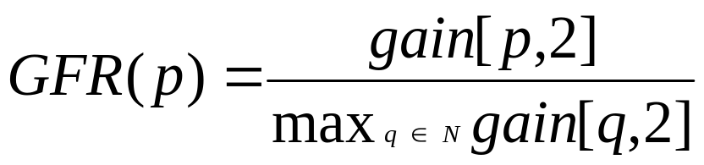
Priority Search
Prioritize microarchitectural parameters
High impact parameters are tuned first
Correlation metric can be used to identify critical parameters, but it requires large runtime
Gradient First-order Ratio (GFR) is proposed here as follow:
Higher GFR → Higher priority
Initialization
A uarch parameter (e.g. BTB)
For each uarch
parameter
Gradient Search
The uarch parameter has max IPC gain
End

Slide 12
Adaptive Parameter Tuning Algorithm
Initialization
For each uarch
parameter
ADAPTIVE PARAMETER TUNING
Gradient Search
End

Slide 13
Gradient Search Algorithm
Update Parameter and Prune
Profile-Guided
Microarch_Planning()
Compute Gain
Gradient Search
While Gain > Threshold
&& Acyclic
Return

Slide 14
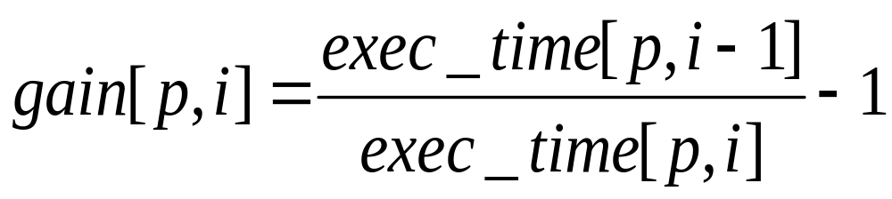
Compute Gain and New Parameters
Let [p,i] be a microarchitecture parameter p at iteration i
Let μ denotes the step size
Gain Equation:
Parameter Calculation Equation:
Parameters are pruned or rounded if unrealistic

Slide 15
Search Pruning Rationale
Reduce search time by pruning unrealistic parameters
Cache size order
  L1 < L2 < L3
Issue width ≥ Number of ALUs
No search in floating point units for integer applications
Upper and lower bound on number of modules and module size

Slide 16
Experimental Results

Slide 17
DSE Runtime Comparison
Bench. | Brute Force |  | Simulated Annealing |  | AMPLE
 | Time | Iteration | Time | Iteration | Time | Iteration
164.gzip | 314 | 384 | 34 | 43 | 29 | 36
175.vpr | 406 | 384 | 50 | 43 | 42 | 35
181.mcf | 209 | 384 | 29 | 43 | 18 | 36
254.gap | 325 | 384 | 49 | 43 | 36 | 35
300.twolf | 202 | 384 | 21 | 43 | 18 | 36
171.swim | 830 | 768 | 62 | 43 | 45 | 33
179.art | 1,561 | 768 | 126 | 43 | 86 | 38
189.lucas | 396 | 768 | 22 | 43 | 15 | 32
Normalized Avg. Time | 14.31 |  | 1.34 |  | 1.00

Slide 18
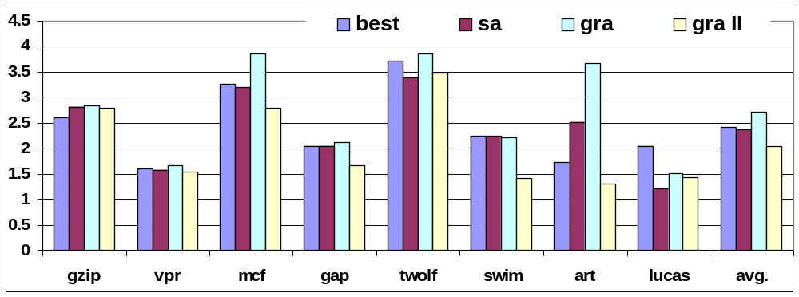
Performance Comparison
Best: best pick from brute force
SA: Simulated Annealing
Gra: AMPLE w/ design goal of “performance”
Gra II: AMPLE w/ design goal of “performance + area”
1.0 = brute force average

Slide 19
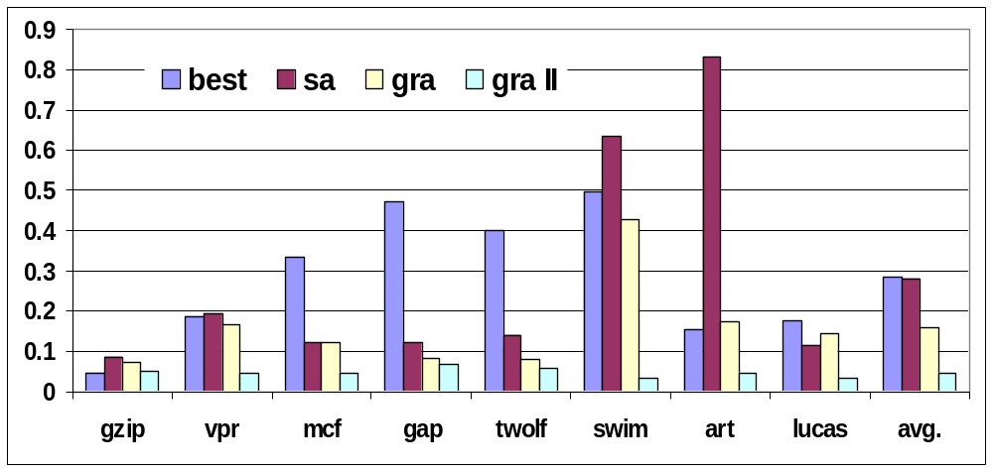
Area Comparison
Best: best pick from brute force
SA: Simulated Annealing
Gra: AMPLE w/ design goal of “performance”
Gra II: AMPLE w/ design goal of “performance + area”
1.0 = brute force average

Slide 20

Contributions and Conclusion
We propose AMPLE DSE Framework
  Wire delay conscious
  Goal-directed
    High performance
    Cost effectiveness
  Highly efficient
    An order of magnitude faster than time-limted (incomplete) brute force
    1.43x faster than simulated annealing
We show that AMPLE outperforms prior art in
  DSE turnaround time
  DSE quality

Slide 21


Q & A
That’s All Folks !

