Slide 1
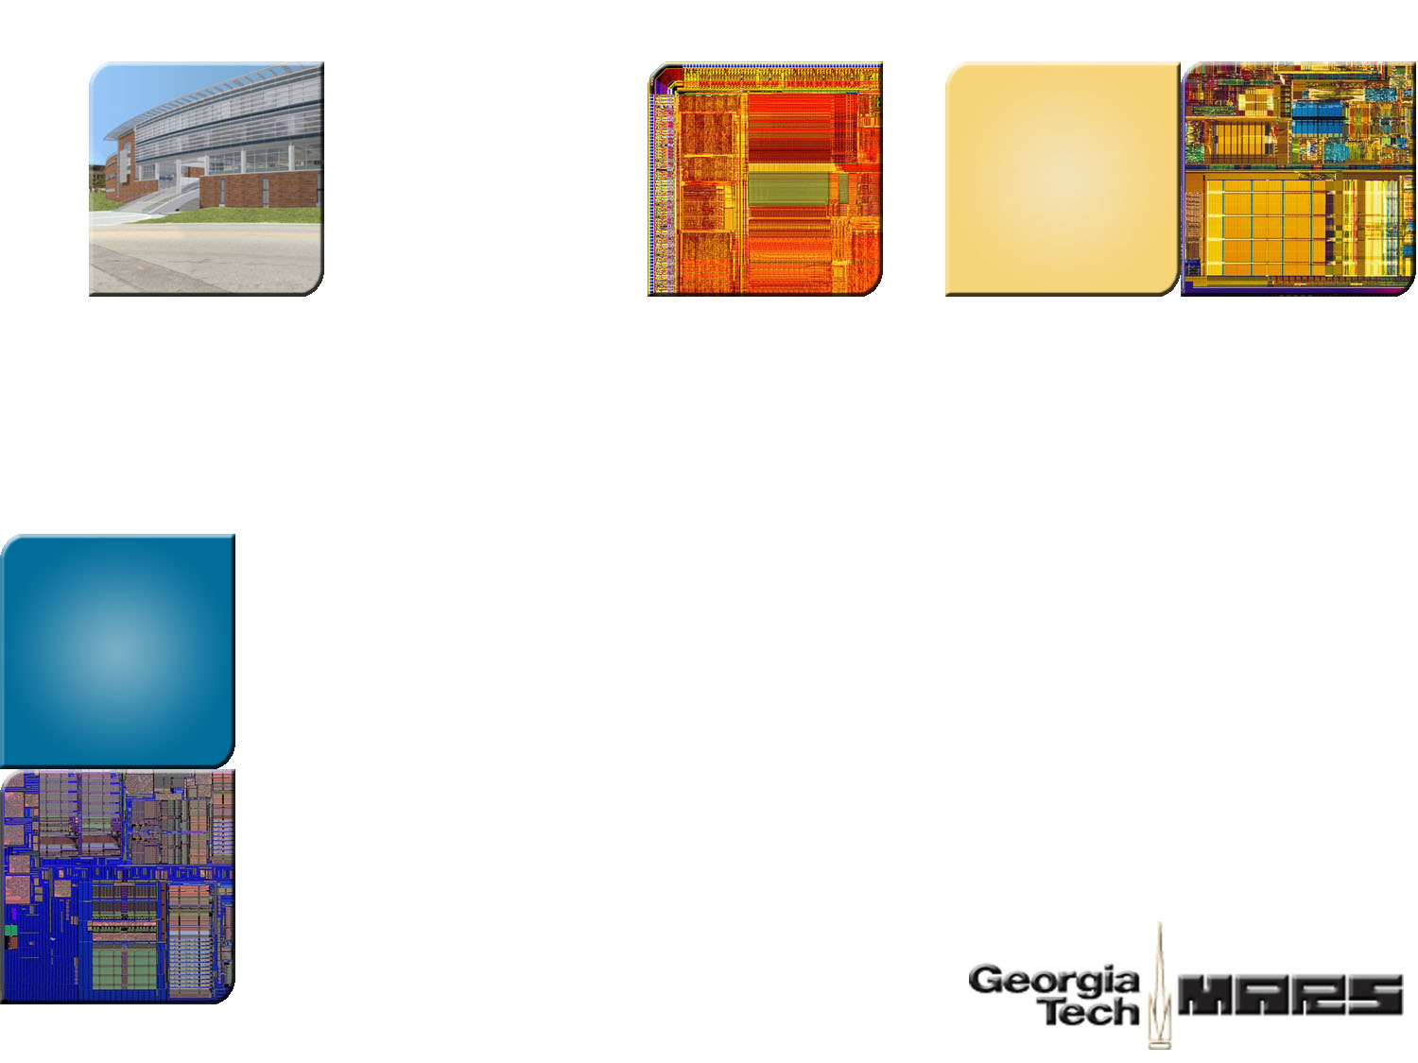



A Floorplan-Aware Dynamic Inductive Noise Controller for Reliable Processor Design
Fayez Mohamood
Michael Healy
Sung Kyu Lim
Hsien-Hsin “Sean” Lee
School of Electrical and Computer Engineering
Georgia Institute of Technology
Notes:
Good Morning Everyone. My name is Fayez Mohamood. I’m glad to be the first presenter at MICRO this year. Our work is entitled “A floorplan aware Dynamic Inductive Noise Controller for Reliable Processor Design”. First off, I’ll start off with acknowledging eveyrone who contributed to this work. I’d like to acknowledge my colleague Michael Healy and his advisor Dr. Sung Kyu Lim who provided floorplanning expertise for this work, as well as my advisor Dr. Hsien-Hsin Lee.
What I will be presenting is a micro-architectural technique, but not a purely traditional technique, but one that invocates a new design methodology as well to dynamically guard against inductive noise regardless of native program behavior. This work represents a concerns a major issue that concerns new microprocessor designs which is an artifact of various technology trends mainly due aggressive mitigation of power consumption.

Slide 2
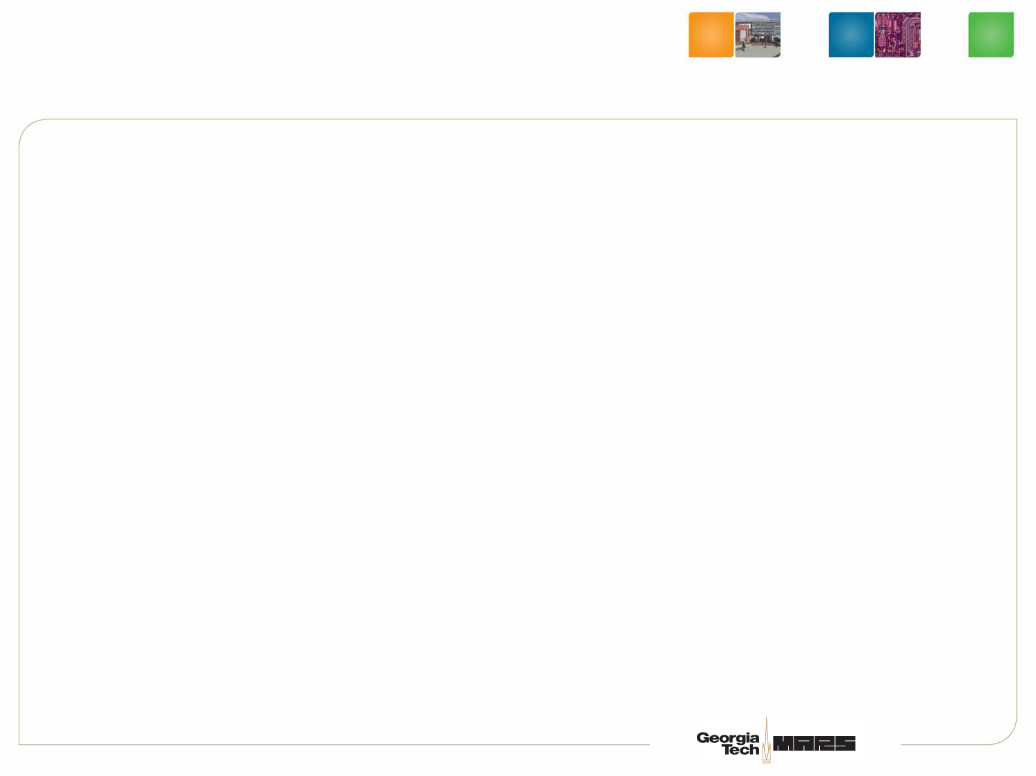
Presentation Overview
Motivation
Inductive Noise Variants
Floorplan aware dynamic di/dt controller
Simulation Results
Conclusion
Notes:
This is a quick overview of my presentation. I will explain the basics of inductive noise and the motivation for this work. Then I’ll go on to clearly identify the specific inductive noise variant that we work on….namely High-frequency inductive noise. I’ll then present the deisgn of a floorplan aware dynamic inductive noise controller, go on to the simulation results, before concluding.

Slide 3
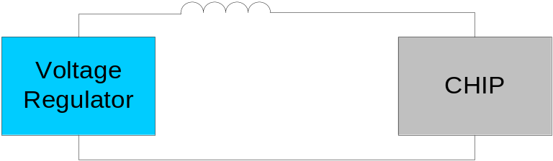

Inductive Noise Overview & di/dt basics
V
t
Power supply noise caused due to high variability in current consumption per unit time
  ΔV = L(di/dt)
Reliability Issue that needs to be guaranteed
  Typically done through a multi-stage decap solution (motherboard/package/on-die)
Can be addressed by an overdesigned power network, however
  Leads to high use of multi-stage decap
  More metal for power grid, leaving less for signals
Chip is designed to account for a program that can induce the worst-case power supply noise
Notes:
So let me explain quickly what di/dt is, and why it is more of a concern now. Conside a simple first order model, with a power supply, a voltage regulator and a microprocessor. Everything is fine as long as the chip draws steady state current. But when there is a sudden current demand, the chip will experience a voltage drop because the power supply is unable to respond instantaneously. What you see is a dip that can cause a glitch in the power supply network. The traditional way to mitigate this effect is to add a decap that can alleaviate (but not eliminate) this issue by bringing the dip within the violation margin.
Since voltages have to be preserved within the margin, di/dt presents reliability issue that NEEDS to be guaranteed. Addressed my a multi stage decap nad an overdesigned power grid. “Talk from slide” `

Slide 4
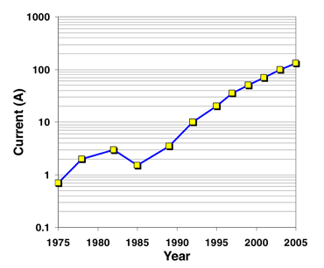
Why Noise and Why Now?
More active devices on chip
  Higher power consumption
Exponential increase in current consumption
  Intel reports 225% increase per unit area per generation
Device size miniaturization leads to lower operating voltages
  Lower noise margins
Multi-core trend can exacerbate di/dt issues
Aggressive power saving techniques
  Clock-gating
Source: Intel Technology Journal
Volume 09, Issue 04 Nov 9,2005
Notes:
So this is obviously not a new problem, then why is it important now? Well, there are multiple technology trends that are responsible. So first, power consumption is up from a decade ago, chips are getting feature rich. Intel reports a 225% increase per unit per area generation in current consumption. The graph on the bottom right shows the current consumption trend for major chips over the last few decades. Traditional feature size scaling also leads to lower operating voltages. So even if the noise margin stays the same as a percentage, the absolute voltage noise margin gets smaller.
But importantly, the multi core trend is exacerbating di/dt issues at the package level, both because power consumption goes up and because dynamic power management between cores increases varibaly. But most importantly, this work is going to focus on one of the most importanat sources of high frequency inductive noise, mainly coarse gated clock gating techniques that result in local variations of current demand across the chip

Slide 5

Worst-case Design Inefficiency
Is the design reliable?
YES
Ship IT !
NO
NO
Worst-case Design
Average-case Design
Post-Design Decap Allocation
  Consumes chip real-estate
  Contributes to leakage
Finer clock gating domains
  Increases design complexity
Ex: Design package/heatsink for
worst-case thermal profile
Static control through physical design
Dynamic di/dt control for worst case
Ex: DTM (Dynamic Thermal Management)
Thermal diode monitoring to throttle
CPU activity
A one-size-fits-all approach is needed
Notes:
As I mentioned before, di/dt violations need to be guaranteed, so this is done through worst case design. Explain the slides and examples.

Slide 6
Inductive Noise
Inductive Noise Classes
Low – Mid Frequency
High Frequency
Characteristics
Caused by global transient
Typically in the 20-100 MHz range
Does not require instantaneous
response
Mostly due to local transient
(clock-gating)
di/dt effects over 10s of cycles
Instantaneous response critical
Mitigation
Low impedance path between
power supply and package
Handled by package/bulk decap
Low impedance path between
cells and power supply nodes
Handled by on-die decap
M. Powell, T.N. Vijaykumar (ISCA’03/’04)
R. Joseph, Z. Hu, M. Martonosi (HPCA ‘03/’04)
K. Hazelwood, D. Brooks (ISLPED ‘04)
M. Powell, T.N. Vijaykumar (ISLPED ’03)
Notes:
Explain low frequency and high frquency noise

Slide 7
di/dt from a Microarchitectural Perspective
Noise characteristics reflect program behavior
  Static characteristics like the FU usage
  Dynamic characteristics like cache misses
Power Viruses characterize noise limits on a chip
  A program that alternates between extremely low to extremely high levels of activity (ILP for example)
An effective high frequency dynamic di/dt controller
  Guarantees that a power virus will not result in integrity issues
  Is acutely aware of the module activity and floorplan
  Provides a good tradeoff between noise vs. performance

Slide 8
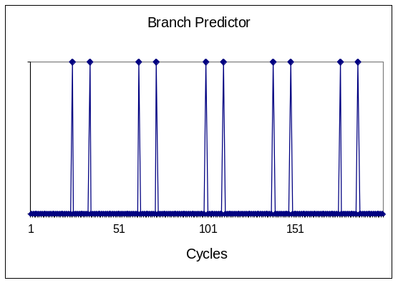
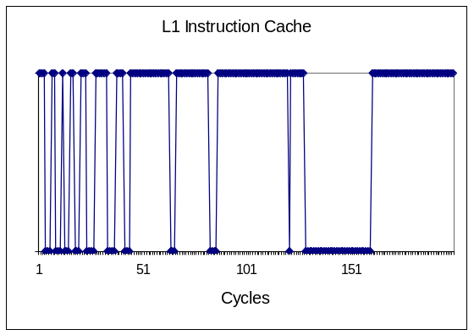
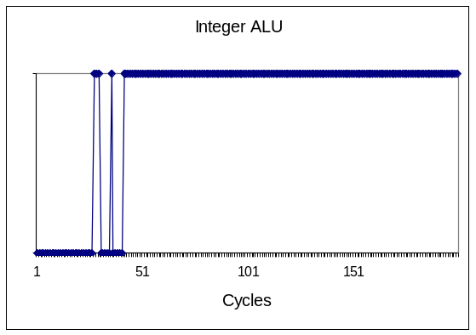
Decay-Counter Based Clock Gating
When can a module be reliably gated on and off?
How can module activity be monitored with ultra-low overhead?
How can we fine-tune clock-gating activity?
Decay Counters present an effective means

Slide 9
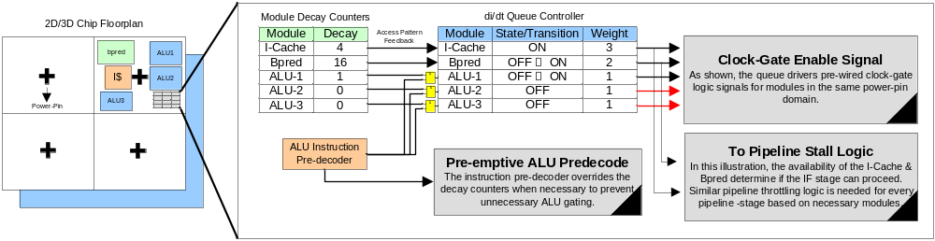
Floorplan-aware dynamic di/dt controller
Chip Floorplan
Pre-wired Clock-Gaters
Pre-emptive ALU
gating
Pipeline Stall Logic
Decay counters alone are not floorplan-aware
Can improve the current profile, but not guarantee current demand
Simultaneous gating needs to be controlled
A “queue-based” di/dt control mechanism can achieve all of the above.

Slide 10
Example Illustration
Re-sizeable
Sliding Window
Cycle:
1
Pre-wired
Clock Gating Signal
2
3
5
4
7
6
0
Floorplan
LSQ
di/dt Queue Controller
I$ and LSQ violates
3 Amp Threshold!
Module | Decay | Weight | State
I$ |  | 2
LSQ |  | 3
B-Pred |  | 1
Total Weight = 2
<
Threshold = 3
Gate OFF I$
Fetch Blocked
Request for LSQ
&
B-Pred Decay → 0
I$
3
Gate OFF LSQ
2
1
0
ON →OFF
OFF
ON
B-Pred
3
2
1
0
3
ON →OFF
OFF
OFF →ON
ON
ON
3
2
1
0
OFF
ON→OFF
ON
Cluster with three modules in same power pin domain
Assume permissible gating threshold → 3 Amps
ON→OFF is a negative switch
OFF→ON is a positive switch

Slide 11
Experimental Setup
Parameters | Values
Fetch/Decode Width | 8-wide
Issue/Commit Width | 8-wide
Branch Predictor | Combining 16K-Entry Metatable Bimodal: 16K Entries 2-Level: 14 bit BHR, 16K entry PHT
BTB | 4-way, 4096 sets
L1 I$ & D$ | 16KB 4-Way 64B Line
I-TLB & D-TLB | 128 Entries
L2 Cache | 256KB, 8-way, 64B Line
L1/L2 Latency | 1 cycle/6 cycles
Main Memory Latency | 500 cycles
LSQ Size | 64 entries
RUU Size | 256 entries

Slide 12
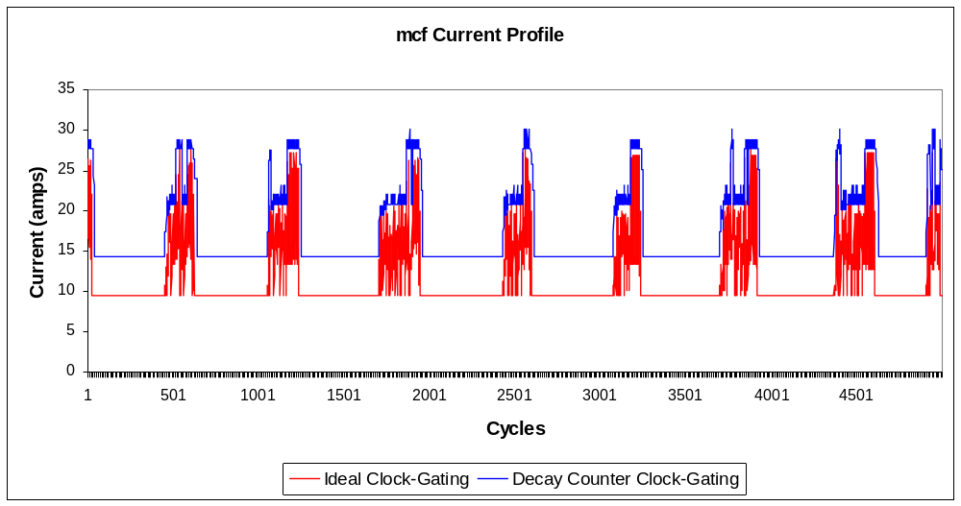
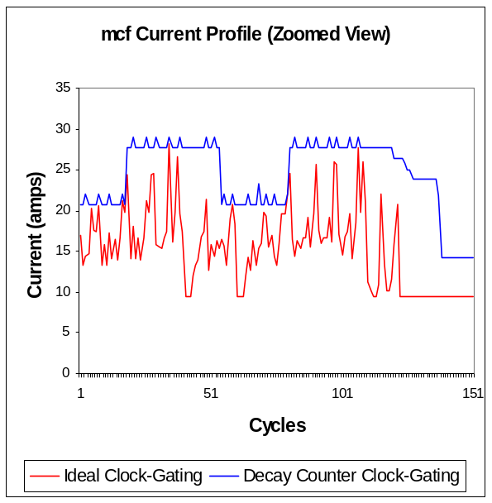
Full Chip Current Analysis
Low ILP benchmark – 164.mcf
Decay counter maintains an optimal power envelope
Smoothens the down-ramp

Slide 13
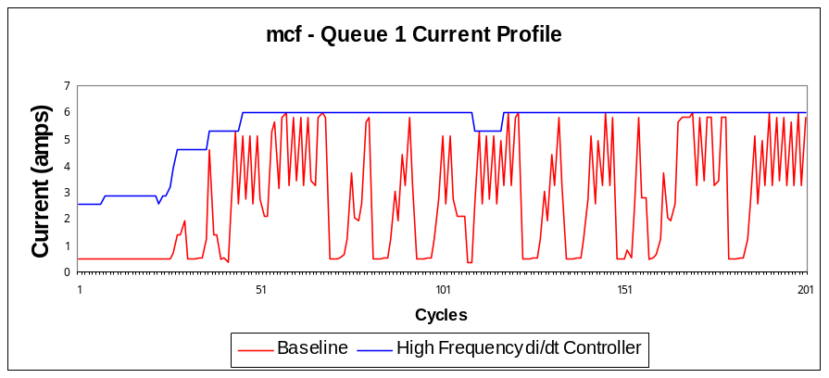
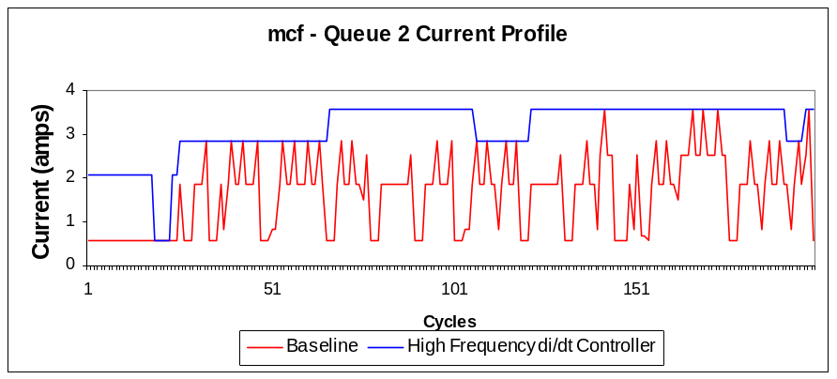
Queue Current Analysis
Low ILP benchmark – 164.mcf
Queue prevents simultaneous gating
Alleviates both abrupt up/down ramps

Slide 14
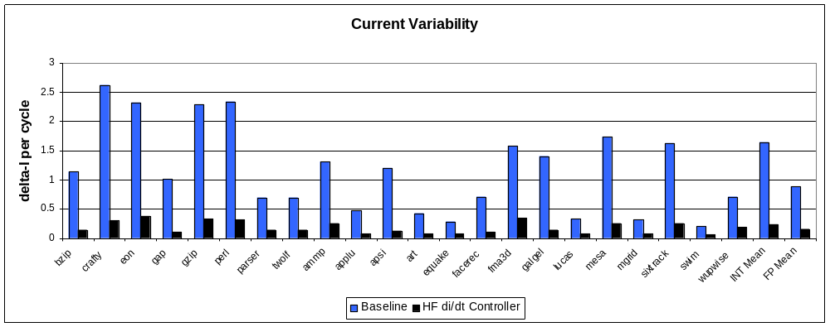
Current Variability
Reduces current variability by 7x average
All benchmarks are consistently below 0.5 amps/cycle

Slide 15
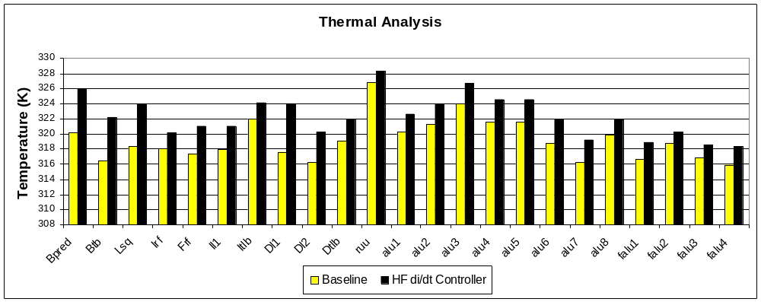
Thermal Analysis
Hotspot → Initial Temperature 300K
Avg. temperature increase of 3.15K

Slide 16
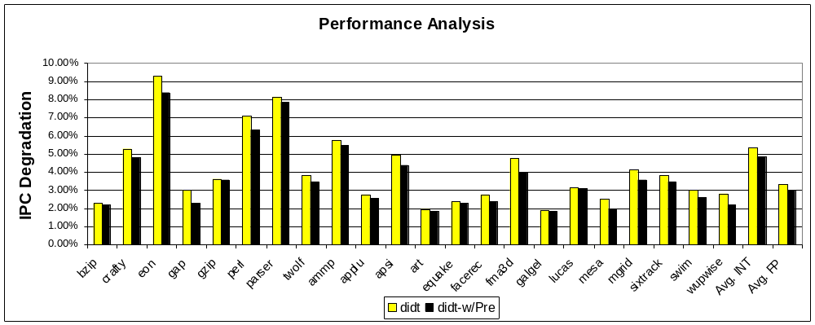
Performance Analysis
Baseline (full-speed) vs. didt throttling
Avg. IPC degradation of 4.0%

Slide 17
Conclusions
Traditional design methodologies continue to be inefficient
Inductive noise no longer a design afterthought
Decaps consume chip real-estate, and contribute to leakage, eroding benefits from clock-gating
Our research proposes
  Cooperative physical design and microarchitecture techniques
  Static control through physical design
  Dynamic di/dt control through microarchitecture techniques

Slide 18



Thank you
http://arch.ece.gatech.edu
http://www.3D.gatech.edu

Slide 19
BACKUP SLIDES

Slide 20
Guaranteeing Reliability
Reliability for di/dt guaranteed traditionally via worst-case design
  Post-design decap allocation till modules under noise margin
    → Consumes chip real-estate and adds leakage
  Fine-grained or progressive gating of microarchitectural modules
  → Increased design complexity (e.g. IBM Power5)
Worst-case design → inefficient, high cost/design effort.
A “one-size fits all” approach is needed
  di/dt needs to be considered in the early design phase
  Post design efforts need to be mitigated with effective dynamic noise control

Slide 21
Inductive Noise Classes(2)
High-frequency inductive noise
  di/dt effects over few cycles
  Current solution: on-die decaps
  Requires immediate response (existing solutions inadequate)
Implications on a microarchitecture-based control system
  Simple yet effective, need to be
    Low overhead
    Fast response
  Minimize performance throttling
Notes:
What is a decap on chip

Slide 22
Variations of Inductive Noise
Mid to Low-frequency inductive noise
  Typically in the 50 to 200 MHz range (resonant frequency)
  di/dt effects spread across thousands of cycles
  Handled by package and/or bulk motherboard decaps
  Does not require instantaneous response
  Worst possible di/dt effect occurs at resonance frequency
  Prior studies by
    Joseph et al. (HPCA-03, HPCA-04)
    Powell and Vijaykumar (ISCA-30)

Slide 23
Controller Features
Main objective → preventing simultaneous gating
Salient features of the queue
  Floorplan aware → spatial location of modules
  Decay counters based feedback
  Preemptive ALU gating-on through pre-decode
  Progressive gating large blocks within predefined bounds
Pre-wired clock gating logic for easy integration into conventional OOO pipeline
Customizable architecture depending on the design power vs. performance requirement

