Slide 1
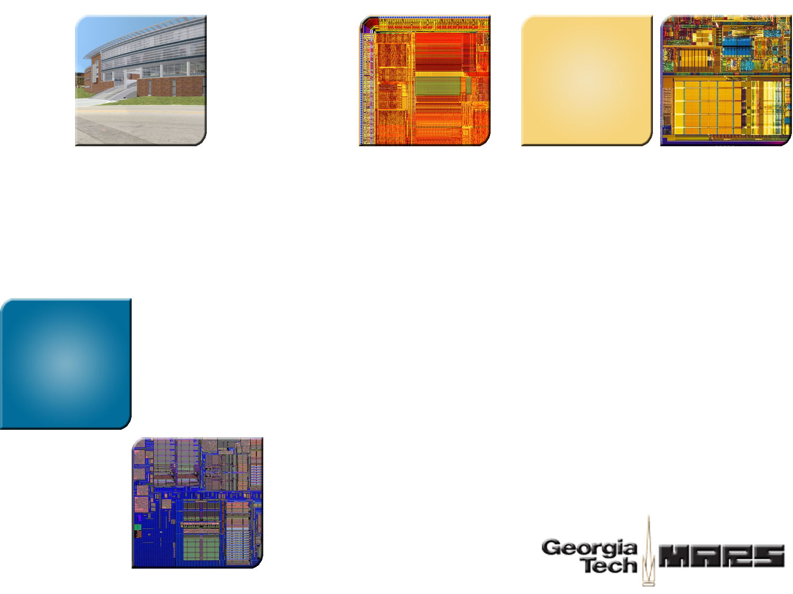


Authentication Control Point and Its Implications For Secure Processor Design
Weidong Shi Motorola Labs
Hsien-Hsin S. Lee Georgia Tech

Slide 2

Problem Statement
Excerpt From SOD Public Document
“ Studies indicate that approximately 80% of all CPI (Critical Program Information ) is contained in software/firmware. A broader range of robust techniques or technologies that protect software, data, and firmware is essential and will have a broad impact on protecting CPI. Secure programmable logic devices and secure processors are needed. “

Slide 3
Layered Security Architecture
Layer | Exploits | Solution
Application | software patching/amputation, de-compilation, worm, virus | application signing, access control, …
OS | rootkit, system call tampering kernel space eavesdrop | OS signing, virtualization, …
Firmware/ Boot image | BIOS spoof/hijack,boot image virus | TCG/TPM (trusted platform module)
Platform Level | chip interconnect/bus snoop, eavesdrop, device spoof | secure processor, memory encryption
Sub Platform Level (side-channels) | power analysis,timing analysis, etc | self-timed circuit, obfuscated power footprint
Package & Circuit Level | de-packaging, micro-probing, optical reverse engineer | secure packaging, private circuit
chip interconnect/bus
snoop, eavesdrop, device spoof
secure processor,
memory encryption

Slide 4


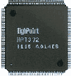


Architecture Overview
Processor Core
L1/L2 $
Memory Enc/Dec,
Integrity Verification Engine
Trusted Secure μProc
Encrypted Memory
MICRO 2003, PACT 2004/2006, ASPLOS 2002/2004,
ISCA 2005/2006, HPCA 2003.

Slide 5

Integrity Check vs. Superscalar Processor
Issue of implementing integrity verification in superscalar processor
  Decryption is faster than authentication
  Great temptation to issue decrypted instructions/data before authentication
Encrypted Memory Line
Decryption
Integrity
Verification
Wait for integrity
verification
Disassociation of decryption and authentication
  Memory fetch side-channel
  Disclose information through fetch address
  Confidentiality violations
Processor Pipeline

Slide 6
Decryption and Integrity Verification
Decryption Pad
Computation
Memory Fetch
Decryption
Pad
Decryption
Pad
Decryption
Pad
Decryption
Pad
Cipher
Block
Cipher
Block
Cipher
Block
Cipher
Block
MAC
Cipher
Block
Cipher
Block
Cipher
Block
Plaintxt
Block
Plaintxt
Block
Plaintxt
Block
Plaintxt
Block
Cipher
Block
= =?
MAC

Slide 7
Integrity Verification and Stall
Reorder
Buffer
Authentication-then-commit
Rename File
Issue Queue
Reservation Station
Issue Queue
Reservation Station
FU
LQ
SQ
Instruction Fetch
Authentication-then-issue
Integrity Veri
dL1$
iL1$
Veri Request FIFO
Authentication-then-write
Memory
Enc/Dec
WriteBack
Buffer
L
2
$
Authentication-then-fetch
Front Side Bus Control

Slide 8
Write/Fetch Stall Due to Integrity Veri
R1<-[R3]
Authentication-then-fetch
Stall external Mem fetch
TEST
R1, R5
Authentication-then-write
  Stall external Mem write
BEQ Addr2
NO
R3<-R1+4
R2<-[R1]
R4<-[Add1]
R1<-[R3]
R4<-R4+R2
R1<-[R3]
[Addr1]<-R4
[Addr1]<-R4

Slide 9
Pitfall of Speculative Fetches
Bit Flipping Attack
Why?
Fetches not considered as
state changes.
ciphertext
plaintext
1
0
1
1
0
1
0
1
0
1
0
1
0
0
1
1
0
1
Fetch is launched
speculatively to improve
performance.
addr =
0
0
0
0
1
1
0
0
Data
Next
Secret
Fetch as a result of malicious
tampering.
Data
Cipher text of NULL Pointer
Next
1
1
1
0
0
1
0
1
Target Address
XOR
0
0
0
0
1
1
0
0
Data
NULL
1
1
1
0
1
0
0
1

Slide 10
Pitfall of Speculative Fetches
Int* p;
Sum = 0;
while (p)
{
Sum += *p;
p++;
}
R1<-[R3]
Load Tampered
Pointer
JMP
Add1
JMP
Add1
TEST
R1, R5
TEST
R1, R5
NO
NO
BEQ Addr2
BEQ Addr2
Data
R2<-[R1]
R3<-R1+4
R2<-[R1]
Tampered
Pointer
Secret
Disclose Secret
R4<-R4+R2
R1<-[R3]
Load Secret

Slide 11
Comparison of Different Schemes
Precise
Interrupt
Uncorrupted
Memory State
Uncorrupted
Proc State
Risk of Tampered
Speculative Fetch
Authen-then-Issue
Yes
Yes
Yes
No
Authen-then-Commit
Yes
Yes
Yes
Yes
Authen-then-Write
No
Yes
No
Yes
Authen-then-Fetch
No
No
No
No
Authen-then-Commit
+ Fetch
Yes
Yes
Yes
No
Authen-then-Commit
+ Addr Obfuscation
Yes
Yes
Yes
No

Slide 12
Simplified Implementation
Verified Integrity of Line (Tag = 6)
Integrity
Verification Logic
Verified Integrity of Line (Tag = 8)
ID, Enc Line, MAC
Tag
MAC Veri Reqs
Tag
Addr
Line
Tag
Addr
4
8
0x120
4
Line X
Line X
6
0xff0
0xdeadbeef
5
Line Y
5
Line Y
6
6
Line Z
Line Z
7
Line U
7
Line U
8
Line V
Write Line
Read Line
8
Line V
Memory Line Authentication
Request FIFO

Slide 13
Experimental Setup
Parameters | Value
L1 I/D Cache | DM, 16KB
L2 Cache | 4way, unified, 256KB/1M
Memory Bus | 200MHz, 8B wide
CPU Clock | 1GHz
L1 Latency | 1 cycle
L2 Latency | 4 cycles (256KB), 8 cycles (1MB)
Decryption Latency | 80ns
RUU | 64, 128 entries
Simplescalar 3.0
SPEC2000 INT/FP

Slide 14
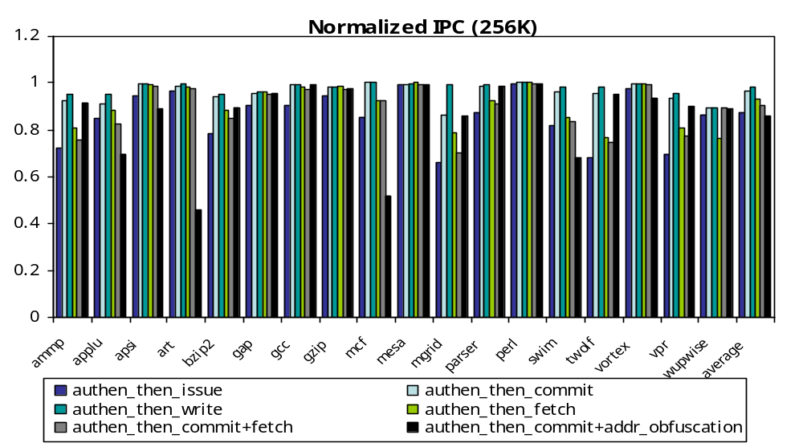
Results
Performance Ranking
  write > commit > fetch > commit+fetch > issue > commit + addr obfuscation

Slide 15
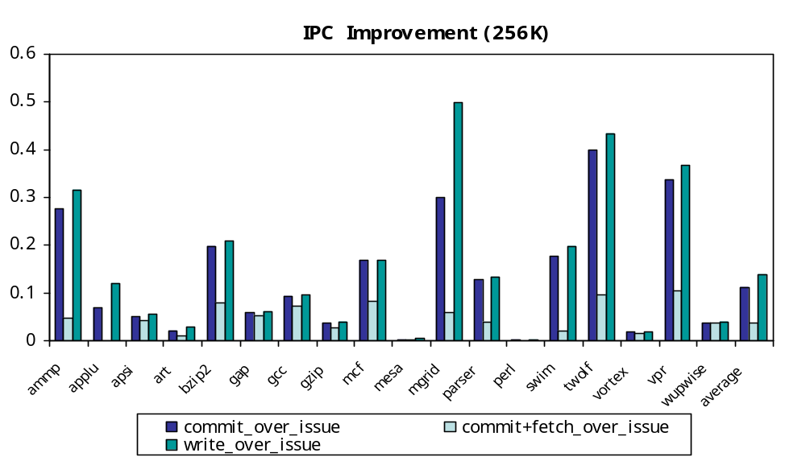
Results
Significant Advantage of Write, Commit Over Issue
Commit + Fetch 5-10% Faster Than Issue

Slide 16
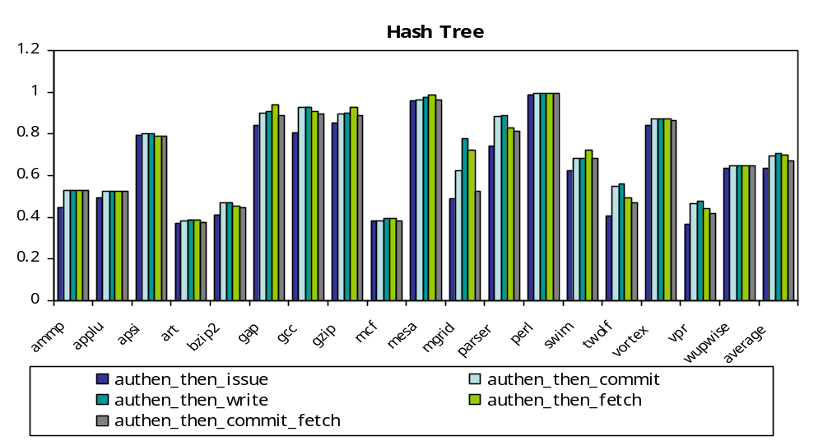
Results
Write > Fetch > Commit > Commit+Fetch > Issue

Slide 17
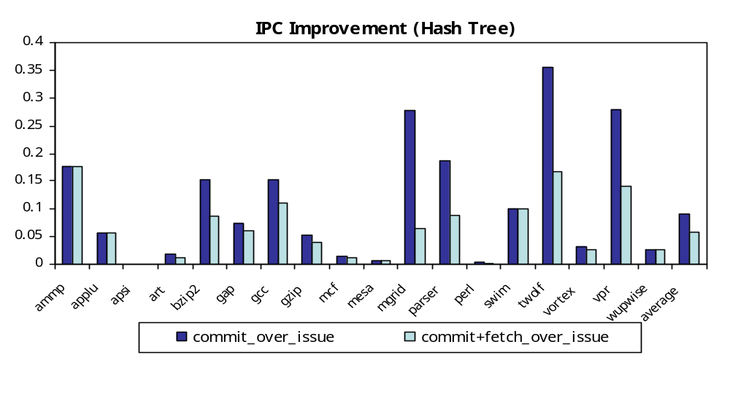
Results
Significant Advantage of Commit, Commit+Fetch Over Issue

Slide 18
Conclusions
The bottleneck is not decryption speed but authentication and
integrity verification performance.
To prevent memory fetch address side-channel exploits,
authen-then-issue and authen-then-fetch+commit are recommended.
Authen-then-issue is favored for design simplicity and security. Only 5-10% performance advantage for design that is equally secure.
Authen-then-commit and authen-then-write may be appealing when physical attack is less a concern.

Slide 19



Thank you
http://arch.ece.gatech.edu

Slide 20
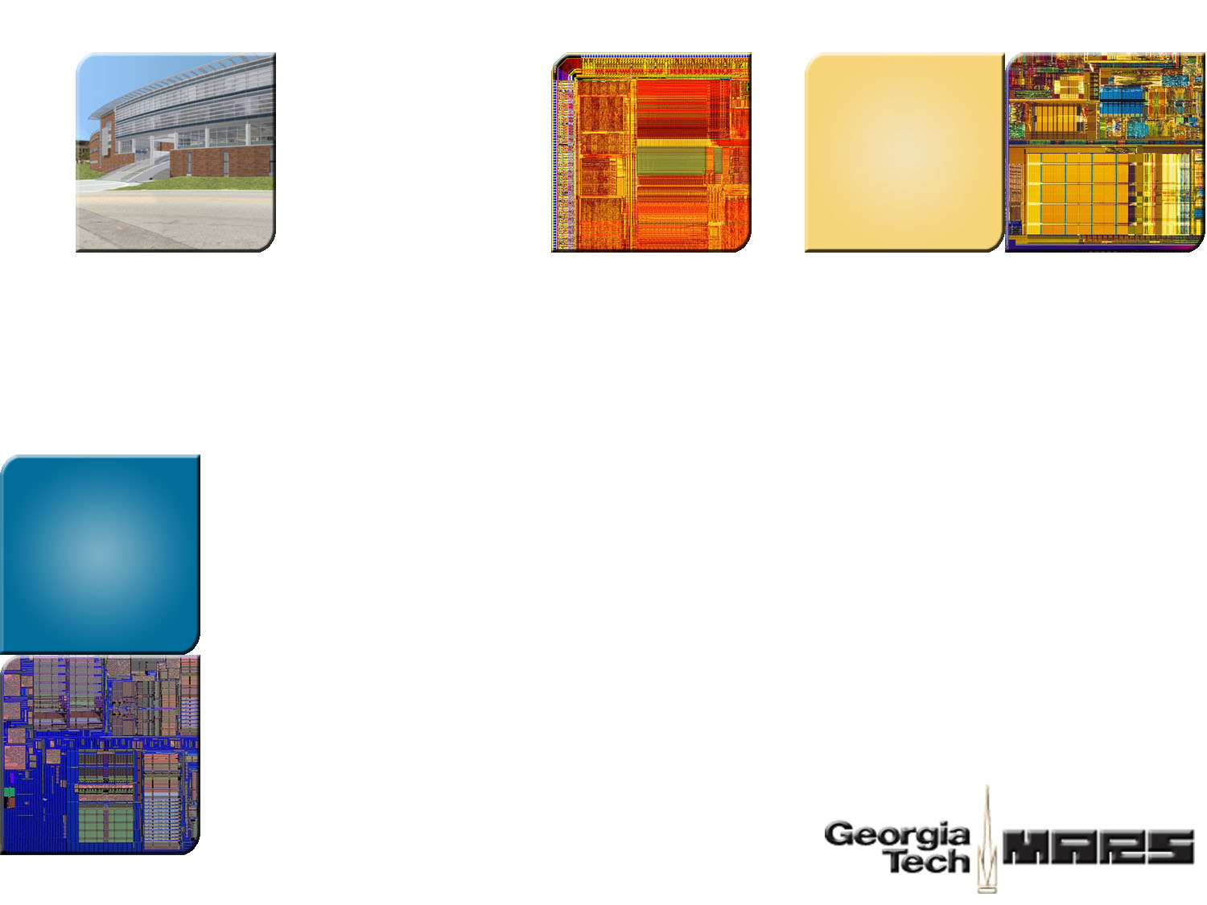
Georgia Tech MARS Labs http://arch.ece.gatech.edu

Slide 21
Much Simplified Exploits
Invariant Prologue
After Step 2
Look for Invariant
Prologue or Epilogue or
Predicable Code Sequence
(e.g., NOPs)
SP, -16(SP)
R1<-[addr]
STQ Zero, 8(SP)
R2<-[R1]
…
…
Replace the Victim Code
Sequence with Disclosing
Kernel
Runtime
Issued
Executed
Verified
R1<-[addr]
X
X
X
R2<-[R1]
X
X
X
…
Run the Tampered
Code
R1<-[addr]
Load Secret
Recover Secret from
Logical Analyzer
R2<-[R1]
Disclose Secret

Slide 22


Timing Analysis
Latency of new fetch address from the previous fetch
Authentication-then-issue
Time Line
external
memory fetch
decryption
authentication
external
memory fetch
decryption
authentication
Stall
Issue decrypted
inst/operand
Issue new fetch
Issue decrypted
inst/operand
Latency of new fetch address from the previous fetch
Authentication-then-fetch
external
memory fetch
external
memory fetch
decryption
authentication
decryption
authentication
Issue decrypted
inst/operand
Issue new fetch
Issue decrypted
inst/operand

