Slide 1
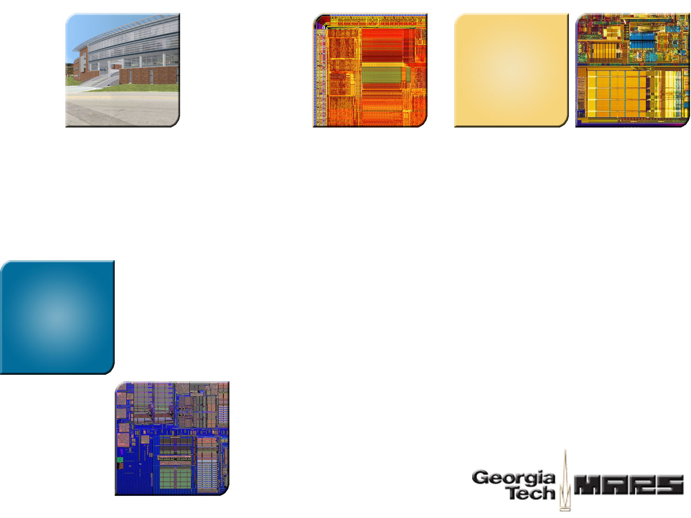

Smart Refresh: An Enhanced Memory Controller Design for Reducing Energy in Conventional and 3D Die-Stacked DRAMs
Mrinmoy Ghosh
Hsien-Hsin S. Lee
School of Electrical and Computer Engineering
Georgia Tech

Slide 2
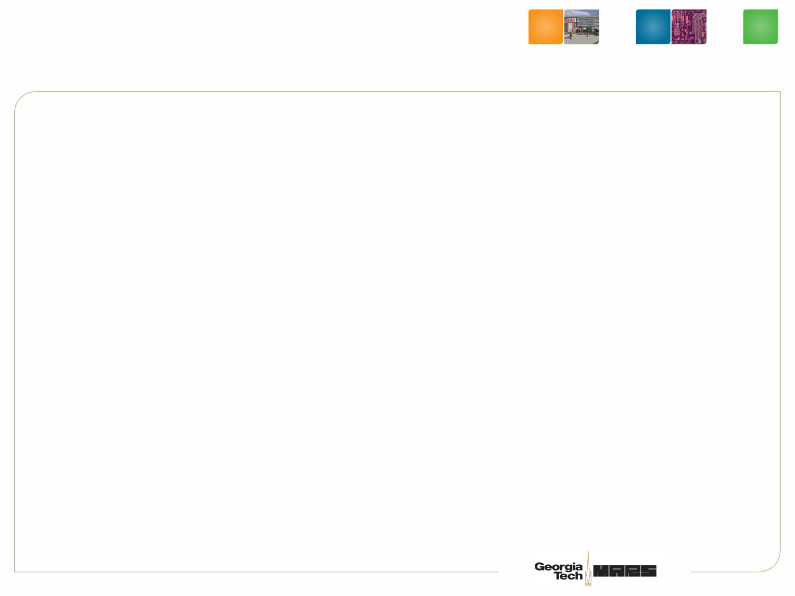
Motivation
Increase in DRAM power consumption
Increasing DRAM density
Ability to put more DIMMs in a computing system
Refresh is a major component of DRAM energy
  up to 1/3 of DRAM energy ¹
  DRAM energy is a major component of system energy
  (consumes up to 10W)
1 M.Viredaz and D. Wallach, “Power Evaluation of a Handheld computer: A Case Study”, Technical report, Compaq WRL, 2001.
Notes:
Current trend of increasing transistors on-chip manifests in two ways: larger caches as well as more number of levels of caches on the chip. Hence, memory hierarchy increasingly influences the performance of the system. The memory hierarchy being a significant portion of the chip area makes it a major contributor to the power as well. For example, the larger cache area may dissipate a significant amount of leakage power. This increased consumption is not only a major concern in embedded systems, where battery life and heat dissipation are important design concerns but also in desktop systems and servers due to their increased cooling costs. In my work, I focus on microarchitectural techniques that reduce the energy consumption of the memory hierarchy and increase its efficiency.

Slide 3
Outline
Redundancy in conventional DRAM refresh techniques
Smart Refresh architecture
Our technique for 3D die-stacked DRAMs on processors
Results

Slide 4
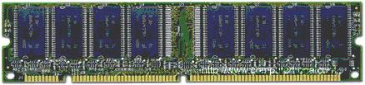
Current Refresh Policies
Row Address Strobe (RAS) Only Refresh
CAS Before RAS Refresh
DRAM Module
Assert RAS
Memory
Controller
RAS
CAS
R
R
A
R
WE
Row Address
Addr Bus
Refresh Row
DRAM Module
Assert RAS
Memory
Controller
RAS
Assert CAS
CAS
WE High
R
R
A
R
WE
Addr Bus
Refresh Row
Increment RRAR

Slide 5
Redundancy in Existing DRAM Refresh Techniques
Mem Refresh
Mem Refresh
Mem access
Mem access
Mem access
Mem access
Mem Refresh
Mem Refresh
Time
Refresh Time
for Row 0
Refresh Time
for Row 1
Refresh Time
for Row 2
Refresh Time
for Row 3
Each row accessed as soon as it is to be refreshed
Refresh of DRAM is not required if the row is accessed

Slide 6
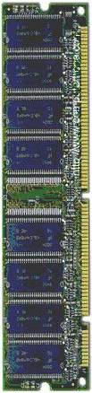
Smart Refresh
Memory Controller
DRAM Module
Update Counter
Circuit
Pending Refresh
Request Queue
Countdown Counters
A countdown counter for each DRAM row
The counter decrements to zero just before the row needs refreshing

Slide 7
Smart Refresh
Memory Controller
DRAM Module
Update Counter
Circuit
Pending Refresh
Request Queue
Countdown Counters
Implemented using RAS-only refresh
Provides better energy savings than CBR refresh

Slide 8
Naïve (Simultaneous) Counter Updates
3
3
…
3
0
0
…
0
1
1
…
1
2
3
2
3
…
…
2
3
Counters initialized to max after access/ refresh
Refresh if counter = 0
Simultaneous update causes burst refresh
Solution? If the counters are initialized to different initial values

Slide 9
Naïve (Simultaneous) Counter Updates
2
1
3
2
…
…
1
0
1
…
0
0
1
…
3
3
0
…
3
2
One fourth of the counters simultaneously become zero => Burst refresh situation
Solution? Staggering of counter updates

Slide 10
Staggered Counter Updates
Segment 1
Segment 2
Segment 8
1 2 ….. 16
1 2 ….. 16
1 2 ….. 16
T+1 ms
T+2 ms
T+16 ms
T
3
2
…
0
3
0
1
2
…
…
0
3
1
…
0
3
2
…
0
3
2
…
0
3
0
3
2
1
…
…
0
0
0
3
1
2
…
…
0
3
1
…
3
3
1
…
0
3
This Example:
Refresh Interval = 64 ms, All counters updated once within 16ms
Iterates over all the indeces four times within 64 ms
At most K simultaneous refreshes, K = number of logical segments.
Correctness condition: Interval between two counter updates must be enough to handle K refresh operations.

Slide 11
3D Die Stacking
Why stack DRAM on top of processors
  High density inter-die vias
  Short distance inter-die vias
  Lower power
  High throughput
Heat sink
Processor
Die-to-die vias
DRAM (Thinned die)

Slide 12


Smart Refresh for 3D DRAM Cache
Core
0
Core
1
Off Chip
DRAM
Memory
L2 Cache
Tags
64 MB
DRAM Cache
DRAM Cache Issues
  More accesses per cycle
  Higher temperature (90 C) → higher refresh rates.
  Significant potential for Smart Refresh

Slide 13
Other Applications of Smart Refresh
Use programmable counters to keep rows off
Implement Retention-aware DRAMs [HPCA-06]
Change protocol to reduce address transmission overhead

Slide 14
Experimental Framework
Simulation:
  Simics
  (Full system
  functional
  simulator)
Instruction stream
  Ruby
  (Cache
  hierarchy
  simulator)
Memory references
DRAMsim (DRAM simulator)
Power model:
    DRAM: DRAMsim
    Counters: Artisan SRAM generator
Workload:
    Biobench
    Splash-2
    SpecInt 2000

Slide 15
DRAM Configurations
Parameter | Conventional DRAM | 3D die-stacked DRAM cache
Type | DDR2 | DDR2
Size | 2 GB and 4 GB | 64 MB
Rows | 16384 | 16384
Frequency | 667 MHz | 667 MHz
Number of banks | 4 and 8 | 4
Number of ranks | 2 | 1
Number of columns | 2048 | 128
Data width | 64 | 64
Row buffer policy | Open page | Open page
Refresh interval | 64 milliseconds | 32 milliseconds
L2 cache size | 1 MB | 1 MB

Slide 16
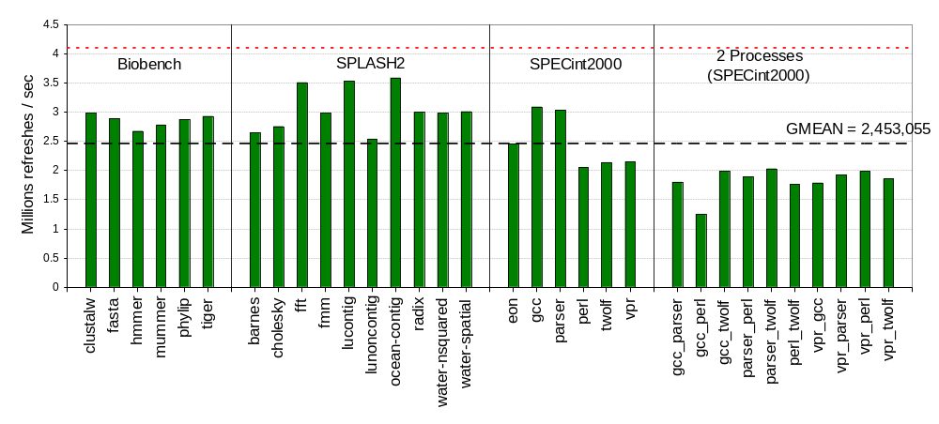
# of Refreshes Per Second (4 GB DRAM)
Baseline = 4,096,000
Average reduction in number of refreshes per second = 40 %

Slide 17
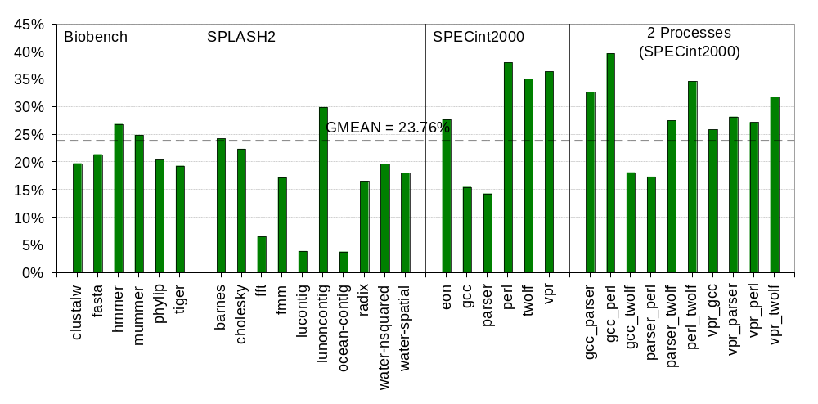
Refresh Energy Savings (4GB DRAM)
Average energy saving = 23.8%

Slide 18
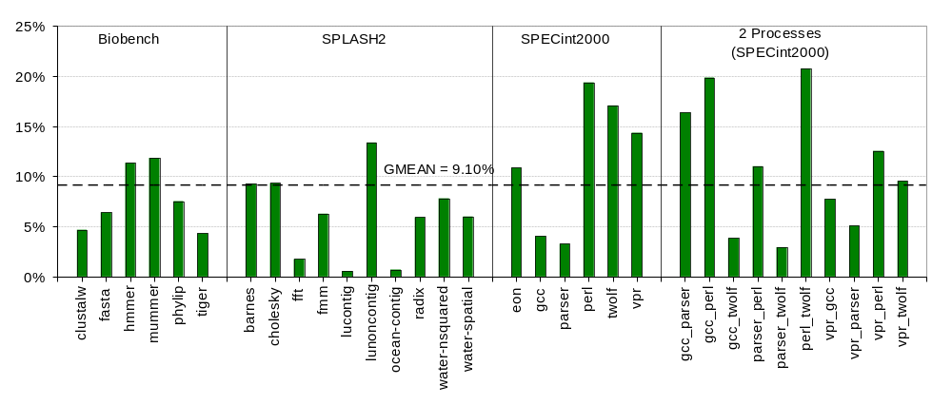
Total DRAM Energy Savings (4 GB DRAM)
Average energy saving = 9.1% (up to 21% in perl_twolf)
No performance degradation

Slide 19
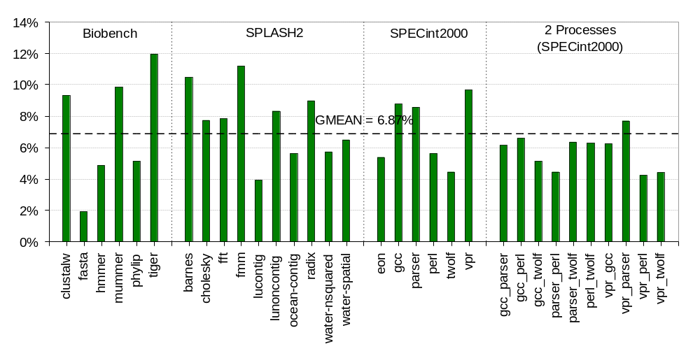
Total Energy Saving (64 MB 3D DRAM Cache)
Average energy saving = 6.9% (up to 12% in Tiger)

Slide 20
Conclusions
Redundant refresh operations cost significant energy
Smart refresh eliminates unnecessary periodic refreshes
11% (up to 17%) energy savings in conventional DRAMs
7% energy savings in 3D DRAM caches
No performance impact

Slide 21
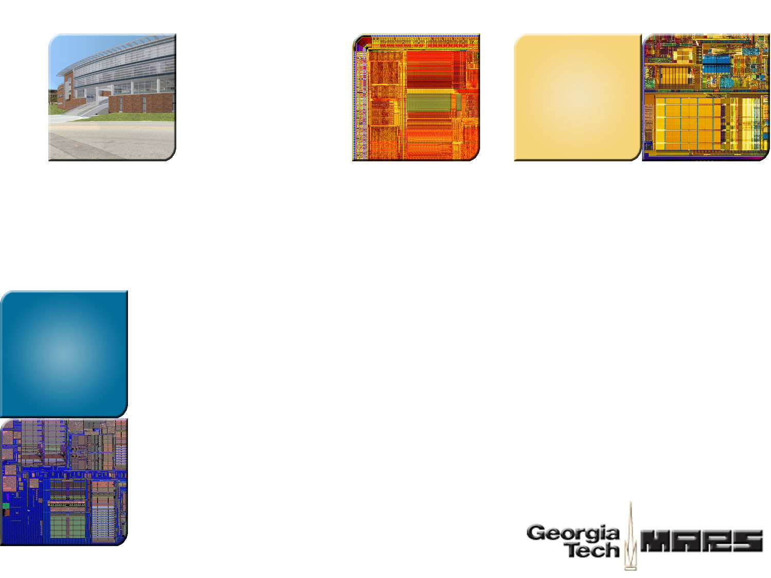

Thank You!
Georgia Tech
ECE MARS Labs
http://arch.ece.gatech.edu

Slide 22
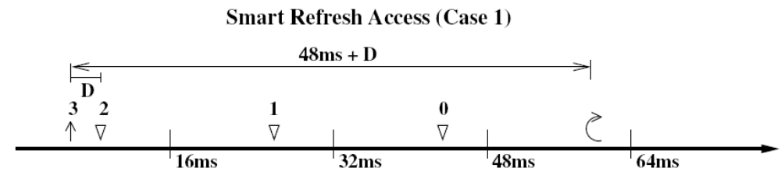
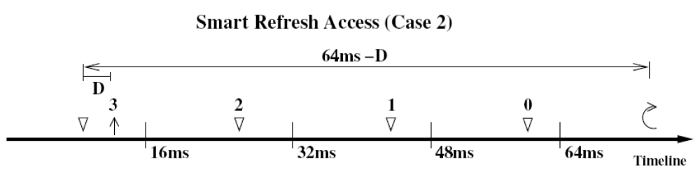
Correctness of Smart Refresh

Slide 23
No overflow of refresh queue
Typical Refresh Time = 70 ns
Counter Update Period = 8ms/((16384)/8)
= 3906 ns
Number of refreshes possible = 56
Number of refreshes required = 8

Slide 24
Area Overhead
Number of counters = 16384*2*4 = 131072
Space for 3 bit counters = 131072*3/(8*1024)
= 48kB
Ways to mitigate Area Overhead;
Use 2 bit counters.
Have DRAM module block for counters

