Slide 1
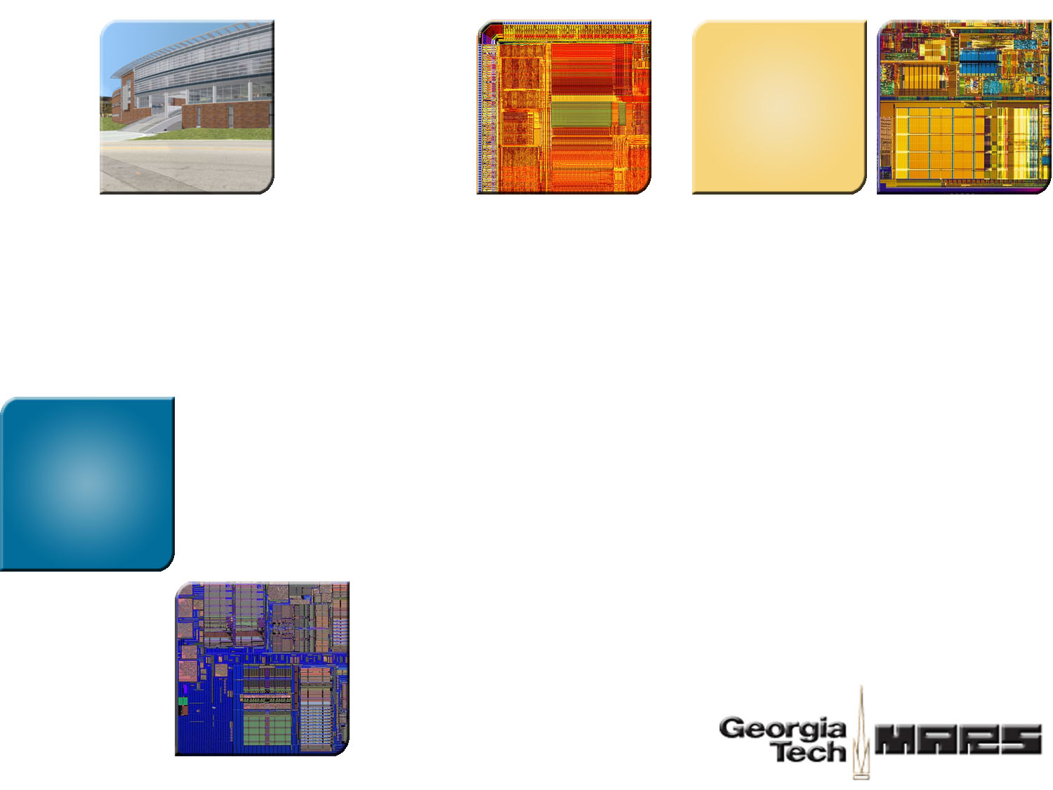


SHARK: Architectural Support for Autonomic Protection Against Stealth by Rootkit Exploits
Vikas R. Vasisht
Hsien-Hsin S. Lee
School of Electrical and Computer Engineering
Georgia Tech

Slide 2
Rootkit Definition
A set of programs that allows a permanent or
consistent, undetectable presence on a computer
  Not an exploit to gain elevated access
  Conceal all evidences and malware activities
Rootkit’s functions:
Hide processes, files, network connections and
conceal malware activities

Slide 3

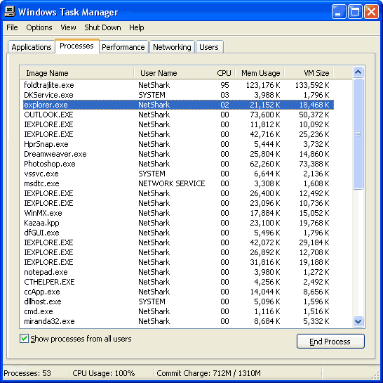


Example ­ Hidden Keylogger
Adversary
Task Manager looks clean
www.anybank.com
…login…
…password…
OS compromised & Rootkit installed

Slide 4








Rootkit Technique (I)
User Program
API Function
Library
Return
Choose Interrupt
Handler from IDT
Choose Syscall from SSDT
Syscall Function

Slide 5

Rootkit Technique (I)
User Program
API Function
Library
Return
Choose Interrupt
Handler from IDT
Choose Syscall from SSDT
Syscall Function
Modify OS execution flow to hide traces of malware

Slide 6
Rootkit Technique (II)
“ps”
Process-1
Safe machine Compromised Machine
>>ps >>ps
P-1 P-1
P-2 P-2
P-3 P-3
Malware P-5
P-5
Process-2
Process-3
Malware
Process-5
Direct Kernel Object Modification
Manipulate Kernel Data to remove malware information

Slide 7
Rootkit Detection Techniques
Software based techniques:
  Signature/Behavioral detection
  Works for only known rootkits
  Cross-View based detection
  Complex rootkits compromise low level OS view
  Integrity based detection
  Rootkits fake memory contents – Shadow Walker rootkit
Hardware based techniques:
  CoPilot (N. Petroni et al. [USENIX’04])
Integrity of host memory checked in a remote admin station
Send a faked memory snapshot to the remote machine.



√


Slide 8
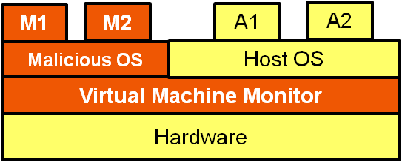
Sophisticated Rootkits
Sub-Virt¹
Bluepill²
A1
A2
A3
Host OS
Native OS
Hardware
Infection
VMRUN
Native OS continues execution inside VM
Hypervisor installed on-the-fly
Host OS downgraded to VM
Hypervisor below the host OS
1. King et al. [Symposium on Security and Privacy’06]
2. Joanna Rutkowska [Black Hat’06]

Slide 9



Challenge
We cannot detect hidden processes, VMs and VMMs using software techniques
Seeing a clean system
Applications
Sys. Admin Utilities
Get direct feedback from HW
Guest OS
VMM
H/W
Malware enjoying hardware resources
•
•

Slide 10


Motivation –
Process Context Aware Architecture
Process 1
Process 2
Process 3
Processes Spawned
Possible!
Page Tables
PT 1
PT 2
PT 3
Address Space
AS-1
AS-2
AS-3
OS completely manages processes and HW can be fooled

Slide 11



SHARK Big Picture
Process 1
Process 2
Process 3
Process Spawned
1st Page Table Update
Success
Fails
Encrypt
Page Tables
PT 1
PT 2
PT 3
Address Space
AS -1
AS -2
AS -3
Address space isolation achieved by page table encryption

Slide 12
SHARK – Secure Hardware Against RootKits
Hardware assisted PID Generation
  Software PIDs vulnerable
Page Table Encryption/Decryption
  Page table update: Hardware support for every update
  TLB miss: Page table decryption
Process Authentication
  On a context switch, PID → HPID Register
  TLB miss: HPID used for decryption

Slide 13
Hardware Assisted PID Generation
OS
New Process
Page Table
Encrypted PTE
1st PTE
Counter mode
AES
Encryption
SHARK
PID++
PID
64-bit Counter
128-bit
Secret Hardware Key
PID returned to the OS only after initial encryption

Slide 14
Page Table Encryption (x86)
Faulted VPN
V
Byte within page
PTE
Level 1
Level 2
Level 3
3rd Level - PT
128 V-Bits
4 PTEs
2nd Level - PMD
PDE
V
32-bits PTE
128 V-Bits
1st Level - PGD
CR3

Slide 15
Page Table Encryption (x86)
Faulted VPN
V
Byte within page
PTE
Level 1
Level 2
Level 3
3rd Level - PT
128 V-Bits
4 PTEs
2nd Level - PMD
V
PDE
32-bits PTE
128 V-Bits
1st Level - PGD
CR3

Slide 16


Page Table Encryption (x86)
V
PTE
PID
PID
128 V-Bits
3rd Level - PT
128-bit secret H/W key
AES – 128
4 PTEs
128-bit
Cipher-Text
4- PTEs
128-bit
Plain-Text
4-PTEs
32-bits PTE
Counter(PID) not a secret; HW key is secret
PID
PID
V-Bit
Block ID
AES – 128
128-bit secret H/W key
128-bit
Cipher-Text
V-bit Array
128-bit
Plain-Text
V-bit Array

Slide 17
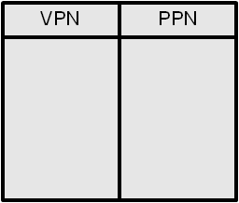

TLB Update (x86) – Handled by SSM
Memory Access
TLB miss: Two V-bit array decryptions + one PTE decryption
VPN
PPN
V
PTE
3rd Level - PT
TLB
TLB Update
Counter Mode
Decryption
(AES-128)
Hardware Page Table
Walk
Page Table
walk
V
PDE
1st Level -PGD
Counter Mode
Decryption
(AES-128)
Counter Mode
Decryption
(AES-128)
CR3
HPID Register

Slide 18
Instructions supported in SHARK
GENPID- Generate a new PID
  Used when a new process is created
MODPT- Update the page table of a process
  Used when page tables have to be modified
DECPT- Decrypt a process' page table entry
  Used to know the physical pages of processes

Slide 19
MODPT: Physical Page Tracking
MODPT used to Invalidate a page table entry:
PID
^{Physical Page}
^{Physical Page}
Counter Mode
Encryption
(AES-128)
SHA-256 Checksum
32B Encrypted Checksum
MODPT used to Validate a page table entry:
PID
Update PTE
^{Physical Page}
SHA-256 Checksum
Counter Mode
Encryption
(AES-128)
YES
=?
NO
Illegal PT Update
32B Encrypted Checksum
Tracks the association of memory page and owning process

Slide 20


Stealth Checker
I can compare and catch hidden software contexts
OS
“ps”
Context Switch
•
•
HPID
Page Tables
SHARK
VPN-PPN
PID 1
PID 2
PID 3
Master PID List
PIDs
Hardware
Implemented in Firmware
Encrypts and sends PIDs to a remote system admin machine
Hardware and software lists compared in the remote machine

Slide 21
Experimental Analysis
Functionality Evaluation
  BOCHS emulator + modified Linux 2.6.16.33
  Rootkits installed: Adore 0.42, Knark 2.4.3, Phide, Enyelkm.en.v1.1, and Mood-nt-2.3
  SHARK was able to detect all rootkits
Performance Evaluation
  VirtuTech SIMICS
  Performance overhead due to encryption/decryption

Slide 22
Performance Evaluation
SPEC 2006 benchmark suite
Emulated first 2B instructions
  More page faults and TLB updates
SHARK Overhead in recompiled Linux kernel 2.6.16.33
  MODPT instruction: 6 * AES + SHA-256
  TLB Refill: 3 * AES
  DECPT instruction: 3 * AES
Sensitivity study for different TLB configurations
  4 KB and 2 MB pages supported (x86)
  Varied number of TLB entries
TLB flushed upon every context switch as in x86 machines

Slide 23
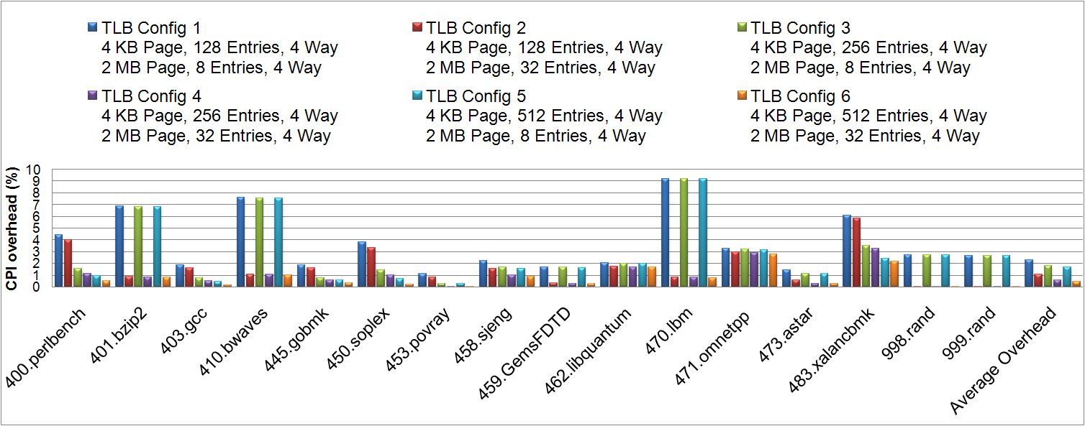
SPEC2006
Performance impact with different TLB organizations
More context switches and more TLB misses
Sensitive to the number of entries for 2MB pages in TLB
Average CPI overhead is 1.3%

Slide 24
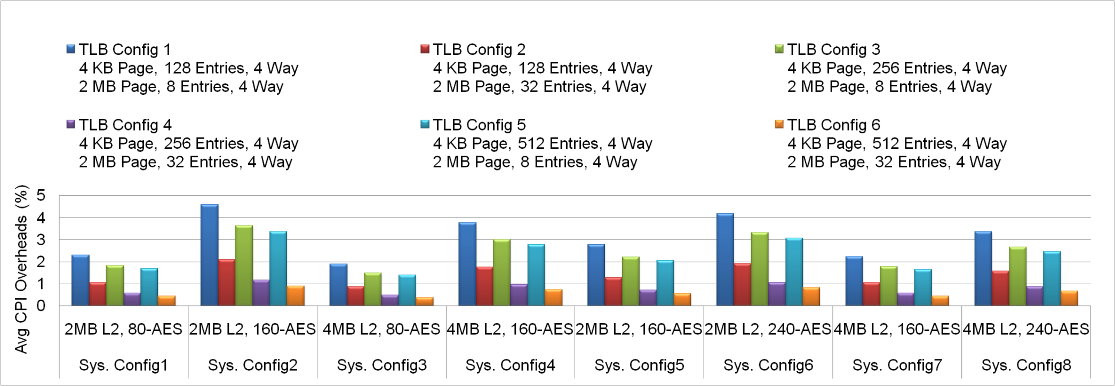
SPEC2006 (6 System Configurations)
Larger AES latency increases the overhead
Larger L2 cache (longer L2 latency) lowers the overhead
Average overhead:
Range : 0.45% - 4.7%

Slide 25
Conclusions
SHARK is the first synergistic micro-architecture and OS technique to address the Rootkit exploits
Concealed activity at User, Kernel and VMM levels will be revealed
Low performance overhead makes it practical

Slide 26



Thank you
http://arch.ece.gatech.edu

Slide 27
BACKUP SLIDES

Slide 28
Software Detection Techniques
Signature-based detection
- Identify fingerprint
- Works only for known rootkits
Heuristic/Behavioral detection
- Deviation in expected normal system behavior
- False positives
Cross View-based detection
- Compare high level OS view with low level one
- Low level OS can also be compromised
Integrity-based detection
- Compare memory snapshot with a trusted baseline

Slide 29

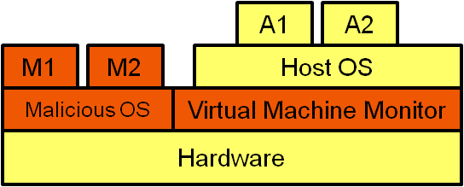
Sophisticated Rootkits
Shadow Walker Rootkit¹
Sub-Virt²
Malware
Code
A1
A2
A3
TLB
Page Table
Host OS
Hardware
NP
Integrity Checking
Tools
Infection
Patched Fault Handler
Page Fault Handler
Memory Read
Memory Execute
Original Memory Contents
Malware Pages
Host OS downgraded to VM
Memory contents are faked
Jamie Butler, 2005
King et al. [SOSP’06]

Slide 30
Virtualization­based Rootkits
Bluepill Rootkit
Native OS
Installs hypervisor below the host OS on-the-fly: no changes to boot files
Exploit hardware support for virtualization
VMRUN
Native OS Continues execution inside VM
Hypervisor installed on-the-fly
Today we can’t effectively prevent nor detect virtualization-based rootkits
- Joanna Rutkowska

Slide 31
Copilot¹ – Hardware Solution
Host
Independent Communication Link
PCI
Card
Snapshot of
Host memory
Admin Station
OS-independent HW solution
Integrity of host memory checked in a remote admin station
Counterattack²:
Create different views of the system memory to the processor and the co-processor.
Nick L. Petroni , 2004
Joanna Rutkowska, 2007

Slide 32
Software Detection Techniques
Signature-based detection
- Memory scanned to identify fingerprints of particular rootkits.
- Works only for known rootkits.
Heuristic/Behavioral detection
- Deviation in the expected normal system behavior is used as evidence
(e.g. Increase in execution time)
- Generates many false positives.
Cross View-based detection
- Compares a low-level system view with the high-level view obtained by compromised high-level OS calls.
(e.g. scheduler data structures compared with data used by “ps”)
- Assumes that low-level system view cannot be changed.
Integrity-based detection:
Compares the current snapshot of system memory with a trusted baseline.
- Was successful! Are we sure ?

Slide 33
Process Context Aware Architecture
Can current hardware architectures identify software process contexts?
Use Tagged TLB and create a master list of PIDs in hardware.
OS
Can OS use PID_{L} to run Malware ?
Context Switch
PID
PID
VPN-PPN
Yes! Flush the TLB
PID 1
Tagged TLB
PID 2
PID 3
Master PID List
Hardware

Slide 34
Process Context Aware Architecture
Use Page Table Base Address of a process to recognize the respective process in hardware.
OS
Context Switch
Hardware Page Table Walk
Good Approach!
Malware process cannot run if it uses PTBA_{L}
CR3
VPN-PPN
CR3 - P1
Page Table
CR3 – P2
CR3 – P3
Master CR3 List
Hardware
Not Enough! Swap page tables and use PTBA_{L}

Slide 35
SHARK – Secure Hardware Against Rootkits
Hardware Assisted PID Generation
- Software PIDs are vulnerable to attacks.
- Serves as Process ID Registration for every new process
Hardware Assisted Page Table Encryption/Decryption
- Page Table of process is encrypted using the PID of the respective process
- Any page table update from the OS has to go through the
Shark Security Manager (SSM)
- TLB stores plain-text translations. TLB miss requires page table decryptions.
Process Authentication
- On every context switch, OS loads the PID of the upcoming process into HPID register.
- On a TLB miss, all page table decryptions are performed using the contents of HPID as the key.

Slide 36
Instructions supported in SHARK
GENPID- Generate a new PID
- Initial Valid-bit array and PTE encryption is performed.
- M-bit of the respective PTE is set.
- Hardware generated PID is returned
MODPT- Update the page table of a process.
- Useful when the kernel directly updates page tables of Processes.
Every page table update needs decryption of the V-bit Array and PTE and re-encryption of the updated PTE.
DECPT- Decrypt a process' page table entry.
Useful if the kernel needs to know the physical addresses
by directly reading the page tables

Slide 37
MODPT Instruction
Two important Status bits in Page Table Entry:
Valid-bit (V)
Page present in Memory or Swapped out to disk
Mapped-bit (M)
Tracks whether the respective Virtual Page is mapped to a physical page or yet to be swapped-in for the first time.
Note that in SHARK, M-bit is completely managed in SSM and it cannot be
modified by OS
V = 0, M = 0: Virtual Page is not mapped.
V = 0 , M = 1: Virtual Page is mapped and physical page is swapped out.
V = 1, M = 1: Virtual Page is mapped and physical page is in memory
Page table Entry
V
M
Physical page

Slide 38
MODPT Instruction
M = 0 and MODPT used to Validate ?
Set M-bit and update the physical page in the respective PTE.
b) M = 1 and MODPT used to Invalidate ?
Implies that virtual page is mapped and swapping out the physical page to disk.
PID
^{Physical Page}
^{Physical Page}
Counter Mode
Encryption
(AES-128)
SHA-256 Checksum
32B Encrypted Checksum
c) M = 1 and MODPT used to Validate ?
Implies that virtual page is mapped and swapping in the page from disk.
PID
Update PTE
^{Physical Page}
Counter Mode
Encryption
(AES-128)
YES
SHA-256 Checksum
=?
NO
Illegal PT Update
32B Encrypted Checksum

Slide 39
Strengths of SHARK
With SHARK hardware support can OS run a process using a
different process’ PID ?
All possible combinations of (Key for Decryption, Page Table, Pages)
CASE 1 : (PID_{L} , PT_{L}, Page_{M} )
Not Possible- MODPT (PID_{L} , PT_{L}) expects E_{L}(Checksum(Page_{M}))
CASE 2: (PID_{L} , PT_{L}, Page_{L}) and copy malware to Page_{L} .
Not Possible- This needs a victim legitimate process whose memory
footprint is exactly same as malware.
CASE 3: (PID_{M} , PT_{M}, Page_{L})
Not possible – Same as case 1 and even if possible revealing PID_{M.}
CASE 4: (PID_{M} , PT_{M}, Page_{M})
This is the only possible way to run malware and has to reveal PID_{M}

Slide 40
Performance Evaluation
Processor System Configurations
Sensitivity Study on TLB configs
Sys, Configs | L1 | L2 | AES | SHA-256 Latency | Memory latency
Config 1 | 32KB, 8-way, 2 cycles | 2MB, 12 cycles,8-way | 80 | 138 | 200
Config 2 |  |  | 160
Config 3 |  | 4MB, 19 cycles,16-way | 80
Config 4 |  |  | 160
Config 5 | 32KB, 8-way, 3 cycles | 2MB, 25 cycles,8-way | 160 | 276 | 300
Config 6 |  |  | 240
Config 7 |  | 4MB, 38 cycles,16-way | 160
Config 8 |  |  | 240
TLB Config 1 | 4 KB Page, 128 Entries, 4 Way 2 MB Page, 8 Entries, 4 Way
TLB Config 2 | 4 KB Page, 128 Entries, 4 Way 2 MB Page, 32 Entries, 4 Way
TLB Config 3 | 4 KB Page, 256 Entries, 4 Way 2 MB Page, 8 Entries, 4 Way
TLB Config 4 | 4 KB Page, 256 Entries, 4 Way 2 MB Page, 32 Entries, 4 Way
TLB Config 5 | 4 KB Page, 512 Entries, 4 Way 2 MB Page, 8 Entries, 4 Way
TLB Config 6 | 4 KB Page, 512 Entries, 4 Way 2 MB Page, 32 Entries, 4 Way
Sources of Overhead in SHARK | Overhead
MODPT | 6 * AES + SHA-256
TLB Refill | 3 * AES
DECPT | 3 * AES
Overheads in SHARK

Slide 41
Functionality Evaluation
Bochs, an open source x86 PC emulator, was used to emulate Shark Security Manager and the infected OS.
Linux kernel version 2.6.16.33 was modified and recompiled
to use the SSM: Changed MMU, Scheduler of the OS. The practicality of the solution was verified.
To evaluate security, we installed rootkits over the modified kernel for SHARK running over the emulated SHARK hardware architecture.
(Rootkits installed: Adore 0.42, Knark 2.4.3, Phide, Enyelkm.en.v1.1, and Mood-nt-2.3)
Our SSM succeeded in all scenarios by triggering security alarms to reveal the processes running in stealth, demonstrating the effectiveness of our SHARK architecture.

Slide 42
Related work
Software techniques for kernel mode detection?
Not Enough to defend against new attacks.
Co-Pilot - hardware detection scheme aimed at providing a more reliable, OS-independent hardware solution.
Not safe anymore
Use VMMs to check the integrity of Host OS ?
Not safe because of emerging sophisticated rootkits like Bluepill
Micro-architectural Solutions for un-trusted Os – AEGIS, XOM?
The attack model we are considering here is different.

