Slide 1

A Vision for
Next Generation System Monitoring
Martin Schulz, Lawrence Livermore National Laboratory
Brian White, Sally A. McKee, Cornell University
Hsien-Hsin Lee, Georgia Institute of Technology

Slide 2
Motivation
Growing System Complexity
  Black-box effects
  Performance analysis increasingly difficult
We need more Self-Introspection
  Observe own system state
  Detect own bottlenecks
  Foundation for autonomic systems
Current State of the Art
  Few, limited counters in the core
  Event processing in the host CPU
  Low-level access
  Few external components contain counters

Slide 3
The Road Ahead
New data sources
  From all levels of the system
  Inside peripheral devices (network, I/O)
New data types
  Event-based data
  Event attributes
New metrics
  Custom on-line aggregation
  Higher level of abstraction
  But: must still ensure low overhead
Example: Memory system optimization
  Source = memory/cache bus activity
  Data/Event = memory transactions

Slide 4
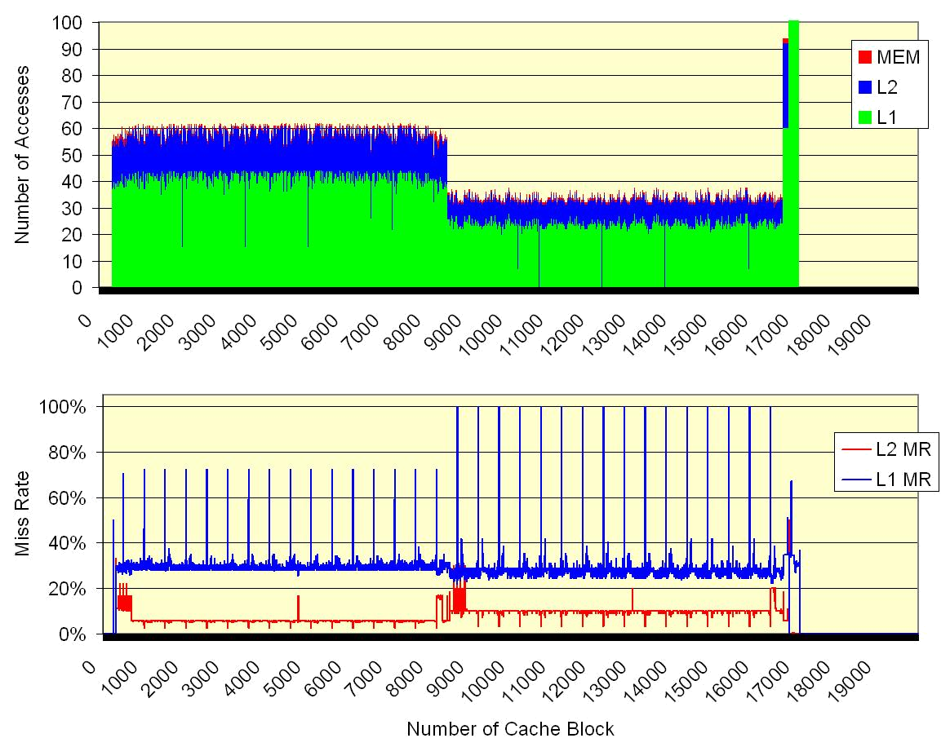
Cache Miss Histograms

Slide 5
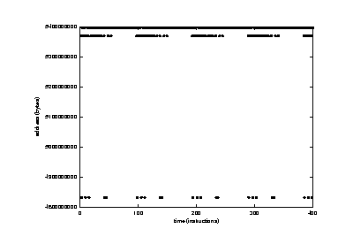
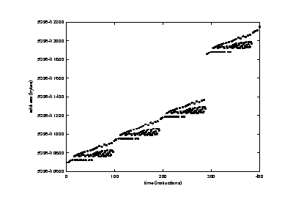
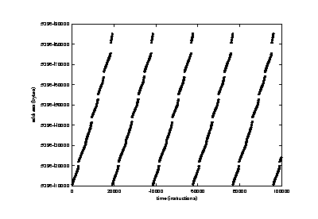
Memory Access Patterns
Repeating patterns
  Access to data structures
  Loops
Example: ammp
  SPECfp 2000 code
  Particle simulation
  Standard pattern matching algorithm on trace data
Useful for
  Guided prefetching
  Trace compression
  Workload characterization

Slide 6
Beyond Performance
Power/Heat control
  Temperature and power sensors
  Autonomous watch dogs
Debugging
  “Out-of-bounds” checks
  Complex assertion checks
Reliability
  Fault detections
  Access logging for checkpointing
Security
  Intrusion detection
  Decoupling from main CPU

Slide 7
Requirements
Future monitor systems must …
Be deployed system-wide in all components
Operate independent of host
Act coordinated and cooperative
Observe individual events and attributes
Contain hardware assist for aggregation
Be reconfigurable
Deliver data autonomously

Slide 8
Owl: System-wide Monitoring
Decouple source and metric
  Identical capsules
  Reconfigurable analysis modules
Capsules in all components
  Upload analysis modules
  Process data at source
Advantages:
  Low-level integration
  Interchangeable modules
  Similar access for tools
  Low overhead
CPU
M
CPU
M
M
M
L1 Cache
L1 Cache
M
L2 Cache
M
L2 Cache
M
M
M
M
Memory
M
I/O
Bridge
M
M
Notes:
<API to HW to get data <-> probes>

Slide 9
Monitoring Capsules
Capsules
  Access to probes
  Standardized interfaces
  Reconfigurable
  Data transfer to ring buffer
Control Interface
  Upload modules
  Configure modules
Query API (part of OS)
  Access to observed data
  High-level abstractions
  Persistent storage
  Inter-module analysis
Caches, Network, I/O, Core, …
Probe interface
Monitoring
Modules
Std. Interface
Monitoring
Modules
Analysis
Compression
Evaluation
Reduction
Capsule
Monitoring
Modules
Std. Interface
Monitoring
Modules
Eval. interface
Main memory
OS / Middleware / Application
Notes:
mention commercial FPGA implementations of machines
-> check IEEE computer article
-> OctigoBay and SRC systems

Slide 10
Research Challenges
Preprocessing Algorithms
  On-line algorithms for event processing
  Machine learning
  Application specific modules
Module Design
  Hardware/Software tradeoff
  Storage constraints
  Pipelining
  High-level design beyond HDL
Tools
  Visualization of observed data
  Guided optimizations
  Autonomic systems

Slide 11
Conclusions
We’ll need more than just counters
  Multiple data source (to cover the complete state)
  System-wide monitoring (the core is not enough)
  Aggregate metrics (not just sampling)
  Intelligent pre-processing (pre-sort event data)
Autonomous monitoring infrastructure
  Independent of host CPU
  System-wide
  Programmable/Reconfigurable
  Standardized query interface
More information on Owl:
http://owl.csl.cornell.edu/

