Slide 1
DLL-Conscious Instruction Fetch Optimization for SMT Processors
Fayez Mohamood
Mrinmoy Ghosh
Hsien-Hsin (Sean) Lee
School of Electrical and Computer Engineering
Georgia Institute of Technology

Slide 2
Dynamically Linked Libraries
An efficient way to develop software on a common platform
Modules that provide a set of services to application software
System DLLs help manage system functionality
Application DLLs enable flexibility and modularity
Name | Functionality
KERNEL32.DLL | Memory, IO and Interrupt functions
NTDLL.DLL | Core operating system functions
USER32.DLL | User Interface functionality like window handling, message passing
GDI32.DLL | Functions for creating 2-D graphics
MFC42.DLL | Contains the Microsoft Foundation Classes used by many Windows applications

Slide 3
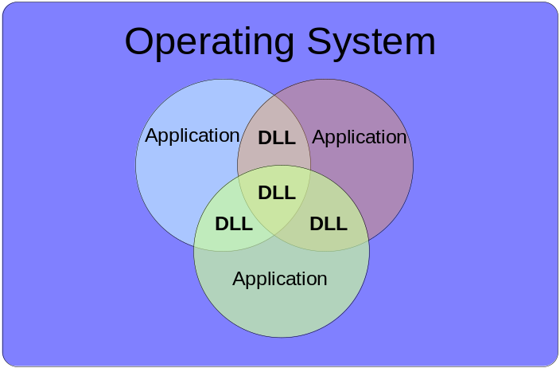
Shared Libraries
Process 0
Address Space
Process 1
Address Space
Application
Code
Application
Code
System
DLL
DLLs house major system and application functionality
Typical Microsoft Windows applications uses 30 DLLs on an average
Average of 20 DLLs are shared among different applications
Different applications share system DLLs on the same virtual page
Notes:
Define DLL loading into address space on different OSs.

Slide 4
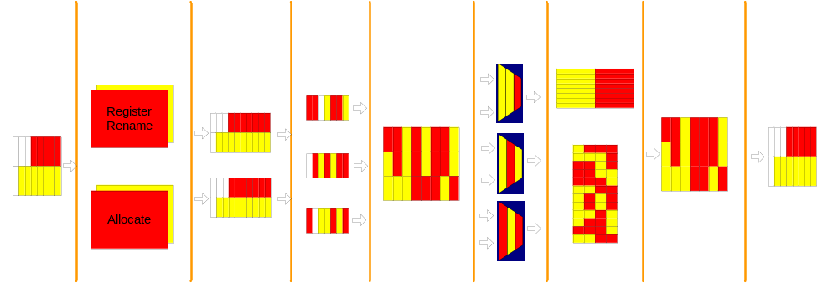
Simultaneous Multithreading
Boost instruction throughput with minimal hardware increase
Bottleneck due to resource sharing
I-Cache, branch predictor, LSQ, ROB etc shared
Commercial processors: IBM Power5, Intel Pentium4, Alpha 21464
Presence of DLLs exacerbates I-Cache performance

Slide 5
DLL Thrashing and Duplication
Virtual Memory is supported by common desktop platforms
Virtually-Indexed instruction caches accelerate lookup
Aliasing needs to be resolved in the I-Cache and the I-TLB
How can homonym aliasing be prevented ?
  Non-SMT processors can flush the cache/TLB upon a context switch
  SMT processors require a Process or Address Space Identifier to prevent access violation
PID or ASID induces false misses when a different process looks up an instruction that is part of a shared DLL

Slide 6
DLL Thrashing and Duplication
DLL Thrashing: In a direct-mapped I-Cache, shared DLL instructions will result in an increased number of conflict misses
Process 0: 0x1000 0x3453
PID | Valid | Tag | Data
0 1 0x100 0x3453
X 0 X X
Process 1: 0x1000 0x3453
1 1 0x100 0x3453
← FALSE EVICTION
DLL Duplication: In a set-associative I-Cache, shared DLL instructions will exist in multiple locations resulting in wasted space
PID | Valid | Tag | Data
X 0 X X
Process 0: 0x1000 0x3453
0 1 0x100 0x3453
Process 1: 0x1000 0x3453
DUPLICATION
PID | Valid | Tag | Data
X 0 X X
1 1 0x100 0x3453
Notes:
Mention tag 0x100, index 0;

Slide 7
DLL-Conscious Instruction Fetch
Program locality in presence of DLLs disturbed due to PID matching
Alleviate the DLL thrashing and/or duplication effect
We propose making the micro-architecture aware with capability to distinguish DLL and non-DLL instructions
DLL-Conscious Instruction Fetch:
  DLL (or L bit) in the page table, I-TLB
  Modified OS page fault handler that will set the L bit for DLLs
  For VIVT caches, an L bit in each line of the I-Cache to facilitate faster translation

Slide 8


VIVT I-Cache Optimization
HIT !
=
PID
Instruction Cache
PID | V | L | TAG | DATA
=
L1 Cache Index
Block Offset
Virtual Page Number
I-L1 Tag Compare
Page Offset
I-TLB for Thread 2
VALID | SHARED | VPN | PPN
I-TLB Lookup necessary only upon I-Cache Miss
I-TLB for Thread 1
V | L | PID | PPN
Notes:
Do animation for this slide and the next.
This is a 2-Way SMT I-Cache

Slide 9
VIPT I-Cache Optimization
HIT !
I-TLB for Thread 2
VALID | SHARED | VPN | PPN
=
PID
I-TLB for Thread 1
V | L | PID | PPN
Instruction Cache
V | TAG | DATA
I-L1 Tag Compare
=
L1 Cache Index
Block Offset
Virtual Page Number
Page Offset
Virtual Address of Instruction

Slide 10
VIPT Illustration
MISS
HIT !
Process 0: 0x1000 0x3453
Process 1: 0x1000 0x3453
I-TLB for Thread 2
VALID | SHARED | VPN | PPN
=
Process Identifier
I-TLB for Thread 1
V | L | PID | PPN
Instruction Cache
V | TAG | DATA
0
1
X
1
X
0
0x100
X
0
1
0x100
X
0x3453
X
I-L1 Tag Compare
=
L1 Cache Index
Block Offset
Virtual Page Number
Page Offset

Slide 11
Simulation Methodology
Studying DLLs required the modeling of an entire platform
TAXI: Trace Analysis for x86 Interpretation (by Vlaovic et al.)
  Bochs System Emulator
  Modified SimpleScalar with x86 front end
Kernel Debugger to capture DLL behavior
Bochs
System Emulator
Instruction
Traces
Instruction
Traces
Memory
Traces
Memory
Traces
x86 Out-Of-Order
Performance Simulator
x86 SMT Out-Of-Order
Performance Simulator

Slide 12
Simulation Parameters
Parameters | Values
Fetch/Decode width | 4
Issue/Commit width | 4
Branch Predictor | 2-Level GAg, 512 entries
BTB | 4-Way, 128 sets
L1 I-Cache | DM, 2-Way and 4-Way 16KB and 8KB, 32B line
L1 D-Cache | DM, 16KB, 32B line
L2 Cache | 4-Way, Unified, 64B line 256KB
L1/L2 Latency | 1 cycle / 6 cycles
Main Memory Latency | 120 cycles
ROB Size | 48 entries

Slide 13
DLL Instruction Percentage
Application | Total Instructions (millions) | System DLL Instructions
Adobe Acrobat Reader 6.0 | 410 | 14.6 %
MS PowerPoint 97 | 366 | 20.8 %
MS Word 97 | 378 | 16.4 %
MS Internet Explorer 5.0 | 446 | 15.3 %
MS Visual C++ 6.0 | 398 | 11.4 %
Netscape Communicator 4.7 | 432 | 17.4 %

Slide 14
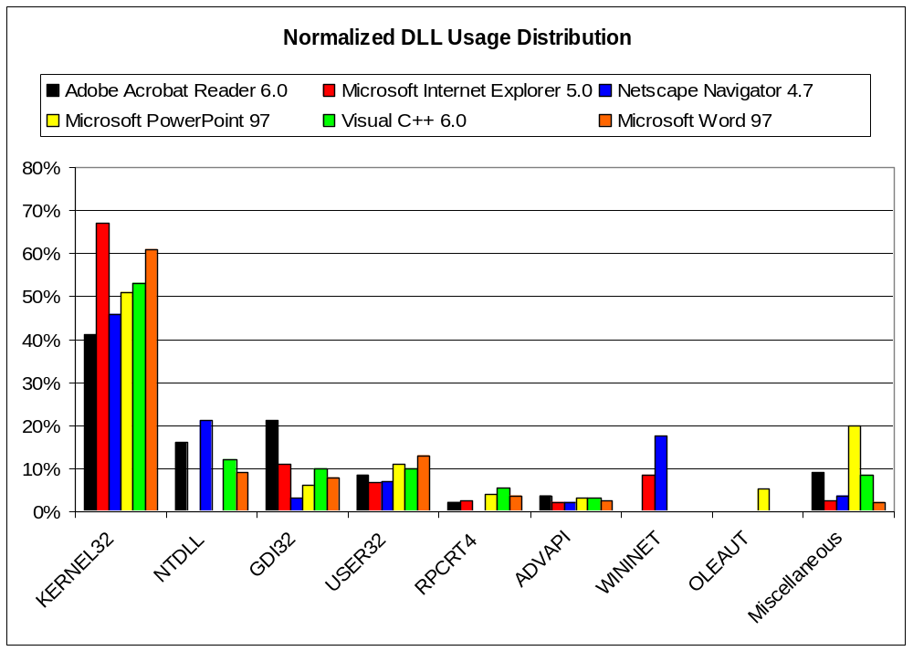
DLL Usage Distribution
Notes:
Percentage of DLLs among all instructions. Copy from the paper.
Graph for DLL percentage of different applications.

Slide 15
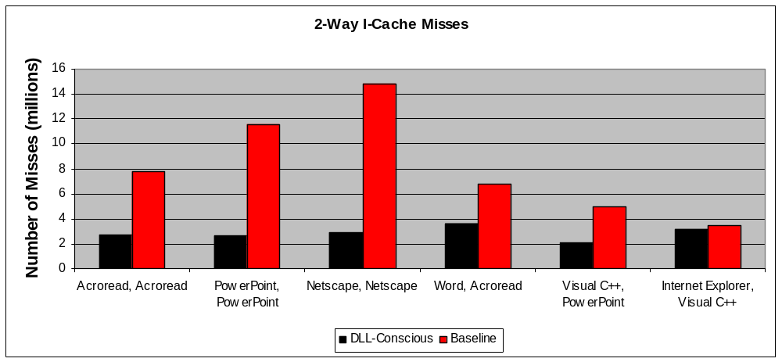
2-Way DLL I-Cache Misses
Homogeneous Threads
Heterogeneous Threads
Number of misses per thread decrease anywhere between 3.3 and 5.0 times for homogeneous threads
Heterogeneous threads decrease the number of misses by up to 2.5 times
Notes:
Draw a box for homogeneous threads, for visual separation.
Reconsider title (check out 2-Way)

Slide 16
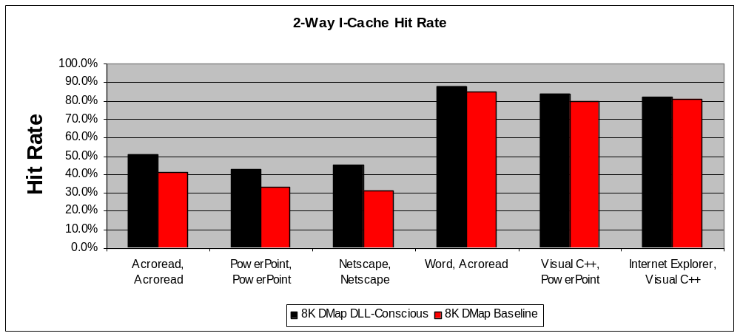
2-Way I-Cache Hit Rate
Homogeneous Threads
Heterogeneous Threads
Overall I-Cache hit rate increased by 50% (from 30% to 47% for Netscape Communicator)
Homogeneous threads show promise for more performance benefits
Notes:
Explain why the overall I-Cache hit result is lesser for homogeneous threads.

Slide 17
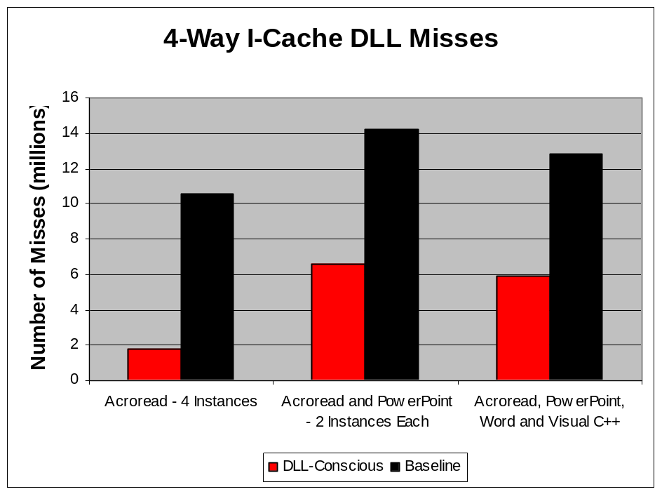
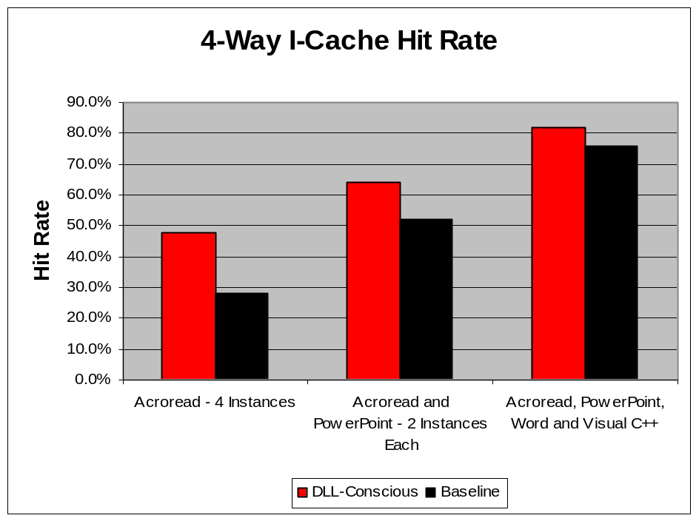
4-Way I-Cache Misses and Hit Rate
Misses per thread decrease by up to 5.5 times for homogeneous threads
I-Cache hit rate improves by as much as 62% (from 28% to 47% for 4 instances of Acrobat Reader)

Slide 18
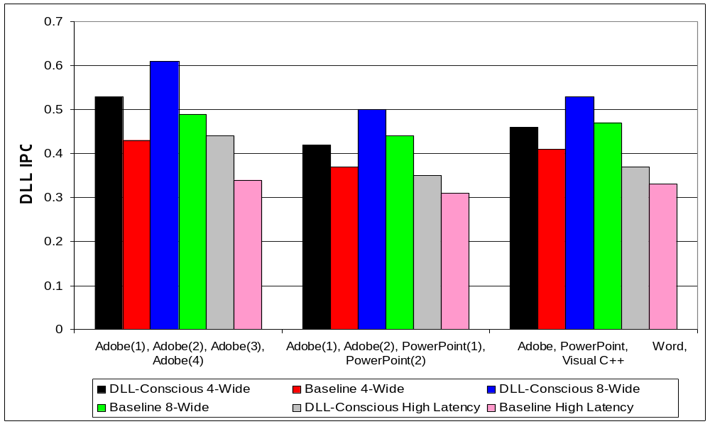
4-Way DLL IPC Improvement
4-Wide Machine: Up to 21% improvement
8-Wide Machine: Up to 24% improvement
High Latency Machine: Up to 30% improvement

Slide 19
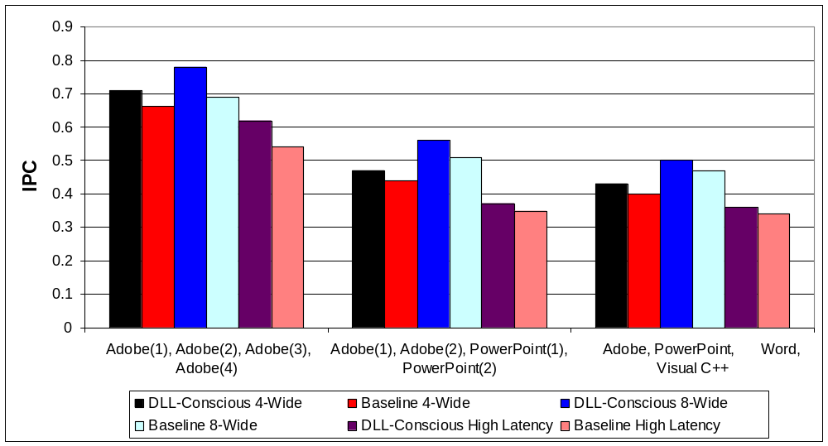
4-Way IPC Improvement
4-Wide Machine: Up to 10% improvement
8-Wide Machine: Up to 14% improvement
High Latency Machine: Up to 15% improvement

Slide 20
Related Work
Execution Trace Characteristics of Windows NT Applications (Lee et. al, ISCA 1998)
DLL BTB proposed by Vlaovic et. al (MICRO 2000)
OS techniques including Page Coloring and Bin Hopping (Lo et. al, ISCA 1998)
Commercial implementation of Global bit for reducing burden of context switch:
  MIPS: (G)lobal bit in TLB
  ARM 1176: nG bit in the TLB for global data
  Intel P6: PGE bit in the CR4 register
Notes:
Make the last 3 bullets into one or sub bullet:
Eg: Commercial processors have implemented Global register bits.
s

Slide 21
Conclusions & Contributions
Current and future generations of Operating Systems will be highly modular
Analyzed and quantified the effect of DLL thrashing and duplication
Devised a light-weight technique to reinstate DLL sharing in processor micro-architecture
Evaluated the benefits using a complete system level simulation methodology
  2-Way IPC improved up to 10%
  4-Way IPC improved up to 15%
Exploiting system features is yet another way to continue providing performance boosts in processors at the system level
Notes:
Show performance numbers.
Emphasize contributions.

Slide 22


Questions & Answers
That’s All Folks !

